Slide 1

Presentation by
Theoretical insights into gender and sexual violence for university students in the UK.
Helen Bovill,
Associate Head of Department Research and Scholarship.
Department of Education and Childhood, UWE
@helenbovill
Dec 19
BRIDGE

Slide 2
Aims and focus.
‘Playing it safe to stay safe’.
‘Atypical’ sexual harassment
Spaces to
re-theorise gender?

Slide 3
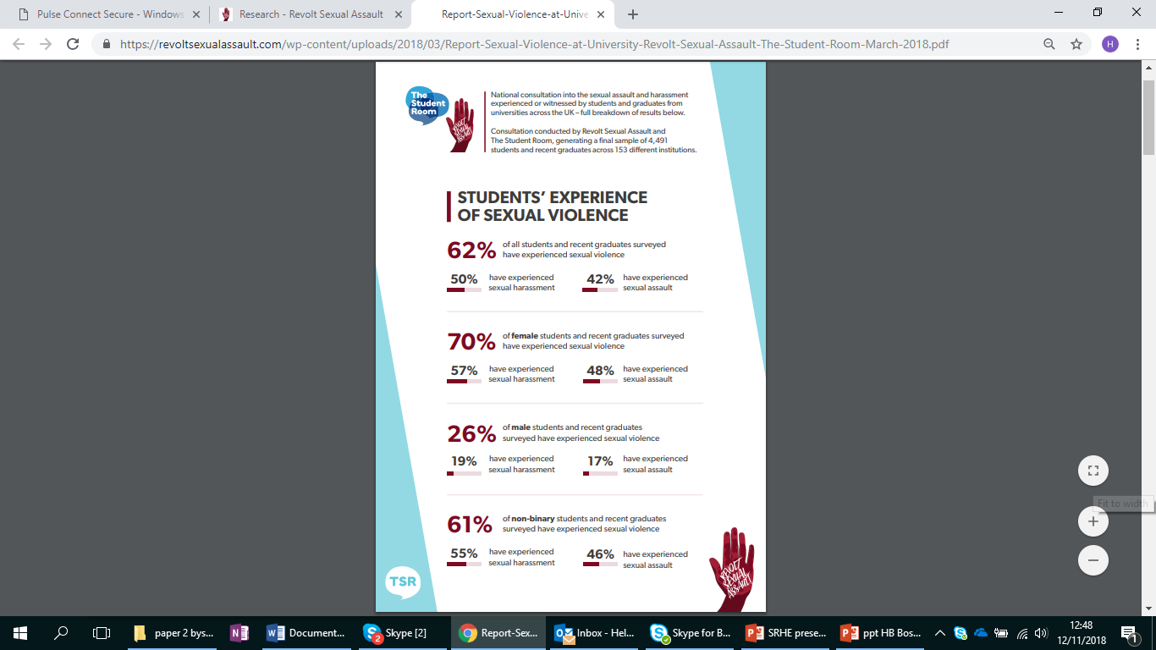

Slide 4
What UWE is doing
SpeakUp
Film/Posters/2 hour intervention/support and guidance structures
Social norms identified by students:
Unwanted sexual touching and groping
Sexual consent
Inappropriate use of social media
Initiation ceremonies/humiliation
Intimate partner abuse

Slide 5
Students talking: normal and expected.
Participant C (M): They walk in a club and something goes over their eyes and they think they can just grab, touch everyone.
Participant D (F): In Fresher’s, I was having a photo taken and someone literally grabbed my arse. I didn’t want to ruin the photo so I moved that arm behind me I was still smiling.

Slide 6
Students talking: Restricting female freedom.
Participant A (F): If I go out with a group of girls…We just can’t do it anymore… you end up with a group of guys coming around circling you…we mix in a few boys with that, we’re pestered less, because the other men know that someone might intervene.
Participant B (M): I reckon you could literally video it and compare the difference.
Participant C (F):I’ve had guys grab you and then, if you reject, they get quite physical. I’ve had a guy hit me before because I pushed him away, but other guys around me were there to challenge it.

Slide 7
Theory
Danger: passive victims in dangerous environments
Lewis et. al. (2018)
Paternalism and protection: excessive masculinity. Essentialises men as sexual predators, women as responsible for preserving sexual restraint
(Phipps & Young, 2015)
Undermines women’s visibility: Men reclaim a sense of masculine status and space in the academy
(Phipps et. al. 2018)
Undermines women’s voice: normalise and trivialise, play down a tendency to be seen as too militant
(Gartner and Sterzing 2016)

Slide 8
Sexual harassment
Sexual harassment is any unwanted behaviour of a sexual nature that you find offensive or which makes you feel distressed, intimidated or humiliated.
Sexual harassment can include:
someone making sexually degrading comments or gestures
your body being stared or leered at
being subjected to sexual jokes or propositions
e-mails or text messages with sexual content
physical behaviour, including unwelcome sexual advances and touching
someone displaying sexually explicit pictures in your space or a shared space, such as at work

Slide 9
Atypical sexual harassment
‘Harassment by men towards men and by women towards men or other women’ (McDonald and Charlesworth, 2016, p. 118).
‘Despite an increasing recognition of SH ‘at the margins’, studies of SH experienced by men are relatively few and those that do include men in their samples often aggregate the data, treating men’s experiences of SH as identical to women’s
(Magley et al., 1999, in McDonald and Charlesworth, 2016, p. 119).

Slide 10
Hegemonic and toxic masculinities
Hegemony- cultural practices which enable and sustain dominance, ‘the winning and holding of power’ (Donaldson 1993, p. 3).
Hegemonic masculinity - Practice that permits men’s collective dominance (Connell and Messerschmidt 2005, p, 840).
Toxic masculinity - practices of competitiveness, misogyny, rigid sexual/gender identity and roles, entitlement, objectification ….(Bovill, Waller and McCartan 2018, in review).
Men: Pursue sex (with women)/be sexually ready
Women: policers of sex/restraint/keep order

Slide 11
Contradictory findings
Low-level sexual molestation in particular appears to be becoming a norm in many parts of the night-time economy. Young women reported often putting up with it as part of the culture of drunken nights out yet also say they find it unpleasant. Young men may also be on the receiving end of uninvited molestation by women, although they appear to be unlikely to describe it as unpleasant (Christmas and Seymour, 2014, p. 9-10).

Slide 12
Students talking: ‘Atypical sexual harassment’
Participant G (M): I’ve shared my personal experience, do you remember, I was on the phone it was two in the morning…I was just coming home from my sister’s, so I wasn’t drunk…some really drunk girl came up and hugged me and I was so uncomfortable.
Participant B (F): I was watching something on telly and it was a guy and he was saying that his girlfriend pushed him or something, then all the audience laughed. If this was the other way round and it was a guy pushing a girl, then no one would be laughing.

Slide 13
Students talking: ‘Atypical sexual harassment’
Participant C (M): On the radio recently with all these scandals that have been coming out, guys have said, like bartenders, that women will put their hands down their pants and grope them and think it’s acceptable.
Participant D (F): We were in the gym the other day, there was this lady, she was maybe late 50s and she shouted across the gym at this guy…’oi, get your dick out!’ And this guy was absolutely mortified. He was just so red, he put down his weights, grabbed his bag and left.

Slide 14
Why focus on ‘atypical SH’?
Not to marginalise violence against women
Women are victims of SH more often than men
SH against women is often more extreme/extended/violent
Not to divert attention away from patriarchy
Not to divert attention away from misogyny
Not to divert attention away from gender inequality

Slide 15
Focus on ‘atypical SH’
As spaces to challenge hegemonic and toxic masculinity:
Hegemonic and toxic masculinities (Elliott, 2018; Fleming, Lee, and Dworkin, 2014; Mackay, 2017; Sculos, 2017)
Patriarchy and neo-liberalism/conservatism/compulsory heterosexuality (Phipps 2014, and Phipps and Young 2015)
Misogyny (Manne, 2016 and 2017)
Rape permissive cultures (Keller, Mendes and Ringrose, 2018)
Lad cultures (Jackson 2007, Phipps 2014, and Phipps and Young 2015)
As spaces to build:
Empathy
Allies
Shared understandings
Fluid gender identities
And re-theorise gender (Phipps, 2017)

Slide 16
References
Christmas, S. and Seymour, F. (2014) Drunken Nights Out: Motivations, norms and rituals in the night-time economy. DrinkAware.
Connell, R. and Messerschmidt, J. (2005) “Hegemonic masculinity: Rethinking the concept.” Gender and Society 19 (6): 829-859.
Donaldson, M. (1993) “What Is Hegemonic Masculinity?” Theory and Society, Special Issue: Masculinities 22 (5): 643-657. Copyright 1993 Springer. The original publication is available here at www.springerlink.com.
Elliott, K. (2018) Challenging toxic masculinity in schools and society. On the Horizon. 26, 1, p, 17-22
Fleming, P.J., Lee, J.G. and Dworking, S.L. (2014) “Real Men Don’t”: Constructions of Masculinity and Inadvertent Harm in Public Health Interventions. American Journal of Public Health. 104, 6, 1029-1035.
Jackson, C and Tinkler, P (2007) ‘Ladettes’ and ‘Modern Girls’: Troublesome Young Femininities. The Sociological Review. 55, 2, 251–272.
Keller, J., Mendes, K. and Ringrose, J. (2018) Speaking ‘unspeakable things’: documenting digital feminist responses to rape culture, Journal of Gender Studies, 27, 1, 22-36.
Lewis, R., Marine, S. and Kenney, K. (2018) ‘I get together with my friends and try to change it’. Young feminist students resist ‘laddism’, ‘rape culture’ and ‘everyday sexism’. Journal of Gender Studies. 27, 1, 56-72.

Slide 17
References
Mackay, F. (2017) Combating toxic masculinity in our schools – un-teaching gender stereotypes for boys. Teacherwire. 6th June. Retrieved from https://www.teachwire.net/news/combatting-toxic-masculinity-in-our-schools-un-teaching-gender-stereotypes-
Manne, K. (2016) The logic of misogyny forum. Boston Review. Retrieved from http://bostonreview.net/forum/kate-manne-logic-misogyny
Manne, K. (2017) Down girl: The logic of misogyny. Oxford: Oxford University Press.
McDonald, P. and Charlesworth, S. (2015) Workplace sexual harassment at the margins. Work, Employment and Society. 30, 1, 118-134.
Mendes, K. (2015). SlutWalk. Basingstoke: Palgrave Macmillan.
Phipps, A. (2014). What’s Driving the New Sexism? The New Statesman, May 19. Retrieved from http://www.newstatesman.com/voices/2014/05/what-s-driving-new-sexism.
Phipps, A. and Young, I. (2015) Neoliberalisation and lad cultures in higher education. Sociology, 49, 2, 305-322.
Phipps, A. (2017) (Re) theorising laddish masculinities in higher education.
Gender and Education, 29, 7, 815-830. DOI:10.1080/09540253.2016.1171298
Phipps, A. (2018): Reckoning up: sexual harassment and violence in the Neo liberal university. Gender and Education, DOI: 10.1080/09540253.2018.1482413

