Slide 1
The state of the evidence: What we know, and don’t know, about the interaction of environment and health
Presentation at Building health into the urban environment: Evidence and opportunities
Royal Society of Medicine, Thursday 13 December 2018
Paul Pilkington and Janet Ige, University of the West of England, Bristol
Notes:
Might need the other logos, but BATH presentation just has Uni of Bath so probably just leave as it is.

Slide 2
UPSTREAM Project Team
Prof Gabriel Scally, Principal Investigator
Prof Judy Orme, Principal Investigator
Daniel Black, Project Director
Dr Paul Pilkington, Research Lead
(Literature Review and Interviews)
Dr Alistair Hunt, Research Lead (Economics)
Eleanor Eaton, Research Associate
Dr Laurence Carmichael, Project Faculty Lead
Dr Ben Williams, Project Manager and
Research Fellow
Janet Ige, Research Associate
Dr Emily Prestwood, Research Associate
Prof Jim Longhurst, Senior Advisor
PUBLIC ENGAGEMENT
Ruth Larbey, Project Manager
(Shape Our City) Science Communication Unit
Sophie Laggan, Project Coordinator
(Shape Our City) Science Communication Unit
Dr Margarida Sardo, Project Evaluator
(Shape Our City) Science Communication Unit
Eleanor Shipman, Participatory artist
(Something Good, Something Useful)
INTERNATIONAL ADVISORS
Prof Kristie Ebi, Advisor (Climate Change and Health)
Prof Roderick Lawrence, Advisor (Trans-disciplinarity)
Notes:
Complete from list in the report
JI- done

Slide 3
Presentation Outline
Context
Aim of review
Systematic review methods
Findings
Gaps and future challenges

Slide 4
Context

Slide 5
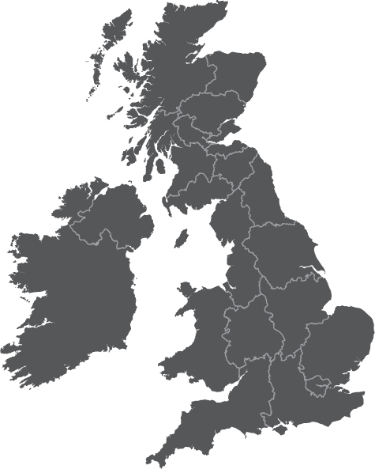
Moving health upstream
in urban development planning
1
Estimating cost of poor quality urban environment
2
Exploring barriers and opportunities for creating healthy urban environments

Slide 6
Aim of review
To systematically review the health outcomes associated with urban developments and linked interventions:
Buildings
Neighbourhood Design
Transport
Food environment
Natural environment
Notes:
Foundation for evidence-based economic valuation

Slide 7
Systematic Review Methods

Slide 8
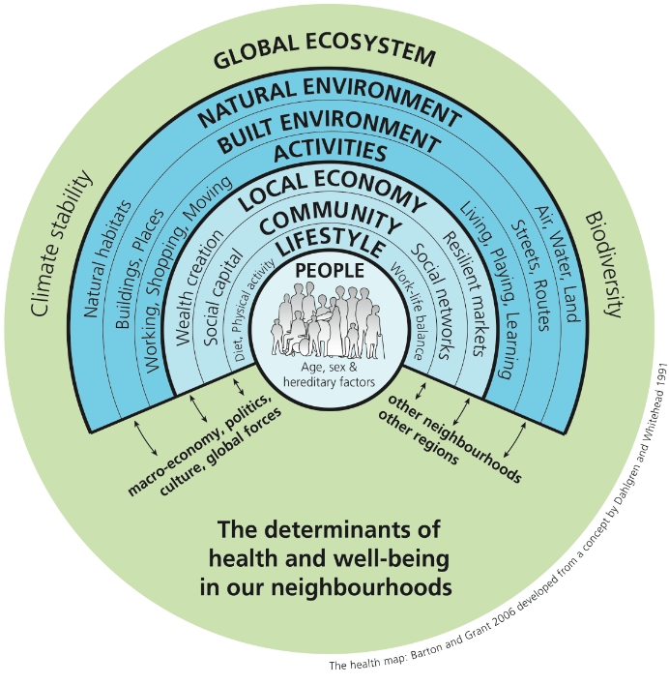
PHE Spatial Planning for Health tool
Vancouver Healthy toolkit
BREEAM Communities
HUDU Rapid HIA
Egan Review

Slide 9
Quality Appraisal
Conducted using the Quality Assessment Tool for Quantitative Studies
Studies were rated High, Moderate or Low
Six Quality Domains:
Selection bias
Design of the study
Control of confounders
Blinding
Reliability and validity of data collection
Reporting of dropout rate

Slide 10
Findings

Slide 11
Results
26,428 studies retrieved from a range of electronic databases
Review of studies for suitability
Followed by quality appraisal
209 studies remaining

Slide 12
Action areas
Outcome
Reduced risk of hypertension
Improve walkability
Improved mental health
Reduced risk of prediabetes and diabetes
Increased physical activity levels
Access to facilities
Improved mental health
Neighbourhood design
Enhance neighbourhood connectivity
Reduced risk of obesity among women
Reduced limitation in performing ADL among men
Quality of evidence
Improved mental health
High quality
Improve access to open green space
Increased physical activity levels
Moderate quality
Reduced cardiovascular risk factors
Low quality
Reduced risk of non-accidental mortality
Reduced risk of asthma
Reduced risk of prediabetes and diabetes
Notes:
Red dot needs re-aligning.
Please compare the dots on this slide to the next- which is preferable?

Slide 13
Action areas
Outcome
Improve general health and respiratory outcomes
Improve thermal quality and ventilation
Reduced blood pressure
Reduced cost associated with heating
Improved school attendance among children
Reduced mould contamination
Improve quality of housing
Reduced falls and fall related injuries among older adults
Improved mental health
Inadequate quality of housing
Increased risk of mortality from coronary heat disease
Buildings
Quality of evidence
Improved general health among previously homeless people
High quality
Increase access/relocation to affordable homes or social housing
Moderate quality
Improved mental health among adults and children
Low quality
Improved educational achievement among young boys

Slide 14
Action areas
Outcome
Increased physical activity levels
Improve infrastructure for walking and cycling
Reduced risk of pedestrian motor vehicle collision
Reduced amount of car use
Increased levels of walking and cycling
Improve road safety
Reduced risk of pedestrian motor vehicle collision
Reduced risk of pedestrian injury
Transport
Improve infrastructure for public transport
Increased active transport
Quality of evidence
Reduced exposure to road traffic collision
High quality
Moderate quality
Increased risk of pre/post menopausal breast cancer
Exposure to transportation noise
Low quality
Increased systolic blood pressure levels

Slide 15
Action areas
Outcome
Increase access supermarkets and healthy food outlets
Reduced BMI levels
Reduced odds of obesity among girls
Reduced odds of obesity among general population
Higher density of and proximity to fast-food restaurants
Increased risk of diabetes
Increased risk of obesity
Increased childhood obesity and overweight
Food
Proximity of full-service restaurants
Increased BMI levels
Quality of evidence
High quality
Living far away from super-markets (≥4 miles)
Moderate quality
Reduced diet quality index among pregnant women
Low quality
Apple graphic designed by rawpixel.com / Freepik

Slide 16
Action areas
Outcome
Increased risk of cervical cancer
Increased risk of brain cancer
Exposure to environmental hazards
Increased risk of dementia and Alzheimer’s disease
Increased risk of Type II diabetes
Increased risk of lung cancer
Increased risk of myocardial infarction among males
Poor academic performance among children
Natural environment
Exposure to traffic noise
Increased risk of Type II diabetes
Worsened mental health
Quality of evidence
Reduced quality of life among women
Increased blood pressure
High quality
Reduce exposure to traffic noise
Increased average life expectancy
Moderate quality
Low quality
Result in high economic savings
Improve access to open green space
Improved respiratory outcomes
Increased physical activity levels

Slide 17
Gaps and future challenges

Slide 18
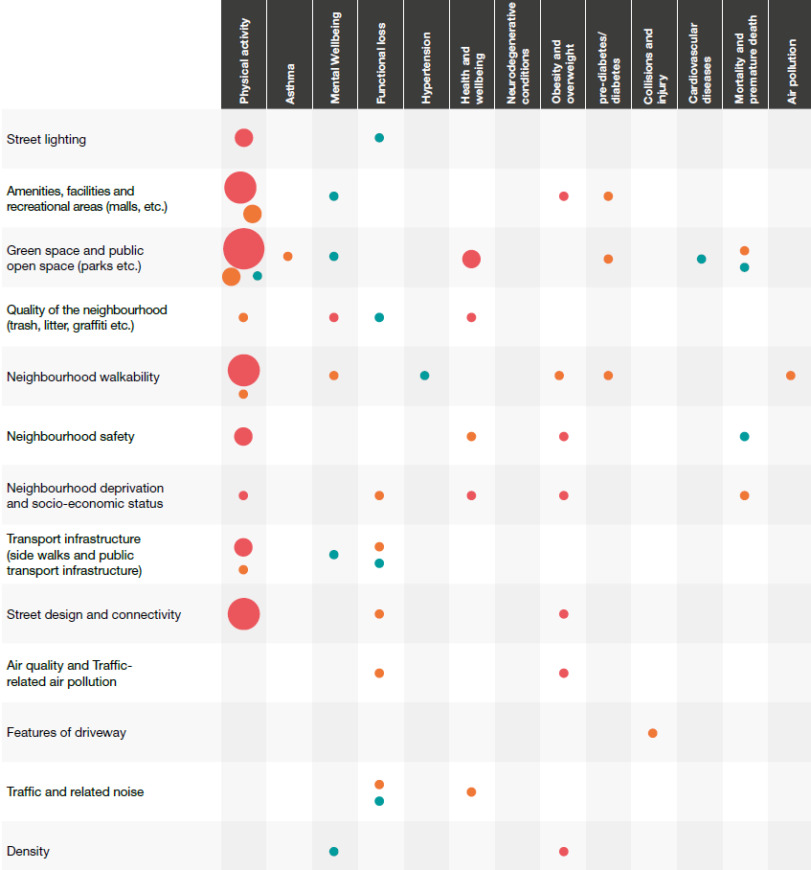
Gap analysis: Neighbourhood design

