Slide 1


Hip arthroplasty surveillance:
Is it really needed?
Lindsay K. Smith PhD, MSc, MCSP
University of the West of England, Bristol
Musculoskeletal Research Unit, University of Bristol, Southmead Hospital

Slide 2
Hip arthroplasty surveillance:
Is it really needed?

Slide 3
Follow up visits:
ODEP 10A rated implants should be followed up in the first year, once at seven years and three yearly thereafter in asymptomatic patients. Telephone or web-based PROMS may be useful to monitor outcome
Patients over 75 years at primary THR with ODEP 10A rated implants need not be routinely reviewed after successful recovery from the procedure has been documented
Hip arthroplasty surveillance:
Is it really needed?

Slide 4
Hip arthroplasty surveillance:
Is it really needed?

Slide 5
411 orthopaedic units
Survey of 42 units
18 units (43%) nothing beyond 1 year
18 units beyond 5 years
86% of follow up delivered by arthroplasty practitioner within the orthopaedic team
Hip arthroplasty surveillance:
Is it really needed?

Slide 6
Hip arthroplasty surveillance:
Is it really needed?

Slide 7
The lack of predictive criteria for its occurrence and the lack of symptoms encourages us to propose regular monitoring of these patients after 10 years of implantation as well as early preventive acetabular revision when progressive osteolysis occurs
Bidar et al 2009. Orthop Traumatol Surg Res 95:579-587.
Hip arthroplasty surveillance:
Is it really needed?
The fact that expansile osteolysis does not always lead to symptomatic loosening points to the necessity of close radiographic monitoring of the patients with total hip arthroplasty, especially in those with uncemented acetabular components.
Hartofilikadis et al 2009. Journal of Arthroplasty 24:217-225.
We consider radiological loosening as an indication for surgical revision, as osteolysis progresses at least linearly, so an early revision on adequate bone stock presents more chances of success and a better functional prognosis for the patient
Boyer et al 2012. Int Orthop 36:511-518.

Slide 8

Hip arthroplasty surveillance:
Is it really needed?

Slide 9
Baseline assessment OHS, EQ-5D, EQ-VAS, UCLA
↓
REVISION HIP SURGERY
↓
4 weeks Resource use log sent to patient
↓
6 months Resource use questionnaire and SAE
↓
12 months OHS, EQ-5D, EQ-VAS, UCLA
↓
Medical records retrieval
↓
ALLOCATION
↓
ANALYSIS
Hip arthroplasty surveillance:
Is it really needed?

Slide 10
Baseline assessment OHS, EQ-5D, EQ-VAS, UCLA
↓
REVISION HIP SURGERY
↓
4 weeks Resource use log sent to patient
↓
6 months Resource use questionnaire and SAE
↓
12 months OHS, EQ-5D, EQ-VAS, UCLA
↓
Medical records retrieval
↓
ALLOCATION
↓
ANALYSIS
 | Participants with complete data, follow up | Participants with complete data, no follow up | Participants with incomplete data
Number | 17 | 17 | 10
Age in years (mean) | 73.3 | 77.5 | 70.2
Gender (% male:female) | 35:65 | 41:59 | 60:40
Laterality (right:left) | 11:6 | 9:8 | 6:4
Charlson Comorbidity Index (mean, range) | 3.65 (2 to 8) | 4.0 (1 to 6) | 3.4 (0 to 6)
Length of surgery (hours: median, range) | 2.84 (1.14 to 7.0) | 3.0 (1.31 to 7.6) | 3.50 (1.69 to 11.0)
Hip arthroplasty surveillance:
Is it really needed?

Slide 11
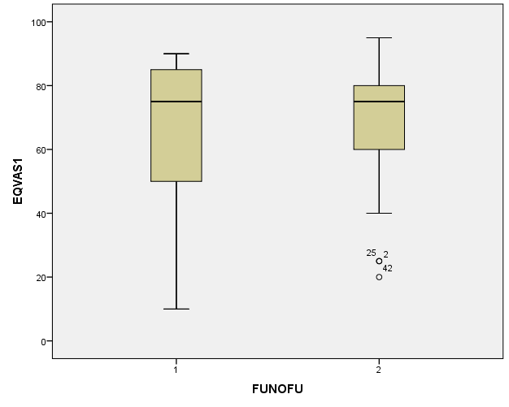
Hip arthroplasty surveillance:
Is it really needed?
EQ-VAS

Slide 12
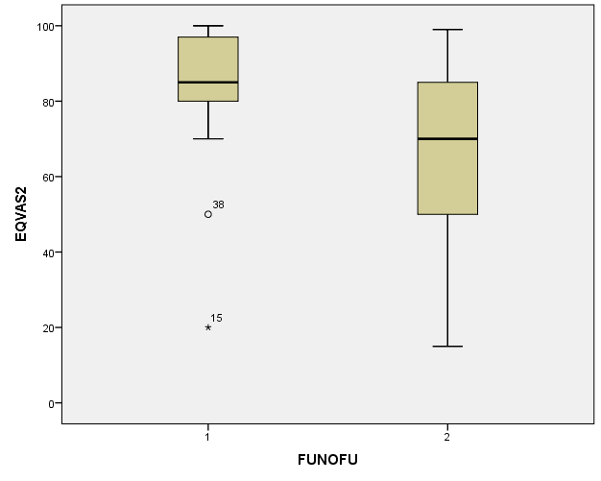
Hip arthroplasty surveillance:
Is it really needed?
EQ-VAS

Slide 13
Hip arthroplasty surveillance:
Is it really needed?
EQ-VAS
ICER: Incremental cost-effectiveness ratio
If a patient has long-term follow-up, there is a saving of £18,876 for every QALY gained in the 12 months after surgery

Slide 14

Hip arthroplasty surveillance:
Is it really needed?

Slide 15
Hip arthroplasty surveillance:
Is it really needed?
87% in support of…
33% suggest
changes

Slide 16

Hip arthroplasty surveillance:
Is it really needed?

Slide 17
..not everybody will fill it in, but it's a very good way of identifying people that have got a problem. If they've got a problem, they'll fill the form in…
Hip arthroplasty surveillance:
Is it really needed?
I think like having someone at the end of a phone…you just want to be seen and you just want to be heard. I think that, especially with follow up, I like to think I can call someone when I need help and there's someone there….they can put you at ease a little bit.

Slide 18

NIHR HS&DR: UK SAFE
Hip arthroplasty surveillance:
Is it really needed?

Slide 19
With grateful thanks to colleagues including Professors Ashley Blom, Shea Palmer, Jane Powell , Emma Dures and Fiona Cramp;
to Erik Lenguerrand, Andrew Beswick, Alice Rose, Emma Turner, Eirini Troupkou, Amanda Burston and Harvey Dymond.

