Slide 1


Patient reported outcomes and health economics after revision hip arthroplasty
(WHISTLER study)
Lindsay K. Smith PhD, MSc, MCSP
University of the West of England, Bristol
Musculoskeletal Research Unit, University of Bristol, Southmead Hospital

Slide 2

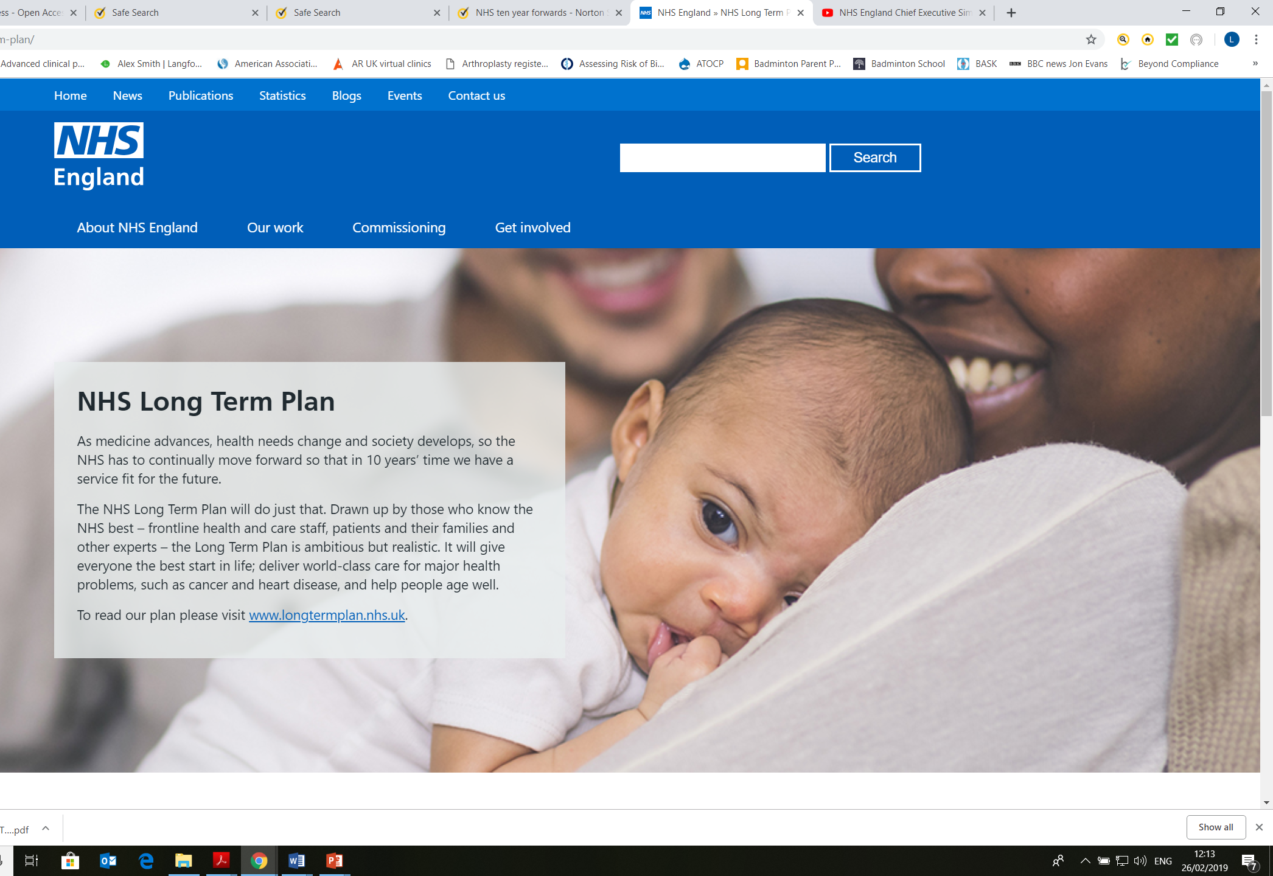
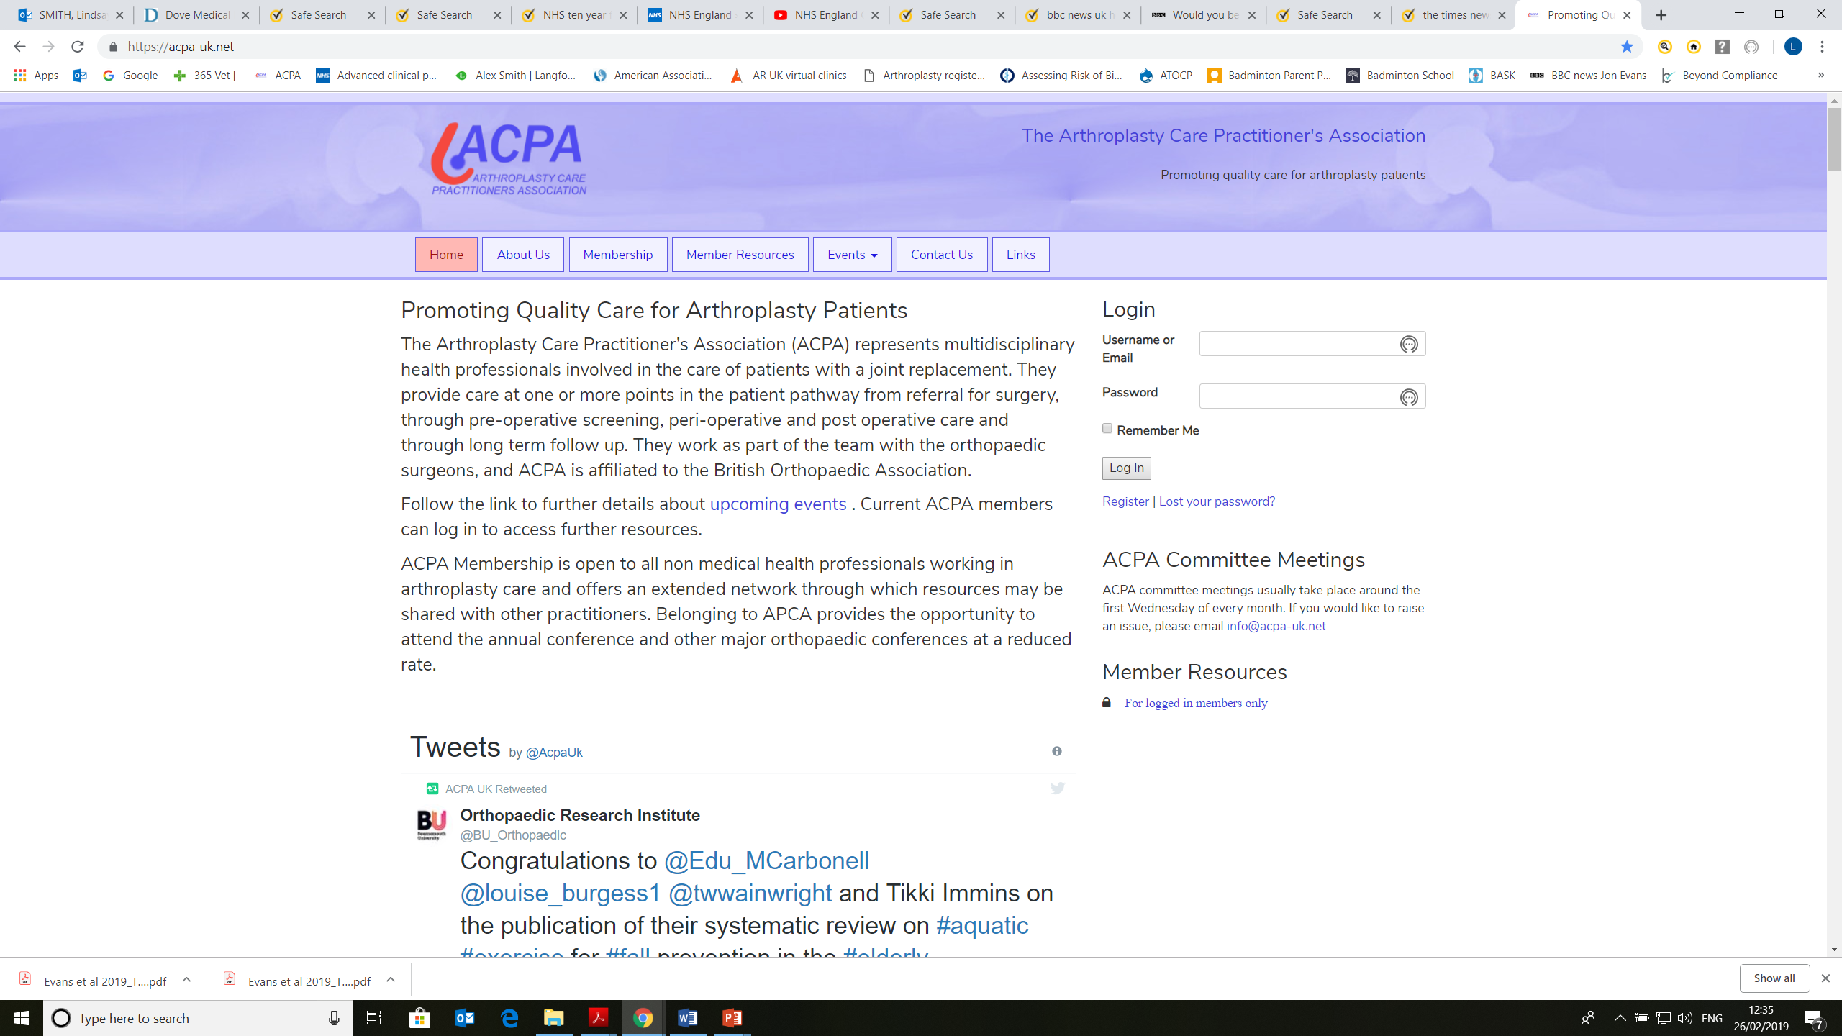
Budget 2018: 'NHS will face cuts as well as gains'
Hugh PymHealth editor@BBCHughPymon Twitter
WHISTLER study
Background

Slide 3

WHISTLER study
Patients and methods

Slide 4
Baseline assessment OHS, EQ-5D, EQ-VAS, UCLA
↓
REVISION HIP SURGERY
↓
4 weeks Resource use log sent to patient
↓
6 months Resource use questionnaire and SAE
↓
12 months OHS, EQ-5D, EQ-VAS, UCLA
↓
Medical records retrieval
↓
ALLOCATION
↓
ANALYSIS
WHISTLER study
Patients and methods

Slide 5
Baseline assessment OHS, EQ-5D, EQ-VAS, UCLA
↓
REVISION HIP SURGERY
↓
4 weeks Resource use log sent to patient
↓
6 months Resource use questionnaire and SAE
↓
12 months OHS, EQ-5D, EQ-VAS, UCLA
↓
Medical records retrieval
↓
ALLOCATION
↓
ANALYSIS
WHISTLER study
Patients and methods

Slide 6
 | Participants with complete data, follow up | Participants with complete data, no follow up | Participants with incomplete data
Number | 17 | 17 | 10
Age years (mean) | 73.3 | 77.5 | 70.2
Gender, % (male:female) | 35:65 | 41:59 | 60:40
Laterality (right:left) | 11:6 | 9:8 | 6:4
Charlson Comorbidity Index (mean, range) | 3.65 (2 to 8) | 4.0 (1 to 6) | 3.4 (0 to 6)
Length of surgery, hours (median, range) | 2.84 (1.14 to 7.0) | 3.0 (1.31 to 7.6) | 3.50 (1.69 to 11.0)
Length of stay, days (median, range) | 4 (2 to 13) | 11 (3 to 86) | 6.5 (3 to 22)
Primary indication for revision | Follow up | No follow up
Pain | 6 | 11
X-ray changes | 13 | 2
Peri-prosthetic fracture | 0 | 4
Dislocation/subluxation | 1 | 2
Adverse Reaction to Metal Debris | 5 | 0
Total | 25 | 19
WHISTLER study
Results

Slide 7
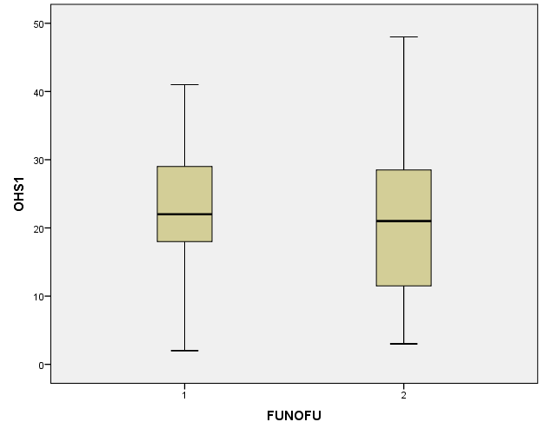
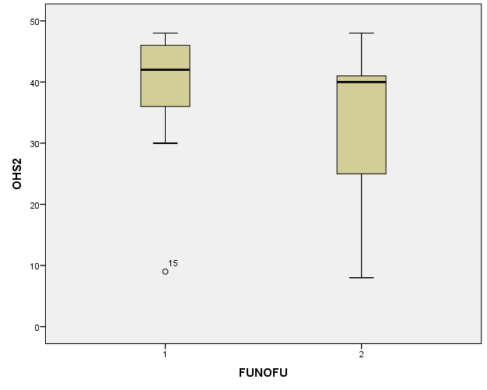
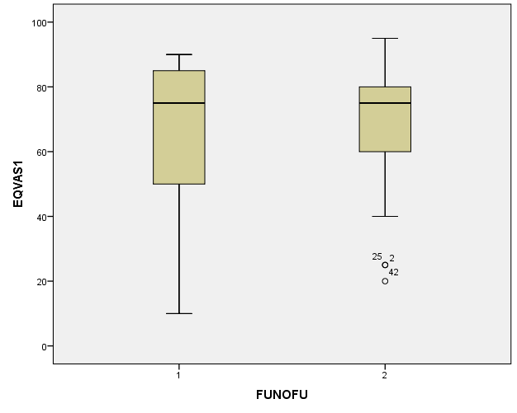
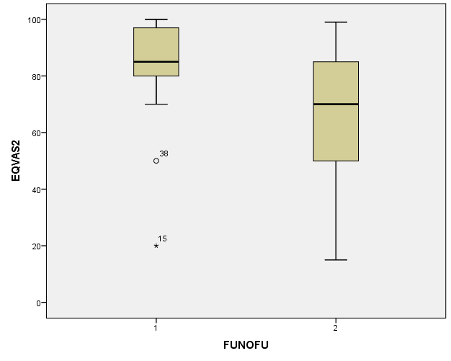
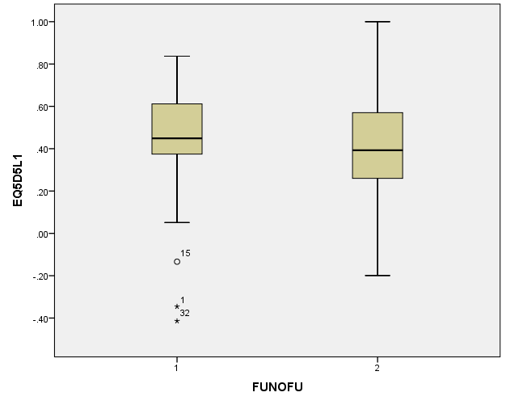
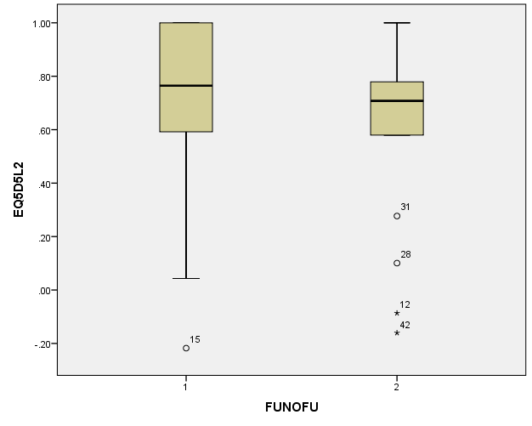
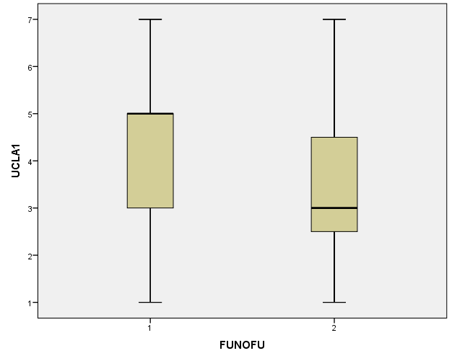
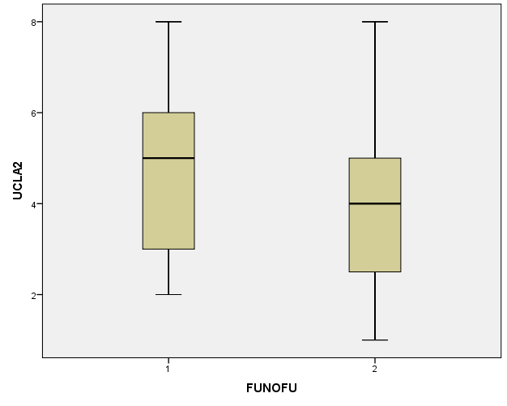
Left box = With follow up
Right box = No follow up
Pre-op
12 months after
Pre-op
12 months after
Oxford Hip Score
EQ-VAS
WHISTLER study
Results
Pre-op
12 months after
Pre-op
12 months after
EQ-5D-5L
UCLA

Slide 8
Health resources included:
Component costs for the revision surgery
Length of stay
Theatre time
Patient reported resource use in 6 months after surgery
WHISTLER study
Results
ICER = £18876
For patients with follow up, there is a saving in cost of £18,000+ for every QALY gained over the first 12 months after surgery
Incremental cost-effectiveness ratio (ICER)
Difference in costs between the groups / Difference in QALYs gained

Slide 9
WHISTLER study
Discussion
PROMS
Health Economics
For whom, when and how…

Slide 10
With grateful thanks to colleagues including Professors Ashley Blom, Shea Palmer and Jane Powell at the Universities of Bristol and of the West of England; to Dr. Erik Lenguerrand (Statistician) and Emma Turner; and the R&D department at North Bristol NHS Trust including especially the T&O research nurses.

