Slide 1
Don’t forget to follow and tweet us @TheEAUC Join in the conversation using #Influence2019

Slide 2
National Clean Air Day
National Clean Air Day
What are Universities and Colleges doing to advance the
achievement of clean air for all?
Professor James Longhurst
Assistant Vice Chancellor, UWE Bristol
EAUC Trustee and Director

Slide 3
National Clean Air Day – what are we doing to advance the achievement of clean air for all?
Introduction and welcome
Brief summary of the air quality challenge
Discussion on the role of Universities and Colleges in addressing air quality
Conclusions and a draft statement on the role of Universities and Colleges in achieving clean air

Slide 4
National Clean Air Day
June 20th is National Clean Air Day. The World Health Organisation describe air pollution as the world’s biggest environmental health risk.
Through a round table discussion, this session will ask “what is the role of universities through research, teaching, operations and community engagement to address this public health emergency?”
Universities and FE colleges are ideally placed to lead and influence debates and actions designed to improve air quality.
How can universities and FE colleges realise this potential?

Slide 5
A Starting Perspective
Anthropogenic air pollution is not an accident.
It results from the decision others take to shape land use, develop transport infrastructure and to develop the economy.
Air pollution results from the interactions of these processes and the way citizens’ practices are conditions by the systems in which they live their lives.
The consequence is an impact on public health and the environment.
Different groups in society have different experiences of pollution.
In general, the richest in society emit the most pollution and are exposed the least.
In general, the poorest in society emit the least pollution and are exposed the most.

Slide 6
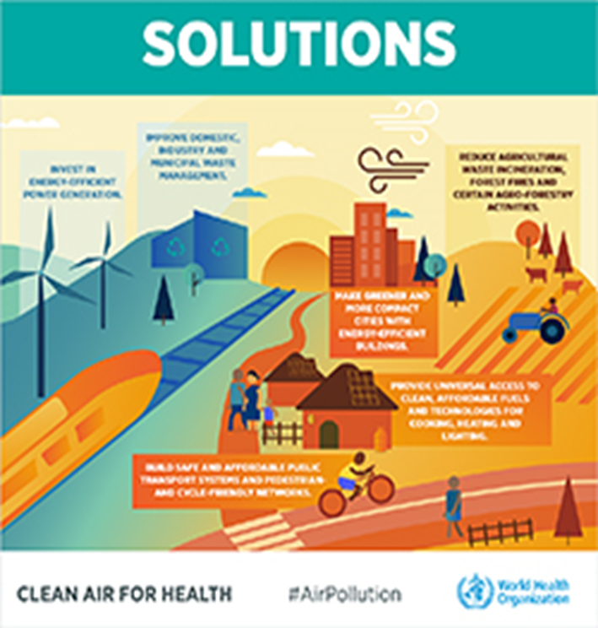
A Public Health Emergency

Slide 7
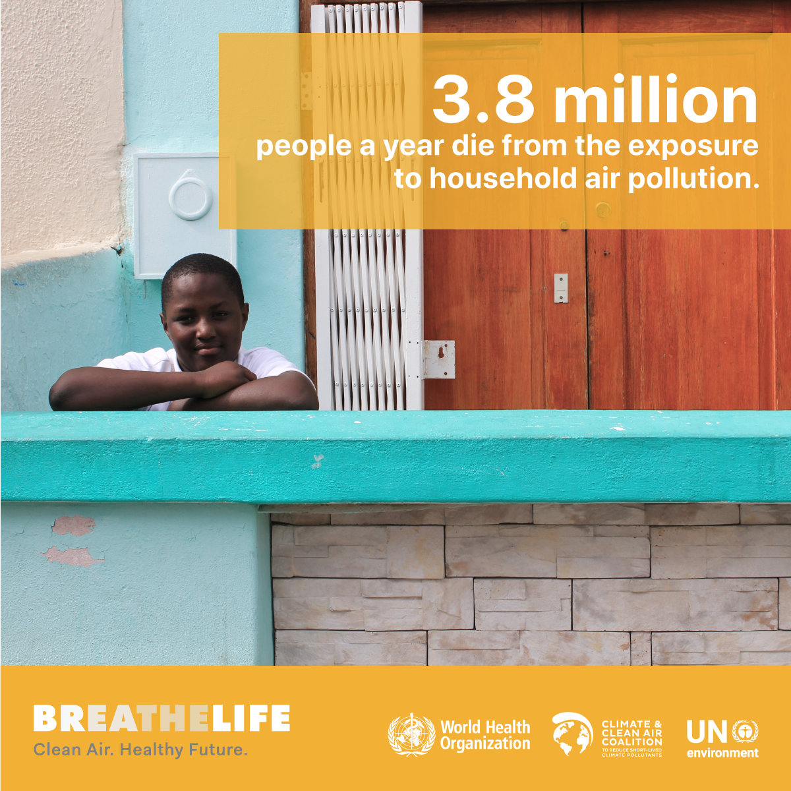
The World’s Biggest Environmental Health Risk
4.2 million deaths every year as a result of exposure to ambient (outdoor) air pollution
WHO
https://www.who.int/airpollution/en/

Slide 8
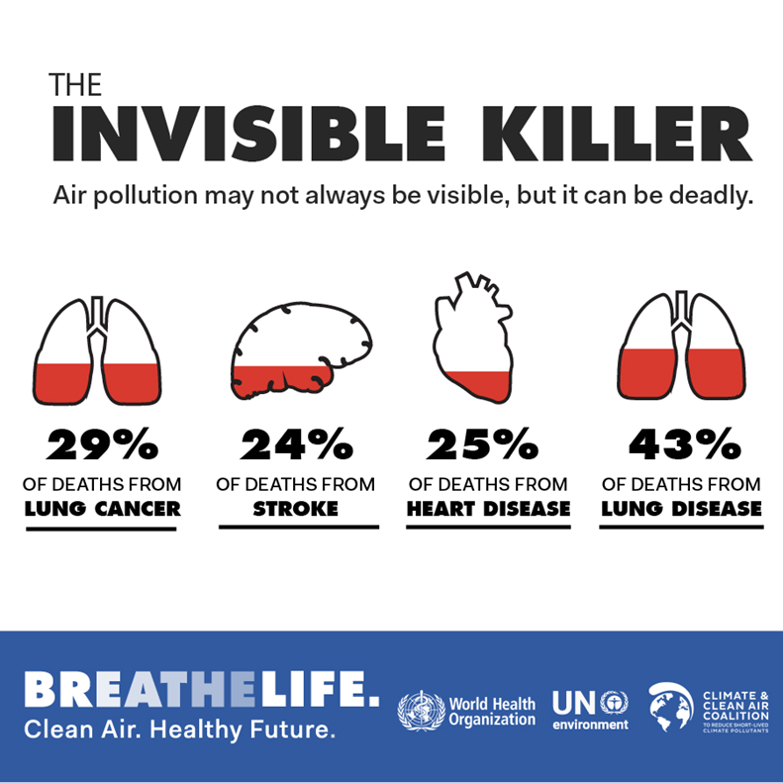
91% of the world’s population lives in places where air quality exceeds WHO guideline limits

Slide 9
European Death Toll
Some 500,000 premature deaths in Europe every year
Premature deaths attributable to fine particulate matter (PM_{2.5}), ozone (O₃) and nitrogen dioxide (NO₂) exposure in 2012 in 40 European countries.
https://www.eea.europa.eu/media/newsreleases/many-europeans-still-exposed-to-air-pollution-2015/premature-deaths-attributable-to-air-pollution

Slide 10
EU’s Biggest Environmental Health Risk
“Air Pollution is the Biggest Environmental Risk to Health in the European Union”
Air pollution causes about 400 000 premature deaths in the EU and hundreds of billions of euros in health-related external costs.

Slide 11
An Annual Toll of Death and Ill Health
In the UK estimates vary as to the annual death toll associated with exposure to air pollution with the most recent data suggesting that between 28 000 and 36 000 people die prematurely each year, principally associated with exposure to fine particles and nitrogen dioxide.
Air pollution is estimated to cost the UK some £20 billion per annum in health care costs and lost productivity.
Public Health England estimate the 2017 costs of air pollution to the NHS and social care in England as about £157 million.

Slide 12
Greater Manchester AQMA - NO₂
First declared in 2001-2002 for an objective that should have been achieved in 2005 and is still in existence 18 years later.
Both Manchester universities appear to be in the AQMA
Source https://cleanairgm.com/air-quality-management-areas

Slide 13
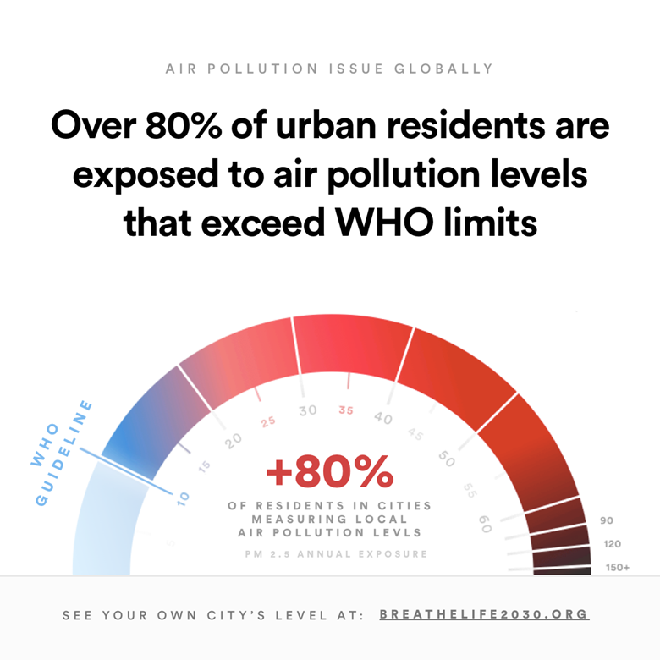
Discussion
Hearing from each other – how can your University or College help beat air pollution?
Teaching
Research
Campus Operations
Civic Engagements
Investments
Other?

Slide 14
Feedback
Sharing key insights, great ideas and inspiration!
Teaching
Research
Campus Operations
Civic and Community Engagements
Investments
Other?

Slide 15
UWE Actions for Cleaner Air
Teaching - Air Quality in various UG, PG and CPD provision
Research - Air Quality Management Resource Centre, ClairCity, CADTIME, Air Quality and the SDGs. 382 air quality deposits in UWE’s Research Repository http://eprints.uwe.ac.uk/
Campus Operations – electrification of the vehicle fleet, CHP, PV, REGO certified renewable electricity supply
Civic and Community Engagements – Bristol Green Capital Partnership, Clean Air Bishopston, Bristol City Council etc.

Slide 16
UWE Actions for Cleaner Air
Research
Consultancy
Live Briefs
UG Dissertation topics
MSc Dissertation topics
Placements
Part funded internships
Knowledge Transfer Partnerships
PhDs

Slide 17
A Draft Declaration of Intent
The Manchester Air Quality Declaration
The EAUC recognises the urgent need to address the public health emergency caused by air pollution.
Through their teaching, research, operations and community engagement Universities and Colleges are ideally placed to lead and influence debates and actions designed to improve air quality. Through their operations institutions contribute to the problem of air pollution. In their research and teaching, Universities and Colleges make a significant contribution to understanding the causes, consequences and solutions to air pollution and to inform management policy and practice at scales from the local to the global. Universities and Colleges have a major role to play in informing the public about the risks of air pollution and the actions that can be taken to reduce emissions and personal exposure.
The EAUC calls upon Universities and Colleges to join the BreatheLife campaign and to use their intellectual and other resources to help beat air pollution.

Slide 18
Resources
BreatheLife https://breathelife2030.org/
Beat Air Pollution #BeatAirPollution
UNEP https://www.unenvironment.org/interactive/how-to-beat-pollution/
WHO https://www.who.int/airpollution/en/
National Clean Air Day https://www.cleanairday.org.uk/forms/clean-air-day-resources
ClairCity http://www.claircity.eu/

Slide 19
BREATHE LIFE

Slide 20
The SDG Accord
Headline Sponsor
Don’t forget to follow and tweet us @TheEAUC Join in the conversation using #Influence2019
End extreme poverty, inequality and climate change
www.sdgaccord.org

