Slide 1
Making the invisible visible. Using art to engage people in healthy urban development
Dr Margarida Sardo
Ruth Larbey and Sophie Laggan
Science Communication Unit, UWE Bristol
21st June 2019

Slide 2
Bristol-based creative engagement project working on understanding the city's priorities for achieving healthy urban development.

Slide 3
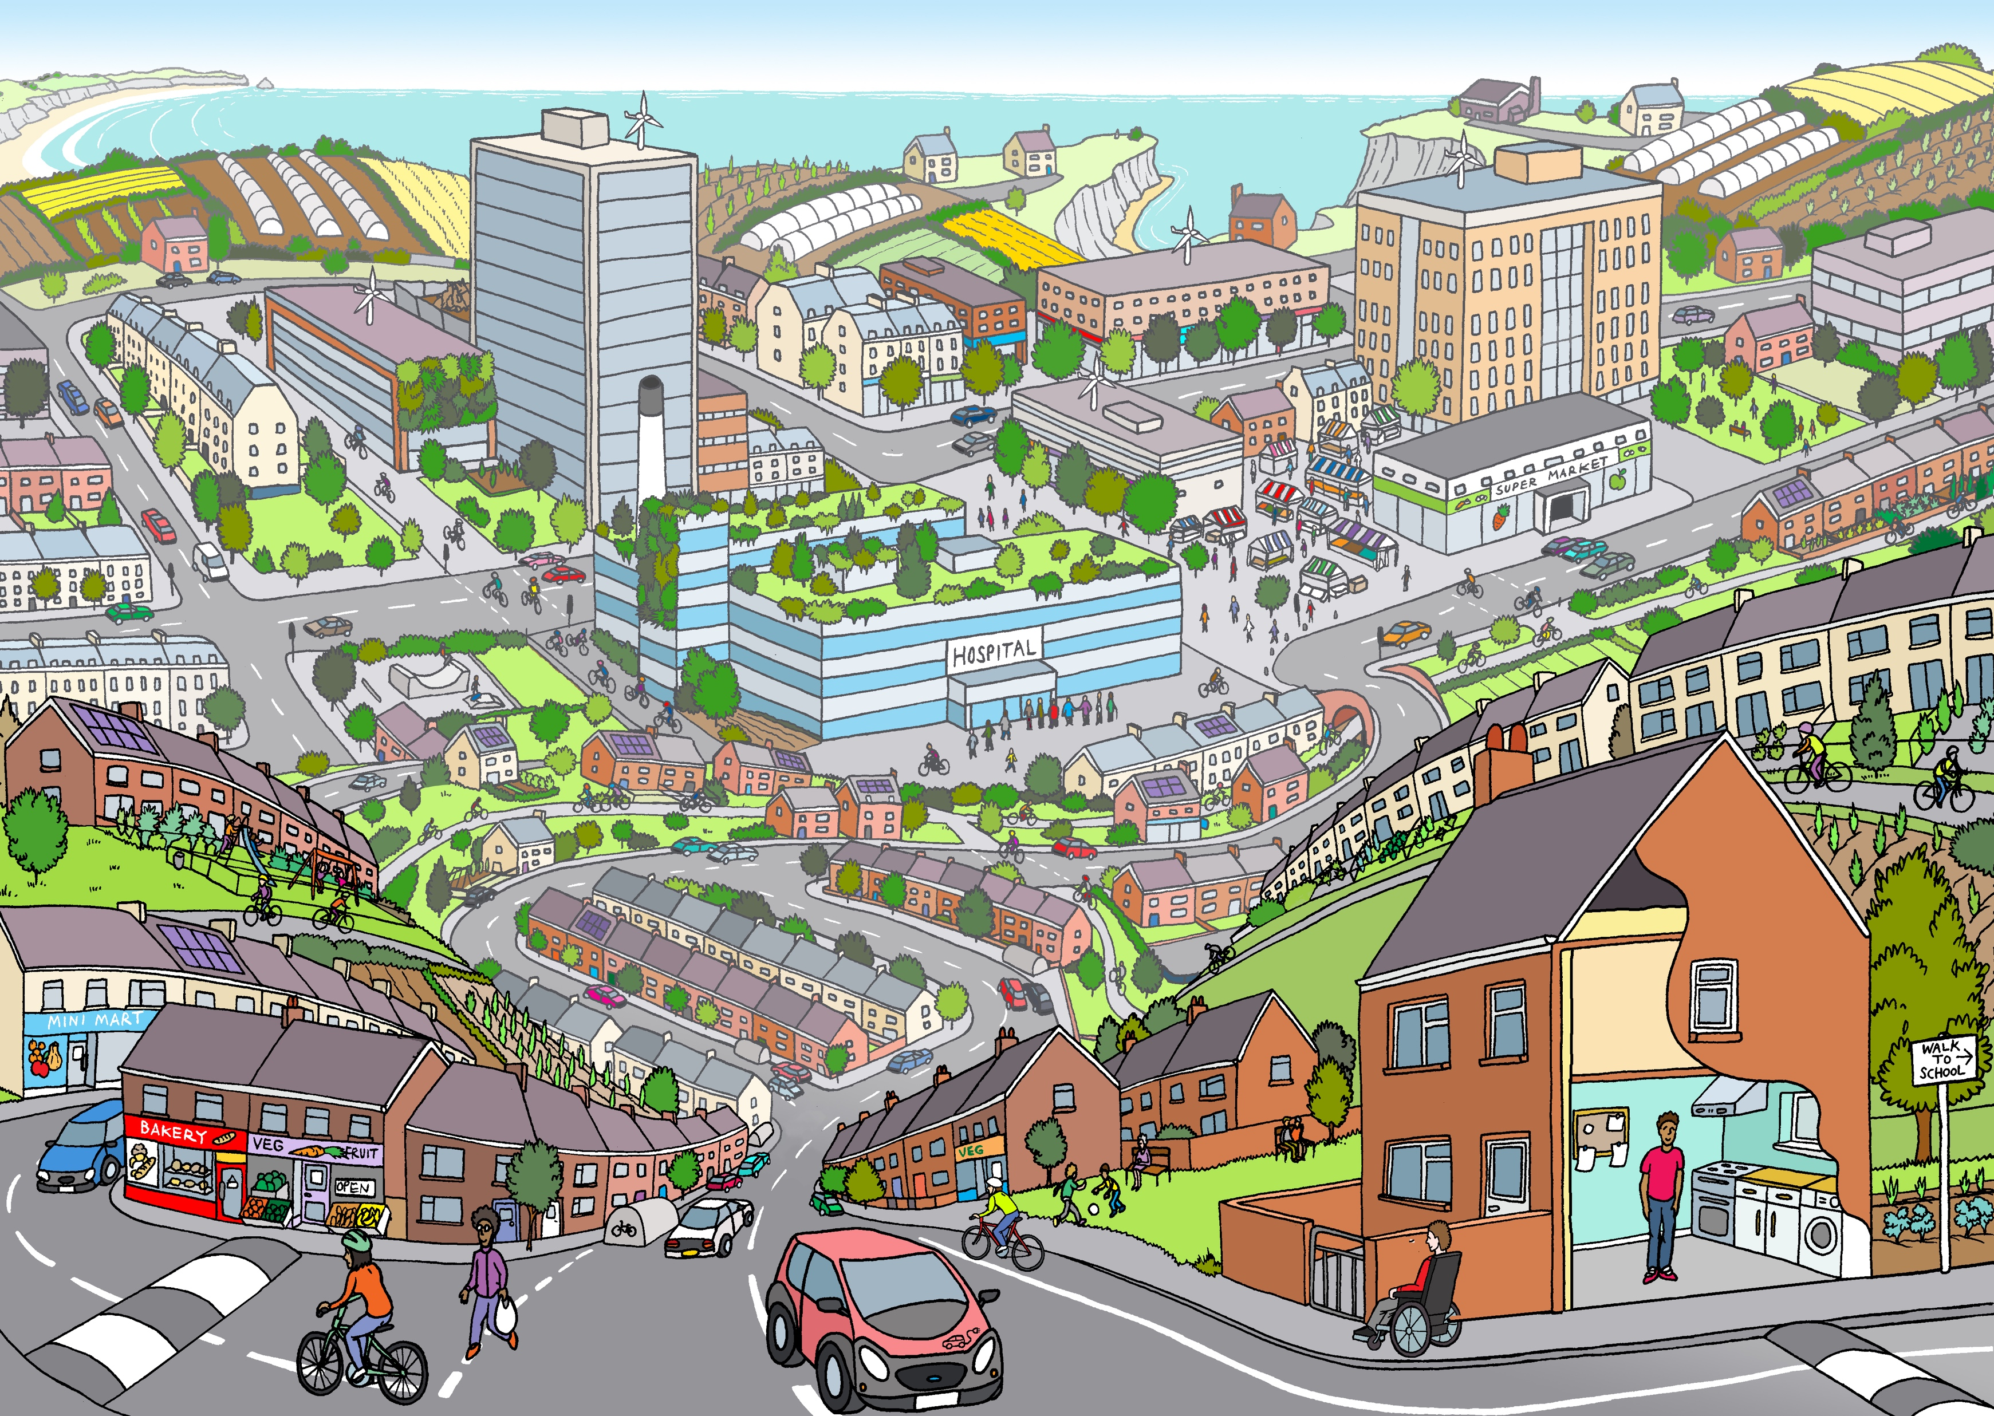
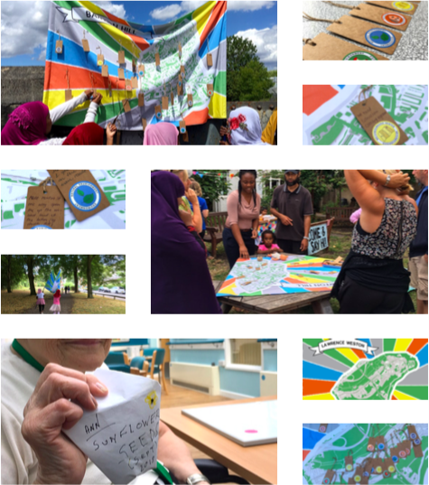
Using art to communicate and engage
Illustration: Andy Council
Photos: Eleanor Shipman

Slide 4
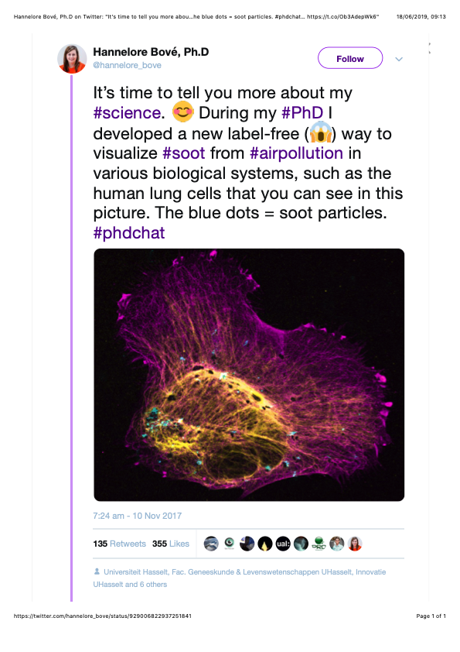
Inspiration
Soot particles in a human lung cell
Soot is a fine black or brown powder and is a product of incomplete combustion.
It can be harmful to human health when inhaled.
Soot is one of the main causes of air pollution.

Slide 5
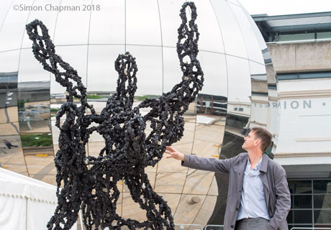
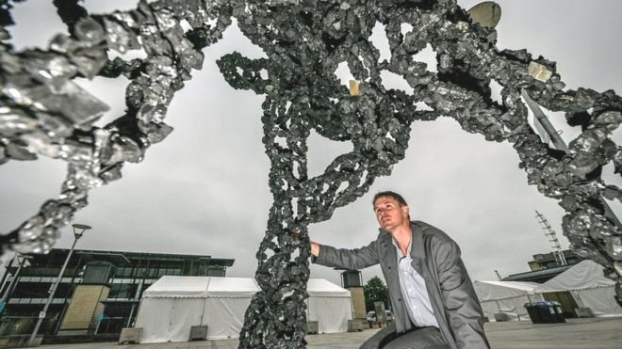
Inhale
Luke Jerram (Photo: Simon Chapman)
diesel soot particle, three million times larger (Photo: BBC)

Slide 6
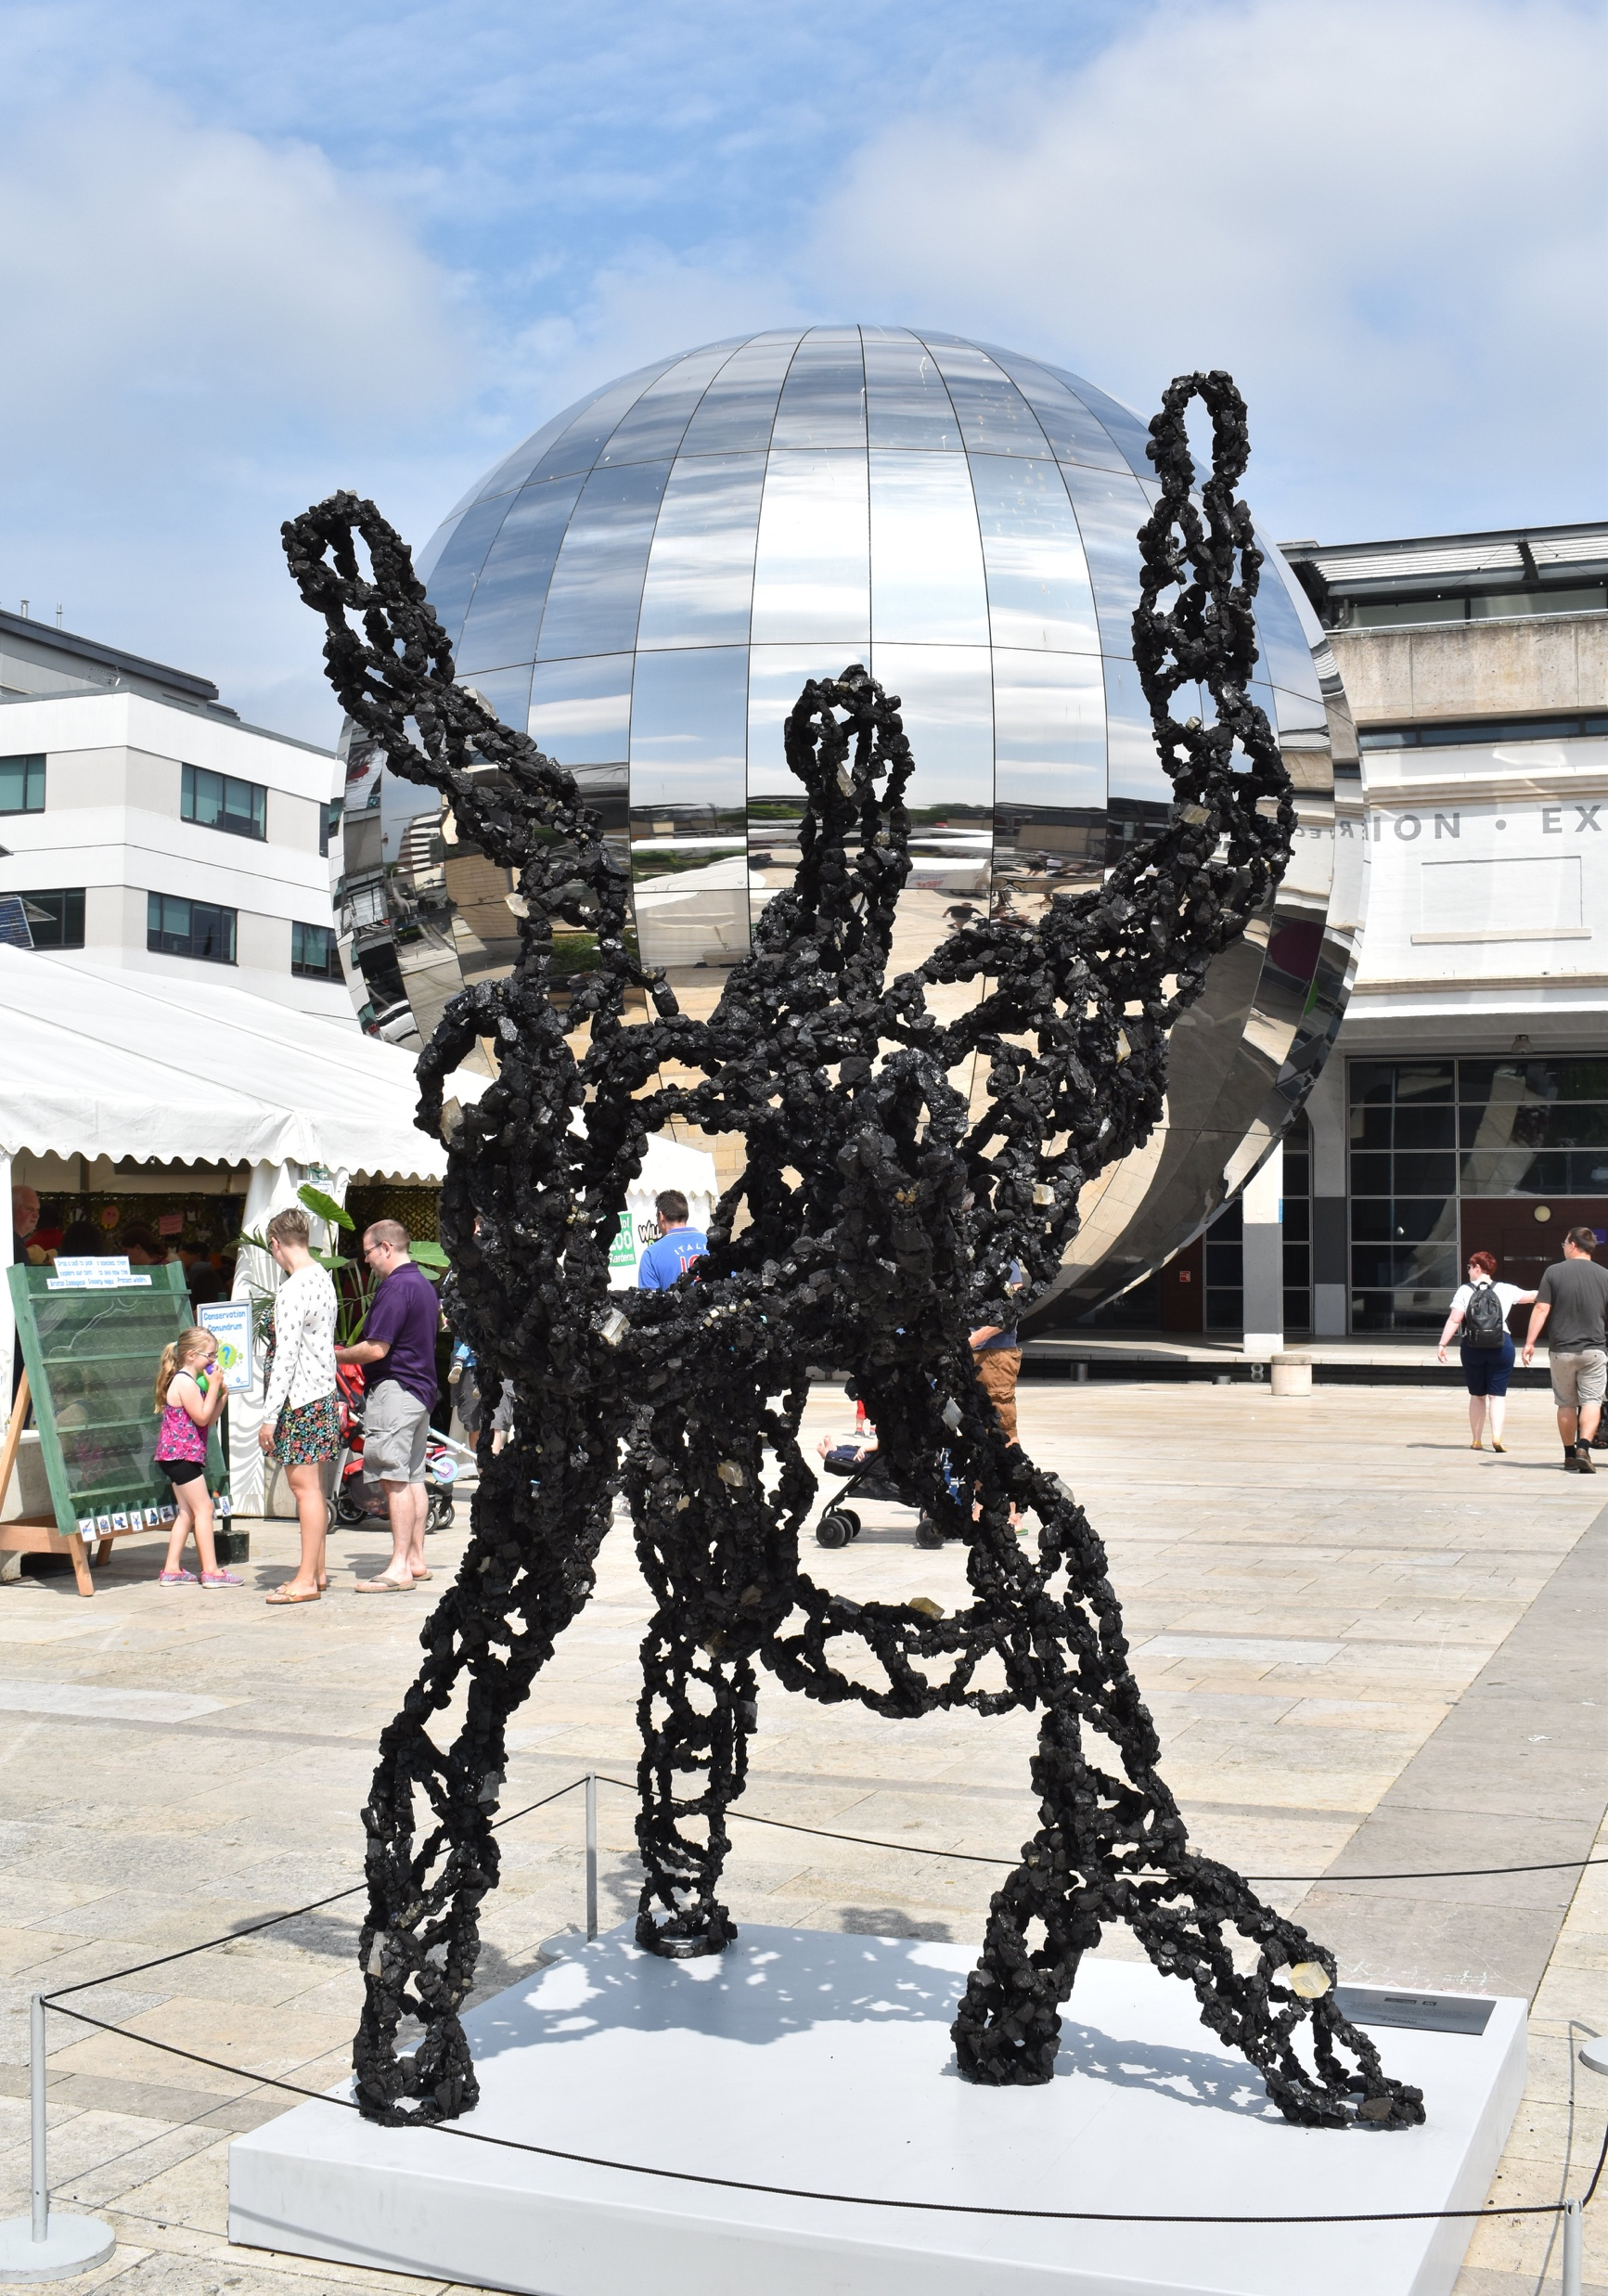
(Video: Luke Jerram)
black carbon from vehicle engines
metal from brake pads
silicate from the road
(Photo: Wayne Powell)

Slide 7
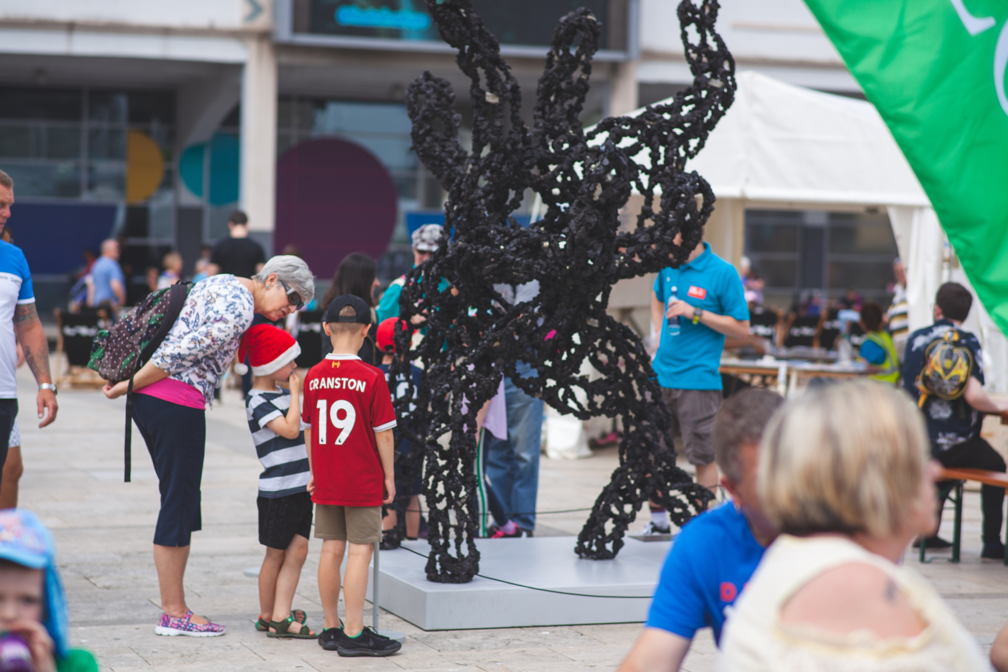
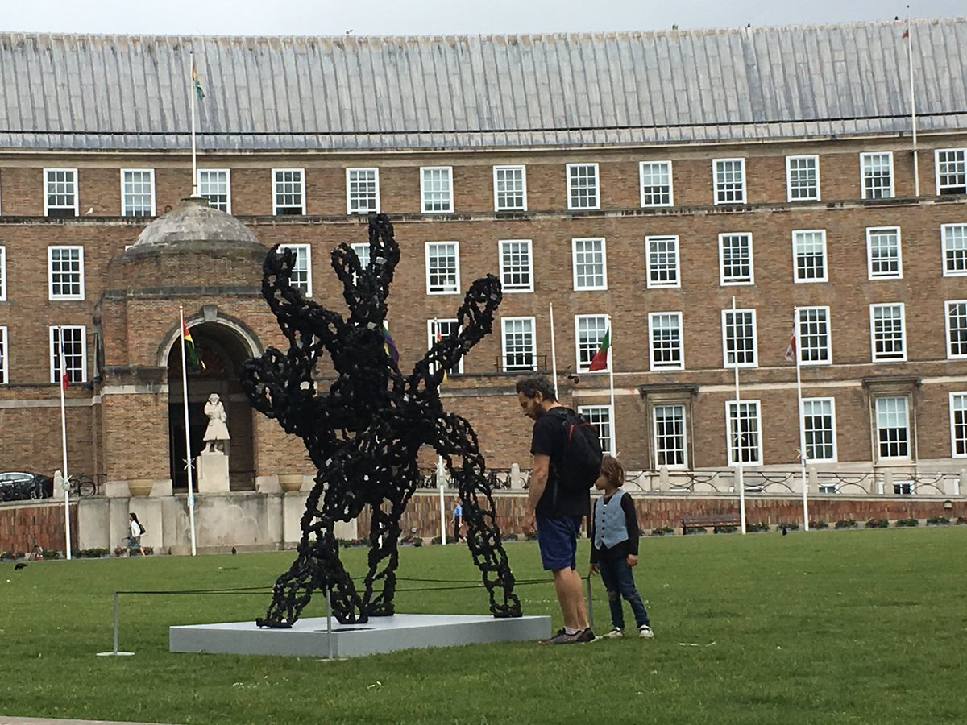
To draw people's attention to the health impacts of poorly designed cities; conversation starter
Festival of Nature
(Photo: Eight Photography)
College Green, Clean Air Day
(Photo: Luke Jerram)

Slide 8
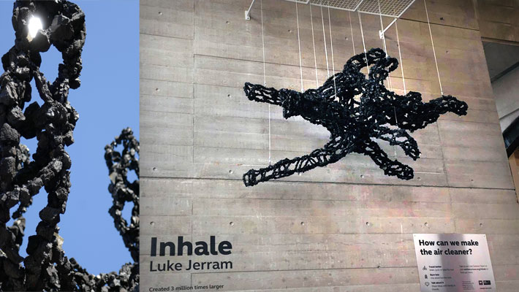
Legacy and further impacts
Press Coverage BBC News British Medical Journal Bristol Evening Post Bulgarian News Agency BBC Radio Bristol Heart FM
We The Curious
(Photo: Luke Jerram)

Slide 9
Legacy and further impacts
Feedback loop into campaigns and politics
Green Councillor for Ashley, Jude English said:
“There is a real role for art in making this invisible killer visible for the people of Bristol. Luke Jerram’s sculpture reminds us of the invisible particles that we breathe in every day. It reminds us of the consequences our poor transport infrastructure, congestion and reliance on cars has on our city and on each other.”

Slide 10
How art can
spur people into action or
fill them with fear

Slide 11
[makes me feel] Sad. It’s quite shocking. I did not expect that amount of impact that such a little thing has on the environment. It’s quite sad. (visitor, Festival of Nature)
sad

Slide 12
worried
I think it makes you worry, it feels like a monster and an invisible monster that we are just letting happen. To bring it to light. Like an alien. So it makes me feel quite worried and quite concerned but also you know, feels like you can then go and maybe do something about it.
(visitor, Clean Air Day Stunt)

Slide 13
scared
I think the fact that it’s 3 million times larger and the fact that is what we are all breathing in all the time in the city centre is pretty damn spooky.
(visitor, Clean Air Day Stunt)

Slide 14
inertia
It makes me feel a little bit sad that there is nothing you can do about it.
(visitor, Clean Air Day Stunt)

Slide 15
Well, there are little things (…) little things that you can do and I was just consciously thinking well actually I want to take a step towards making a difference.
(visitor, Festival of Nature)
If transport, public transport was cheap, easier and much more available I think that would be a solution and I am prepared to pay more taxes for it.
(visitor, Clean Air Day Stunt)
I wish we could plant more green spaces in the city centre and educate people about healthy living with concerns to other people.
(visitor, Clean Air Day Stunt)
action

Slide 16
It will start conversations and it will start people see that they might be able to do something about the issue. They might be part of the issue and they might be able to be part of the solution.
So I think it brings the issue alive as opposed to it being, oh air quality, that’s those people who drive diesel. Well that’s all of us potentially.
(visitor, Clean Air Day Stunt)
it’s all of us

Slide 17
It does make me think differently. It makes me realise how much pollution is actually around. I thought global warming is not really a thing but it actually is. (visitor, Clean Air Day Stunt)
To give us an idea about how much pollution is actually going around, that’s the main thing. Not a lot of people know about how dangerous air pollution really is but this really shows how much of an impact it will really make.
(visitor, Clean Air Day Stunt)
eye-opener

Slide 18
‘making the invisible visible’

Slide 19
Made people think about air pollution in a different way, as it made the issue very obvious and visible.
Inhale emphasised that something so small (the soot particle) can have a large impact on health and the economy.
Art

Slide 20
What are the invisible elements of the everyday that you could make visible in your own work?

Slide 21
Thank you.
Margarida.Sardo@uwe.ac.uk

