Slide 1

The University of the West of England, Bristol

Slide 2
Presentation by
The UK Clean Air Strategy 2019.
Is this a new start for the management of air quality?
27th International Conference on
Modelling, Monitoring and Management
of Air Pollution
University of Aveiro, Portugal
26th – 28th June 2019
Professor Jim
Longhurst
Dr Jo Barnes
Professor Enda Hayes
Dr Laura De Vito
Dr Ben Williams
Air Quality Management Centre
UWE Bristol
26th June 2019

Slide 3
Structure of Presentation
Introduction and context
A brief overview of the UK’s air pollution problem
The Clean Air Strategy 2019 – aims and intentions
Evaluating the Strategy
Conclusions

Slide 4

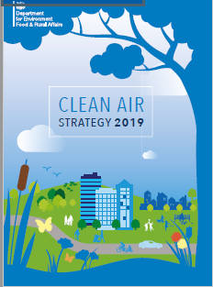
Clean Air Strategy 2019
The new strategy was published in January 2019.
The foreword by the Secretary of State for Environment, Food and Rural affairs (Defra) identifies air pollution as the top environmental risk to human health in the UK.
The Clean Air Strategy sets out the case for action to improve UK air quality.
The strategy is focused on tackling air pollution in England but also highlights action being taken in Northern Ireland, Scotland and Wales.

Slide 5
The Clean Air Strategy
The Strategy sets “ambitious goals to reduce people’s exposure to nitrogen oxides, ammonia, particulate matter, non-methane volatile organic compounds and sulphur dioxide”.
It estimates that the actions outlined could cut the costs of air pollution to society by £1.7 billion every year by 2020, rising to £5.3 billion every year from 2030.
The traditional focus on road transport and industrial emissions is supplemented by a need to tackle other sources of air pollutants including agricultural and domestic sources.

Slide 6

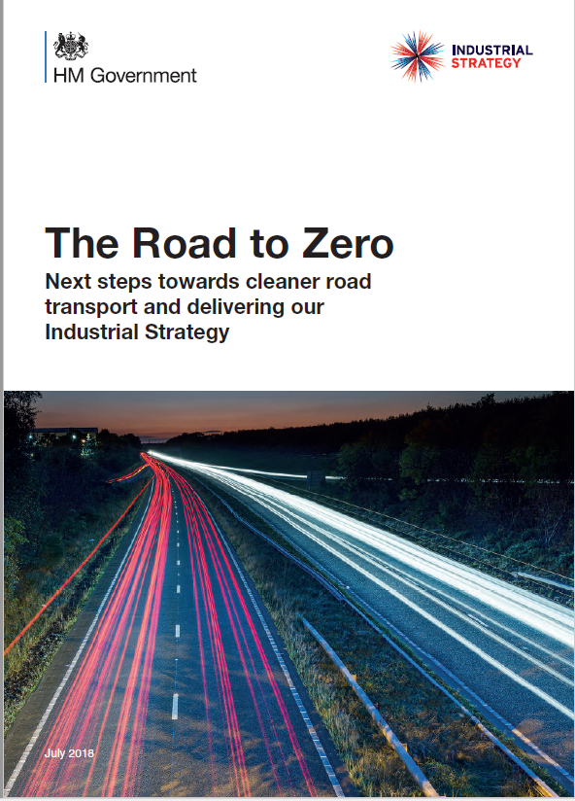
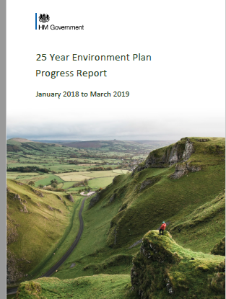
The Clean Air Strategy
The Clean Air Strategy should be seen as part of a suite of policy documents including
The 25 Year Environment Plan, https://www.gov.uk/government/publications/25-year-environment-plan
25 Year Environment Plan progress report: January 2018 to March 2019
https://www.gov.uk/government/publications/25-year-environment-plan-progress-reports
The Industrial Strategy, November 2017 updated June 2018
https://www.gov.uk/government/publications/industrial-strategy-building-a-britain-fit-for-the-future
Clean Growth Strategy, October 2017
https://www.gov.uk/government/publications/clean-growth-strategy
The Road to Zero, July 2018
https://www.gov.uk/government/publications/reducing-emissions-from-road-transport-road-to-zero-strategy

Slide 7
A Challenge to Conventional Thinking
The easy wins with air quality policy have been taken.
Low hanging fruit has been picked
The remaining challenges are deeply entrenched and resistant to change.
Policy implementation becoming tougher.
The direct costs, financial and political of air quality improvements rising.
How to respond?
Need to think systematically
Integrate the science and human dimensions
Recognise that air quality is a multifaceted, emergent problem.
Encourage more integrated thinking.
Does the Clean Air Strategy do this?

Slide 8
The UK Air Quality Problem
What is the problem the Clean Air Strategy is designed to fix?

Slide 9
The UK Air Quality Problem
Whilst national emissions of air pollutants have fallen quite considerably concentrations measured at the local scale have been more resistant to change.
Does the Clean Air Strategy address these issues?
See Barnes, J. et al (2013) Environmental Planning and Management 57 (5). pp. 660-681.
Brunt, H. et al (2016) Environmental Science and Policy 58 52-60.
Barnes, J. et al (2018) Environmental Science & Policy 85, pp 28–39

Slide 10
A Starting Perspective
Air pollution is not an accident.
It results from the decision others take to shape land use, develop transport infrastructure and to develop the economy.
Air pollution results from the interactions of these processes and the way citizens practices are conditions by the systems in which they live their lives.
Different groups in society have different experiences of pollution.
In general, the richest in society emit the most pollution and are exposed the least.
In general, the poorest in society emit the least pollution and are exposed the most.
This is an environmental justice issue.
See Barnes, J.H., et al. (2019) Emissions vs exposure: Increasing injustice from road traffic-related air pollution in the United Kingdom Transportation Research Part D: Transport and Environment 73 56-66
Does the Clean Air Strategy consider environmental justice?

Slide 11
Times have changed
We know from past experience that air pollution can be managed when there is a political will to act.
Air pollution is a societal choice – we could reduce concentrations if we choose to do so.
The perspective on air pollution will differ when considered at the national scale or the local scale.
A challenge is how to connect the two spheres of government.
See Longhurst et al (2006) Environment International 32(8) 934-947.
Does the Clean Air Strategy strengthen the link between national and local action?

Slide 12
The Long Term Solution
Land Use Planning including Agriculture
Transport Infrastructure Planning
Industrial and Economic Planning
The problem is that the beneficial air quality impacts arising from systematic planning processes are long term whilst the problems of air pollution and the impact of policy change are immediate and near term.
Does the Clean Air Strategy address the long term solutions through planning processes?
    See Longhurst et al (2016) Sustainable Development & Planning 11 (4) 491–499
    See Longhurst et al (1996) Atmospheric Environment. 30 (23) 3975-3985

Slide 13
The World’s Biggest Environmental Health Risk
The WHO estimates that 4.2 million people die prematurely each year as a result of exposure to ambient air pollution and that 91% of the world’s population lives in places where air quality exceeds WHO guidelines. The WHO describes air pollution as “the world’s biggest environmental health risk”. https://www.who.int/phe/publications/air-pollution-global-assessment/en/ and https://www.who.int/airpollution/en/
Air Pollution is the Biggest Environmental Risk to Health in the European Union. European Court of Auditors, September 2018 “air pollution causes about 400 000 premature deaths in the EU and hundreds of billions of euros in health-related external costs.” Special Report No 23/2018 ,“Air pollution: Our health still insufficiently protected”, JOUE C 324 of 13 September 2018 and https://www.eca.europa.eu/en/Pages/DocItem.aspx?did={AE82EA38-A430-48F1-A21E-349B2E4B5249}
In the UK estimates vary as to the annual death toll associated with exposure to air pollution with the most recent data suggesting that 28 000 – 36 000 premature deaths per year are associated with exposure to fine particles and nitrogen dioxide. https://www.gov.uk/government/publications/clean-air-strategy-2019
Estimated annual cost of £18.6 billion to health and social care services by 2035 https://www.gov.uk/government/publications/clean-air-strategy-2019.
Including lost productivity in the calculation the House of Commons Environmental Audit Committee estimated the health and economic costs today to be £20 billion

Slide 14
Managing UK Air Quality
Three regimes – mostly disconnected although seeking similar outcomes in terms of managing air quality
International law – the UNECE Convention on LRTAP - UK and EU are parties
European legislation on emissions and concentrations – applies to the whole of the UK
Local Air Quality Management – a devolved responsibility for governments in the UK who set policy and technical guidance for implementation by local authorities.
Specifics differ across the UK space dependent upon the requirements of devolved administrations in Scotland, Wales, Northern Ireland as well as the Mayor of London and Secretary of State for Defra.
See Longhurst et al (2009) Atmospheric Environment 43 (1) 64-78
Does the Clean Air Strategy propose better integration of the horizontal and vertical legislative regimes?

Slide 15
It’s Not for the Want of Legislation
We have had plenty in the UK.
In the 63 years since the 1956 Clean Air Act we have many, many acts that directly or indirectly relate to air pollution.
Perhaps not always as effective and hard hitting as we might want
Often the intent has been watered down by special interest lobbying
Does the Clean Air Strategy propose new legislation and regulation?

Slide 16
Regulation and Enforcement
To conceive and execute environmental protection responsibilities National and Local Authorities require an effective regulatory framework and a well trained and efficient enforcement capability.
Both most be present to deliver effective environmental protection.
Does the Clean Air Strategy recognise the importance of a capable enforcement agency?

Slide 17
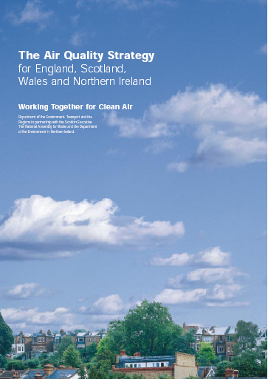
The Increasing Evidence of Policy Failure
1995 Environment Act and UK Air Quality Strategy set domestic annual mean AQ Objective for NO₂ of 40μg/m³ to be achieved by 2005
It was expected that there would be “a handful of AQMAs in large cities and metropolitan areas”
2004 more than one hundred local authorities have AQMAs for NO₂
2008 225 LAs (52%) had AQMAs (≈500 AQMAs in total)
2016 259 /389 LAs with AQMAs (613 AQMAs in total)
July 2018 264/391 Local Authorities – 68% of those in the UK – have one or more AQMAs.
These are not ‘localised hotspots’ they are local manifestations of a systemic national problem
A problem that has proved strongly resistant to the current policy prescriptions for management
See Longhurst et al (1996) Atmospheric Environment. 30 (23) 3975-3985
Longhurst et al (2009) Atmospheric Environment 43 (1) 64-78
Barnes, J. et al (2013) Environmental Planning and Management 57 (5). pp. 660-681.
Barnes, J. et al (2018) Environmental Science & Policy 85, pp 28–39
Does the Clean Air Strategy address this issue?

Slide 18
The Air Quality Strategy, 2000
“Clean air is an essential ingredient of a good quality of life. People have the right to expect that the air they breathe will not harm them”.
Does the Clean Air Strategy 2019 commit to a right to Clean Air?

Slide 19
What is in the Clean Air Strategy 2019
The strategy is organised in 10 chapters
    Understanding the Problem,
    Protecting Health,
    Protecting the Environment,
    Securing Clean Growth
    Actions to reduce emissions from Transport,
    Actions to reduce emissions from Homes,
    Actions to reduce emissions from Farming,
    Actions to reduce emissions from Industry,
    Leadership,
    Progress towards our goals.

Slide 20
Understanding the problem
Commitments in the strategy
Investing £10 million in improving modelling capabilities, data management, public presentation and analytical tools to give a more precise picture of current air quality and the future impact of policy options.
Emissions of all five key air pollutants in England have fallen over the latest 18 years for which annual, country-level data are available.
Emissions of SO₂ have seen the greatest reductions, falling by over 90% between 1998 and 2016.
Emissions of NOx and NMVOCs have fallen by over 60%.
Emissions of PM_{2.5} and NH₃ have fallen by 32% and 12% respectively.
https://www.gov.uk/government/publications/25-year-environment-plan-progress-reports

Slide 21
Understanding the problem
Emissions for five air pollutants in England, 1998 to 2016
https://www.gov.uk/government/publications/25-year-environment-plan-progress-reports

Slide 22
Protecting health
Commitments in the strategy
A new, long-term target to reduce exposure to PM_{2.5}
A commitment to examine what action would be needed to meet the WHO annual mean guideline limit of 10 μg/m3.
Reduce PM_{2.5} concentrations across the UK, so that the number of people living in locations above the WHO guideline level of 10 μg/m3 is reduced by 50% by 2025.
A personal air quality messaging system to inform the public about the air quality forecast, providing clearer information on air pollution episodes and accessible health advice.
New powers to enable targeted local action in areas with an air pollution problem.
New appraisal tools and accompanying guidance to enable the health impacts of air pollution to be considered in every relevant policy decision.

Slide 23
Protecting the environment
Commitments in the strategy
A new target for the reduction of reactive forms of nitrogen and to review what longer term targets should be to further tackle the environmental impacts.
Reporting annually on the impacts of air pollution on natural habitats and report annually to chart progress.
Guidance for local authorities explaining how cumulative impacts of nitrogen deposition on natural habitats should be mitigated and assessed through the planning system.

Slide 24
Clean growth and innovation
Commitments in the strategy
Support for UK industry to engage with development, manufacture and use of technologies, systems and services that tackle air pollution.
In partnership with UKRI support investment in Clean Air innovation. A £19.6 million R & D programme to develop cleaner technologies and new research insights.
Phasing out coal-fired power stations, improving energy efficiency, and shifting to cleaner power sources.
Strengthen the collaboration between Defra and BEIS, to articulate the trade-offs between energy and public health when developing strategies to meet air quality and carbon targets.
Minimise the air quality impacts of the Renewable Heat Incentive Scheme and tackle non-compliance.

Slide 25
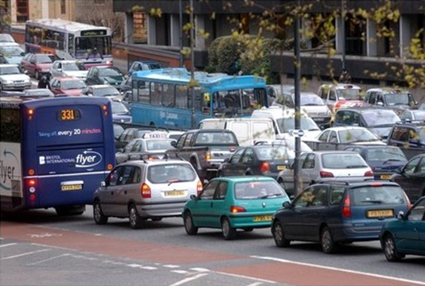
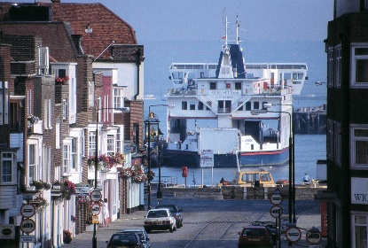
Action to reduce emissions from transport
Commitments in the strategy
Road to Zero sets out the Government’s plans to end the sale of new conventional petrol and diesel cars and vans by 2040.
Support for the development, manufacture and use of zero exhaust emissions vehicles.
Consultations on Aviation 2050 and Maritime 2050.
New legislation to enable the Transport Secretary to compel manufacturers to recall vehicles and non-road mobile machinery for any failures in their emissions control system.
Unconventional emission sources such as non-road mobile machinery in agriculture and construction have become a matter of policy concern.
Work with international partners to research and develop new standards for tyres and brakes to address non-exhaust particulate emissions from vehicles.
A route map to phase out diesel-only trains by 2040.
Requirement for UK ports to develop an Air Quality Strategy by the end of 2019 and covering emission reductions form shore activities and visiting ships.

Slide 26
Action to reduce emissions from homes
Commitments in the strategy
New legislation to prohibit the sale of the most polluting fuels and stoves, particularly targeted at residential wood combustion for domestic heating.
Revision to existing smoke control legislation to make it easier to enforce and new powers for local authorities to take action in areas of high pollution.
Government to align work on air quality, clean growth and fuel poverty in future policy design.
Development of a communication campaign targeted at domestic burners.
Revised test standard for new solid fuels entering the market.
Consultation on changes to Building Regulations standards for ventilation in homes and other buildings.

Slide 27
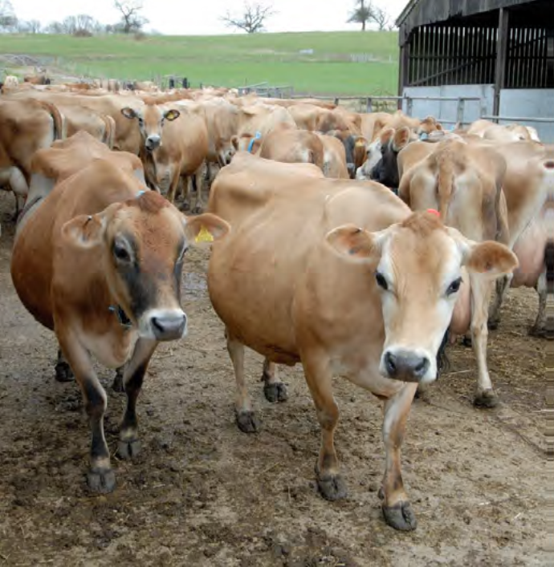


Action to reduce emissions from farming
Commitments in the strategy
New national code of good agricultural practice (COGAP) to reduce ammonia emissions.
A nitrogen deposition target protecting an additional 200,000 hectares of natural habitat from excessive nitrogen deposition
A 17% cut in nitrogen emissions.
Support for farmers to make emission reduction investments.
New environmental land management system proposed to fund targeted action to protect habitats impacted by ammonia.
Work with the agriculture sector to ensure the ammonia inventory reflects existing farming practice and the latest evidence on emissions.
New regulation to reduce ammonia emissions from farming by requiring adoption of low emissions farming techniques.
Environmental permitting extended to the dairy and intensive beef sectors.
New regulation to minimise pollution from fertiliser use, seeking advice from an expert group on the optimal policy approach.

Slide 28
Action to reduce emissions from industry
Commitments in the strategy
Clear process for determining future UK Best Available Techniques for industrial emissions.
Work with industrial sectors to develop a series of clean technology sector roadmaps for UK industry.
Closing the regulatory gap between the current Ecodesign and medium combustion plant regulations to tackle emissions from plants in the 500kW to 1MW thermal input range.
Consideration of the case for tighter emissions standards on medium combustion plant.

Slide 29
Leadership at all levels
Commitments in the strategy
Commitment to cut national emissions to reduce population exposure. Alongside this, the UK will continue to play an active, leading role in international action to improve air quality.
New Office for Environmental Protection.
Introduce a set of environmental principles that will be used to guide future government policy and place the 25 year environment plan on a statutory footing.
New provisions on air quality in 2019 including a new legislative framework for tackling air pollution at national and local level, tying this into the development of the new environmental principles and governance framework to be outlined in an Environment Bill.

Slide 30
Leadership at all levels
Commitments in the strategy
To enable greater local action on air pollution responsibility for action will sits at the right tier of local government and will be backed up with new powers Neighbouring local authorities and other public bodies will work collectively to tackle air pollution.
International air quality commitments will continue to be agreed at a UK level.
However, air quality is a substantially devolved policy area. Scotland has already produced its own Air Quality Strategy, and Wales and Northern Ireland are currently in the process of drafting their own .
The UK government will work in partnership with the governments of Scotland, Wales and Northern Ireland to develop a National Air Pollution Control Programme as required under the National Emissions Ceilings Directive for publication in 2019.

Slide 31
Leadership
This Strategy sets out the comprehensive action that is required from across all parts of government and society to meet these goals. New legislation will create a stronger and more coherent framework for action to tackle air pollution.
This will be underpinned by new England-wide powers to control major sources of air pollution, in line with the risk they pose to public health and the environment, plus new local powers to take action in areas with an air pollution problem.
These will support the creation of Clean Air Zones to lower emissions from all sources of air pollution, backed up with clear enforcement mechanisms.

Slide 32
Evaluating the Clean Air Strategy
A Policy Document not an Act of Parliament.
Its content sets out a policy framework and is a suite of intentions. Until enshrined in law by Parliament it remains good intentions.
To be a published document the Strategy has met three tests
Technical Feasibility – are the measures technical feasible now or in the near future?
Economic Impact – are the direct and indirect economic impacts – positive and negative – acceptable to the Treasury?
Political Acceptability – are the measures consistent with the ideology of the governing party and will they be acceptable to the electorate? A component of this will be an assessment of the impact on different demographics within the electorate.

Slide 33
Evaluating the Clean Air Strategy
Key tests
How efficient will be the resources deployed to secure the intended outcomes?
How effective will be the measures be in securing the intended outcomes?
Implementing Authorities
Do they have the capability to achieve the intended outcomes within the available resources and timescale?
Do they have the capacity to achieve the intended outcomes?
Do they have the necessary competency to achieve the intended outcomes at the required standard?

Slide 34
Evaluating the Clean Air Strategy
Are the following addressed?
Rights – to Clean Air
Responsibilities - of Governments, economic actors, citizens
Obligations - of Governments, economic actors, citizens
Requirements - enshrined in law
Responsibilities, obligations and requirements are present in the Clean air Strategy 2019.

Slide 35
Right to Clean Air
European Court of Justice
Judgment of the Court (Second Chamber) on the 25th of July 2008, confirmed the enforceable “right to clean air” for all EU citizens.
The Court, interpreted Article 7(3) of Council Directive 96/62/EC of 27 September 1996 on ambient air quality assessment and management.
Confirmed the entitlement of a third party whose health is impaired to have an action plan drawn up as provided for by the Directive, where that third party is entitled under national law to bring legal proceedings for measures to prevent the value limits of particulate matter being exceeded.
Rights appear to be missing from the Clean Air Strategy.

Slide 36
Evaluating the Clean Air Strategy
Applying the Design Principles of the National Air Quality Strategy, 1997
Application of sound science to decision-making
Human health effects-based assessments and control actions
Cost-effectiveness of actions to control issues of concern
Polluter pays
Proportionality of response to identified problems
Sustainability of the control action
Application of the precautionary principle in the formulation and application of the assessment and control measures
Application of assessment methodologies at the appropriate spatial scale (subsidiarity)
These design principles do appear to have guided the 2019 Clean Air Strategy.
Department of the Environment, Scottish Office, Welsh Office, 1997. The United Kingdom National Air Quality Strategy. CM3587. The Stationery Office Ltd., London.
Longhurst, J.W.S., Irwin, J.G., Chatterton, T.J, Hayes, E.T. Leksmono, N.S., & Symons, J.K., (2009). The development of effects based air quality management regime. Atmospheric Environment 43 (1) 64-78.

Slide 37
Evaluating the Clean Air Strategy
In addition to the original principles it is now necessary to add three further principles
Globally and nationally connected
Environmental Justice
Better regulation
These are assessed in the next slides.

Slide 38
Evaluating the Clean Air Strategy
Does the Clean Air Strategy encourage integrated thinking?
Yes. Spatial and temporal integration is carefully considered.
Does the Clean Air Strategy address the fact that concentrations are not falling in line with emission reductions?
Yes. The Strategy makes clear the current legislative framework has not driven sufficient action at a local level. In the Environment Bill, associated secondary legislation and statutory guidance this is to be addressed Proposals are made to ensure accountability sits at the right tier of the local government structure
The Strategy seeks to shift the focus towards prevention, promoting greater action to avoid exceedances, rather than tackling air pollution only when limits are surpassed.
The Strategy proposes new guidance on how Air Quality Management Areas, Smoke Control Areas and Clean Air Zones interrelate and how they can be used by local government to tackle air pollution

Slide 39
Evaluating the Clean Air Strategy
Does the Clean Air Strategy consider environmental justice?
No. Not explicitly and the term is not present in the Strategy
Does the Clean Air Strategy strengthen the link between national and local action?
Yes. The link is made and the need to strengthen it is made clear
Does the Clean Air Strategy propose better integration of the horizontal and vertical legislative regimes?
Yes. The strategy is clear about the need to properly integrate UK wide and devolved responsibilities in an effective manner. Equally, it is clear that the UK’s international air quality commitments remain in place.
Does the Clean Air Strategy address the long term solutions through planning processes?
Yes. The need to assess and mitigate air pollution through the land use planning system is recognised. Avoiding the creation of air pollution problems is central to the thrust of Strategy and interdepartmental work with the Ministry of Housing, Communities and Local Government is identified to strengthen the planning practice guidance on air quality to ensure planning decisions help to drive improvements in air quality.

Slide 40
Evaluating the Clean Air Strategy
Does the Clean Air Strategy propose new legislation and regulation?
Yes. New legislation is proposed to create a stronger and more coherent framework for action to tackle air pollution.
New England-wide powers to control major sources of air pollution, in line with the risk they pose to public health and the environment, plus new local powers to take action in areas with an air pollution problem.
These will support the creation of Clean Air Zones to lower emissions from all sources of air pollution, backed up with clear enforcement mechanisms.
The Strategy proposes new legislate to ensure that major sources of air pollution are subject to proportionate controls that reflect the risk they pose to public health and the environment.

Slide 41
Evaluating the Clean Air Strategy
Does the Clean Air Strategy recognise the importance of a capable enforcement agency?
Yes. Local authorities will have flexible, proportionate enforcement powers. The role of the Environment Agency in England is referenced at places in the Strategy.
Does the Clean Air Strategy address the failure of Air Quality Management Areas?
Yes. New legislation, powers for local authorities and guidance proposed to address hot spots alongside a shift in focus towards prevention, promoting greater action to avoid exceedances, rather than tackling air pollution only when limits are surpassed.
Does the Clean Air Strategy 2019 reaffirm the right to Clean Air first outlined in 2000?
No. There is no reference to rights in the Strategy

Slide 42
The Air Quality Problem
In the last 25 years there has been lots of management activity, especially at the local authority level, but very little success in achieving cleaner air!
The good intentions have been overwhelmed by societal and structural changes. New thinking is required.
Recognise the multiple causes – structural, social and technical - and solutions to air pollution.
Address the social and structural inequalities related to both the cause of air pollution and its impacts.
Enable widespread emission reductions - not just hotspot management.
The Clean Air Strategy promises a new start for the management of air quality.

Slide 43
Air Pollution 27
Thank you
Professor Jim Longhurst
Air Quality Management Resource Centre
University of the West of England,
Bristol,
BS16 1QY
UK
Email James.Longhurst@uwe.ac.uk

