Slide 1
Reconceptualising assessment to promote student learning, resilience and wellbeing
Teaching and Learning in the Spotlight:
Innovation in Teaching Excellence
Northumbria University
Jennifer Hill - Associate Professor L&T, UWE Bristol
Sophie Keywood - APD Student Partner, UWE Bristol
Gemma Malcolm - APD Student Partner, UWE Bristol
Harry West - Graduate Tutor, UWE Bristol
Advance HE Teaching and Learning Conference 2019
2-4th July 2019

Slide 2
Context – student wellbeing challenges
Number of students disclosing a mental health condition has tripled since 2007/08 (Equality Challenge Unit, 2015)
Students report significantly lower levels of mental wellbeing than the general population - more so with respect to minority groups (Ferguson, 2017)
HE sector is experiencing a ‘mental health crisis’ (The Guardian, August 2018)
20% Australian students experiencing a mental health issue (Carter et al. 2017) and a fifth of Canadian post-secondary students identifying as depressed, anxious or battling other mental health issues (Pang, 2017)
Why?
Notes:
1. Introduction and context – 5 minutes
Academic pressure is cited as the primary cause of stress for student (YouGov, 2016). Finding a job after university is the second highest cause of stress (YouGov, 2014).
Also: living independently, financial challenges established by high tuition and living fees, social media, social pressures (Anthoney et al., 2017).
Students with between 30 and 39 hours of workload per week report greater happiness, greater feelings that their lives are worthwhile and less anxiety than others, The 2016 HEPI / HEA Student Experience Survey

Slide 3
What is wellbeing?
‘A sustainable positive mood and attitude, health, resilience, and satisfaction with self, relationships and experiences’ in their
educational environment’
(DEECD, 2010: 1)
Notes:
1. Introduction and context – 5 minutes

Slide 4
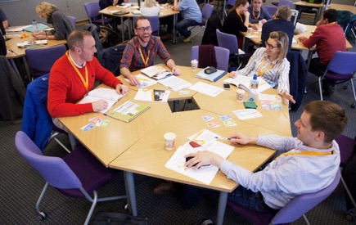
Break out activity
What concerns / challenges do you see with respect to enhancing wellbeing through teaching, learning and assessment?
5 Minutes
Notes:
2. Sharing concerns and challenges – 10 minutes
Today’s students experience the challenges of living independently, autonomous learning and comparisons between themselves and their peers. Alongside this, they face significant pressures including competition for graduate jobs and financial challenges established by high tuition and living fees.
Worry about academic stress, the future, social media, transitions

Slide 5
Wellbeing, the learning experience & student performance
To enhance student wellbeing in HE, we need to work more closely with the emotional realm of learning and the wider student experience
Consider how we can support students and their emotions in learning
We offer an example of success in working towards this at UWE, based in assessment practice (full paper – Hill & West, 2019 – Assessment & Evaluation in Higher Education)
Notes:
3. Present our research – 10 minutes
‘Fear of being judged’ came top of a list produced by Student Minds of the ten Grand Challenges in student mental health (Student Minds 2014).
Barnett (2007) identifies three connected fears that face students in a higher education context (all uncovered via assessment):
fear of failure in a given task
fear of falling short in their role (authentic student)
fear of rejection as a person
Barnett, R. (2007) A Will to Learn: Being a Student in an Age of Uncertainty. Maidenhead: Open University Press.

Slide 6
Assessment and wellbeing – discovering positive links
AY 2015-2016 - new assessment approach implemented on a second year geography module
Aimed to improve student learning experience through dialogic feed-forward assessment
Focus was cognitive:
Did the approach assert a positive influence on the student learning experience?
Did it enhance student performance and raise NSS
scores related to feedback?
Notes:
3. Present our research – 10 minutes
dialogic feedback is the creation of meaning and understanding via spoken discourse between lecturer and student, or student to student (Nicol, 2010)
feed-forward refers specifically to feedback given by tutors that:
- impacts upon an upcoming assignment
- is given post-assignment with more specific direction on how this can be applied to future assignments (Carless, 2007)

Slide 7
Module teaching and assessment structure
Supporting Lectures
25% module assessment
75% module assessment
Students choose essay from selection
Students write draft essay
Students submit draft and attend ‘feed-forward’ meeting
Students reflect on meeting and essay – grading their work
Students complete and submit final essay
Assessment discourse
Feedforward
discourse
Essay marking
Seminar
(peer assessment)
Notes:
3. Present our research – 10 minutes
We offered preparatory guidance, in-task guidance and performance feed-forward.
Interviews were audio-recorded and exemplar paragraphs were used during them. Students engage with learning ‘head on’
Also undertook essay marking seminar: students work with marking criteria and match LOs to standards

Slide 8
Qualitative case study approach
Individual semi-structured interviews … two consecutive year 2 cohorts at end of module (2015-16 and 2016-17) … analysed thematically via grounded theory
44 interviews ( x 30 mins ), 61% response rate: male = 45% female = 55%
Group semi-structured interviews with level 3 students elucidating post-assignment behaviour
Essay performance data pre- and post-assessment intervention (inferential stats)
Answers to NSS feedback questions
Notes:
3. Present our research – 10 minutes
full-time students, most aged 18-21 years
Interview average = 29.58 minutes. Range = 13.02 mins - 56.33 mins

Slide 9
Results - Enhanced learning experience
Conversation compelled students to engage critically with their work:
‘when I have had drafts handed back to me and it’s just written over, either I don’t understand what they are trying to say, or it’s not clear enough. I can ask you questions if we’re talking to each other about it, it’s easier to see things … It’s definitely better to talk about it’
‘I’ve had it before where you get electronic feedback and you might not be sure what some of the comments mean … being able to discuss it is important. You get that progress and can discuss how you can change it as opposed to just saying this is wrong’
Notes:
3. Present our research – 10 minutes
Point of contact with tutor pulled thinking forward - more time/thought put into assessment:
‘you don’t just have the hand-in at the end of the semester. You have something a bit earlier on to make you get more work done, which I find really good because it’s more of a motivation and driver to get work done early’

Slide 10
Results - Enhanced student performance
Band (%) | 2011-2012 (%) | 2012-2013 (%) | 2015-2016 (%) | 2016-2017 (%)
0-39 (inc. NS) | 16 | 5 | 0 | 5.5*
40-49 | 9 | 14 | 3* | 5.5*
50-59 | 34 | 38 | 28 | 17
60-69 | 41 | 38 | 58 | 58
70-100 | 0 | 5 | 11 | 14
Number (n) | 32 | 37 | 36 | 36
Average Ecology mark 4.5% higher than average mark for other second year optional modules
(p = 0.01)
Significantly higher marks 2015-17 v 2011-13
(p = <0.0001)
* Did not have a meeting
Dialogic assessment
Notes:
3. Present our research – 10 minutes
Mean course mark 2011-2013 (pre-intervention) (n=69 students) compared with 2015-2017 (post-intervention) (n=72 students) increased by 7% from 56% to 63%.
Mean final year mark for students taking Ecology (n=31): 61.7%
Mean final year mark for students not taking Ecology (n=12): 57.2%
Difference of 4.5% again but not significant at p=0.05

Slide 11
Then we delved deeper …
The approach uncovered the inherently emotional experience for students of receiving assessment feedback
Clear evolution in emotions over the feed-forward process:
apprehensive, scared, disappointed, upset, ashamed
enjoyment, satisfaction, motivation
For some, the meetings were cathartic, reducing their anxiety as they ‘came clean’ with their level of progress
Notes:
3. Present our research – 10 minutes

Slide 12
consciously encountering and talking through emotions in a collaborative manner supported a personalised and inclusive learning experience
students noted that the individualised nature of the meeting made them feel cared about:
‘Generic comments can be good … but you never know whether they are applicable to you or not. So getting personalised feedback is really useful’
‘I definitely felt like you cared about what [grade] I was getting’
Notes:
3. Present our research – 10 minutes

Slide 13
students reported altered behaviour post-meeting, within-task and with respect to post-assignment self-regulation
they self-avowed to increased self-efficacy, believing more strongly in their capabilities to accomplish assignments in future:
‘I definitely feel more confident … being able to prepare, structure and write in the future. Not only will I now be able to repeat these steps … but I will also be able to self-critique and identify mistakes or weak areas that I may not necessarily have done before’
Notes:
3. Present our research – 10 minutes
Developed resilient academic behaviours – facilitate wellbeing

Slide 14
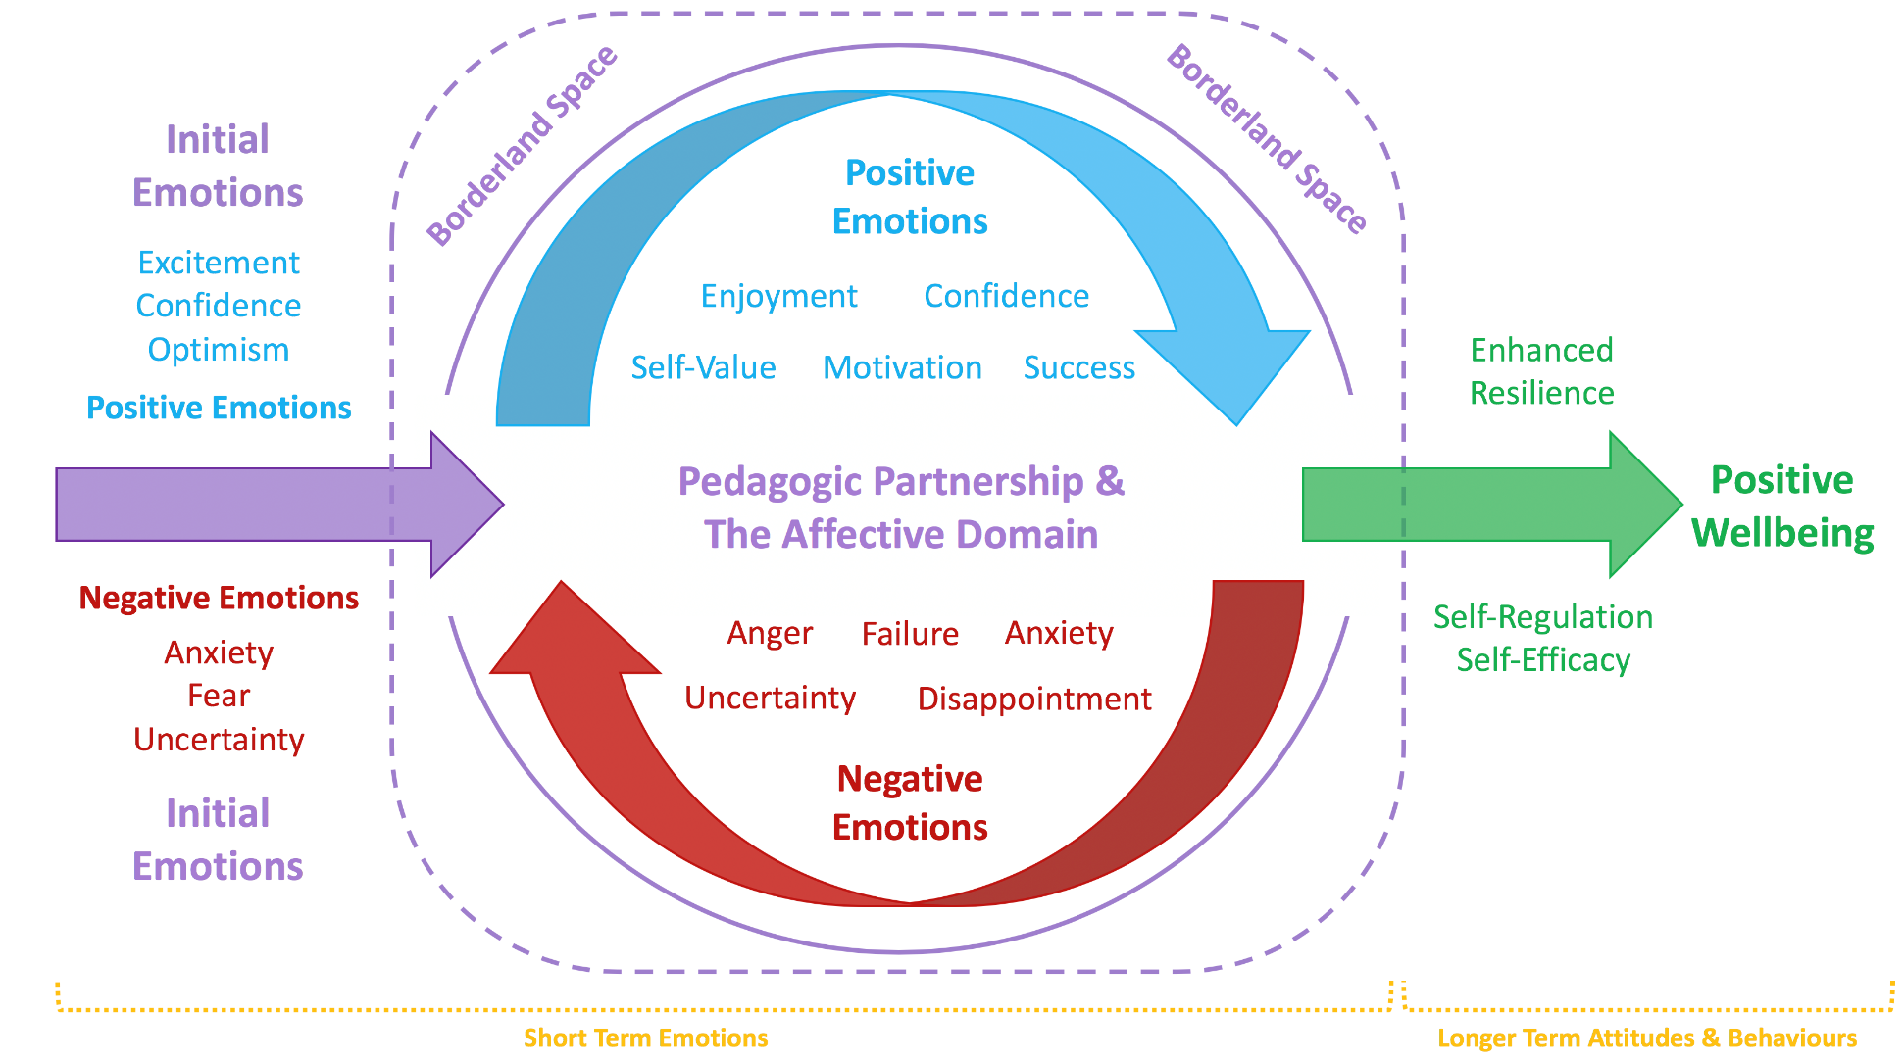
(Hill, Healey, West & Déry, 2019)
Notes:
3. Present our research – 10 minutes
Consciously encountering emotion within assessment can move students from negative feelings towards positive emotions, attitudes and learning behaviours, building their resilience and wellbeing. Also raises their satisfaction and performance.
Through open dialogue with students, academic staff can expose their own struggles with learning and normalise the emotions that underlie the development of knowledge.

Slide 15
Notes:
3. Present our research – 10 minutes
This process works with ‘productive failure’ – you don’t have to be afraid to fail or fall short – it becomes part of learning – dare to fail.
Professor Laura Ritchie (Chichester – music): Learning is about taking a risk – going to the edge, doing what’s uncomfortable, accepting the ‘I don’t know’ with one another.
IF YOU’RE NOT FALLING OFF IT, YOU’RE REALLY NOT EXPLORING THE EDGE
Laura Ritchie blog

Slide 16
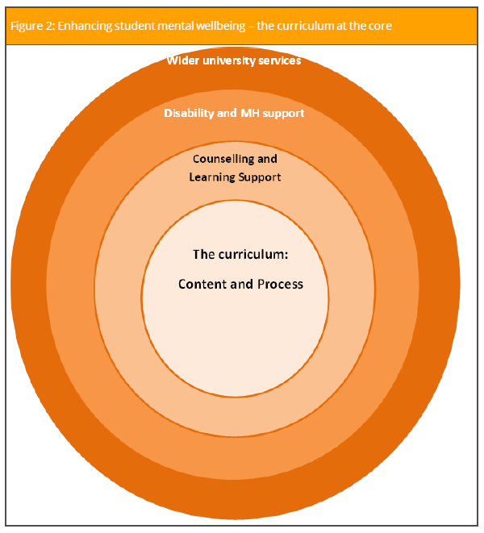
Wellbeing audit in your context
Key message from this workshop:
Wellbeing is core to the curriculum in the way we teach (process / approach) and what we teach (content)
Effective learning, teaching and assessment, mainstreaming wellbeing, can complement the role of student support services
(HEA, 2017)
Notes:
4. Wellbeing audit in your context – 30 minutes

Slide 17
Wellbeing audit in your context
Consider a contribution you make to TLA
Ask yourself the following questions:
Are there specific learning environments that can be stressful – first time in labs, field, groups, crits/simulations, presentations, internships / placements?
What approaches to teaching create or work to dissipate stress?
How can I dissipate the stresses associated with assessment?
15 Minutes
How do I guide my students through transitions (across semesters / years?)
How do I communicate with my students to build a sense of belonging?
Could I make better use of technology to support wellbeing?
Notes:
4. Wellbeing audit in your context – 30 minutes
Begin considering on your own – but feel free to buddy up and share ideas in pairs to help you with your thinking – 15 mins
10 minutes and 5 for debrief
At UWE we have: study skills advice & support, UWE's Disability Service, UWE Student Union’s Academic Survival Guide, Student Support Adviser, UWE Library’s study skills workshops / online tutorials, Espresso maths/programming, Resilient U workshops, Wellbeing service
PAL workshops: Resilient U (see video: https://www.youtube.com/watch?v=LX_FsKbwa6w&list=PLdxx_CsFYRDTQjnY0SjN77hdPOCKHjXkx&index=6)
PAL Mentoring: UWE Cares
Library Academic skills workshops
See also library study skills web pages: https://www1.uwe.ac.uk/students/studysupport/studyskills.aspx
How can you empower the students to help themselves? Plan for and with them. What do you need the students to do for you to help the further?
Induction – culture shock – 6 months to hit home and 48 months thereafter to mastery – role for student-geneated induction here. See Nicholas Bowskill (2013) Student-Generated Induction: A Social Identity Approach: A Staff Development Guide.
Role of APT?

Slide 18
Wellbeing audit in your context
On your table, try to identify one stress mitigation action you believe would impact on student stress and enhance performance in your context
Groups to share with the room
15 Minutes
10 Minutes
Notes:
4. Wellbeing audit in your context – 30 minutes

Slide 19
Wellbeing audit in your context - debreif
Effective TLA approaches that promote wellbeing embrace relational partnership working and acknowledge the whole student:
Active, experiential learning: group work, inquiry- / research-based learning, service learning, practice-based learning
Compassionate T&L: relate to students in ways that are welcoming, and sensitive to them as individuals (Gilbert compassion video)
Inclusive and contemplative (contemplative pedagogy network blog)
Dialogic teaching and assessment (see later case study)
Create a sense of identity and safety for students – fellow students viewed as resources for learning not competitors
Notes:
4. Wellbeing audit in your context – 30 minutes
A hospitable and compassionate pedagogy argues for staff to engage in reflexive dialogue with their students to elicit new insights and create meaning together. This can help foster personalised and inclusive learning environments.
Contemplative pedagogy aims to connect students to the lived, embodied experiences of their learning. Also conveys that academic staff value their students not only in their capacity as learners but holistically.
Students are known by their peers and teachers, they feel welcomed, recognised and valued, and their aspirations to learn are encouraged and facilitated.
Collaboration and sharing
UWE student quotes here from Gemma and Sophie

Slide 20
Conclusions
Implications for practice:
Relate to students in ways that are hospitable and attuned to them as individuals
Adopt active student-centred and social pedagogic approaches such as group work, inquiry-based learning and authentic assessment
Seek training from Educational Developers who might support you to work positively with the emotional aspects of learning
Learn from one another through co-teaching or simply sharing the emotional labour of teaching
Consider how to adapt different teaching, learning and assessment practices across different FHEQ Levels which consider wellbeing and emotion
Notes:
5. Conclusions – 5 minutes

Slide 21
References
Department of Education and Early Childhood Development (2010), The effectiveness of student wellbeing programs and services, https://www.parliament.vic.gov.au/papers/govpub/VPARL2006-10No270.pdf.
Carter, M.A., Pagliano, P., Francis, A. & Thorne, M. (2017), Australian university students and mental health: Viewpoints from the literature, International Journal of Innovation, Creativity and Change, Vol.3, 1-25.
Equality Challenge Unit (2015), Equality in higher education: Statistical report 2015, https://www.ecu.ac.uk/publications/equality-higher-education-statistical-report-2015/
Ferguson, D. (2017), The rise in student mental health problems – I thought my tutor would say deal with it, The Guardian, 29th August 2017.
Hill, J., Healey, R., West, H. & Dery, C (2019), Pedagogic partnership in higher education: Encountering emotion in learning and enhancing student wellbeing, Journal of Geography in Higher Education, In Press.
Hill, J. & West, H. (2019), Improving the student learning experience through dialogic feed-forward assessment, Assessment & Evaluation in Higher Education, DOI: https://doi.org/10.1080/02602938.2019.1608908.
Pang, W. (2017), Peace of mind: Universities see spike in students seeking mental-health help, The Globe and Mail, 18th October 2017.

