Slide 1
Promoting healthy and sustainable environments: opportunities for injury prevention
Dr Paul Pilkington, Senior Lecturer in Public Health, UWE Bristol
Safety 2010 World Conference, Friday 24th September 2010, Session J10, 11.30, Rutherford Room

Slide 2
Outline
Promoting healthy and sustainable environments
Advancing injury prevention through shared agendas: reducing traffic speeds
Getting injury prevention on other people’s agendas
Role of public health professionals
Conclusions

Slide 3
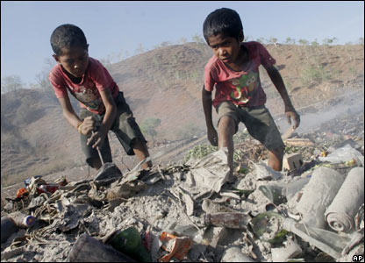
Healthy and Sustainable Environments
“Improve the conditions of daily life – the circumstances in which people are born, grow, live, work, and age”
WHO, 2008. Closing the Gap in a Generation
FIA Foundation
BBC News
Notes:
Renewed emphasis on the importance of place as a major health determinant
Need to promote healthier and more sustainable environments and communities
Address inequalities in health
“
This presents opportunities for injury prevention

Slide 4
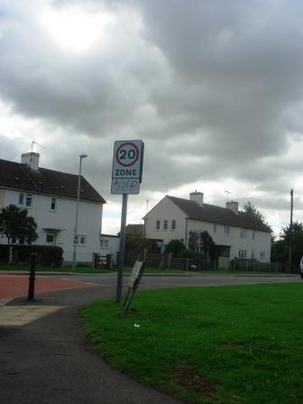
Reducing traffic speeds

Slide 5
Injury Prevention
Reduce Obesity
Environmental Sustainability
Reduction in injuries and deaths on the roads
Shared agenda = reduce traffic speeds
Increase use of sustainable travel modes
Increase walking and cycling
More sustainable driving
Increase levels of play

Slide 6
Getting injury prevention onto other people’s agendas
Increasing awareness and understanding of injury prevention
More effective multi-disciplinary working
Role of Health Impact Assessment

Slide 7
Role of public health professionals
Responsible for the wider health of their population
Facilitate shared agendas
Engage with communities
Frame issues appropriately
Promote holistic evaluation

Slide 8
Conclusions
Injury prevention needs to take advantage of the opportunities that shared policy agendas relating to healthy and sustainable communities present
Reducing traffic speeds is one example of advancing injury prevention aims through shared agendas
Public health professionals can ensure that common purpose leads to action

Slide 9
Contact Details
paul.pilkington@uwe.ac.uk
UWE Institute for Sustainability, Health and Environment (ISHE)
www.uwe.ac.uk/ishe

