Slide 1
Shame, Psychology and ME
Richard and Katharine Cheston
Presentation to PSRG
20th February, 2025

Slide 2
My daughter, Katharine, developed ME in 2008 aged 15
What I’d like to do today is to initiate a conversation about the way in which some psychologists talk about ME.
I am talking from my personal experience as Katharine’s father, rather than from a position of research or clinical expertise.
I also include some of Katharine’s reflections

Slide 3
Maeve Boothby O’ Neill
Diagnosed with ME in 2011.
By 2019 she had become so severe that she was bedbound for 21 hours per day. Too weak physically to wash, eat or drink.
Three admissions to general hospital during 2021 to have a nasogastric tube. Doctors refused to do this until the third admission (to eating disorders ward) when her condition was so weak it was removed, and she was discharged
Died at home on 3rd October 2021 aged 27
Two-week inquest in August 2024
Verdict of death by natural causes

Slide 4
Maeve (in a letter written to her GP 4 months before she dies): “I don’t understand why the hospital didn’t do anything to help me when I went in. I am hungry. I want to eat … Please help me get enough food to live.”
Maeve’s mother: the consultant (for the 2nd admission) “was adamant she would not tube feed Maeve and told Maeve she would ‘feel much better if you gave your hair a wash’”
Maeve’s father: “Towards the end of Maeve’s life, in the last few days when she was dying, people in the NHS were refusing to give her palliative care. They questioned her need for palliative care, questioned whether she was properly ill … and we had to fight really hard at the last minute to get her palliative care, just to ease her pain, because doctors didn’t believe in ME”

Slide 5
Testimony of doctors who treated her
Lucy Shenton – GP - “Several doctors involved in her care stated they do not believe ME is a medical problem.”
Roderick Warren – RDE consultant - “I do not know what the cause of ME is. Therefore, I’m not able to say if it is or is not a physical condition. That isn’t at all the same as saying I believe it isn’t … I find the literature generally to be unclear. For me the focus needs to be on what management does a patient need who is suffering with that diagnosis.”
David Strain – RDE consultant “This is a disease that has been tremendously stigmatised … Even today there are people who have been through the historic medical schools that didn’t recognise this as a physical disease. That’s a travesty … This is a physical disease.”

Slide 6
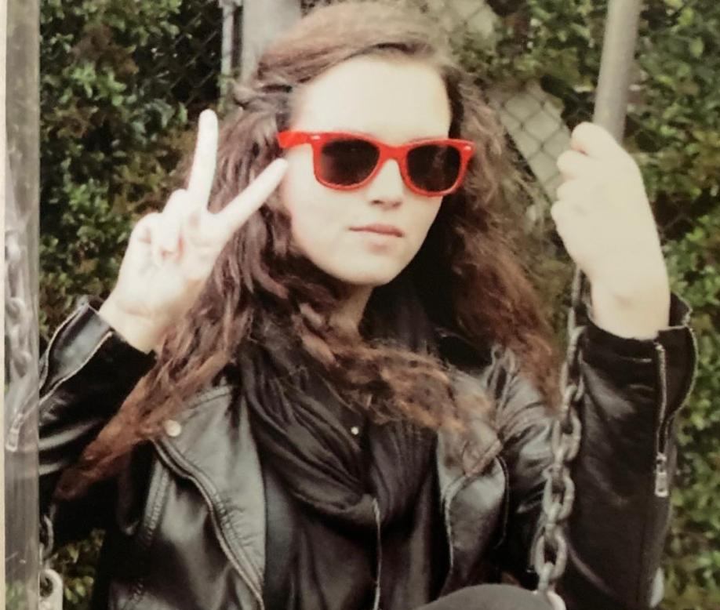
Dr William Weir’s testimony
Maeve had previously privately consulted Dr William Weir. Three weeks before she died, Weir wrote to the RDE CEO criticising attitudes of some doctors and urging them to introduce total parenteral nutrition “I am not exaggerating the issue when I say this may well save Maeve’s life”
“it would appear a considerable portion of the staff at [the hospital], including some consultants, still hold onto the now outdated understanding that ME/CFS has psychological causes”.
He urged her to support Strain and to tackle the “dogma concerning the cause of ME/CFS that some of his colleagues are still perversely adherent to”.

Slide 7
Coroner’s report: matters of concern
No specialist hospitals for patients with severe ME in UK.
No funding for the research and development of treatment of ME
Extremely limited training for Doctors on ME - especially severe ME.
NICE guideline on ME did not provide any guidance at how severe ME should be managed including guidance around tube feeding

Slide 8
Weir told the inquest that ME had “nothing to do with psychological conditions” and was a demonstrable physical illness, although its causes were unclear. He was asked by Boothby O’Neill’s father, Sean O’Neill, a senior journalist at The Times, whether there was still a professional and institutional resistance in medicine to accept ME as physical. Weir replied: “There are none so blind who cannot see. There are still people in the medical profession and out there in the community who are still adhering to the dogma. Sadly, that has a very damaging effect on understanding ME.”’
The Times, 24,7,24

Slide 9
Dogma: An opinion, a belief; spec. a tenet or doctrine authoritatively laid down, esp. by a church or sect. Also: an imperious or arrogant declaration of opinion.
Oxford English Dictionary

Slide 10
Katharine Cheston – aged 15
November 2008 – had a flu virus. On recovery …
  Post-exertional fatigue – never completely resolves, not alleviated by sleep
  Dizziness, falls at school. Stops judo, guides, walking dog, golf, seeing friends
  Can’t concentrate, poor memory, problems around temperature regulation
  Muscular pains, often severe, plus pain in hips, elbow & wrist
January 2009 – paediatrician diagnoses ME once alternative explanations eliminated
  Cuts back activity to baseline level, monitors activity levels (green, amber, red) and increases activity 10% every week but monitor for flares and reduce activity by 50% - focus on how you feel
  Drastically reduces school attendance (initially 15 minutes/day in class)
  Refers to specialist ME/CFS service

Slide 11
Sees locum paediatrician in specialist service (red activity now 4.5 hours/day and at school 2 hours/day)
“Katharine’s worries are using up a lot of her energy and I have explained that worries can cause fatigue too. Katharine told me today that she didn’t think she was worrying. I have explained that unless we help her with her worries, it is hard to make progress with symptoms of chronic fatigue syndrome … I have given her several leaflets about emotions and feelings. I think she would benefit from cognitive behaviour therapy.”
Wants Katharine to be referred to CAMHS for CBT. States that if we don’t do this, then she won’t get better.
Implies we may be referred to social services if we refuse.

Slide 12
Katharine’s memory of this
“Becoming so unwell, so suddenly is a frightening and anxiety-inducing experience. I’d gone from being totally healthy, loving school, with a great social life and groups of friends - doing lots of extracurricular activities including high-impact sports - to, within a matter of months, being unable to get off the sofa, go to school, go to judo, collapsing in whole-school mass … and feeling utterly awful and having absolutely no idea what was wrong with me (and having lots of blood tests, an ultrasound of my heart and an MRI of my head).
All of this would be scary for an adult, let alone a 15-year old! But the locum paediatrician couldn’t see any of this - she couldn’t see a 15 year old who’s going through a life-changing experience and who was suffering. She was blinded by her own beliefs: my ’worries’ became pathological - they were causing my symptoms, not being caused by them. She was totally unprepared to listen to alternative explanations - that I wasn’t worrying unduly, and that I really was ill”

Slide 13
Katharine’s health gradually improved
June 2010 – back at school almost full-time but still a long way short of previous levels of activity. Gains 9 GCSEs with 8 A*
June 2012 – gets 3 A* - still not full-time at school and with very restricted life outside school. Accepts place at Durham University.
Starts as full time, but finds this increasingly difficult – pain increases, muscular spasms, difficulty forming words or concentrating.
Occur 3 to 4 x week, lasting for about 4 hours. Ambulance attends.
Returns home and seek help – epilepsy?

Slide 14
Spring 2013
First consultant Neurologist diagnoses “Hyperventilation attacks with carpopedal spasm and tetanic posturing … I am sure she is describing physical manifestations of an anxiety state leading to carpopedal spasm and other tetanic posturing of muscles”
Katharine: “He had actually Googled images of hysterical convulsions (they were old-fashioned paintings of women having bizarre seizures) before the appointment - based, presumably, on the sole knowledge that I had ME. He then asked me very few basic questions, before saying (something along the lines of) ‘I know exactly what this is’, did my reflexes, got me to hyperventilate, then got me to sit back down in front of the desk, at which point he promptly turned his monitor screen on and turned it around so I could look at it, and told me that I had hyperventilation syndrome - a physical manifestation of an anxiety state.
As I left the room, he called after me (in a jovial voice) ‘Enjoy Durham!’ - as if the reason I wasn’t at university, indeed had been sent home after having three ambulances called on me in the space of a fortnight and being incredibly unwell, was my failure to enjoy it - and as if this was something I could simply choose.

Slide 15
More helpful explanations
Second consultant neurologist focuses on physical elements of ME (e.g., inflamed tonsils) as cause, discusses symptoms and advises treatment
Physiotherapist – “due to a combination of weak postural muscles due to the ME and the hypermobility, the joints will often impinge or catch when held in an unsupported or stretched position … invoking a spasm around the joint”.
Consultation with an experienced Occupational Therapist who had worked in ME services for many years – writes letter to GP advising muscle relaxants which improve her condition
Katharine able to return to university on a part-time basis which college supports. Has a year out then completes UG degree and returns to full-time study for masters and PhD.

Slide 16
What helped Katharine
Helpful
Less than helpful
People believing that something was wrong, that she wasn’t doing this to herself in someway, and that they cared
Pacing
Advice from some HCPs (physio and OT in particular)
Supportive GP, school and college
Medication for spasms
Some of the things we tried (e.g., co-enzymes)??
Luck??
Dogmatic beliefs
Two senior consultants in positions of authority who had preconceived ideas around thinking patterns causing anxiety around exercise
Neither was prepared to modify these beliefs and insisted they were correct

Slide 17
The wider issues

Slide 18
CBT model of ME (CBM)
“CFS may begin with a viral infection, which leads to symptoms such as fatigue or pain, which cause a sufferer to rest and become fearful of activity …. whereby avoidance behaviours lead to anxiety and depression, which exacerbate physiological and mental deconditioning” (Geraghty et al., 2019 based on Sharpe, 1993, 2007)
Led to two specific types of intervention
  Graded exercise (“making fixed incremental increases in the time spent being physically active”)
  NICE (2007) guidance - CBT addressed underlying causes of ME – it was a cure
Patient surveys show strong evidence of harm caused by GET (focused on avoidance) rather than pacing (listening from your body)
NICE 2021 – reassessed evidence – found quality “ranged from low to very low quality”.
Revised guidance - no longer recommended GET and changed role for CBT from curative to supportive/adjunctive.

Slide 19
The CBT model of ME and our experiences
The two consultants who saw Katharine (and probably some of those who saw Maeve Boothby O’Neil) framed ME as an illness in which maladaptive thoughts (worries, catastrophic beliefs about hyperventilation) lead to avoidance and other dysfunctional behaviours
We have also encountered them amongst our colleagues - “Katharine will get better when she wants to”
However, we saw no evidence that Katharine experienced catastrophic deconditioning. In addition to post-exertional fatigue she had many other symptoms which couldn't be accounted for by worrying (which anyway occurred as a consequence of the ME)
More generally, if recovery involves adjusting dysfunctional beliefs and behaviours and reversing the deconditioning, then this places those who do not make progress in a precarious psychological position.
You either get better (the model works) or you blame yourself (because the model cannot be wrong) – questioning self, self-blame and shame.

Slide 20
ME as a contested illness
Dispute about what to call it (ME, CFS, ME/CFS or neurasthenia)
Some proponents of CBT model argue that it is a real (but psychiatric) illness - “CFS is a real but reversible condition that the patient may influence by practical self-help …” (Sharpe, 1997)
From this it follows that a rejection of CBT model reflects prejudice against real (psychiatric) illnesses – antipsychiatry
People living with ME who object are routinely described as “ME militants” with extreme views – and framed in the context of threats against researchers
Positions opponents of this view as being at best irrational and at worst having an underlying disturbance

Slide 21
Anti-psychiatry?
Rejection of psychological account of ME is ascribed to a wish to ‘avoid the stigma of a psychiatric illness” (Page and Wessely, 2003)
Smith and Wessely (2014) “Internet searches of patient group websites and forums reveal a stream of antipsychiatry views, not only rejecting psychiatry in relation to ME/CFS, but also conducting personal attacks on those professionals who are involved in scientific research and review that come to opposing conclusions that are not aligned with these antipsychiatry views …”
These antipsychiatry views mean that “the millions of those who suffer from illnesses” are “covertly, and sometimes overtly, stigmatised in the more strident voices of the ME activists?”
Blamed for driving researchers away

Slide 22
“First they came for the Communists” (Fox, 2022)
There are jobs that carry a risk, such as volunteering as a human cannon ball at a funfair. There are jobs that attract opprobrium and abuse, such as becoming an estate agent …. And then there is the job of trying to conduct research into chronic fatigue syndrome/myalgic encephalomyelitis (CFS/ME) … Patients are incapacitated for years, unable to move, sometimes bed ridden and fed through a tube. Yet it doesn’t prevent some people, who claim to be its victims, from conducting a relentless personalised attack on doctors and academics who are trying to discover its cause and improve its treatment. Simon Wessely … has been the target of such attacks for years … he gave up active research on CFS/ME 10 years ago. He now specialises in the problems of war veterans. “I now go to Iraq and Afghanistan, where I feel a lot safer,” he says.
(Hawkes, 2011)

Slide 23
Decision to release data from PACE trial (2016)
In its submissions QMUL made a number of accusations of harassment from patients, while QMUL’s expert witness characterized PACE trial critics as "young men, borderline sociopathic or psychopathic", remarks the Information Commissioner dismissed as "wild speculations".
When pushed to provide evidence of these threats and harassment under cross examination, witnesses speaking for QMUL were unable to do so, and ultimately conceded that "no threats have been made either to researchers or participants."
The tribunal found QMUL's assessment of activist behaviour to be, “grossly exaggerated” stating that “the only actual evidence was that an individual at a seminar had heckled Professor Chalder.” [Professor Chalder is a leading researcher in the PACE trial and a key witness for QMUL.]
ME Action Press release

Slide 24
Othering opponents of the CBM
The marginalisation of people criticising the research evidence has the effect of discounting or minimalizing the substance of their arguments
It positions ME researchers and clinicians as the victims and “ME activists” as threatening/irrational – thus further justifies the psychological model of ME
For opponents of the CBM it is a maladaptive illness beliefs
The associated discourse defending the CBM evidence of the weaponisation of stigma – appending blame to shame
Not different, in substance, to wider social beliefs about ME

Slide 25
Ricky Gervais adding insult to injury

Slide 26
Changing landscape

Slide 27
Although exact numbers are not known, a significant percentage of people with Long Covid present with symptoms of ME. The long history of the psychologising of ME has had and continues to have devastating consequences. As psychologists, as healthcare professions and as people, we will encounter and work with people with Long Covid. We can, and must, inform ourselves and challenge misinformation about ME, Long Covid and other chronic health conditions, and the psychologising of a truly devastating physical health condition.
(Keith and Gahan, 2024)

Slide 28
New education on this topic is required to reflect:
The huge paradigm shift in understanding of the illness
Up-to-date international biomedical research and education on ME/CFS
The experience of patients whose lives are completely changed by the illness
(Nina Muirhead, expert testimony to NICE, 2019)

Slide 29

Shamed and stigmatized: narratives of complex, poorly-understood illness (Cheston, K., 2024)
Focus on the additional burden that CBM places on people with ME
What are the consequences of these beliefs for those who live with illnesses for which a medical explanation has not (yet) been identified?
Thesis examined how women living with ‘medically unexplained symptoms’ are stigmatised. They endure a dual burden of suffering: symptoms and shame.
Articles in Journal of Medical Humanities, Journal of Evaluation in Clinical Practice, Literature and Medicine.

