Slide 1
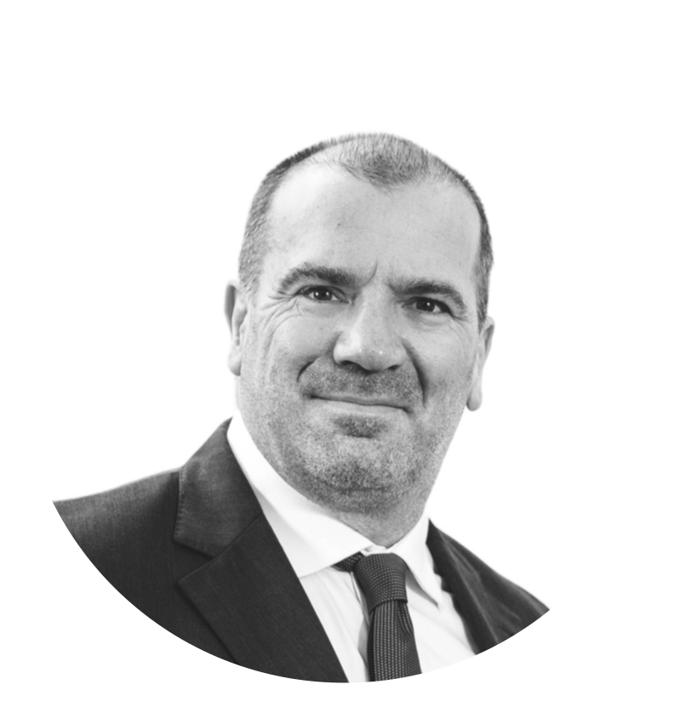
Second Chances
HMPPS Wales – Learning and Skills
Continuing Professional Development
2024 Event
Dr Jonathan Gilbert
Lecturer in Law

Slide 2
Jonathan’s background – Barry Boy Done Good!!
Jonathan, the professional enabler. The slippery slope: contrived ignorance to willful complicity
Jonathan’s reengagement with education from behind the door.
Convict criminology. Researching financial crime.
OVERVIEW

Slide 3
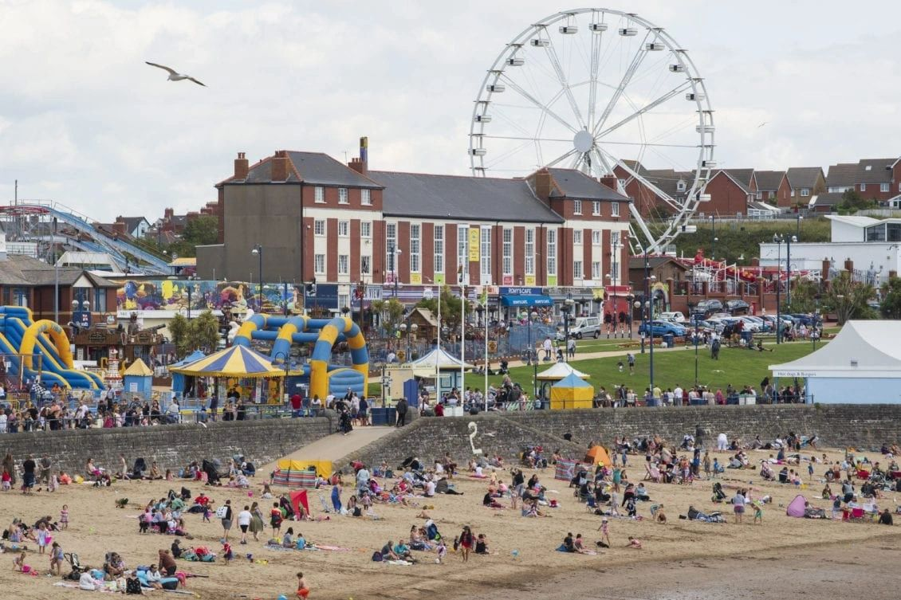
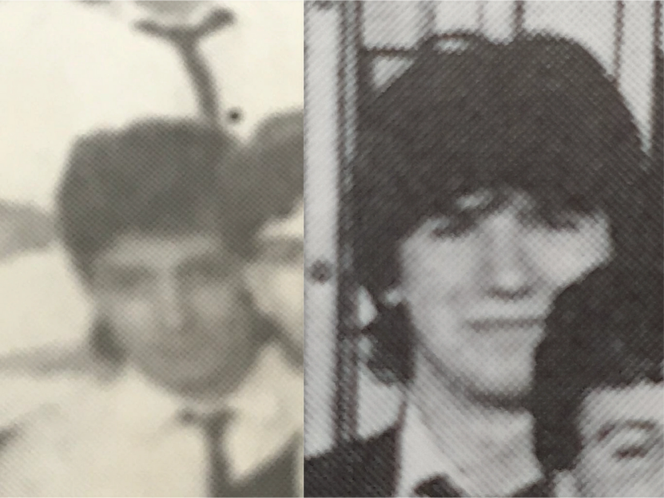
Barry Boys Comprehensive
Family values & education
Studying law at university
Early career as a solicitor and an early partnership

Slide 4
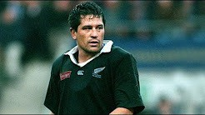
A successful practice
Notes:
Techniques of neutralization are a theoretical series of methods by which those who commit illegitimate acts temporarily neutralize certain values within themselves which would normally prohibit them from carrying out such acts, such as morality, obligation to abide by the law, and so on.

Slide 5
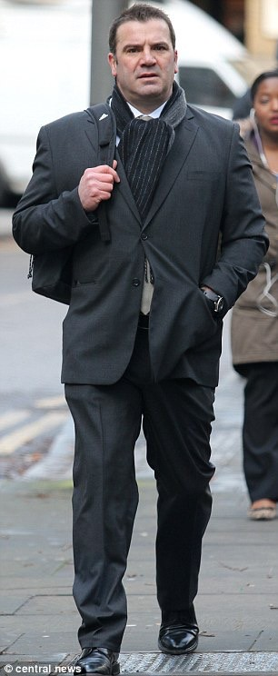
Jonathan, the professional enabler
The charismatic Virgin airline captain
Ethical slippage, contrived ignorance leading to wilful complicity
Facilitating a multi-million-pound mortgage and bank fraud

Slide 6
“…yours was about as bad a breach of trust as it possibly could have got – that is compounded by the fact that Entwistle could have achieved almost nothing of what he did without your active complicity”
- HHJ Beddoe, Southwark Crown Court, 22nd July, 2014

Slide 7
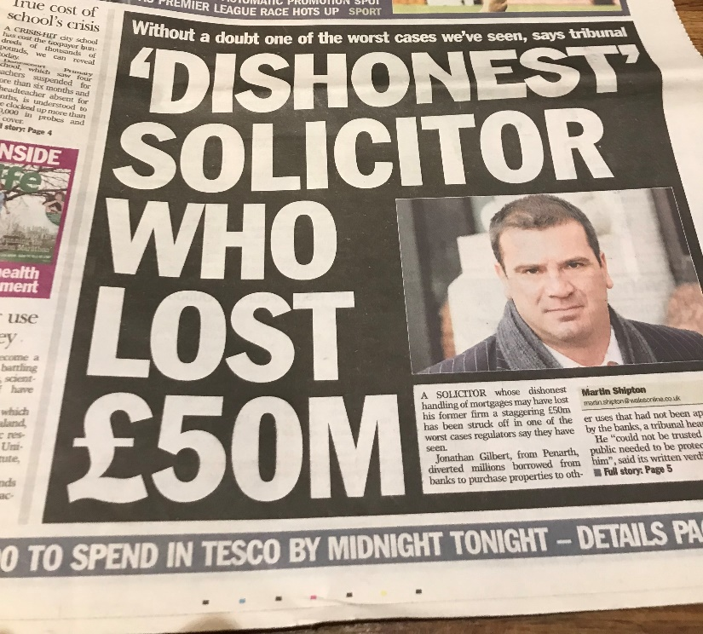
Bonfire of the vanities…

Slide 8
Regulatory
Civil
Bankruptcy
Criminal
Bewildering multiple jeopardy
Collateral Damage
Public shaming
Post-conviction
Impact on family

Slide 9
Breaking the shackles and re-engaging with education

Slide 10
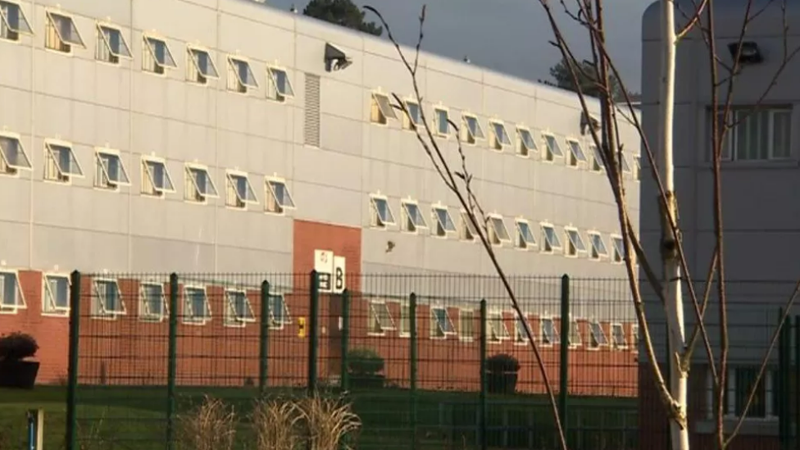
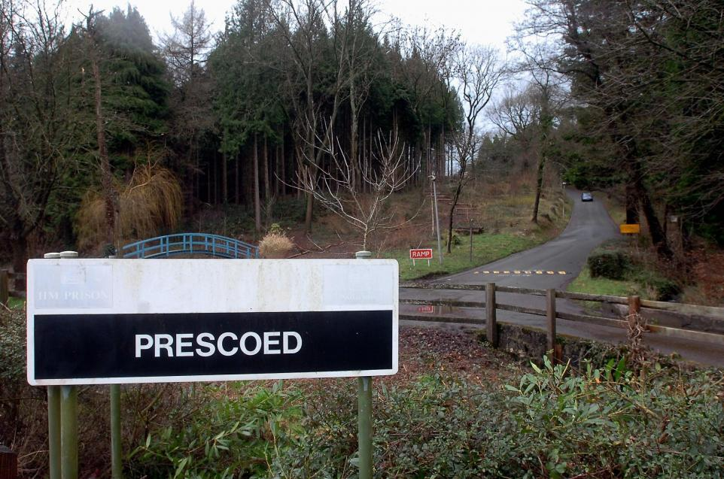
Stage 1 – Helping others
Open University mentor
Stage 2 – Helping yourself
MSc distance learning – Portsmouth University
Overcome obstacles, funding and resources
Stage 3 – Motivating yourself
PhD – Cardiff University – Researching mortgage fraud
Overcome obstacles, education v vocation
Convict criminology
Rehabilitation and restorative justice

Slide 11
Methodology | Interviewing offenders, law enforcement, regulators, fraud prevention agencies and victim lenders
 | Data collection from regulatory enforcement files (including the FCA, SRA, ICAEW, RICS)
 | Multiple case study analysis (Operations Oyster, Cassandra and Azure)
Research Objectives | To understand how MF is organised. To utilise crime scripting as a means of identifying its crime commissioning processes. To identify necessary and contingent factors that support the commission and reproduction of MF and in certain circumstances disruption. To consider the interrelationship between causal agency, dispositional factors and facilitative conditions that make the commission of MF and its reproduction possible.
The organisation of mortgage fraud and its relationship to the governance, control and regulation of financial services in the UK

Slide 12
Facilitative conditions
Causal Agency
Dispositional factors
Act 1: Victim targeting
Scene 1: Motivated offender engages necessary KPA-panel broker
Scene 2: Target suitable lender, mortgage product
Scene 3: Assess underwriting weaknesses
Neo-liberal political philosophies supportive of homeownership and entrepreneurship
Motivated offenders predisposed to defraud mortgage lenders
Competitive financial services sector, securitisation, defective board governance and bonus culture
KPA predisposed to disregard rules and membership of their respective professions
Act 2: Mortgage application
Scene 1: Procure false documents to support employment status/income, including engaging, if necessary, KPA-accountant
Scene 2: Instruct broker to submit application
Scene 3: Prepare and respond to lender underwriting query, procure additional false documents
Scene 4a: Mortgage offer receipt OR
Scene 4b: Fraud displacement – re-enter process at Act 1, Scene 2
The role of key government agencies in providing an otherwise legitimate public service
Competition in financial services market,
availability of high risk, innovative mortgage products
Failures in the state’s responsibility to govern and fraud minimalist criminal justice policies
Decriminalisation of fraud-for-property and
depenalisation of fraud-for-profit
Erosion of rules and meaning of membership amongst lenders and the uncoupling of prudential risk from responsible business practices
Deficient regulatory frameworks based upon light touch regulation and reactive enforcement strategies
Act 3: Mortgage drawdown
Scene 1: Engage KPA-panel solicitor/conveyancer (either complicit or ignorant)
Scene 2: Prepare and respond to any outstanding enquiries, requirements
Scene 3: Complete mortgage, acquire property or dissipate advance, full or part
Scene 4:Post-completion matters, including concealment, banking facilities to pay monthly instalments
Notes:
The conventional mortgage fraud script

Slide 13
The second chance… Teaching on financial crime and criminal law modules at UWE Supervising LLM students on their dissertations Carrying out research in the areas of financial crime and criminal justice Disseminating research and lived experience of financial crime and the CJS, nationally and internationally, to law enforcement, regulators and banks Working with CJS stakeholders and NGOs in prison education, including the Prisoners Education Trust Working with stakeholders in financial crime, including the UK and Dutch governments, Solicitors Regulation Authority, the ICA, UNODC…

Slide 14
Inspiring the family that my actions harmed… At an early age, I was exposed to a culture that emphasised the transformative power of education. My father, who served six of a twelve-year prison sentence for fraud, pursued further education (in the form of a PhD in criminology) to revitalise his future prospects. His example, along with educational resources available during visitations, were influential in my own progression, including becoming a spokesperson for the Children's Commissioner and winning a Barnardo's creative writing award. Zach Gilbert’s UCAS Personal Statement, December 2024

Slide 15
Please keep in touch if my experiences may be of further use to you.
jonathan.gilbert@uwe.ac.uk
Jonathan Gilbert | LinkedIn

