Slide 1

“Where are all the men?”
Working-class male students and care-based degrees
Dr. Craig Johnston
SL Criminology - UWE
@DrCEJohnston

Slide 2
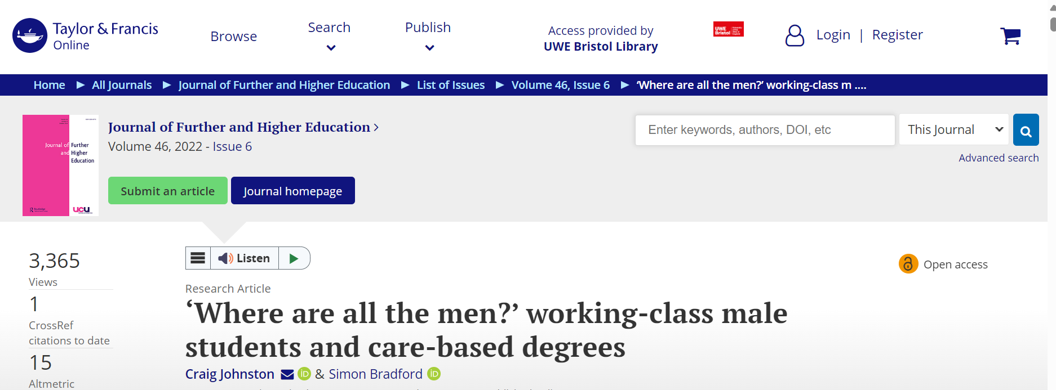

Slide 3
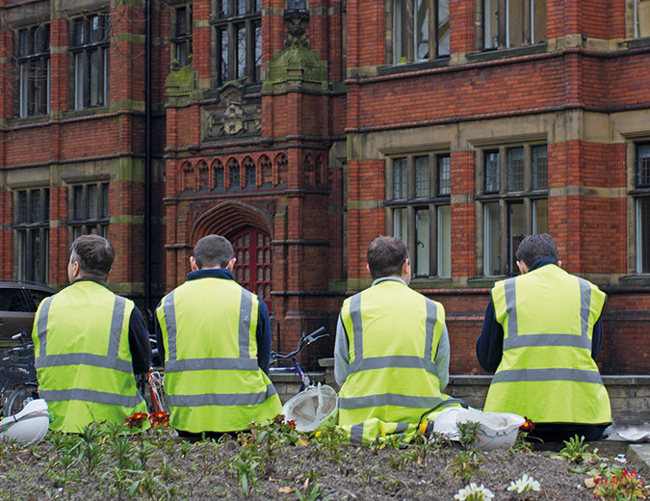
Made for the trade?
Who am ‘I’ – I am many, but one of the ‘few’, who lived the tensions of transgression /liminality in the care industry.
Why (working class) males entering care-based industries?
The study – FHEA/ MEd

Slide 4
Masculinities and the male:
Biological and cultural traits that are commonly although not exclusively, associated, with the male
A social construction and linked to the contexts into which individuals are embedded
Differs both locationally and temporarily across history
Key aspects of dominant masculinity have remained over a thousand years
Masculinity is not monolithic
In official discourse, class (working-class) has long been referred to indirectly. One reason for this may be because it is seen to be too blunt and divisive. More recently, it has been rendered through various euphemisms: ‘disadvantaged’ or ‘deprived’ areas and culture, These are euphemisms that construct phenomena and ‘things’ we think is at issue. Such terms transform (working) class into something that seems natural and, almost by default, in deficit rather than social (Finlayson, 2007).
“Working-class identity is more than one’s economic position; it is also a lived experience, a set of relationships and expectations, legacies, and entitlements (or lack of them)” (Coles & Zandy, 2007).
“In the context of lecture rooms, class is a facet of students’ and lecturers’ identities, part of their symbolic representation of self, their ‘presence’ within HE”. (Johnston & Bradford – forthcoming).
Class and masculinity are therefore “not problems” nor ‘monolithic’ – not also in the sense of something that needs to be fixed (or, worse still, curiosities) but as ‘constructs’ that require ongoing consideration - if nothing else, because class and masculinity are deeply intersectional.

Slide 5
Literature
98% of female practitioners in the Early Years Workforce suggest - despite the changes in the family (roles), and parenting models - that in our society the care and education of young children is not seen as an expected, appropriate, or necessary role for men (DfE, 2016).
Closed Identity
Gender Expectations – male role models
Women as gatekeepers
Culture/
and missing men
Fear and suspicion
WRight and Warin, (2019, p. 48)
Peer pressure/
cultural
preferences
Job status and pay
Intersection of class? (missing)

Slide 6
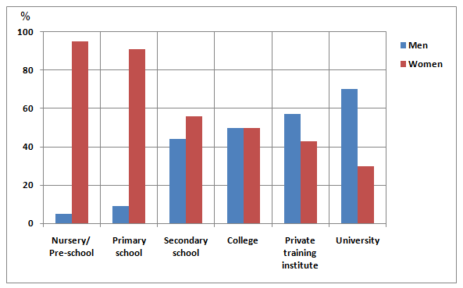
15% of teachers in primary schools are men, dropping to less than 2% in some early years’ locations or settings; nurseries, pre-schools. 10% of men in Nursing, 12% in social care settings;
There are more female than male teachers, nurses and social and care workers in every ethnic group;
Across various studies, people consistently indicated greater support for social action to correct the gender imbalance in male-dominated as compared to female-dominated fields (Block et al, 2019)
Data on class is rarely recorded in care-based career data, as well as gender/class on care-based degrees;
School teacher workforce 2020

Slide 7

What about social-class and care-based degrees?
Class differences impacts on levels of integration and the extent to which students feel that they ‘fit in’ (Aries, & Seider, 2007), with studies noting a push away from (not pull to) the language, culture, and practices of HE;
Classrooms are important spaces - fields - in which social difference are played out, (Bourdieu, 1993);
Only “10% of men from the most disadvantaged backgrounds go into HE” (Department for Business, Innovation and Skills 2016, 37);
The recruitment of (working-class) men is very low on care-based degrees (none or 1 in most intakes);
Care work invokes fixed representations of ‘femininity’ with emotion and intimacy largely, but not uniquely, understood as antithetical to tough, stoic, ‘hands on’ working-class masculinity (Harland & McCready, 2012);
Working class men are also still portrayed in the media as “knuckle draggers”, “racist” violent, misogynist, and uneducated “CHAVs” = unprofessional and at tension in the contexts of care work (trust, care and cooperation).

Slide 8
Research Background
The research used semi-structured interviews and focus groups.
The participants included male students from different racial and ethnic backgrounds - across three different year groups
Participants all self identified as ‘working-class’ and were asked about their early course experiences and what they found helpful in supporting their identities as learners.
Data constitute reflexive accounts that exemplify participants’ complex lived experiences (Flyvberg, 2006). My theoretical interests in social difference and pedagogy shaped the collection, and analysis, of data which were gathered half-way through and near the end of the year.

Slide 9
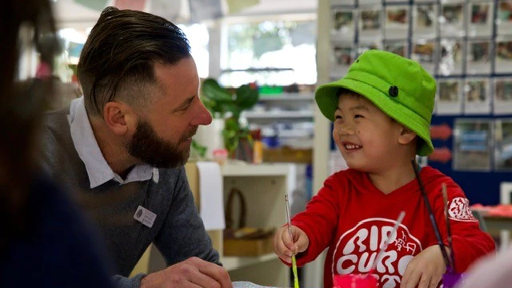
Belonging and disclosure - gender
“My first thought (on induction day) was, ‘where are all the men?’…I know one guy who left the course because he just felt out of place, I mean, there was only three of us (men)… at the start.
Participants were gender conscious of classrooms unsettled by gender division and their own uncertain positions within them, raising fundamental questions about belonging. These were marked with an acute awareness – often for the first time – of ‘being different’.

Slide 10
… some (working-class) mates don't get why I am here (university). At least here I get a chance to get into something that is missing when you step out of being a ‘guy’… I’d never talk about teaching or working with children with them (friends from his local community)”.
The frequency with which the participants’ said 'I’d never talk about' an interest in care work suggested the extent to which the imperatives of a hegemonic masculinity and non- disclosure had been internalised prior to going to university;
Recognition of pressure encouraged self-disclosure in the focus group and a willingness to share private concerns about both gendered and classed learning identities.
Belonging and disclosure - Class

Slide 11
Participation in the classroom: trespassing and transgression
Accounts from lone male interviewees reflected anxieties about participation.
“I can’t say that, because I’m a guy”. This account signals how both men and women are caught in gendered discourse and the importance of disciplinary knowledge in untangling the social relations shaped by gender;
“You sort of just feel like you can’t say anything, you have to just be quiet in classes like safeguarding… it might be an unpleasant interruption for the girls in my class…”.
Depictions of being silenced and having to mask emotions, opinions and perspectives in some lectures was noted particularly by second and third-year student after their placements.

Slide 12
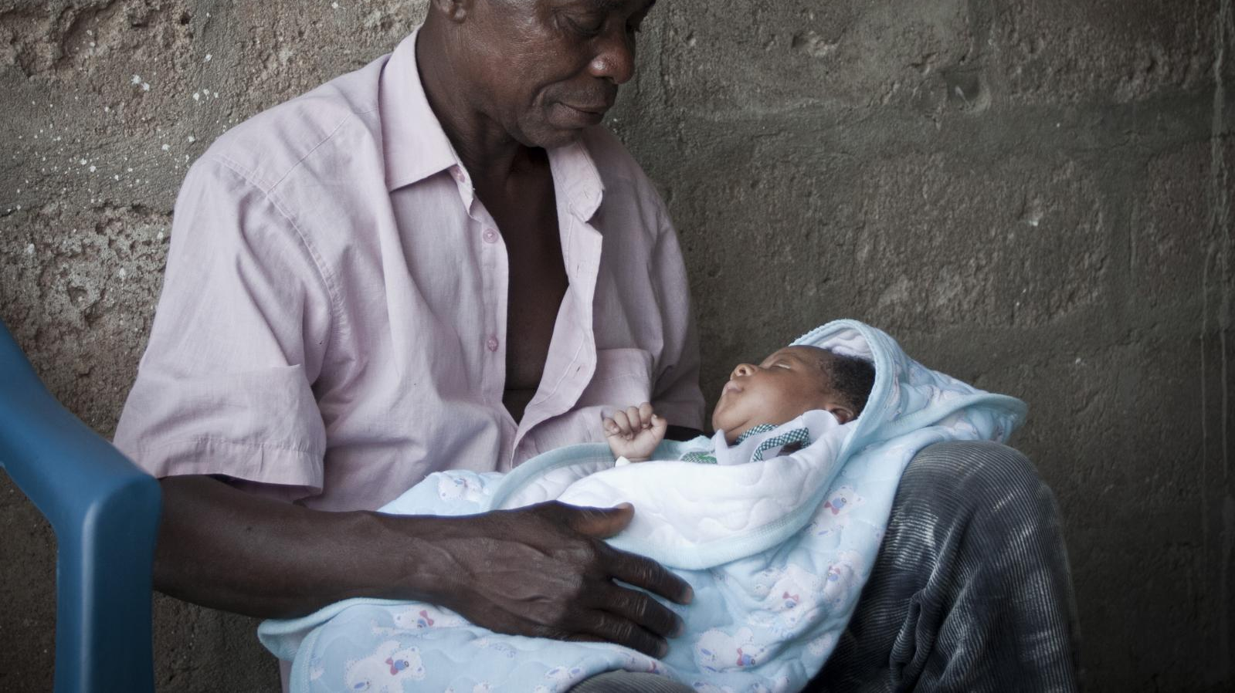
Discussion
The analysis suggests that both gender and class matters. For men, their gender and class are sometimes the dominant factors shaping their experiences on care-based degree programmes;
The data suggested that some female students were believed to share popular (negative) representations of men in care-work (Clow, Ricciardelli, & Bartfay, 2015);
Gender-equality and ‘feminist’ themes were apparent to interviewees as elements of curriculum but were invariably understood as being ‘about women’, as if gender was a feminine matter;
Working-class male students’ aspirations to work in the care sector were accompanied by a sense of ‘trespassing’, of transgressing social and cultural boundaries. Boundaries are, of course, potentially hazardous thresholds whose “… displacement unleashes danger for someone” (Douglas, 2002, 140);
Students recognised that a combination of continued group-based activities – with abstract and concrete learning offered a sense of belonging and allowed hidden voices to emerge. Some tutors’ ability to work reflexively with ALL students helping them to imagine the relation between being working-class and male within care settings and the art and expectations of care-work itself.

Slide 13
Key takeaways
Isolation/
Silence
Male discussion groups
Trespassing/
transgression
Internalising various concerns and experiences
Valuing boundary experiences
Lecturers as gatekeepers/
Intermediaries
Classroom Culture
Stereotypes Stigma and Micro-aggressions
Active Learning
WC/Males creating their own support – cementing boundaries
The “yet to be thought”

Slide 14
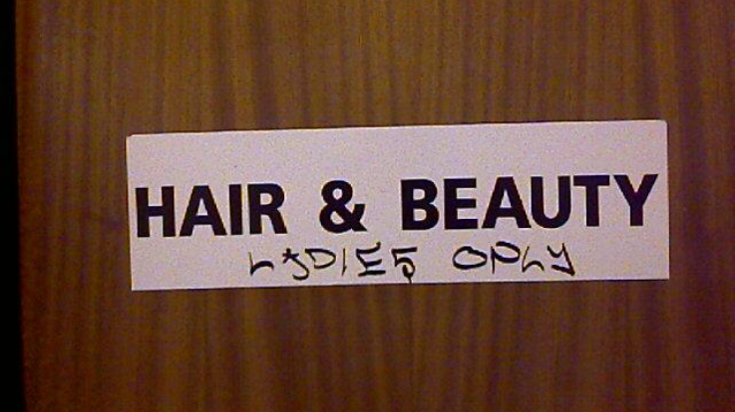
c.johnston@uwe.ac.uk
Thank-you for listening

Slide 15
REFERENCES
Aries, E., & Seider, M. (2007). The role of social class in the formation of identity: a study of public and elite private college students. Journal of Social Psychology, 147(2): 137–157.
Bourdieu, P. (1993) Sociology in question London: Sage Publications.
Cullen, F. & Johnston, C. 2018 Playwork goes to school: professional (mis)recognition and playwork practice in primary school, Pedagogy, Culture & Society, 26:3, 467-484
Douglas, M. [1966] (2002) Purity and Danger, London: Routledge
Department for Business, Innovation and Skills (2016) Success as a knowledge economy: Teaching excellence, social mobility and student choice. White paper presented to Parliament.
Education Policy Institute (2020) Trends in the diversity of teachers in England, Accessed 07/03/2021: Online: https://epi.org.uk/publications-and-research/diversity-of-teachers/
Harland, K., & McCready, S. 2012. Taking Boys Seriously: A Longitudinal Study of Adolescent Male School-Life Experiences in Northern Ireland Ulster University Accessed 01/03/2021 http://www.socsci.ulster.ac.uk/sociology/research/young.html
Mann, S. (2001) ‘Alternative Perspectives on Student Experience: alienation and engagement’, Studies in Higher Education 26:1.
Warin, J. (2018) Men in Early Childhood Education and Care, Palgrave, Macmillan, Lancaster.
Wright, D. & Brownhill, S. (2019) Men in Early Years Settings, Jessica Kingsley, London

