Slide 1
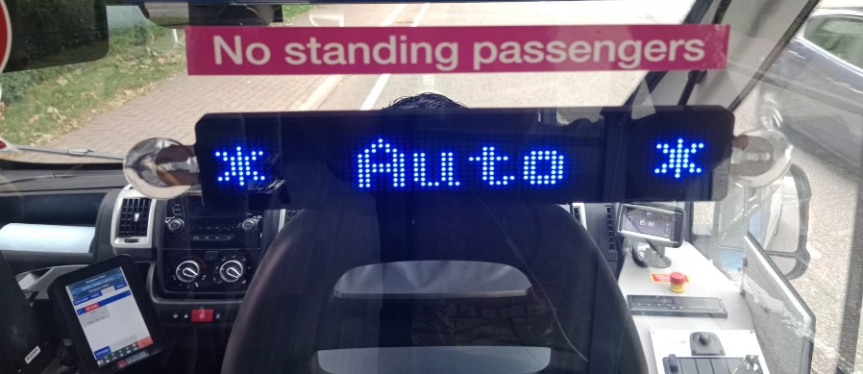
Passenger experiences of an Autonomous Bus service:
The MultiCAV project
Presentation by
Billy Clayton
Senior Lecturer in Human Geography
Research team
Graham Parkhurst
Ben Clark
Jonathan Flower
Muhammad Adeel
Xabier Gangoiti
Paper presented at the Royal Geographical Society (RGS) 2024 conference, 27th – 30th August 2024, Imperial College, London, UK

Slide 2
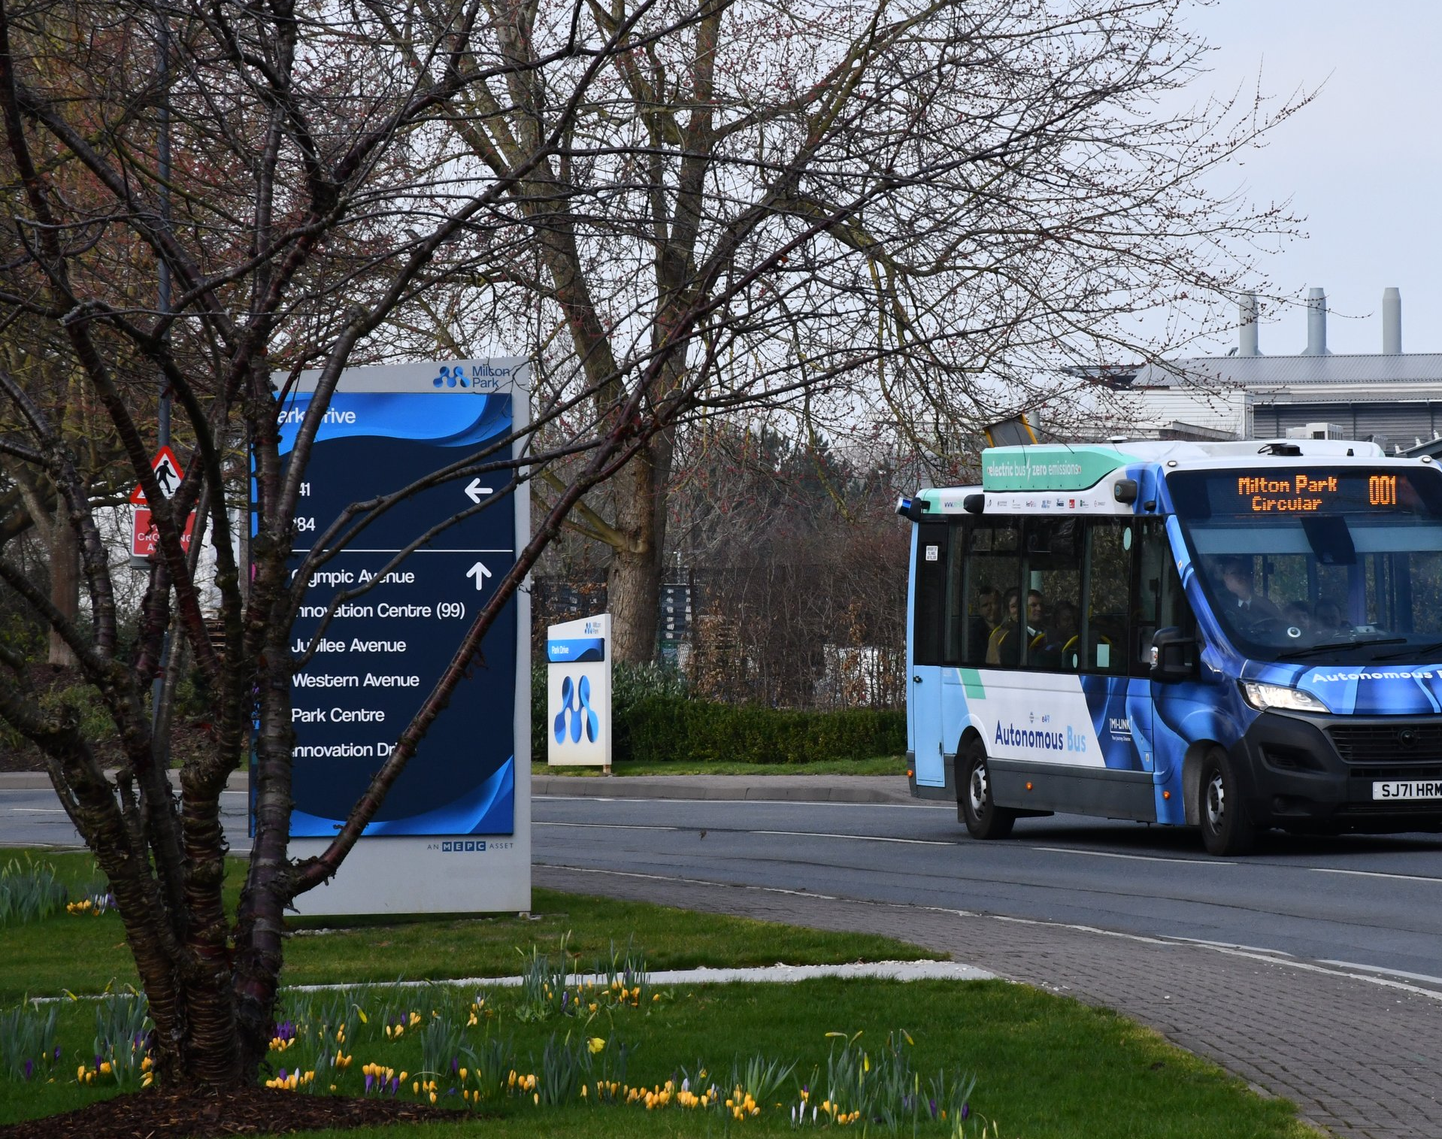
Contents
AV buses in the literature
MultiCAV service overview
Methods
Results
Conclusions

Slide 3
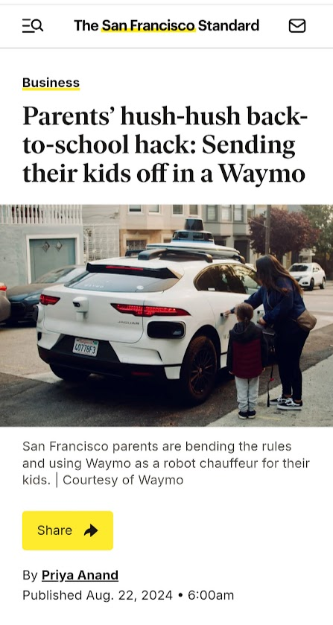
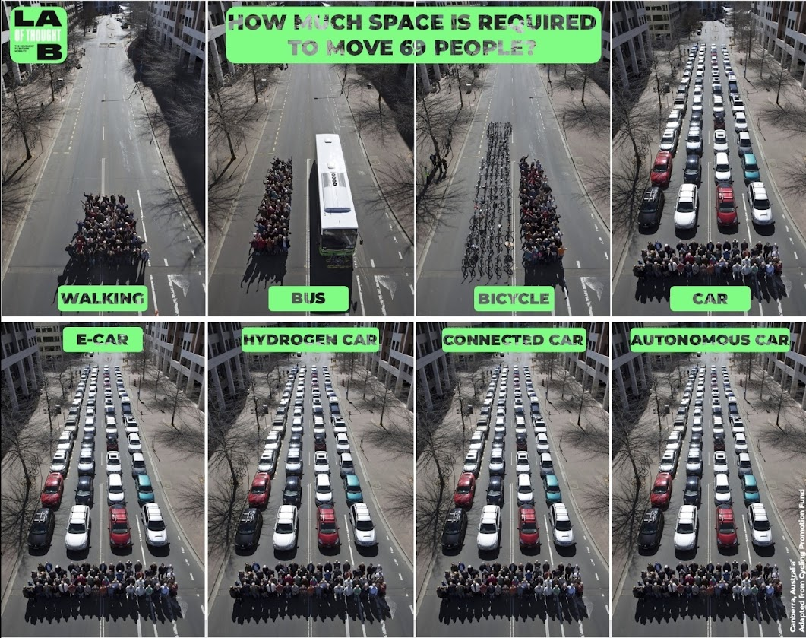
The promise of autonomy
Autonomous vehicles have the potential to broaden access to some motorised transport modes, through the removal of current barriers, e.g.:
Driving capability
Age
Cost
Location
Etc.
However, there is a risk that unmanaged rollout of autonomous vehicles might maintain or even worsen existing transport issues:
Congestion
Air and noise pollution
Health and safety
Community/urban degradation
Perpetuating Motonormativity
Anand (2024)

Slide 4
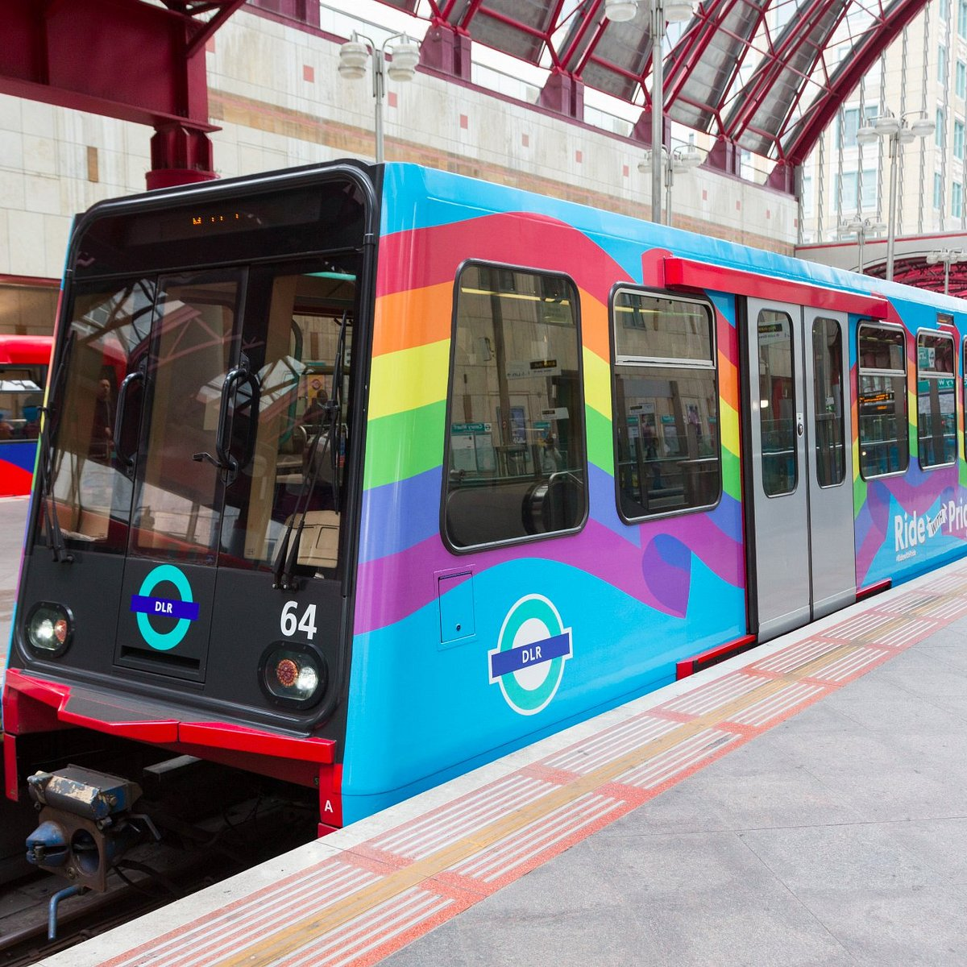
SAVs and AV buses in the literature
Shared AVs (SAVs) represent the best opportunity for sustainable automation of transport networks (e.g. Chng et al., 2022; Salonen and Haavisto, 2019; Gao et al., 2014)
  E.g., public transport (train, metro, bus coach), ridesharing (Uber Pool, Lyft Share)
Driverless Public Transport vehicles are not new, and have been common in underground rail and metro systems for decades (Cartenì, 2020)
However, the automation of road PT (e.g. buses and coaches), represents a very different challenge
  Vehicles interacting in close operation alongside other road users, often in unrestricted public road space (Chng et al., 2022)

Slide 5
AV buses in the literature
Recent public autonomous shuttle trials have shown positive results in terms of passenger perceptions and experience (Wicki and Bernauer, 2018; Feys et al., 2020)
  “[Participants] were surprised by how safe and secure they felt in the Autonomous Vehicle [shuttle bus]” (Salonen and Haavisto, 2019, p. 1)
Determinants of perception in shuttle bus trials include:
  Safety: shuttle bus trial participants prefer SAVs travelling at low speeds (Salonen and Haavisto, 2019). Driver (or other authority presence) is important (Nordhoff et al., 2018)
  Ride experience: a smooth, comfortable ride is important for acceptance (Bernhard et al., 2020)
  Novelty: passenger curiosity and the novelty of these autonomous shuttle technologies can be exciting, and attract people to try them out (Hilgarter & Granig, 2020; Andersson et al., 2021)
  Demographics: there is some variation between studies, but in general, younger demographics report higher acceptance, while older participants were more sceptical (Andersson et al., 2021).

Slide 6
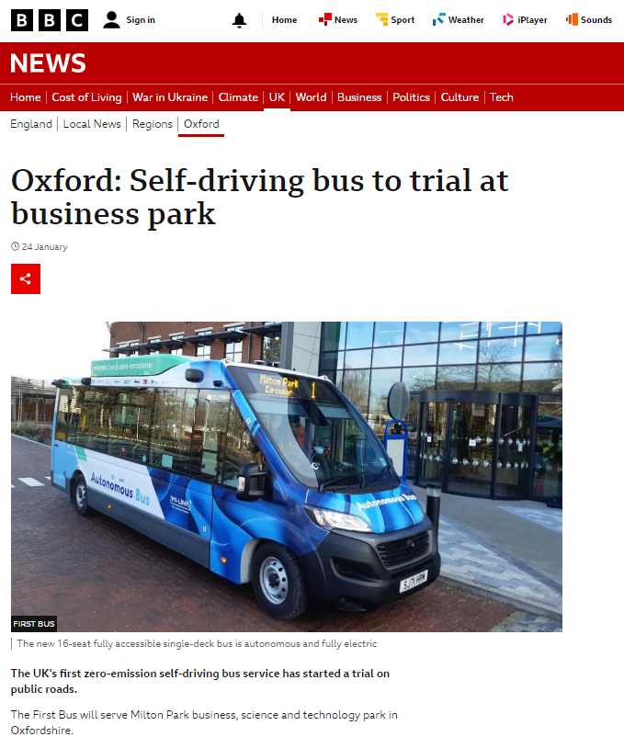
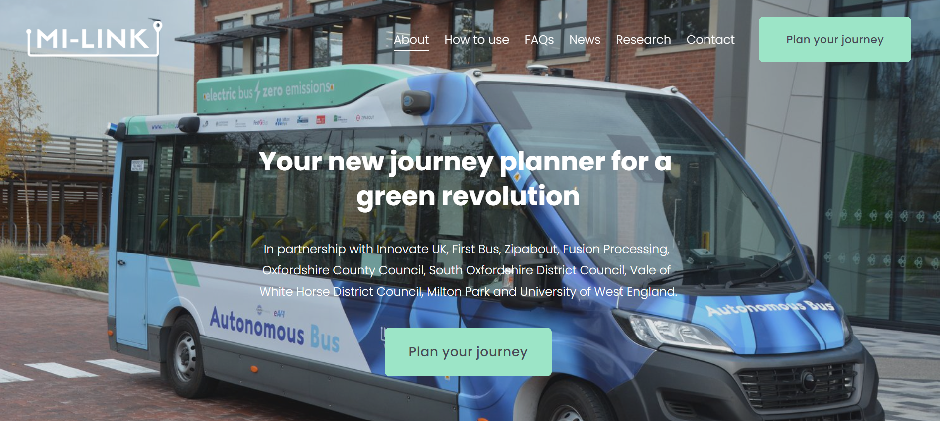
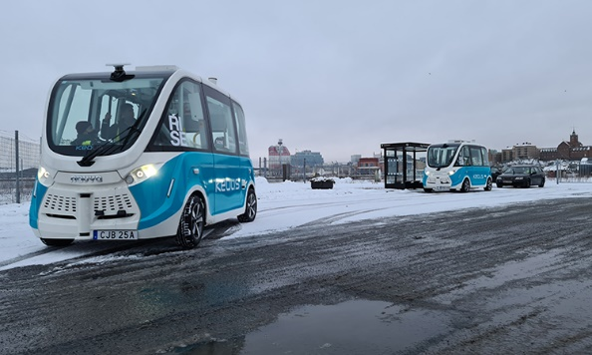
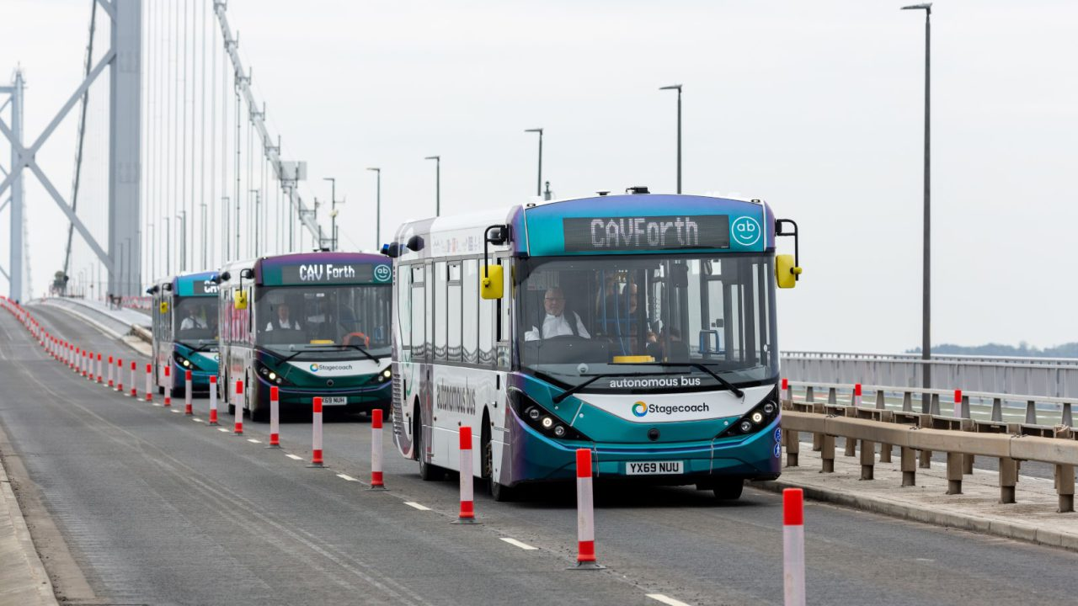
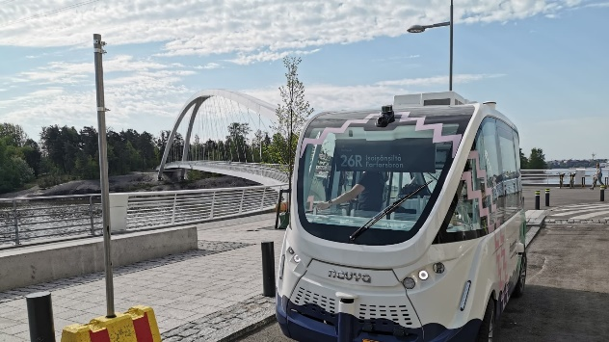
Service Overview
AV bus trial examples
“Positive attitudes towards autonomous vehicles can be supported by giving people possibilities to try autonomous vehicles in a safe, real-life environment.”
(Salonen and Haavisto, 2019, p. 1)
UK examples
CAV Forth (Edinburgh) – Public AV bus trial across Forth Bridge
Greenwich Trials (London) – AV trials, incl. pods
Cranfield University AV Trials – AV bus trials on test road through university campus
Project Apollo (Manchester) – AV trials, incl. pods, at Manchester Airport
Venturer (Bristol and Bath) – AV trials and public perception
International examples
Singapore
Helsinki, Finland
Gothenburg, Sweden
Shanghai, China
Phase 1 route: Milton Park circuit (<3km round-trip)
  Ten autonomous bus stops around the circuit
Phase 2 route: Milton Park and Didcot Parkway (10km round-trip)
  Twenty 'autonomous' bus stops along the route

Slide 7

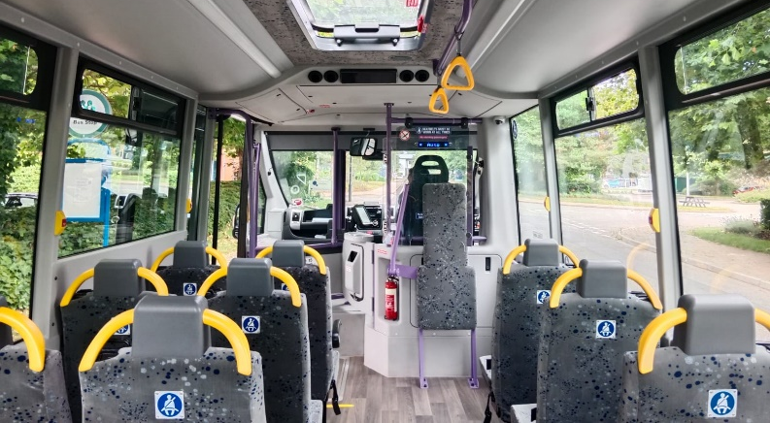
MultiCAV Overview
Level 4 operation with occasional driver-intervention needed in specific parts of the route
Driver always present in the driving seat for monitoring and control
Vehicle displayed 'Auto' sign when in autonomous mode
Fares not charged & smaller vehicle capacity
Existing diesel single and double deck buses also served the business park

Slide 8
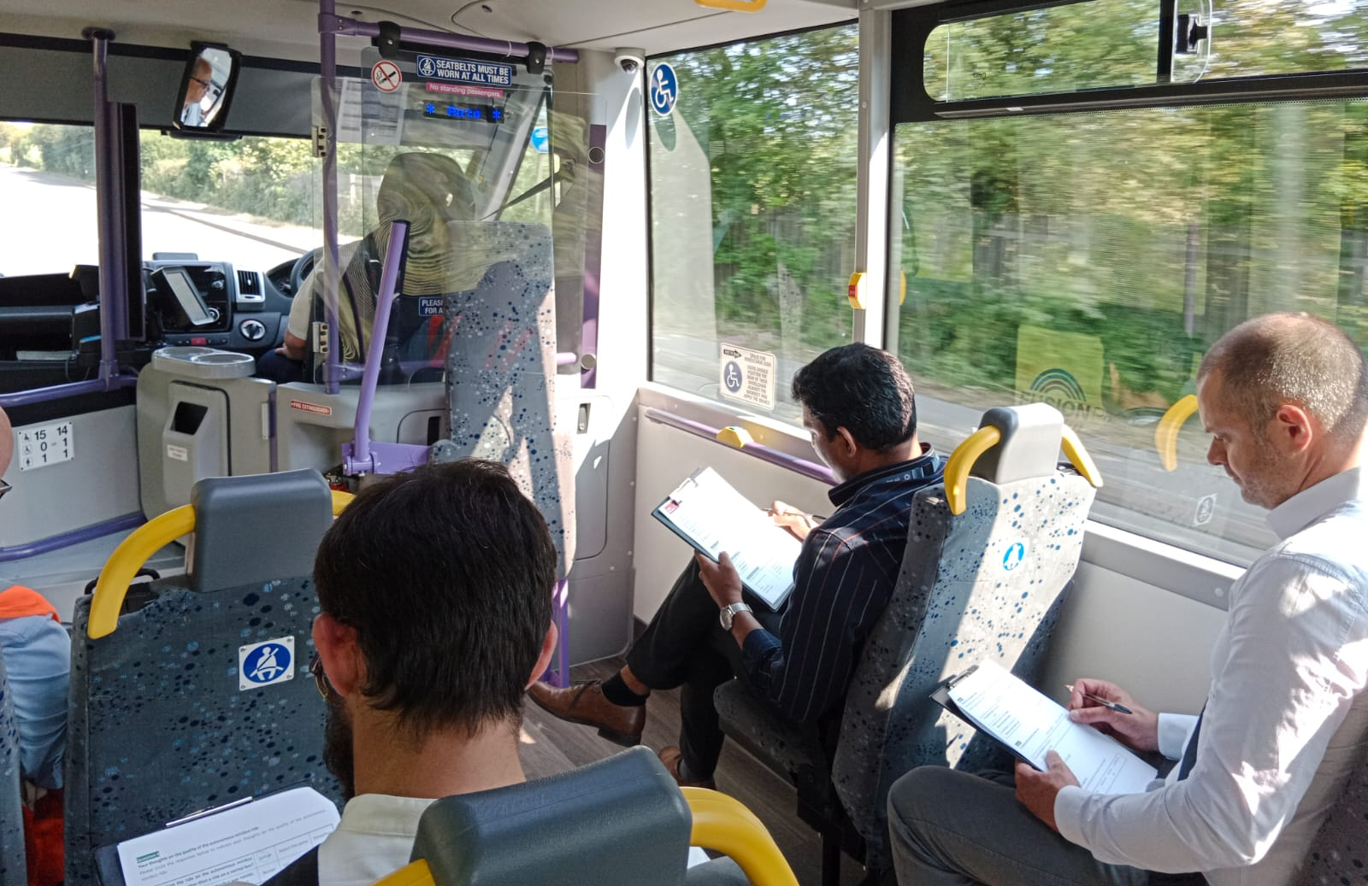
Methodology
Passenger survey | Passenger interviews
Took place during Phase 2 Administered on-board AV bus during normal operations Took around 5 minutes to complete | Took place during Phase 1 and Phase 2 Conducted off-bus either in person or on MS Teams Lasted 15-30mins
Sample 119 completed surveys 60% men, 39% women, 1% nonbinary / other Average age = 37 years, range = 18 – 77 63% were daily users, 27% used a few times a week, 10% used once or twice a month, 1% less than once or never | Sample 12 participants: 5 female, 7 male Employees of organisations on Milton Park Age range spread from 25 - 65+

Slide 9
AV experience and trip purpose
Whether knew about autonomous minibus before trip (n=107)
Prior experience with AVs (n=119)
Trip purpose (n=119)

Slide 10
Ride quality and noise perceptions
Ride quality (n=114)
Noise level (n=114)

Slide 11
Safety perceptions
“I probably felt safe, because I knew that there was a driver there as well. So I think I would feel a bit nervous if there wasn't anyone there.”
(Female passenger, 35-44)
Feeling safe on the autonomous minibus in different situations (n=115)
“Milton Park is a private estate and there isn't that much traffic, and there is a 20 mile [limit]… so you'd be less anxious anyway. So, I'd be very keen to try it again on one's journey to Didcot station.”
(Male passenger, 65+)
“When it slips from autonomous to non-autonomous. It's quite sudden braking.”
(Male passenger, 45-54)
“I think it was very gentle, in comparison with a bus with a driver.”
(Female passenger, 35-44)

Slide 12
Driving under different conditions
“I was disappointed. You know, whenever I looked at the driver, he was “driving”. (…) To me... It looked like the driver was driving. It was just an ordinary bus.”
(Male passenger, 45-64)
How the autonomous minibus was perceived to be 'driving' compared to a human (n=115)
“I guess it was less exciting to see a driver there. So, you didn't have that feeling of... […] I guess I was hoping take a video and say: “hey, yeah, this is me on the bus!”. It was a lot more boring than that.”
(Male passenger, 45-64)
“It is that jarring illness of stopping. (…) it doesn't feel natural. (…) It's quite a dramatic braking. Feels like… you know, when you're in a drive on a bus with like, a driver hasn't been driving that long.”
(Female passenger, 35-44)

Slide 13
Technology adoption
“I think this is new technology, new exciting technology, so… so if we could travel without drivers, that would be fantastic. And it's electric as well, so….”
(Female passenger, 35-44)
Trying a new technology in general (n=113)
“Financially, it makes sense because the cost of the driver is such a high proportion of the cost of a commercial bus. So, I'm hopeful that it is that is the future, and I would like to be alive to see it if I could”
(Male passenger, 65+)
“Excited because it's a new technology.”
(Male passenger, 55-64)
“I was just intrigued to see how it operated”
(Male passenger, 65+) “
“It's interesting, because (…) you can see that it's learning.”
(Female passenger, 35-44)

Slide 14
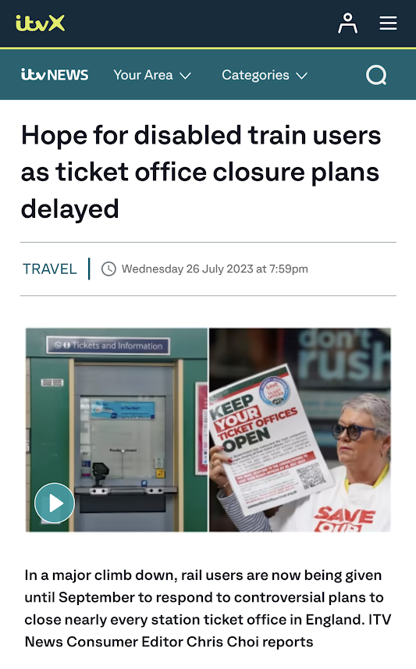
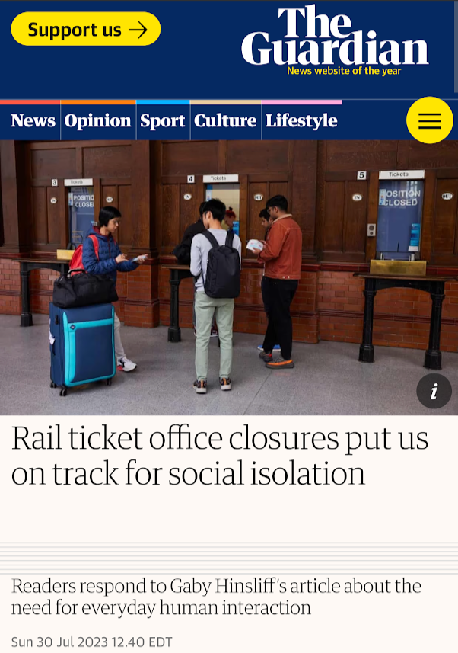
Unintended impacts of AV?
“What's the advantage of an autonomous bus? I'm not sure (…) We could make it work great (…) but what you ultimately end up with is bus drivers will lose their jobs. And is that a good use of the technology? (…)
I love technology, and I love everything it can do. But do we think about how it's actually going to be used in practical terms? The market economy will say, great, we can get rid of bus drivers. Yeah, we can get rid of train drivers. (…)
So… there's a technological debate (…) But think about the social cultural aspects, how does it change society?”
(Female passenger, 35-44)

Slide 15
Conclusions
No clear difference in ride quality perception as compared to a normal urban bus
72% found autonomous minibus quieter than a traditional diesel bus (electric motor)
Overall positive feedback about AV: Quiet ride, similar to human-driven bus
Driving Quality Perception:
  1/5 preferred autonomous bus in certain situations
  1/4 reported worse experience in approaching/leaving junctions
Safety Perceptions:
  High acceptance with human operator or low speed (88% agreement)
  Somewhat lower acceptance (72%) for 'traveling at high speed’
  Acceptance issues in complex situations and operating at 40mph (relatively high speed for urban bus service)
Debate still very much open about the wider impacts of the continued automation of Public Transport services
  If an authority figure will always need to be present, what is the value of automating buses?
  What will Autonomous Buses mean for accessibility and transport justice?

Slide 16
References
Andersson, L., Ayala, A., Chan, S., Hickerson, K., Kettle, L., Malcein, L. A., & Lee, Y.-C. (2021). User experience and analysis of an autonomous shuttle service. Proceedings of the 2021 International Conference on Intelligent Transportation Systems (ITSC). https://doi.org/10.5220/0010408703700377
Bernhard, C., Oberfeld, D., Hoffmann, C., Weismüller, D., & Hecht, H. (2020). Valence of an autonomous minibus experience. Transportation Research Part F: Traffic Psychology and Behaviour, 73, 398-414. https://doi.org/10.1016/j.trf.2020.02.008
Brannon, G. (2017) Americans Feel Unsafe Sharing the Traffic with Fully Self-Driving Cars. American Automobile Association. Available online: http://newsroom.aaa.com/2017/03/americans-feel-unsafe-sharingtraffic-fully-self-driving-cars/
Cartenì, A. The acceptability value of autonomous vehicles: A quantitative analysis of the willingness to pay for shared autonomous vehicles (SAVs) mobility services. Transp. Res. Interdiscip. Perspect. 2020, 8, 100224.
Chng, S.; Anowar, S.; Cheah, L. (2022) Understanding Shared Autonomous Vehicle Preferences: A Comparison between Shuttles, Buses, Ridesharing and Taxis. Sustainability, 14, 13656. https://doi.org/10.3390/su142013656
Fagnant, D. J., and K. M. Kockelman. 2015. “Dynamic Ride-sharing and Optimal Fleet Sizing for a System of Shared Autonomous Vehicles.” In Transportation Research Board 94th Annual Meeting, January (No. 15-1962).
Faisal, A. et al. (2019) ‘Understanding autonomous vehicles: A systematic literature review on capability, impact, planning and policy’, Journal of transport and land use, 12(1), pp. 45–72. Available at: https://doi.org/10.5198/jtlu.2019.1405.
Feys, M., Rombaut, E., & Vanhaverbeke, L. (2020). Experience and acceptance of autonomous shuttles in the Brussels Capital Region. Sustainability, 12(8), 8403. https://doi.org/10.3390/su12208403
Hilgarter, K., & Granig, P. (2020). Public perception of autonomous vehicles: A qualitative study based on interviews after riding an autonomous shuttle. Transportation Research Part F: Traffic Psychology and Behaviour, 73, 252-263. https://doi.org/10.1016/j.trf.2020.05.012
Nordhoff, S., de Winter, J., Madigan, R., Merat, N., van Arem, B., & Happee, R. (2018). User acceptance of automated shuttles in Berlin-Schöneberg: A questionnaire study. Transportation Research Part F: Traffic Psychology and Behaviour, 58, 843-854. https://doi.org/10.1016/j.trf.2018.06.024
Penn Schoen Berland (2016) Sit Back and Enjoy the View! Survey Shows Self-Driving Cars Could Make You Happier—And Maybe Give up the School Run; Ford Motor Company: Cologne, Germany.
Power, J.D. (2017) Hands Off? Not Quite. Consumers Fear Technology Failures with Autonomous Vehicles; J.D. Power U.S. Tech Choice Study: Costa Mesa, CA, USA.
Wicki, M.; Bernauer, T. (2018) Public Opinion on Route 12. Interim Report on the First Survey on the Pilot Experiment of an Automated Bus Service in Neuhausen am Rheinfall; ISTP Paper Series 3; Institute of Science, Technology and Policy (ISTP), ETH Zürich: Zürich, Switzerland.

Slide 17
Thank you!
Any questions?
Do you have your own experience of using Autonomous Buses/Vehicles?
Are AVs the future of our transport systems?
What are the implications for accessibility and transport justice?
Can we balance the challenges against the opportunities?

