Slide 1





















Children’s
Participation in Schools
Embedding children's participative rights in pedagogical practice in lower primary classrooms in Wales
Dr Alison Murphy
Lecturer in the Athrofa: Institute of Education,
University of Wales Trinity Saint David
BERA, Manchester, Sept 2024
Notes:
Sarah
Collab between
1,2,3,4

Slide 2


About this research
Economic and Social Research Council (ESRC) funded - budget £700,000+
3-year project - Dec 22 to Nov 25
A collaboration across four UK universities
A focus on young children’s participative rights in lower primary settings
The research aims to uncover ways to integrate participative rights into everyday teaching and learning activities, and to create classroom environments where children's voices are not only valued but actively integrated into the teaching and learning processes.
Notes:
Why we are attending to the Gap which we suspect exists between policy ambition and policy enactment in relation to young children's participatory rights in school
Children, Schools, teachers and children across the seven Initial Teacher Education (ITE) partnerships in Wales (WP2)
Teachers and student teachers from one ITE partnership.
Planned over 4 work packages

Slide 3
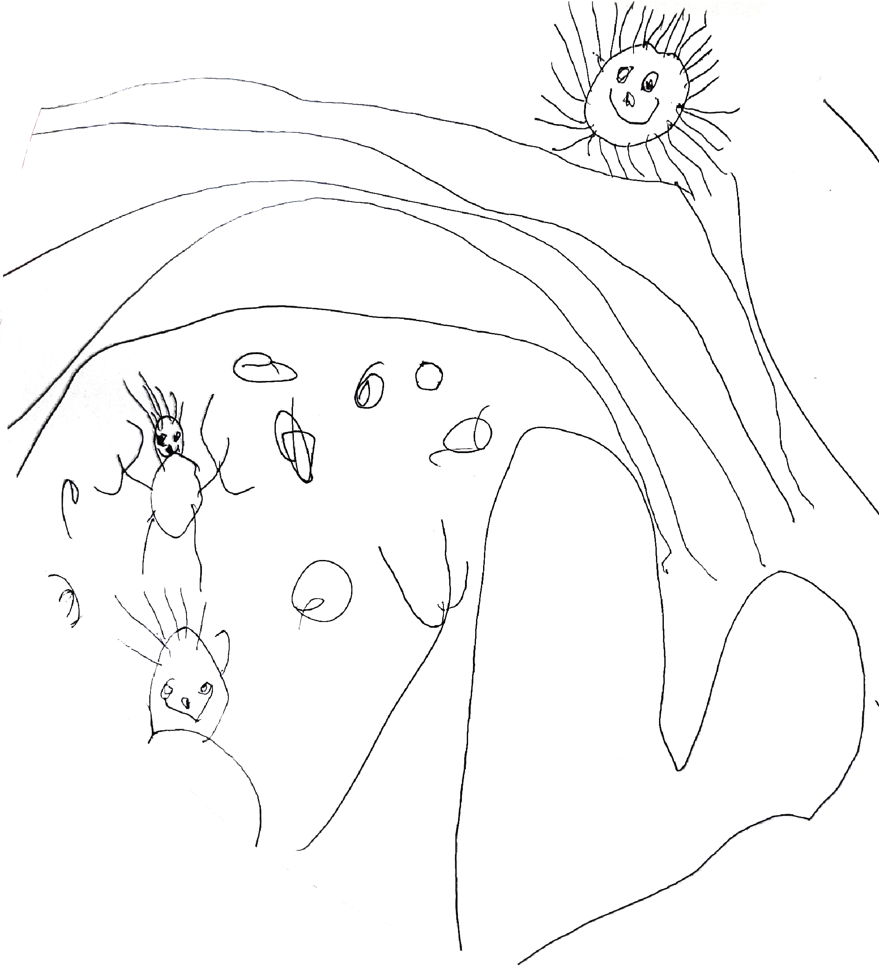
Project work packages
WP1: Scoping out the landscape
  Legislative and policy review
  Survey of ITE and CPD providers
WP2: Using Reggio Emilia inspired pedagogy to explore participative rights
  Interviews and dialogic workshops with teachers
  Supported class-based projects with children
  Focus groups and creative research with children
WP3: Embedding participative rights in practice
  Focus groups and dialogic workshops with educators and student teachers from UG and PG courses in Wales
WP4: Impact and dissemination

Slide 4
Scoping out the legislative and policy landscape

Slide 5
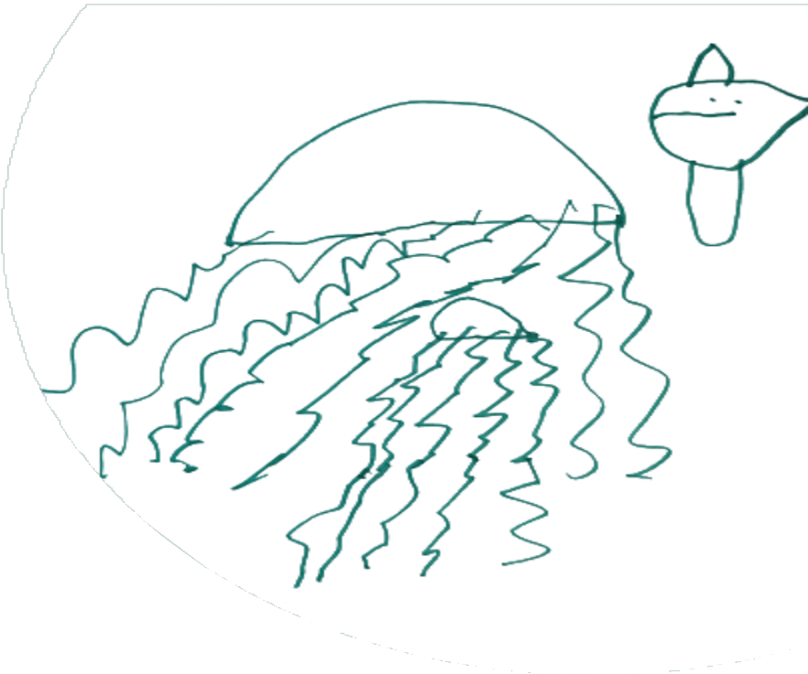
Research questions
How does the distinct Welsh policy context position teachers
in relation to young children’s participative rights in
primary schools in Wales?
To what extent do providers of professional learning (including
initial teacher education) support Welsh Government rhetoric for
pedagogic practice that embeds young children's participative rights?
How do primary teachers in Wales conceptualise and support young children’s participative rights and what are perceived enablers and barriers to practice?
How are young children's participative rights in Welsh primary schools understood and experienced by young children themselves?
How can findings from this work be drawn together to understand the process by which pedagogies can be transformed in order to embed participative rights?

Slide 6
Methodology
Range of legislative and policy documents from Devolution
2000-2022
Cardno (2018)
  Authorship / Audience / Purpose / Context
  Text
  Consequences
Deductive qualitative content analysis
Notes:
How do the narratives of these policy documents frame teachers in relation to children?
Evidence within Welsh education policies for support for the enactment of children’s participative rights in the classroom would challenge the dynamics to social systems and structures where child-adult power imbalances exist

Slide 7
Defining participative rights
Article 7: birth registration and nationality
Article 8: identity
Article 12: right to express those views freely in all matters affecting the child, the views of the child
being given due weight in accordance with the age and maturity of the child. Opportunity to be heard
in any judicial and administrative proceedings affecting the child.
Article 13: freedom of expression, including freedom to seek, receive and impart information and ideas of all kinds
Article 14: freedom of thought, conscience and religion. Respect the rights and duties of the parents and, when applicable, legal guardians, to provide direction to the child in the exercise of his or her right in a manner consistent with the evolving capacities of the child
Article 15: freedom of association and peaceful assembly
Article 16: freedom from arbitrary or unlawful interference with privacy, family, home or correspondence, and from unlawful attacks on child’s honour and reputation.
Article 17: obligation to encourage mass media to enable child’s access to information and material from a diversity of national and international sources, especially those aimed at the promotion of child’s social, spiritual and moral well-being and physical and mental health
Articles 28 and 29: right to and aims of education
Article 42: obligation to make the principles and provisions of UNCRC widely known, by appropriate and active means, to adults and children alike
Notes:
Considering human rights as inalienable, indivisible and interdependent. So participative rights must be seen as part of the system of enactment of the full range of rights.
Why a special Convention for children – to reiterate they are human, and have rights, and to adopt agreed additional human rights obligations and standards in relation to children. Art 12 is one of those additional obligations and standards.
It is about article 12 but it is not only about article 12
Promoting the rights of others, democratic and civic engagement come not from specific rights but from the underlying values and aims of the human rights project (i.e. the whole system of human rights protections that has developed over the last 70 years at international and regional levels)
Article 12 is thus only the tip of the iceberg.
Not limited to UNCRC but also other international texts. Human rights apply to everyone from birth. ECHR and UNCRPD among other important texts for children in schools in Wales and wider UK.
Defining participative rights
Participative rights
Participatory pedagogies
Participation

Slide 8
Legal framework in Wales
Children and Families (Wales) Measure 2010
Rights of Children and Young Persons (Wales) Measure (2011)
Welsh Ministers’ Children’s Scheme (under s.2 of the 2011 Measure)
UNCRC (to which Welsh Ministers must have ‘due regard’)
  Interpretative texts: General Comments issued by the UNCRC (we identify 1, 7, 9, 12, 14, 17 and 25 as of particular relevance)
Social Services and Well-being (Wales) Act 2014
Wellbeing of Future Generations (Wales) Act 2015
Additional Learning Needs and Education Tribunal (Wales) Act 2018
Curriculum and Assessment (Wales) 2021
Notes:
We looked at a range of legislation relevant to children and education

Slide 9
Policy analysis
We looked for references to the UNCRC, Human Rights
Education and participation
We found four kinds of data:
  Entirely absent
  Referenced with no detail or further explanation
  Containing differing understandings of participative rights
  Explicit and contextualised

Slide 10
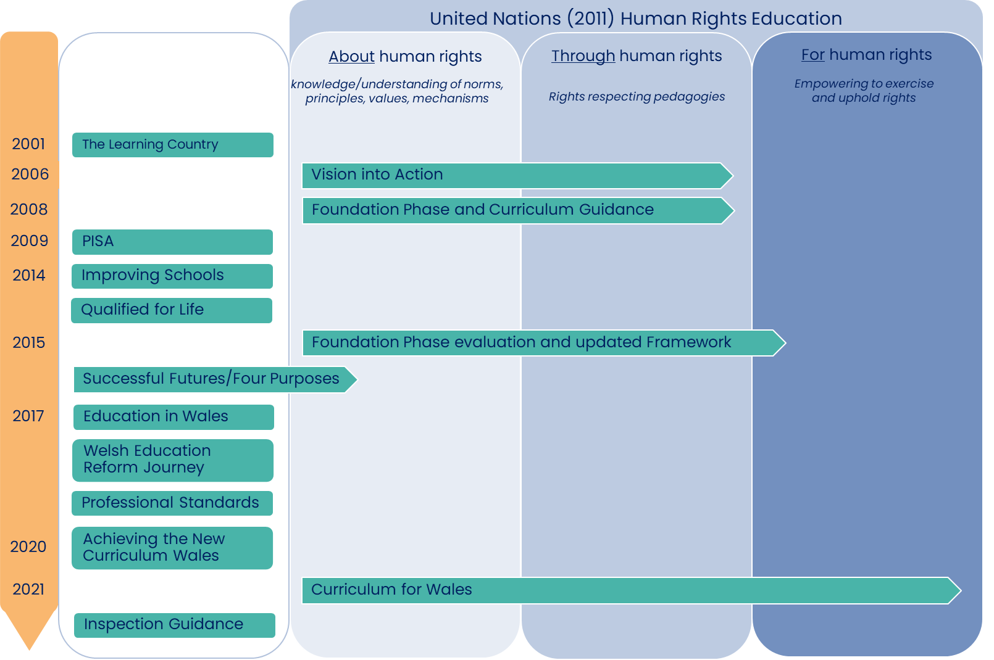
Policy analysis
Notes:
LENS OF UNITED NATIONS HUMAN RIGHTS EDUCATION FRAMEWORK
In the majority of Welsh education policies we didn’t find any references to the UNCRC / HRE / Participative rights
However, in the practical guidance Welsh Government provide for practitioners, online guidance on the Hwb, education about and through human rights is detailed.
So I would like to focus on the Successful Futures document from 2015 which was widely considered as a progressive development in many ways, before talking about the new curriculum for Wales of 2021.

Slide 11
Successful Futures
Dominant themes
  Improving literacy, numeracy, digital skills
  Reducing the impact of deprivation on educational outcomes
  Skill acquisition, preparing future citizens, ‘participation’ in society
Participative rights
  Cites WG commitment to UNCRC as a positive aspect of Welsh Education.
  One of the four purposes for pupils to be “ethical informed citizens of the world”…
  …but there is very limited detail of what is meant by an ethical informed citizen
  Within 68 recommendations - no references to UNCRC / HRE / participative rights
Notes:
Successful Futures viewed as very progressive move for Wales – giving teachers and children more agency
Perhaps understandably in response to the 2009 PISA Donaldson’s Successful Futures report dominant themes of raising standards and improving outcomes, a strong focus on literacy, numeracy, digital skills, as well as developing the skills needed for future employment, and a rhetoric that this was required to alleviate the impact of disadvantage on educational outcomes in Wales.

Slide 12
Successful Futures
Lemke and Zhu (2018)
  Technocratic and performance-oriented language,
  fundamentally future-oriented
  Doesn’t address necessary reworkings of curricula and pedagogy
  required to enact transformational change
  Successful Futures (2015) fails to engender child rights consonant with the spirit of the UNCRC
Notes:
Lemke and Zhu – the clue is in the name – Successful Futures

Slide 13
Curriculum for Wales: UN Framework
Experiencing rights through education
Children’s rights approach
The right to participate in decisions
Collaboration
Equality, dignity, respect, non-discrimination
Both practitioners and learners
Duty bearers accountable
Motivation of social action
Empowerment of active citizenship
Advance respect for the rights of all
What it means to be an ethically informed citizen of Wales and the world
School leaders responsible for ensuring knowledge and understanding of the UNCRC
Notes:
Strong and robust framework

Slide 14
Curriculum design
Human rights is one of five cross-cutting themes
“Ethical and informed citizens’ understanding and exercising their
human and democratic responsibilities and rights”
Co-constructing the curriculum
Enabling learner participation in creating an engaging curriculum
Dialogue between learner and professionals is a valuable learning experience Feedback should be given on decision-making
Differing levels of participation are appropriate at different points
Assessment
Learners at the heart of assessment
A holistic picture of the individual learner should be used
In discussion with learner

Slide 15
Headline findings
Legislation introduces requirements to know about and have
due regard to children's rights but lacks detail on what this
means in practice
Omissions and inconsistencies in Welsh education policy as well as
differing understandings of participative rights
Practical guidance for educators in Wales (Hwb) from 2006 is inclusive of education about and through human rights at all ages
The new Curriculum for Wales (2021) is underpinned by HRE and details extensively the about, through and for of the United Nations Framework (2011)
Focus on ‘what’ not ‘how’
Golden thread of implementation through to impact
Maintaining the commitment

Slide 16
Young children’s participative rights across Initial Teacher Education (ITE) in Wales
Notes:
ALISON

Slide 17
Research question
How does the distinct Welsh policy context position teachers
in relation to young children’s participative rights in
primary schools in Wales?
To what extent do providers of professional learning (including
initial teacher education) support Welsh Government rhetoric for
pedagogic practice that embeds young children's participative rights?
How do primary teachers in Wales conceptualise and support young children’s participative rights and what are perceived enablers and barriers to practice?
How are young children's participative rights in Welsh primary schools understood and experienced by young children themselves?
How can findings from this work be drawn together to understand the process by which pedagogies can be transformed in order to embed participative rights?

Slide 18
Methodology
A survey administered to all HEIs that provide ITE in Wales
  Programme title
  Number of current students
  Aims and learning objectives related to young children’s participative rights in validation documents
  Modules titles where young children’s participative rights are covered
  Aspects of young children’s participative rights to rank order
Deductive content analysis (Elo & Kyngas, 2008)
Tibbitts (2017) three models of Human Rights Education
Notes:
ALISON

Slide 19
Tibbitts models of
Human Rights Education
Values and Awareness
  Affirm existing HR discourse
  Provide knowledge of HR
  Learner is not encouraged or empowered to take action
Accountability
  Linked to professional roles
  Intended to influence knowledge, attitude and actions specific to roles
Transformation
  Transformative learning to bring about profound change in the individual learner
  Results in taking action to eliminate HR violations
Notes:
ALISON

Slide 20
Survey responses
Of 11 programmes across 7 HEIs:
9 responses
5 postgraduate courses (PGCE)
4 undergraduate courses (BA)
Programmes noted between 21-316 students each
(2022-2023) reflecting 1666 student teachers
Notes:
ALISON

Slide 21
ITE programmes
7 programmes: No specific aims or learning objectives
2 programmes: Included specific aims or learning objectives
  Recognising the needs and rights of all pupils
  Familiarising students with the most recent national guidance on UNCRC
4 Programmes: Implicit references within aims or learning objectives
  exercise their contractual, pastoral, legal and professional responsibilities to meet the needs and maximise the potential of all learners
  meet the [requirements for] Professional Standards for QTS
Notes:
ALISON

Slide 22
ITE modules
Within 9 programmes there were 24 modules that related to
young children’s participative rights:
16 modules: No specific aims or learning objectives
8 modules: Included specific aims or learning objectives
  develop skills of listening to learners and valuing pupil voice
  the use of learner voice
  appreciate and accommodate the role of the learner’s voice in the development of effective learning and teaching
  voice of the teacher and the learner in relation to co-shaping school experiences and curricular experiences
  consider the role of pupil voice
Notes:
ALISON

Slide 23
Module content
Additional modular content outside specific aims and
objectives included:
  “…understand the key principles of the UNCRC”
  “…gain an understanding of current legislation, including ... children’s rights”
  “…explore . . . learner rights in the context of Four Purposes”
  “…consider global curriculum models and approaches (such as Reggio Emilia) where the voices of young children are considered”
  “…design a research project that ensures that the voices of young children are respected and listened to in their research”
Notes:
ALISON

Slide 24
Support for ITE
Participants were asked whether and how they would like
support in developing this area of practice
More information on children’s participative rights
Guidance and resources to supplement delivery, curriculum design and implementation
Specific professional learning regarding children’s participative rights
Guest lectures
Resources (current and relevant)
Development of assessment criteria that better reflects theory relating to children’s participative rights
Notes:
ALISON

Slide 25
Headline findings
Tibbitts models of HRE
The programme and module aims and objectives detailed sat within the first two of Tibbitt’s models of HRE
  Values and Awareness
  Accountability and professional Role
Only one programme had some features of Tibbitt’s third model of HRE
  Transformation
Notes:
ALISON

Slide 26
Headline findings
Themes related to children’s participative rights were ranked
Those considered to be covered most were:
  Knowledge of the UNCRC
  Pedagogies to support young children’s participative rights
Those considered to be covered the least were:
  Understanding tensions between theory, policy and practice
  Constructions of children and childhood
All but one response asked for support with young children’s participative rights
Notes:
ALISON

Slide 27



Any Questions?
Learn more by visiting our webpage…
Latest news and events - upcoming training sessions, conferences and webinars.
Become a Network Member - receive a monthly newsletter and invitation to our events
  Follow us on Social Media…
@ChildPart
@child.participation
child.participation@uwe.ac.uk

