Slide 1
Human Rights Education: Teachers’ perceptions about the value of children’s participation
BERA, Manchester, Sept 2024
Presenter: Dr Jane Waters-Davies
Dr Sarah Chicken, Dr Jacky Tyrie, Prof. Jane Williams, Dr Jennie Clement, Dr Alison Murphy
Jacqui Lewis, Louisa Roberts, Dr Patrizio De Rossi

Slide 2
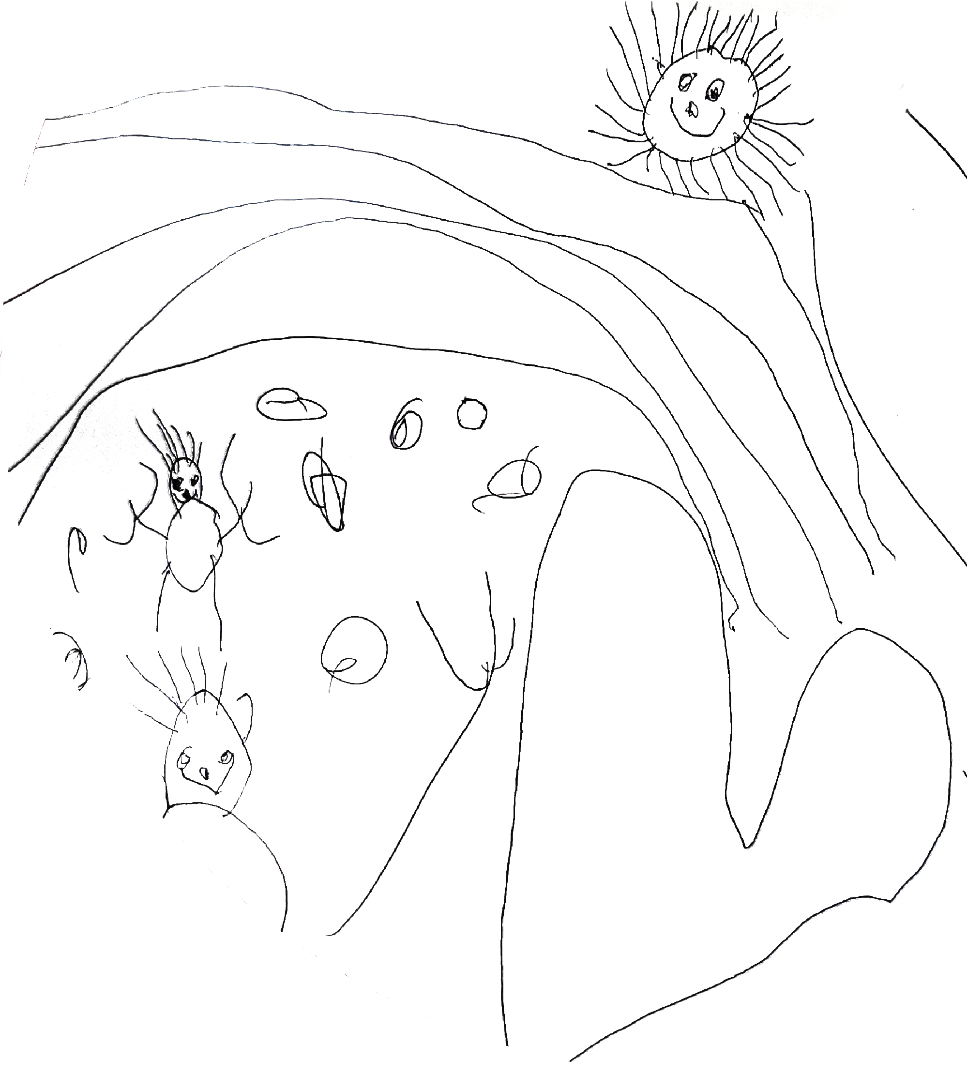
Project work packages
WP1: Scoping out the landscape
Legislative and policy review
Survey of ITE and CPD providers
WP2: Using Reggio Emilia inspired pedagogy to explore participative rights
Interviews and dialogic workshops with teachers
Supported class-based projects with children
Focus groups and creative research with children
WP3: Embedding participative rights in practice
Focus groups and dialogic workshops with educators and student teachers from UG and PG courses in Wales
WP4: Impact and dissemination

Slide 3
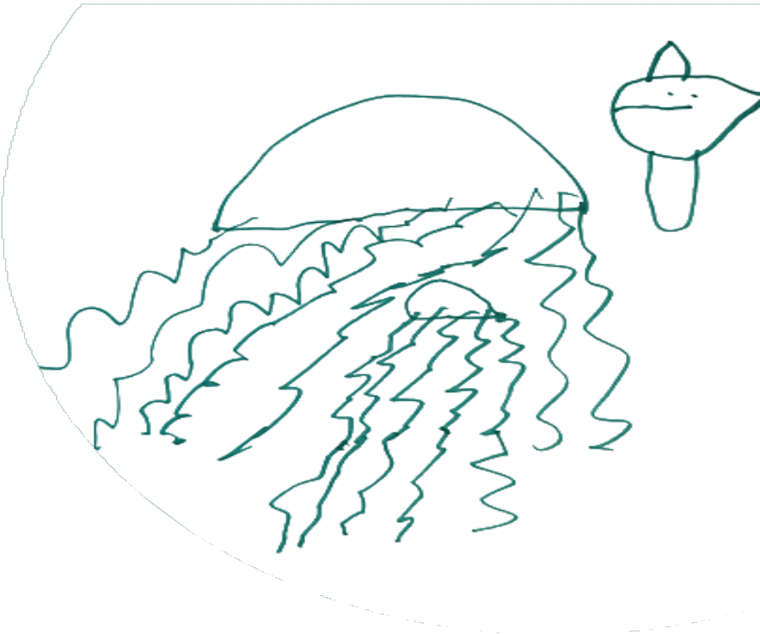
Research questions
How does the distinct Welsh policy context position teachers in relation to young children’s participative rights in primary schools in Wales?
To what extent do providers of professional learning (including initial teacher education) support Welsh Government rhetoric for pedagogic practice that embeds young children's participative rights?
How do primary teachers in Wales conceptualise and support young children’s participative rights and what are perceived enablers and barriers to practice?
How are young children's participative rights in Welsh primary schools understood and experienced by young children themselves?
How can findings from this work be drawn together to understand the process by which pedagogies can be transformed in order to embed participative rights?

Slide 4
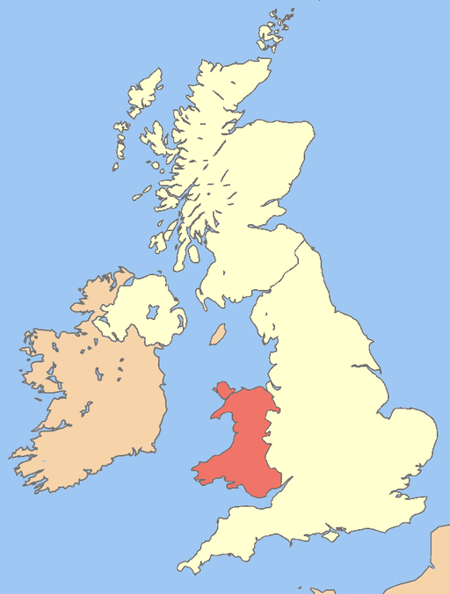
About Wales
Population: 3.1 million people. 4.8% of the UK population (Welsh Government, 2021)
Devolved Government with responsibility for education
Strong Welsh Government vision for children rights since devolution – supported by legislation (Williams, 2013)
Curriculum for Wales (3-16 year olds)

Slide 5
Curriculum for Wales (2021)
Individual school flexibility to develop their own curriculum.
The Four Purposes as a starting point and aspiration for all children:
Consistent learning continuum for all, but the pace of progress is individual to each learner. Progression and assessment are expressed from the learner's perspective.
Curriculum development seen as the vehicle for embedding the UNCRC in children's experiences of education.
(Welsh Government, 2021)
Ambitious, capable learners
Enterprising, creative contributors
Ethical, informed citizens
Healthy, confident individuals

Slide 6
UNCRC
The project is framed within the context of the UNCRC and the Welsh Government commitment to children’s rights
Concerned with adult’s positioning, behaviours and attitudes relative to the child
Including but not limited to Article 12, the ‘right to participate’
Participative rights:
Article 12 as indivisible from and interconnected with all children’s rights
Participation:
the varying ways in which children can be involved in decision-making
Participatory pedagogies:
the ways that educators enable participation and enact children’s participative rights
Notes:
The UNCRC was first adopted by the United Nations in 1989 and subsequently ratified by the UK government in 1991. It is described as a complete framework of standards, principles and implementation guidance in relation to the human rights of children (Children in Wales, 2014), encompassing ideas from the protectionist days of Eglantine Jebb, founder of Save the Children, and discourse arising from the horrors of the world wars (Boylan and Dalrymple, 2009). The international agreement sets out fifty-four articles which influence all aspects of a child’s life, including their economic, social, cultural, civil and political rights and are broad philosophical principles which can be interpreted and applied according to context (Jones and Walker, 2011; Kanyal, 2014). As such, it has gained a universal prominence and globally it is considered the most ratified international human rights treaty in history (UNICEF, 2019). Hart (1997) described the treaty as ‘an instrument of persuasion for those persons wishing to promote the ideas of children as independent, thinking subjects, capable and deserving of a greater degree of participation’ (Hart, 1997, p. 37). This latter definition places emphasis on one of the more unique aspects of the treaty, which is its comprehensive focus on the ‘three Ps’ - Provision Rights; Protection Rights; Participation Rights. Unlike previous legislation, the UNCRC includes a strong focus on participation (Alderson, 2008). Advocates claim therefore that inherent within such rights is the view of children as the agents of their own lives, capable of contributing and participating in decision-making (Jones and Walker, 2011; Thomas, 2021).

Slide 7
Shifting the discourse: The UNCRC
Paradigmatic shift shaped by the UNCRC (Invernizzi and Williams, 2011)
New sociology of childhood (Prout and James, 2015)
Schools of Reggio Emilia, Italy (Chicken, 2023)
UNCRC as a key driver for children’s rights in Wales (Stewart, 2024)
‘Normalising’ of a rights-based discourse (Quennerstedt et al., 2018)

Slide 8
Literature: Children’s participation within early education in the UK
Limited research in this area (Lewis et al., 2017; Correia et al., 2019)
Understandings of participatory pedagogies are varied (Chicken and Tyrie, 2023)
A tension between desires to enact participation and required outcomes (Maynard and Chicken, 2010).
Participation could be developed further by many teachers (Robinson et al., 2015).

Slide 9
Literature: Children’s participation within early education in the UK
It has been argued that the adult’s underpinning constructions of the child maybe key to rights-enactment. (Lyle, 2014)
A strong conceptualisation of the child has been proposed as a ‘threshold concept’ (Waters-Davies and MacDonald, 2022)
Understandings reflect 'boundaried' approaches to children's enactment of rights (Clement et al., in press; Waters-Davies et al., 2024), often with a focus on certain spaces, such as the outdoors (Maynard et al., 2013; Waller, 2006).
Notes:
Very limited research within the Welsh context
Clement has argued that when children are not completely involved with the process of classroom design, that their involvement is tokenistic.
Lyle (2014) and how they attempted to enact these within their practice. Findings suggested that teachers held a range of different constructions of children such as ‘the innocent child,’ ‘the child as a blank slate’ and ‘the developing and immature child’. Some of the participants (Lyle 2014) felt that the implementation of UNCRC principles were a ‘threat’ to how they viewed their role as teachers, erasing some of their power and agency and this was more likely to be the case where they were authoritarian in teaching style. Where a social competency model of the child was held, teachers were more likely to embrace UNCRC principles, particularly Article 12, a child’s right to have their voice recognised within the curriculum. Whilst this study was related to teachers working with the over sevens, it remains relevant since it suggests that the constructions that teachers hold of children and associated views of their roles as teachers, will impact on how they understand and enact UNCR principles within their practice

Slide 10
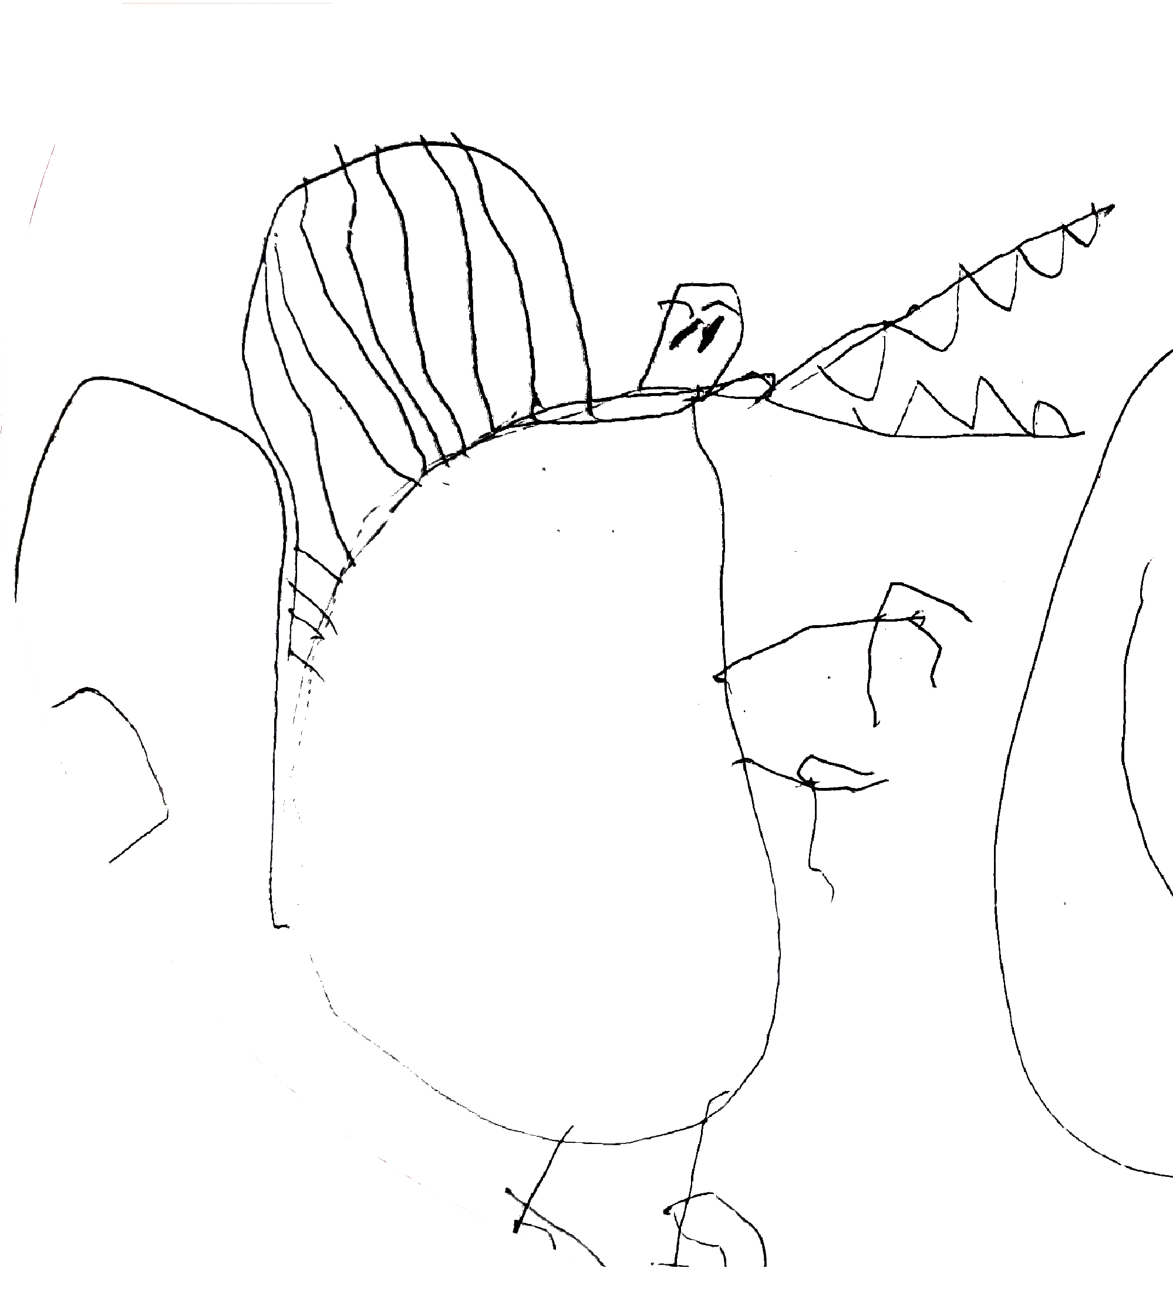
Theoretical orientation
The study adopted a rights-based approach (Bessell, 2017).
An axiological position with young children constructed as capable, agentic meaning-makers (Malaguzzi, 1998).
Social-constructionist stance for this interpretivist study (Berger & Luckman, 1991).
Notes:
a ‘child’ is defined in accordance with the UNCRC, as a person under the age of eighteen, which is the legal age of attaining adult status in Wales (Welsh Government, 2019) and as a fully autonomous person

Slide 11
Findings from year one
Legislative and policy analysis (Murphy et al., 2024)
A strong commitment to the UNCRC since devolution
Curriculum for Wales (2021) provides a clear framework for Human Rights Education
More support needed around how children's participative rights can be enacted in education
Survey of ITE providers
2 out of 9 ITE programmes had explicit aims / learning objectives related to young children's participative rights
Some individual modules and additional content reflected participative rights
All participants asked for support and guidance in this area

Slide 12
Methodology / methods
Participatory action research (Townsend, 2013)
14 teachers of children between the ages of 3 and 7.
Term 1
Semi-structured interviews with teachers
Dialogic workshops with an artist consultant using Reggio Emilian pedagogy as a provocation
Term 2
Class based projects with children
Online support sessions
Term 3
Sharing events
Post interviews with teachers

Slide 13
Analysis of pre-interviews with teachers
RQ3: How do primary teachers in Wales conceptualise and support young children’s participative rights and what are perceived enablers and barriers to practice? ​
Interview schedule:
Understandings of participative rights/child voice*
Classroom and school-wide practice*
Planning
Children’s role in developing the curriculum
Behaviour & discipline
Barriers and enablers*
The four purposes and CfW

Slide 14
Analysis of pre-interviews with teachers
Reflexive Thematic Analysis (Braun and Clarke, 2022)
Methodology
Inductive, collaborative, reflexive, iterative
Epistemology & Ontology
Interpretivist, social constructionist, semantic and latent meaning-making
Axiology
Strong construction of children and professionals.

Slide 15
Findings
Understanding participation
Personal value based
responses
…but boundaried*
Supporting participation across schools
Democratic processes*
Supporting participation in class
Knowing your children
Following children’s interests*
Classroom environment

Slide 16
Understanding and supporting participation
Understanding Participation: ‘Boundaried’ participation
Implicit and explicit
Tokenism or modelling participation?
Level of teacher control
Time, space and curriculum
“... letting them think they've got that control. Whereas obviously as the teacher... that's where we were going to go anyway. But you've just let them think that they've come up with a suggestion.”
(Lizzie, Year 1 & 2, Age 5-7)
“they think they’ve got a choice but obviously we’ve narrowed it down… we would limit their choice.”
(Freya, Year 2, Age 6-7)
Notes:
Implicit – “certainly not at the start of the year”, “doing a mini topic”, “let them have a go”, “do a little job”
Explicit “ little fake elections” – tokenism? Or is modelling in safe spaces with limited consequences appropriate “of course they will be in the School Senedd one day won’t they”
Teacher control – many teachers acknowledge the need to maintain control of the classroom and the structure of the day
Time – specific times when children can choose eg ‘over to you time’ ‘continuous provision’ ‘choosing time’ – even when it’s a large part of the day there are them parts of the day with no choice
space – some spaces are more suited to children choosing? Eg outdoor v indoor
Subjects – some subjects are ‘easier’ to allow child choice – eg topic based learning as opposed to phonics/numeracy
How teachers value formal v informal learning and adult-led v child-led tasks

Slide 17
Understanding and supporting participation
Supporting participation in the classroom: Following children’s interests
All 14 teachers
Central to ‘child voice’, participation, and children’s rights
What they learn, where they learn, not how they learn
“in the early years … isn't just about them speaking and communicating. It's about us observing as well.”
(Eleri, Reception, Age 4-5)
”It's all I do, follow what the children's interests are ... it's just from little chats on the carpet in the morning, something will crop up.”
(Barbara, Year 1 & 2, Age 5-7)
“I give them a spark … then they go off and do what they want...”
(Barbara, Year 1 & 2, Age 5-7)
Notes:
The Welsh expression (we learned at the Welsh medium school) is ‘Pen agored’ – literal translation ‘open end’ – means a spark when you have no idea where it will lead

Slide 18
Understanding and supporting participation
Supporting participation across the school: Democratic Participation
Action groups, individual representatives, voting
Primarily for older children
Modelling democracy?
“they're too young to often understand, like they'd understand the practical side of things. They wouldn't necessarily understand the more, bigger picture stuff like my year six girls”
(Seren, Year 1, Age 5-6)
“I don't know, maybe it's more of the adult’s role in nursery to make sure that the children are having their rights, you know, respected.”
(Rebecca, Nursery, Age 3-4)
“obviously they will one day be part of the Senedd won’t they”
(Enfys, Reception, Year 1 & Year 2, Age 4-7)
Notes:
School councils, School Senedd, junior leadership team, eco committee, criw cymraeg
Digital leaders, workshop leaders, sports ambassadors, head boy and girl
Voting for class representatives, class pet name,
Drawing up class rules together with children

Slide 19
Findings – Enablers and Barriers
Overarching culture
School community
Classroom environment
Curriculum (local & national)
Pedagogy
Flexibility & rigidity
Planning
Time and space
Expectations
Parents, children, teachers
Senior leaders & inspection
Consortia
Constructing the roles of…
Children*
Teachers*
Teaching and learning

Slide 20
Enablers and barriers: Constructions of……
…too young to often understand…
(Seren, Year 1, Age 5-6)
Children
Teachers
Teaching and learning and the purpose of education
Wider societal views?
I think the issue with the new curriculum and maybe with child's voice, with pupil's voice, moving forward might be with older classes, particularly secondary I think it could be much more difficult
(Karan, Reception, Age 4-5)
…it's more of the adults' role in nursery to make sure that the children are having their rights, you know, respected.
(Rebecca, Nursey, Age 3-4)
I don't think they have the language or the emotional maturity to make decisions... Really…
(Josey, Year 1&2, Age 5-7)

Slide 21
Enablers and barriers: Constructions of……
It is the fear of the unknown move into this way of teaching is scary and we we're five years along now and we're I feel that we're just getting the hang of it
(Alison, Year 1&2, Age 5-7)
Children
Teachers
Teaching and learning and the purpose of education
Wider societal views?
there are challenges … you know we are slight control freaks, and we know we've got to get this, this, this and this done that sometimes it's training ourselves just to step back and [let them] have that opportunity.
(Julie, Year 1 & 2, Age 5-7)
To listen to the pupils as you know, it doesn't always have to be what I've planned. If it goes in a different direction that's OK. But it does take some training to kind of go with that, especially for me.”
(Lizzie, Year 1&2, Age 5-7)

Slide 22
Early headlines from pre-interview data
Teachers showed a clear personal value base around children’s rights. This aligned with ‘child voice’, but they were less clear about ‘how’ to enact participative rights in practice.
They offered ‘boundaried’ views of the enactment of participative rights.
Enablers and barriers are complex and not binary. The same concept can be seen as both an enabler and a barrier, even for individual participants.
Findings suggest that context and relationships are key.
Research suggests constructions of children are a threshold concept. This data suggests further connections with constructions of teachers.
Our post-interview interim findings suggest constructions of children and teachers may be changing within the new curriculum in Wales.
Notes:
At pre-interview teachers had a strong sense of what 'child voice' meant to them, in their class and across their school. They aligned children's participation with these ideas about child voice. Whilst teachers referenced the UNCRC and revealed a personal value-base of respecting children's rights, their understandings of what participative rights were and how they could be enacted in class and in school were less clear. In explicit and implicit ways, teachers revealed how children's participative rights can be boundaried within the school environment.

Slide 23
Conclusions
Initial findings suggest that teacher understandings of participative rights and associated pedagogy are underpinned by a complex interrelationship between implicit constructions of (a) young children and (b) teachers (and their role) and further, with wider philosophical debates about the purpose of education.
Constructions of the child have been viewed as a threshold concept (Waters-Davies & Macdonald, 2022) and opportunities for teachers (students and in-service) to explicitly unpick constructions may be useful in actualising a children’s rights agenda.
These data go further suggesting that constructions of the role of the teacher are also significant and need deconstructing. This is particularly pertinent in the current policy context.
Notes:
allowing an avenue through which discussions and agitations can be explored to support the increased enactment of participative rights within practice.

Slide 24
References
Berge, P. & Luckmann, T. (1991) The social construction of reality. Penguin Books
Bessell, S., 2017. Rights-based research with children: Principles and practice. Methodological Approaches Geographies of Children and Young People, 2, pp.223-240.
Chicken, S. (2023). ‘Doing Reggio?’ Exploring the complexity of ‘curriculum’ migration through a comparison of Reggio Emilia, Italy and the EYFS, England. Global Studies of Childhood, 13(4), 322-340
Chicken, S. and Tyrie, J., 2023. Can you Hear me? Problematising the Enactment of uncrc Article 12 in Welsh Early Years Classrooms: Exploring the Challenges of “Children’s Voice”. The International Journal of Children's Rights, 31(2), pp.301-325.
Correia, N., Camilo, C., Aguiar, C. and Amaro, F., 2019. Children's right to participate in early childhood education settings: A systematic review. Children and Youth Services Review, 100, pp.76-88.
Invernizzi, A. and Williams, J. (eds) (2011) Human Rights of Children: From Visions to Implementation, London: Routledge.
James, A. and Prout, A., 2015. Re-presenting childhood: Time and transition in the study of childhood. In Constructing and reconstructing childhood (pp. 202-219). Routledge.
Waters, J., Lewis, A., Sarwar, S. and Tyrie, J., 2017. Exploring the extent of enactment of young children's rights in the education system in Wales. Wales Journal of Education, 19(2).
Lyle, S., 2014. Embracing the UNCRC in Wales (UK): Policy, pedagogy and prejudices. Educational Studies, 40(2), pp.215-232.
Malaguzzi, L., 1994. Your image of the child: Where teaching begins. Exchange, Vol 3, No: 94
Malaguzzi, L., 1998. Part I: History. The hundred languages of children: The Reggio Emilia approach--advanced reflections, 49.
Maynard, T. and Chicken, S., 2010. Through a different lens: Exploring Reggio Emilia in a Welsh context. Early Years, 30(1), pp.29-39.
Murphy, A., Roberts, L., Williams, J., Chicken, S., Clement, J., Waters-Davies, J. and Tyrie, J., 2024. Participative rights in Welsh primary schools: Unpicking the policy rhetoric. Policy Futures in Education, p.14782103241257281.
Quennerstedt, A., Robinson, C. and I’Anson, J., 2018. The UNCRC: The voice of global consensus on children’s rights?. Nordic Journal of Human Rights, 36(1), pp.38-54.
Robinson, C., 2016. Listening to the voices of young people: Working towards the genuine participating young people in discussions about school transformation. Reimagining the purpose of schools and educational organisations: Developing critical thinking, agency, beliefs in schools and educational organisations, pp.79-91.
Stewart, Sarah (2024) An Exploration of the Conceptualisation and Enactment of Children’s Rights in the Curriculum for Wales. Doctoral thesis, University of Wales Trinity Saint David.
Townsend, A., 2013. Action research: The challenges of changing and researching practice: The challenges of understanding and changing practice. McGraw-Hill Education (UK).
Waters-Davies, J. and Macdonald, N., 2022. The capable child as a threshold concept for inclusive early childhood education and care. In Inclusive Pedagogies for Early Childhood Education (pp. 164-181). Routledge.
Waters‐Davies, J., Murphy, A., Chicken, S., Tyrie, J. and Clement, J., 2024. Constructing child participation in early years classrooms: An exploration from Wales. Children & Society.
Welsh Government, 2021, Curriculum for Wales. Available at: https://hwb.gov.wales/curriculum-for-wales [Accessed 31 Jul 2024]

Slide 25
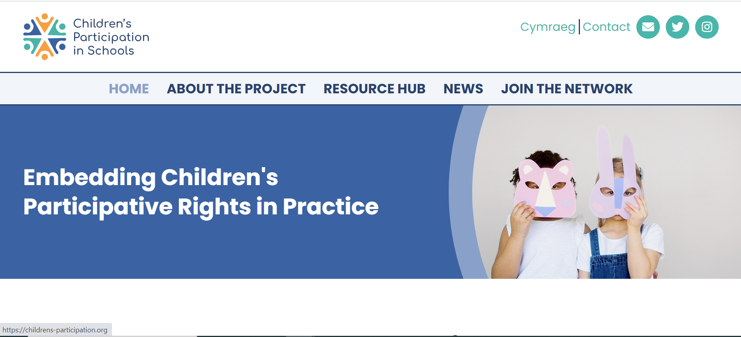
Keeping in touch with the project
Follow us on Social Media!
@ChildPart
Children's Participation in Schools
child.participation@uwe.ac.uk
Website you can find out more about all parts of the project.
Resources Centre for all things related to children’s participation in schools
Latest news and events in the field such as upcoming training sessions, conferences and webinars.
Visit our website on: https://childrens-participation.org/

Slide 26
Join the Network!
Become a Network Member - receive a monthly newsletter and invitation to our events

