Slide 1
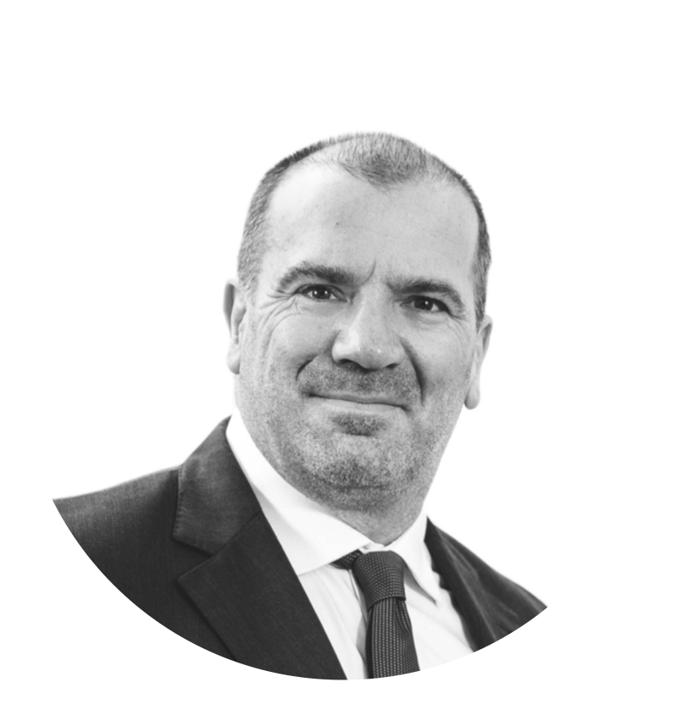
Professional Enablers and the Facilitation of Mortgage Fraud
JONATHAN GILBERT
Head of Learning & Development, IN8 PhD Researcher, Cardiff University
GilbertJM@cardiff.ac.uk
JonathanGilbert@in8consulting.com
Wales Fraud Forum Conference
23rd September 2022

Slide 2
OVERVIEW
Identify the professional enabler
Discuss what constitutes mortgage fraud
Consider examples of contrived ignorance and willful complicity
Describe pathway into fraud, offering insight into offending
Researching mortgage fraud

Slide 3
WHAT IS A PROFESSIONAL ENABLER?
An individual who intentionally uses their professional status, knowledge and know- how to manipulate an otherwise legitimate transactional process in order to facilitate criminal activities on behalf of their clients and/or other connected parties.
Note: this definition applies to complicit enablers. There are also situations where professionals can inadvertently facilitate crime

Slide 4
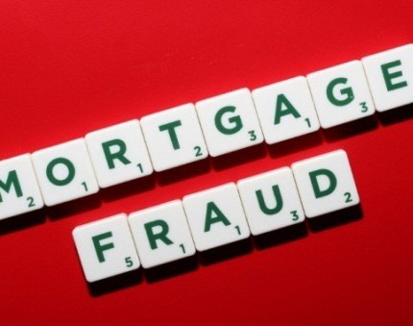
There is no statutory definition of mortgage fraud within the Fraud Act 2006
An otherwise convenient definition of mortgage fraud was proposed by the Law Commission as:
“the obtaining of mortgage advances on properties by making fraudulent statements” (1996, para.1.1)

Slide 5
The FBI defines mortgage fraud as either:
Fraud-for-property: “represented by illegal actions taken by a borrower motivated to acquire or maintain ownership of a house”
Fraud-for-profit: “misuse[s] the mortgage lending process to steal cash and equity from lenders or homeowners”

Slide 6
The Professional Enabler’s Progression
Willful Ignorance
Active Facilitation

Slide 7
“…yours was about as bad a breach of trust as it possibly could have got – that is compounded by the fact that Entwistle could have achieved almost nothing of what he did without your active complicity”
- HHJ Beddoes, Southwark Crown Court, 22nd July, 2014

Slide 8
Why Risk Everything?

Slide 9
Regulatory
Civil
Bankruptcy
Criminal
Bewildering Multiple Jeopardy
Collateral Damage
Shaming
Post-conviction
Impact on family

Slide 10
Why Did I Offend?

Slide 11
OPPORTUNITY
Experience as a property solicitor, wide panel appointments
Partner status at branch office
PRESSURE
NEUTRALISATION TECHNIQUES
WORKPLACE SOCIALISATION
Boom strain
Bust strain
Rationalisation and denial techniques
The Jekyll and Hyde practice
Education continuum
Hunter and gatherer
Ethical slippage

Slide 12
CLIENT STRAIN:
STRAIN TRANSFERENCE:
Strain transferred to professional- enablers to attain client's goal
SOLICITOR- ENABLER STRAIN:
Facilitates fraud to relieve client pressure, includes an autonomous strain (including lifestyle, financial, client satisfaction, career progression)
Client has fraudulent intent to expand their property portfolio/ launder monies (supported by rising property market and lending bubble)
BOOM STRAIN

Slide 13
CLIENT STRAIN:
STRAIN TRANSFERENCE:
Applied to professional- enablers already linked into the fraud to recycle fraudulent debt to avoid detection
SOLICITOR- ENABLER STRAIN:
Facilitates fraud to relieve client's strain and to avoid detection, leading to entrenchment.
Autonomous
financial strain caused by a decline in business and the need to sustain
the firm
Client pressurised to meet loan repayments (increased audit/security checks due to default). Property values decline.
Reduced mortgage funding availability/Difficult to sell
BUST STRAIN

Slide 14
Neutralisation Techniques
DENIAL OF RESPONSIBILITY | “I don’t know what is owed on what site”
DENIAL OF INJURY | “It will be repaid when the new apartments are sold, We’re just taking the profit now”
DENIAL OF THE VICTIM | “The bank manager is smashing his lending targets”
CONDEMNATION OF THE CONDEMNERS | “The banks were selling dodgy CDOs and rigging LIBOR. By the way, where are the regulators?”
APPEAL TO HIGHER LOYALTIES | “The payroll was owed. People’s financial wellbeing depends on this working itself out”

Slide 15
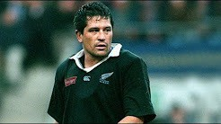
The Jekyll and Hyde Effect
A professional alter-ego supports neutralisation techniques

Slide 16
Researching Mortgage Fraud

Slide 17
Methodology | Interviewing offenders, law enforcement, regulators, fraud prevention agencies and victim lenders
 | Data collection from regulatory enforcement files (including the FCA, SRA, ICAEW, RICS)
 | Case study analysis (Operations Oyster, Cassandra and Azure)
Research Objectives | To crime script mortgage fraud and identify the crime commissioning processes that frame its organisation
 | To assess crime reduction strategies in the ‘arms race’ against fraudsters
The organisation of mortgage fraud and its relationship to the governance, control and regulation of financial services

Slide 18
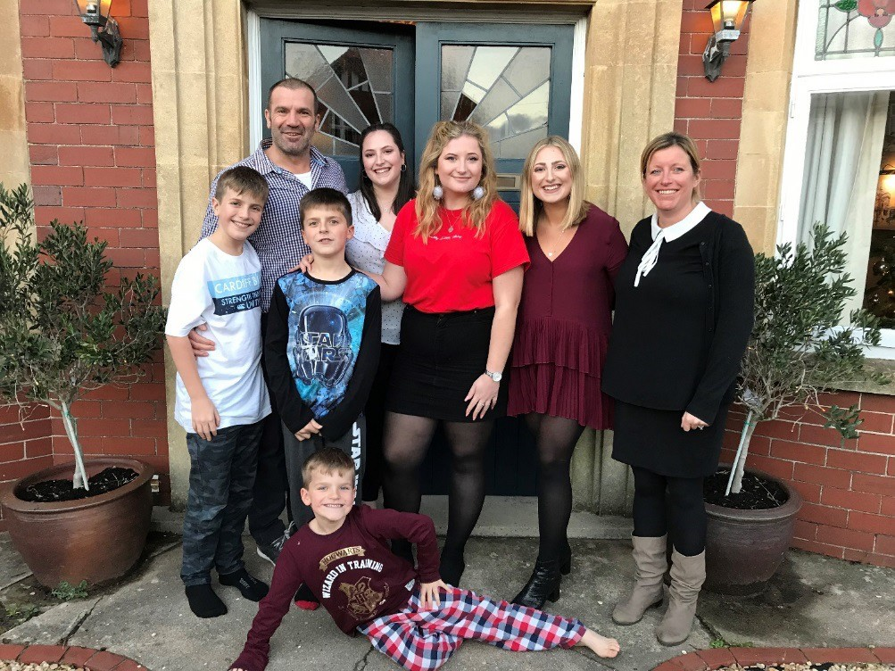
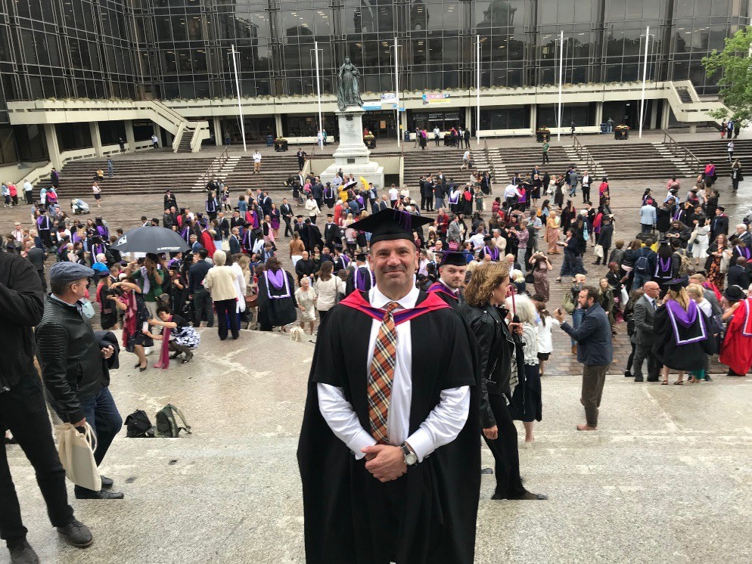
Please keep in touch if my experiences are of use to you or if you have any experience of mortgage
fraud you are willing to share.
GilbertJM@cardiff.ac.uk
Jonathan Gilbert | LinkedIn

