Slide 1
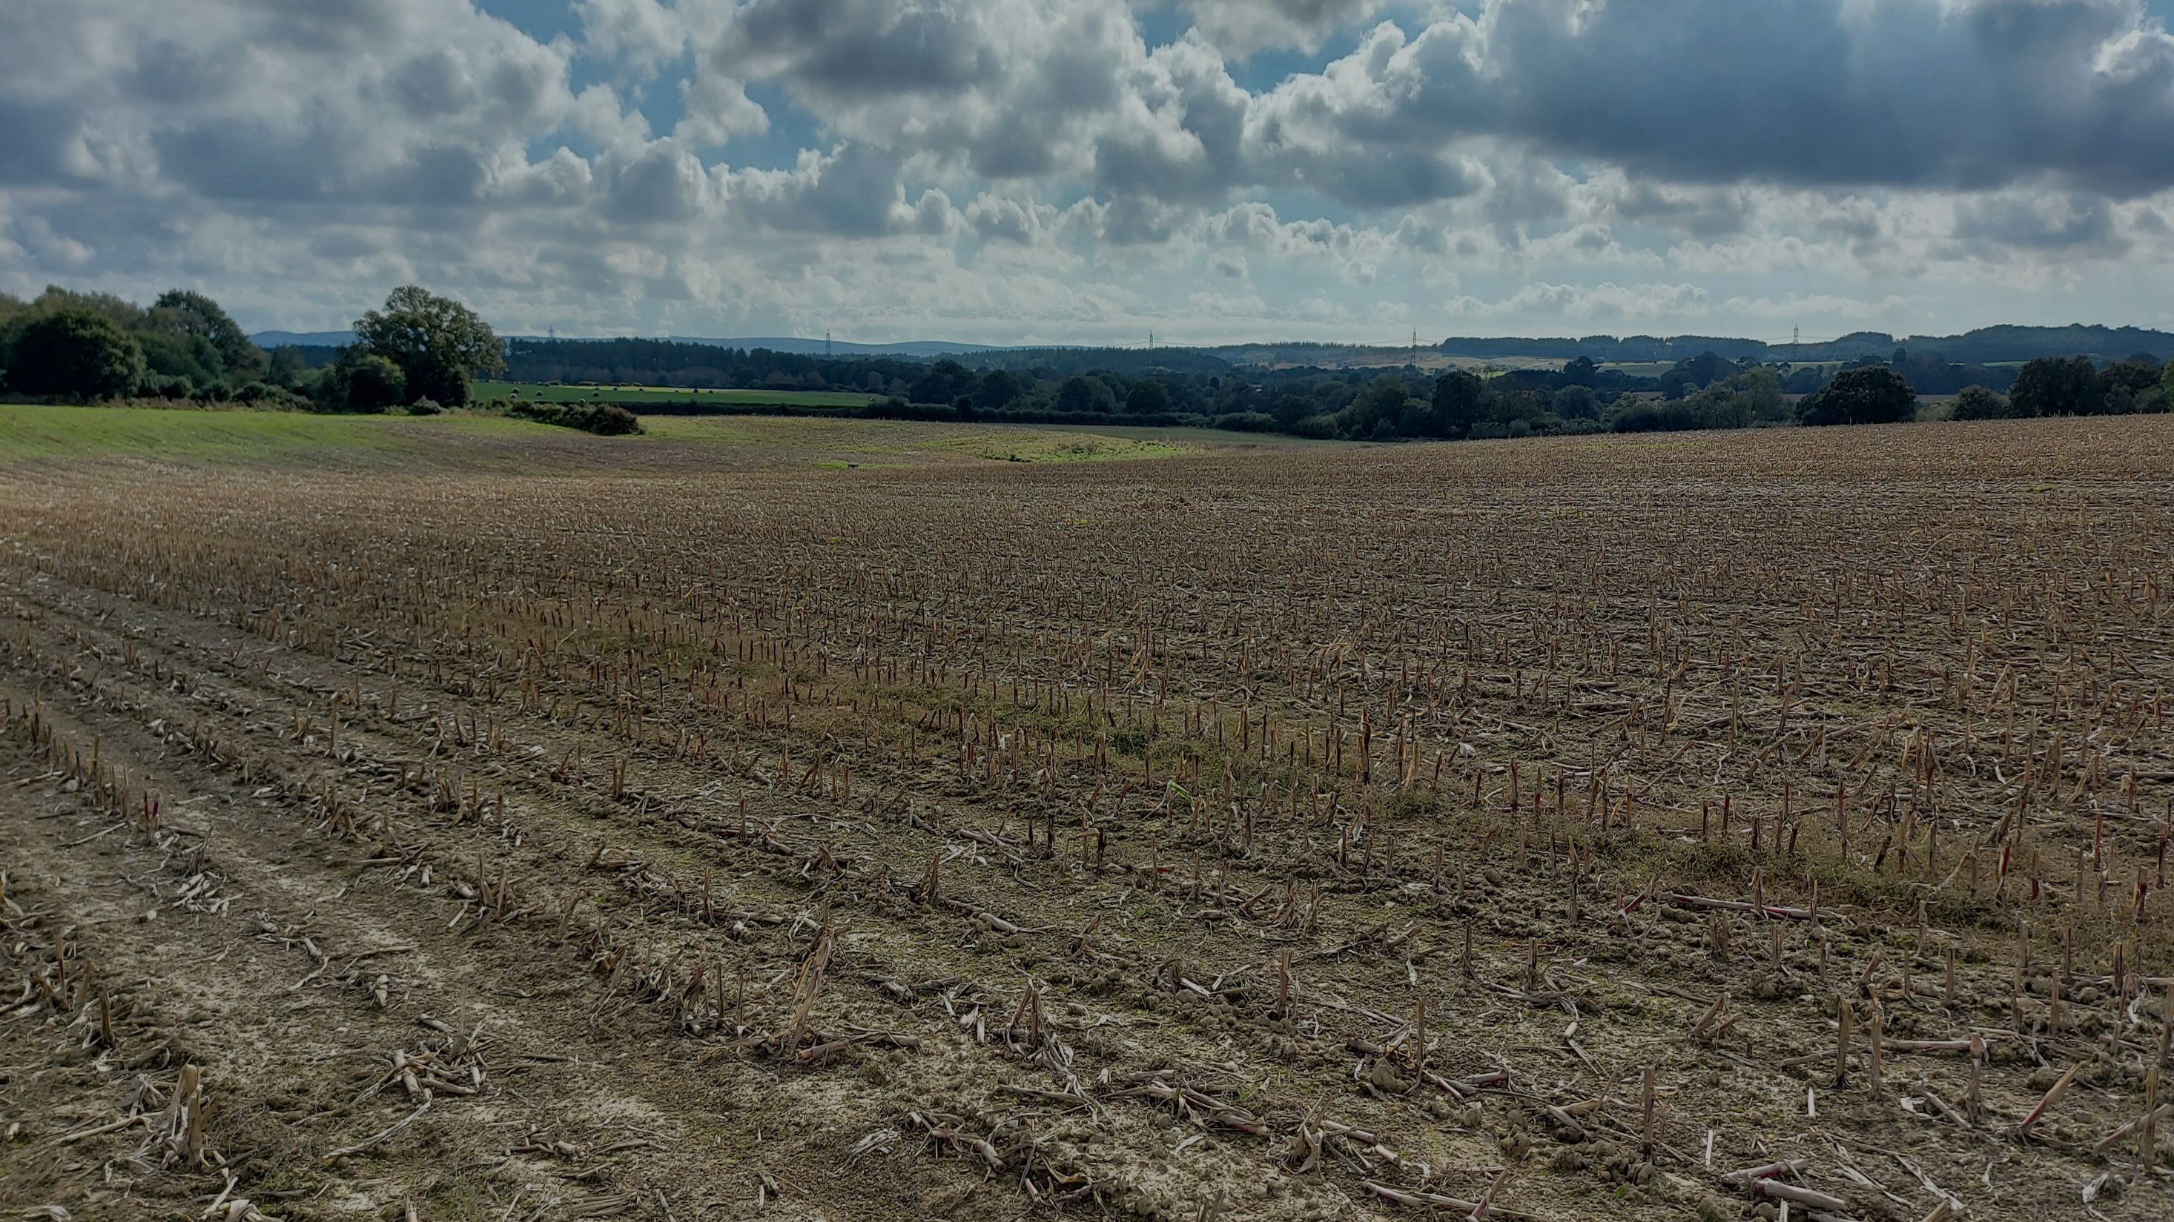
Sensing Solutions in Soil Biodiversity and Carbon Monitoring; From Acoustics to Biosensing
Adrian Crew, Sam Bonnett & Luke Reed (UWE), Prof Matt Bell (Hartpury University)
PhD students: Marcus Palmer & Efe Okekporo
MRes students: Luke Ramsay & Robbie Sidhu

Slide 2
Our Background:
Involvement in electrochemical biosensing research for >30years (not me!)
One of a wide range of complimentary biosensing and analytical technologies
Applications across biomedicine, food & agriculture, environment and manufacturing
Industry-focussed (i.e. application design/problem-solving)
Electrochemical biosensing group:
Carbon-based electrode systems (low-cost)
Manufactured using screen-printing technology (low cost)
Aqueous matrices, gas analysis and direct sample analysis (inc. reagentless)
Soil carbon and biodiversity group:
Analysis, monitoring, modelling, dynamics/fluxes, remote sensing and novel technologies.

Slide 3
A library of analyses
Metals
Amino acids
Fatty acids
Organic acids
Hormones
DNA products
Volatile organics
Thiol compounds
Aromatic hydrocarbons
Hydroperoxides
Enzymes and other proteins
Immunoglobulins
Why haven’t these been exploited so far? Communication (or lack of it)!
The challenge of using different electrochemical techniques in the same sample

Slide 4
Carbon and Biodiversity
Increasingly clear that carbon dynamics and biodiversity are intrinsically linked
Ever increasing estimations of the extent and importance of soil biodiversity
Essential role in soil ‘health’, farm productive potential and pest/pathogen management
How do we manage the two aspects of soil that we cannot measure accurately?
We have methods:
For carbon (solid): Loss-on-ignition, TOC, NIR etc
For carbon (gas): Surface sensing, closed chamber systems, remote sensing(?)
For biodiversity: Earthworm counts, invertebrate surveys, DNA/eDNA, teabags, ecoplates, etc.

Slide 5
The Problem of Soil
Traditional methods require disturbance of the soil and its biology combined with mostly destructive techniques
How representative are the results??
Survey methods use point sampling that ignores spatial variability
Current ‘in situ’ devices often effect the locality of the measurement
Soil is dynamic spatially and temporally, so timing and location of monitoring is critical
Soil itself is underestimated and over-simplified

Slide 6
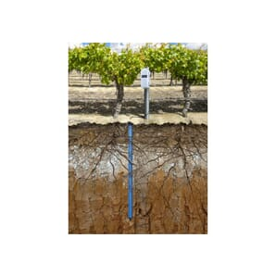
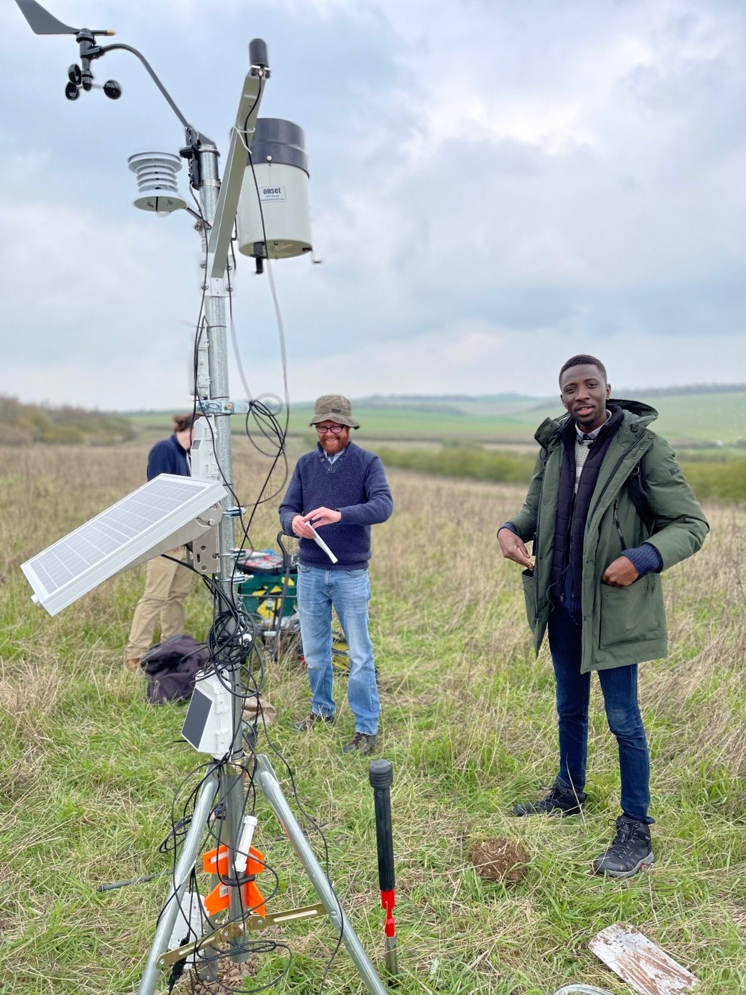
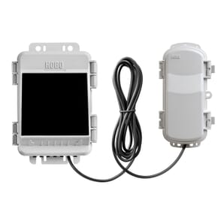
HOBO RX2106 MicroRX Cellular Web-enabled Outdoor Monitoring Station (Wireless Sensors)
HOBOnet T11 Soil Moisture & Temperature Sensor x 4
Spatial variation: a conventional approach
Determine appropriate sampling approach
Detailed spatial variation at plot and landscape scales, spatial variograms for autocorrelation, sensors for temperature, moisture and PAR, diurnal variation over 24 hours, control plots
GHG flux twice per year (Winter and Summer) – 2 weeks in situ gas analysis with chambers

Slide 7
Gas chamber design
Vegetation to tall for small chambers sampling

Slide 8
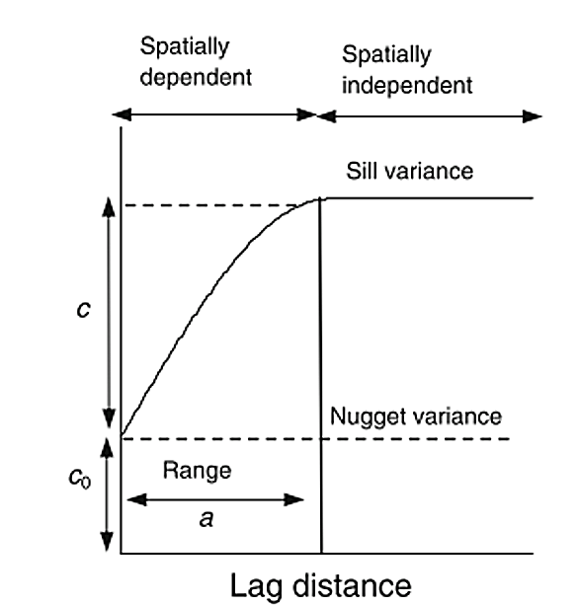
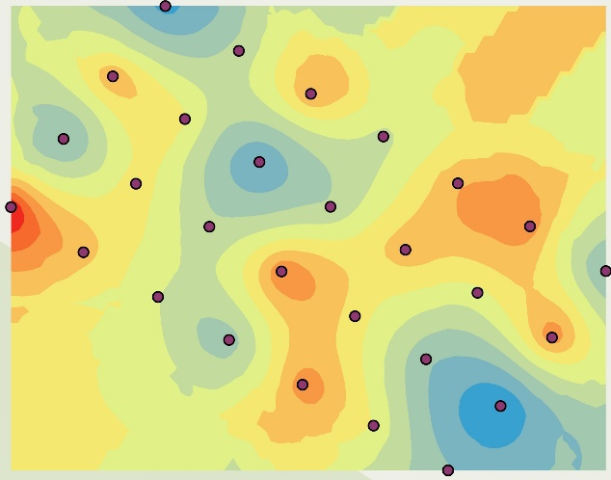
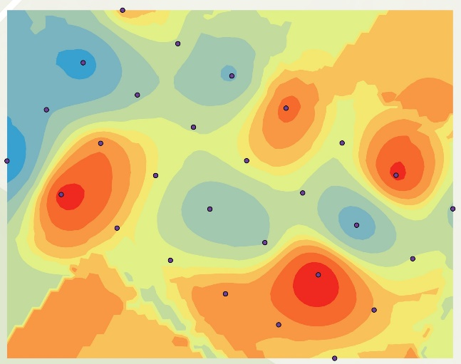
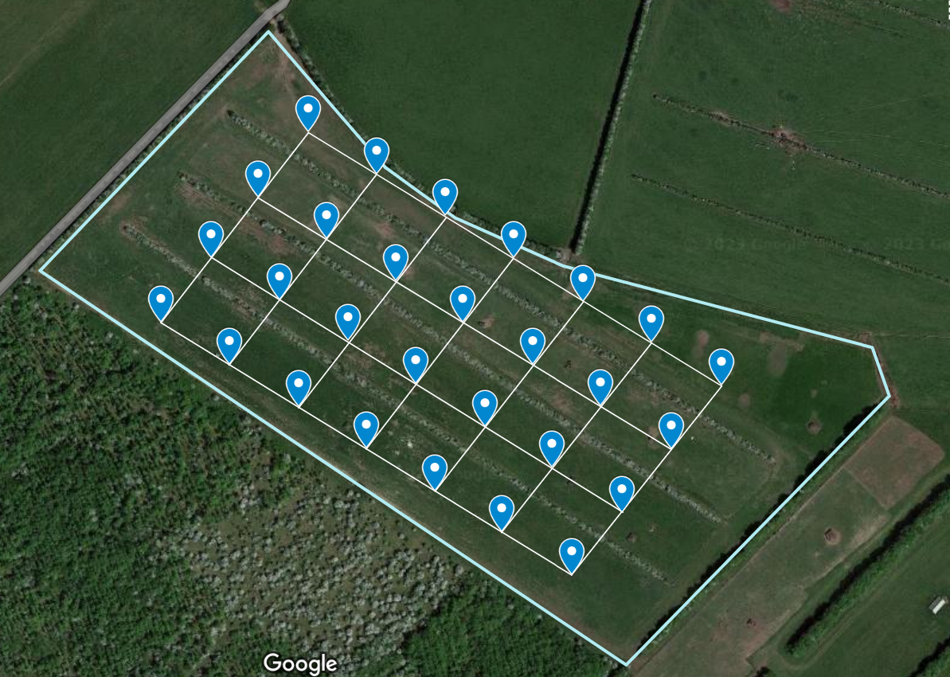
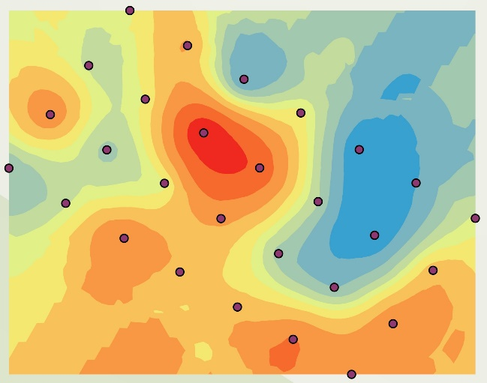
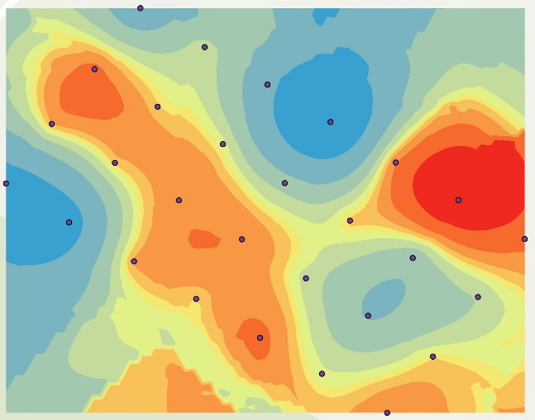
Results – Spatial mapping of CO₂ and CH₄ flux
June 2023 August 2023
CO₂
Semi-variogram analysis
Range = 100m
Red = source
All = sinks
CH₄
N
WS
Red = source
Red = source

Slide 9
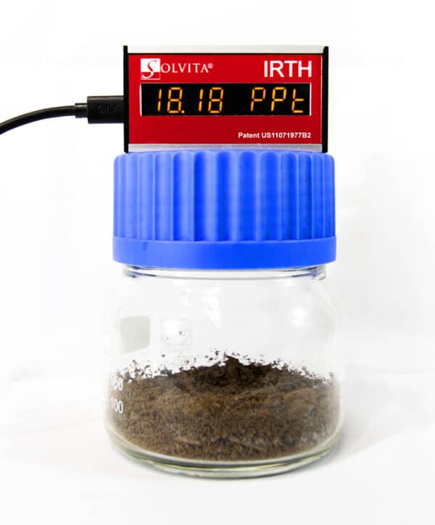
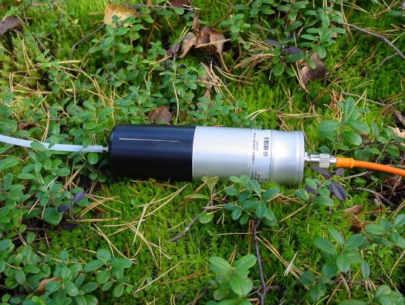
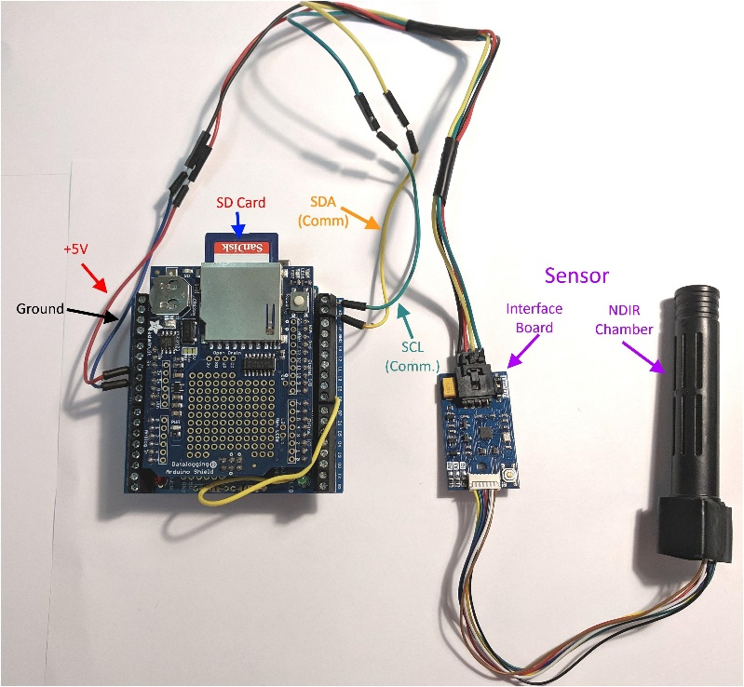
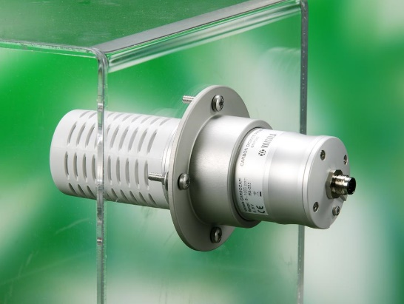
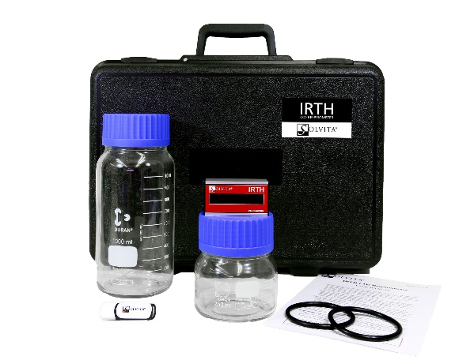
CO₂ Sensors: One Option? Cost!
Vaisala CO₂ probe GMP343
3 approaches – open or closed chambers
Or soil gradient method
£2000
£120
$2400

Slide 10
A possible solution
We have a range of ‘cheap’ sensors for bio-indicators and carbon compounds and we know how to integrate these sensors for simultaneous multi-analysis
For CO₂/CH₄/VOC we are testing four cutting-edge gas sensors with an Arduino ecosystem to provide a compact and energy-efficient device that redefines intelligent sensing solutions. The sensors on our Arduino board houses:
Motion sensor system with integrated AI
Magnetometer
Pressure sensor
4-in-1 gas sensor with AI and integrated high-linearity, as well as high-accuracy pressure, humidity and temperature sensors.
The above solution is about the size of a matchbox, robust, WiFi-enabled, and very importantly an extremely cost-effective method for long-term continuous analysis in situ.

Slide 11
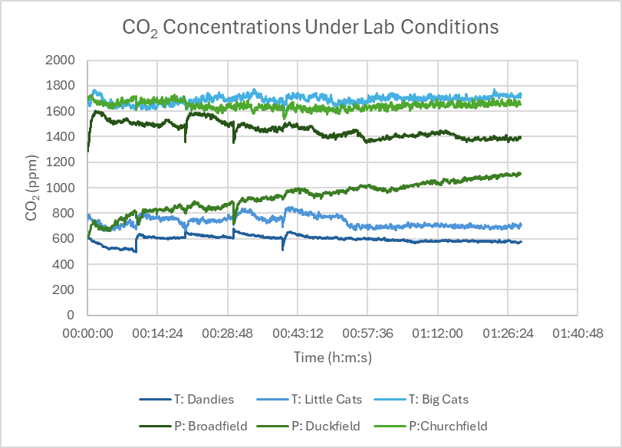
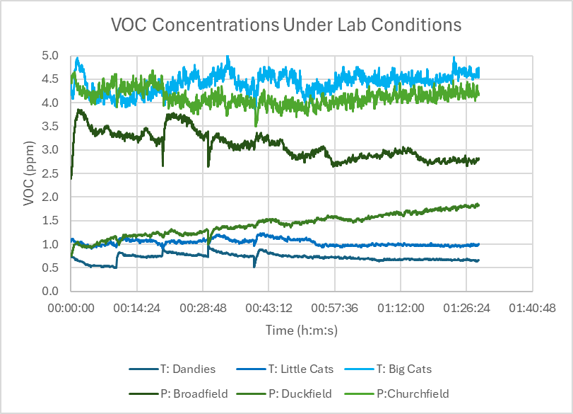
How the new sensors perform so far
Effective monitoring of CO₂ and VOCs
To be trained for CH₄ and target individual volatile compounds
Field testing over extended periods.

Slide 12
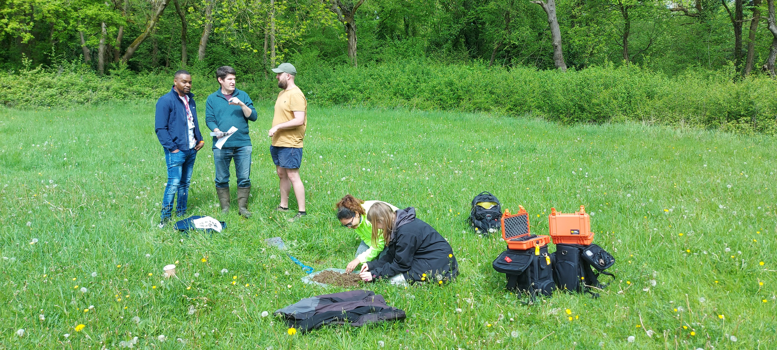
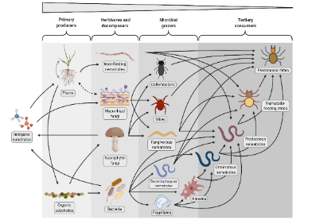
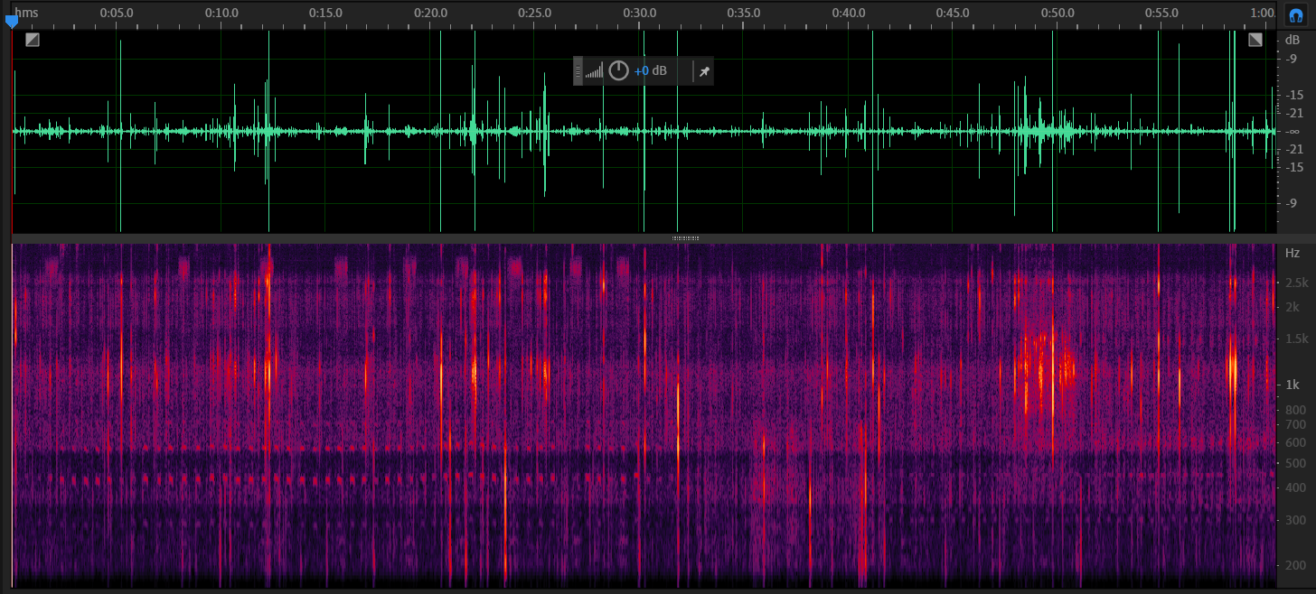
And the ecoacoustics
Monitoring biophony, geophony and anthrophony for soil health
To monitor biodiversity in soil using acoustics, we need to understand the interactions between geophonies, anthrophonies and biophonies across distinct habitats.
Soil foodweb ‘orchestra’
Typical spectrogram of a soil recording
Geophonies
Anthrophonies
Biophonies

Slide 13
Our goal:
Multi-sensor integration into a single robust, adaptable unit:
C-dynamics and flux via gas sensing + electrochemical (bio)sensing
Biodiversity monitoring via biomarker sensing + ecoacoustics/biomotion and other technologies
We have a target to do all this to allow long-term in situ analysis close to the cost of current standard commercial sampling at a field and farm scale.
Our goal is to provide farm-relevant information for effective management.

