Slide 1
Human Rights in Early Education: Teachers’ Perceptions on Embedding Participation into their Classrooms
European Conference on Educational Research
August 2024
Presenter: Dr Jacky Tyrie (Swansea University)
Team: Dr Sarah Chicken, Dr Patrizio De Rossi, Jacqui Lewis, Louisa Roberts
Notes:
Abstract: This paper reports on phase-two of an ESRC-funded project, aiming to examine teachers understanding of participation and how it relates to their pedagogy in Wales. Previous research of the team argues that understandings of participatory pedagogies are varied (Chicken and Tyrie, 2023) reflecting 'boudaried' approaches to children's enactment of rights (Clement et al, in press), The study adopted a rights-based approach (Bessell, 2017) and an axiological position with young children constructed as capable, agentic meaning-makers (Malaguzzi, 1998). Rooted in socio-constructionist interpretivism, participatory action research was utilised (Townsend, 2013) for data-generation. During collaborative dialogical workshops, Reggio Emilian pedagogy was explored as an example of a participatory pedagogy and later participants experimented with ‘projects’ investigating what ‘rights’ meant to children. Semi-structured interviews were carried out with 14 teachers before and after engagement. The research team were steered by a duty of care to participants with ‘care to do no harm’ as a guiding principle, EECERA (2015) ethical code was adhered to, and appropriate ongoing consent gained. Initial findings suggest that teacher understandings of participative rights and associated pedagogy are underpin by a complex interrelationship between implicit constructions of (a) young children and (b) teachers (and their role) and further, with wider philosophical debates about the purpose of education.
Consequently, opportunities for teachers to explicitly unpick constructions of children and teachers may be useful in actualising a children’s right agenda, allowing an avenue through which discussions and agitations can be explored to support the increased enactment of participative rights within practice.

Slide 2
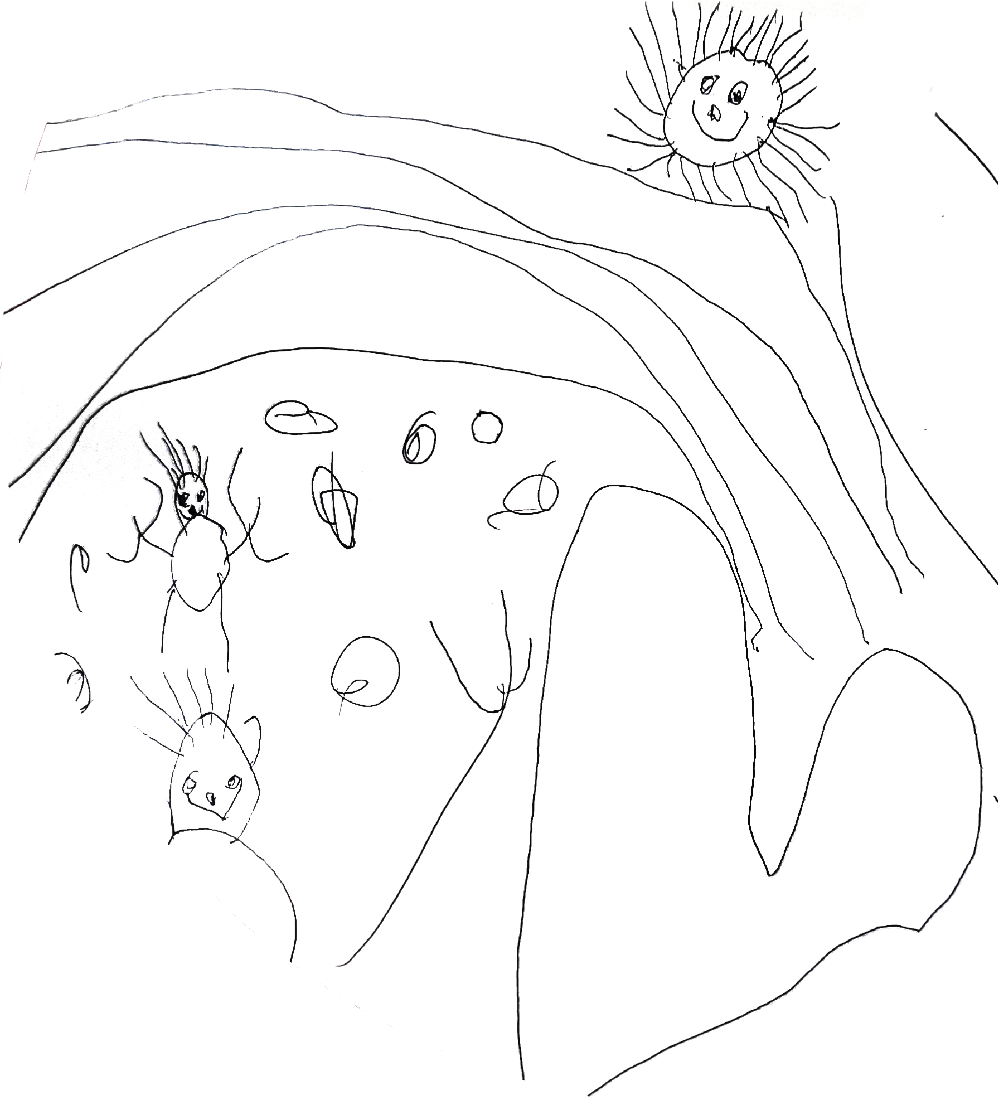
Today
Findings
How primary school teachers in Wales conceptualise and support children’s participative rights
The perceived barriers and enablers to supporting the enactment of participative rights
Background and Overview
Background Literature
Methodology

Slide 3
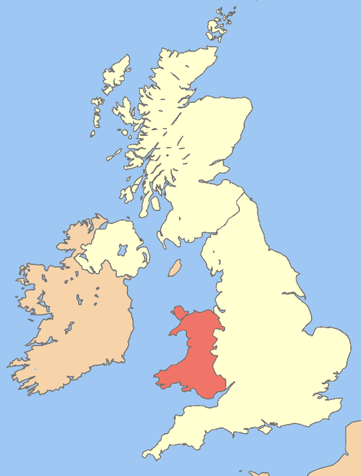
About Wales in the UK
Population: 3.1 million people. 4.8% of the UK population (Welsh Government, 2021)
Devolved Government with responsibility for education
Strong Welsh Government vision for children rights since devolution – supported by legislation (Williams, 2013)
Curriculum for Wales (3-16 year olds)

Slide 4
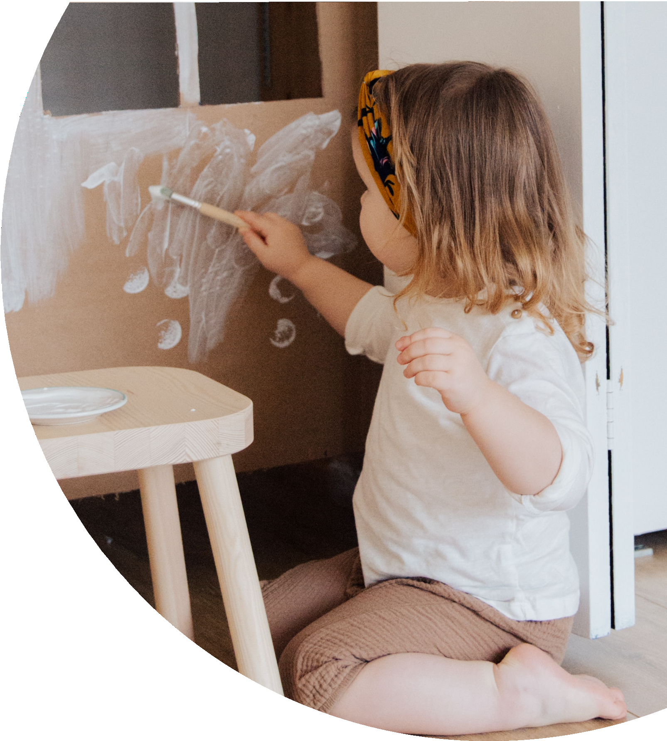
About this research
Economic and Social Research Council (ESRC) funded - budget £700,000+
3-year project - Dec 22 to Nov 25
A collaboration across four UK universities
A focus on young children’s participative rights in lower primary settings (aged 5-7)
The research aims to uncover ways to integrate participative rights into everyday teaching and learning activities, and to create classroom environments where children's voices are not only valued but actively integrated into the teaching and learning processes.

Slide 5
Research questions
How does the distinct Welsh policy context position teachers in relation to young children’s participative rights in primary schools in Wales?
To what extent do providers of professional learning (including initial teacher education) support Welsh Government rhetoric for pedagogic practice that embeds young children's participative rights?
How do primary teachers in Wales conceptualise and support young children’s participative rights and what are perceived enablers and barriers to practice?
How are young children's participative rights in Welsh primary schools understood and experienced by young children themselves?
How can findings from this work be drawn together to understand the process by which pedagogies can be transformed in order to embed participative rights?

Slide 6
Background - UNCRC
The project is framed within the context of the UNCRC and the Welsh Government commitment to children’s rights.
Concerned with adult’s positioning, behaviours and attitudes relative to the child.
Including but not limited to Article 12, the ‘right to participate’.
Participative rights:
Article 12 as indivisible from and interconnected with all children’s rights
Participation:
the varying ways in which children can be involved in decision-making
Participatory pedagogies:
the ways that educators enable participation and enact children’s participative rights
Notes:
The UNCRC was first adopted by the United Nations in 1989 and subsequently ratified by the UK government in 1991. It is described as a complete framework of standards, principles and implementation guidance in relation to the human rights of children (Children in Wales, 2014), encompassing ideas from the protectionist days of Eglantine Jebb, founder of Save the Children, and discourse arising from the horrors of the world wars (Boylan and Dalrymple, 2009). The international agreement sets out fifty-four articles which influence all aspects of a child’s life, including their economic, social, cultural, civil and political rights and are broad philosophical principles which can be interpreted and applied according to context (Jones and Walker, 2011; Kanyal, 2014). As such, it has gained a universal prominence and globally it is considered the most ratified international human rights treaty in history (UNICEF, 2019). Hart (1997) described the treaty as ‘an instrument of persuasion for those persons wishing to promote the ideas of children as independent, thinking subjects, capable and deserving of a greater degree of participation’ (Hart, 1997, p. 37). This latter definition places emphasis on one of the more unique aspects of the treaty, which is its comprehensive focus on the ‘three Ps’ - Provision Rights; Protection Rights; Participation Rights. Unlike previous legislation, the UNCRC includes a strong focus on participation (Alderson, 2008). Advocates claim therefore that inherent within such rights is the view of children as the agents of their own lives, capable of contributing and participating in decision-making (Jones and Walker, 2011; Thomas, 2021).

Slide 7
Research rationale
Limited research in this area (Lewis et al., 2017; Correia et al., 2019).
Research indicates a gap between the policy ambition and enactment (Murphy et al, 2024).
Understandings of participatory pedagogies are varied (Chicken and Tyrie, 2023).
A tension between desires to enact participation and required outcomes (Maynard and Chicken, 2010).
Participation could be developed further by many teachers (Robinson et al., 2016).
This paper argues that if we understand what participation means to teachers, and what barriers they face in embedding participation – action can be suggested for improvement.

Slide 8
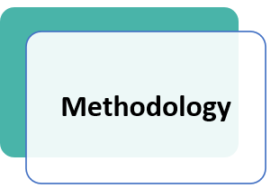
Methodology / methods
Participatory action research (Townsend, 2013).
14 teachers of children between the ages of 3 and 7.
10 month data collection - between Sept 2023 and July 2024
Term 1
Semi-structured Pre-interviews with teachers
Dialogic workshops with an artist consultant using Reggio Emilian pedagogy as a provocation
Term 2
Class based teacher led ‘projects’ with children
Online support available
Term 3
Sharing events between participants
Post interviews with teachers
Notes:
Methods (400 words)
The research runs from December 2022 until December 2025, with the component for this paper being undertaken between September 2023 and July 2024. For the research presented here, the teacher participants (n=14) were based in two Welsh speaking and seven English-speaking schools across Wales. They were all female (this reflects a predominantly female workforce) and working with children aged three to seven years. Class sizes range from 9 to 30 students, and school sizes range from 45 to 633 students. The teacher participated in one-to-one semi-structured interview pre and post and ‘intervention’. There are three stages to this data gathering, 1) pre-interviews, 2) Workshops and project work (intervention) 3) post-interviews.
The pre-interview (stage 1) focused on teachers understanding and their experience of young children’s participative rights in their classroom and their school, and the perceived barriers and enablers to enabling young children to enact their participative rights in school. The interviews were video recorded and transcribed.
Following these interviews the teachers took part in five face-to-face workshops (stage 2), which drew on Reggio Emilia ideas and were supported by an artist consultant. These workshops, based on a participatory approach, were an opportunity for the teachers involved to consider education ‘about’, ‘through’, and ‘for’ human rights (United Nations, 2011). Reggio Emilia's principles and pedagogy served as an example and a provocation to their way of teaching, and to increase their knowledge about the participative rights of children in education. The teachers then developed projects in their class (stage 2) to enable children to explore their understandings and experiences of participative rights in school.
The second post intervention semi-structured interviews (stage 3) with teachers explores in detail their reflections on their involvement in the research, their projects with the children, and any changes to their pedagogic practice.
NVivo data analysis software was used implement Reflective Thematic Analysis (Braun & Clarke, 2019, 2020, 2022) with the data. The identification of initial codes generated from data, was the product of a process of collaborative data coding. Each interview was coded by at least two members of the research team, the interviewer and another member of the research team, first separately and then discussed together. Subsequently, the research team met several times to generate initial themes and then develop, review, and define themes. These themes were the effect of the continuous and systematic process of reflective dialogue and collaborative discussion.

Slide 9
Analysis of pre-interviews with teachers
Reflexive Thematic Analysis (Braun and Clarke, 2022)
Epistemology & Ontology
Interpretivist, social constructionist, semantic and latent meaning-making
Axiology
Strong construction of children and professionals.
Methodology
Inductive, collaborative, reflexive, iterative

Slide 10
Findings
Findings - Explore how primary school teachers in Wales:
Conceptualise and support children’s participative rights
The perceived barriers and enablers to supporting the enactment of participative rights
Notes:
Data analysis is currently on-going and detailed findings will be presented at the conference, however initial themes from practitioners’ pre-interviews include constructions of children, teachers and schools; differing pedagogical approaches; understandings of children’s voice and participation; and differing school and local contexts. A range of barriers and enablers to young children’s participative rights were also surfaced during the data collection and analysis. How teachers’ perceptions evolved during the research process, and the implications of these perceptions for participatory pedagogies with young children will be presented.

Slide 11
How do primary school teachers in Wales conceptualise and support children’s participative rights?
Notes:
Data analysis is currently on-going and detailed findings will be presented at the conference, however initial themes from practitioners’ pre-interviews include constructions of children, teachers and schools; differing pedagogical approaches; understandings of children’s voice and participation; and differing school and local contexts. A range of barriers and enablers to young children’s participative rights were also surfaced during the data collection and analysis. How teachers’ perceptions evolved during the research process, and the implications of these perceptions for participatory pedagogies with young children will be presented.

Slide 12
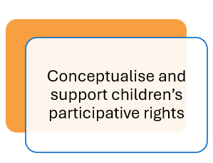
Findings – conceptualising and supporting Participation
How teachers understand and support participation 1. Personal value base - listening to children as humans
2. Following children’s interests
2. Knowing your children
4. Classroom environment
5. ‘Boundaried’ participation
Democratic processes
School councils, Representatives and Voting
Notes:
Sarah (2 – total 9)
Question asked - “What does children’s participation mean to you as a teacher?”
Language and terminology
Terminology used the same, an example of this...
Illusttatve of this are the following commnets:
The aim should be to fully emerged [sic] the child in the provision. They should be given a voice, to have some ownership of the task. They should be challenged and supported to reach their full potential. (P12, age 4-5)
Pupil voice is essential and leads to improved learning experiences as children have been involved in their own learning and taken ownership of what they would like to learn. (P18, age 5-7)
The terminology was assocaited with the children’s involvement in curriculum in some way e.g. choosing activites, expressing preferences, having some ownership, planning of learning
Participation linked to children’s ownership over and involvement in planning of their learning through the recognition and support for ‘pupil voice'
Understanding - Participation linked to learning dispositions
For younger children dispostions and learning behaviours
Children were identified to be participating if they could be seen to be joining in and this participation was often connected to learning behaviours and dispositions.
Coming to school, listening, asking questions, giving opinions, trying their best even if it doesn't interest them fully. (P3, age 3-4)
Being curious, to observe, explore, experiment. To be present in the moment and to be able to express and share thought feelings and emotions. (P5, age 3-4)
Understanding - The spatial aspect of the learning environment
Outdoors - engaged in task, being creative, working co-operatively with others, problem solving and resilience when faced with problems (P.22, aged 6-7)
Pupil Voice on what activities are accessible outside
During the Autumn Term they requested a pirate ship with a treasure chest and maps….. during Summer Term we are looking to revamp our mud kitchen. (P11 aged 4-5)

Slide 13
1. Listening to children as humans (with rights)
“in a broad sense, it means children are able to feel that they can be listened to, heard, respected. They feel they can come to you, be taken seriously.”
(Shelly, children aged 5-6)
Personal value base
All encompassing ethos of respect for the child as a human
“respecting the children's views and their thoughts and their feelings, and recognising that they are little humans too.”
(Rebecca, children aged 3-4)
“Children need to be heard. They need to be listened to. They need to be treated with kindness and I think that should just be a norm”
(Alison, children age 5-7)
Notes:
Our research suggests that many teachers (but not all) of 5-7 year olds felt that children’s participative rights were about listening to children though seeing and treating them as human beings and respecting them as people.

Slide 14
2. Following children’s interests
All 14 teachers
Central to ‘child voice’, participation, and children’s rights
What they learn, where they learn, but not how they learn
“in the early years … isn't just about them speaking and communicating. It's about us observing as well.”
(Eleri, children aged 4-5)
“I give them a spark … then they go off and do what they want...”
(Barbara, Year 1 & 2, Age 5-7)
”It's all I do, follow what the children's interests are ... it's just from little chats on the carpet in the morning, something will crop up.”
(Barbara, Year 1 & 2, Age 5-7)
Notes:
All the participant teachers also felt that participation for them about listing to children’s interests and following them.

Slide 15
3. Knowing your children
“to understand their rights and for them to know their rights, a lot of that just comes with dialogue, especially with the little ones.”
(Florence, Reception, Age 4-5)
More about knowing than building relationships
Central to ‘child voice’, participation, and children’s rights
“visuals is huge for us … They might not be able to tell you, why they're upset or what the other child is upset for, but be able to show you. So it's about kind of knowing your children”
(Eleri, Reception, Age 4-5
“it's how you know your children ... You know whether you're experience enough, or you know the families well enough”
(Alison, Year 1 & 2, Age 5-7)
)

Slide 16
4. Classroom environment
Classroom environment was felt to be central to teaching and learning, but also as enabler of participation
Teachers used observation and communication to create engaging and flexible environments
Planning resources
Time allowed in different spaces through the day
“the classroom itself is a way that they can show their own voice, their expression of what they want to do, when they have their choosing time in the, in the classroom.”
(Karan, Reception, Age 4-5)
“I plan for the skills and I plan for progression and my learning environment is enabling and progressive. The content, so their voice, the content of what is learned is their choice. It's all child participation.”
(Alison, Year 1 & 2, Age 5-7)
Notes:
Classroom environment was felt to be central to teaching and learning as well as enabler of participation
Using observation and communication to create engaging and flexible environments
Planning resources
Time allowed in different spaces through the day

Slide 17
5. Understanding Participation: ‘Boundaried’ participation
“... letting them think they've got that control. Whereas obviously as the teacher... that's where we were going to go anyway. But you've just let them think that they've come up with a suggestion.”
(Lizzie, Year 1 & 2, Age 5-7)
Implicit and explicit
Tokenism or modelling participation?
Level of teacher control
Time, space and curriculum
“whatever interest they have, they get to do that in their choosing time. And that's a large amount of our day.”
(Karan, Reception, Age 4-5)
“they think they’ve got a choice but obviously we’ve narrowed it down… we would limit their choice.”
(Freya, Year 2, Age 6-7)
Notes:
We found that despite all the positives of the last 4 points for some of our participants participation was bound’ried by either time to space and in some cases tokenistic. This did change over the course of the research and in the post inetrviews there was much less evidence of the boudried nature of participation in the teachers reporting.
Implicit – certainly not at the start of the year, doing a mini topic, have a go, do a little job
Explicit – modelling?
Teacher control
Time eg over to you time – even when it’s a large part of the day
space – outdoor v indoor
Subjects v eg phonics and numeracy
value of formal v informal and adult-led v child-led tasks

Slide 18
What are the perceived barriers and enablers to supporting the enactment of participative rights?

Slide 19
Barriers and Enablers: for the enactment of participation Rights
1. The overarching cultural environment
Children
Parents and children.
Teachers
Teaching and learning and the purpose or education
Leadership & Inspection mechanisms.
3. Constructing roles
within the classroom environment.
within the wider school community.
2. External Expectations
Notes:
The first thoughts were to present the enablers and barriers as separate entities in line with the RQ, however on reflection, this did not recognise the complexity of what we were seeing
In the initial interviews, the same themes were noted as both enablers and barriers across the data set and sometimes by the same participants at different times ( give an example here)
Very few participants (six out of the 19 responses to this question) described enablers for participation in their schools or classrooms. Again, we conjecture this might illustrate difficulties teachers may have in articulating their views around enactment of participation.
The main enabler discussed was ‘allowing’ or ‘valuing’ pupil voice, the comment below providing an example of this:
Allow pupils to have a voice and to feel their opinions have been valued and listened to will encourage them to have the confidence to participate. (P18, age 5-7)
Following on from the discussion above about understandings and enactment of participation, the learning environment was seen as being a significant enabler as described below:
Learning environment which is resourced with open ended resources. Enhancing to follow individual needs and interests. Adapting spaces when needed. (P3, age 3-4)
Alongside the learning environment, participants also raised the need for differentiation as an enabler and the necessity of meeting individual needs. For example, one respondent emphasised ‘differentiation so that all pupils have opportunities to participate at their own level of input’ (P24, age 6-7).
Other enablers were described in terms of solutions to the barriers, for example, the use of technology to overcome the barriers caused by Covid-19 pandemic and the use of other pedagogical tools to improve language skills. The following two response provide examples of this:
I use a lot of P4C to help the children develop speaking and listening skills. This will help them develop their voice and ability to share what they want. (P5, age 3-5)
You can overcome this barrier (Covid 19) with technology. (P9, age 4-5)
Participants seemed much more willing and able to describe barriers for participation in their schools and classrooms. Key themes emerging from this part of the data include the need for staff to be trained to support participatory approaches, class size coupled with the need for support staff, children with additional learning needs, children’s maturity, and children’s willingness or confidence. The Covid-19 pandemic was also reported to be a barrier to participation.
Staff training was reported to be a significant barrier, not just for teachers, but also in terms of support staff. Attitudes and dispositions of staff members was seen as problematic by some participants, one of whom commented that, ‘motivation to change is needed in the part of staff to enable meaningful participation’ (P4, age 3-5).
However, a barrier to participation was also reported to be class sizes. One teacher reported that they could not offer one-to-one time for each child and that consequently some children were not included. Commenting on barriers to participation, this participant wrote:
Class sizes. I can't reach all the children's interests/needs. Support - mainstream are asked to be fully inclusive but I feel more adult support is needed to achieve this. Sometimes I feel we just make it through a day and some children that are happy to keep themselves occupied don't get any 1:1 attention. (P3, age 3-4)
This suggests that participation is understood to be tied to engagement with the teacher – children who are ‘happy to keep themselves occupied’ seem to be deemed to be at some disadvantage or lacking in participation.
The remaining barriers expressed by practitioners concerned children with additional learning needs (ALN), the maturity of the children, and children’s willingness or confidence to participate. This suggests that understanding of participation was limited by judgements about competence and capability of individual children to take part in prescribed mechanisms. Children with ALN were identified as needing additional support in order to contribute to these mechanisms, with comments below providing a flavour of this view:
Children that have additional needs that don't have the adult support they need to help them participate (P24 age 6/7)
ALN - lack of support/ expertise from outside agencies to support adults and children. Not enough staff in certain year groups to provide interventions. (P18 age 6/7)
It is interesting to note that confidence and willingness to participate is perceived as a barrier created by children themselves:
Barriers - lack of confidence, not yet resilient or willing to persevere. (P18, age 6/7)
Confidence and willingness on behalf of the children. (P28, age 5/6)
Barriers- pupils lack of confidence could prevent them from participating and voicing their opinions (P20, age 6/7)
The issues raised here indicate that the enactment of participation is established within specific mechanisms and, should these not be suited to some children, then they are deemed lacking rather than the mechanism being at fault.
As stated above, solutions to overcoming barriers include use of technology to overcome the barriers that have developed as a result of the Covid-19 pandemic and other mechanisms to support speaking and language skills, the latter arguably suggesting deficits in children’s language skills prevent them from participating. There were other solutions implied as indicated below:
However, most barriers can be overcome or nurtured by ensuring inclusion, nurture and sometimes bespoke intervention. (P24, age 6-7)
In terms of the Covid-19 pandemic, this was reported as a barrier by teachers of children primarily between the ages of 3-5 years, though applicable across the school setting . One respondent stated, ‘C19 was a barrier to participation across a whole school’ (P9, age 4-5), while another commented:
Currently in the pandemic there are lots of barriers in terms of what resources and activities we are allowed to do. (P5, age 3-5).

Slide 20
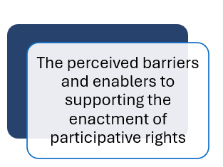
Barriers and enablers: The overarching cultural environment
(There is ) a lack of understanding….. We quite often get they can't play all day, but I don't think you know if you've taught in year six all your life. I don't think you understand what exactly the play is and how much the children are gaining from that.’ Julie (Year1 &2 Teacher, aged 5-7)
Values across the school (shared / disjointed?)
Leadership who are knowledgeable (or not) about EYs and PRs
Staff feeling valued and listened to
Relevant CPD opportunities
“We are very trusted in our planning of where we go and it’s constantly following the children” Barbara, (Year 1&2 Teacher, aged 5-7)

Slide 21
Barriers and enablers: Within the class
Relationships
Teamwork including TA support
Flexible classroom environment and resourcing
‘I'm not saying that it all comes down to finances, but having an extra person is a huge benefit, and that is a financial challenge’
Seren (teacher of children aged 5-6 ).
‘I think there's a bit of a conflict between trying to fit everything into timetable, but also trying to listen to the pupils as well’
(Lizzie, Year 1&2 Teacher, aged 5-7).
Notes:
“Involving children in their learning and the decision-making process and listening to their ideas only makes them feel more valued and by valuing their opinion and valuing their views and listening to them, you reduce the behaviour challenges".Seren (Year 1 Teacher, aged 5-6 ).
I've got a class of 30. So you know when you've got the pressures of getting something else done, … I couldn't manage foundation phase philosophy properly without a TA there. You know there are amazing" Julie (Year 1 & 2 Teacher, aged, 5-7)
“I think those relationships are so vital and these first weeks are really, important in establishing … and building those strong relationships.”
Florence (Children aged 4-5)

Slide 22
Barriers and enablers: External expectations
Children
The teacher themselves
Expectations of other teachers
Support staff
School management teams
Parents
Internal and external inspection mechanisms
Wider societal views? This is not explicitly in the data, but it is something we are reflecting as team
“In our school parents are quite demanding in what they expect, so I think it's teaching everybody that they might not be lots of working books. By showing the proof, ... of what you're doing and how effective it is. I think that would break down the barriers.” (Julie Year 1&2 Teacher, aged 5-7)
"They [inspectors] don't come and see the listening that they might be going on. They want that end result“ (Lizzie, Year 1&2 Teacher, aged 5-7)
Notes:
"we recently had an inspection and we were very shocked cause we… thought we were in a good place with the provision and providing the children with the opportunities of …really authentic learning and they came in and focused on outcomes and progression steps. It was the fact that …they didn't recognise everything else. They went back to that stage role progression and assessment”
Joanna (Year 2 Teacher, aged 6-7)
"those things are also difficult to manage when you know, like, actually, your children don't really wanna be doing those things like I know coming up to Christmas, most of my children aren't wanna do a school play. They're not wanna sing for hours on end"
( Seren, Year 1 Teacher, aged 5-6 ​)

Slide 23
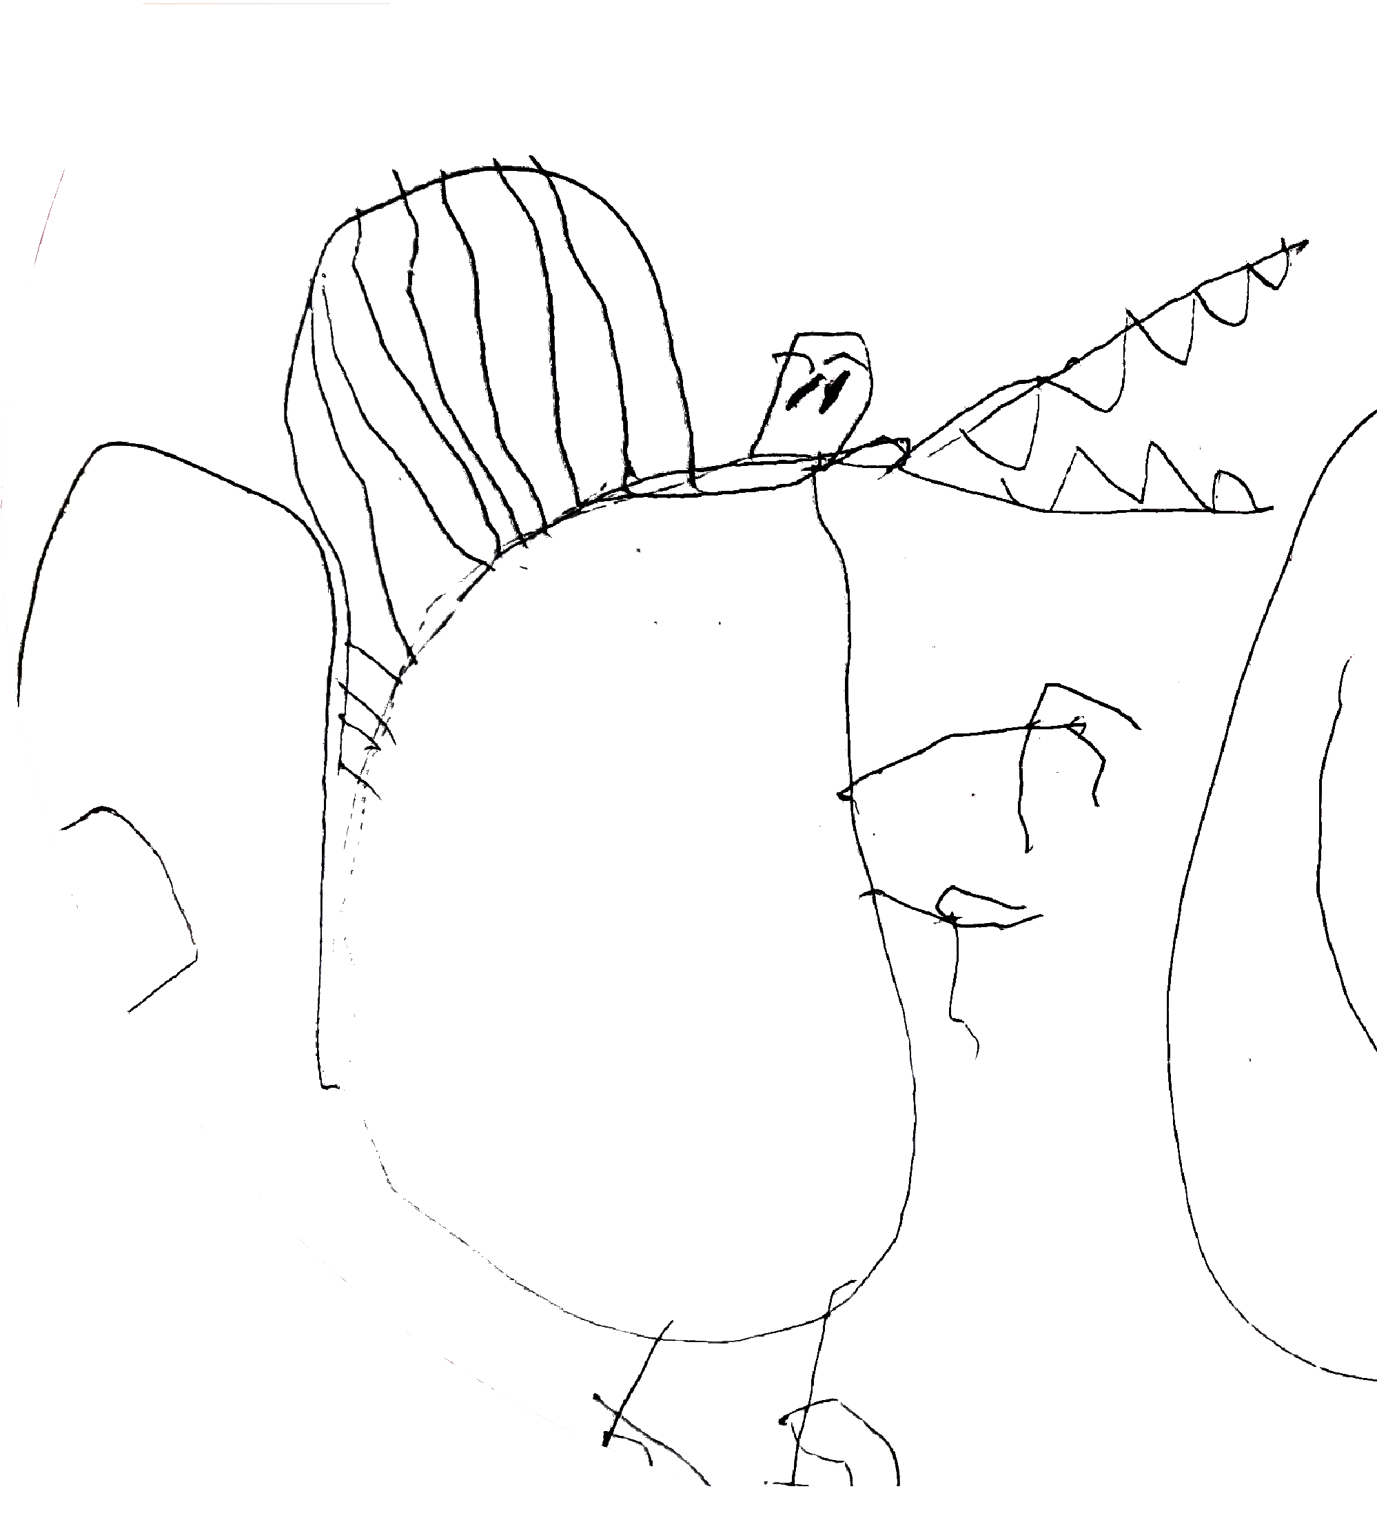
Conclusions and next steps
Conceptualising participation
Teachers of 5–7-year-olds felt that participative rights were about, knowing their children, ‘listening’ in multiple ways, and taking their interests forward.
But this participation of children was limited and ‘boundried’ by time and space (for most teachers)
Supporting participation and removing barriers to participative rights
Within the classroom having teaching assistants and pedagogues in the class to enable children to be ‘listened to.
A trusting environment from leadership where teachers are trusted and are not pressured to focus on ‘outcomes’ but where listing to young children is valued.
More educational support for parents about the pedagogy of early years education.
Notes:
allowing an avenue through which discussions and agitations can be explored to support the increased enactment of participative rights within practice.

Slide 24
Learn more by visiting our webpage…
Latest news and events - upcoming training sessions, conferences and webinars.
Become a Network Member - receive a monthly newsletter and invitation to our events
Follow us on Social Media…
@ChildPart
@child.participation
child.participation@uwe.ac.uk
Notes:
Find slide with more detail and add QR code
https://childrens-participation.org

Slide 25
References
Berge, P. & Luckmann, T. (1991) The social construction of reality. Penguin Books
Bessell, S., 2017. Rights-based research with children: Principles and practice. Methodological Approaches Geographies of Children and Young People, 2, pp.223-240.
Chicken, S. (2023). ‘Doing Reggio?’ Exploring the complexity of ‘curriculum’ migration through a comparison of Reggio Emilia, Italy and the EYFS, England. Global Studies of Childhood, 13(4), 322-340
Chicken, S. and Tyrie, J., 2023. Can you Hear me? Problematising the Enactment of uncrc Article 12 in Welsh Early Years Classrooms: Exploring the Challenges of “Children’s Voice”. The International Journal of Children's Rights, 31(2), pp.301-325.
Correia, N., Camilo, C., Aguiar, C. and Amaro, F., 2019. Children's right to participate in early childhood education settings: A systematic review. Children and Youth Services Review, 100, pp.76-88.
Invernizzi, A. and Williams, J. (eds) (2011) Human Rights of Children: From Visions to Implementation, London: Routledge.
James, A. and Prout, A., 2015. Re-presenting childhood: Time and transition in the study of childhood. In Constructing and reconstructing childhood (pp. 202-219). Routledge.
Waters, J., Lewis, A., Sarwar, S. and Tyrie, J., 2017. Exploring the extent of enactment of young children's rights in the education system in Wales. Wales Journal of Education, 19(2).
Lyle, S., 2014. Embracing the UNCRC in Wales (UK): Policy, pedagogy and prejudices. Educational Studies, 40(2), pp.215-232.

Slide 26
References
Malaguzzi, L., 1994. Your image of the child: Where teaching begins. Exchange, Vol 3, No: 94
Malaguzzi, L., 1998. Part I: History. The hundred languages of children: The Reggio Emilia approach--advanced reflections, 49.
Maynard, T. and Chicken, S., 2010. Through a different lens: Exploring Reggio Emilia in a Welsh context. Early Years, 30(1), pp.29-39.
Murphy, A., Roberts, L., Williams, J., Chicken, S., Clement, J., Waters-Davies, J. and Tyrie, J., 2024. Participative rights in Welsh primary schools: Unpicking the policy rhetoric. Policy Futures in Education, p.14782103241257281.
Murphy, A., Roberts, L., Williams, J., Chicken, S., Clement, J., Waters-Davies, J. and Tyrie, J., 2024. Participative rights in Welsh primary schools: Unpicking the policy rhetoric. Policy Futures in Education, p.14782103241257281.
Prout, A. (2000). Childhood bodies: Construction, agency and hybridity. In The body, childhood and society (pp. 1-18). London: Palgrave Macmillan UK.
Quennerstedt, A., Robinson, C. and I’Anson, J., 2018. The UNCRC: The voice of global consensus on children’s rights?. Nordic Journal of Human Rights, 36(1), pp.38-54.
Robinson, C., 2016. Listening to the voices of young people: Working towards the genuine participating young people in discussions about school transformation. Reimagining the purpose of schools and educational organisations: Developing critical thinking, agency, beliefs in schools and educational organisations, pp.79-91.
Stewart, Sarah (2024) An Exploration of the Conceptualisation and Enactment of Children’s Rights in the Curriculum for Wales. Doctoral thesis, University of Wales Trinity Saint David.
Townsend, A., 2013. Action research: The challenges of changing and researching practice: The challenges of understanding and changing practice. McGraw-Hill Education (UK).
Waters-Davies, J. and Macdonald, N., 2022. The capable child as a threshold concept for inclusive early childhood education and care. In Inclusive Pedagogies for Early Childhood Education (pp. 164-181). Routledge.
Waters‐Davies, J., Murphy, A., Chicken, S., Tyrie, J. and Clement, J., 2024. Constructing child participation in early years classrooms: An exploration from Wales. Children & Society.
Welsh Government, 2021, Curriculum for Wales. Available at: https://hwb.gov.wales/curriculum-for-wales [Accessed 31 Jul 2024]

