Slide 1





















Participative rights in Welsh primary schools:
Unpicking the policy rhetoric
Notes:
Present on the policy focussed aspect of a larger research project

Slide 2


The project
Embedding children’s participative rights in pedagogical practice in lower primary classrooms in Wales
  ESRC funding
  3 years from Dec 22 – Nov 25
  Collaboration across four HE institutions
  Follows the Curriculum and Assessment (Wales) Act 2021
Notes:
Led by UWE collaborating with Cardiff Metropolitan University, Swansea University, and University of Wales Trinity St Davids.
Welsh Government have a strong commitment to children’s participative rights, with the Rights of Children and Young Persons (Wales) Measure (2011) an embodiment of the WG commitment to the UNCRC.
Critical pivotal exciting time for reform in education in Wales

Slide 3
Research Questions
  How does the distinct Welsh policy context position teachers in relation to young children’s participative rights in primary schools in Wales?
    To what extent do providers of professional learning (including initial teacher education) support Welsh Government rhetoric for pedagogic practice that embeds young children's participative rights?
    How do primary teachers in Wales conceptualise and support young children’s participative rights and what are perceived enablers and barriers to practice?
    How are young children's participative rights in Welsh primary schools understood and experienced by young children themselves?
    How can findings from this work be drawn together to understand the process by which pedagogies can be transformed in order to embed participative rights?
Notes:
Aim
The study aims to establish how pedagogic practices can embed participative rights and attend routinely to young children's voice and agency, with children aged 5-7 years
Research strands
Policy analysis
Survey of initial teacher education and ongoing professional learning opportunities in Wales with regard to children's participative rights
Working with in-service teachers and leaders using Reggio-Emilio inspired pedagogy to explore participative rights
Working with children age 5-7 to explicate their understandings of their participative rights and how they would like them to be enacted within education

Slide 4
Policy Analysis: Methodology
Range of legislative and policy documents from Devolution in 2000-2022
Cardno (2018)
Deductive qualitative content analysis / elements of critical discourse analysis
Notes:
How do the narratives of these policy documents frame teachers in relation to children?
Evidence within Welsh education policies for support for the enactment of children’s participative rights in the classroom would challenge the dynamics to social systems and structures where child-adult power imbalances exist

Slide 5
Defining participative rights
Defining participative rights
  The underlying values and aims of the human rights project
Four types of data where UNCRC / Human Rights Education (HRE) / participation were:
  Entirely absent
  Referenced with no detail or further explanation
  Explicit and contextualises
  Containing differing understandings of participative rights
Notes:
Legal perspective
Considering human rights as inalienable, indivisible and interdependent. So participative rights must be seen as part of the system of enactment of a full range of rights.
It is about article 12 but it is not only about article 12

Slide 6
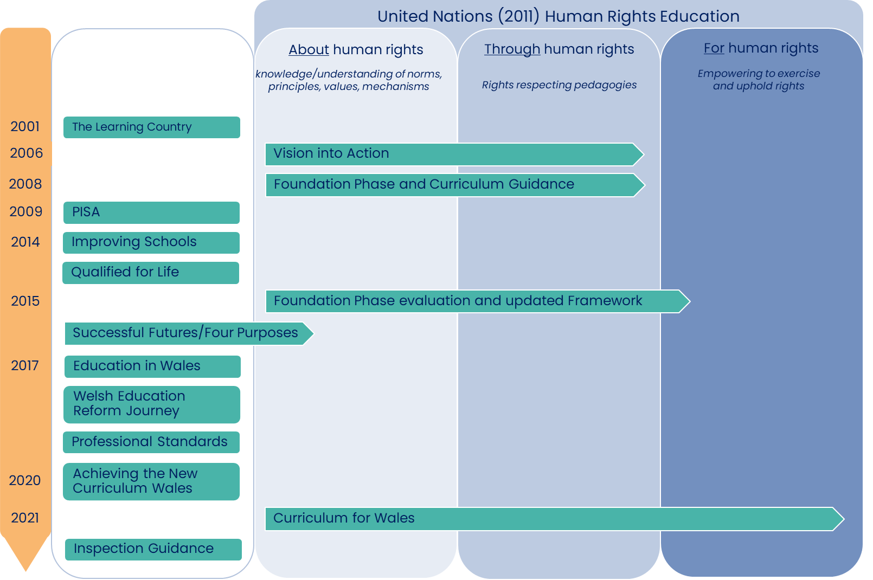
Welsh education policy and HRE
Notes:
LENS OF UNITED NATIONS HUMAN RIGHTS EDUCATION FRAMEWORK
In the majority of Welsh education policies t we didn’t find any references to the UNCRC / HRE / Participative rights
However, in the practical guidance Welsh Government provide for practitioners, online guidance on the Hwb, education about and through human rights is detailed.
In PISA 2009 Wales had a notably poor performance and Welsh Government responded swiftly and publicly stating that action must be taken.
So I would like to focus on the Successful Futures document from 2015 which was widely considered as a progressive development in many ways, before talking about the new curriculum for Wales of 2021.

Slide 7
Successful Futures (Donaldson, 2015)
Dominant themes
  Improving literacy, numeracy, digital skills
  Reducing the impact of deprivation on educational outcomes
  Skill acquisition, preparing future citizens, full ‘participation’ in society
Participative rights
  Cites WG commitment to UNCRC as a positive aspect of Welsh Education.
  One of the four purposes for pupils to be “ethical informed citizens of the world”…
  …but there is very limited detail of what is meant by an ethical informed citizen
  Within 68 recommendations - no references to UNCRC / HRE / participative rights
Lemke and Zhu (2018)
  Technocratic and performance-oriented language, fundamentally future-oriented
  Doesn’t address necessary reworkings of curricula and pedagogy required to enact transformational change
  Successful Futures (2015) fails to engender child rights consonant with the spirit of the UNCRC
Notes:
Successful Futures viewed as very progressive move for Wales – giving teachers and children more agency
Perhaps understandably in response to the 2009 PISA Donaldson’s Successful Futures report dominant themes of raising standards and improving outcomes, a strong focus on literacy, numeracy, digital skills, as well as developing the skills needed for future employment, and a rhetoric that this was required to alleviate the impact of disadvantage on educational outcomes in Wales.
Lemke and Zhu – the clue is in the name – Successful Futures
Despite this shift in focus, the practical guidance for educators, updated in 2015 remains less outcomes focussed with a more holistic, child-centred approach.

Slide 8
Curriculum and Assessment (Wales) Act 2021
“Nothing is so essential as universal access to and acquisition of the experiences, knowledge and skills that our young people need for employment, lifelong learning and active citizenship.”
“Not simply what we teach, but how we teach and crucially why we teach it”
“Set high expectations, promote individual and national well-being, tackle ignorance and misinformation, and encourage critical and civic engagement”
“CfW is an important vehicle for embedding the UNCRC in the experience of learning and teaching for our children and young people, and for giving them an understanding of their rights.”
Notes:
There is a marked shift away from notions of future citizens, significantly reduced reference to outcomes and measures
and the CFW is predicated on the notion individual progression pathways placing a value on the child in their here and now equal to the value placed on that child’s future self
These quotes are from the Hwb guidance
1. Important and
2. Opening debate around why we teach and the purpose of education – research active / critical thinking of teachers
3. Setting expectations that around wellbeing, tackling ignorance, critical civic engagement in the here and now, no longer future-oriented
4. Quote could and perhaps should have been in explicit in policy documents 20 years prior to the CfW

Slide 9
CfW: Designing your curriculum
Five Cross-cutting themes for curriculum design
  Relationships and Sexuality Education
  Human rights
  Diversity
  Careers and work experience
  Local/national/international contexts
‘Ethical and informed citizens’ which now includes “understanding and exercising their human and democratic responsibilities and rights”
Notes:
One of the purposes was for pupils to be ‘ethical and informed citizens’ which includes understanding and exercising their human and democratic responsibilities and rights

Slide 10
Co-constructing the curriculum
Enabling learners to make choices about what and how they learn.
Enabling participation to create an engaging curriculum that responds to learners’ interests, needs and priorities.
Dialogue between learner and professionals is of itself a valuable learning experience.
Feedback should be given on decision-making.
Differing levels of participation are appropriate at different points in curriculum design.

Slide 11
CfW: United Nations Framework (2011)
Experiencing rights through education
Children’s rights approach
The right to participate in decisions
Collaboration
Equality, dignity, respect, non-discrimination
Both practitioners and learners
Duty bearers accountable
Motivation of social action
Empowerment of active citizenship
Advance respect for the rights of all
What is means to be an ethically informed citizen of Wales and the world
School leaders responsible for ensuring knowledge and understanding of the UNCRC
Notes:
Education through human rights
Learners should experience their rights through their education and develop a critical understanding of how their educational experience supports their rights
Schools and settings can take a children’s rights approach. A key principle is the right to participate in decisions about their learning and wider school experience
Opportunities for learners and adults to collaborate to develop and maintain a school or setting community based on equality and dignity, respect, non-discrimination in the context of participation. This includes learning and teaching in a way that respects the rights of both practitioners and learners and promotes well-being.
Duty bearers are accountable for ensuring that learners experience their rights
Education for human rights
the motivation of social action and empowerment of active citizenship to advance respect for the rights of all
Human rights education empowers learners as rights holders, enables learners to critically examine their own attitudes and behaviours and to develop skills to be ethically informed citizens of Wales and the world, who can be advocates for their rights and the rights of others.

Slide 12
Policy Analysis: Findings
  Majority of education policy documents 2000-2020 are absent of references to UNCRC / HRE / participative rights
  Practical guidance for educators in Wales (Hwb) from 2006 is inclusive of education about and through human rights at all stages
  The new Curriculum for Wales (2021) is underpinned by HRE and details extensively the about, through and for of the United Nations Framework (2011)
Notes:
Participative rights…

Slide 13
Policy Analysis: Conclusions
  Omissions and inconsistencies as well as differing understandings of participative rights
  Focus on ‘what’ not ‘how’
  Golden thread of implementation and impact
  Maintaining the commitment
Notes:
Omissions and inconsistencies as discussed, differing understandings of participative rights
What not how: There are explicit aims in the New Curriculum for Wales to teach not only about, but also through and for human rights, and whilst there is practical guidance on HRE, the necessary theory of pedagogy that would support these changes is lacking. Needs to be more opportunities for teachers to be confidently positioned as critical agents of change.
Golden thread: from legislation and policy rhetoric, through systemic change and teacher education, into the classroom children’s lives. How do Welsh Government envision HRE participative rights will be enacted in classrooms and therefore impact children in Wales in their here and now?
Maintaining the commitment: Subsequent Curriculum for Wales Annual Report 2023, and research carried out on behalf of the Welsh Government are limited in their evaluation of the implementation and impact of HRE by comparison to other underpinning elements of the new Curriculum. There is potential for this bold and progressive commitment to HRE to be overshadowed by competing priorities…

Slide 14
☺ Thank you for listening ☺

