Slide 1
Evaluating the utility of Sentinel-2 in estimating water quality in an ecologically significant, shallow, and optically complex estuarine lake system
Harry West, Nevil Quinn, Michael Horswell, Nicola Carrasco
University of the West of England, University of KwaZulu-Natal

Slide 2
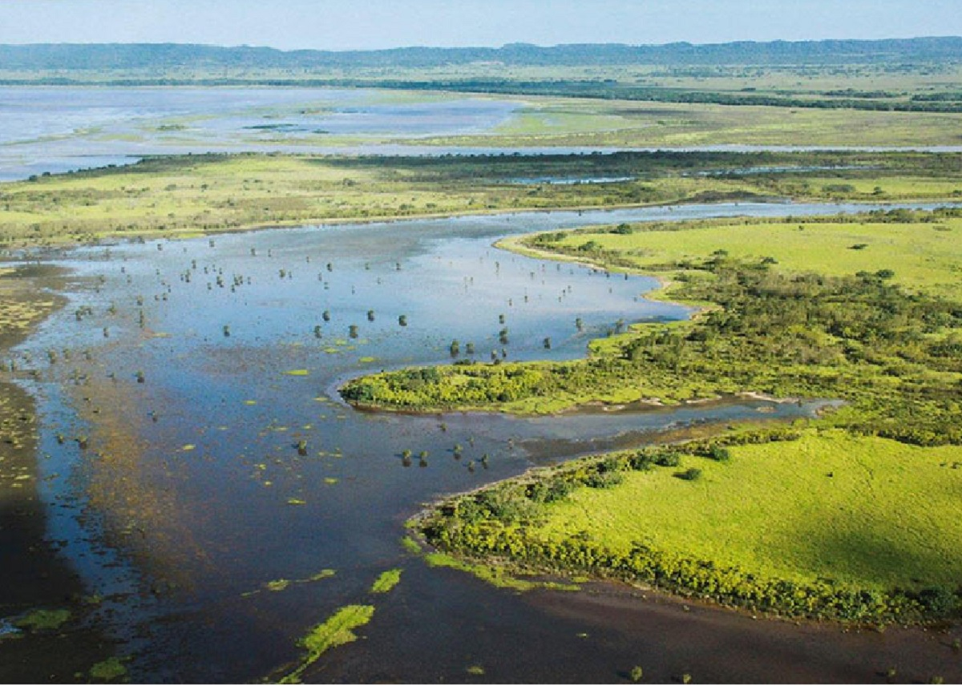
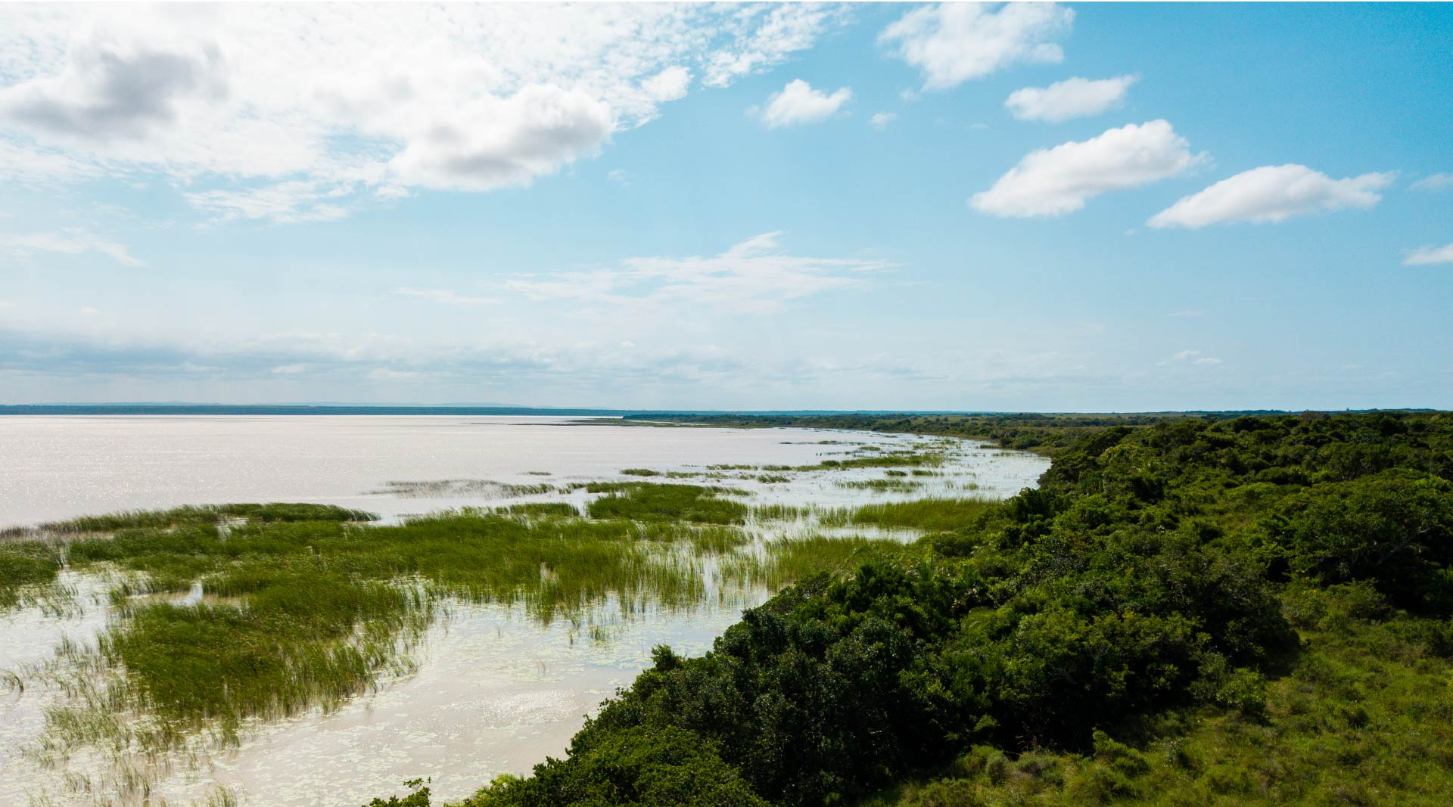
Geographical Setting
Greater St Lucia Wetlands park one of nine UNESCO World Heritage Sites in South Africa – first to make it onto the list
220km long coastline within its boundaries
Combination of fluvial, marine and Aeolian processes = Large variety of landforms
Situated between subtropical and tropical climatic zones; high species diversity
Important driver of diversity is the varying levels of salinity in the lakes, which are connected to the ocean via the estuaries.

Slide 3
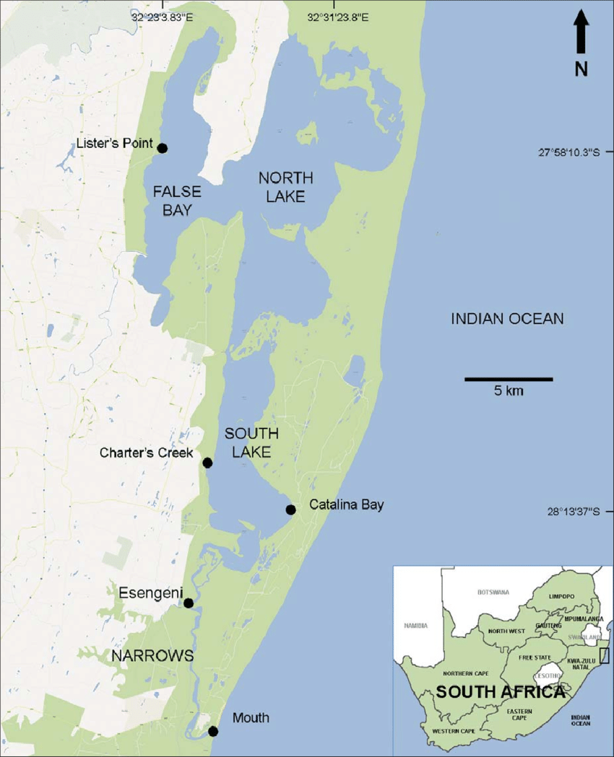
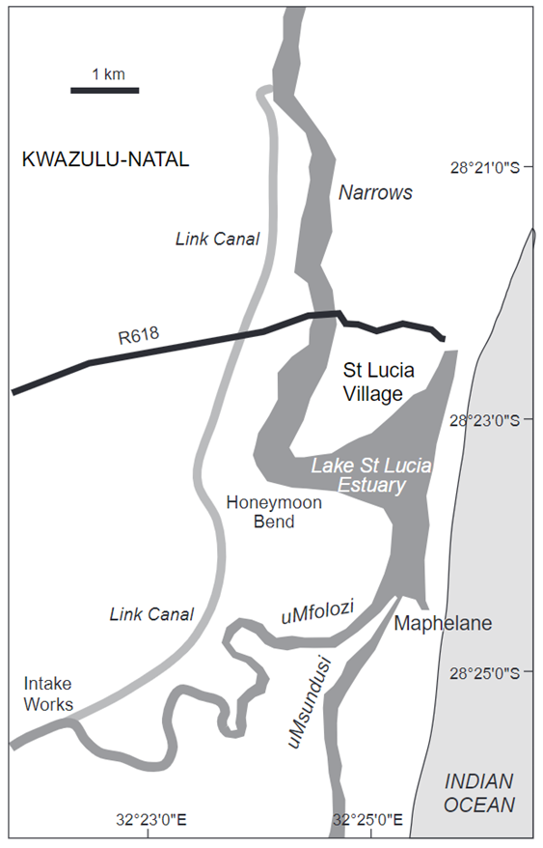
Perissinotto et al (2013)
Forbes & James (2020)

Slide 4
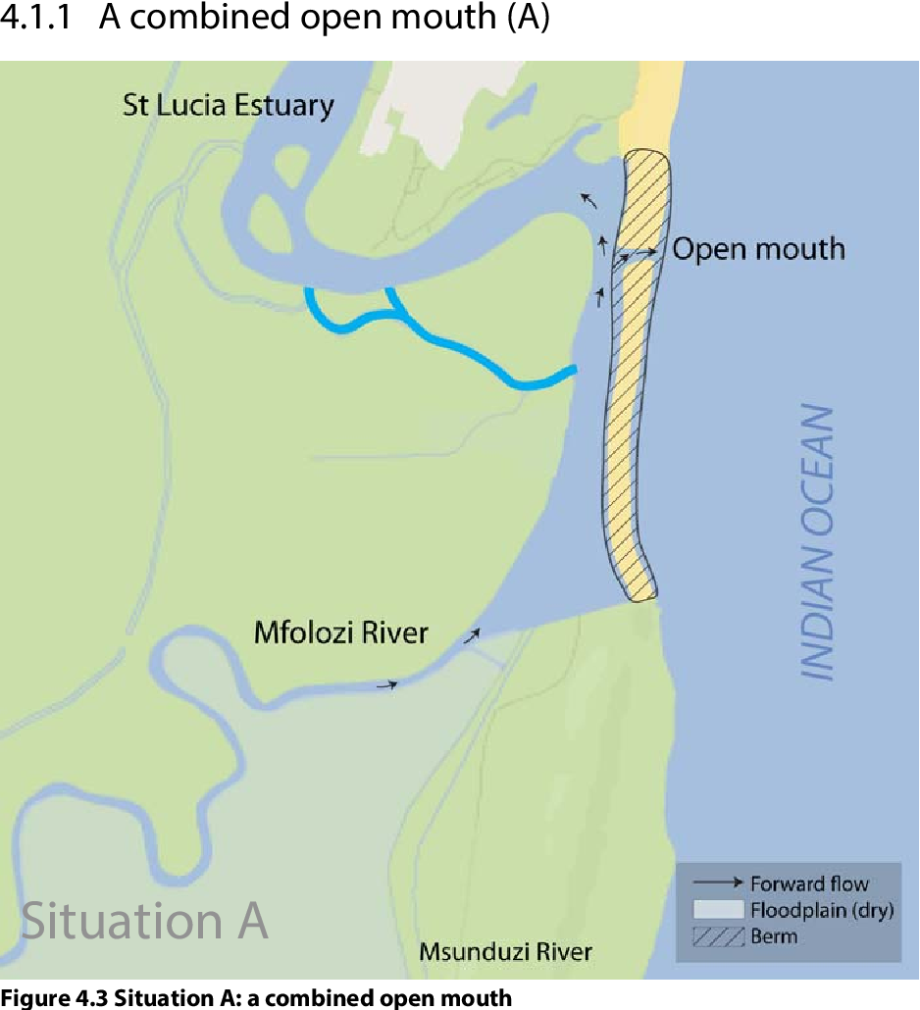
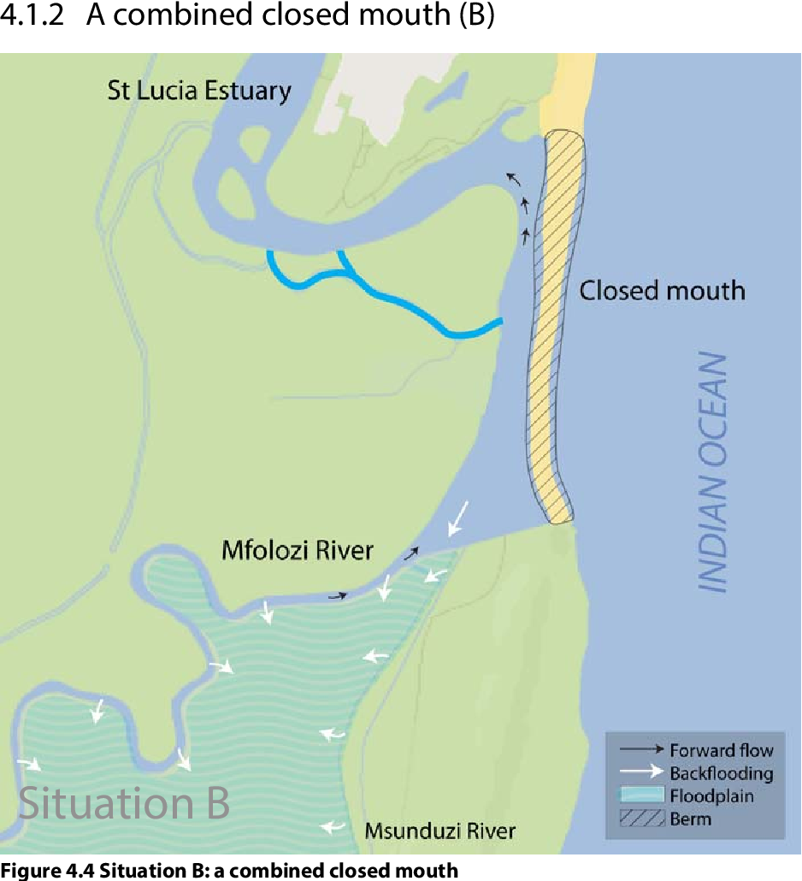
Mouth Management
The mouth of the St Lucia Estuary has been both open and closed in recent times.
Loon et al. (2013)

Slide 5
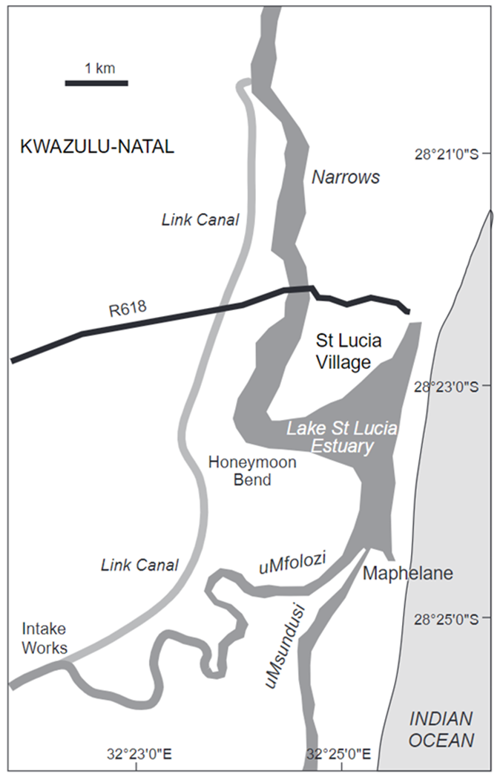
Mouth Management
Concerns around flooding resulted in a hard engineering open mouth policy in the 1950s.
Further concerns around sedimentation from the Umfolozi then led to the construction of a sand barrier disconnecting the Umfolozi from the St Lucia estuary.
By the late 1960s, the isolated St Lucia mouth was being maintained in an open state by a combination of retaining walls, dolosse and active dredging to remove incoming marine sediments
Edited from Forbes & James (2020)

Slide 6
Mouth Management
The open state allowed sea water to enter the system and maintain water levels in the lake that compensated for water lost through evaporation.
While the mouth was open the system eventually became hypersaline.
This understanding supported the management decision that resulted in the mouth being kept closed between 2002-2010.
The estuary was then characterised by high salinity but low water levels.
Edited from Loon et al. (2013)

Slide 7
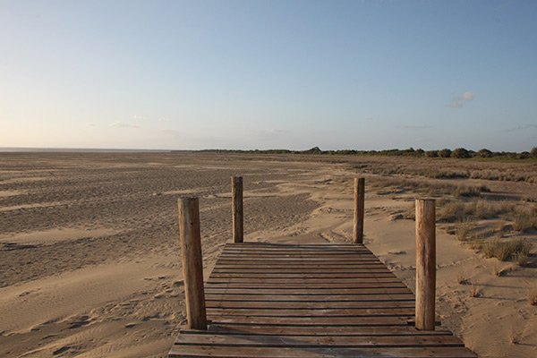
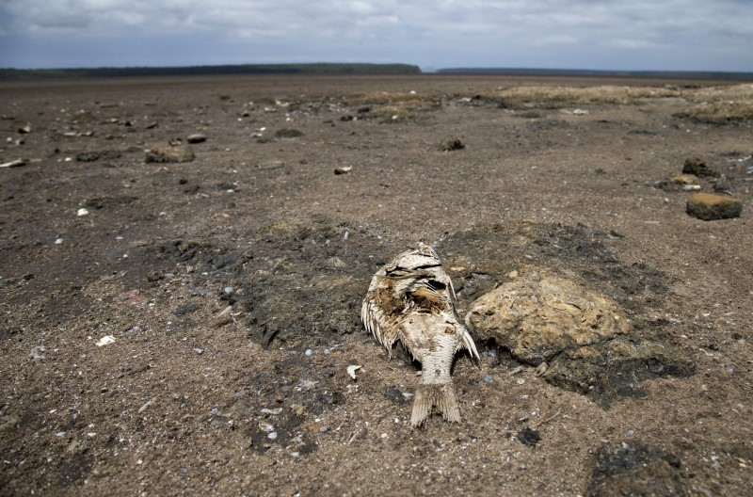
Mouth Management
The closed mouth resulted in no marine water input… plus the uMfolozi was still diverted…
As a result, during drought periods (i.e. little rain or tributary input from the north) the lakes dried up.

Slide 8
iSimangaliso Board ratified a policy decision that natural mouth movement would no longer be obstructed, a decision in direct contradiction to the 50-year-old previous policy.
It was clear that from the Umfolozi was critical for the estuary as a whole and that its connection to the St Lucia Umfolozi should be restored.
Studies also highlighted that the Umfolozi River controlled the St Lucia Estuary mouth’s natural cycle of opening and closing, and that the sediments it carried posed little threat to the physical functioning of the estuary.
Recommended the removal of the dredge spoil that had been placed in the Umfolozi natural path, and that the diversion of the Umfolozi at Maphelane be stopped.
Complete removal of the sand bar disconnecting the Umfolozi in early 2017

Slide 9
Reconnected Umofolzi (Since 2017)
Open Estuary Mouth
(Jan - June 2021,
April 2022- Present)
Authors Own (2024)

Slide 10
Research Aim
To utilise medium resolution satellite imagery from Sentinel 2 to assess changes in water quality parameters since 2015.
Can changes be detected following the full reconnection of the Umfolozi in April 2017?
Can changes be detected since the opening of the mouth in Jan 2021/April 2022?

Slide 11
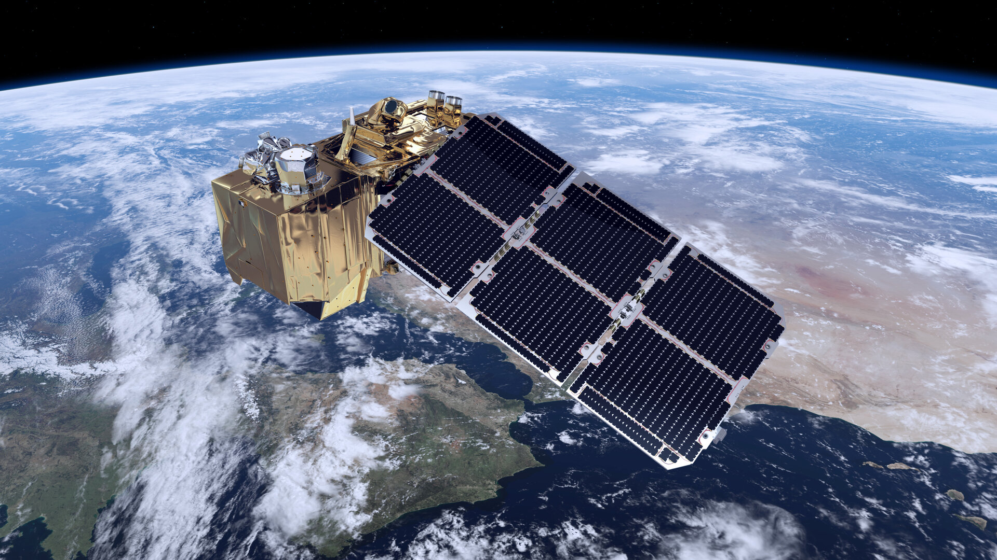
Data Collection
Sentinel 2 imagery was chosen due to its:
- Relatively good spatial resolution (10m in the visible and NIR regions)
- High revisit time (increased in 2017 with the launch of Sentinel 2B)
- High spectral resolution bands at 20m
- Freely available imagery
98 images were downloaded between Nov 2015 and August 2024
All with 0% cloud cover in the estuary area
ESA 2024

Slide 12
Identification of Water Bodies
Initially a mask was created to constrain the subsequent analyses to the offshore, estuary and Narrows areas.
MNDWI was calculated at 20m resolution for each image:
$$MNDWI= \frac{Green \left(B3\right)−SWIR(B11)}{Green \left(B3\right)+SWIR(B11)}$$
Water bodies were extracted based on areas with positive (>0) MNDWI values.
Manual extraction and validation of the main estuary, Narrows and offshore area.

Slide 13
Water Quality Indices
For the water areas two water quality indices were calculated for each image:
1. Normalised Difference Chlorophyll Index (NDCI) at 20m resolution (Mishra & Mishra 2012):
$NDCI= \frac{Red Edge1 \left(B5\right)−Red (B4)}{Red Edge1 \left(B5\right)+Red (B4)}$
2. Normalised Difference Turbidity Index (NDTI) at 10m resolution:
$NDTI= \frac{Red \left(B4\right)−Green (B3)}{Red \left(B4\right)+Green (B3)}$

Slide 14
Data Analysis
Nine sample points were established from the northern Esengeni area to the estuary mouth and offshore area.
Sample points were checked for full temporal coverage and water body consistency using the MNDWI masks.
For each sample point a time series was constructed of NDCI and NDTI values.
Kruskall-Wallis tests used to look for statistically significant differences in NDCI/NDTI under three conditions: 1) Estuary mouth closed (Umfolozi disconnected), 2) Estuary mouth closed (Umfolozi connected), 3) Estuary mouth open

Slide 15
Turbidity Results
No significant changes detected in NDTI between the two closed mouth scenarios (i.e. no significant difference in NDTI as a result of the reconnection of the Umfolozi)
Significant differences in NDTI between the closed mouth conditions and open mouth conditions.
Reduction in NDTI with an open mouth – indicating clearer water conditions.
More notable changes in the more northern reaches of the St Lucia Estuary.

Slide 17
Turbidity Results
Significant differences in turbidity also detected in the offshore area.
Increase in NDTI associated with an open mouth.
Still negative NDTI however still an increase compared to closed conditions.

Slide 18
Chlorophyll Results
For 7/9 sites (excluding the mouth and offshore area):
No significant changes detected in NDCI between the two closed mouth scenarios (i.e. no significant difference in NDCI as a result of the reconnection of the Umfolozi)
Significant differences in NDCI between the closed mouth conditions and open mouth conditions.
Reduction in NDCI with an open mouth – indicating reduced chlorophyll.
More notable changes in the more northern reaches of the St Lucia Estuary.

Slide 20
Chlorophyll Results
No significant differences detected in NDCI for the mouth and offshore areas related to mouth condition:

Slide 21
Summary
The St Lucia Estuary has experienced significant changes in management approaches in the past which have resulted in a very dynamic system.
In this exploration we show how Sentinel-2 can be used to estimate turbidity and chlorophyll parameters in the estuary and how this has changed since 2015 with the reconnection of the Umfolozi to the estuary and the opening of the mouth in 2021/22.
We found significant changes in turbidity and chlorophyll following the opening of the estuary mouth for most areas – with the biggest changes occurring in the northerly reaches.
No significant changes with the reconnection of the Umfolozi in 2017.

Slide 22
Next Steps
Compare NDTI/NDCI estimations from Sentinel-2 with water quality samples taken in the St Lucia Estuary
Explore how vegetation dynamics in the estuary have changed as a result of prolonged mouth closure between 2015 and 2021.
Notable development of reeds and estuarine vegetation linked to low energy conditions and suspended sediment.
Evaluate the utility of Landsat in being able to detect longer term trends pre-2015.
In particular whether the coarser spatial, spectral and temporal resolution of Landsat presents a limitation to this application of remote sensing technology.

