Slide 1
Feeling our way forward: Embracing emotions in geography higher education
Professor Jennifer Hill (Visiting Professor)
Dr Harry West (Senior Lecturer in Geography)
School of Architecture & Environment
University of the West of England
Bristol, UK

Slide 2
Initial Premise
We argue that future-facing HE geography will privilege, as one of its vital components, a focus on the affective domain (Bloom, 1956; Krathwohl, 1964)
In particular, an embodied, emotional engagement with the production of knowledge and understanding through relational learning and assessment
Impetus for a focus on the affective:
Neoliberalisation of the academy
Disruption within and beyond the academy (notably pandemics, AI)
Social and environmental crises and a need for justice

Slide 3
Research Aims
To undertake a systematic review of JGHE content since journal inception to demonstrate growth in intellectual engagement with the affective realm and emotions in geography teaching, learning support, and assessment.
To identify the impacts of greater engagement with emotions on geography student learners and their performance outcomes.
To highlight the impacts of greater engagement with emotions on geography faculty pedagogic practices and experiences.
Identify the conceptual registers employed by geography educational researchers that have driven their research questions and shaped their methods and findings.
Highlight the varying spaces that geography educators and learners inhabit, within and beyond formal classrooms, campuses and curricula.

Slide 4
Emergent Areas
Transition into HE and out of HE to employment
Teaching and learning practices:
fieldwork
disrupted academic practices
decolonised and anti-racist curricula and pedagogies
discomforting topics
geographic thought and methods
students as researchers/change agents
faculty-learner relationships (e.g. mentoring, partnerships)
Assessment and feedback

Slide 5
1. Transition into the academy
Geographers have explored how transition evokes various emotions linked to changing identities and sense of belonging …
Richardson & Tate (2013) examined an intervention to improve the transition experience into university by introducing student voices into induction
Case study based at Newcastle University:
Students brought actively into formal / informal lectures, seminars, workshops, and student-student mentor meetings, running from freshers’ week through to first-year residential field trip fifth teaching week
Engaging students actively led to stronger feelings of engagement, “geographical community” and belonging in the department

Slide 6
1. Transition out of the academy
Barbara-I-Molionerao et al. (2019) examined disparate images held of geographers by students and professionals
Identified a need for undergraduate students in the discipline to understand who they are as holistic individuals:
Strengthen geographers’ sense of professional identity from early stages of undergraduate studies
Redesign the curriculum: clarifying knowledge, skills, attitudes, behaviours, values
Build integrative over modular knowledge, incorporating project mgt and understanding tech tools

Slide 7
2. Teaching and learning practices
Fieldwork (Marvell et al. 2013, Simm & Marvell 2015, Marvell & Simm 2018):
(International) fieldwork can be an emotional experience for students
Student-led teaching in situ, and a purposeful drawing upon the affective domain during fieldwork, helps students draw out deeper emotional engagement with and sense of place
Field experience goes beyond emotional involvement to challenge perceived ideas/understanding
Students gain better understanding of geography (practical and theoretical) and greater awareness of their role in learning (especially if linked to appropriate assessment – e.g. reflective diaries and essays)
Emotional intelligence can be a learning objective stemming from innovative fieldwork
Notes:
Richard Phillips (2015) Playful and multi-sensory fieldwork: seeing, hearing and touching New York - collecting sounds, urban climbing, finding “accidental art” and getting lost. Students enjoy a sensory approach, inspiring them to learn actively and creatively. Fosters the acquisition of new skills.
Sam Staddon et al 2023 – A token of love: the role of emotions in student fieldtrips teaching critical development geographies – JGHE.
Emotions are integral to the pedagogic process and critical political potential of the trip. We show how emotions are central to the connections students create with people and places during the trip and to their learning within it. Highlight crucial emotions of curiosity and care, cultivated by reflective pedagogies.

Slide 8
Disrupted academic practices (pandemic pedagogies):
West et al. (2024) used the community of inquiry framework to examine the benefits and challenges of online learning during the Covid-19 pandemic
Positives: flexibility in student work patterns and use of technology to facilitate engagement in learning
Challenges: engaging students in online classes, maintaining motivation, feeling part of an online learning community (especially for new students)
Conclude that collaborative-constructivist online learning, generating a sense of belonging and allowing learners to project themselves socially and emotionally, can achieve a high-quality student learning experience and outcomes

Slide 9
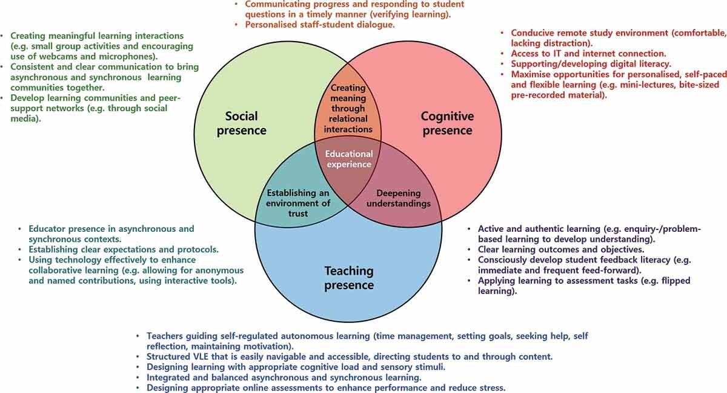

Slide 10
Dyer et al. (2024) collated international reflections on geographers’ responses to teaching geography during the Covid-19 pandemic
Geography educators enacted courage and compassion in their teaching by:
Recognising educator and student embodiment in a novel context
Prioritising listening, acknowledging and sharing with students
Intentionally encountering and navigating difference amongst learners and colleagues
Resisted pandemic pressures to do more faster, avoiding pedagogic frailty (Kinchin & Francis, 2017)
Adopted slow pedagogy (Berg & Seeber, 2016), enacting pedagogies of care and compassion
Follow Oden’s (2001) definition of hospitality as “an orientation that attends to otherness, listening and learning”, offering a “relentless” welcome (Felten & Lambert, 2020)
Notes:
1 An educator set students the task of making video tours for other students on the topics of the meaning of home and a walk in nature, prompting students to take a short walk engaging with module themes corporeally and affectively.
2. Listening as part of hospitality - pivot online associated with flipped learning to reduce content delivery. One vignette began with an introductory session asking students to introduce themselves using an object or image of their own heritage as a way of clarifying the diverse interpretations of the concept.
Strengthening student-teacher relationships through dialogue - Starting sessions with
key word(s) or concept of the week. Students were asked to consider the word/concept in their language of choice and reflect on what it meant to them individually. Took turns sharing their viewpoint and listening with a partner. Pairs then shared their results with the entire class.
Teachers listening to other teachers and sharing their pedagogy -
3. Reconsidering identity and power: decentring ourselves as experts, drawing upon the affordances offered by a variety of learners in social constructivist learning. We acknowledged diversity in terms of accessibility to the internet and associated tech tools, home circumstances, learning styles, culture, language, values and ideologies, prior educational experiences, and levels of self-regulation and self-efficacy. Prompted a more relational pedagogy,
Facilitating diverse student presences - flipped” tutorials in which students undertook work prior to meeting online, preparing questions and seeking dialogic feed forward, and developing shared understanding of content. Students commented that sessions felt more personalised and tailored to their individual needs.
Engaging in meta-cognitive conversations - made ourselves vulnerable enough to foreground, discuss, and work together to enhance the processes that take place behind the scenes of education.

Slide 11
Decolonised and anti-racist curricula and pedagogies:
Increasing application of critical / liberatory pedagogies and the advocation of decolonizing and anti-racist geography teaching and curricula (Alderman et al. 2019, Millner, 2023, Caretta and Pepa 2024)
Fritzsche (2022) argues that introducing contemplative pedagogy into classrooms moves towards producing anti-oppressive geographic knowledge, prompting students to reflect mindfully on their positionalities and privilege
Addresses the emotional, personal, and embodied components of learning
Need to unlearn oppression, to dismantle deeply held ideologies, and create more empowering ways of relating to one another
Notes:
Caretta and Pepa 2024 - Decolonising pedagogy in practice. Emotions play a major role in consolidating knowledge – asked students to explore their embodied feelings related to the course content by reflecting and representing them in visual form.
Millner 2023 – unsettling feelings in the classroom: scaffolding pedagogies of discomfort as part of human geog in HE.
This leaks into discomforting pedagogies and teaching sensitive topics. Conclude discomfort is integral to a transformative approach, but scaffolding is necessary to enable such learning experiences. Links to radical pedagogy (Freire), borderland spaces (Giroux 1991) and self authorship (Baxter Magolda xxx).

Slide 12
Faculty-learner relationships:
Geographers have led the development from transactional teaching to relational learning.
For example, working with students as partners in teaching and learning:
Moore-Cherry et al. (2016) propose inclusive partnerships: working with the wider student body rather than select cohorts
Present case studies from geography which enhance student autonomy, cultivate belonging and a sense of community, and build a geographic identity
Through partnership, staff and students enter borderland spaces (Hill et al. 2016): novel, challenging, permissive and liminal, which destabilize traditional power hierarchies
Students gain confidence in accepting agency in learning, moving towards critical thinking and reflective judgement, thereby developing self-authorship.
Notes:
Borderland examples – Student Environment Research Teams, student-led teaching on international fieldtrips, Twitter as a digital learning space, PAL.

Slide 13
3. Assessment
Student emotions:
Assessment and receiving feedback is inherently emotional for students, exposing their capabilities as learners
Hill et al. (2021a) investigated emotions experienced by undergraduate students in relation to assessment feedback
Respondents drawn from different years of study and subject (including geography) across different countries
Results demonstrated that receiving feedback was inherently emotional for students …
Notes:
Many students struggled to receive and act upon negative feedback, especially in early years, when it was often taken personally and linked to a sense of failure.
Negative emotional responses tended to reduce students’ motivation, self-confidence, and
self-esteem.
Positive feedback evoked intense but fleeting emotions. Positive feedback made students feel cared about, validating their self-worth and increasing their confidence, but it was not always motivational.

Slide 14
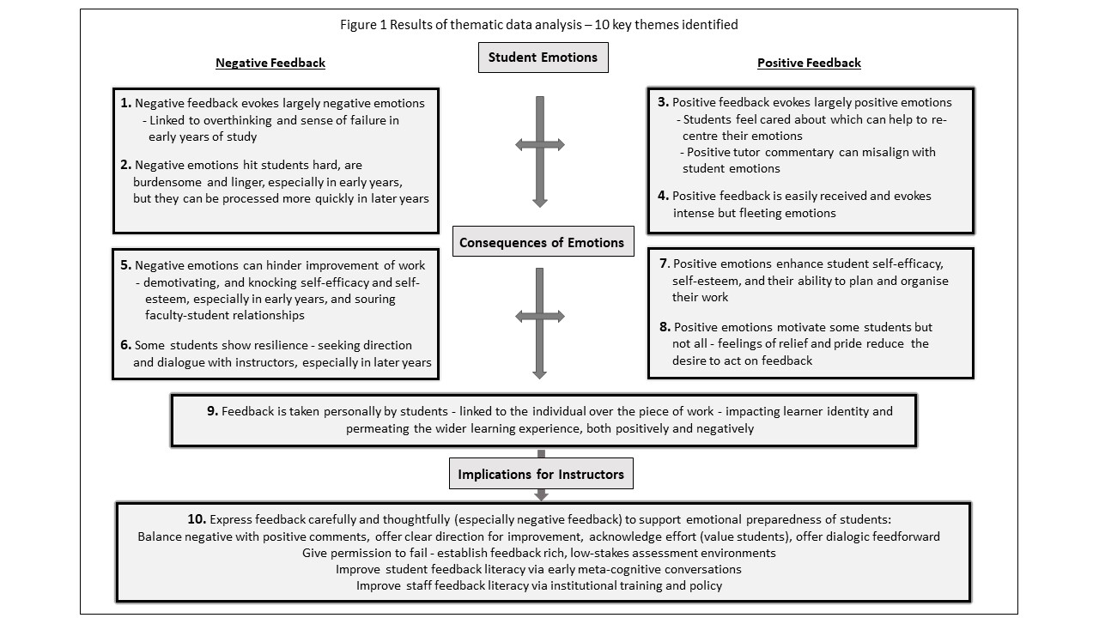
Hill et al. (2021a)

Slide 15
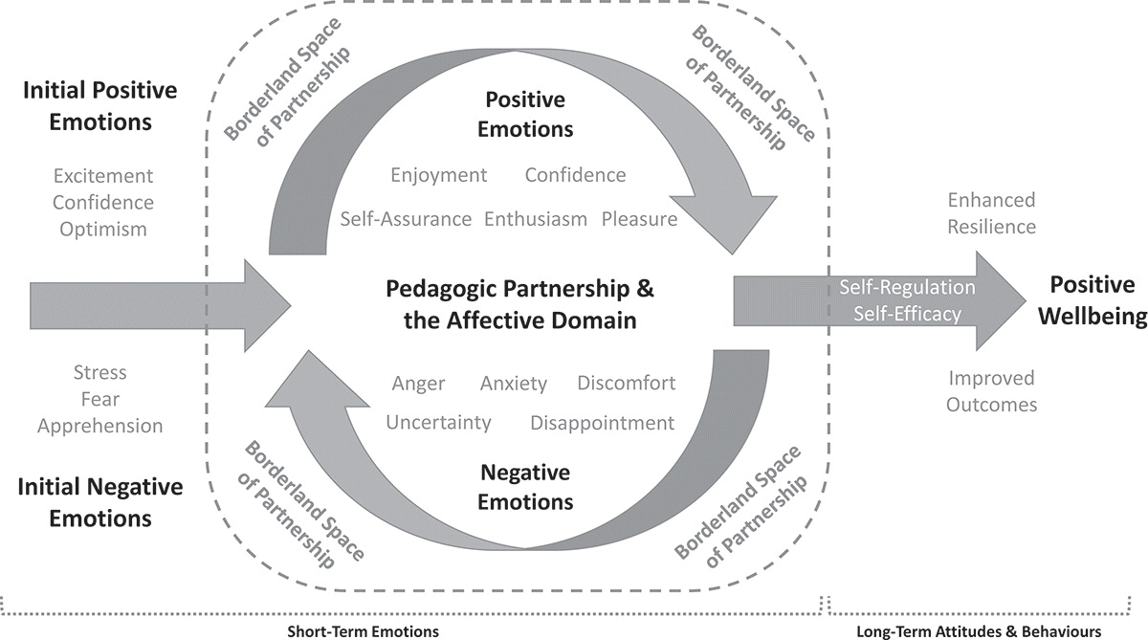
Hill et al. (2021b/c) examine role of dialogic feedforward in dissipating student anxiety, enabling productive learning attitudes and behaviours, and supporting wellbeing:
negative emotions arising from feedback did not dwell with the students as they had done previously with respect to written commentary
dialogue helped the students feel positive about their work in real time, boosting their confidence to act on instructor commentary
the relationship with the instructor [pedagogies of mattering and care] is important in encouraging students to seek wider learning support
Hill et al. (2021c)
Notes:
talking with the instructor about draft work helped the students to process and deal with their emotions, both short- and long-term:
derived from six central aspects of the relational feed-forward encounter:
The open and supportive environment prompted student questions
Talking clarified the tone of instructor comments
The instructor offered constructive critique, giving students a sense of direction
The dialogue pertained to the work in progress rather than personal ability
The dialogue directed student attention to assessment as a process
The instructor focused student attention on the assessment rubric

Slide 16
Implications for Instructors:
Prepare students early in their university learning experience with information about feedback theory and practice, from pre-arrival information, through induction, to development over the first year and onward
Scale up relational feed-forward by developing first-year curricula specifically around assessment, in which students are taught feedback literacy as an intended learning outcome
Position relational feed-forward as an act of care, but consider the challenges to this in the neoliberal university

Slide 17
Hill et al. (2023) studied emotions experienced by instructors giving feedback
Research elicited five themes:
Summative written feedback aroused largely negative emotions in instructors because they felt distanced from their students
Instructors experienced a broad range of emotions related to dialogic feed-forward encounters, emerging from their proximity to students
Dialogic feed-forward, as an affective encounter, was emotionally challenging for instructors
Dialogic feed-forward built strong learning relationships between students and instructors, strengthening students’ sense of belonging
Dialogic feed-forward was transformational for instructors as educators

Slide 18
But …
We need to consider the emotional labour invested in its delivery
We must avoid a gendered emotional division of labour, with female instructors engaging more than their male counterparts with relational feedforward
Instructors need to be provided with tools, resources, and professional development to manage affective demands
Promotion of SoTL career progression is a positive avenue through which to recognize skill and effort
Support for good teaching, learning and assessment, coupled with recognition and reward, can help us / our students to flourish and secure positive outcomes
Notes:
Emotional labour: the “effort, planning and control needed to express . . . desired emotions during interpersonal interactions” (Morris and Feldman 1996, 987)
Training should be reflective and participatory, involving development in understanding of power and relationship dynamics between instructor and students and emotional intelligence.
See Fabienne Vailes – ‘The Flourishing Student’. Second Edition.

Slide 19
References
Clayton, John, Paul Griffin & Graham Mowl (2024) Experiencing (dis)comforting pedagogies: learning critical geography beyond the here and now, Journal of Geography in Higher Education, 48:2, 211-227, DOI: 10.1080/03098265.2023.2198201
Dyer, Sarah, Jennifer Hill, Helen Walkington, Pauline Couper, Chris McMorran, Yvonne Oates, Laxmi Pant, Bradley Rink & Harry West (2024) Courageous and compassionate teaching: international reflections on our responses to teaching geography during the pandemic, Journal of Geography in Higher Education, 48:4, 557-574, DOI:10.1080/03098265.2023.2266999
Hill, Jennifer, Greg Thomas, Anita Diaz & David Simm (2016) Borderland spaces for learning partnership: opportunities, benefits and challenges, Journal of Geography in Higher Education, 40:3, 375-393, DOI: 10.1080/03098265.2016.1144728.
Hill, Jennifer, Kathy Berlin, Julia Choate, Lisa Cravens-Brown, Lisa McKendrick-Calder, and Susan Smith. 2021. “Exploring the Emotional Responses of Undergraduate Students to Assessment Feedback: Implications for Instructors.” Teaching & Learning Inquiry 9 no. 1. http://dx.doi.org/10.20343/teachlearninqu.9.1.20
Hill, Jennifer, Kathy Berlin, Julia Choate, Lisa Cravens-Brown, Lisa McKendrick-Calder, and Susan Smith. 2021. “Can Relational Feed-Forward Enhance Students’ Cognitive and Affective Responses to Assessment?” Teaching & Learning Inquiry 9 no. 2. http://dx.doi.org/10.20343/teachlearninqu.9.2.18
Hill, Jennifer, Kathy Berlin, Julia Choate, Lisa Cravens-Brown, Lisa McKendrick-Calder, and Susan Smith. 2023. “Emotions Experienced by Instructors Delivering Written Feedback and Dialogic Feed-Forward.” Teaching & Learning Inquiry 11. https://doi.org/10.20343/teachlearninqu.11.6
Fritzsche, Lauren (2022) Integrating contemplative pedagogy and anti-oppressive pedagogy in geography higher education classrooms, Journal of Geography in Higher Education, 46:2, 167-184, DOI: 10.1080/03098265.2021.1946766.
Kinchin, Ian M. & Robert A. Francis (2017) Mapping pedagogic frailty in geography education: a framed autoethnographic case study, Journal of Geography in Higher Education, 41:1, 56-74, DOI: 10.1080/03098265.2016.1241988.
Marvell, Alan, David Simm, Rebecca Schaaf & Richard Harper (2013) Students as scholars: evaluating student-led learning and teaching during fieldwork, Journal of Geography in Higher Education, 37:4, 547-566, DOI: 10.1080/03098265.2013.811638
Phillips, Richard (2015) Playful and multi-sensory fieldwork: seeing, hearing and touching New York, Journal of Geography in Higher Education, 39:4, 617-629, DOI: 10.1080/03098265.2015.1084496
Richardson, Michael J. & Simon Tate (2013) Improving the transition to university: introducing student voices into the formal induction process for new geography undergraduates, Journal of Geography in Higher Education, 37:4, 611-618, DOI:10.1080/03098265.2013.769092
West, Harry, Jennifer Hill, Aida Abzhaparova, Will Cox & Anoushka Alexander (2024) Pandemic pedagogies: reflecting on online learning using the community of inquiry framework, Journal of Geography in Higher Education, 48:2, 157-176, DOI:10.1080/03098265.2023.2190962

