Slide 1
The presence of people and over-crowding in urban greenspaces: examining the impacts on social connectedness and restoration
Rebecca Reece
Supervisors: Dr Issy Bray (UWE), Dr Lewis Elliott (Exeter)

Slide 2
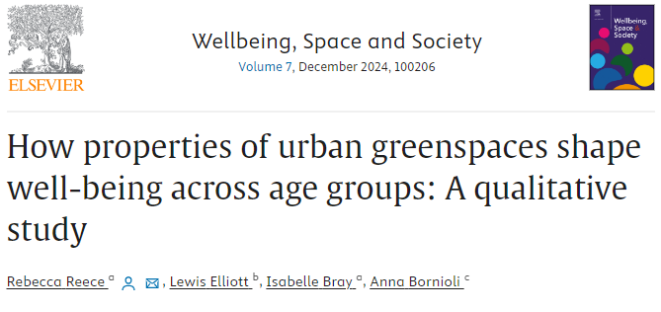
Theme: ‘Sharing a space with others’ ¹

Slide 3
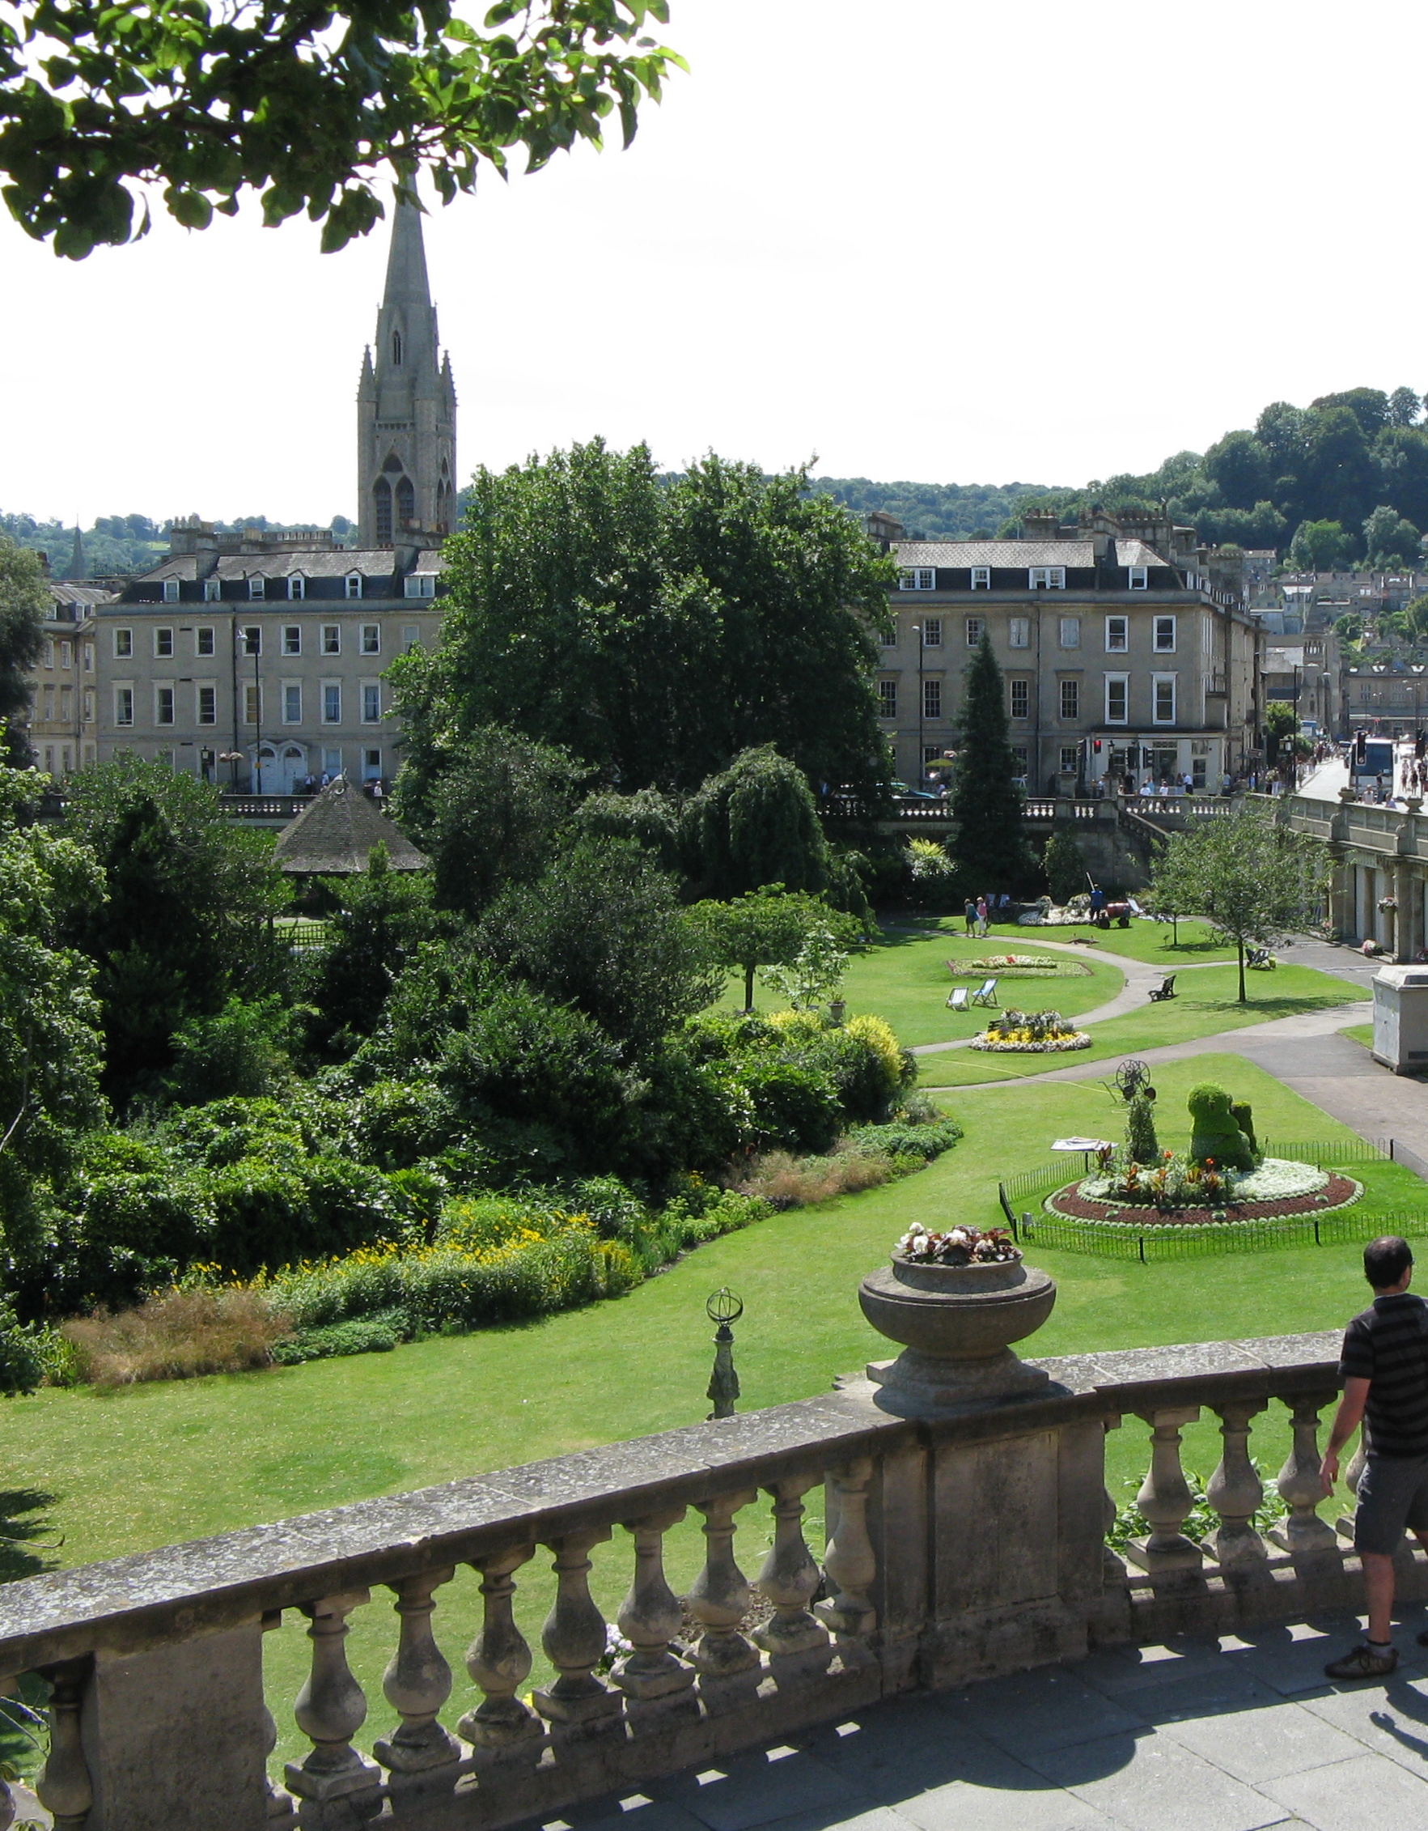
Introduction
Urban greenspaces can provide multiple benefits including psychological restoration², facilitating social cohesion³, and improving mood⁴.
Lack of experiments (1) looking at the presence of people (+ varying amounts) in their stimuli and (2) measuring state social connectedness as an outcome.
Generalisability? Urban greenspaces are often not free from people.
Use of virtual reality as a research tool.
This Photo by Unknown Author is licensed under CC BY-SA

Slide 4
Research questions
RQ1: To what extent does crowdedness impact the restorative experience of urban greenspace exposure?
RQ2: What effect does crowdedness have on feelings of social connectedness in an urban greenspace?
RQ3: Are RQ1 and RQ2 impacted by age?
Pending…

Slide 5
Methods - Experimental design
Figure 1. Experimental design

Slide 6
Measures
Subjective
Well-being/stress (UWIST MACL)⁵, restoration (PRS short)⁶, state social connectedness (UBC-SSCS)⁷
Trait social connectedness (SCS-R)⁸, loneliness (UCLA)⁹, connectedness to nature (CNS)¹⁰
Objective
Heart rate
Blood pressure
Qualitative
Semi-structured questions, e.g., which environment did you prefer and why?

Slide 7
1. No people

Slide 8
2. Few people

Slide 9
3. Lots of people

Slide 10
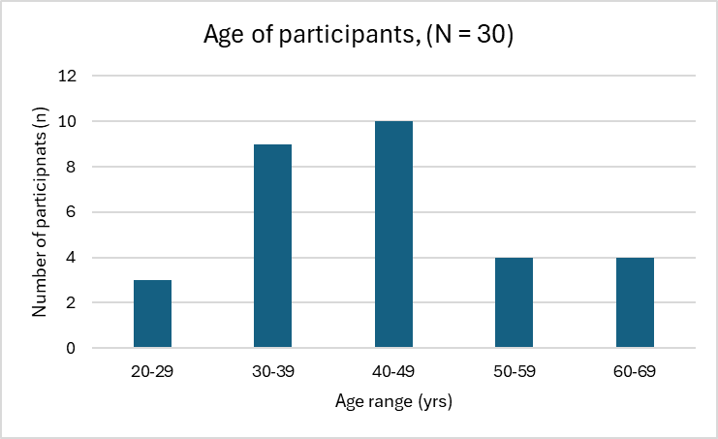
Results –
Participants so far (N=30)
Figure 3. Gender split
Ethnicity | n
White or White British | 24
Indian | 1
Chinese | 1
Arab | 2
Black - African | 1
Iranian | 1
Figure 2. Age of participants. M = 43.6 yrs, Range = 24-63 yrs
Table 1. Participant’s ethnicity

Slide 11
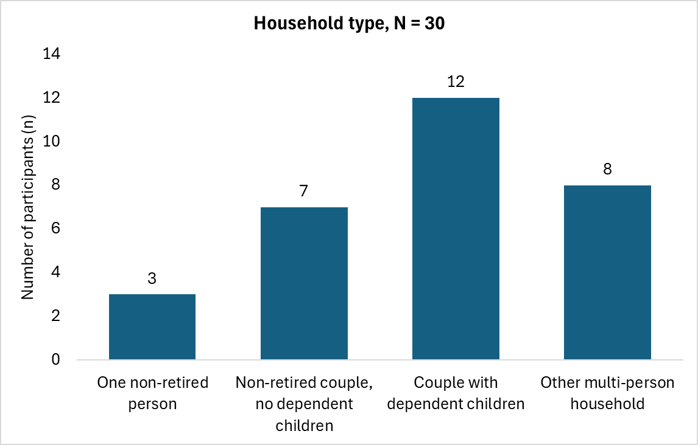
Experience with VR before
Figure 4. Prior experience with VR
Figure 5. Participant’s household type
Job role/department at university
Alumni Services
Careers and Enterprise
Doctoral Academy
Engineering/Bristol Robotics Lab
Film marketing
Human Resources
IT Services
Library
Nursing - simulation
Planning and Business Intelligence
Policing
Procurement
Research Associate
Research, Business and Innovation (RBI)
Science Technician
Strategic Programmes Office
Student and Academic Services
Student Outreach
Student Union – Advisor

Slide 12
Initial results - descriptive statistics
Data collection is ongoing. Today will only present initial findings (N = 30). Blood pressure/heart rate data has not been analysed yet.
Baseline/trait measures
 | Mean (SD)
Well-being - Stress - Hedonic tone - Energy | 7.5 (2.1) 13.8 (1.7) 11.9 (2.0)
Trait social connectedness | 91.1 (15.9)
Loneliness | 34.9 (8.3)
Connectedness to nature | 51.6 (7.9)
Well-being – stress: Scale = 4-16 (higher stress)
Well-being – hedonic tone: Scale = 4-16 (increased pleasantness)
Well-being – energy: Scale = 4-16 (increased energy)
Trait social connectedness: Scale = 20-120 (stronger sense of social connectedness)
Loneliness: Scale = 20-80 (increased feeling of loneliness)
Connectedness to nature: Scale = 14-70 (feeling more connected to nature)
Table 2. Descriptive results of baseline/trait measures

Slide 13
Well-being
 | Baseline | Post traffic 1 | Post Environment 1 (no people) | Post traffic 2 | Post Environment 2 (few people) | Post traffic 3 | Post Environment 3 (lots of people)
Stress | 7.5 (2.1) | 8.0 (2.7) | 5.8 (2.0) | 8.3 (3.2) | 5.6 (1.6) | 8.2 (3.1) | 7.3 (2.7)
Hedonic tone | 13.8 (1.7) | 13.1 (2.2) | 14.1 (1.6) | 12.3 (2.6) | 14.5 (1.3) | 12.2 (2.5) | 13.6 (2.0)
Energy | 11.9 (2.0) | 11.0 (2.5) | 11.3 (2.7) | 10.7 (2.7) | 11.8 (2.3) | 10.4 (2.6) | 11.8 (2.3)
Table 3. Descriptive results of well-being measures (UWIST MACL). Mean (standard deviation).

Slide 14
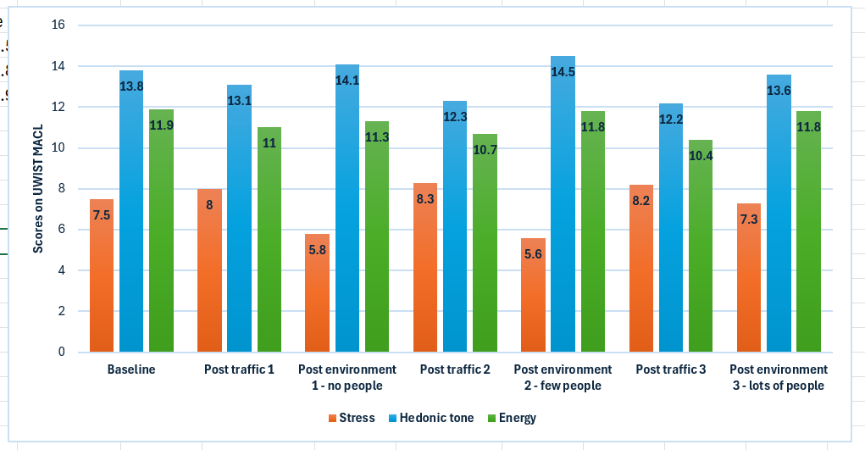
Well-being
Figure 6. Descriptive results of well-being measures (UWIST MACL) (Mean).

Slide 15
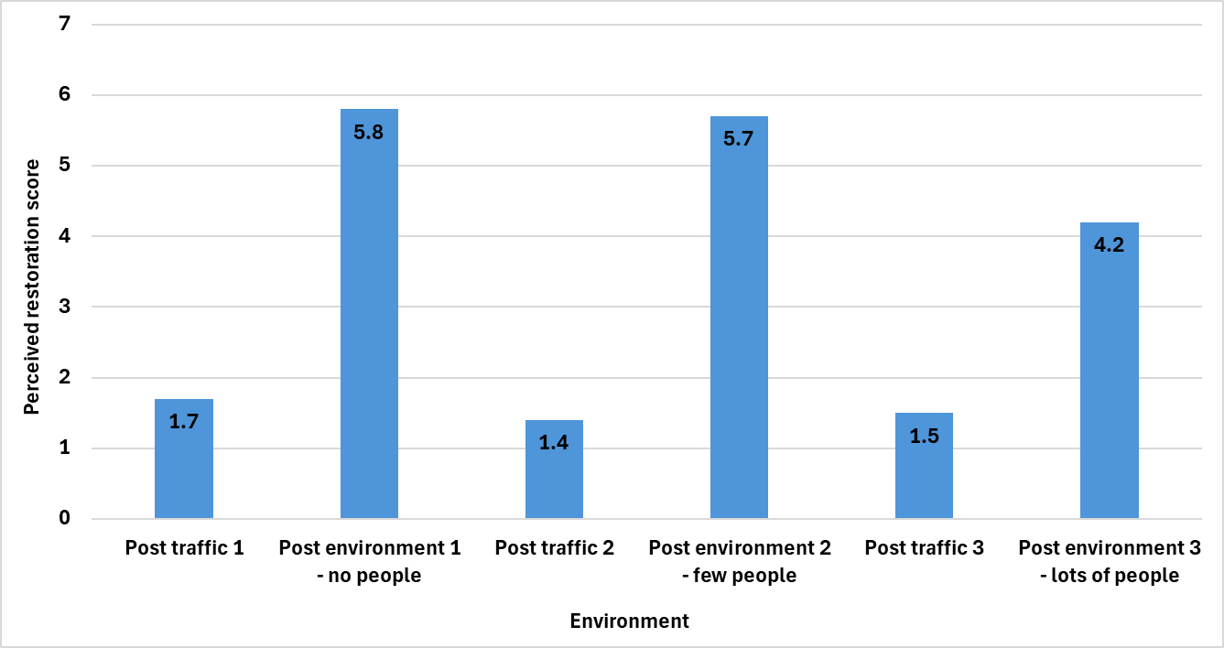
Restoration
Figure 7. Descriptive results of restoration (PRS short) (Mean).

Slide 16
Restoration
Post traffic 1 | Post Environment 1 (no people) | Post traffic 2 | Post Environment 2 (few people) | Post traffic 3 | Post Environment 3 (lots of people)
1.7 (1.4) | 5.8 (2.1) | 1.4 (1.2) | 5.7 (2.0) | 1.5 (1.2) | 4.2 (1.9)
Table 4. Descriptive results of restoration measure (PRS short). Mean (standard deviation).
State social connectedness
Post Environment 1 (no people) | Post Environment 2 (few people) | Post Environment 3 (lots of people)
41.9 (10.0) | 50.7 (8.5) | 46.9 (10.5)
Table 5. Descriptive results of state social connectedness measure (UBC-SSCS). Mean (standard deviation).

Slide 17
State social connectedness
Post Environment 1 (no people) | Post Environment 2 (few people) | Post Environment 3 (lots of people)
41.9 (10.0) | 50.7 (8.5) | 46.9 (10.5)
Table 3. Descriptive results of state social connectedness measure (UBC-SSCS). Mean (standard deviation).

Slide 18
Initial results - qualitative
It depends…
“Sometimes I need a quieter space outside to order my thoughts so I would prefer the empty one. But sometimes I want to be close to people and want the second one (environment 2 – few people)”
“Well, the second environment, number 3 (lots of people), I found quite overwhelming. This many people in the park”
“The empty one in the daytime… it would be ok. If it was really early or really late, it would be creepy. Whereas the last one (few people), it was a happy medium. There was enough people so that if I needed help, there would be someone to help me”
“If I was there (environment 3 – lots of people) with a friend or a partner, it would be a bit nicer”
“The one with the people… it was more closed in. I was looking at the people themselves rather than the landscape”
“... it depends on what you're feeling that day I suppose. If you're feeling ‘I wouldn’t mind a chat with someone’, you can go have a chat. But sometimes if you’re having a really rubbish day, sometimes you just want no one around and you can stare into space or hum a tune and no one will give you a weird look”
“I like nature, but I also need the social interaction, I don’t think they work in isolation”

Slide 19
Discussion
Well-being better when a few people are present.
Whilst other people being present can reduce the restorativeness of an UGS, feelings of social connectedness increase.
Useful in understanding how people perceive and use UGS depending on the social context and what they want – it can depend!
Particularly relevant due to the pandemic and peoples changing use of UGS and being around other people.
“I have become more agoraphobic since lockdown”
This Photo by Unknown Author is licensed under CC BY-SA

Slide 20
References
Reece, R., Elliott, L., Bray, I., and Bornioli, A. (2024). How properties of urban greenspaces shape well-being across age groups: A qualitative study. Wellbeing, Space and Society. 7, 100206.
Ohly, H., White, M., Wheeler, B.W., Bethel, A., Ukoumunne, O.C., Nikolaou, V., and Garside, R. (2016). Attention Restoration Theory: A systematic review of the attention restoration potential of exposure to natural environments.. 19(7), 305-434. Journal of Toxicology and Environmental Health, Part B
Wan, C., Shen, G.Q., and Choi, S. (2021). Underlying relationships between public urban green spaces and social cohesion: A systematic literature review. City, Culture and Society. 24, 100383.
Callaghan, A., McCombe, G., Harrold, A., McMeel, C., Mills, G., Moore-Cheery, N., and Cullen, W. (2020). The impact of green spaces on mental health in urban settings: a scoping review. Journal of Mental Health. 30(2), 179-193.
Matthews, G., Jones, D.M., and Chamberlain, G. (1990). Refining the measurement of mood: The UWIST Mood Adjective Checklist. British Journal of Psychology. 81(1), 17-42.
Berto, R. (2005). Exposure to restorative environments helps restore attentional capacity. Journal of Environmental Psychology. 25(3), 249-259.
Lok, I., and Dunn, E. (2023). The UBC State Social Connection Scale: Factor Structure, Reliability, and Validity. Social Psychological and Personality Science. 14(7), 835-844.
Lee, R.M., Draper, M., and Lee, S. (2001). Social connectedness, dysfunctional interpersonal behaviors, and psychological distress: Testing a mediator model. Journal of counselling psychology. 48(3), 310.
Russell, D.W. (1996). UCLA Loneliness Scale (Version 3): Reliability, Validity, and Factor Structure. Journal of Personality Assessment. 66(1), 20-40.
Mayer, F.S., and Frantz, C.M. (2004). The connectedness to nature scale: A measure of individuals’ feeling in community with nature. Journal of Environmental Psychology. 24(4), 503-515.

Slide 21
Thank you Any questions?

