Slide 1


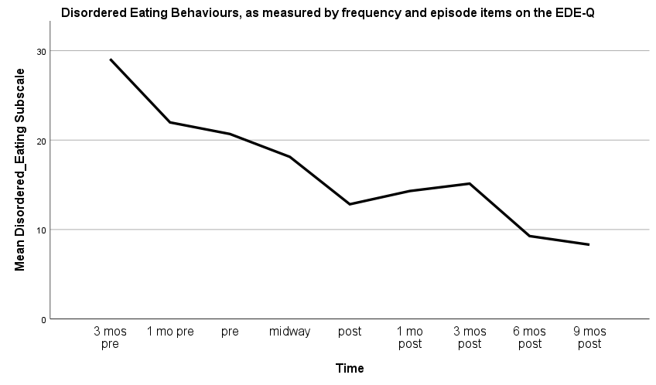
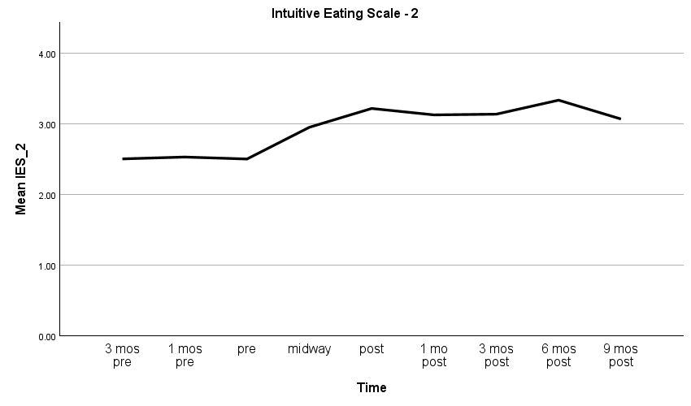
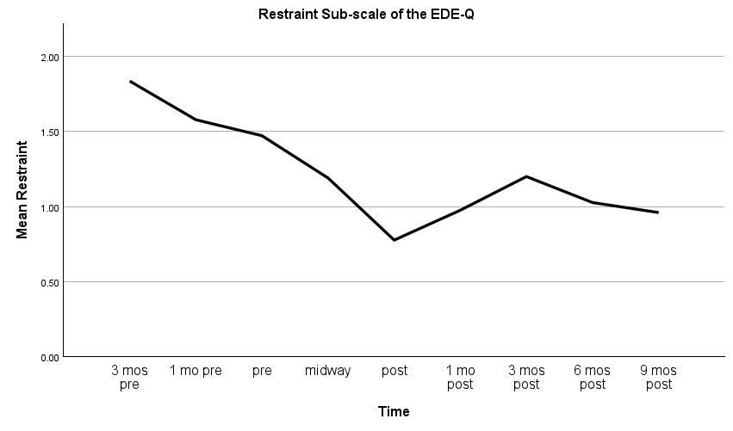
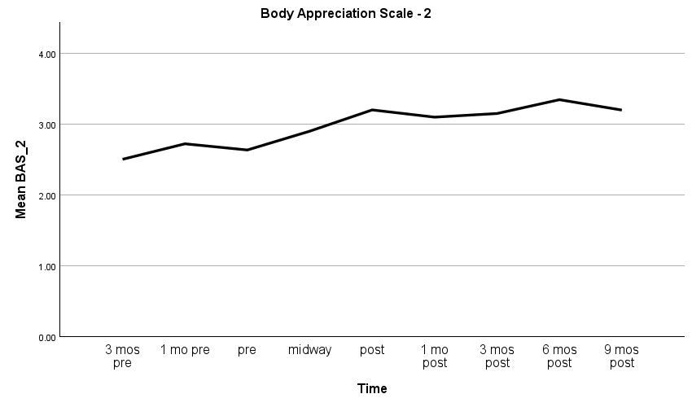
Can mindfulness training reduce disordered eating or increase intuitive eating?
Ramsey-Wade, C.¹, Daniels, E.¹, Williamson, H.¹, Atkinson, M.² & Halliwell, E. (¹UWE, ²UoBath)
Correspondence: christine.ramsey-wade@uwe.ac.uk
Background and Aim
Disordered eating is widespread, and we need a wide range of effective, evidence-based treatments that appeal to the different people who experience it (Atkinson, 2015). Mindfulness training has been shown to be as effective as other active interventions in improving mental and physical health (de Vibe et al., 2017), and so offers an embodied, experiential, non-verbal alternative to CBT or dissonance-based interventions for disordered eating (Atkinson, 2014). Some systematic reviews have found positive results for mindfulness training for disordered eating (Godfrey et al., 2015; Mercado et al., 2021), and mindful eating programmes now proliferate (Beccia et al, 2020; Kristeller et al., 2014). Mindful Eating – Conscious Living™ (ME-CL) is an American 8-week mindfulness programme that focuses on cultivating a joyful relationship with food. ME-CL™ is already being delivered internationally, without any formal evaluation. The aim of this study was to teach ME-CL™ under research conditions to test its effectiveness.
Method
Design: non-randomised controlled trial with internal control
Participants:
  47 women
    Mean age in years: 39.51, SD 11.36
    85.10% White
Self-report survey data using the following measures:
  Disordered Eating Behaviours subscale of EDE-Q (Gideon et al., 2016): Number & frequency of episodes over last 4 weeks
  Restraint sub-scale of EDE-Q (Gideon et al., 2016): 7 item Likert scale ranging from 0-6
  Intuitive Eating Scale – 2 (Tylka & Kroon Van Diest, 2013): 5-point Likert scale from 1-5
  Body Appreciation Scale – 2 (Avalos et al., 2005): 6-point Likert scale from 0-5
Data collected over 9 time points:
  3 months before the intervention
  1 month before
  Pre-intervention
  Midway through intervention
  Post-intervention
  1 month follow-up
  3 months follow-up
  6 months follow-up
  9 months follow-up
Analysis: Linear mixed models
Results: Significant trends over time for all measures
Disordered eating (F = 14.460; p = <0.001)
Intuitive eating (F = 23.309; p = <0.001)
Restraint (F = 7.538; p = 0.007)
Body appreciation (F = 18.721; p = <0.001)
Conclusion
Mindful Eating – Conscious Living™ can reduce disordered eating and increase intuitive eating in women with an interest in mindfulness. Further trials are warranted with more diverse samples, in fully randomised designs, to investigate ME-CL™ and its key components.

