Slide 1




The role of GBGI in levelling up in Bristol
UWE team:
Issy Bray (Associate Professor in Public Health Epidemiology)
Danielle Sinnett (Professor in Sustainable Built Environments)
Harry West (Senior Lecturer in Geography and Environmental Management)
Notes:
To change the picture in the background:
Right click
Format background
Picture/texture fill
Insert…
Use the Offset settings to make sure the image isn’t stretched

Slide 2

AIM - to explore relationships between GBGI and a range of health and social outcomes in neighbourhoods across Bristol
Background
Objectives
Mental health, particularly for urban populations, is a growing public health concern.
Understanding how people relate to and feel a sense of belonging in the urban environment is an important research agenda.
There is mounting evidence about the importance of green (e.g. parks, trees) and blue (e.g. rivers, lakes) infrastructure for the health and wellbeing of urban residents.
There is also emerging evidence about the benefits of certain ‘grey’ features (e.g. historic buildings, active travel routes).
Collate health and wellbeing data from the Bristol Quality of Life Survey for 2011-2022 (3000-5000 responses per year)
Select outcome measures from ~190 indicators of QoL and wellbeing of residents
Collate spatial GBGI data from openly available sources e.g. OS, Bristol Open Data, Census, Natural England
Identify the most useful indicators of exposure to GBGI e.g. the number of trees within a 10-minute walk of a postcode, distance to the nearest bus stop, river or green space
Use GIS and regression modelling to link GBGI exposure to measures of QoL and wellbeing e.g. self-reported health, social interaction and neighbourhood satisfaction

Slide 3
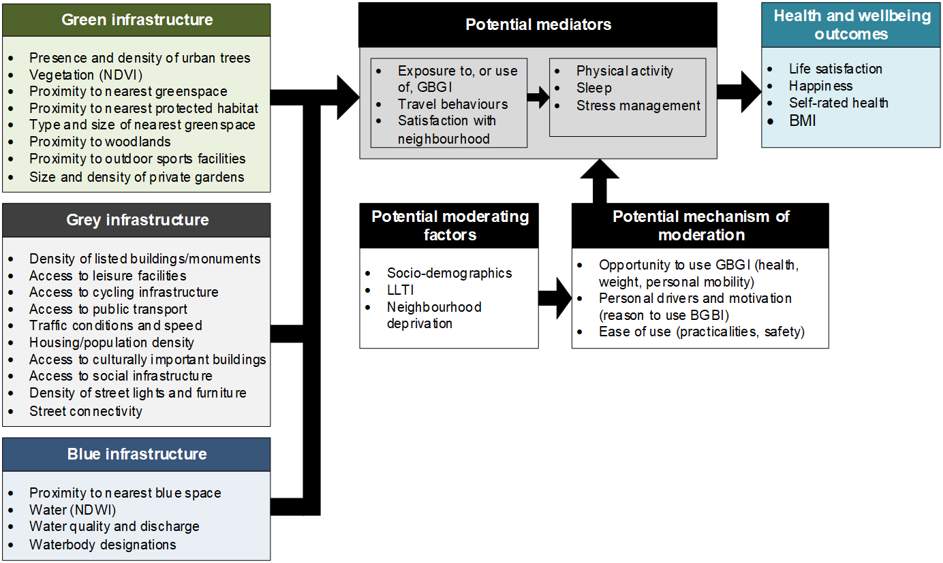
Model

Slide 4
Results
Life satisfaction
GBGI exposure
GBGI satisfaction*
GBGI use
Mental wellbeing
* Satisfaction with green space, buses, leisure facilities, neighbourhood (noise, litter, air quality)

Slide 5
Conclusions
In this project we investigate the relationship between GBGI and self-reported life satisfaction and wellbeing over a long time period at high-resolution in Bristol.
Multiple GBGI factors were explored, including detailed mapping of GBGI exposure and reported satisfaction with and frequency of use of GBGI.
No significant relationships have been found between GBGI exposure and self-reported life satisfaction and wellbeing.
However, significant associations found between GBGI satisfaction and frequency of use and self-reported life satisfaction and wellbeing.
GBGI satisfaction and frequency of use is somewhat linked to GBGI exposure.
Suggests enhancing GBGI exposure in itself is not likely to directly lead to improvements in LS and wellbeing.
However, improving the quality of and peoples experience of GBGI and their local environment (as well as exposure) is potentially important in enhancing life satisfaction and wellbeing.

