Slide 1
Unfinished AI Experiments
Erinma Ochu
erinma.ochu@uwe.ac.uk

Slide 2
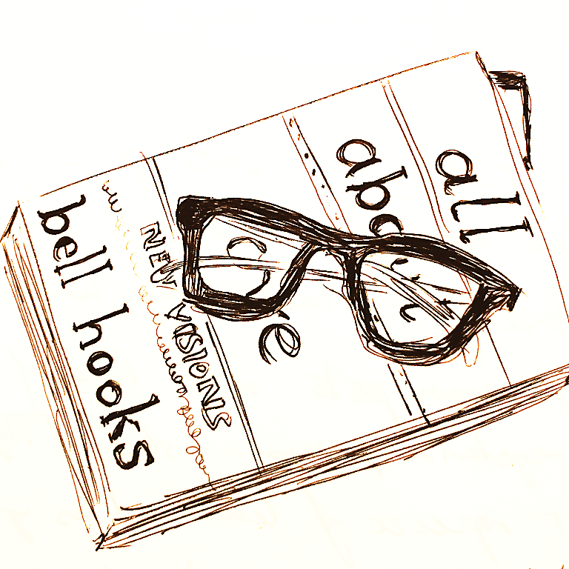
To know compassion
That love redeems
That fear stands in the way of knowing love
Choosing love against lovelessness
hooks, 2000
Notes:
I wanted to open with short readings, to acknowledge the challenge times we’re living through –
- To know compassion
- Love redeems
- Understanding all the ways fear stands in the way of knowing love challenges us
- Choosing love against lovelessness

Slide 3
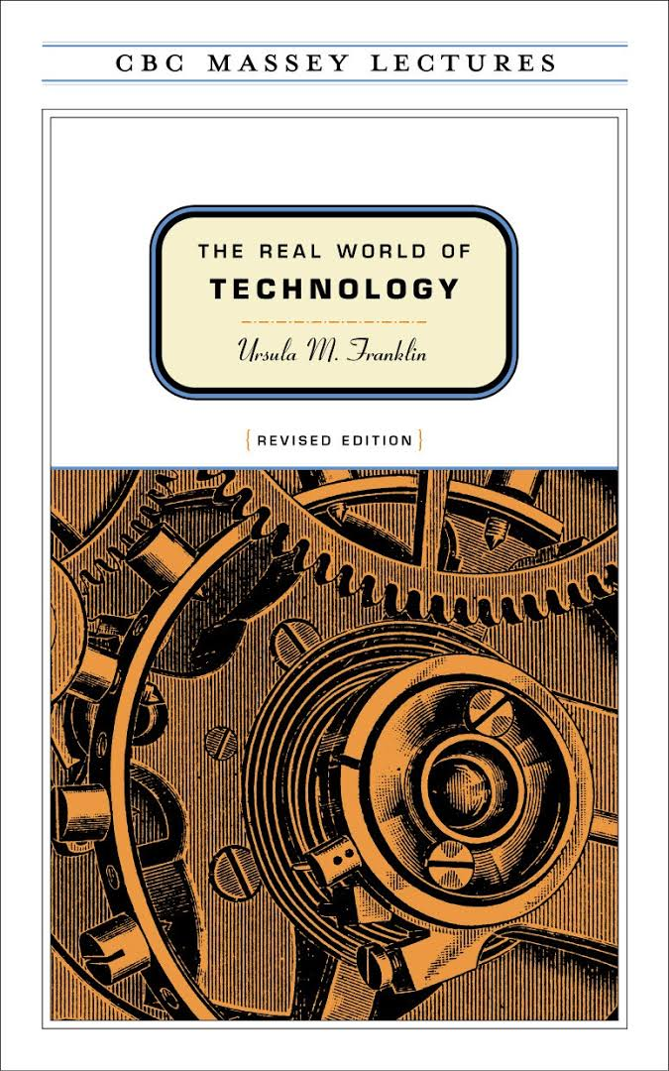
‘…technology as ideas, and dreams, as practices and procedures, as hopes and myths’
Ursula M Franklin
Podcasts https://www.cbc.ca/radio/ideas/the-1989-cbc-massey-lectures-the-real-world-of-technology-1.2946845
Franklin, 1990
Notes:
Worth noting that technology has always always been part of human existence, and has large scale effects on culture itself.
I find this 1989 lecture series on ‘The Real World of Technology’ by Canadian Experimental Physicist, Ursula M Franklin, gives an interesting perspective
She looks at technology as ideas, and dreams as practices and procedures, as hopes and myths.
She also describes extended reality as a body of knowledge and emotions we acquire that is based on the experience of others. It’s this extension of our own reality, through technology as a practice, that creates our world. It’s guided by our values, beliefs and culture.

Slide 4
Swinton, Ochu & the MSI Turing’s Sunflower Consortium 2016

Slide 5
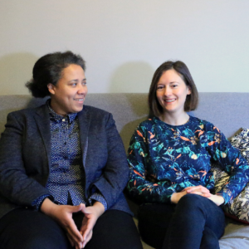
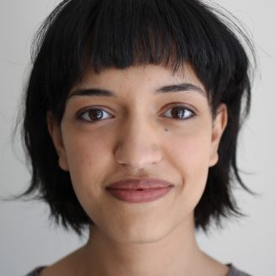
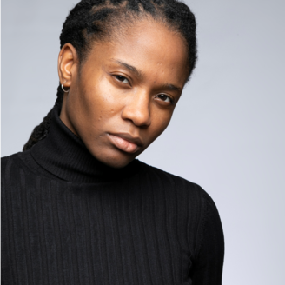
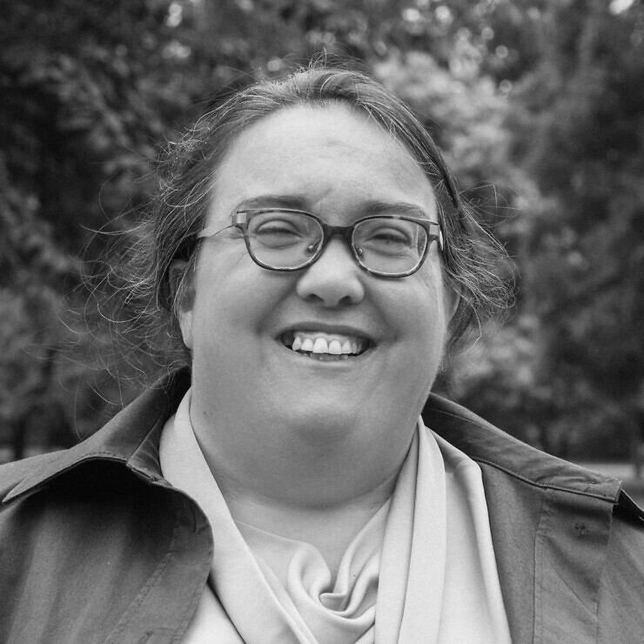
Louise Hickman
Caroline Ward
Sarah Chander
Yasmine Boudiaf
Irene Fubara-Manuel

Slide 6
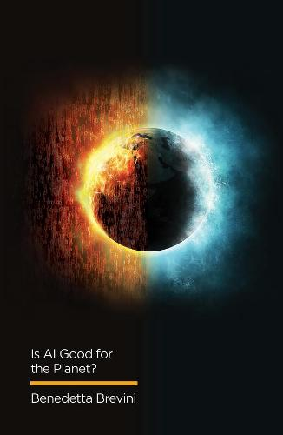
‘AI can be defined as the ability of machines to mimic and perform human cognitive functions. These include reasoning, learning, problem-solving, decision-making, and even the attempt to match elements of human behaviour such as creativity.’ p35
‘AI is a collection of technologies that combine data, algorithms and computing power. Advances in computing and the increasing availability of data are therefore key drivers of the current upsurge of AI’ p40
‘AI can be understood as a set of technologies, machines and infrastructures that demand amounts of energy in order to compute, analyse and categorize. They use scarce resources in their production, consumption and disposal, exacerbating the problems of waste and pollution’ p41
Benedetti Brevini
Brevini, 2021

Slide 7
Jo Bates – Lead investigator
Professor in Data and Society
University of Sheffield
Helen Kennedy
Professor of Digital Society
University of Sheffield
Monika Fratczak
Postdoctoral Researcher
University of Sheffield
Itzelle Medina Perea
Lecturer in Information Sciences
University of Sheffield
Samborne Bush
Research Associate
UWE Bristol
Hadley Beresford
Postdoctoral Researcher
University of Sheffield
Victoria Tillotson
Talent Development Lead, Pervasive Media Studio, Watershed
Martin O’Leary
Studio Community Lead, Pervasive Media Studio, Watershed
Tony Bhajam
Inclusion Producer, Pervasive Media Studio, Watershed
Craig Scott
Instrument Maker & PIP Artist-in-Residence
Toju Duke
Founder, Diverse AI & Dialogue Partner
Tom Marshman
Artist & Dialogue Partner
Project Website, here.
Notes:
Amy Densley, Nick Triggs, Catherine Smith, Abbie Rogers, Toyosi Alasi, Giorgio Stratos,
Jo Lansdowne & Furaha Asani

Slide 8
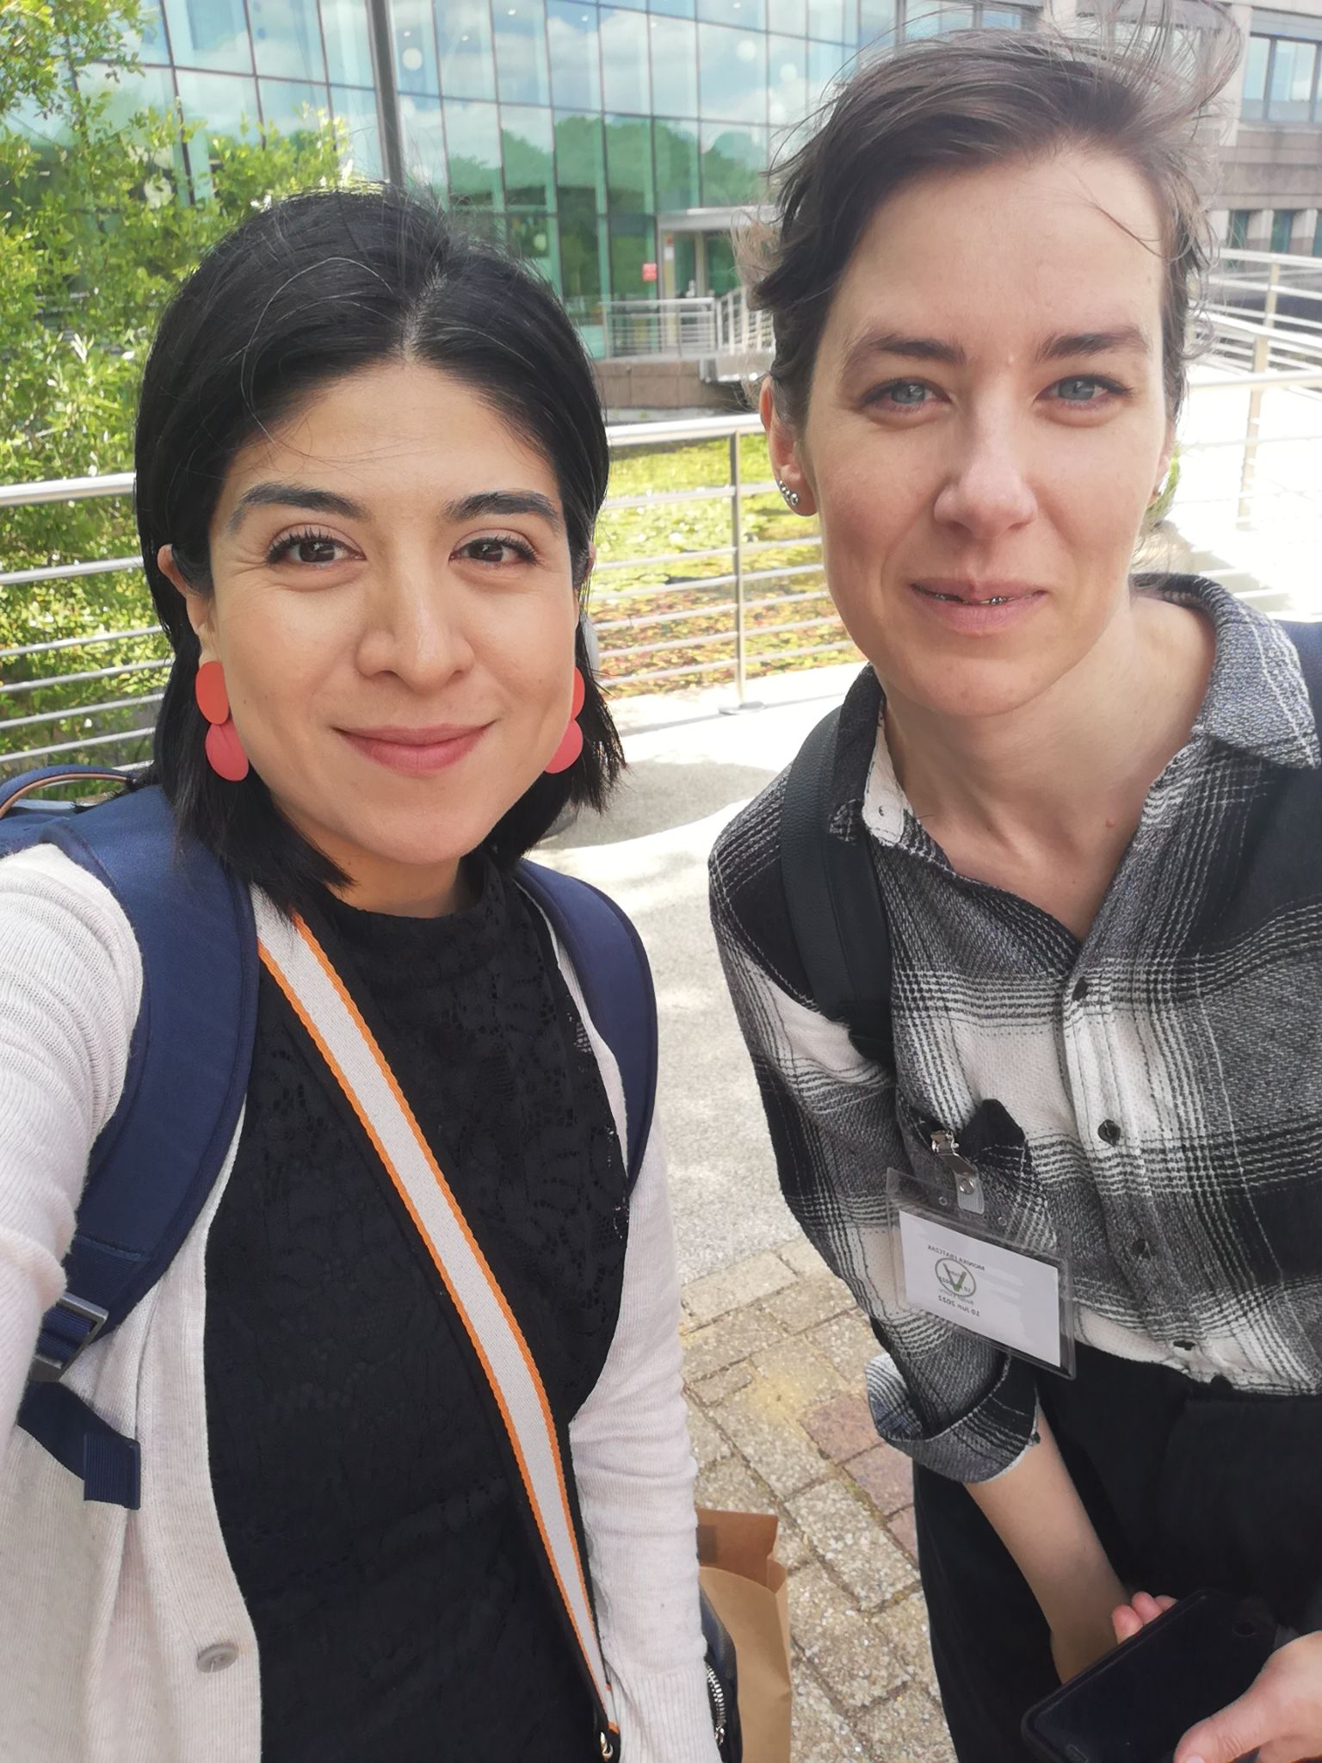
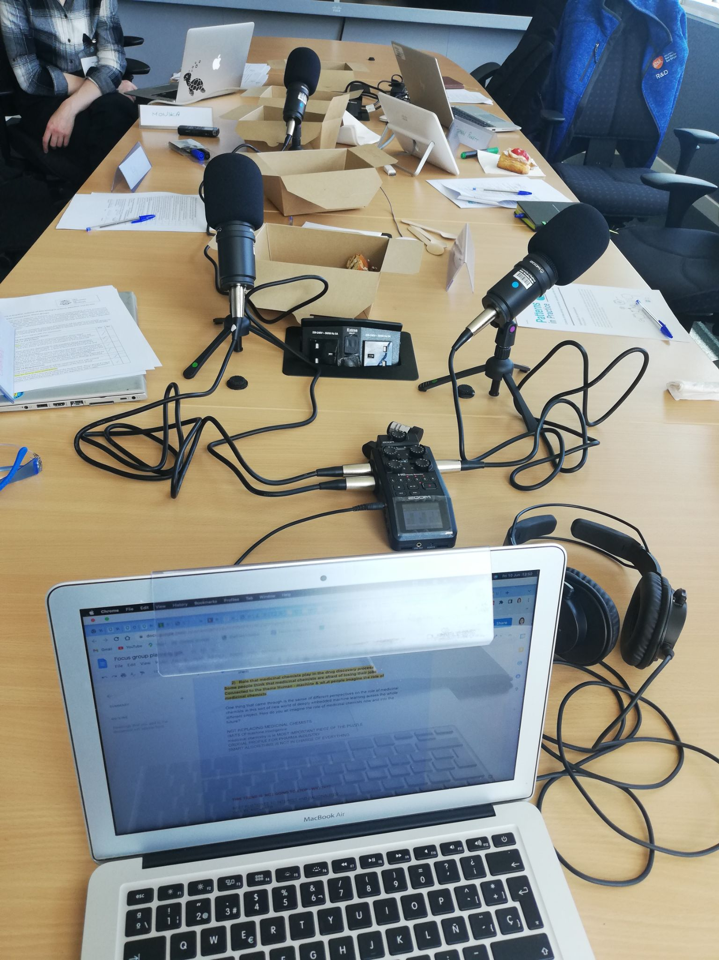
Beliefs, values, and emotions in practitioners’ engagements with machine learning and data mining
Feeding the Machine
Call for Collaboration/ Meaningful work
Tactics of Resistance
Deficit of Surprise
Where the Magic Happens
https://lifeofdata.org/site/patterns-in-practice/publications/

Slide 9
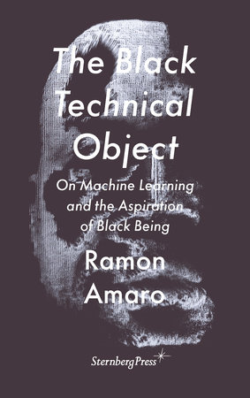
‘We are a social body that feeds on a junk pile of fragmented experiences. We brought into visibility this insatiable need for the algorithmic… to satisfy our overindulgence in a world that we made in our own image. This image not only illuminates a dissatisfaction with the violences the West has projected onto the world, but is also a working model of the epistemic deficiencies of logical positivism….
…a supernatural belief of this vague idea of data - in which the West has placed its confidence - loses its efficacy when faced with the very real notion of a life outside of its own obsession with social administration’
Ramon Amaro, p16

Slide 10
https://www.craigscottslobotomy.com/
Notes:
What reminds us of what it feels like on his fingertips to fight the machine and to feel it’s agency. Do check out Samborne’s podcast.

Slide 11
https://www.watershed.co.uk/studio/projects/more-ai-sandbox

Slide 13
References
Amaro, R. (2022). The Black Technical Object. On Machine Learning and the Aspirations of Black Being. Sternberg Press
Brevini, B. (2021). Is AI good for the planet? Polity
hooks, b. (2000). All About Love: New Visions
Franklin, U.M. (1999). The Real World of Technology. House of Anansi
Hickman, L. Boudiaf, Y., Fubara-Manuel, I., Chander, S., Ochu, E. and Ward, C. (2021). Community Agreement for Open Labs Version 1.0 https://docs.google.com/document/d/e/2PACX-1vSoNVDMnYmcojEUtC4ayxNyZe-vTGtTjYus5MtYK2MAwsQm-coyuDl9XhOQnYf2NF3swr6rA2aPcf6q/pub
Ochu E.E, Rothwell N.J, Waters C.M. (1998). Caspases mediate 6-hydroxydopamine-induced apoptosis but not necrosis in PC12 cells. J. Neurochem. 70(6), pp2637-40
Storey, H. & Storey, K. Primitive Streak http://www.primitive-streak.org/
Swinton, J. Ochu, E. And The MSI Turing’s Sunflower Consortium (2016). Novel Fibonacci and non-Fibonacci structure in the sunflower: results of a citizen science experiment. R. Soc. Open Sci. 3:160091 http://doi.org/10.1098/rsos.160091

