Slide 1





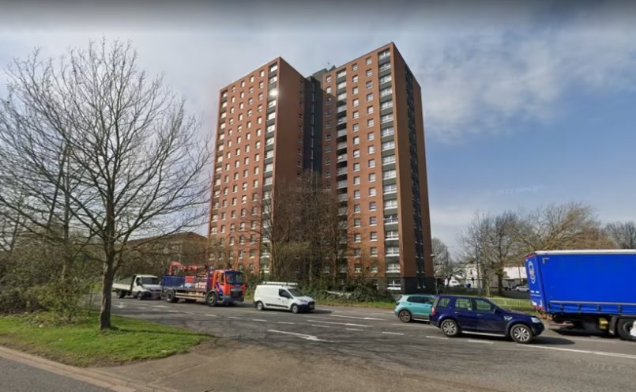
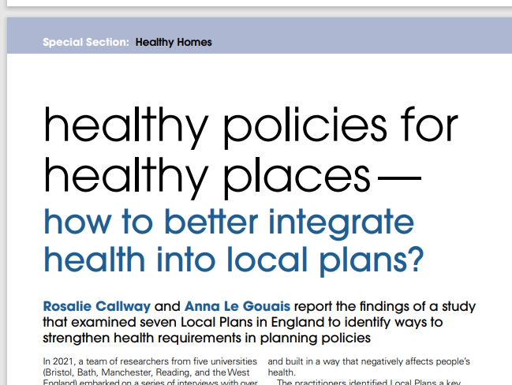
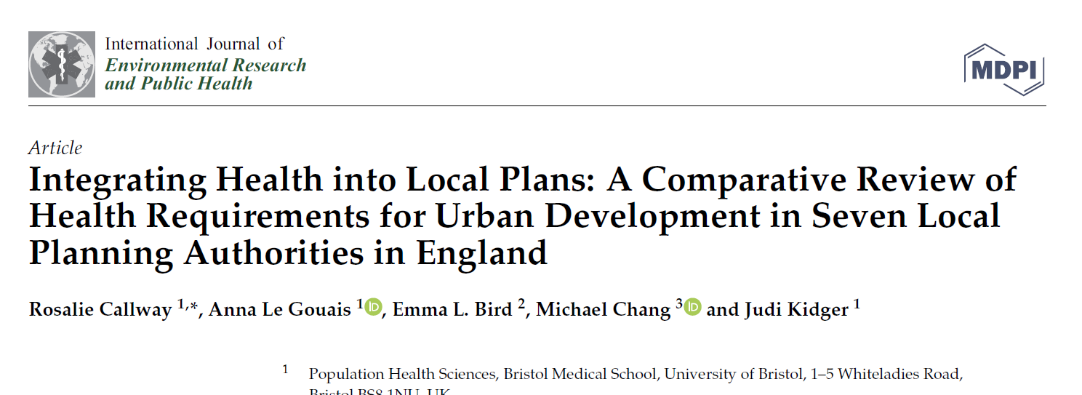


Integrating health in Local Plans: An impact evaluation
E Birdª, K Hanss^{b}, A Le Gouais^{b}, J Kidger^{b} (ª UWE Bristol, ^{b} University of Bristol)
Introduction
Local plans are a set of development policies used by local planning authorities in England for future development in an area.
Local plans need more specific requirements regarding wider health determinants to address potential health outcomes and health inequalities¹.
Findings
Six themes were derived from the data:
1) Increased health coverage
“It had a direct impact on what we’ve been able to include in our [local] plan...able to incorporate a much more detailed policy about build-to-rent.”
2) Importance of precedent and detail
“Having evidence of what other local authorities do was really important.”
3) Stakeholder buy-in
“Councillor recognised that health was not at the centre of the Local Plan and questioned how you make the interventions and outcomes about people and not bricks and mortar.”
4) Relationship building
“Public Health’s involvement has been positive and [created a] space for sharing between officers.”
5) Researcher-in-Residence added value
“[It has] had a direct positive impact on the attention we’ve been giving to public health.”
6) Range of resources required
“Resource is really challenging, and you see it across all levels of the council – it’s austerity.”
Conclusions
The framework review process was valuable for the local government partner involved and its emerging local plan, in addressing barriers and creating facilitators for better integration of health in local development planning policies.
Next steps…
To develop the framework into transferable and sustainable guidance to support its use more widely across English local planning authorities.
Aim
To explore the impact of developing and implementing a co-produced framework^{2,3} to strengthen the integration of health in local plan development.
Acknowledgements
This work was supported by the UK Prevention Research Partnership, an initiative funded by UK Research and Innovation Councils, the Department of Health and Social Care (England) and the UK devolved administrations, and leading health research charities. Weblink: https://ukprp.org/
Contact
Emma Bird emmabird@uwe.ac.uk
www.truud.ac.uk
@researchtruud
truud@bristol.ac.uk
(3)
(2)
Methods
Qualitative evaluation involving collection and analysis of data from:
In-depth online semi-structured interviews with stakeholders, including planning and public health professionals and local councillors.
Researcher-in-Residence fieldnotes.
References
¹Le Gouais, A. et al. (2023). Understanding how to create healthier places: A qualitative study exploring the complex system of urban development decision-making. Health and Place.
²Callway, R. & Le Gouais, A. (2023). Healthy policies for healthy places – how to better integrate health into local plans? Town & Country Planning, 92 (5), 344-349.
³Callway, R., et al. (2023). Integrating Health into Local Plans: A Comparative Review of Health Requirements for Urban Development in Seven Local Planning Authorities in England. Environmental Research and Public Health, 20 (5), 4079.

