Slide 1
Reflections on
XR Audio Craft
Re-Presenting Act & Place
Luke.Reed@uwe.ac.uk

Slide 2
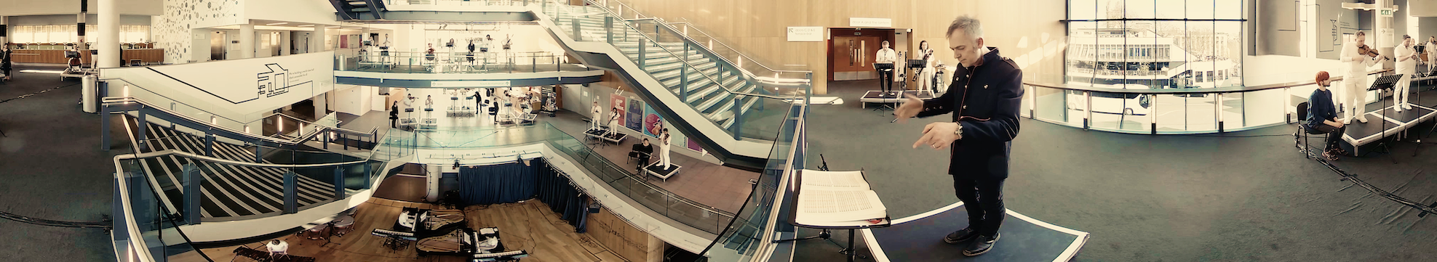
ANATOMY OF THE ORCHESTRA
Charles Hazelwood / British Paraorchestra & Friends / Bristol New Music
360 Film / CineVR (2018)

Slide 3
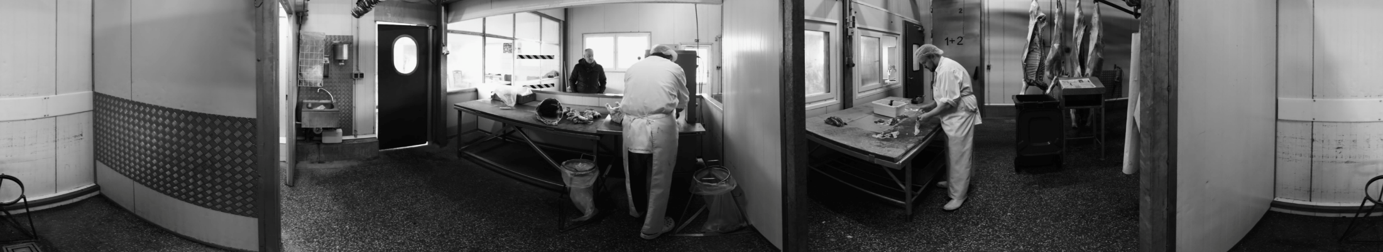
ROOMS
Christian Zipfel / FilmUniversitat Bablesberg
360 Film / CineVR (2018)

Slide 4


Catherine Allen

Slide 5

EARTHSONGS
Mitch Turnbull / AllSeeingEye / SWCTN
Magic Leap / Mixed Reality (2019)

Slide 6
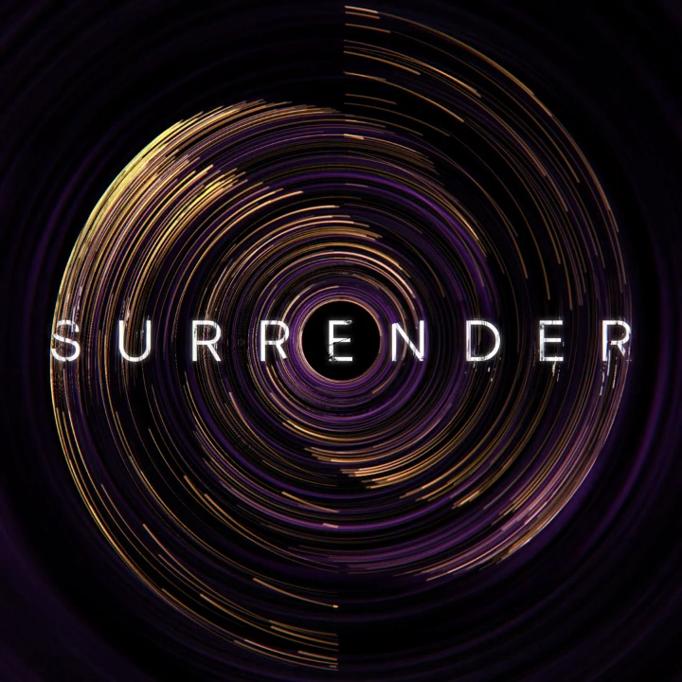

SURRENDER
SHOP / Monika Krajl / SWCTN
Full Dome / 7OA (2019)
Notes:
Neil Harris & Artur Bondarciukas

Slide 7
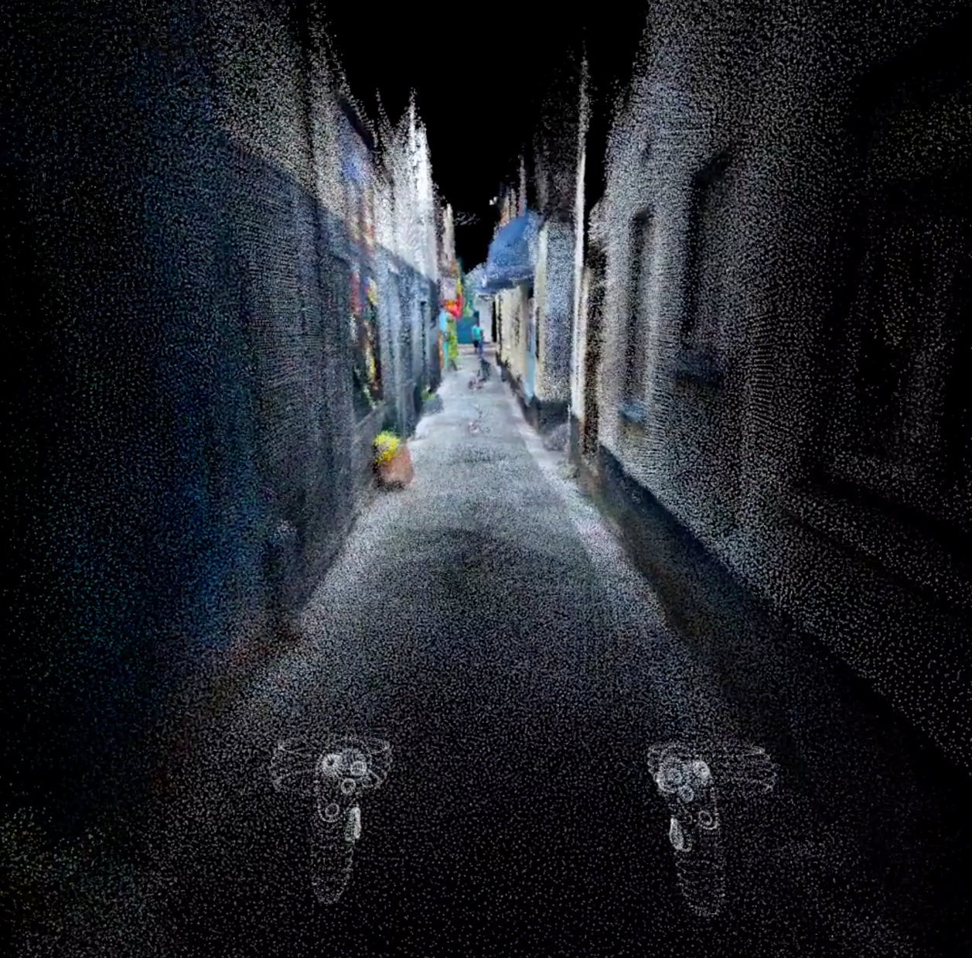
BRIXHAM IMMERSED
Merate Barakat / Natasha Nicolson
Meta Quest / Virtual Reality (2020-2022)

Slide 8
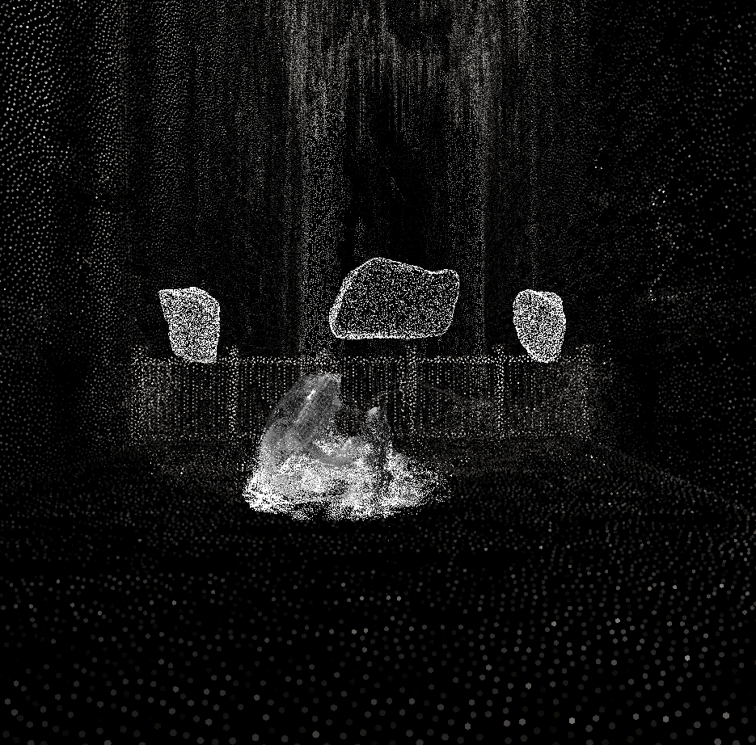
SEDIMENTARY STONE TAPES
Kelly Jayne Jones / Bristol New Music
Meta Rift / Virtual Reality (2022-2023)

Slide 9
Practice
Craft
Permanent
Authorship
Actuality
Audience
Affordance
Research
Auteur
Ephemeral
Agency
Construct
Technology
Limitations

