Slide 1
Regulating Armed Swarms Under International Law. Dr Mike Pollard University of the West of England
24 November 2023

Slide 2
Contents
Defining the scope of the paper.
Defining armed swarms.
Identifying the law applicable to armed swarms.
The issue with the law regarding armed swarms.
The solution.

Slide 3
1 - Scope of Paper
Primary focus upon ‘fully autonomous’ armed swarms.
Some semi-autonomous and/ or non-autonomous swarm deployments may nevertheless be affected by recommendations.
Recommendations are made with specific regard to autonomous armed swarms but are not designed to act as a solution to Autonomous Weapons Systems (AWS) more generally.
The recommendations seek to restrict the number of instances in which armed swarm deployments should be considered lawful.
No intention to argue that an absolute prohibition should be placed upon armed swarm deployments.
Recommendations offered do not constitute a complete regulatory framework.

Slide 4
2 - What is a robotic Swarm?
A collection of individual yet identical mechanical elements.
The collective behaves in a way that is synonymous with the dense collections of insects that are found in nature.

Slide 5
2.2 – What is an Armed Swarm?
An armed swarm is a collection of individual elements that can work together and apply force to achieve a common purpose (e.g., destroy enemy radar).
Could in theory be a collection of individual weapons platforms (e.g., Predator drones).
But are generally seen as a collection of non-recoverable munitions.
Technology is still in its relative infancy.

Slide 6
2.3 – Autonomous Armed Swarms
Courtesy of Collins Aerospace
Autonomous Armed Swarms operate without human supervision
After a human operator authorises deployment, the swarm is capable of making is own battlefield decisions.
Armed swarms are therefore a form of AWS, noting that there is no widely recognised definition of such.
The ‘Loyal Wingman’ project (pictured above) is a semi-autonomous system.

Slide 7
2.4 - Basic Levels of Autonomy.
Human-in-the-loop systems (non-autonomous):
Systems where a human is involved in the decision-making process (e.g., target verification).
Human-on-the-loop Systems (semi-autonomous):
Systems which can make all necessary decisions, but which are also supervised by a human (who can override or abort mission).
Human-out-of-the-loop systems (fully autonomous):
Systems which, after deployment, can make all necessary decisions without human oversight.

Slide 8
3 - The Law Applicable to Armed Swarms.
When deployed as a means or method of conducting warfare swarms must adhere to the rules stemming from International Humanitarian Law (IHL).
Article 48 Additional Protocol II (APII) provides the Basic Rule (of IHL),
[i]n order to ensure respect for and protection of the civilian population and civilian objects, the Parties to the conflict shall at all times distinguish between the civilian population and combatants and between civilian objects and military objectives and accordingly shall direct their operations only against military objectives.
The basic rule is a two-stage test that must be completed by all military decision-makers, whenever civilian harms (however slight) are possible.

Slide 9
4 - The Issue with Armed Swarms.
As with all AWS, humans delegate decision-making responsibilities to machines.
Certain deployments arguably unproblematic.
For example, a swarm may be used to protect a payload by confusing or destroying enemy radar systems.
A swarm may also be directed to ‘destroy all enemy tanks’.
Most controversially, however, a swarm could, at least in theory, be programmed to engage a target or group of targets based on a set of pre-defined criteria.
A swarm may be deployed with the ‘order’, for example, to kill all males of a military age.
Images courtesy of autonomousweapons.org

Slide 10
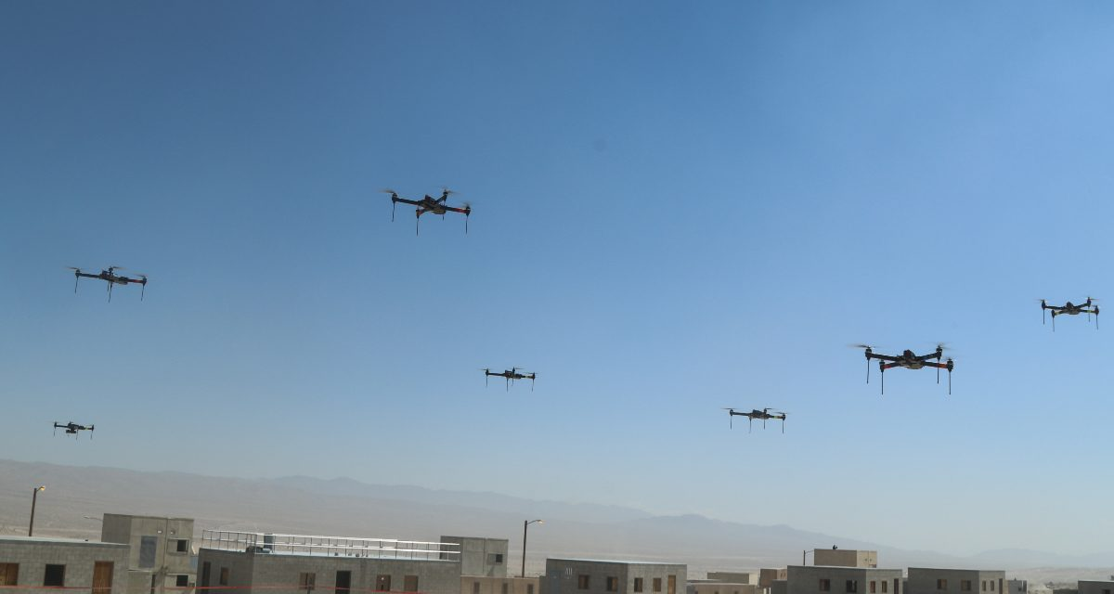
4.2 - Criteria Based Targeting
Allows for a decision-maker to simply direct a swarm to any location, including urbanised areas.
On the face of it, swarm could operate in adherence with the basic rule.
However, the civilian population could be harmed as a result, not only physically but psychologically.
Image courtesy of mwi.usma.edu
Indeed, such an action may cause terror among a civilian population.
May even constitute Human Rights Violations, e.g.,
Art 9 ICCPR, Right to liberty and security of person
Art 14 ICCPR, prohibition on arbitrary or unlawful interference with his privacy, family, home or correspondence

Slide 11
5 – The solution.
Swarms as a form of bombardment.
Bombardment is defined as,
‘a continuous attack with bombs, shells, or other missile’ (ODE).
Difficult to argue that a swarms attack would not qualify as ‘continuous’.
And a missile, for example, is consequently defined as
‘an object which is forcibly propelled at a target, either by hand or from a mechanical weapon’ (ODE).
Armed robots swarms are perhaps unlikely to be on the minds of the drafters of the IHL treaties (consider carpet bombing tactics of Luftwaffe and Allied Airforce’s during WWII).
However, IHL could, and arguably should, be interpreted in a way which accounts for contemporary advances in weapons technology.

Slide 12
5.2 - Relevance
As previously noted, individual swarm members may be capable (theoretically) of acting in accordance with the basic rule (in other words, the IHL Principle of Distinction).
However, a military decision-maker who is responsible for authorising a swarm deployment cannot possibly make such a determination.
Instead, they are merely responsible for directing a swarm to a geographical area (the battlefield), which increasingly includes urban environments (e.g., cities, towns, and villages, which all contain a concentration of civilians and/ or civilian objects).

Slide 13
5.3 - Article 51 API as a Swarm Regulator
Art. 51 (4) API states,
Indiscriminate attacks are prohibited;
Art. 51(5) API continues,…[a]mong others, the following types of attacks are to be considered as indiscriminate:
An attack by bombardment by any methods or means which treats as a single military objective a number of clearly separated and distinct military objectives located in a city, town, village or other area containing a similar concentration of civilians or civilian objects…(Art. 51(5)(a) API).

Slide 14
5.4 Concluding Notes
The proposed interpretation of Article 51 API will not restrict all deployments of armed swarms.
Indeed, there many be many instances where swarms can be deployed in complete adherence to IHL (especially in a battlespace that is devoid of civilians and/ or civilian objects).
The proposed interpretation is also unlikely to stop Non-State Armed Groups from utilising such technology (if/ when it exists).
However, by classifying ‘criteria based’ targeting as a bombardment, armed swarm deployments in armed-conflicts could nevertheless be significantly reduced.

