Slide 1
Everyday Communism in Urban Gardens in Cardiff, Wales
A presentation at the AAG Conference, Denver
9th April 2021
Owain Hanmer
PhD Student
Cardiff University, School of Geography and Planning
HanmerOJ@cardiff.ac.uk

Slide 2
RESEARCH CONTEXT
April-December 2019 in Cardiff, Wales
2 community gardens and 1 allotment site
All semi-self-managed spaces (these are not autonomous spaces)
Distinct spaces (esp scale), but focus on actions and practices
Broadly interested in ‘commoning’ as an ordinary act and practice
focus on retired gardeners

Slide 3
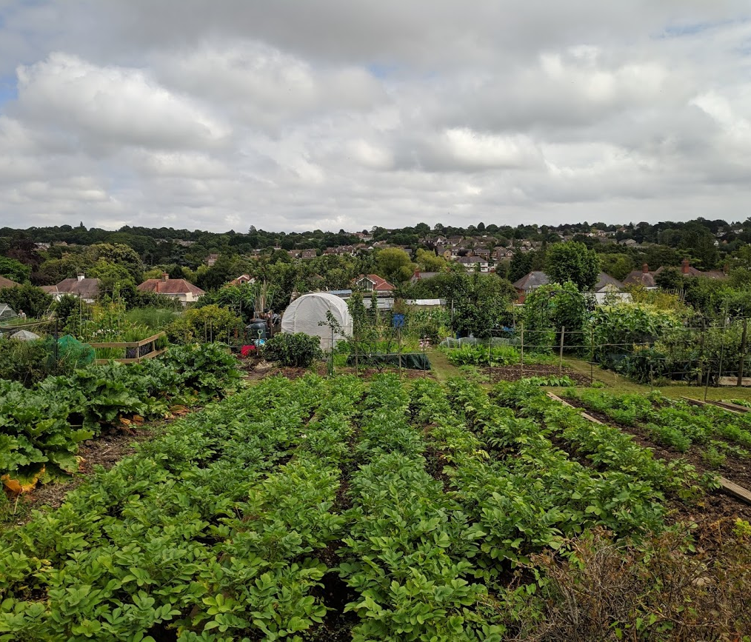
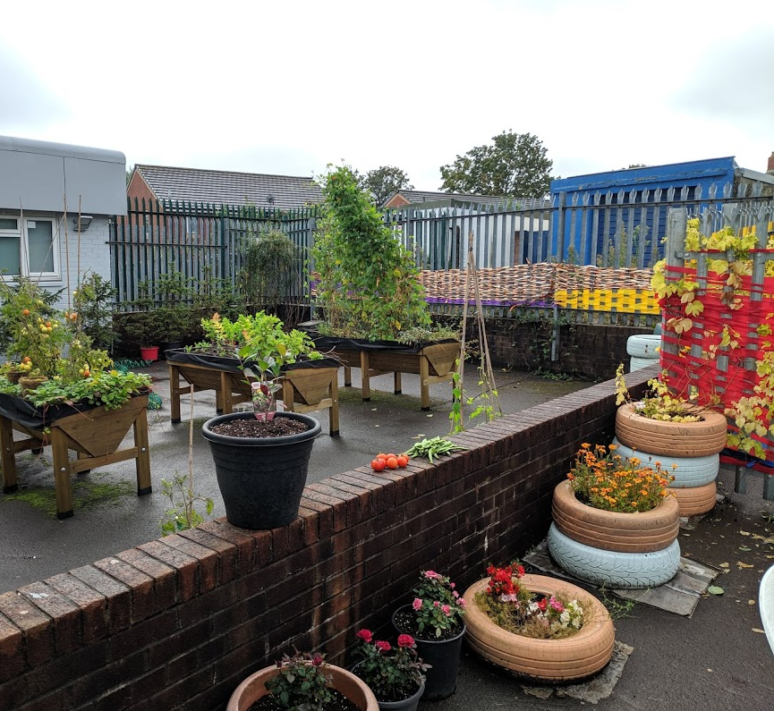
AN EVERYDAY METHODOLOGY
Ethnographic
Embeddedness and participation in ordinary activities
35 interviews with gardeners and external actors and “stakeholders”
To uncover everyday activities of “commoning” without being “vanguardist” (resisting the idea that the research is the transformative activity)…
Experience and concrete practices and empirical everyday life “in situ” (Emirbayer and Maynard 2011)
Research as an “accompanying” element rather than determining actor, and the presence of local knowledge and practices is emphasised (Burdon and Martel 2017)

Slide 4
RE-THINKING BASELINES
Divided literature on urban gardens (McClintock 2014).
Reducing gardeners to passive subjects being duped by powerful state and corporate actors (Crossan et al. 2016)…but also political ambiguity of these sites
Holloway (2012) and Cleaver (1992) are suspicious of the understanding in the social sciences where to be critical is to unmask forms of “unseen” modes of domination, inequality, and exploitation.
Graeber (2004) emphasises the importance of rejecting the idea that all actions only exist by their function in reproducing larger and total forms of power (though he accompanies this with a critique of poststructuralism).
the technique of ‘problematization’ itself can reproduce the Enlightenment’s strategy of unmasking the hidden and obscured, where folk knowledges of the everyday have a “quaint or exotic appeal, but ultimately they must be superceded by social-scientific description and analysis” (Gardiner 2004, p.230)
The result is that social scientists are seen to possess a privileged epistemic status (Jay 1993; Cleaver 1992b; Gardiner 2004)

Slide 5
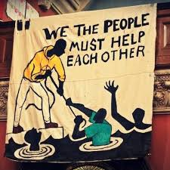
EVERYDAY COMMUNISM
Everyday communism is Graeber’s extension of mutual aid
“In fact, "communism" is not some magical utopia…It is something that exists right now—that exists, to some degree, in any human society. All of us act like communists a good deal of the time.... [we] apply the principles of communism because they're the only ones that really work…This is also the reason entire cities and countries revert to some form of rough-and-ready communism in the wake of natural disasters or economic collapse”
(Graeber 2012, p.95)
“from each according to their abilities, to each according to their needs”
Challenges idea of self-interested interaction (e.g. barter exchange)

Slide 6
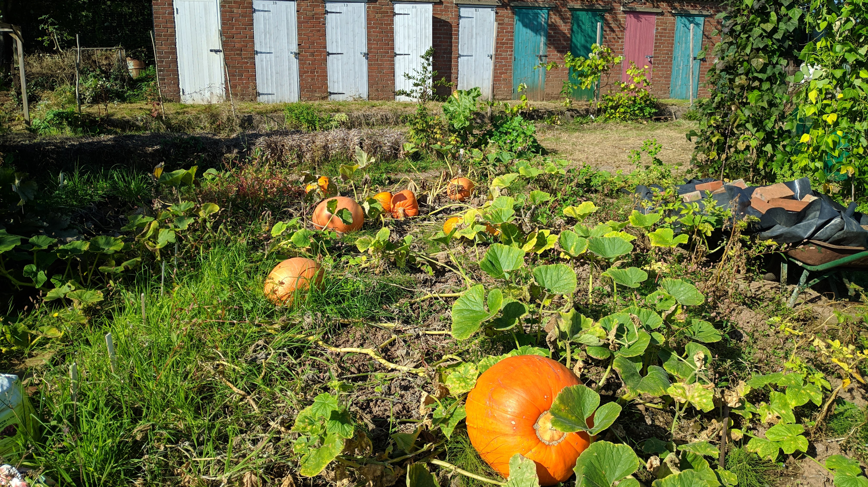
EMPIRICAL EXPLORATION OF EVERYDAY COMMUNISM

Slide 7
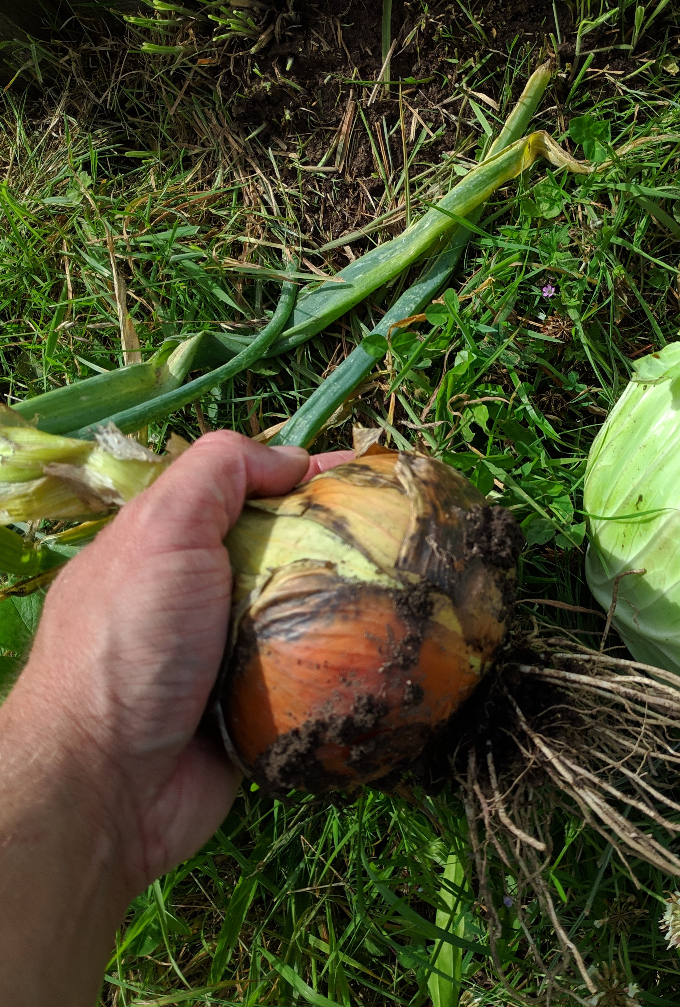
GIFTING
Significant amount of “gifting”—seedlings, produce, unwanted materials—within the sites but also external
Gifting very rarely a deliberate exchange here (i.e. no bartering)
no expectation of something in return, but gifts were often reciprocated as a “thank you”
Direct exchange only with the external (with no ongoing relationship)
Distinct from barter and capitalist exchange
there is no calculation here (in terms of time, effort, or value of a particular thing)
As Graeber (2012, p.99) notes, “the surest way to know that one is in the presence of communistic relations is that not only are no accounts taken, but it would be considered offensive, or simply bizarre, to even consider doing so.”

Slide 8
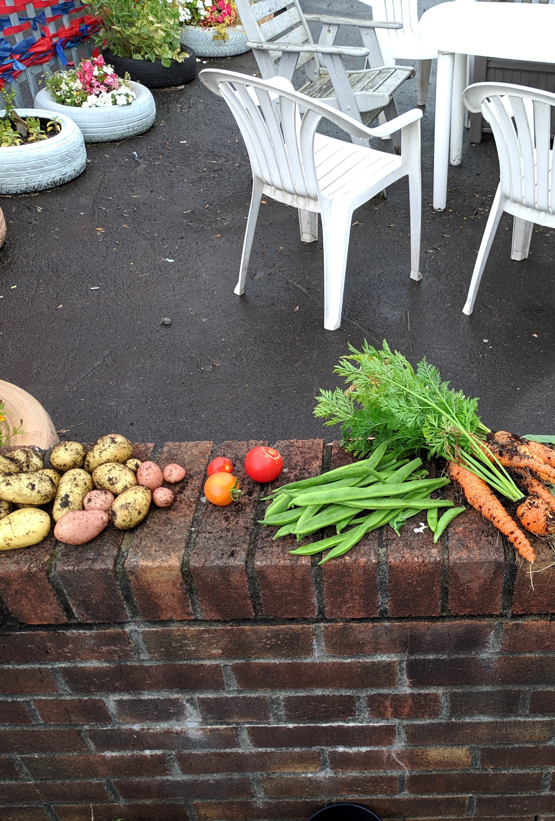
SHARING
Distinct from gifting—sharing is lack of individual ownership, gifting exists when something is initially owned by a person(s)
gifting-sharing distinction reflected in the sites
Allotment is a highly individualised and territorial space—gifting breaks down these boundaries momentarily, e.g. gifting seedlings.
Small amount of sharing (e.g. common tool shed with mowers, strimmers)
Both community gardens are not owned or rented by individuals—everything is shared (compost, tools, sheds, seeds)
Difference of scale (gifting as a way of extending relations?)

Slide 9
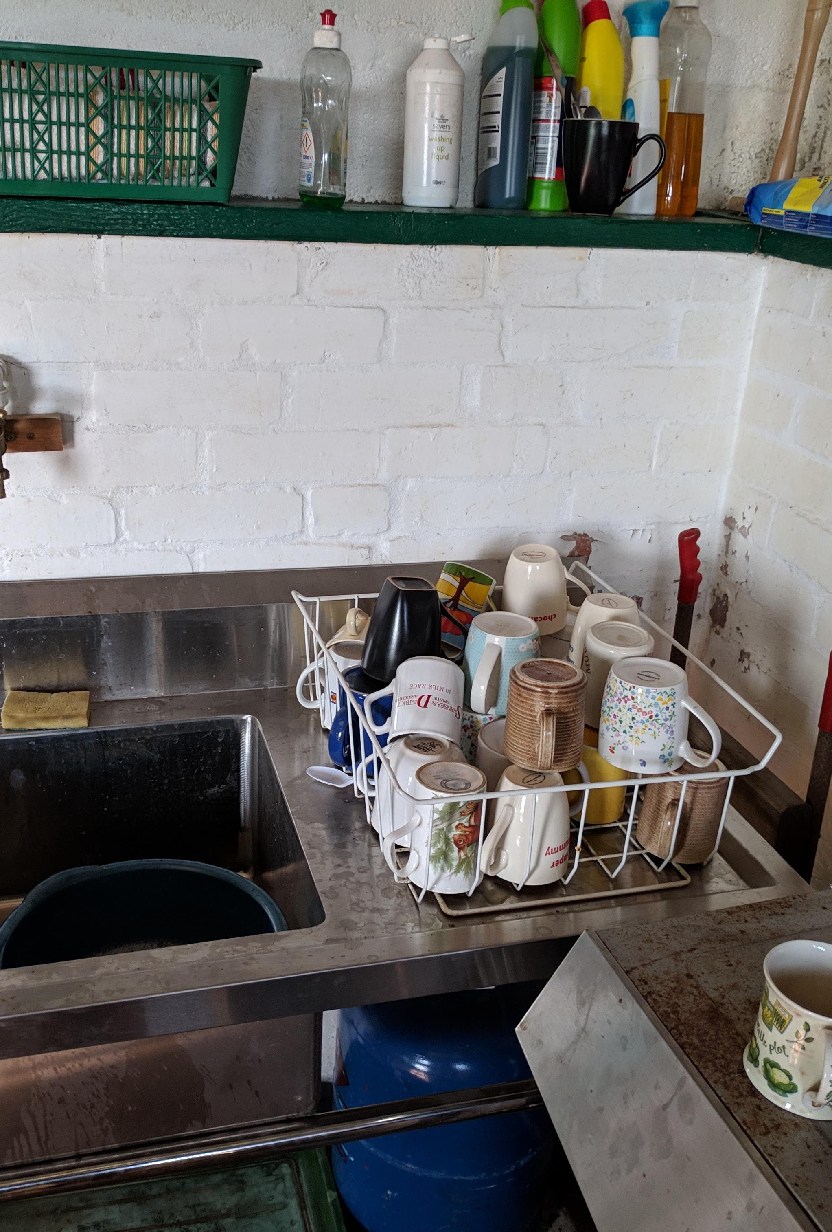
FROM EACH ACCORDING TO THEIR ABILITY, TO EACH ACCORDING TO THEIR NEEDS
Disrupts a static reading of Marx in place of an anthropological one
What skills, capacities, abilities, and needs to people have?
Value of working class job history/skills (e.g. trades, labouring, caring)
Skills for everyday reproduction of these spaces (both physically—fixing, tinkering, repairing, maintaining—and socially…caring, developing mutual trust and respect)
E.g. the politics of tea
Bureaucratic element of the gardens
Balancing of: social reproduction; physical/material reproduction; and bureaucratic management.

Slide 10
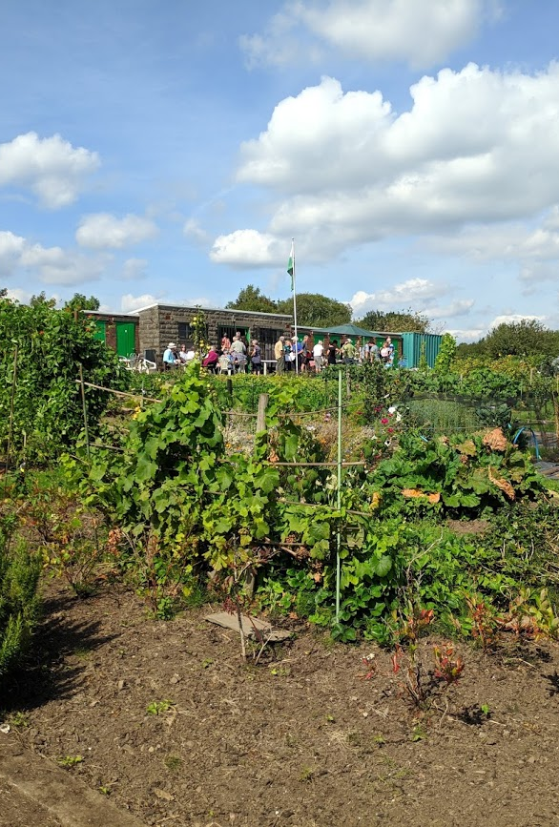
WHO DECIDES WHAT?
Mostly democratic or volunteered based on particular skills/capacities and confidence in that task
monotonous tasks (watering) on a rota (individually in allotment)
But some work was gendered
Women always made the tea, organised the drink and food for events
Men often carried out the “physically dangerous” jobs
Other inequalities of roles (in allotment where collective work was done by a regular minority)

Slide 11
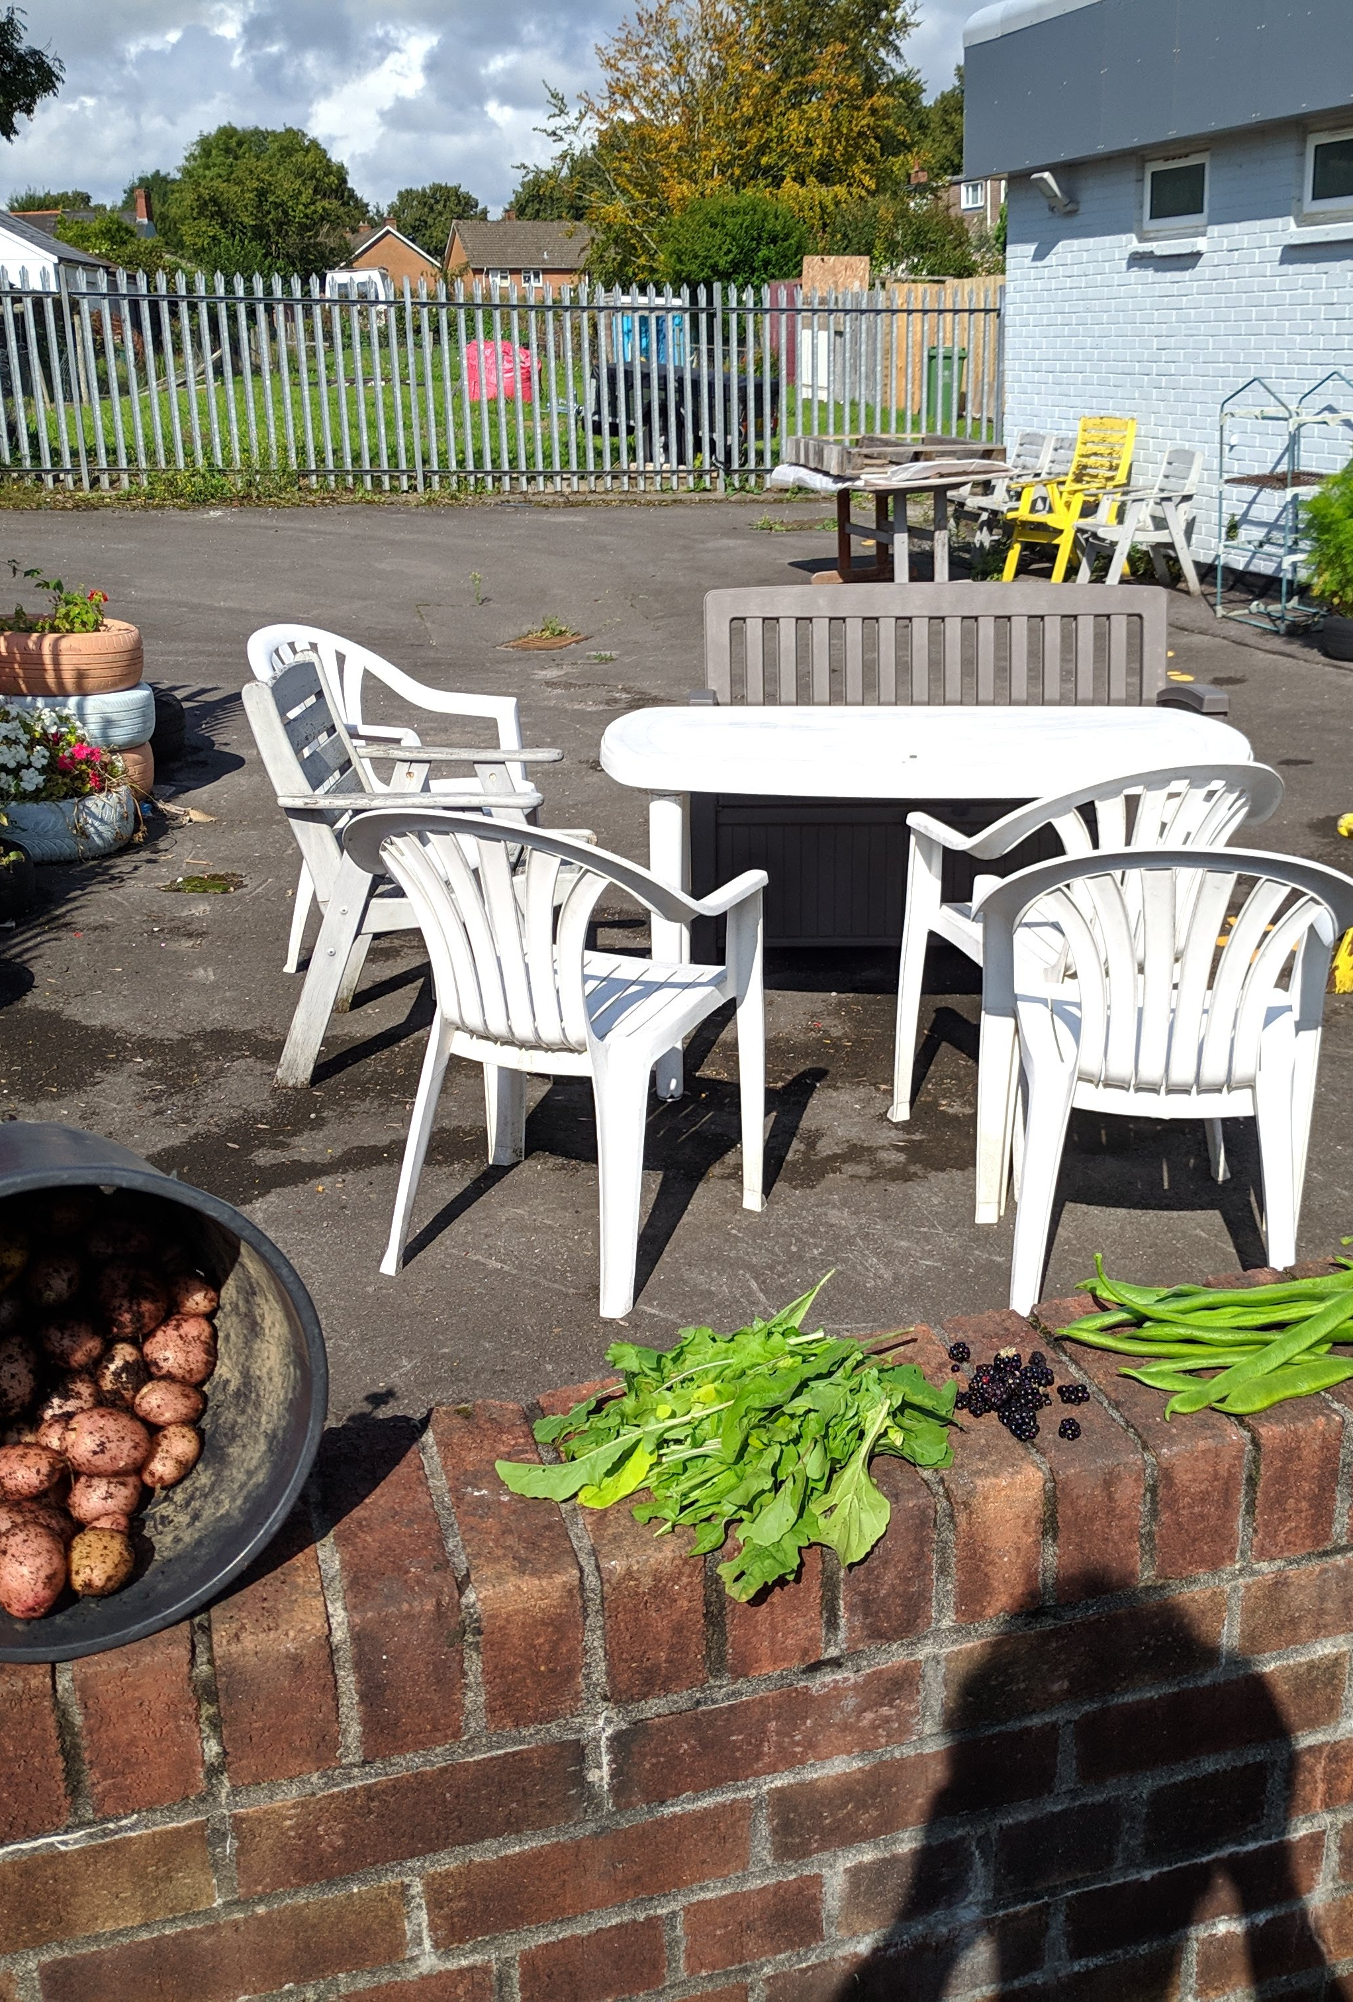
Conclusion
The ordinary is political—beyond social movements or “explicit” politics (of these spaces)
Forms of everyday communism are fundamental for “commoning”
Gifting and sharing (distinct)
People’s different capacities and needs in collective situations—role differentiation for collective work?
But gendered roles are an issue
Inequality of participation at large scales—what to do without resorting to coercive power?

Slide 12
References
Burdon, P. and Martel, J. 2017. Environmentalism and an anarchist research method. In: Research Methods in Environmental Law: A Handbook. Handbooks of Research Methods in Law series. Cheltenham: Edward Elgar Publishing.
Cleaver, H. 1992. The inversion of class perspective in Marxian theory: From valorisation to self-valorisation. Open Marxism 2, pp. 1992–106.
Emirbayer, M. and Maynard, D.W. 2011. Pragmatism and Ethnomethodology. Qualitative Sociology 34(1), pp. 221–261.
Gardiner, M. 2000. Critiques of Everyday Life : An Introduction. London: Taylor & Francis Group.
Gardiner, M. 2004. Everyday utopianism: Lefebvre and his critics. Cultural Studies 18(2–3), pp. 228–254. Graeber, D. 2004. Fragments of an Anarchist Anthropology. Prickly Paradigm Press.
Graeber, D. 2012. Debt: The First 5000 Years. Penguin Books Limited.
Holloway, J. 2012. Crisis and critique. Capital & Class 36(3), pp. 515–519.
Jay, M. 1993. Downcast Eyes: The Denigration of Vision in Twentieth-Century French Thought. Berkeley, CA: University of California Press.
McClintock, N. 2014. Radical, reformist, and garden-variety neoliberal: coming to terms with urban agriculture’s contradictions. Local Environment 19(2), pp. 147–171.

Slide 13
THANK YOU / DIOLCH!
hanmerOJ@cardiff.ac.uk

