Slide 1
Failure to prevent fraud – What impact will the new offence have on UK companies?
Dr Sam Bourton
12th October 2023

Slide 2
Failure to prevent fraud – What impact will the new offence have on UK companies?
Dr Sam Bourton
12th October 2023

Slide 3
Introduction
  Background
  The Identification Doctrine
  Failure to Prevent Offences
  Failure to Prevent Fraud
  Scope
  Impact
  Conclusion

Slide 4
Background
Fraud accounts for 41% of all crime against individuals, making it the most common crime in England and Wales
Fraud increased by 25% during the Covid-19 Pandemic
From 2021-22, losses caused by fraud reached £4billion
Companies often commit fraud, or enable fraud to take place
(House of Lords Fraud Act 2006 and Digital Fraud Committee, 2022)

Slide 5

Prosecuting Companies - The Identification Doctrine
Lennard's Carrying Co. Ltd. v. Asiatic Petroleum Co. Ltd. [1915] A.C. 705 (HL), at p. 713:
‘Its active and directing will must consequently be sought in the person of somebody who for some purposes may be called an agent, but who is really the directing mind and will of the corporation, the very ego and centre of the personality of the corporation.’
Tesco Supermarkets Ltd v Nattrass [1972] A.C. 153 (HL), at p.171:
‘Normally the board of directors, the managing director and perhaps other superior officers of a company carry out the functions of management and speak and act as the company. Their subordinates do not.’

Slide 6
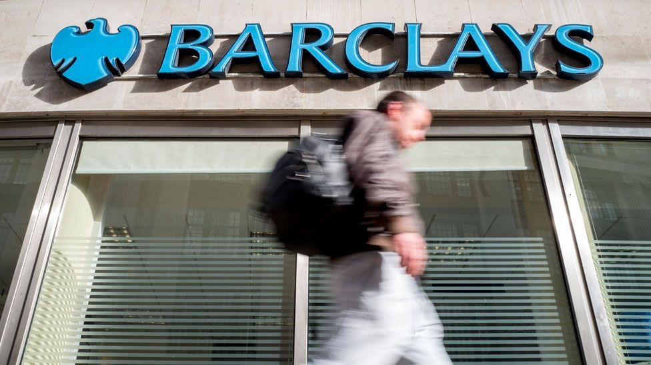
Serious Fraud Office v Barclays Plc and Another
[2018] EWHC 3055
The problems associated with the identification doctrine were illustrated by the failed prosecution of Barclays bank in 2018
Here the court determined that the four senior executives were not the ‘directing mind and will’ of the company
The identification doctrine has become the principal reason that prevents prosecutors bringing criminal proceedings against corporations
Image: BBC/Getty Images

Slide 7
Failure to Prevent Offences
To overcome the issues associated with the identification doctrine, strict liability offences have been introduced:
s.7 of the Bribery Act 2010 - Failure to Prevent Bribery
ss.45&46 of the Criminal Finances Act 2017 - Failure to Prevent Facilitation of UK and Foreign Tax Evasion Offences

Slide 8
Failure to Prevent Offences in Practice
To date, zero prosecutions have been brought against corporations for failing to prevent tax evasion
In 2018, only 25% of businesses were aware of the offence
In comparison, there have been several prosecutions and 9 Deferred Prosecution Agreements for bribery offences

Slide 9
Reform
In June 2022, the Law Commission published an Options Paper. The options include:
  Retaining the identification doctrine as at present
  Retain the identification doctrine, but broaden the scope of the directing mind to include senior management of a corporation
  Failure to prevent fraud offence
  Failure to prevent Human Rights abuses, ill-treatment, neglect or computer misuse offences
A Failure to Prevent Fraud Offence will be enacted in the Economic Crime and Corporate Transparency HC Bill (2022-23) 154

Slide 10
Home Office, April 2023
A new “failure to prevent fraud offence will make it easier to prosecute a large organisation if an employee commits fraud for the organisation’s benefit”.

Slide 11
Failure to Prevent Fraud
An organisation could be held criminally liable if a stipulated fraud offence has been committed by an ‘associated person’ for the organisation’s benefit.
Offences include:
    Fraud by false representation, by failing to disclose information, or by abuse of position,
    Obtaining services dishonestly,
    Participation in a fraudulent business,
    False accounting,
    False statements by company directors,
    Fraudulent trading,
    Cheating the public revenue.
Importantly, the prosecution does not have to illustrate that the organisation’s senior management arranged or knew about the fraud

Slide 12
Failure to Prevent Fraud – Scope
The proposed offence applies to all large corporate bodies and partnerships.
Whilst the offence will apply to all sectors, to ensure burdens on business are proportionate, only large organisations are in scope, irrespective of their place of incorporation.
Large organisations (as defined using the standards of the Companies Act 2006) will need to meet two out of the three following criteria:
  more than 250 employees
  more than £36million turnover
  more than £18million in total assets.

Slide 13
Failure to Prevent Fraud – Impact
An organisation can avoid prosecution if they have ‘reasonable procedures’ in place to prevent fraud
The Secretary of State must issue guidance
The guidance is likely to be similar to the guidance for Failure to Prevent Bribery and Tax Evasion offences, which are based on six ‘guiding principles’:
    Proportionate prevention procedures
    Top level commitment
    Risk assessment
    Due diligence
    Communication (including training)
    Monitoring and review

Slide 14
HM Government, June 2023
The proposed offence “will discourage organisations from turning a blind eye to fraud by employees which may benefit them. The offence will encourage more companies to implement or improve prevention procedures, driving a major shift in corporate culture to help reduce fraud”.

Slide 15
Conclusion
A Failure to Prevent Fraud Offence will be enacted in the Economic Crime and Corporate Transparency Bill
The offence attempts to overcome the issues associated with the Identification Doctrine
The offence is likely to be limited in scope, applying only to large organisations and only to fraud offences committed for the organisation’s benefit
However, the application/scope of the offence could be extended at a later date
Organisations in scope need to implement reasonable procedures to prevent fraud

Slide 16




Contact us
Sam Bourton
Senior Lecturer in Law, University of the West of England
Sam.Bourton@uwe.ac.uk
Follow us on
@CharteredIIA
Chartered Institute of Internal Auditors
@CharteredIIA

Slide 17
Thank you

