Slide 1
Collective Self-Defence and the Criterion of a Request for Aid International Law and the Regulation of Resort to Force: Exhaustion, Destruction, Rebirth? Palacký University Olomouc, Czech Republic
Professor James A. Green
British Academy Mid-Career Fellowship funding supported this research
15 September 2023

Slide 2
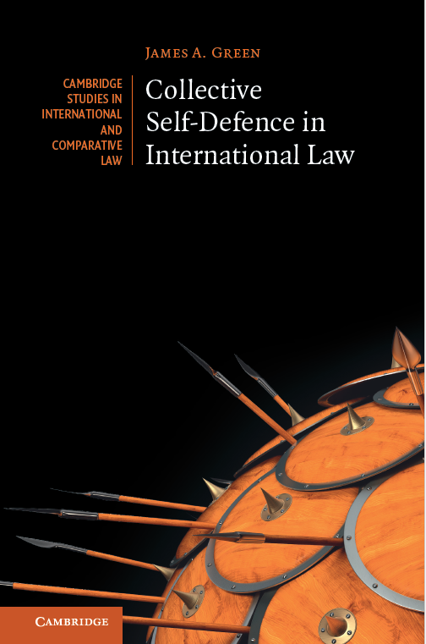
BUY THIS BOOK

Slide 3
The legal criteria for collective self-defence
Many of the criteria are shared with individual self-defence: armed attack, necessity, proportionality, etc.
There is no ‘declaration’ requirement…
Significant evidence that the victim state must ‘request’ aid under CIL.

Slide 4
Nature and importance of the request requirement
Note that ‘request’ ≠ ‘consent’.
The request requirement is fundamental:
Without it ‘the way would be open to unlimited aggression’ (Wright, 1959).
The request must be ‘valid’.

Slide 5
Who can issue a request?
Statehood
UN membership?
De jure government
Effective control?
Other factors key, e.g.:
Democratic legitimacy
External recognition
Internal constitutional (or other) due process
Legal weight?

Slide 6
The manner and form of requests
‘Open’ vs ‘targeted’ requests
Nicaragua case (merits) (1986), para. 196:
The lawfulness of collective self-defence ‘depends on a request addressed by [the victim] State to the third State.’
e.g., Mozambique request (1977)
No formalities/format
Requests have been made in all kinds of ways…

Slide 7
Implied/covert requests
US /Cambodia (1970)
Difficult to establish a legal requirement…
But evidentiarily, would make complying with the requirement extremely difficult.
Clear, explicit, public requests are preferable both on policy grounds and as a procedural matter. They also are overwhelmingly the norm in practice.

Slide 8
Timing of the request
Requests must be made before the use of force begins…
That said, this need for timeliness is complicated if the request can be covert…
Ex ante ‘consent’ in a pre-existing collective self-defence treaty is insufficient: the request must be ad hoc and specific to the relevant armed attack.

Slide 9
Conclusion
No question that the request requirement exists in customary international law, and it is important for protecting against abuse.
But there remain many uncertainties regarding how it operates.
I have started to try to map out the requirement more than had previously been the case, but more work needs to be done.

