Slide 1
Airborne Microplastics measurement: Putting people at the heart of the science
Dr Ben Williams
PlasticsFuture 2023 Conference
Senior Research Fellow
Air Quality Management Resource Centre
Co-Lead
Biospheric Microplastics Research Cluster
20/06/23

Slide 2
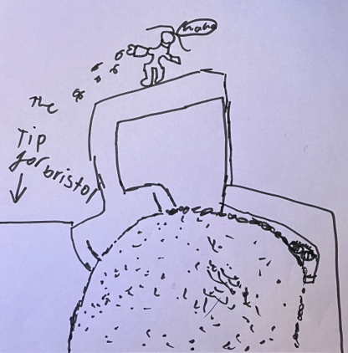
Contents
Microplastic Mindfulness
Biospheric Microplastic
Airborne microplastic
Airborne microplastic sampling
Citizen Science
Homes Under the Microscope
What next for airborne microplastics?
Cautionary tale
Drawing of gleeful littering by Gavriella

Slide 3
Microplastic Mindfulness
Pause and look around
What materials are you wearing?
What are you sitting on?
What have you been walking on?
How robust is that material? Does it fragment/shed?

Slide 4
Microplastics
‘Microplastic’ defines particulate plastic debris measuring less than 5 mm in size
Fragment through mechanical and photochemical degradation
Persistent and abundant throughout an interconnected biosphere

Slide 5
Biospheric Microplastics
Hydrosphere
Microplastics present in the marine environment and impact flora and fauna (Issac & Kandasubramanian 2021)
Found to transport harmful pollutants (Zarfl and Matthies, 2010).
In rivers, between gradients and in sediments (Matjasic et al., 2023)
Lithosphere
Microplastics found in abundance in soils applied with composts (Zhang et al., 2020)
Some crops, including wheat and lettuce can internalise micro and nanoplastics (Li et al., 2020)
Micro- and nano-plastics detected in edible fruit and vegetables (Conti et al, 2020)

Slide 6
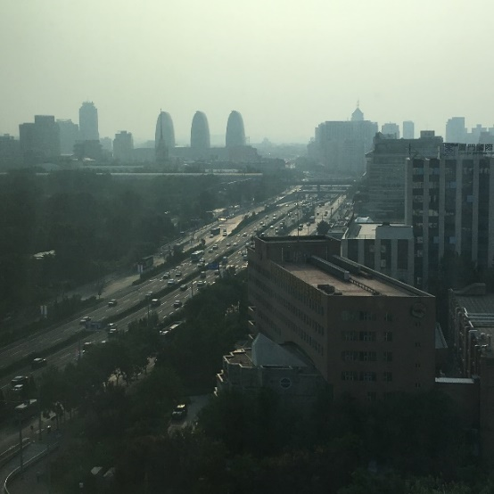
Airborne Microplastics
Found in the Arctic and the Alps (Bergmann et al., 2019).
Found in both indoor and outdoor air samples (Gasperi et al., 2018).
Thought to contribute to a small amount of radiative forcing (Revell et al., 2021)
Microplastics and microrubbers from tyres considered to be a significant source of microplastics to the environment (Kole et al., 2017), likely in air, too.
Largely a focus on ambient outdoor air, not much research indoors.

Slide 7
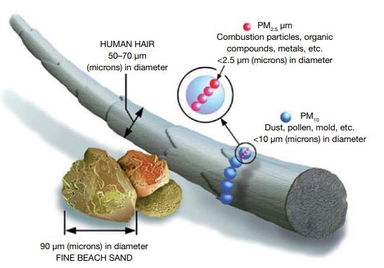
Health implications?
Exposure likely higher through the airborne route and inhalation has been associated with health risks such as Chronic Obstructive Pulmonary Disease (Catarino et al., 2018; Dong et al., 2020).
Presence of non-mineral fibres, including plastic, in lung tissue specimens (Pauly et al., 1998).
Studies detected microplastics in all regions of human lung tissue (Jenner et al., 2021, breast milk (Ragusa et al., 2022), testis (Zhao, 2023) and in human blood (Leslie et al., 2022).
Some particles >100µm. How?

Slide 8
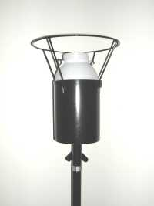
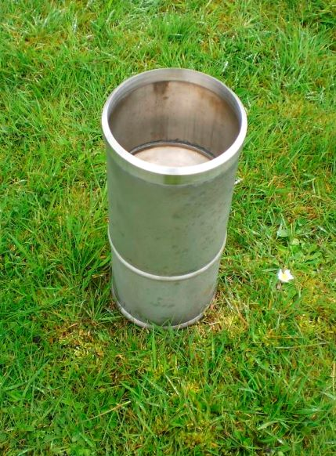
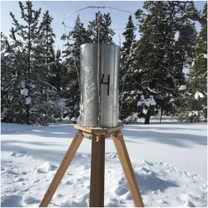
Sampling Approaches: Passive
Bottles, bowls, bespoke samplers (Klein and Fischer, 2019)
Rain gauges (Wright et al, 2020)
Collecting typically for 1 day to 1 month per sample.
Other passive samplers, e.g. Frisbee Samplers, yet to be explored
Postma, 2022

Slide 9
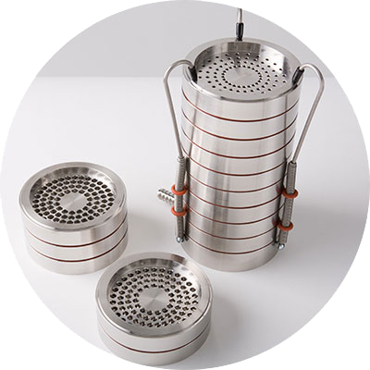
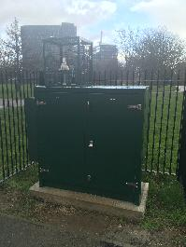
Sampling Approaches: Active
Active sampling instruments used in microplastic studies are typically routine for air quality measurement
Include TSP or size selective inlets, cascade impactors (Kernchen et al. 2022), and cyclone samplers (Levermore et al. 2020).
Further opportunities with established instruments, e.g. BAM.
With both active and passive sampling approaches, extraction and characterisation processes will vary.
Can learn from the Air PT Scheme for diffusion tube analysis.

Slide 10
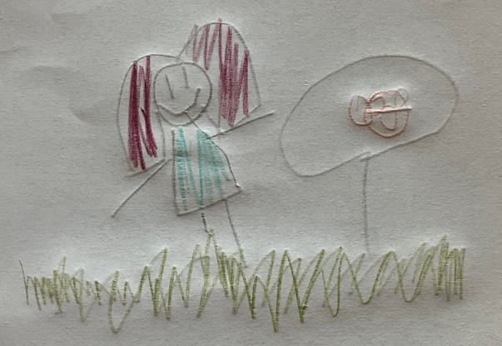
‘Citizen Science’
Multiple definitions without a settled description, often described as Participatory research, community research.
It’s not just public engagement and can go beyond just data collection.
Citizen Science allows us to build broader trust in science
Co-creation allows research to be done with citizens, instead of ‘for’ or ‘to’ them
Ca. 50-60% of studies provide research grade data (Aceves-Bueno et al., 2017)
Looking for microplastics in mushrooms, by unknown
Perfect
Imperfect

Slide 11
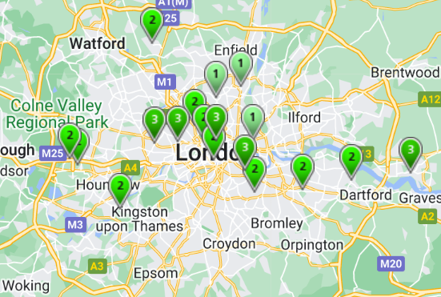
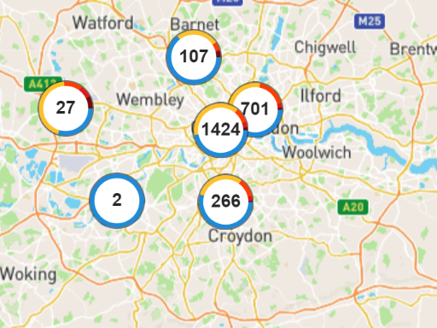
Citizen Science
Allows for broader spatio-temporal resolution
Often a trade-off with accuracy and precision
Implications for how these data are used/interpreted by policymakers
AURN monitoring locations
Mapping for Change monitoring locations

Slide 12
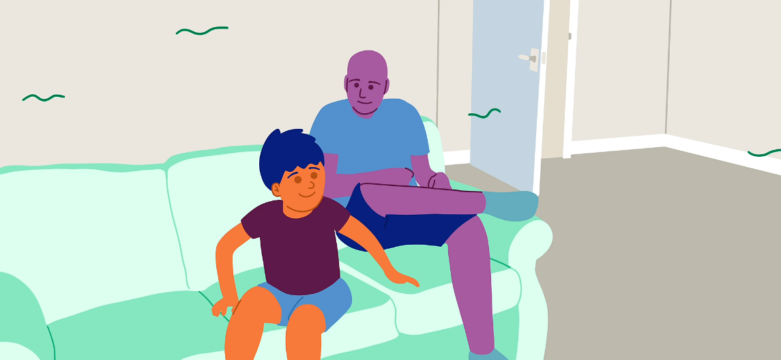
HOMEs Aims and Objectives
Aim
Facilitate, through co-creation with citizens, an investigation of the main sources and distribution of airborne microplastics in the home
Objectives
Design and refine a simple airborne microplastics sampling technique and online analysis tool suitable for public use;
Collect samples of airborne microplastics from a wide range of home environments;
Facilitate two-way dialogue and knowledge exchange between citizens, stakeholders, and policy makers;
Bring together a multidisciplinary team with different levels of citizen science experience to learn and transfer as appropriate

Slide 13
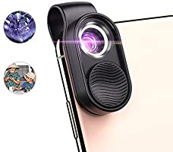
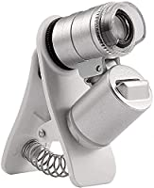
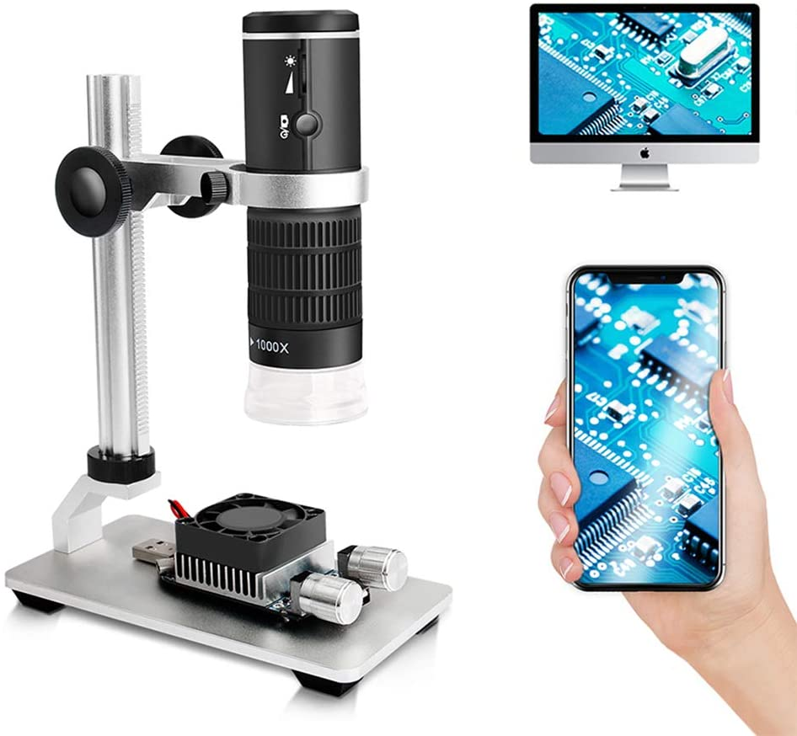
HOMEs Phased Approach
Mix of high and low engagement to lower barriers to participation.
Pre-Pilot: Test accessibility, health and safety, practicality.
Phase 1 Pilot (Bristol): High Engagement (~40 participants)
Evaluation of a range of microscopes
Testing method, microscopes and imaging tools
Identifying microplastics and microfibre abundance within homes
Phase 2 Wider roll out (Bristol and Bradford): Light touch engagement (>100 participants)
More citizens but no need for intense participation

Slide 14
Pre-pilot: Sampler usability challenges
Image particle sizing requires consistent optical depth (or some other approach to address this).
Tested user behaviour within team (some had experience with microscopes, others none).
Each used microscopes differently, take phots from different heights, etc., so hard to scale images consistently to generate particle sizes
Need to resolve this before recruiting.

Slide 15
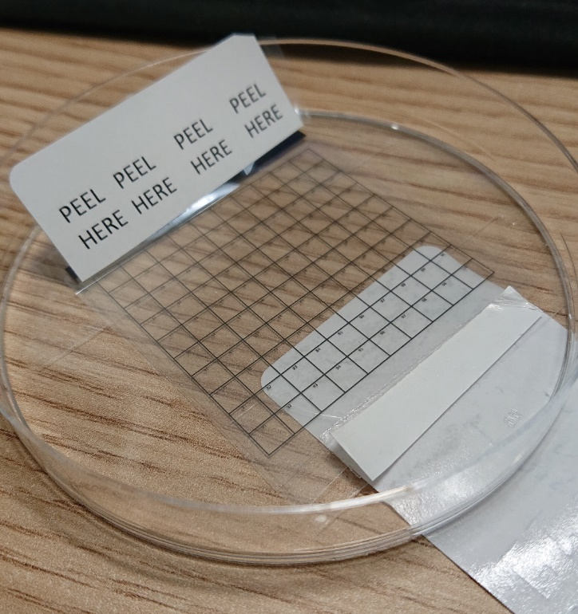
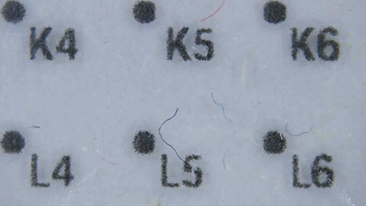
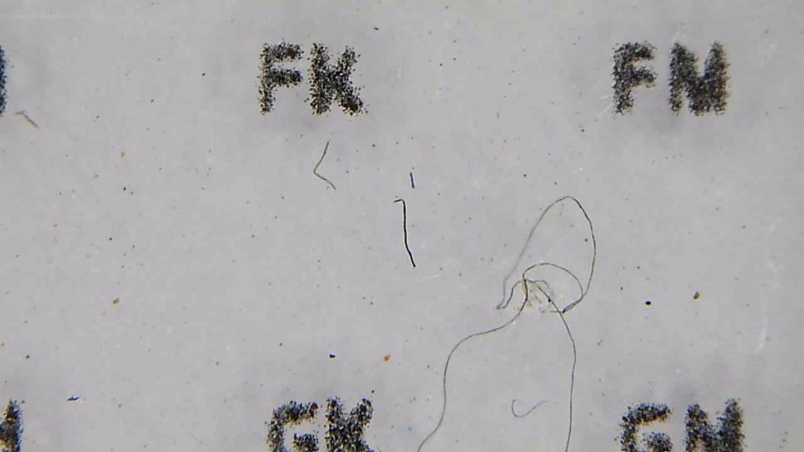
Pre-pilot: Enabling wider usability
V2
V1
V3

Slide 16
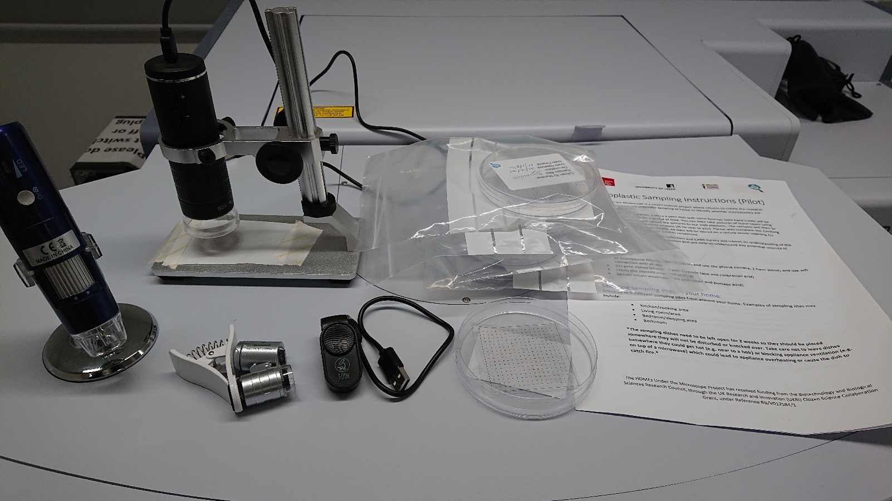
HOMEs distributed sampling kit
Microscopes
Petri Dish & Forensic Tape
Instructions

Slide 17
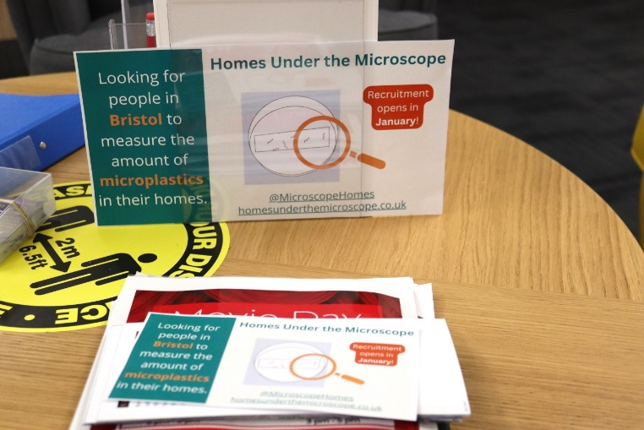
Citizen Recruitment
Particular focus on underrepresented groups.
Flyers handed out at STEM clubs
E-mails sent to Secondary schools and 6th form colleges, resulting in articles included in newsletters and websites.
Direct contact with disability support groups.
Direct contact with community groups in Eastville (e.g. choirs, sports) and Lockleaze.

Slide 18
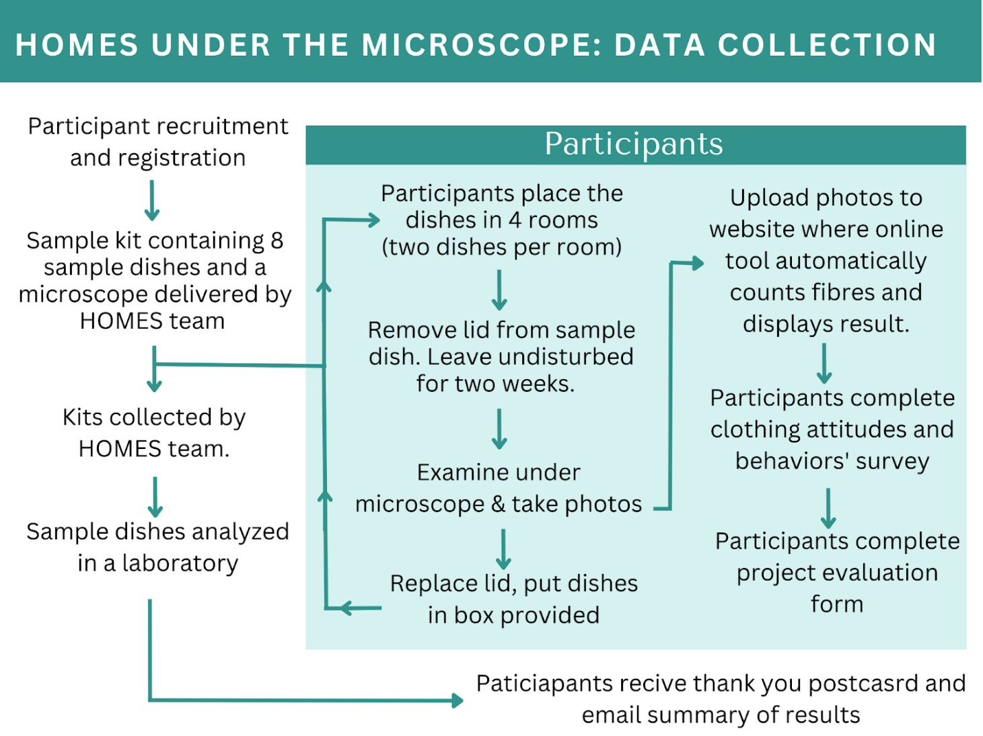
Phase 1: Pilot sampling and analysis approach

Slide 19
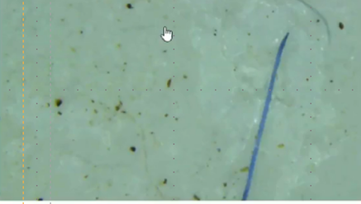
Pilot sampling and analysis approach
Upload picture
Particles and fibres in the air
Sticky tape
Take picture
phone
2 weeks’
exposure
lens
Send sample for
Microplastics identification

Slide 20
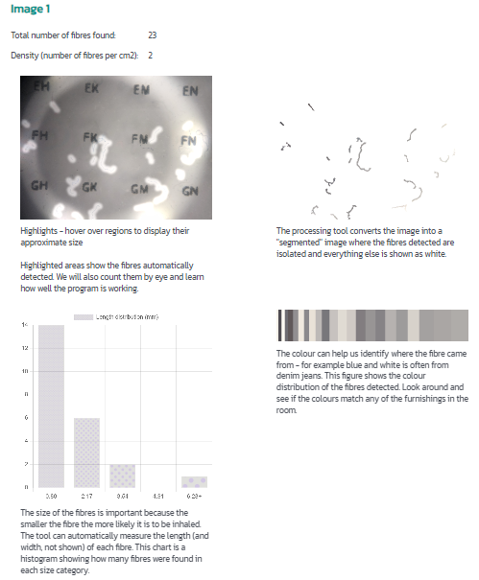
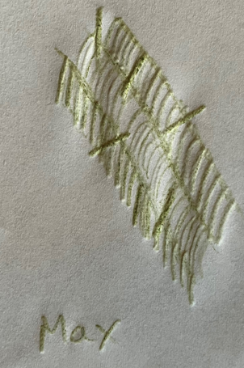
Online analysis
Citizens upload images to the platform
Generate information on particle size, shape etc.
Drawing of a synthetic fibre under magnification, by May

Slide 21
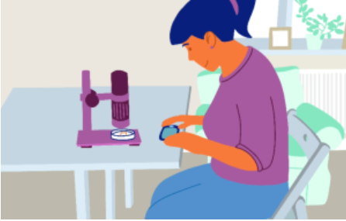
Pilot Results
Room Type
Bathroom
Bedroom
Craft Room
Dining room
Ensuite
Kitchen
Lounge/Sitting/Living Room
Office/Study
Spare Room
Stair/Hallway/Landing
Utility Room

Slide 22
Pilot Results

Slide 23
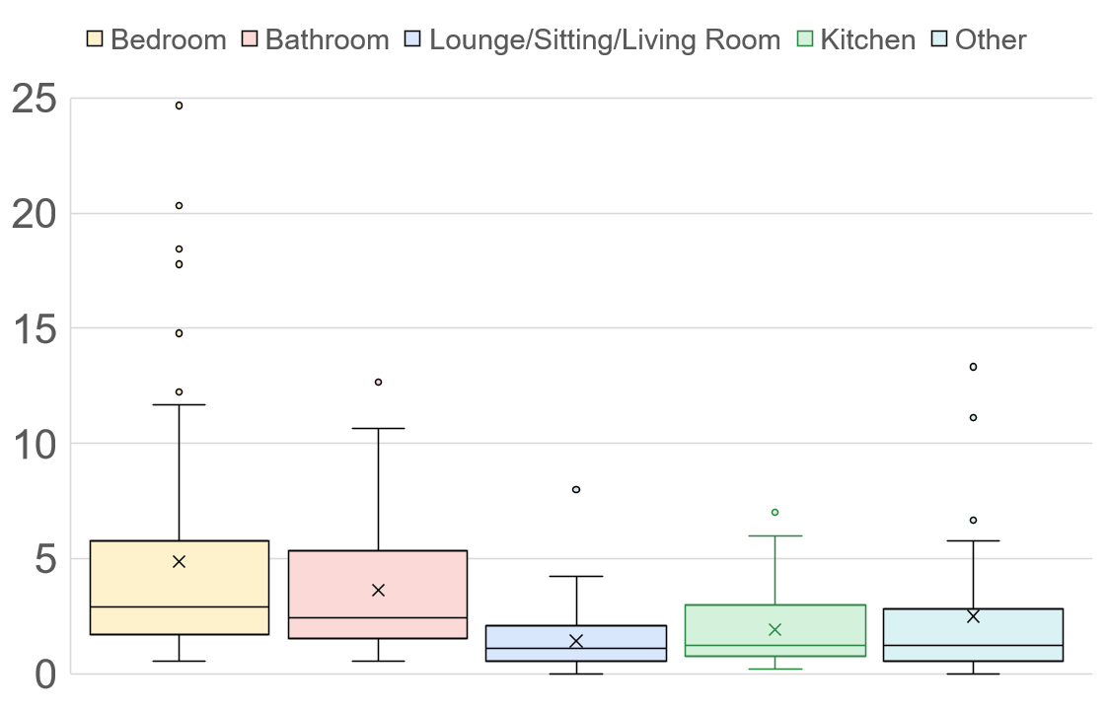
Distribution by room

Slide 24
Comparison with the literature
Study | Deposition rate/m2/day | Fibre/microparticles
Dris et al., 2017 | Range: 1,586 and 11,130 | Fibres
Jenner et al., 2021 | 1,400 | Microparticles
Soltani et al., 2021 | Range: 308 to 17,642 | Fibres
HOMEs Citizens | Range: 714 to 10,000 | Fibres

Slide 25
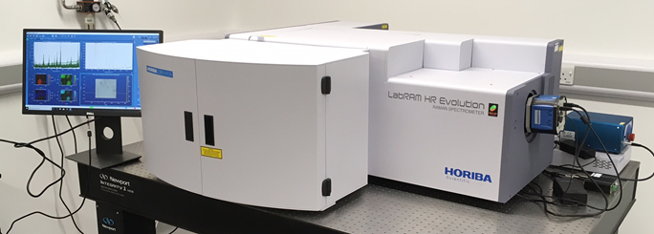
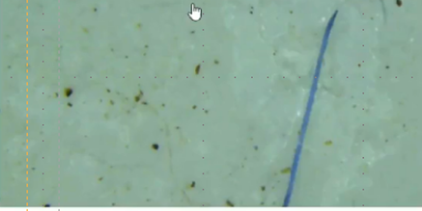
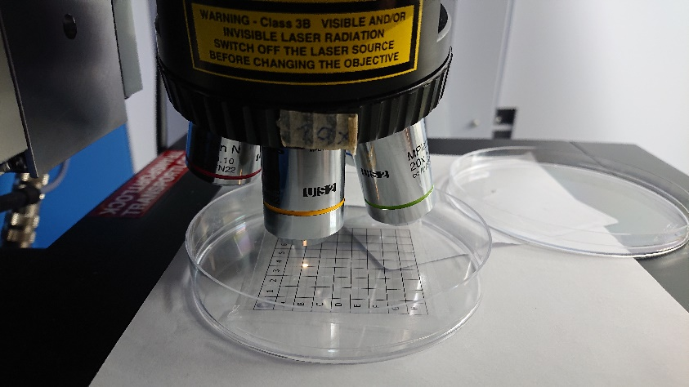
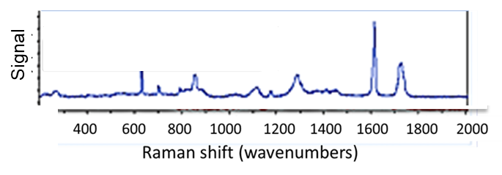
Identification of Microplastics at UWE
+
Raman microscope
Chemical fingerprint for selected particle

Slide 26
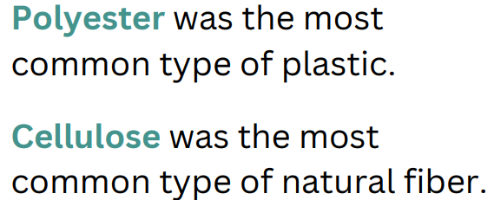
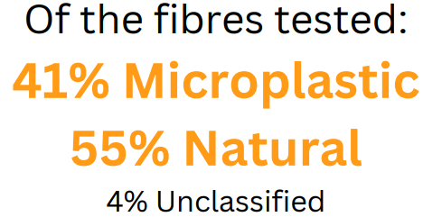
Pilot fibre identification
Study | Focus | Natural | synthetic
KeChi-Okafor et al., 2023 | Kenyan/Tanzanian coast | 55% | 37%
Jones and Johansson, 2023 | Seats of public venues | >70% | 18%
Eng and Koh, 2023 | Parapets of high-rise housing in Singapore | 48% | 37%
Palmer and Oliver, 2004 | Fibres in human head hair | 72% | <20%

Slide 27
How co-creation shaped the wider roll-out

Slide 28
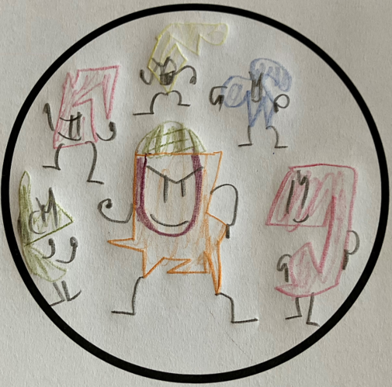
What next for HOMEs
Finalise particle characterisation of pilot and present per room
Samples from the wider roll-out being returned and analysed from over 120 participants
Bring industry and citizens together in a final workshop
Continue to educate, enthuse and engage
Co-create and co-produce schools packs and sampling methods with teachers, children and parents.
Drawing of fighting microplastics by JF

Slide 29
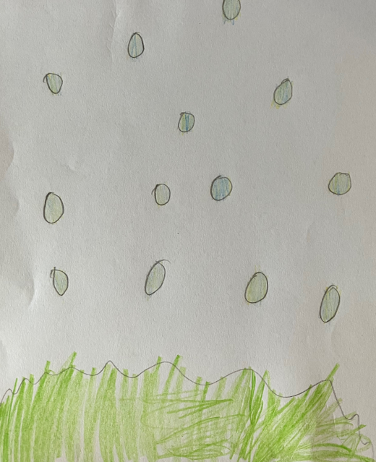
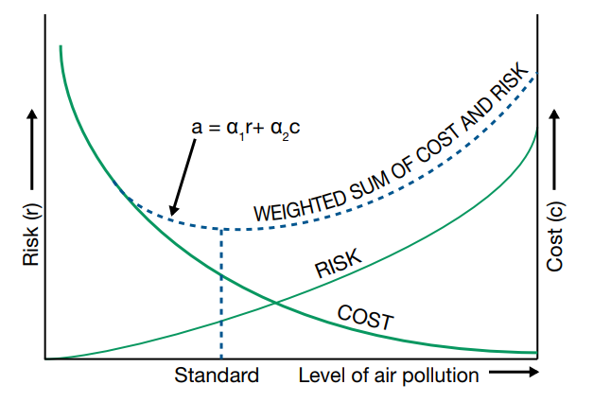
What next for airborne microplastics
For an effective policy response:
Enhance measurement of microplastics in the inhalable and respirable size fractions.
Expand the evidence base on health impacts associated with airborne microplastic exposure
Determine the relative exposure, aligned with health impacts – Is it acute or chronic exposure that needs mitigating?
Determine mitigation costs
Drawing of airborne microplastics by Unknown

Slide 30
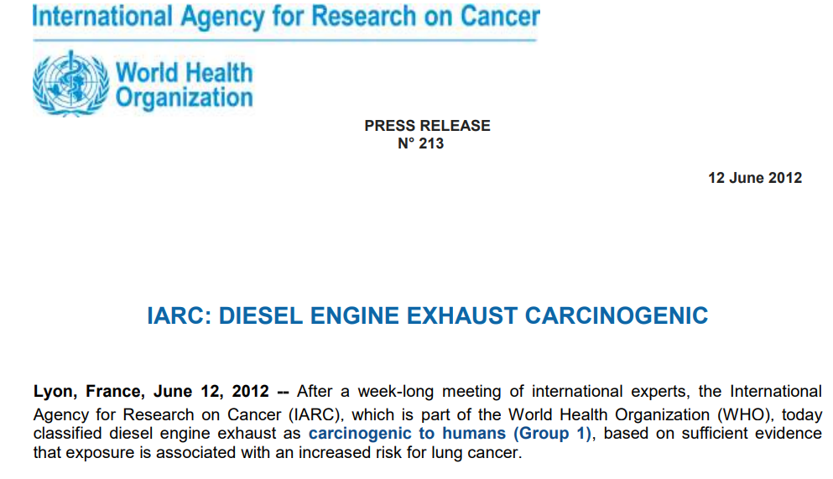
Cautionary tale from air pollution policymaking
CO₂ from vehicles identified as a significant contributor to climate change
Significant research and media interest in the problem and a need to resolve it, ca. 2000.
In 2001, government introduce Vehicle Excise Duty (VED) sliding scale encouraging lower CO₂ vehicle purchases
Caused a rise in diesel vehicle sales, increasing NO₂ concentrations.
2012 IARC declared diesel exhaust emissions as carcinogenic.

Slide 31
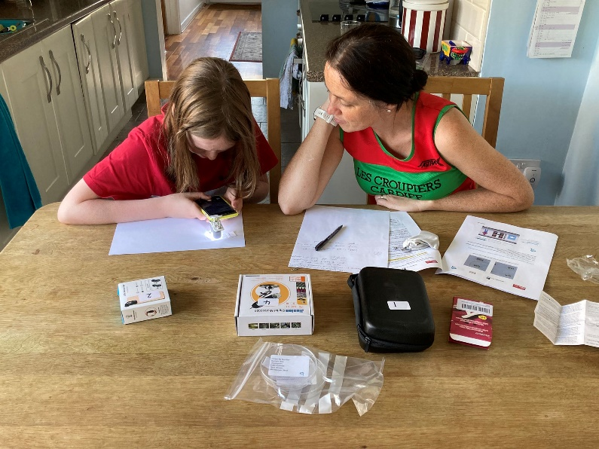
Summary
Microplastics abound, but we need more measurement and analysis, including potential health impacts to aid policymakers
Through co-creation, HOMEs citizens refined a simple and accessible sampling tool for airborne microplastics which could be used widely.
Multidisciplinarity can be really important, but can feel daunting.
Take care that in striving for improvement we do not accidentally introduce further social, cultural and environmental injustices

Slide 32
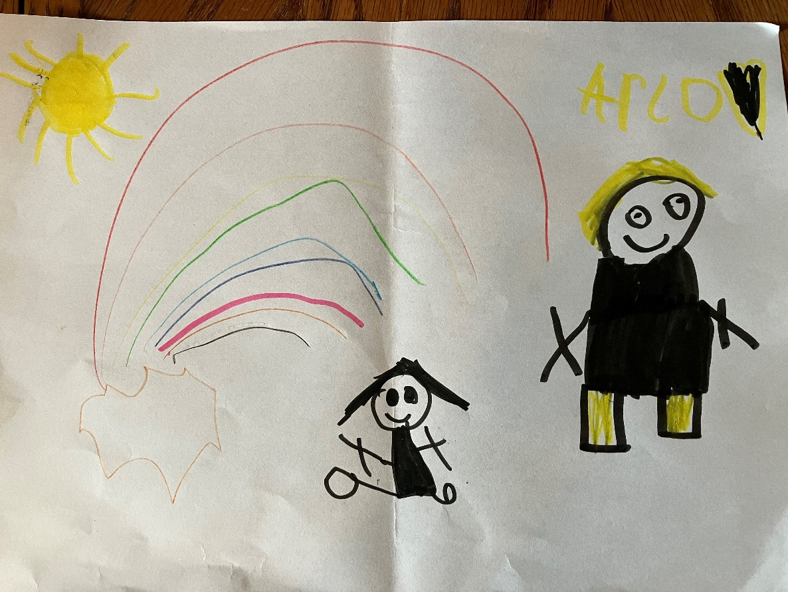
THANK YOU
HOMEs Team
Our Citizens
Festival of Nature Children
This is supported by the Biotechnology and Biological Sciences Research Council through the UK Research and Innovation (UKRI) Citizen Science Collaboration Grant (Reference BB/V012584/1).

