Slide 1
Maximising accessibility of feedback in HEI whilst working within work allocation constraints
Presented by
Amanda Wilkinson
Marcus Witt
Matt Wilkinson
Ali Law
Kane Allen
12th July 2023

Slide 2
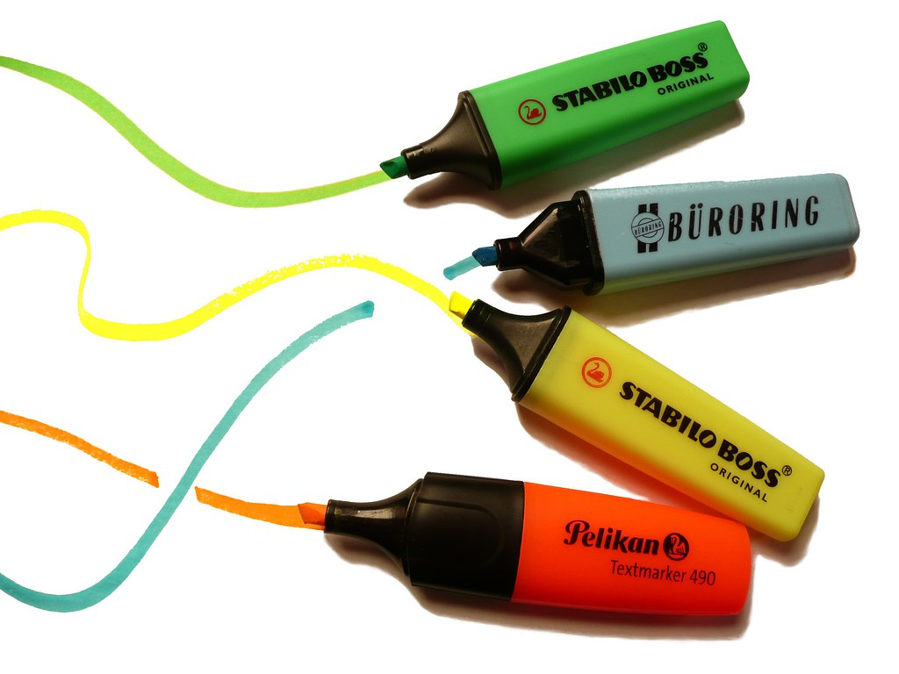
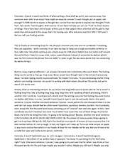




Our pilot
The Driver
Why do we spend so long crafting written feedback to essays when we know that:
most students don’t read it (e.g. Sellbjer, 2018)
those that do read it, often don’t understand it (e.g. Denton & McIlroy, 2018)
The Pilot​
45 minutes per student​
  30 minutes to: read the essay; highlight areas to talk about; pull out one or two ‘better ifs’; highlight an electronic rubric and assign a pre-moderation grade​
  15 minutes to work with the student​
  Blank rubric referred to during discussion​
  Students could audio-record the discussion​
  Emphasis by marker that moderation had not yet ​happened​
  Highlighted rubric and grade not shared at this point​
Notes:
Nb – no written feedback on sheet given after 20 days – just rubric and grade

Slide 3


Theme 1:
Feedback was more accessible in this form; students felt they had agency to act on it
Kluger & DeNisi, 1996
Feedback
Lecturer
Student
'However, overall, the assessment for learning movement has not changed students’ perceptions, on entering HE, that feedback is something they receive rather than something they can generate and orchestrate.'
(Evans & Waring, 2020)

Slide 4




Feedback was more accessible in this form; students felt they had agency to act on it
Key Themes from student responses:
Marks

Slide 5
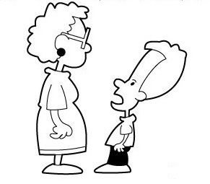

Theme 2:
Feedback was collaborative and dialogic;
Relationships built between student and staff
Key Themes from student responses:
Safe and Supportive: a productive and accessible experience
Winstone & Carless, 2019
Dialogic experience; move from power imbalance to collegiate discussion
Lorber, et al., 2019
Building of relationship;
extended beyond assessment experience
Lorber, et al., 2019; Pitt & Quinlan, 2022
Notes:
The second theme we noticed was that of Collaboration & the Building of Relationships (that went beyond the immediacy of the assessment)
Literature such as the examples cited here explore the emotional response involved in giving and receiving feedback. WIN&CAR discuss the impact of power imbalances on students; this intimidating academic, holder of expertise and knowledge, creates a feeling of imposter syndrome and therefore a reluctance to ask questions or explore the feedback for greater understanding.
They emphasis the need for the building of trust and relationships through feedback – a sense of safety so that meaningful dialogue is possible.
Pitt & Quin also identifed this importance of building relationships through feedback and meaningful dialogic interatctons, identifying that this leads to the breaking down of barriers, fostering effective working relationships. Interestingly they also point out that during this process, students are receiving all sorts of wider feedback, all of which are part of construction this safe, workoing dialoge which Lorber and colleagues identify as key in constructing a shared langauage and understanding of assessment needed for students' engagement with their leanring.
Feedback from the students on the experience was that the process was:
Safe and Supportive: a more human experience where they were not interpreting the tone or phrasing of comments, but instead could see/hear the intended information, and where this was positive about what they were doing well, as well as areas in which they needed to develop
Reduction in a feeling of Imposter Syndrome (where they were very much the junior partner having a judgement handed down. Often in the marking process students only meet their marker if they: are a 'dedicated' student; have failed; or are unhappy with their mark. This frequently creates a defensiveness before any interaction between student and marker even begins.
Feedback from the students identified that the 'live feedback' approach felt like a move instead to a more collegiate, collaborative discursive relationship during the marking process
a two-way conversation where I could ask questions
I was able to better ask questions and get helpful responses
More human touch
Easier to gauge your marker's thoughts and opinions, and allows us to build a relationship
Allows us to build up a relationship with those on the teaching team
I reflected alongside the marker
Interestingly, several students identified that this feeling of building a relationship with the member of the staff team marking their work extended beyond this specific experience.
This was borne out in the experience of the staff participating in the pilot, with students approaching them for support for a wider range of concerns to do with the programme and HE 'life', even where the staff member was not involved in that area. When asked why they had approached the marker instead of the relevant person/department, students answered that they felt they now had more of a relationship with that marker as a member of staff, and more confident to approach them rather than the 'right' person

Slide 6
Theme 2:
Feedback was collaborative and dialogic;
Relationships built between student and staff
Key Themes from staff responses:
Access to aligned/divergent approaches and thought processes; Shared understanding and awareness
Lorber, et al., 2019
Ability to convey feedback in an empathetic and
accessible mode
Lorber, et al., 2019
1:1 opportunity to get to know the student as an individual; opening to do this beyond dealing with academic/challenges; personalisation of learning
Notes:
The benefits of the pilot were not only limited to the students.
Subsequent experiences and reflections on participating highlighted learning for the 'live marking' team too:
Ability to see and listen to approach and to thought process
Discussion, leading to
improved, shared understanding and awareness
Identification of aligned and divergent
1:1 time to get to know the student as an individual, rather than in a group setting can lead to opportunity to get to know them beyond dealing with academic/challenges
understanding of how to support / make accessible
This aligns with the example literature,

Slide 7
Theme 3
Efficiency & Effectiveness
If students can't see past the grade, then is the assessment effective?
Quick and dirty feedback can work much better than slow and perfect feedback – it has to be fast enough that students are still interested. (Gibbs, 2015)
Lecturer Workload: ‘Live marking’ had to fit within lecturer parameters for work allocation marking. 45 mins per student. 30 mins ‘marking’ making notes, points to discuss, assessment rubric. 15 mins with student for verbal feedback. 6 completed in a day (could have been more).
Opportunity to discuss key points, what went well, what might need improving. Feed forwards for next assessment, opportunity to discuss what ‘criticality was’ or how to draft sentences / parts with students.
Students could say – “I don’t understand what that means”, or “how might I do that?” Something not achievable with one-way dialogue of written feedback.
Feedback after the pilot was positive and the opportunity to reflect with the marker/ more detail given were key features. The students felt they left with more understanding

Slide 8

Theme 4
Non-traditional Students
A larger than representative proportion of non-traditional students opted to engage in our pilot
The exercise was a valuable tool in developing assessment literacy
The impact on
non-traditional students
Notes:
A larger than representative proportion of non-traditional students opted to engage in our pilot.
This has inspired us to look deeper into the drivers behind this
Students with dyslexia and EAL informed us that they valued receiving their feedback verbally. This allowed them to write down their own feedback pausing to gain further clarity when needed. This also significantly reduced the amount of time it took to understand the required next steps
Students were actively engaged with assessment processes with a focus on clarifying learning outcomes and expectations. We seemed to share an understanding of the purposes, requirements and approaches of assessment. This has helped us connect our work around the awarding gap as we strive to provide a more purposeful feedback system for our EAL students
Feedback can only be effective if students understand it. Students learning EAL are not only learning English, but also having to process a massive range of cognitive and academic processes through this unfamiliar language. How can students correct their own mistakes if they are unfamiliar with the language those mistakes occur in?
Giroux (2008) states that non- traditional students will feel more vulnerable than their peers with at times a lack of trust in the assessment process. It is important we make the assessment process inclusive and not covert or hidden. Feedback from non- traditional students noted that they felt like live feedback felt like dialogue where as written feedback felt like a set monalogue

Slide 9
References
Denton, P. & McIlroy, D. (2018). Response of students to statement bank feedback: the impact of assessment literacy on performances in summative tasks. Assessment and Evaluation in Higher Education, 43(2), 197–206.
Evans, C. & Waring, M. (2020). Enhancing students’ assessment feedback skills within higher education. In Oxford Research Encyclopedia of Education.
Gibbs, G. (2015). Making feedback work involves more than giving feedback, Part 1: the assessment context. 53 Powerful Ideas All Teachers Should Know About, Idea 27 [online]. Available from: chrome-extension://efaidnbmnnnibpcajpcglclefindmkaj/https://www.seda.ac.uk/resources/files/publications_176_27%20Making%20feedback%20work%20Part%201.pdf [Accessed 13th April 2023].
Kluger, A.N. & DeNisi, A. (1996). The Effects of Feedback Intervention on Performance: A Historical Review, a Meta-Analysis and a Preliminary Feedback Intervention Theory. Psychological Bulletin, 119(2), 254-284.
Lorber, P., Rooney S. & Van Der Enden, M. (2019). Making assessment accessible: a student-staff partnership perspective. Higher Education Pedagogies. 4(1), pp. 488-502.
Pitt, E. & Quinlan, K.M. (2022). Impacts of higher education assessment and feedback policy and practice on students: a review of the literature 2016-2021 [online]. Available from: https://www.advance-he.ac.uk/knowledge-hub/impacts-higher-education-assessment-and-feedback-policy-and-practice-students-review [Accessed 24 February 2023].
Sellbjer, S. (2018). “Have you read my comments? It is not noticeable. Change!” An analysis of feedback given to students who have failed examinations. Assessment and Evaluation in Higher Education, 43(2), 163–174.
Winstone, N. & Carless, D. (2019). Designing effective feedback processes in Higher Education. London: Routledge.

Slide 10
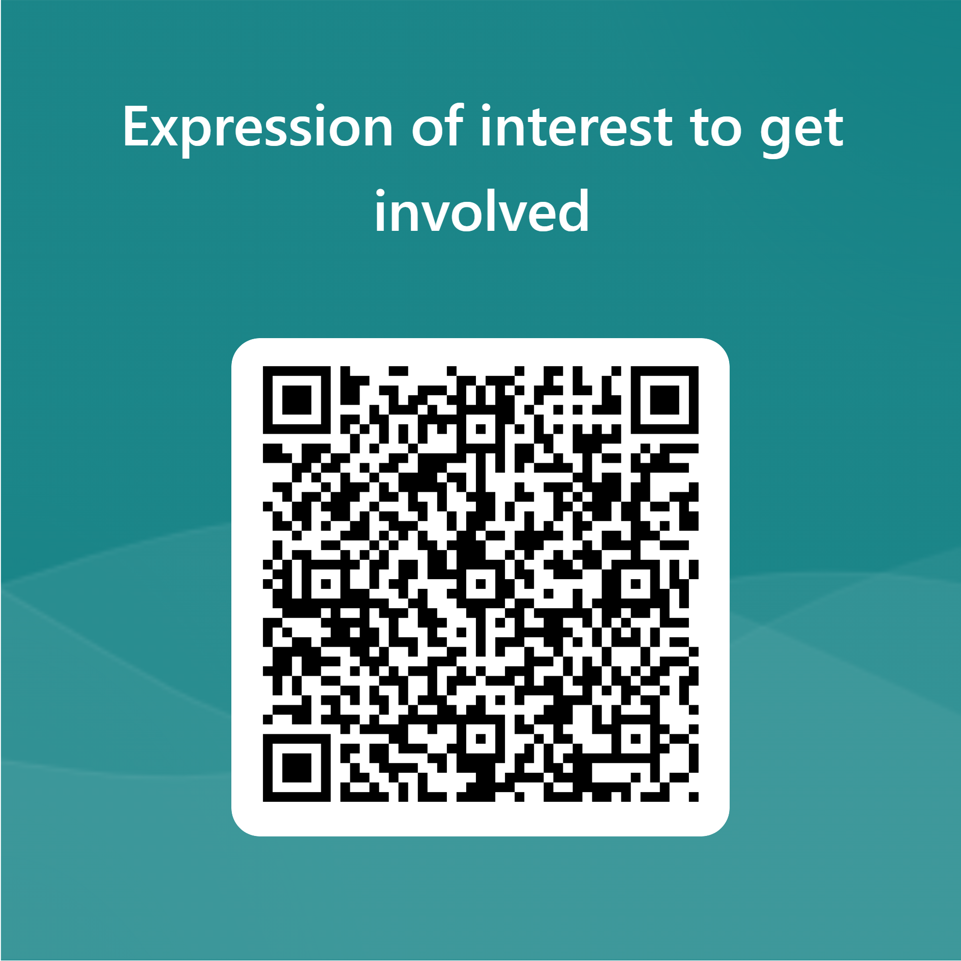

Would you like to get involved? Perhaps expand this to a cross-institutional research project?

