Slide 1





“I got hope but I don't have trust”:
Exploring young people’s thoughts and feelings about the climate emergency
Sara Williams, Rosamund Portus, and the CCC-CATAPULT team
Presentation for International Environmental Psychology Conference, June 2023
Notes:
Hi, thank you for coming to this session.
We are here to tell you a little about our research project: Challenging the Climate Crisis: Children’s Agency to Tackle Policy Underpinned by Learning for Transformation. As you will see this project has involved multiple methods and stages and the data collected is quite vast, including both quantitative and qualitative. In addition we have co-produced this research with young people. We will say a little about this but not in the detail that we plan to as we reflect on the co-productive process from both the young people involved with the research (for over 18 months) and the reflections of the researchers involved in facilitating these processes. We are also going to present for the first time, some of our initial findings from some of the focus groups that formed one stage of the methodology.

Slide 2

Presentation Structure
The CCC-Catapult Project: Aims, Context and Methods
The Focus Group Research
Exploring themes of: Trust; Responsibility; Anxiety
Reflecting on findings
Current work and next steps
Notes:
Sara - structure

Slide 3
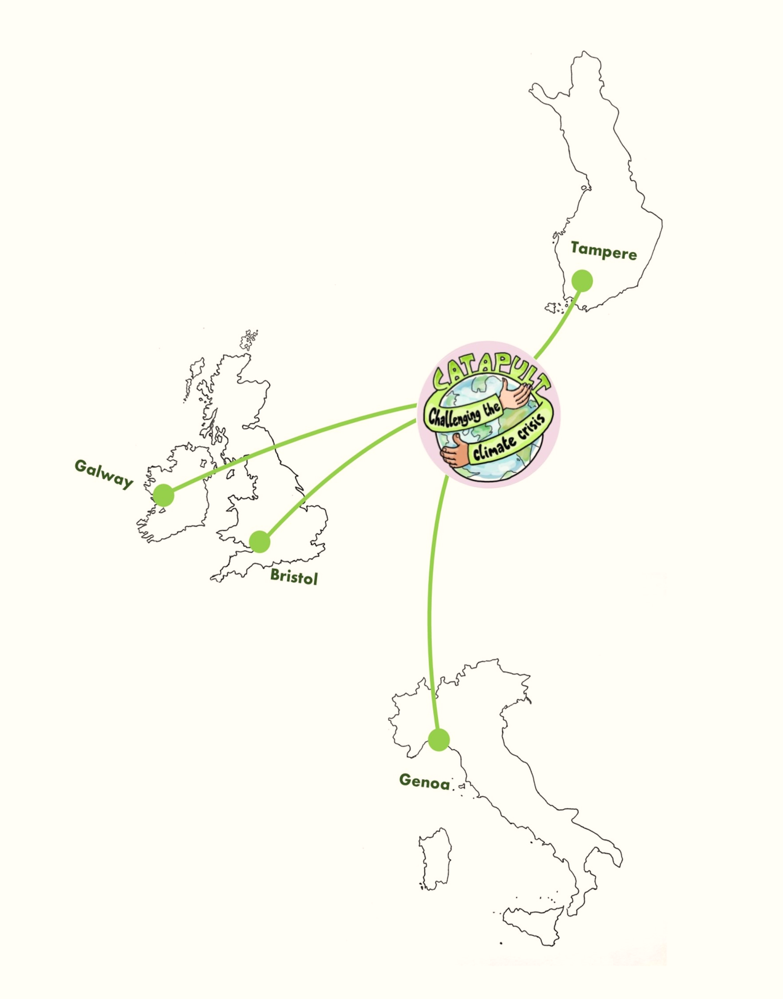
The CCC-CATAPULT Project
A three-year international research project, working across Bristol UWE, University of Genoa (Italy), Tampere University (Finland), and NUI Galway (Ireland).
The project has developed research through the ‘eyes and ears’ of young people, teachers and other supporters of learning to understand how:
The climate emergency is being experienced and felt by young people across different cultural contexts
How young people can be empowered to help challenge the climate emergency and become ambassadors for the future
Notes:
Rozzy –
So CCC-Catapult is a 3-year project working across UWE in Bristol, the University of Genoa in Italy, Tampere University in Finland, and the National University of Ireland in Galway. We are a multidisciplinary group – I myself have an anthropology background, and my colleagues have a variety of disciplinary backgrounds such as educational studies, geography, and psychology.
The project’s core aim is to developing research through the ‘eyes and ears’ of young people, teachers and other supporters of learning to understand how:
The climate emergency is being experienced and felt by young people across different cultural contexts
How young people can be empowered to help challenge the climate emergency and become ambassadors for the future

Slide 4

Youth Action Partnership PROCESS
STAGE 1: 1,879 SURVEY PARTICIPANTS (15-18 years)
Young people in each location took part in our survey. We asked about their experiences, beliefs, and actions in connection with climate change.
Multi-method research design
STAGE 2: 21 FOCUS GROUPS
We have run focus groups with > 100 young people exploring the climate values and actions, intergenerational learning, and tools for climate education.
37 INTERVIEWS
We have interviewed teachers, community workers and other supporters of learning about their experiences of delivering climate education.
STAGE 3: 20 NARRATIVE WORKSHOPS
We have run narrative workshop activities with groups of young people. We are exploring young people’s connection with place, and how this links to climate change learning and envisioning transformative learning possibilities.
STAGE 4: TRIANGULATION OF EVIDENCE
Working across disciplines with input from Youth Action Partnerships
Notes:
Sara
This slide shows the methods involved in the catapult research project. It is a multi-method project and we have conducted a large survey across out 4 locations. The project has worked co-productively with groups of young people from the start. We have conducted a large scale survey which has informed the areas of focus for the qualitative research in focus groups and through using narrative deep mapping methods. We are also conducting focus groups with young people in each location, interviews with teachers and other supporters of learning, and creative narrative workshops
Understanding the Value-Action Gap?
Trust and Intergenerational Influence
Transformative Futures – addressing the value-action gap?

Slide 5

Our Co-productive Approach:
Youth Action Partners
To ensure the project is relevant and meaningful for young people, we are working with groups of 15-18 years olds in each project location.
The young people are co-producers of the research project, and are considered as experts in their own lives. They help produce, guide, and disseminate the research work.
The young people helped develop the content of survey questions and topics covered, and gave feedback on the design of the survey questions.
Notes:
Rozzy – co-production
In order to incorporate young people’s voices into the knowledge creation process, and ensure that the research would be relevant to young people’s actual experiences and concerns, we are working with a co-productive methodology. This means that we are working directly with and for young people by recognising them as not only the experts in their own lives, but as also having the agency and ability to co-develop the direction of the research through their eyes and ears. This, as detailed by Pavarini and others, ensures that the research is genuinely meaningful for young people.
The young people meet with us on average once a month for over two years, and have contributed to all aspects of the work including the survey questions, focus group themes, and interview topics. They have done things like help pilot our narrative work too. A paper is coming out hopefully soon on this aspect of the project.

Slide 6

Focus Groups
Partners in each of the four CCC-CATAPULT city regions held focus group discussions involving 6 – 8 young people, recruited primarily, though not exclusively, through schools. Focus groups were approximately 50 minutes in length. In total, we conducted 21 focus groups.
Location | Tampere / Finland | Galway/ Ireland | Genova/ Italy | Bristol/ UK
Number of Focus Groups | 5 | 5 | 5 | 6
Notes:
Rozzy - Partners in each of the four CCC-CATAPULT city regions held focus group discussions involving 6 – 8 young people, recruited primarily, though not exclusively, through schools who had completed the survey. Focus groups were approximately 50 minutes in length. In total, we conducted 21 focus groups. So for example, all ours took place at Bristol city college.

Slide 7
A Focus on Bristol (UK)
Religion/Worldview/Ethnicity:
Two (5%) participants self-identified as atheist, one (3%) person as black British African, one (3%) person as Catholic, three (8%) as Christian, one (3%) person as Islamic (British Pakistani), one (3%) person as a Jehovah’s Witness, and two (5%) people as White British. Eight (21%) said they didn’t know what religious or worldview group/groups they identified with, eight (21%) did not identify as religious or with a worldview group, 11 (28%) people did not give an answer, and one (3%) person preferred not to say.
Carer’s educational levels:
11 (28%) people identified that a leaving certificate (GCSE’s equivalent) was their carer’s highest level of education, one (3%) person said little or no schooling, five (13%) people said diploma or higher certificate (BTEC/A-levels), two (5%) people said degree, one (3%) said Masters postgraduate degree, 12 (31%) said they did not know, and four (10%) preferred not to say. Three (8%) of people did not answer the question about highest level of education.
Employment in household:
The majority of participants lived in a household with two people in formal employment, with 13 (33%) people stating this to be the case. Seven people stated that three (8%) people were employed, seven (18%) stated that four or more people were employed, five (13%) people stated that one person was employed, one (3%) person stated that no-one was employed, and six (15%) preferred not to say.
Numbers and age:
Six focus groups took place in March 2022 with young people. Aged between 16-18
Place:
All of these sessions held in a Bristol further education college.
Counties of birth:
32 (86%) of the participants identified that they had been born in the UK. One (3%) person was born in Bulgaria, one in Greece, one in Poland, one in India, and one in Australia. Two (5%) people did not identify where they were born.
Languages:
Three (8%) people did not identify which languages they spoke, 36 (92%) participants identified that they spoke English, seven (18%) participants spoke two languages and one (3%) person spoke three, with nine languages being spoken in total.
Gender:
Ten (26%) participants identified as male, 26 (67%) as female, and three (8%) preferred not to say.
Notes:
Rozzy –further demographics are here. I am not going to go through them, but this is to show what kind of data we gathered during the work. You can see here how the specific categories we asked about are age, countries of birth, languages spoken, gender identity, religion/worldview and ethnicity, carer’s education and employment in house they live in.

Slide 8

Thematic Analysis of Focus Groups
119 Codes in total, with two overarching themes:
Young People’s understandings of the Climate Crisis.
Perceived Intergenerational Differences in Knowledge of the Climate Crisis.
Perceived Intergenerational Differences in Priorities.
The Need for Collective Action.
Perceived Expectations on Young People to solve the Climate Crisis.
Young People’s Agency and the Climate Crisis.
Perceived Inaction on the Climate Crisis.
Young People’s Feelings of Trust.
Young People, Climate Burden, and Eco-Anxiety.
Young People’s Experiences of Climate Change Education.
Perceived Failings of Climate Change Education.
The Need for Practical Approaches to Learning.
The Need for Solution-Orientated Learning.
Perceived Misuse of Teaching Time.
The value in Learning Climate Crisis Communication Skills.
The Need for Climate Change Education from a Younger Age
The Need to Demonstrate the Personal Relevance of the Climate Crisis.
Young People’s Perceptions of Teachers.
Notes:
Sara
We used thematic analysis to code and analyse the data across all countries. 119 original codes were generated and through multi-disciplinary discussions themes were identified. We grouped these into 2 overarching themes Young Peoples understanding of the climate crisis and young people's expereinces of climate change education. Today we are going to present some of the data, using selected quotes from the subthemes related to Perceived Expectations on Young People to solve the Climate Crisis, Young peoples feelings of Trust, and Young People, Climate Burden, and Eco-Anxiety.

Slide 9
Young People’s Feelings of Trust: Trust in Adults
“I got hope but I don't have trust in them [older generations]”. (Ellis, Bristol).
“A lot of people like the older generations are conservative, so they stay traditional and they just don't wanna like change anything if they're not used to it”. (Kit, Bristol).
“I mean they made all the problems in the first place, so they're the ones like. We haven't done anything to add to climate change, but they're the ones that have grown up and they've just kept adding to it so yeah, you wouldn't really trust them to do anything”. (Martha, Bristol).
“I feel like older people are very aware of it now because it's been around and like people are talking about it more, they see it all the time on like social media, but they just choose to ignore it, whereas like younger people 'cause they get taught about in school and stuff they like are looking at different ways they can help. Like for example my younger siblings they are very strict on recycling, they'll make sure everything sorted into the right recycling boxes, whereas my parents will just chuck it in so”. (Charlotte, Bristol)
[When asked if anyone does have any sense of trust]. “I think it depends if they have like kids and grandkids and things 'cause then like they'd wanna make things better, you would think”. (Rowan, Bristol).
“They're trying to avoid the whole question”. (Josie, Bristol).
Notes:
Rozzy
One of the most prominent themes to have emerged throughout the focus groups in relation to young people’s understanding of the Climate Crisis was the theme of trust, or lack thereof.
Participants identified a number of reasons for their distrust of older generations. Of the most frequently mentioned justifications for their lack of trust, participants discussed not trusting older generations to solve the Climate Crisis as they are perceived to lack interest or care for the issue due to their more advanced stage in life. Older generations are also blamed for causing the Climate Crisis and not taking action against it sooner, many people from older generations are viewed as not believing in Climate Change or as being unfamiliar with it, and young people question the extent to which older people think about the future:
Despite generally lacking trust for older generations, participants did identify groups that they do trust to tackle the Climate Crisis. For example, here we see mentioned people who have children or hrandchildren – in other countries, experts and researchers were often mentioned.

Slide 10
Young People’s Feelings of Trust: Trust in the Power of Young People
“I understand that you can do, but it's a bit, I'd say there's a lack of hope. 'Cause me as a person. I know that I can't really do a lot. Where I am right now, I can't, you know. I don't have a political standing. Most of the people wouldn't just listen to me, so it doesn't, it doesn't overly matter to be honest. (Cameron, Bristol)
You often get shut down because in terms of like a younger person having an opinion about a social issue or an economic issue or anything like that about something that maybe an adult doesn't know much about, it's a bad thing to have an opinion about that, and you get shut down and be told like, oh, you're just trying to make yourself sound like you're better than me, or like you know more about it than me and it's like I'm not trying to make you feel like that but I think you need the stigma of getting rid of the stigma about younger people not being able to be educated on a lot of topics, because you'll find that they are the people that are the most educated”. (Rosie, Bristol)
“Maybe [trust my own generation] more so, but not completely because even though young people are more like aware that not everyone like cares as much like support like there's obviously so individuals that won't want to do as much”. (Caitlin, Bristol).
“Yeah, like maybe younger people who already have like some kind of power status or have a voice that maybe have a voice for other things, maybe not climate change, but just other stuff and they could use their voice to say like come on like what you doing like stand up, you know”. (Ashley, Bristol).
“Plus, younger people have new ideas. And they get have a better understanding of the world, I think […] Like they have a better understanding of the world, I think. Well, I mean… Yeah. I mean, they can just… Take a different approach”. (Beth, Bristol).
Notes:
Another interesting theme to emerge was young poeples thoughts about trust in their own generation, and more crucially the power or agency that that feel that they have, feel that other young people have, or aspire too.
Here we can see this illustrated by a sense of frustration of not being listened to even though they may have new ideas.

Slide 11

Young People’s Feelings of Trust: Trust in Activism and Change
[Speaking on Greta Thunberg] “I feel like you need someone entirely new because the thing is, is people
like Greta Thunberg, while she does do a lot she hasn't exactly changed the situation to a degree that anyone is content with. And it's this repetition of the same people, like [if] Greta Thunberg had another march tomorrow I probably wouldn't go 'cause I went to the last one and it amounted to nothing”. (Cameron, Bristol)
Notes:
Rozzy
One thing we found in Bristol was a dismissive around typical activist routes, such as protesting. For instance, here we have a quote from a young person talking about the lack of trust they have in protests to create genuine change. More broadly, we found that people had mixed feelings about protesting, with groups such as Extinction rebellion being a very debated issue.

Slide 12
Perceived Expectations on Young People to solve the Climate Crisis: Intergenerational Views and Issues
“They’ve kind of left it up to us, haven’t they though? They can’t… they don’t have that much knowledge when it came to chucking things in the ocean, and burning things that weren’t meant to be burnt. So, now, it’s kind of for us to clean up, pretty much” [when asked if this is fair] “Well, given they didn't really know about it, it's kind of unfair and kind of fair.”. (Natalie, Bristol).
I think because mainly whenever you see someone promoting climate change, or anything to do with it, it’s mainly young people. And there is, you know, older generations that do but it is more likely to be the younger because they care about it more, it seems. I feel like because the older generation’s lived their life, it’s kind of one of those things that they don’t really care about anymore. Because it’s kind of, they just kind of chuck it to the side because they’ve done everything they wanted to do. It’s like, ‘Oh, leave it to them’”. (Emily, Bristol).
[In response to the question do you feel that you have trust in the older generations to tackle climate change?]
“I mean, to be honest, my family doesn’t really care about anyone apart from themselves”.... “Well, they’ve [older people] kind of gone… “We’re going to leave it for them to deal with because they know… they see… they seem to be so smart.” And I’m like, “We have to be.” (Olivia, Bristol).
They contributed to the whole situation instead of, because they’ve gone, ‘Oh, we’re just going to leave it for the younger generation to deal with’. Can you not because I don’t have time for that? You’ve got like five other things to do”. (Olivia, Bristol).
Notes:
Sara
Moving on the second of our sub-themes which centres around the sense of responsibility that young people feel in relation to the climate crisis. There was general agreement that the Climate Crisis was caused by generations of people that came before them and that young people are not only inheriting the crisis from older generations, but that older generations are expecting young people to solve the issues that they are inheriting.
As a result of this perceived inheritance of the Climate Crisis, most of the participating young people felt that young people should be included in plans and discussion on how to address the Climate Crisis. However, for some participants, this inherited responsibility was considered a burden that was beyond their capabilities to address
The belief that older generations are expecting young people to address the Climate Crisis is one that was widely shared by participants, although many participants again highlighted the need for collective action and shared responsibility. Although the need for collective action was a common view, many participants did not believe that older generations would contribute to solving the issue

Slide 13
Perceived Expectations on Young People to solve the Climate Crisis: Individual Responsibility
“I think I feel responsible, personally, because […] Because that… I know a few ways that have already been done, such as me walking to and from school. And I’ve done on both cold and windy weather…” (Josh, Bristol).
I “don’t think it should matter what generation you’re coming from. It should be you as a person”. “Shouldn't you take responsibility for yourself?” (Alfie, Bristol).
“It doesn’t matter like how old you are, or what generation you’re from, or like where you come from. So, we all live on the earth. So, we should all take part in trying to actually make it better. Even though like the earth is getting worse, like we should all try and work together to make it better and make it a better place to live for all of us”. (Alfie, Bristol).
Perceived Expectations on Young People to solve the Climate Crisis: Young People’s Responsibility
So I feel like the way you have change is you need someone new, possibly someone younger who knows more about the younger generations”. […] “'cause they say that we're going to inherit the world so surely we need to be the ones to change it then”. (Cameron, Bristol).
Perceived Expectations on Young People to solve the Climate Crisis: Teacher’s Responsibility
[When asked if teachers have a responsibility to teach climate change]
“Yeah. To younger students”. (Isla, Bristol).
“I feel like, yeah, it’s teachers’ fault. That may sound a bit mean. But secondary school teachers should talk about more because… because it’s only just brought up very briefly in Geography, and […] Yeah. So, nobody really knows anything about climate change”. (Freya, Bristol).
“I think she [Greta Thunberg] makes people take responsibility, and that's very powerful to like be able to point this out, point that out and make them do that”. Rosie.
Notes:
Rozzy – Here we have three more sub-themes under discussion. Now, whilst there was a lot of sense that older people had put the responsibility on young people, there was also discussion about other groups who may have responsibility, including the participants accepting that they feel a sense of responsibility without it being directed from adults. So here we have a sense of individual responsibility being discussed, with one young man questioning that if we are all on Earth we should all take responsibility, and another reflecting on what they already do. Below that, you have one person talking about the need for there to be inspiring young people – he was actually talking about the limits of Greta Thunberg’s influence here. Finally, we have the teacher’s responsibility – when we later asked about education was reiterated time and time again how teachers need to come to the students to inspire conversations about these topics.

Slide 14
Young People, Climate Burden and Eco-Anxiety: Understandings of Eco-anxiety
“[Eco-anxiety is] when people just get really stressed out about what's gonna happen, like with the planet. And obviously 'cause we'll be alive when we're like 80, by that time it's like not knowing what's going to happen by then”. (Martha, Bristol).
No, I understand what it is and I understand that you can do, but it's a bit, I'd say there's a lack of hope. 'Cause me as a person. I know that I can't really do a lot. Where I am right now, I can't, you know. I don't have a political standing. Most of the people wouldn't just listen to me, so it doesn't, it doesn't overly matter to be honest (Cameron, Bristol).
Young People, Climate Burden and Eco-Anxiety: Exploring Emotions
“Well, I think the fact that how big it’s grown, people look at it and kind of get scared because of big it’s amounted to […] Because I reckon if it was like small, people would be like, “Okay, we can do this.” But now, it’s grown to where it is now, people are like, “Well, what do we do about this?” (Olivia, Bristol).
“I think people are trying to bury the… the truth, basically [. . . ] So, we all have like our own worries, our own mental illness to the point we can’t really… we don’t really have any emotions available”. (Erin, Bristol). (Is the issue of eco-anxiety so black and white?)
Notes:
Sara
The final themes that we wanted to talk about are in relation to young people’s understanding of the Climate Crisis are those of the climate burden that young people are faced with, and their subsequent eco-anxiety. There was general agreement that the Climate Crisis was being inherited by young people. The inheritance of this crisis from older generations was considered burdensome by participants, and the idea of having to utilise one’s agency to address the issue further added to the burden for many:
As a result of this burden, many participants described feelings of being overwhelmed and anxious, with some young people explaining that these feelings are caused by fearmongering, the catastrophizing of the crisis, and the uncertainty of the future:
Although participants highlighted the negative impacts that this climate burden and eco-anxiety can have on young people, many also pointed out the necessity of some eco-anxiety in ensuring that young people take the Climate Crisis seriously and act to find solutions

Slide 15
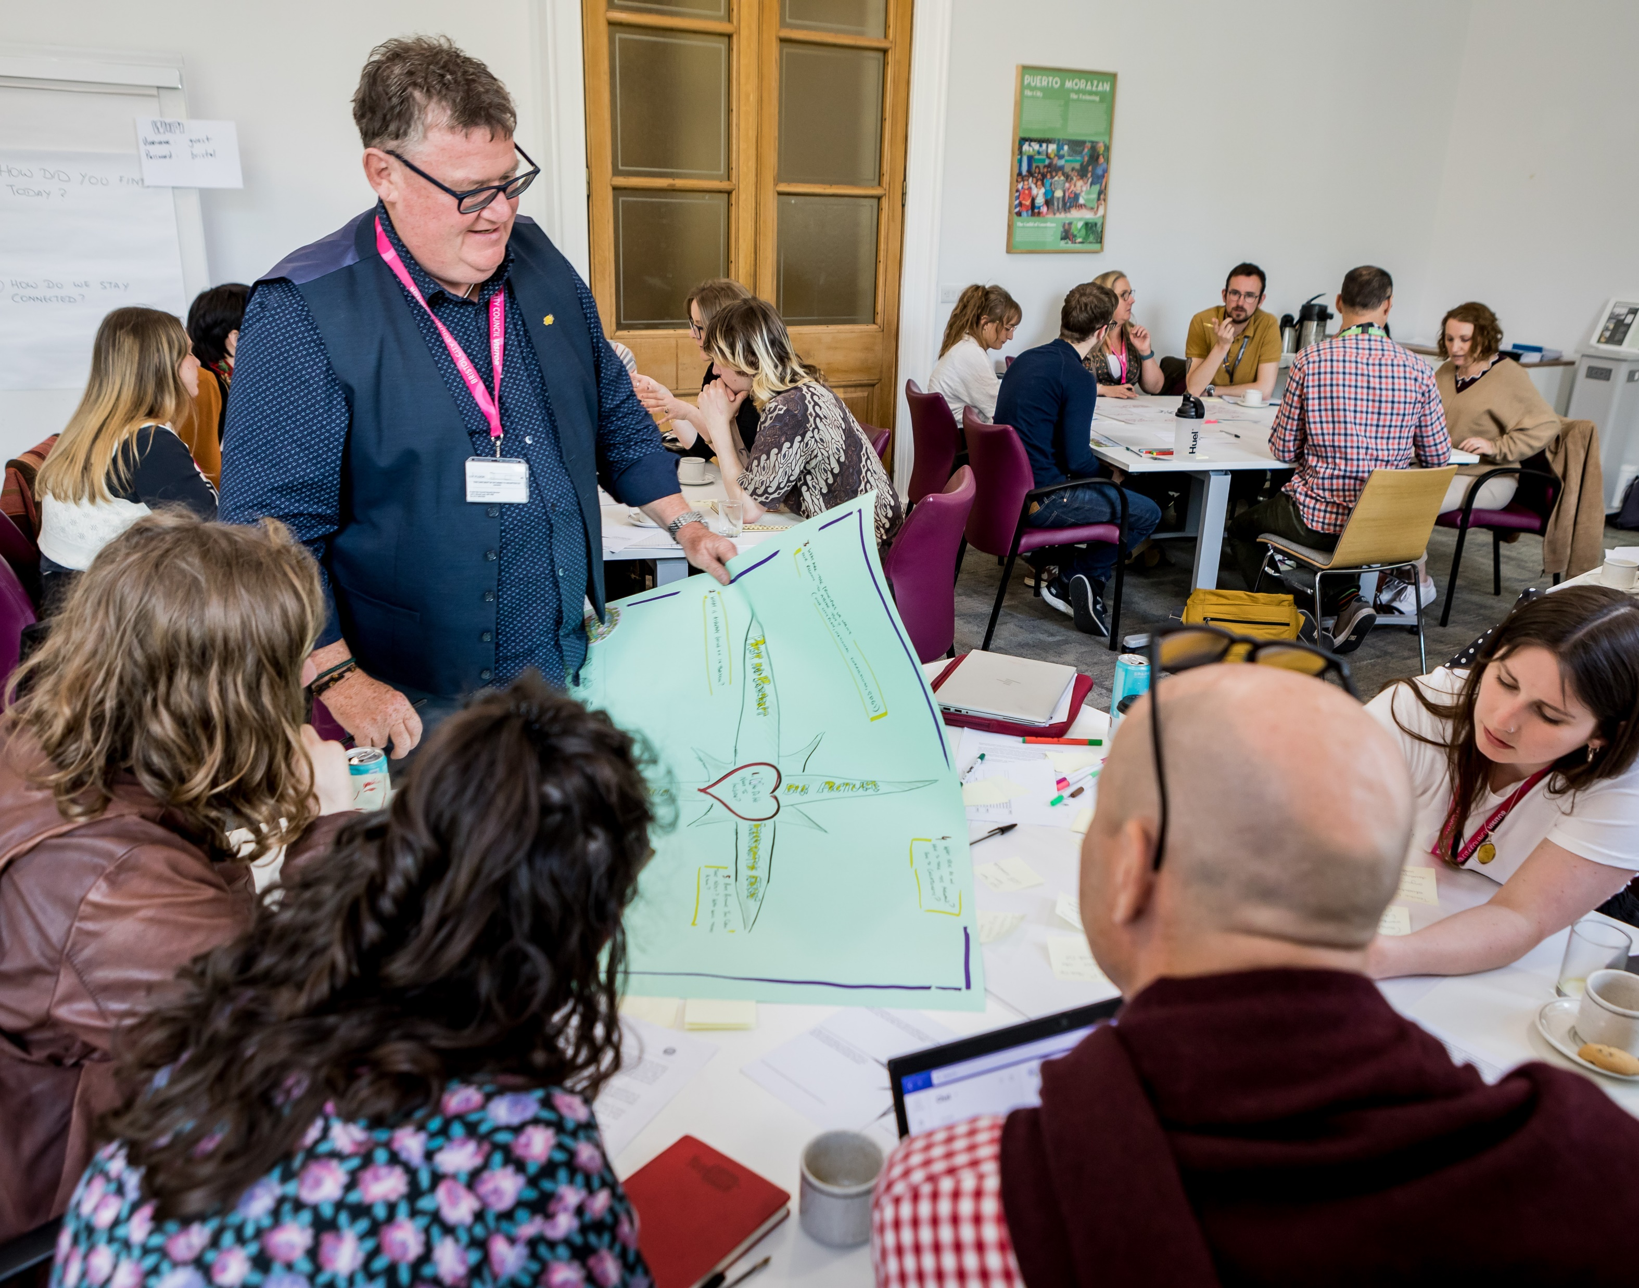
Where do we go?
What are we doing already:
Intergenerational and cross-disciplinary dialogue i.e. policy workshops
Need for toolkits – this work has begun i.e. climate café guide
Future Aspirations and Pathways Forward:
Writing up results for academic and public audiences
Notes:
Rozzy:
We have, within the project, already begun fifuring out ways of directly responding to and building on this work. Here, for example, you can see pictured a workshop which took place bringing together policy makers and people of influence across Bristol and young people to examine and discuss our data. We have also begun to develop many practical toolkits, which Sara will give you some more detail on in a minute.
We have put it in the future, as we are still writing up, but we have many papers in the works, one based on this data too.

Slide 16
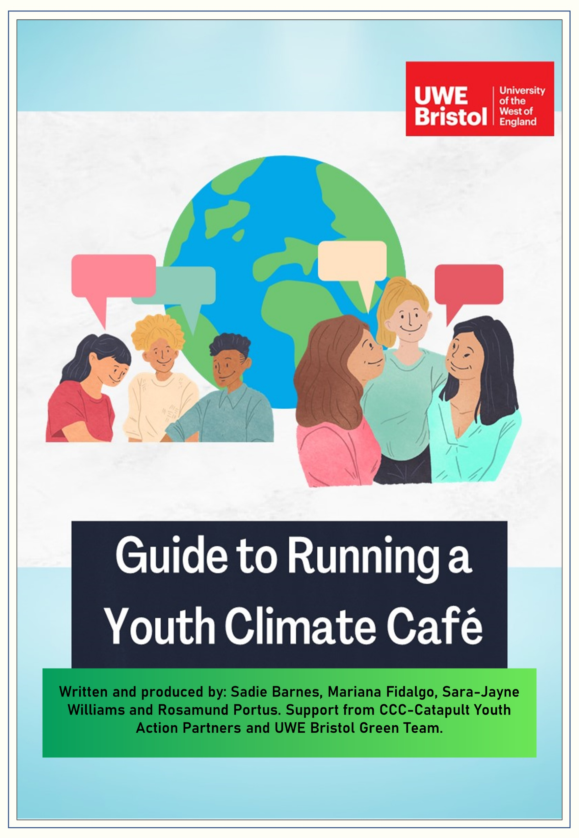
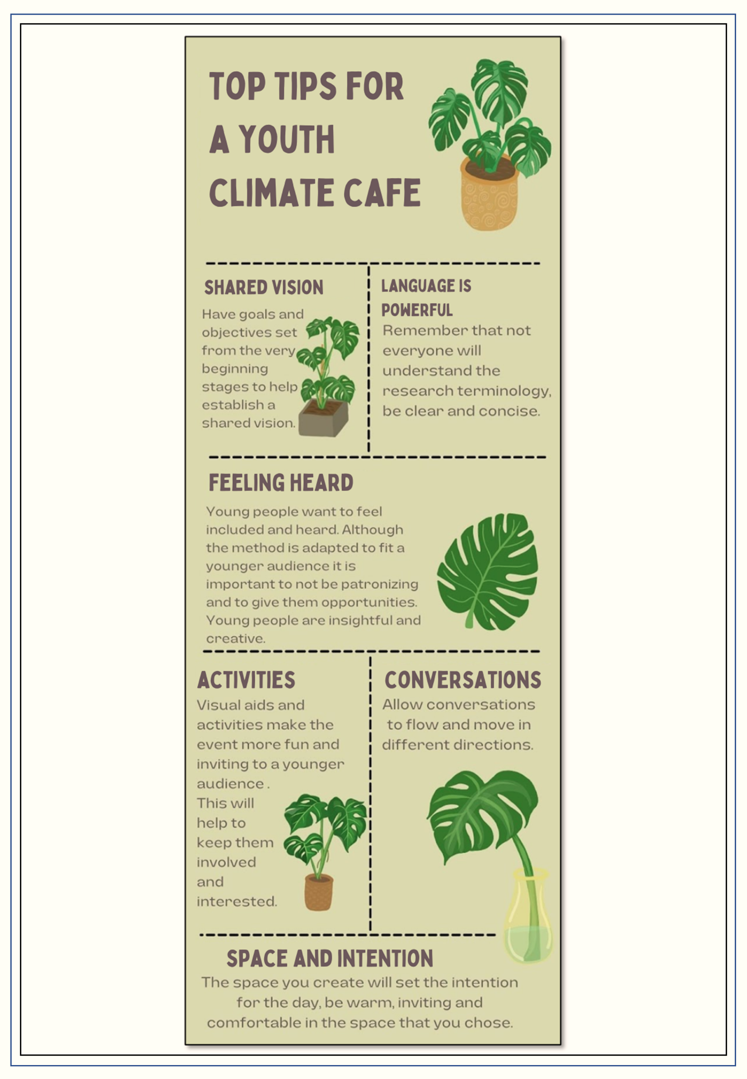
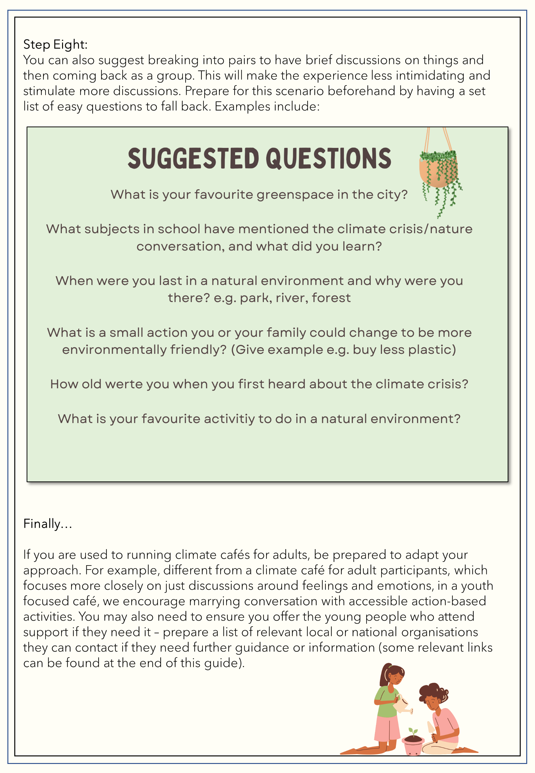
Notes:
The climate café guide is available on the CCC-Catapult website, and has developed with young people to support those who want to use the approach with young people particularly. This is currently based on work we completed in a more culturaaly diverse area of Bristol. We will be sharing this work with teachers at an upcoming workshop and plan to design an implementation guide specifically for teachers to use in schools.

Slide 17

Multidisciplinary discussions: Our Ideas/
Your Ideas
Key take homes:
Young people feel burdened by climate responsibilities
Young people have a fundamental distrust in older generations to act.
Young people do not feel well supported to engage with climate action despite feeling external and internal pressure to take meaningful steps towards climate solutions
We would like to invite audience input: what does this data reveal to you?
Notes:
Rozzy and Sara
Our key take homes is that:
Young people feel burdened by climate responsibilities
Young people have a fundamental distrust in older generations.
Young people do not feel well supported to engage with climate action despite feeling external and internal pressure to take meaningful steps towards climate solutions

Slide 18
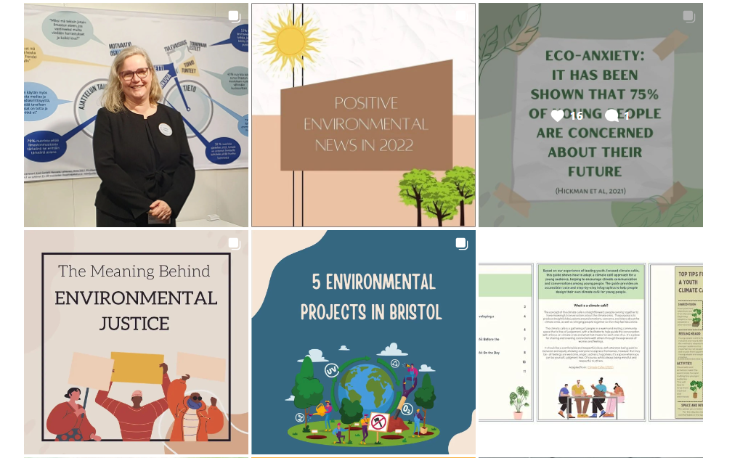
Further Information
CCC-Catapult Website: https://ccc-catapult.org/
Twitter: @CCC_CATAPULT
Instagram: @challenging_climate_crisis
Youtube page: https://www.youtube.com/channel/UCdGqhjoa2te0JQzPAAV0LIQ
Notes:
Rozzy – thank you very much for listening. For further information, please follow these links

