Slide 1
Mapping the relationship between Green-Blue-Grey Infrastructure (GBGI) and Quality of Life
Presented by
Harry West, Issy Bray, Danielle Sinnett
European Urban Research Association Conference
Reykjavík, Iceland, June 2023
24/06/2023

Slide 2
Background
Mental health, particularly for urban populations, is a growing public health concern.
Understanding how people relate to and feel a sense of belonging in the urban environment is an important research agenda.
There is mounting evidence about the importance of green (e.g. parks, trees) and blue (e.g. rivers, lakes) infrastructure for the health and wellbeing of urban residents.
There is also emerging evidence about the benefits of certain ‘grey’ features (e.g. historic buildings, active travel routes).

Slide 3
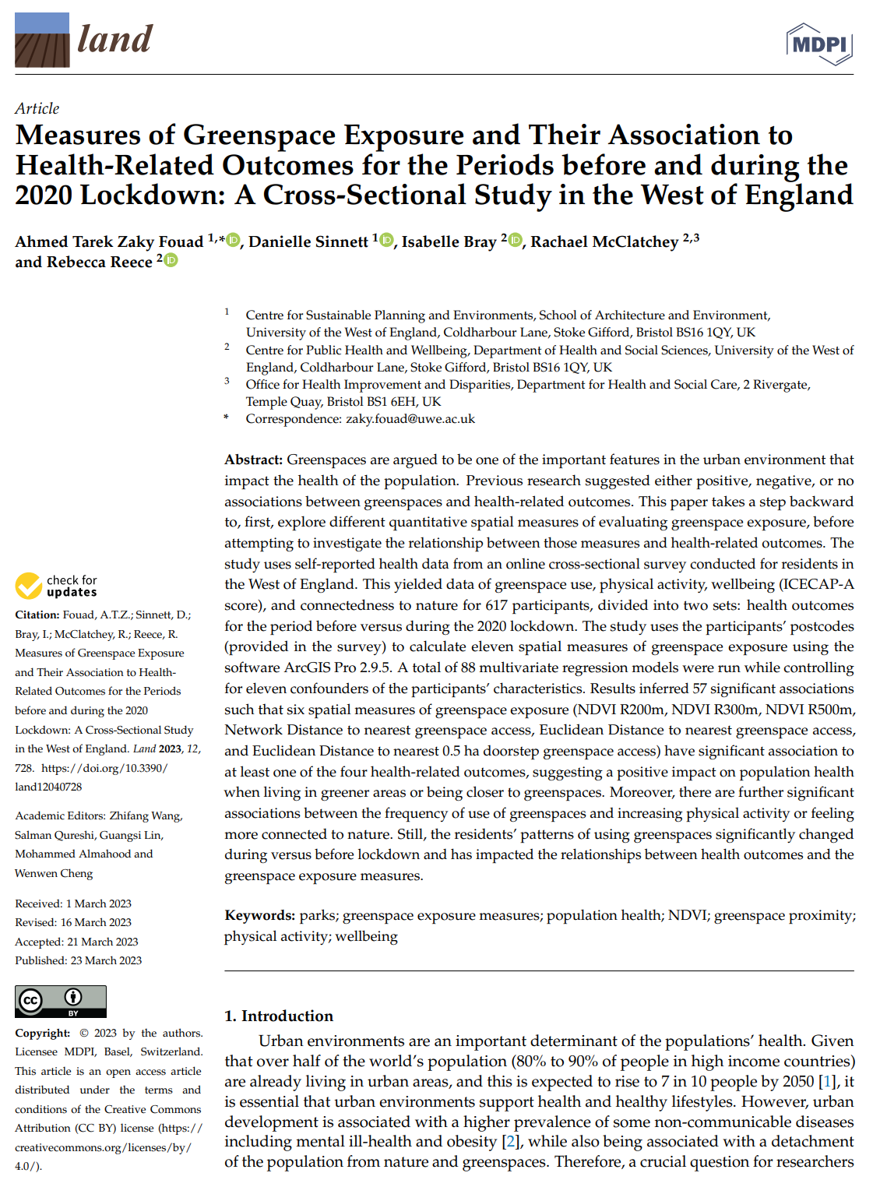
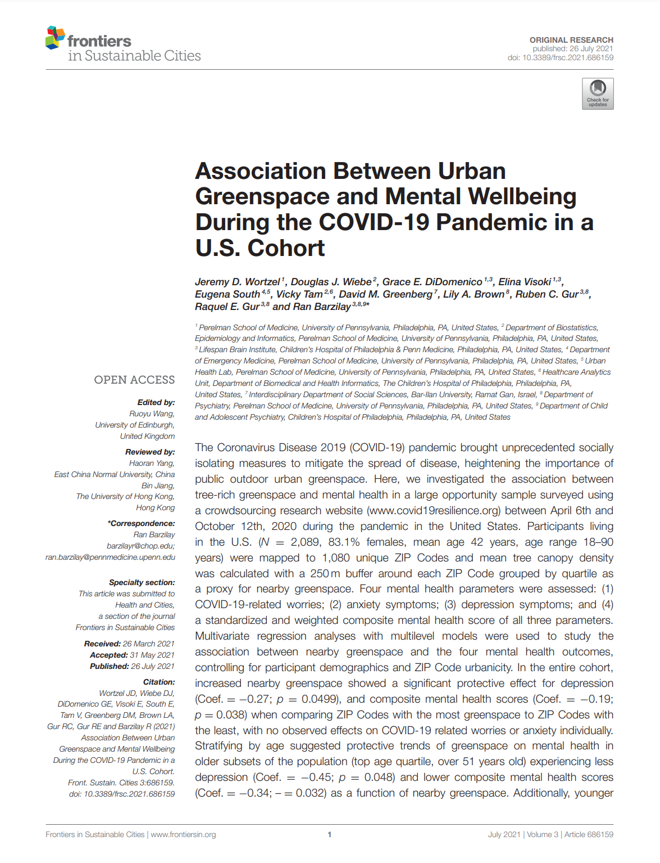
Background

Slide 4
Our Project
Our Reclaim project “The role of GBGI in levelling up across Bristol” seeks to explore relationships between Green-Blue-Grey Infrastructure (GBGI) and a range of health and social outcomes in neighbourhoods across Bristol.

Slide 5
Bristol Quality of Life Survey
The Quality of Life (QoL) survey provides an annual snapshot of the quality of life across Bristol.
This is administered by Bristol City Council.
The survey has run since 2001 (although our project will only explore data from 2011-2022).
The survey includes up to 190 indicators of QoL and wellbeing of residents.
Data for this project is being supplied by BCC at the postcode level with demographic characteristics aggregated to preserve anonymity of respondents.

Slide 6
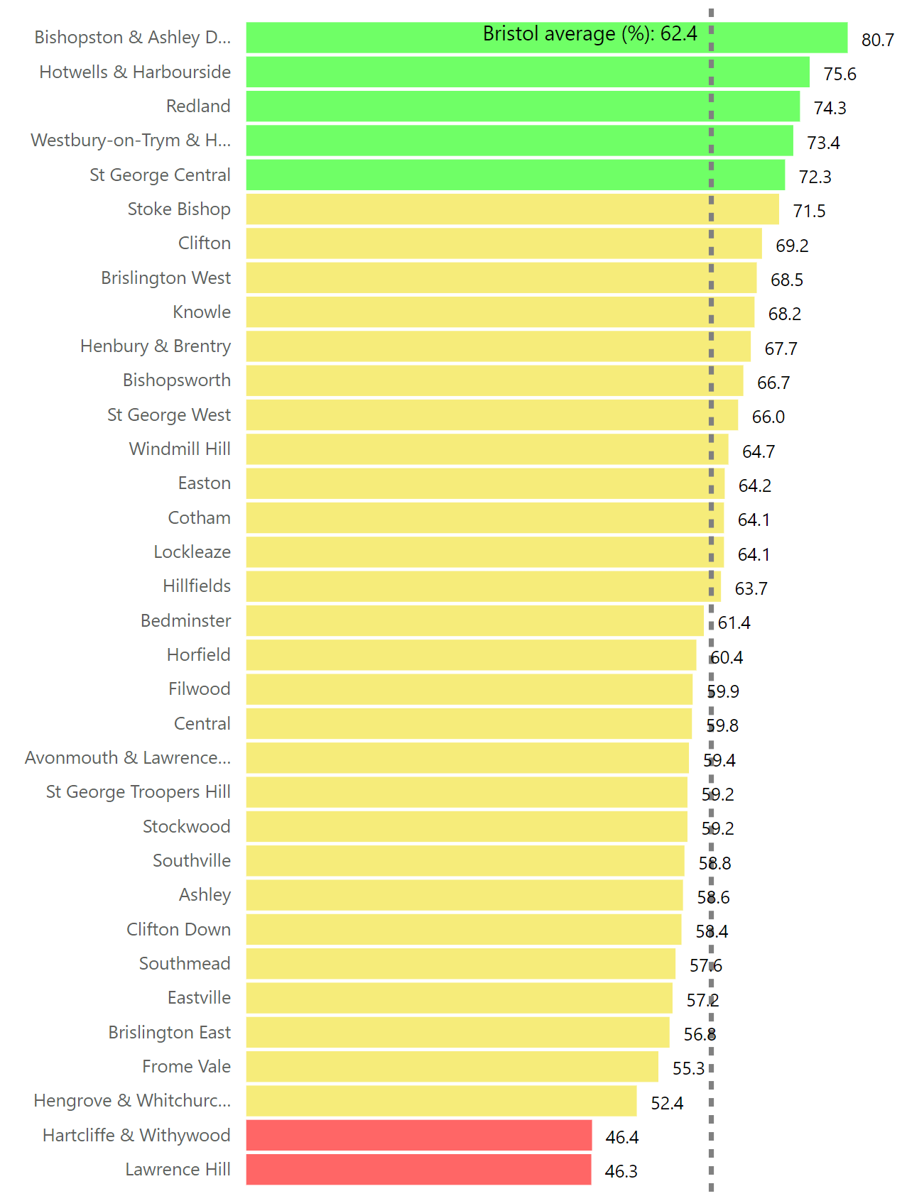
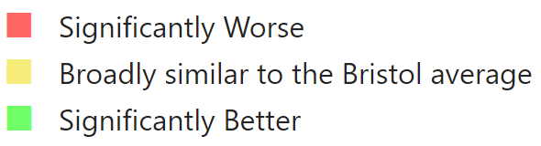
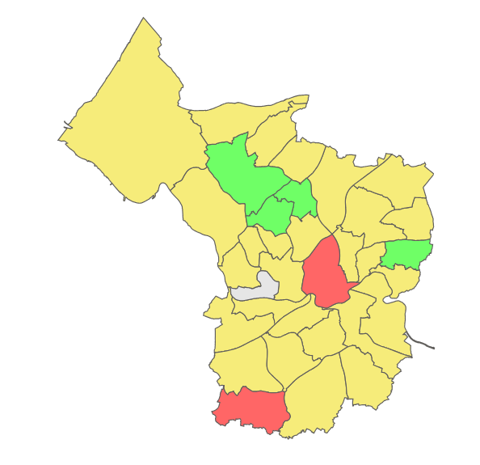
Bristol Quality of Life Survey
% people satisfied with life
https://app.powerbi.com/view?r=eyJrIjoiMjMyNWQ2ODItNjhhMS00NGM3LWFmNGYtYWU0MmExOTQ0YzMzIiwidCI6IjYzNzhhN2E1LTBmMjEtNDQ4Mi1hZWUwLTg5N2ViN2RlMzMxZiJ9

Slide 7
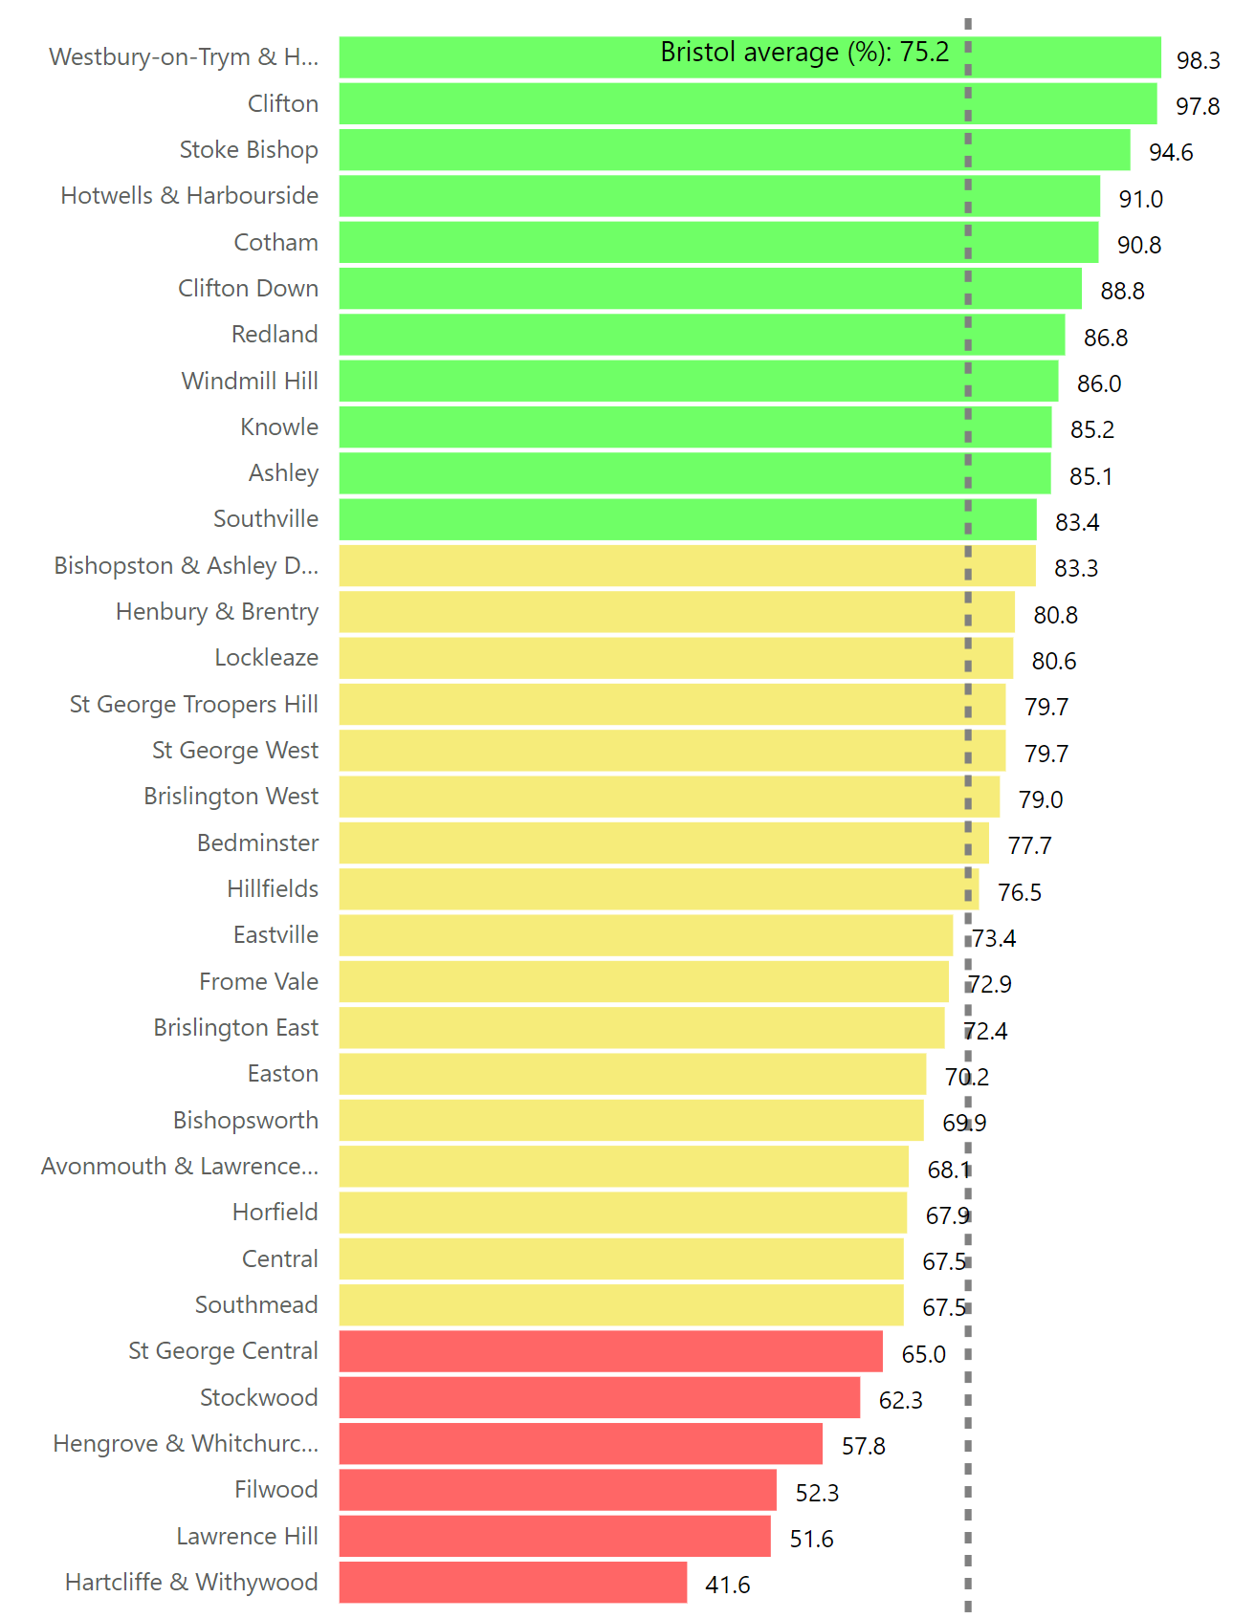
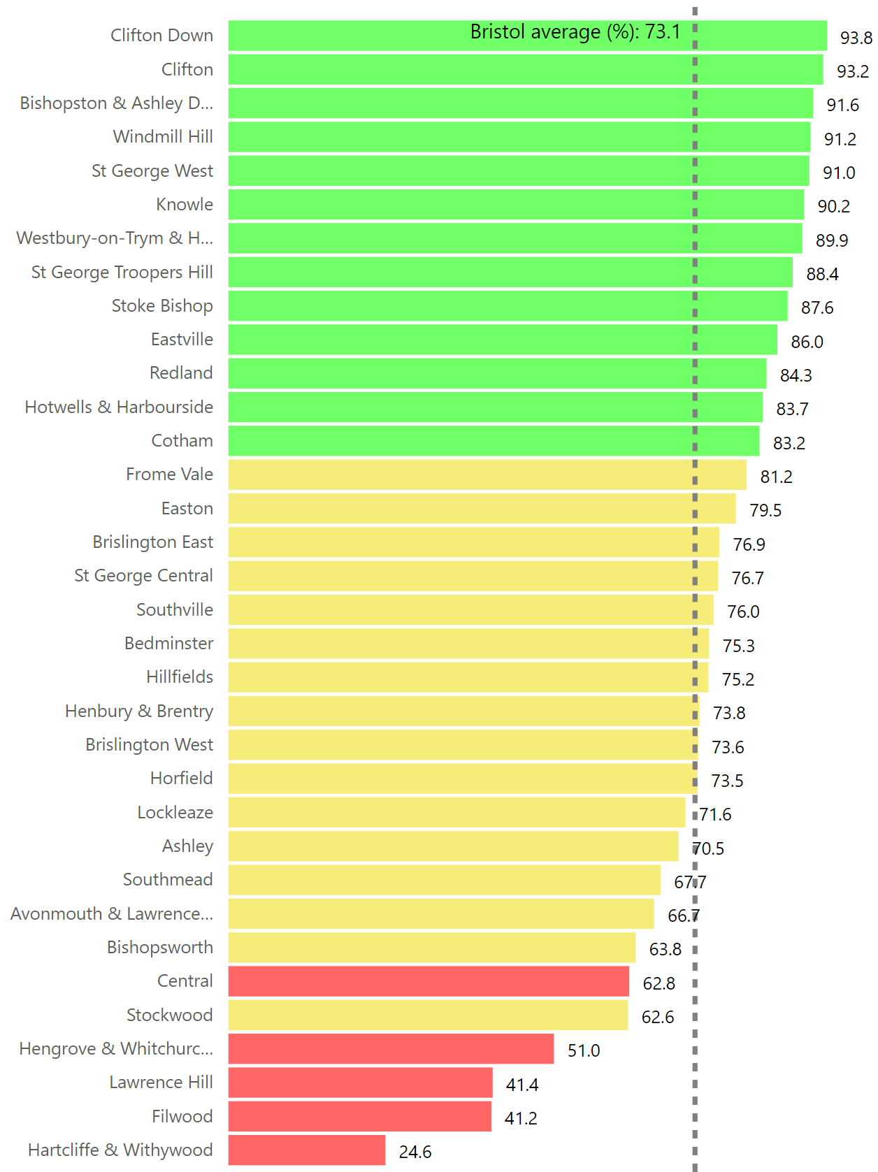
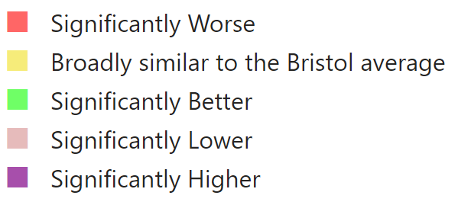
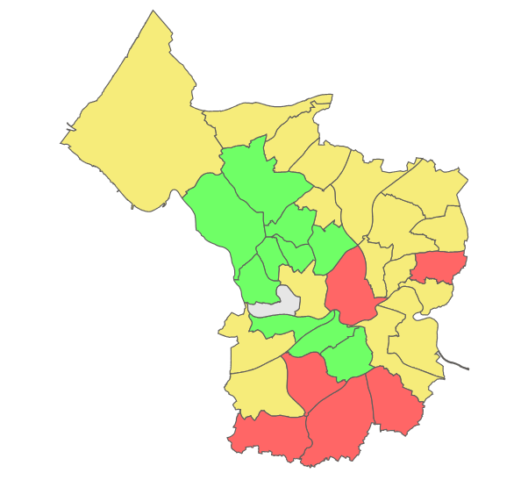
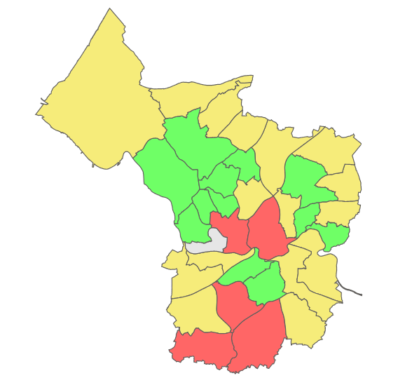
Bristol Quality of Life Survey
% people satisfied with local area
% people satisfied with parks and green spaces
https://app.powerbi.com/view?r=eyJrIjoiMjMyNWQ2ODItNjhhMS00NGM3LWFmNGYtYWU0MmExOTQ0YzMzIiwidCI6IjYzNzhhN2E1LTBmMjEtNDQ4Mi1hZWUwLTg5N2ViN2RlMzMxZiJ9

Slide 8
Methodology
Using GIS and statistical analyses we aim to link various GBGI features to self-reported health, social interaction and neighbourhood satisfaction from the Bristol Quality of Life Survey.
We will be analysing QoL survey data collected over the past 10-11 years (2011-2022) at postcode level.
We aim to explore a broad range of GBGI features in this way, and draw on a large number of secondary spatial datasets in our analysis to measure exposure. These are all sourced from openly available data such as the OS, Bristol Open Data, Census and Natural England.
We are currently piloting multiple GIS methods to quantify exposure to determine the most useful indicators for GBGI (for example identifying the number of trees within a 10 minute walk of a postcode, or distance to the nearest bus stop, river or green space).

Slide 9
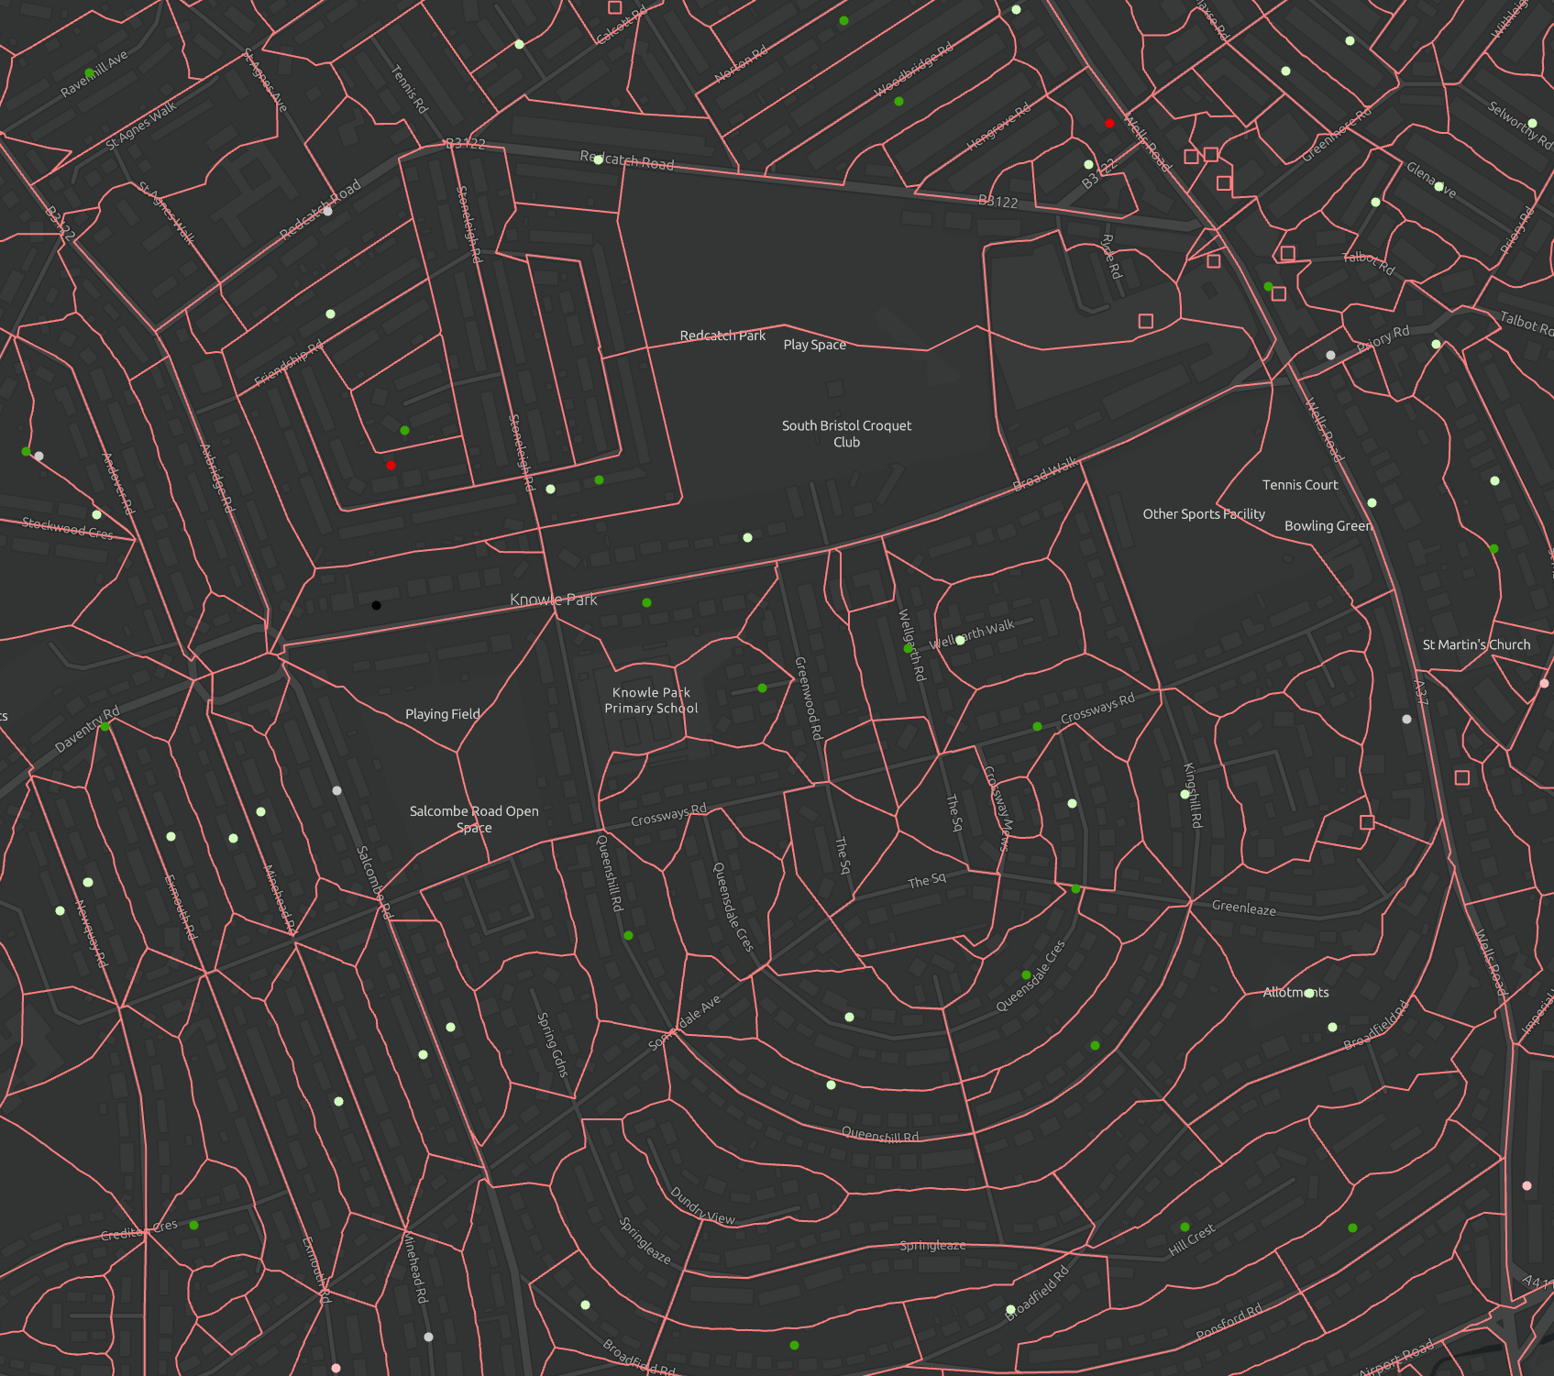
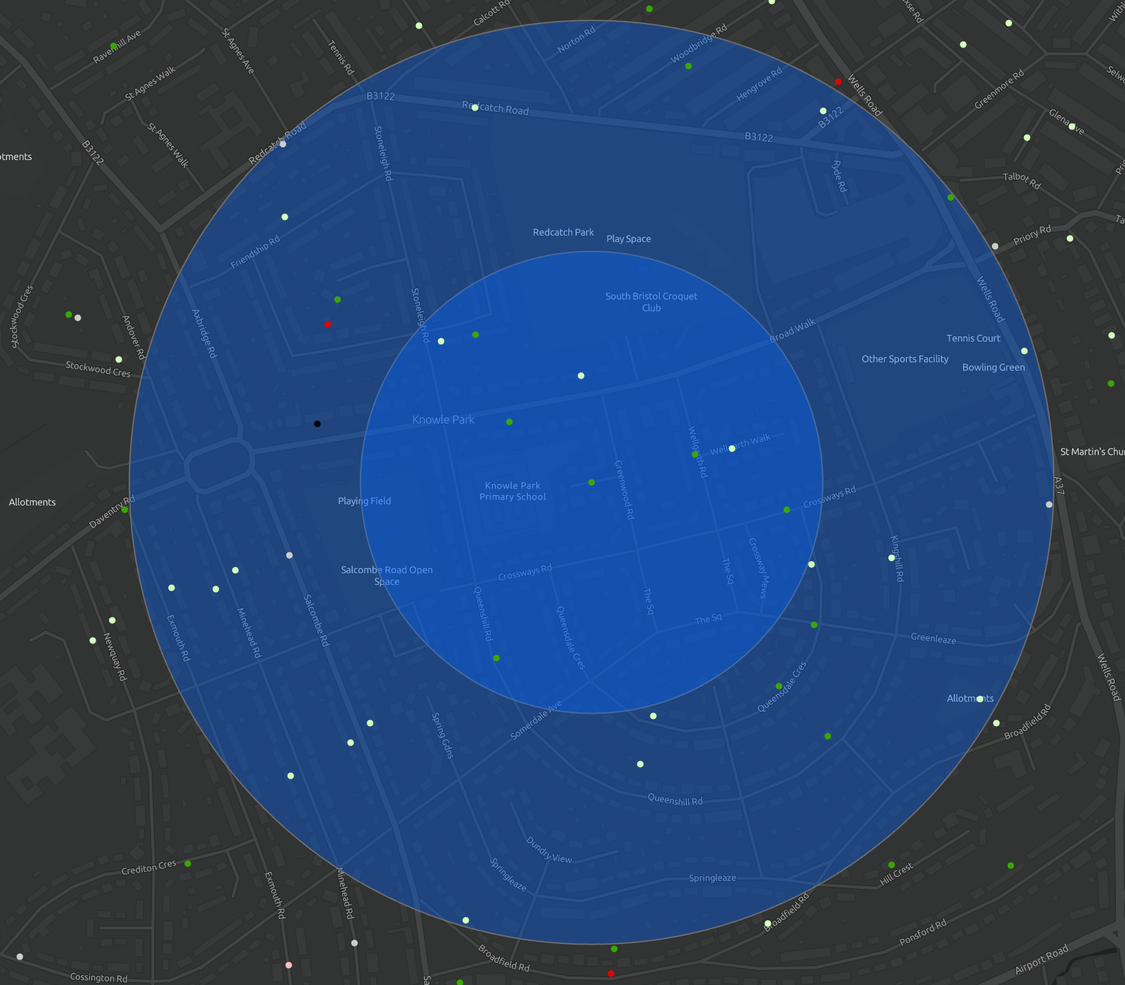
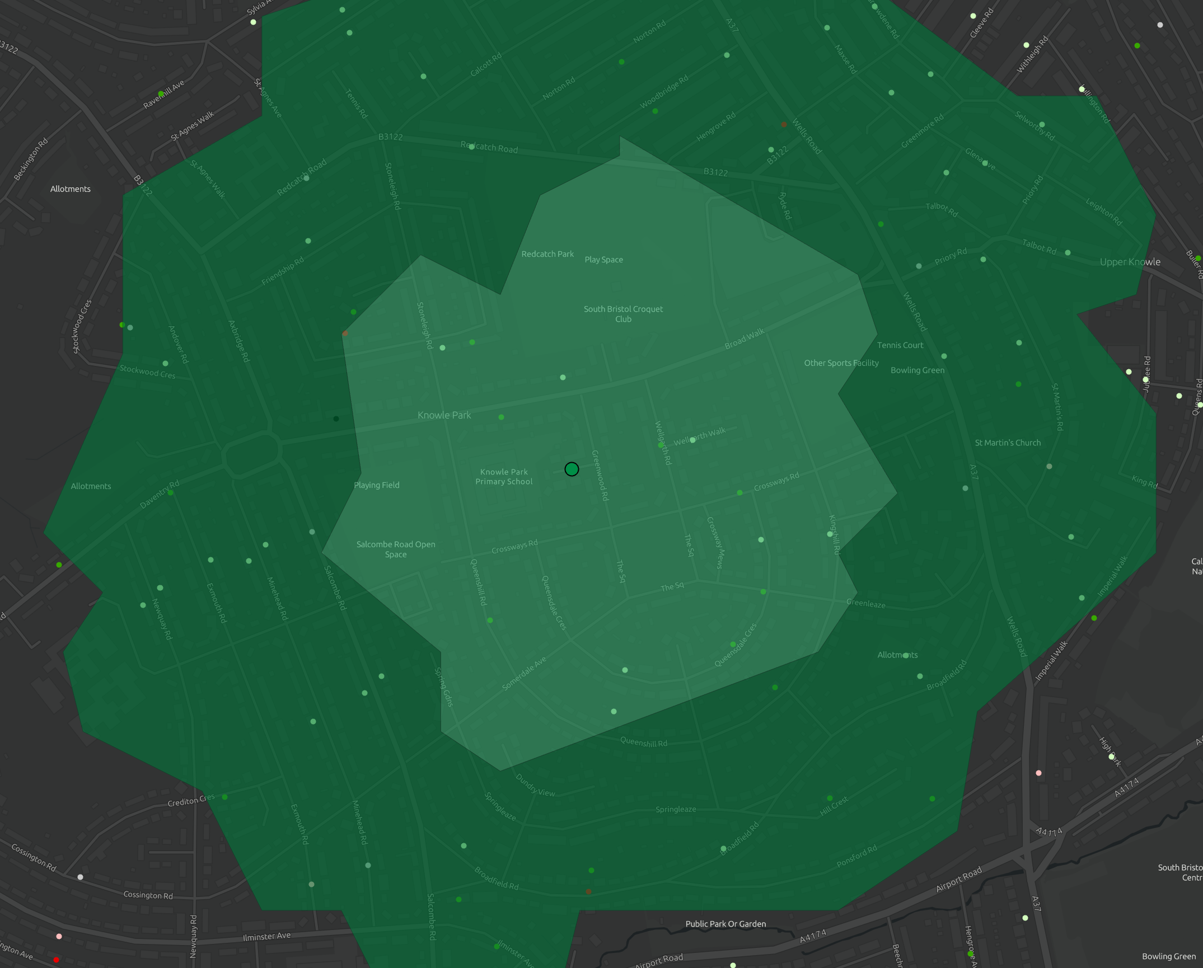
Methodology

Slide 10
GBGI Exposures
Green | Blue | Grey
Presence and density of urban trees | Water bodies such rivers, lakes, ponds (including accessibility) | Listed and historic buildings and monuments
NDVI (Normalised Difference Vegetation Index) | NDWI (Normalised Differenced Water Index) | Bus stops/routes
Open green space (including accessibility) | Waterbody designations (e.g. RAMSAR, SPA) | Cycle network
Conservation areas |  | Urban density
Woodlands |  | Culturally important buildings
Nature reserves |  | Social infrastructure
Outdoor sports facilities |  | Streetlights and furniture
Size and density of private gardens |  | Traffic conditions
 |  | Road speed limits
 |  | Road network
 |  | Ferry and rail network

Slide 11
QoL Indictors
We will be comparing GBGI exposure variables against a number of self-reported QoL measures captured in the survey.
For example:
  Life satisfaction
  How individuals' health has been in the past year
However, it may be that other mediating factors might influence the relationship between GBGI exposure and these QoL measures.
For example:
  Whether the frequency of bicycle riding mediates the relationship between cycle network exposure and self-reported health.
  Whether satisfaction with green spaces mediates the relationship between green space exposure and life satisfaction

Slide 12
GBGI Exposures & QoL

Slide 13
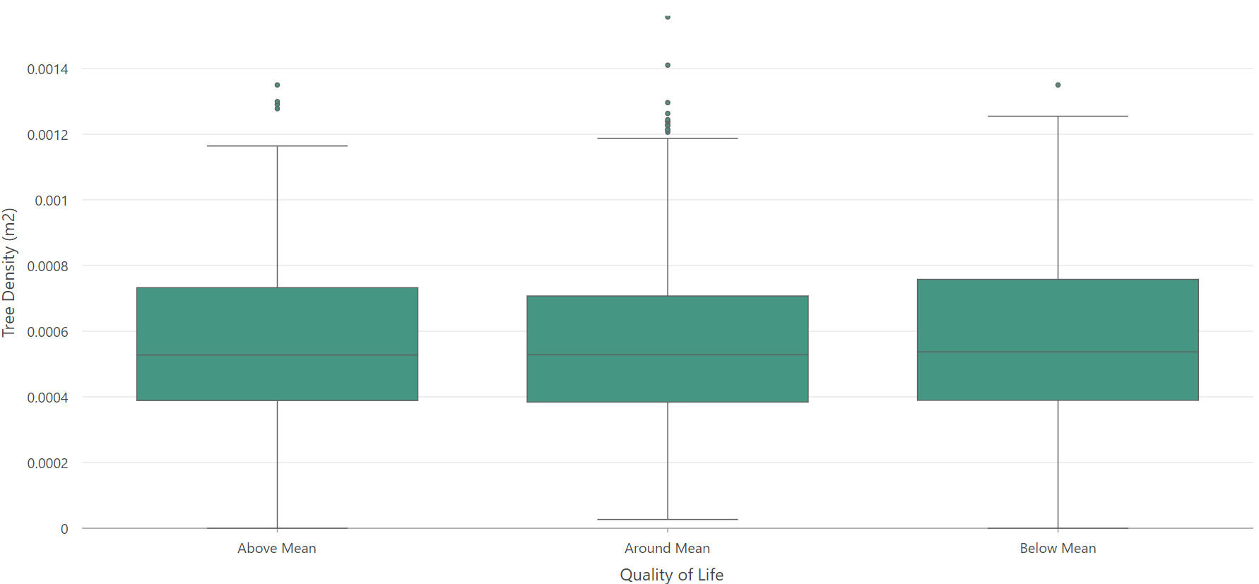
Pilot Analysis – Tree Density

Slide 14
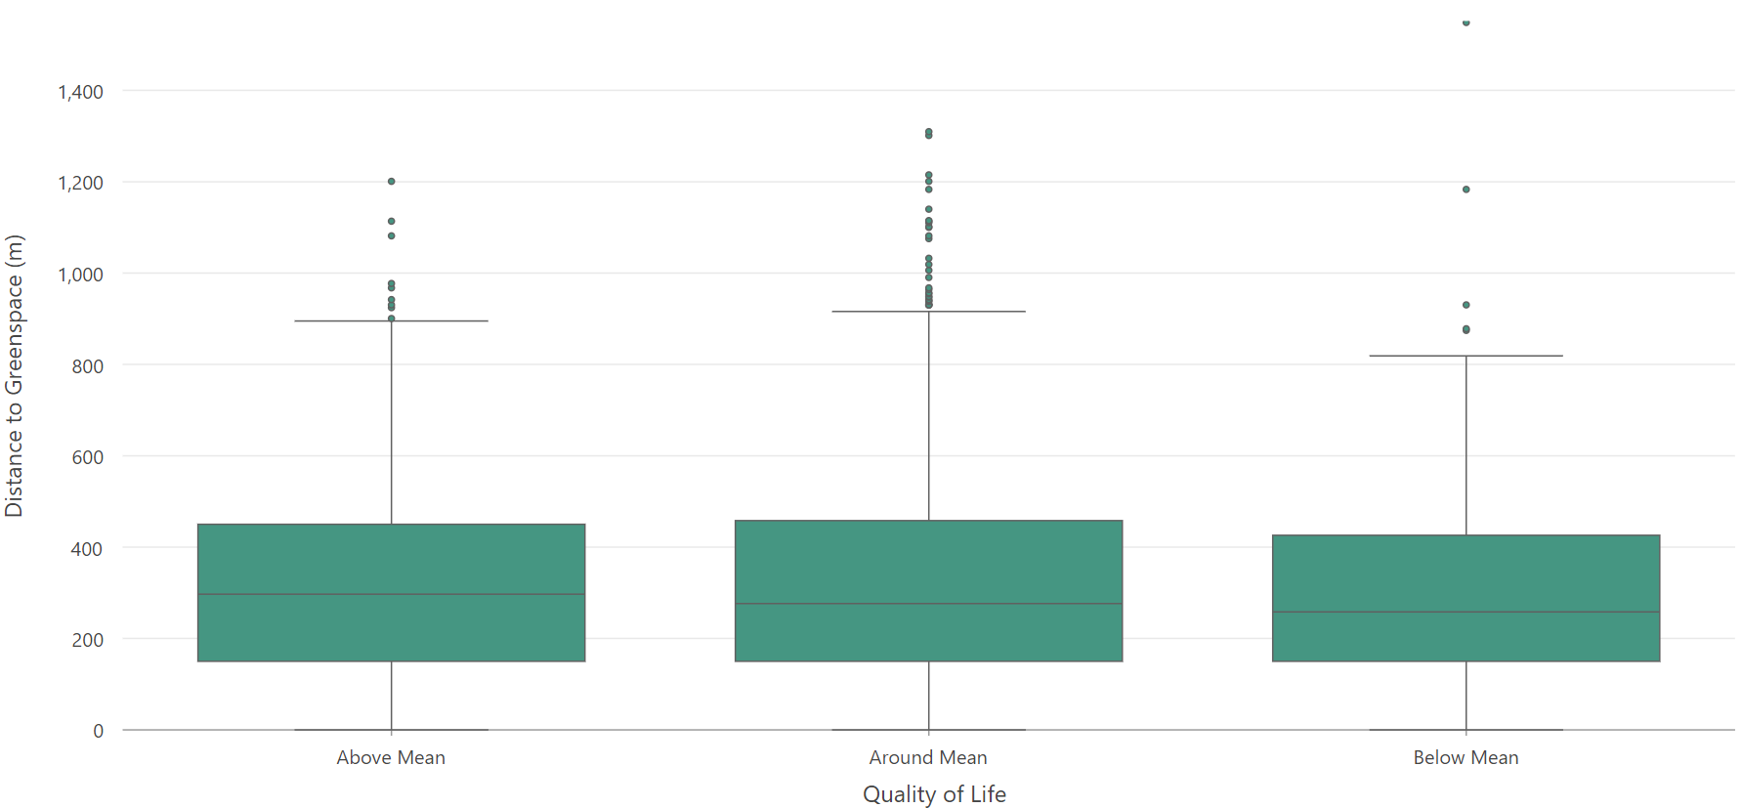
Pilot Analysis – Greenspace Distance

Slide 15
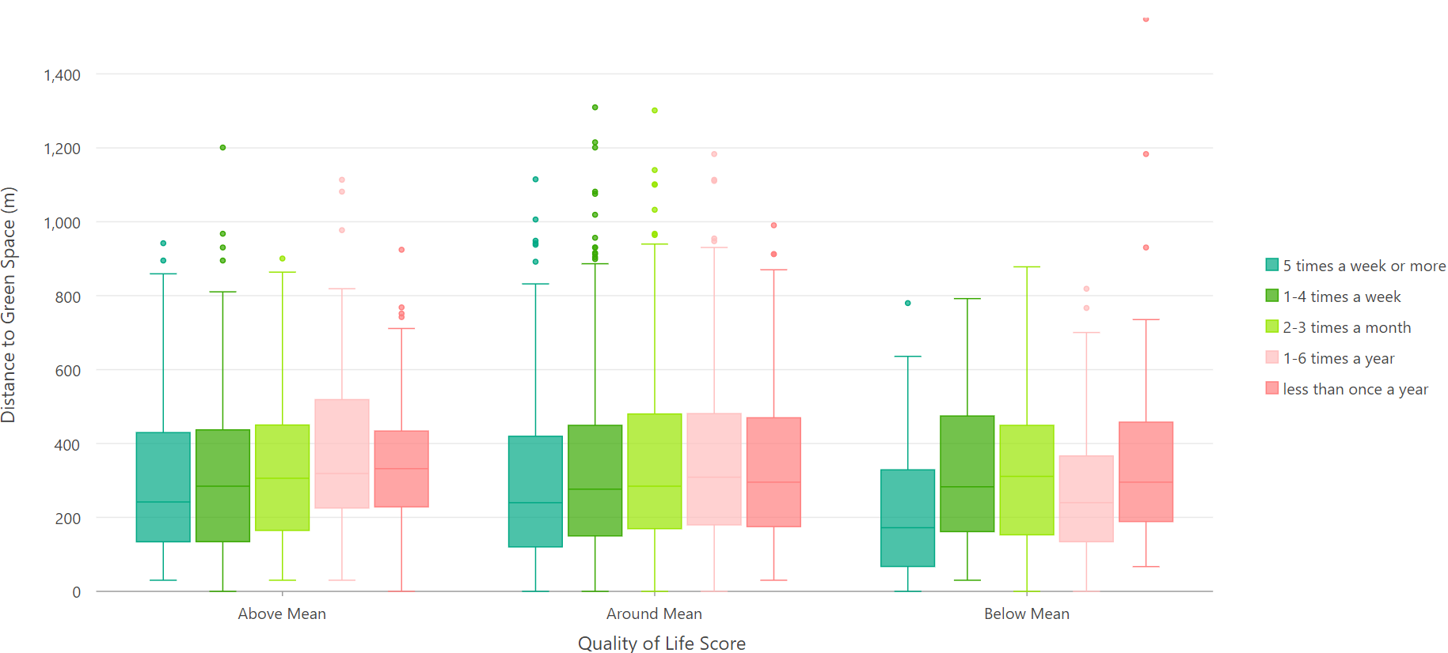
Pilot Analysis – Greenspace Distance

Slide 16
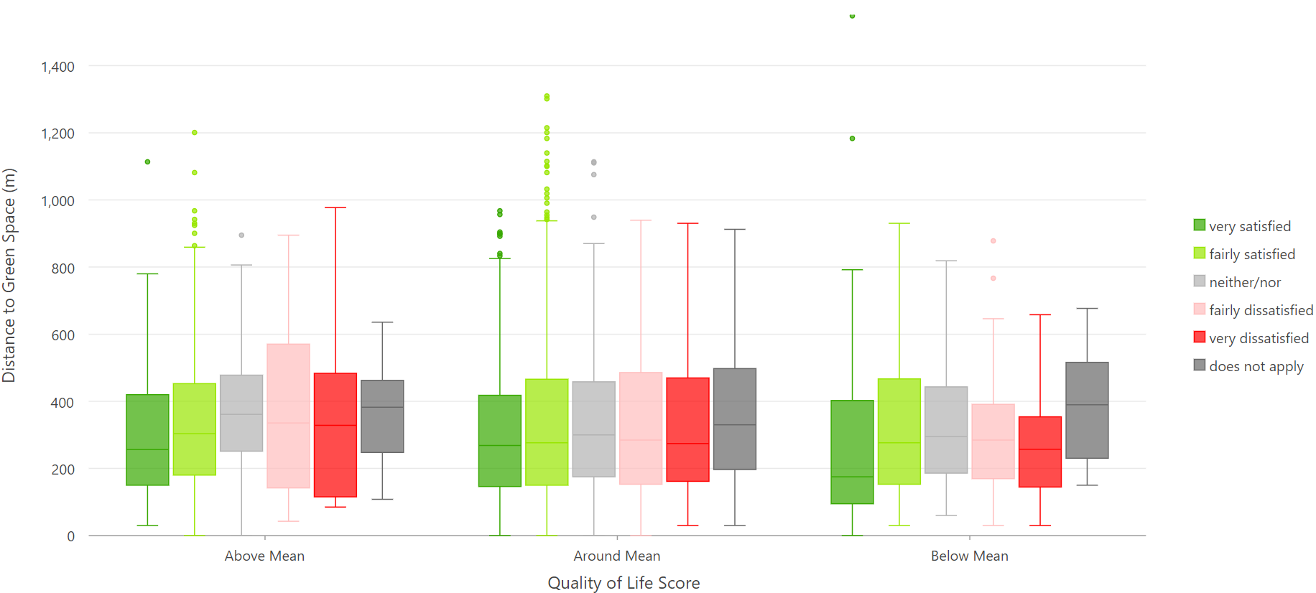
Pilot Analysis – Greenspace Distance

Slide 17
GBGI Exposures & QoL

Slide 18
Our Project Aim
By exploring the relationship between different GBGI and self-reported quality of life we aim to be able to better understand the importance of these features for improving people’s lives and reducing inequalities within neighbourhoods and across the city.
The evidence we produce we hope will further our understanding of how citizens relate to their urban environment, and will help more inclusive decisions to made by local councils about investment to ensure that all residents, wherever they live, benefit from GBGI which enhance quality of life for urban communities.

