Slide 1
Seeing the Trees in the Forest: Opportunities for Inclusive Practice within the Psychology Curriculum
Dr Dawn N Albertson
Bath Spa University

Slide 2
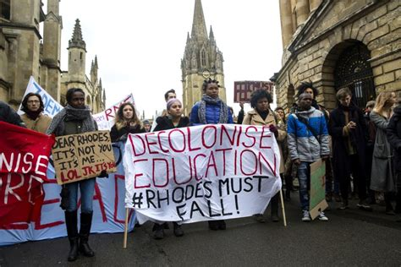
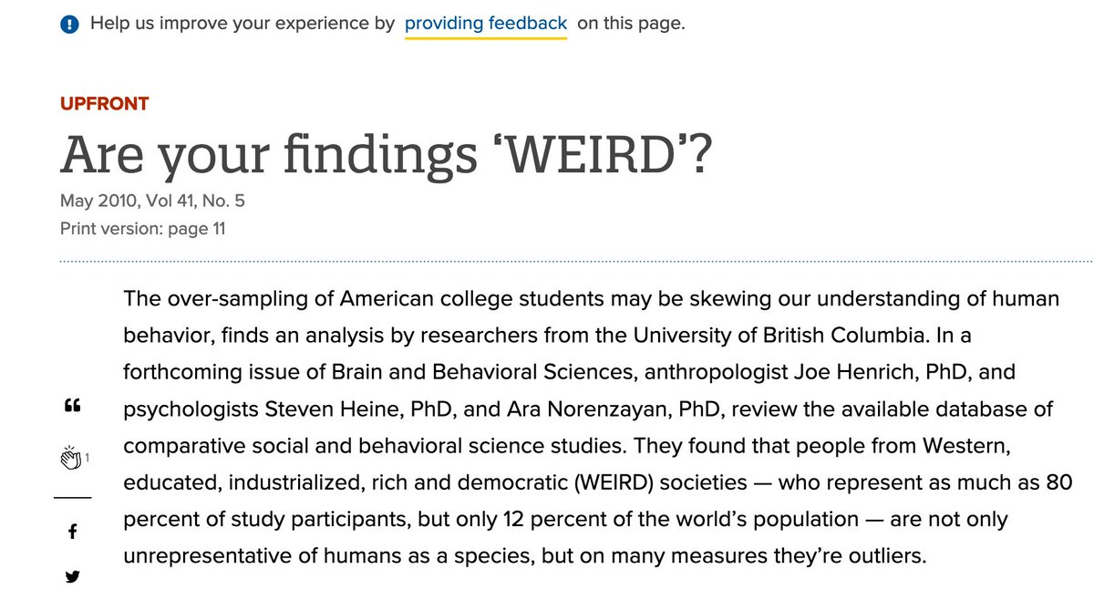

Slide 3
Dr Angela Davis Author: Women, Race & Class
“If we are to maximise the possibilities of something beautiful emerging from this period, we have to do the work right now – the difficult, unglamorous, oftentimes unrecognised, uncredited work of marking change within institutions.”

Slide 4
Wicked Problems
A social or cultural problem that is difficult or impossible to solve because of its complex and interconnected nature
Classic wicked problems: poverty, climate change, political strife
Decolonizing the academy
Key Characteristics
No definitive way to solve, every one is unique
No way to know if your solution is final
Solutions are not true or false, only good or bad
Solution requires a large number of people to change their mindsets or behaviour
There is always more than one explanation because they depend greatly on the individual’s perspective

Slide 5
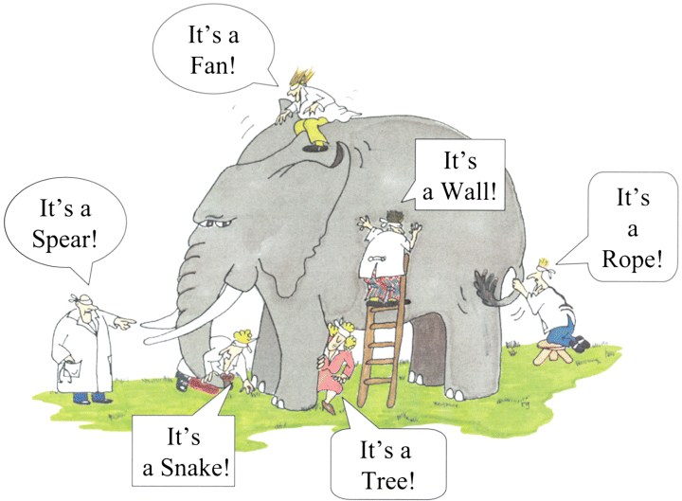
Approaching a Wicked Problem

Slide 6
Which one most motivates you?
WP, APP, Recruitment & Retention
Diversify Psychology
Decolonize Curriculum and Institutions
Inclusion in Teaching and Learning

Slide 7
Motivation + Fit = Action!
Individual Sphere of Influence
Department+
Course
Institution Type and Drivers
Module
Teaching

Slide 8
Inclusive Practice in our Classrooms and Modules
Diversity
Evaluate your reading lists, guest speakers, videos, and content areas
Where is there bias?
Who and what perspectives are missing?
Supporting the Needs of All Learners
Physical Inclusion
Cultural Inclusion
Cognitive Inclusion

Slide 9
Inclusive Assessment
Student choice in demonstration of the learning outcomes
Already do this in topic choice within dissertations
What about assessment modality?
Based around Universal Design for Learning
Flexibility that benefits everyone
Students as Partners

Slide 10
Inclusive Assessment
Piloted within Level 4 introductory research methods module
Kept very tight equivalents – verbal vs typed
Ultimately students responded favourably to the opportunity of choice, though very few took the “alternative” option
COVID confound
No difference in performance
Excellent end of module evaluations
Considerations
Requires cooperation with central university
Careful course-wide design a must
Level 4 only?
Optional modules only?

Slide 11
Pre-Registration and Open Science
Why?
Gold standard in science
Assessment scaffolding
Reveal the hidden curriculum
What do we do?
Embed open science principles from year 1
Use open source software that is compatible with the Open Science Framework and accessible to all
Pre-registration document as semester 1 assessment within dissertation modules

Slide 12
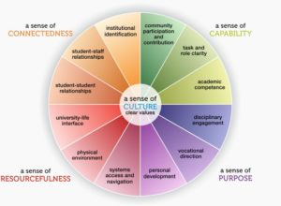
Transition to University
Build for students of all backgrounds
Expose the hidden curriculum
Psychological Science for Student Success Module
Examines the science behind major aspects of university success:
academic performance, social relationships, and wellbeing
Grounded in the literature on successful transition to university
5 senses of success (Lizzio, 2006): Purpose, Resourcefulness, Connectedness, Capability, and Culture

Slide 13
Transition to University
Students interrogate aspects of their student life through the lens of psychological science to develop the understanding, skill, and strategies to approach their university career with knowledge and intention
Topics include learning, motivation, self-control, culture, relationships, health, and happiness
Module Aims
To meaningfully explore components of academic performance and a positive transition to university
To leverage the application of psychology to become more successful academically, socially, and/or emotionally in your own Bath Spa University transition and student life
To develop useful skills in scientific literacy, critical thinking, self-reflection, written and oral communication, and teamwork

Slide 14
Individual Sphere of Influence
Department+
Course
Institution Type and Drivers
Module
Teaching

Slide 15
Connect with Others!
Provides resources and services, access to a global collaborative community, and opportunities for professional development for teachers of Psychology at all levels
Upcoming International Relations Committee Call:
Looking to collect globally sourced resources that help to diversity, internationalize and decolonize all areas of psychology
Assignments – submit details of your assignment and marking rubric in advance, first 25 teachers to upload the resulting assignment to the International Twitter Poster Conference receive a free 1 year membership
Programming – Grants of up to $500 available to support the development of programming opportunities for students and departments
teachpsych.org
@TeachPsych
Society for the Teaching of Psychology - STP

Slide 16
Where will you start?

Slide 17
References and Further Reading
CAST (2018). Universal Design for Learning Guidelines version 2.2. Retrieved from http://udlguidelines.cast.org
Centre for the Development of Teaching and Learning. An A-Z of Assessment Methods. Retrieved from https://www.reading.ac.uk/web/files/eia/A-Z_of_Assessment_Methods_FINAL_table.pdf
Duffy, A., et al. (2020). Predictors of mental health and academic outcomes in first-year university students: Identifying prevention and early-intervention targets. BJPsych Open, 6(3), E46. doi:10.1192/bjo.2020.24
From crisis to cornerstones of culture (2017). The Psychologist (30), 18. Retrieved from https://thepsychologist.bps.org.uk/volume-30/june-2017/crisis-cornerstones-culture
Lizzio, A. (2006). The Five senses of success: A conceptual framework for student transition and orientation. Griffith University y: First Year Experience Project.
Morris, C., Milton, E., & Goldstone, R. (2019). Case study: suggesting choice: inclusive assessment processes. Higher Education Pedagogies, 4(1), 435-447.
Murphy, M. C., Gopalan, M. Carter, E. R., Emerson, K. T. U., Bottoms, B. L., & Walton, G. M. (2020). A customized belonging intervention improves retention of socially disadvantaged students at a broad-access university. Science Advances, 6 (29): eaba4677 DOI: 10.1126/sciadv.aba4677
Newman, I., Healey, C., Osborne, A., & Newman, V. (2018). Diversity for Everybody, Achievement for All: Patterns not labels. NADP Journal of Inclusive Practice, 10, 80-105.
Gopal, P. (2021): On Decolonisation and the University, Textual Practice, DOI: 10.1080/0950236X.2021.1929561
Rad, M. S., Martingano, A. J., and Ginges, J. (2018). Toward a psychology of Homo sapiens: Making psychological science more representative of the human population. Proceedings of the National Academy of Sciences, 115 (45) 11401; DOI: 10.1073/pnas.1721165115
Rittel, H. W., & Webber, M. M. (1973). Dilemmas in a general theory of planning. Policy sciences, 4(2), 155-169.
Thomas, L., Hill, M., O’Mahoney, J.& Yorke, M. (2017). Supporting Student Success: Strategies for Institutional Change. Advance HE. Retrieved from https://www.advance-he.ac.uk/knowledge-hub/supporting-student-success-strategies-institutional-change
Wilson, K. (2009, September). Success in first year. In First Year in Higher Education Conference.
Wray, M. (2018). Re-visioning support for disables students in HE. Wonkhe, Retrieved from https://wonkhe.com/blogs/re-visioning-support-for-disabled-students-in-he/

