Slide 1
Strengthening regional engagement between ICSs, HEE, Higher and Further Education Sectors
Exploring, developing and delivering new models for education and training, taking into account geographical spread, population need and future learner and workforce requirements
Professor Marc Griffiths
Pro-Vice Chancellor & Head of College for Health, Science & Society
16th February 2023

Slide 2
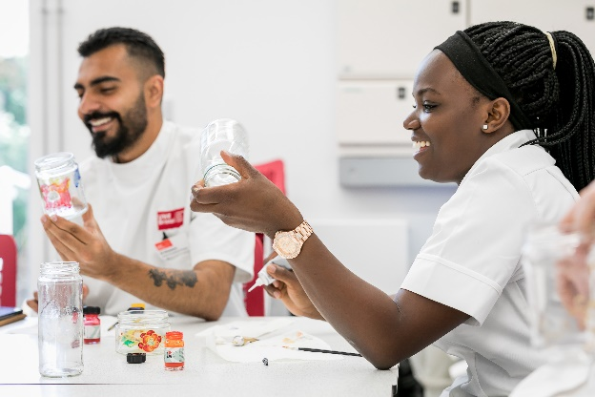
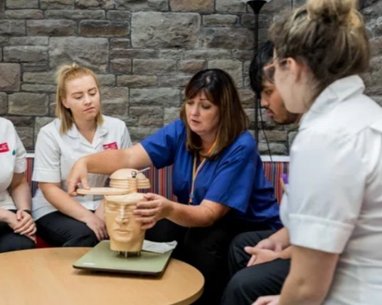
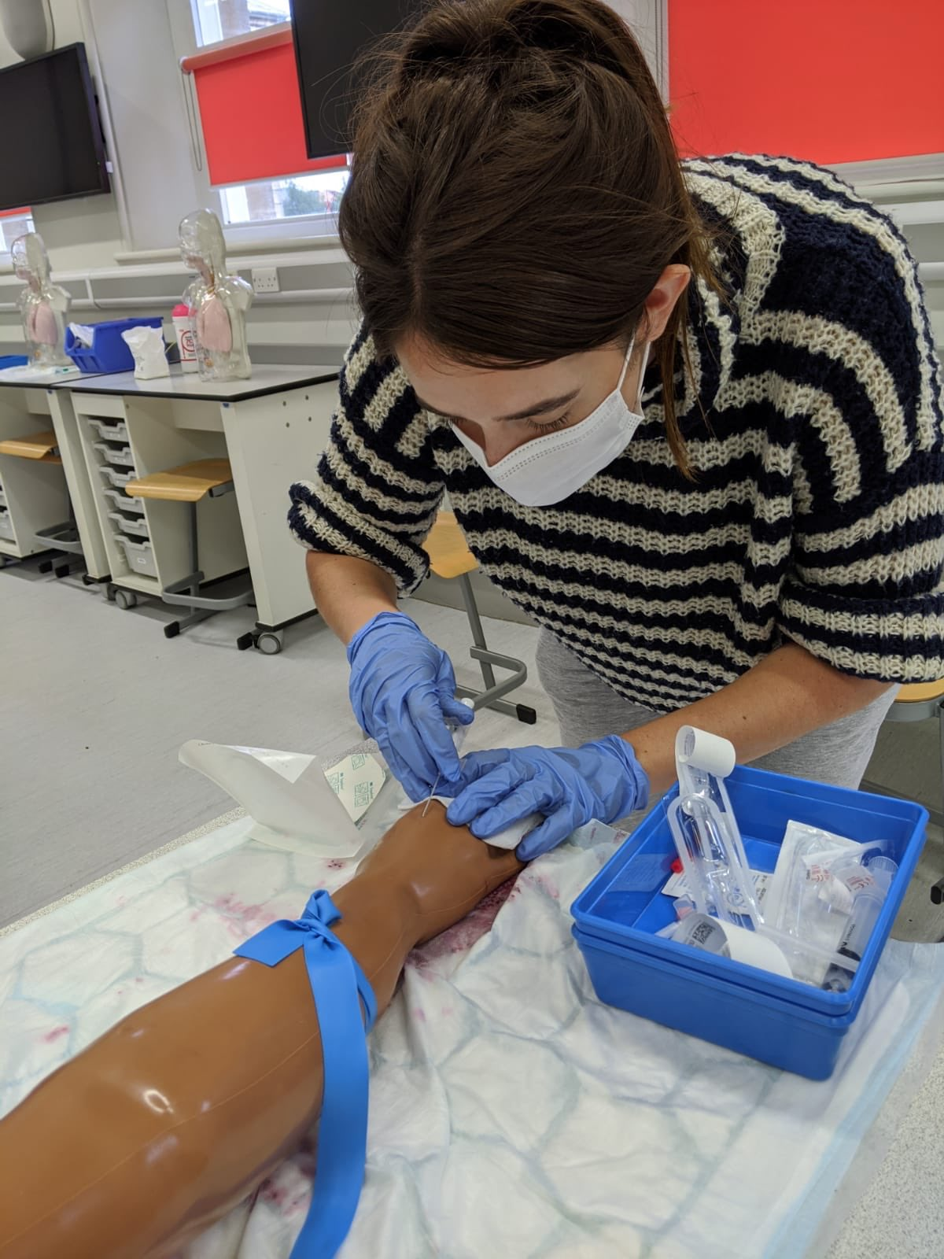
Connected with Partners |Our offer for learners
TNAs
Foundation Degrees
Pre-Degree learning
Degree Programmes
Degree Apprenticeships
Micro-credential learning
Degree learning
CPD provision / Micro-credentials
Specialist Practice
Advanced Practice
Doctorate
Post-qualification/ micro-credentials
FE / HE / NHS Partners
FE / HE / NHS Partners
FE / HE / NHS Partners

Slide 3










Working Together | A multi-system approach for Health & Social Care
Learners / Workforce
Employers / Practice
Service Users
FE
HE
Professional Bodies
Regulatory Bodies
Research / Innovation

Slide 4

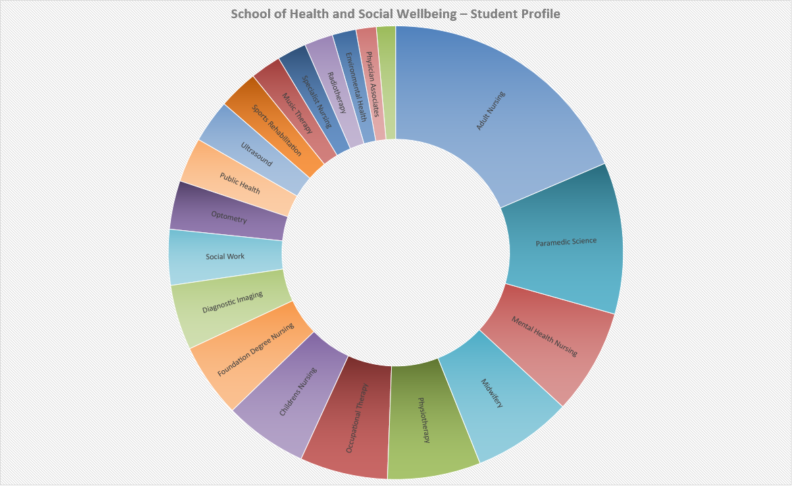
Generalist / Specialist workforce
College of Health, Science & Society
School of Health & Social Wellbeing
Capturing intelligence from workforce
Meaningful Data / Analytics
Connected Health and Social Care Workforce offer
Schools and Colleges Outreach work
Future roles and professional identities

Slide 5
Creating a strong ecosystem
Integrated Care Systems
Higher Education Institutions
NHS England
Health Education England
Further Education Institutions
Developing new models of recruitment
  Students
  Staff
  Researchers
  PPI
  Mentorship & Coaching
Clinical Academic Model
Technicians
Promoting hybrid roles
Exploring future roles in
Diagnostics
Rehabilitation
AI / Digital / Genomics
Clinical Engineering

Slide 6


Our students, our future workforce

Slide 7
New models of education delivery
Changing approaches to workforce provision across the South West of England
  Greater Social Mobility and access to education
Regulatory changes – greater inclusion of simulation and clinical skills within an academic environment (i.e. increase in simulated practice hours mapped against programmes)
Change in organisational workforce design (i.e. impact of NHS People Plan)
The Topol Review – AI, Robotics, Digital literacy, Genomics, Digital Medicine – Evolution of new roles (i.e. Bioinformaticians)
Changing student expectations / greater co-creation opportunities
Graduate skills that are transferable and meet the needs of the NHS People Plan and Integrated Care Systems
Skills development of staff within the organisation – currency and competency
Impact of Covid-19 on learners and the need for holistic care for our students and tomorrow’s health and social care workforce.

Slide 8
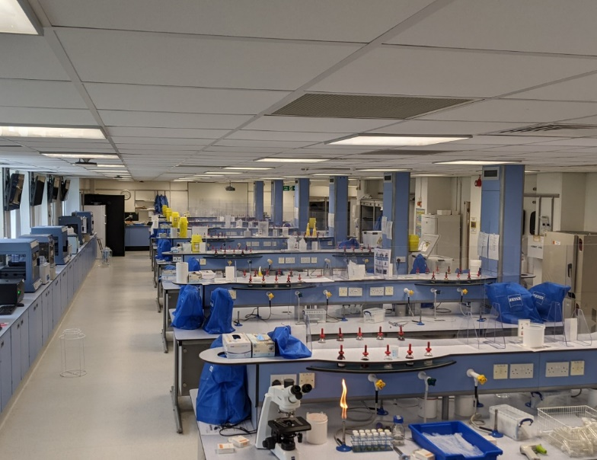
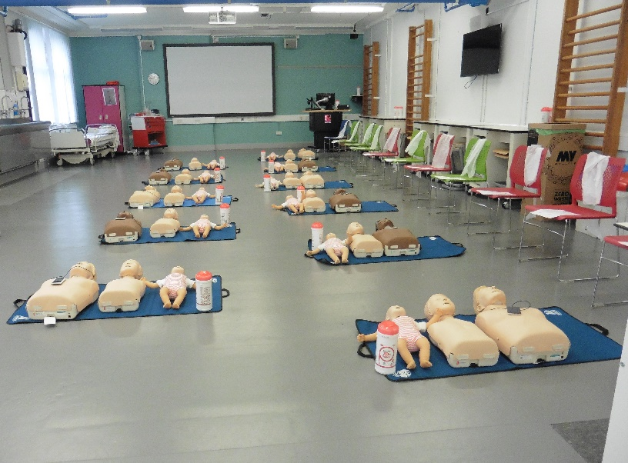
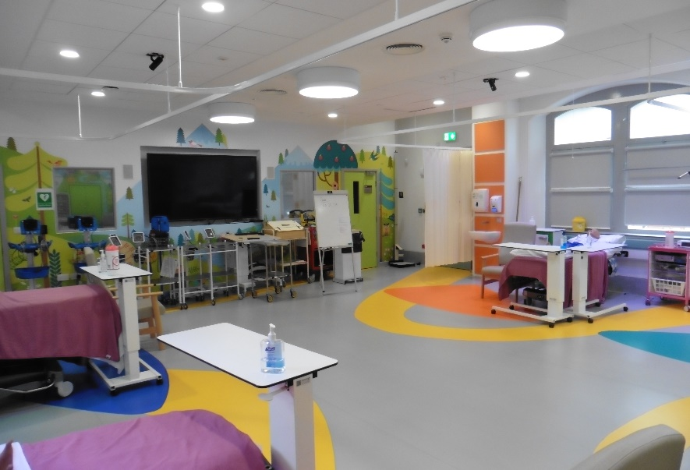
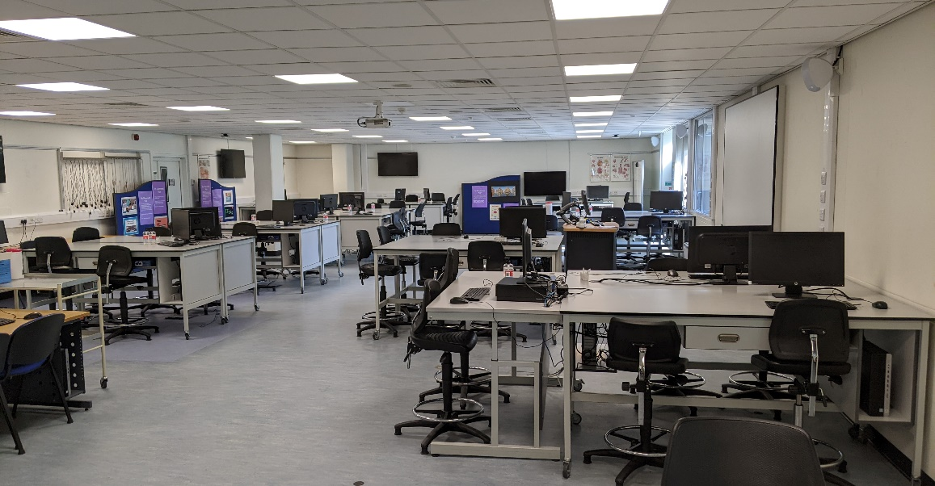
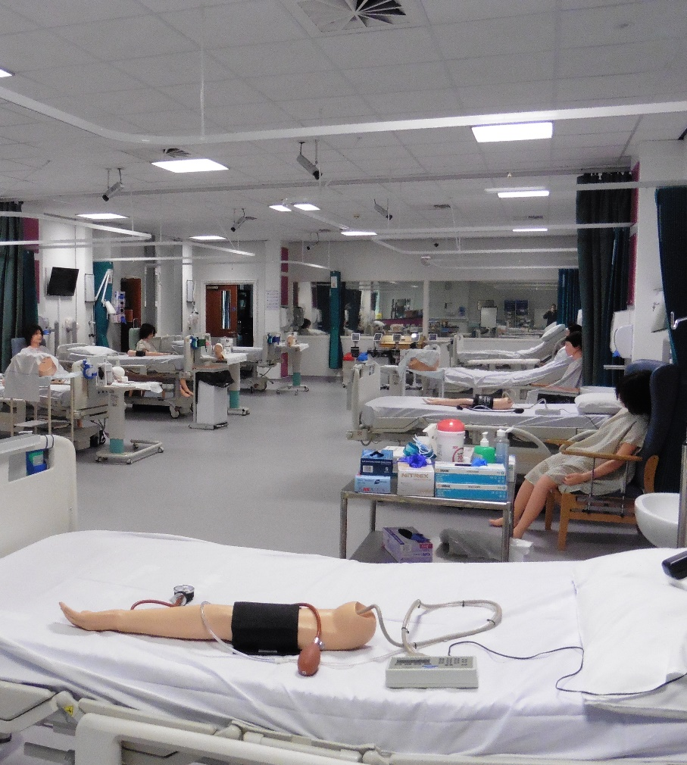
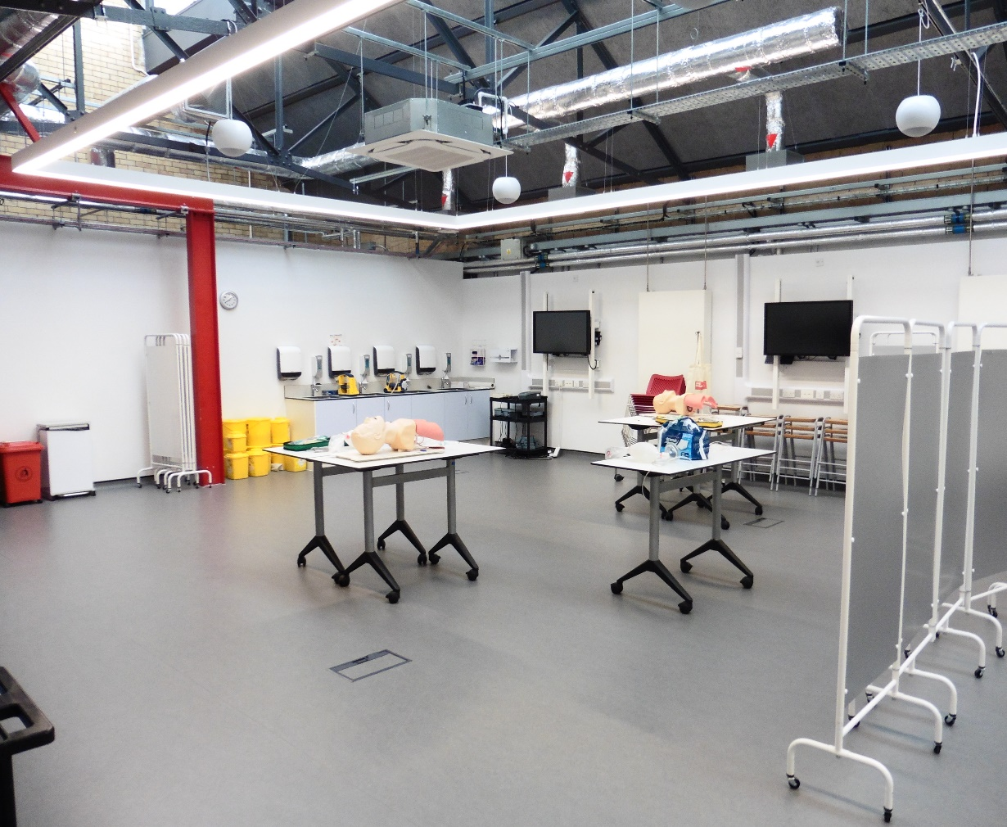
Simulated learning is vital within health and social care education

Slide 9
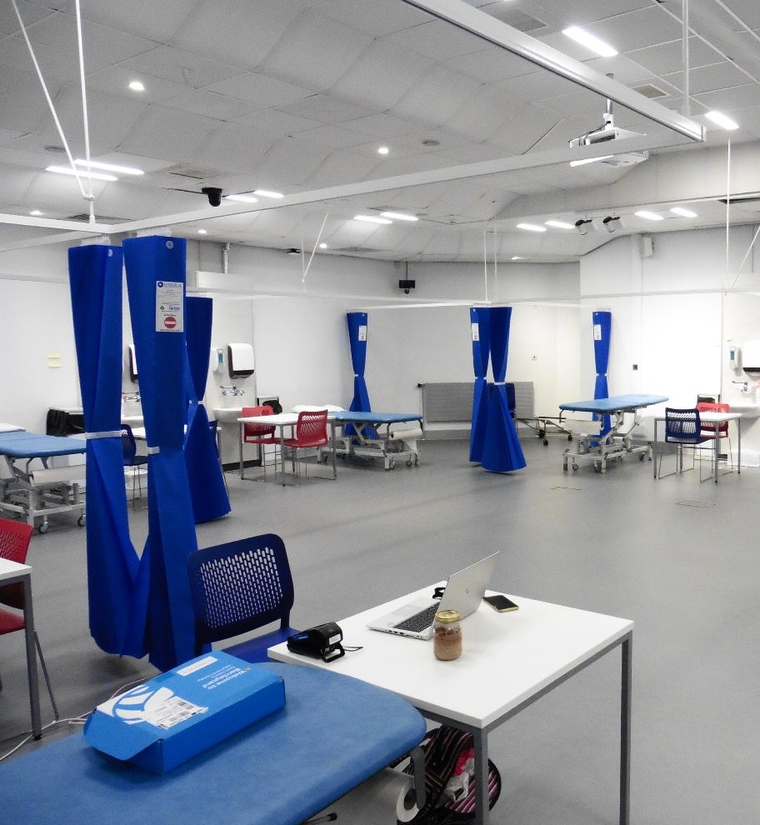
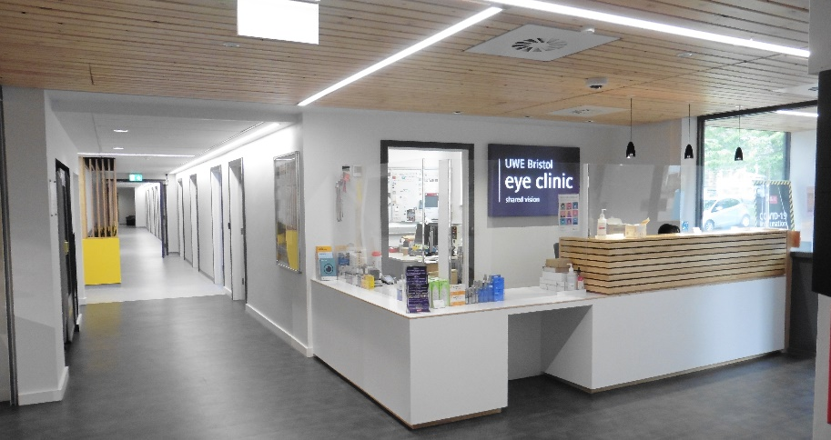
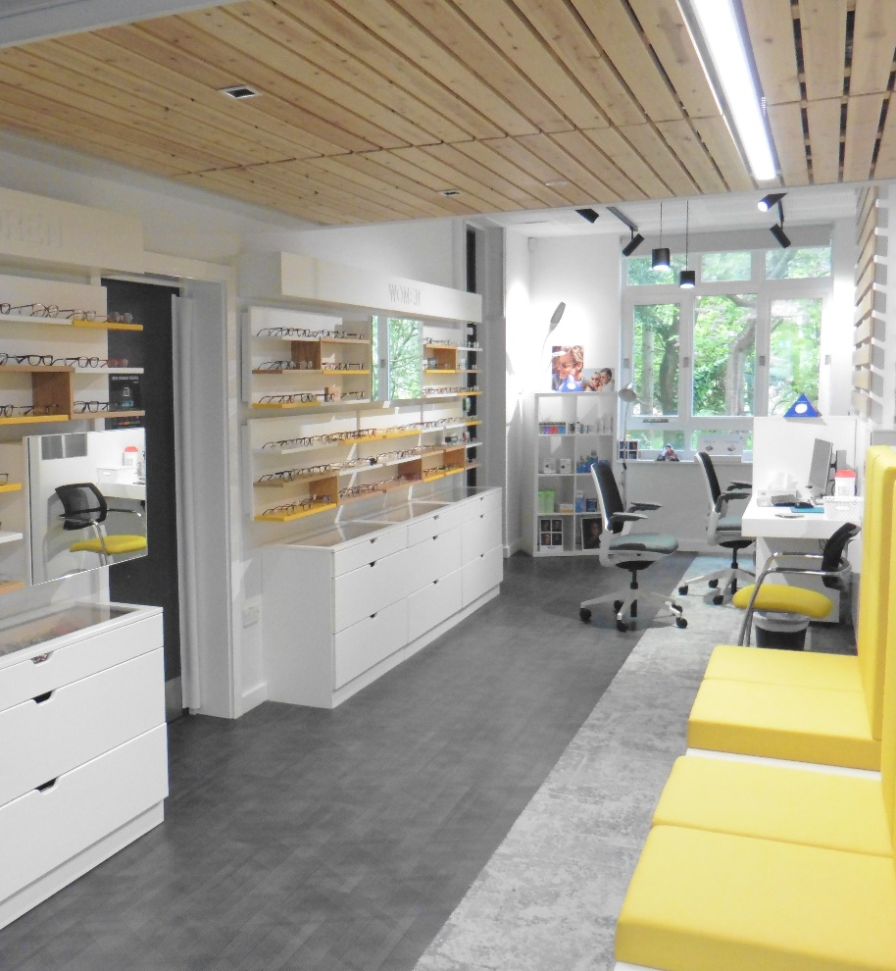
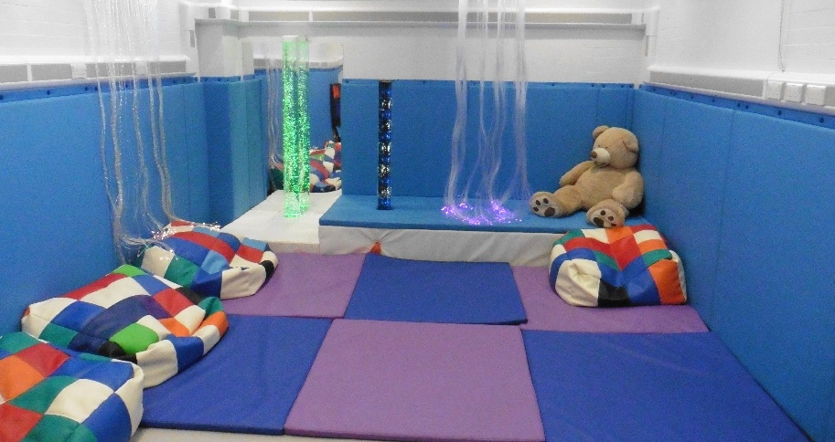
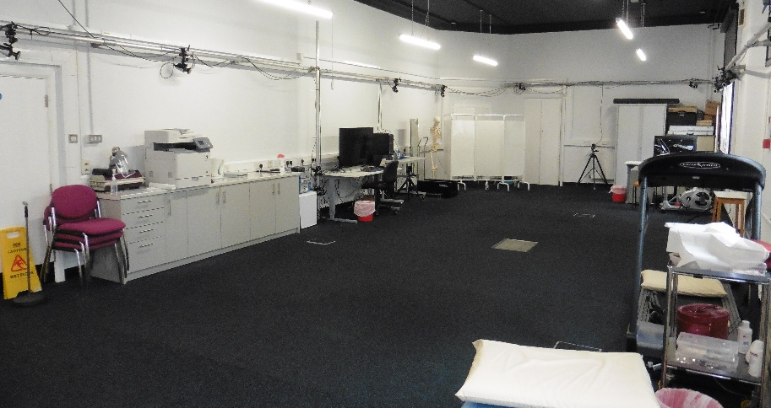
Public Facing Clinics – An integral aspect of any practice facing subject within an academic setting

Slide 10









Why Apprenticeships?
Preparing for the future needs of PSRBs, current technologies and future techniques for industry
Trailblazer Groups
Map to LEP & WECA Priorities
Responding to needs of healthcare sector
(regional and national)
Widen participation in key groups
Widen Access to Higher Education
Stay Relevant & Commercial (supporting business, economy)
Diversify our Offer
Notes:
Apprentices benefit from highly effective skills and behaviours which are delivered through innovative and industry relevant apprenticeship programmes to meet the needs of professional, statutary and regulatory bodies
Trailblazer Groups - Market leading apprenticeship experience is gained where UWE staff form part of Apprenticeship Trailblazer groups (Aerospace Engineer) as national groups to drive policy review and discussion to influence best practice and change
Apprenticeship programmes meet WECA and LEP skills priorities in High Tech and Digital, Aerospace and Advanced Engineering and Business Services meaning provision is relevant to local business growth and productivity, as well as skills priroties such as boosting gaps in the skills pipeline in growing innovation sectors (such as STEAM skills)
Growth in healthcare apprenticeships support Health Education England’s mandate to contribute to the development of of apprenticeship standards in health, responding to growing NHS and care provider needs and pressures locally and nationally. Invitations to tender with Trust mean we are confident we are contributing to workforce needs
WoE is neighboured by 2 counties with no university, apprenticeships at UWE are Providing access and participation to high quality HE level learning for local communities – 148 apps across Somerset region and 92 in Wilts;
Effective employer engagement and promotional apprenticeship activity drives improvement in key skills gaps, such as 17% of our Engineering, Design and Mathematics provision attracting female apprentices, compared to 13% in our region in 2017/18 according to data provided by WECA
Through diversification of our offer UWE stays relevant to prospective learners and employers, and our aim is to be an apprenticeship provider of choice in the region and beyond

Slide 11
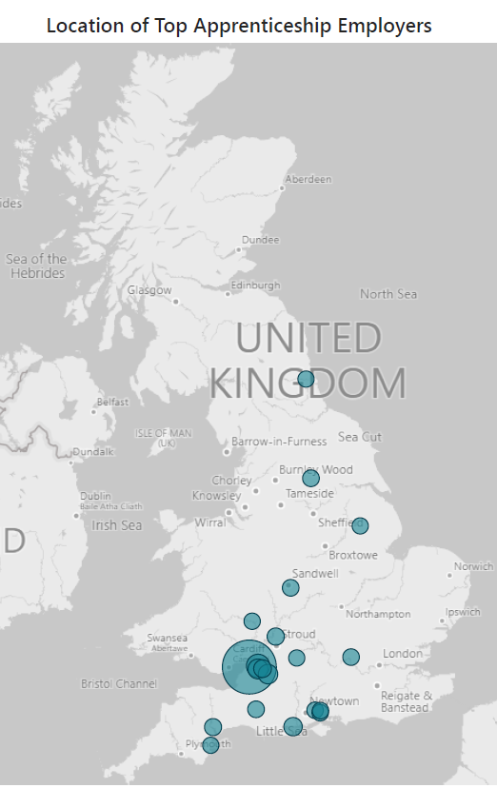
Currently, Apprenticeships make up 13% of all student numbers in the College of Health, Science and Society.
Our largest Apprenticeships are in:
  TNAs (level 4)
  Advanced Practice (level 7)
  Occupational Therapy (level 76)
  Professional Policing (level 6)
  Healthcare Science (level 6)
  Public Health Practitioner (level 6)

Slide 12

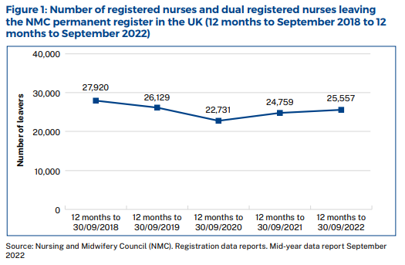
Current market trends – Traditional UCAS data cycle
UCAS applications this cycle are down for key health programmes such as Nursing Degree programmes.
UCAS accepting Apprenticeship application from 2024 –
  However, the DfE is keen that as many apprenticeship vacancies as possible at all levels are advertised on the UCAS hub, meaning it will not just be degree apprenticeships advertised.
  It comes as part of a wider ambition to develop a “one-stop-shop” for education and training options that will include apprenticeships, T Levels, skills bootcamps, higher technical qualifications or degree apprenticeships.
Outreach work undertaken within Schools and Colleges to promote health and social care professions

Slide 13

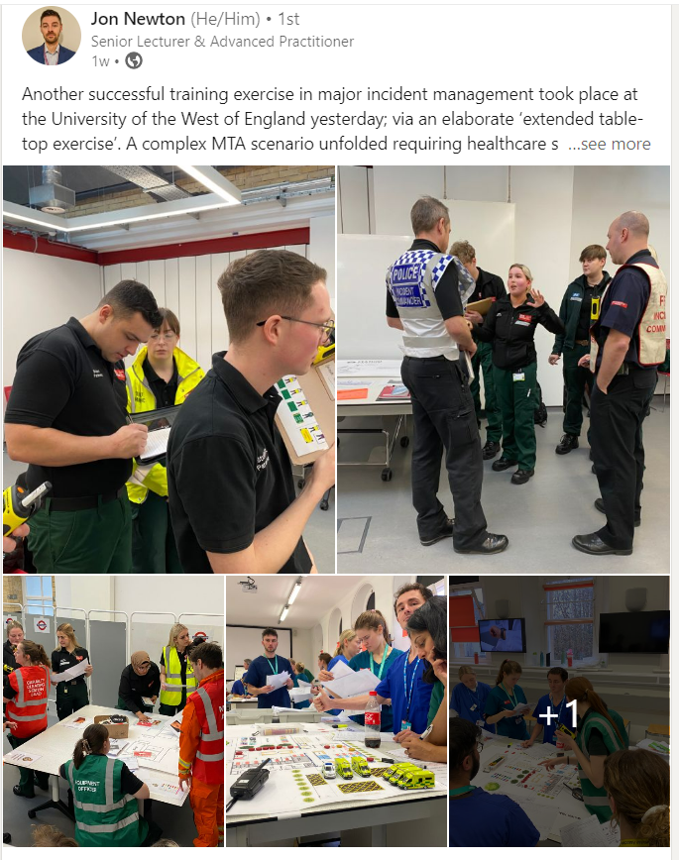

Slide 14
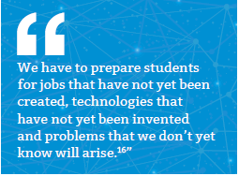
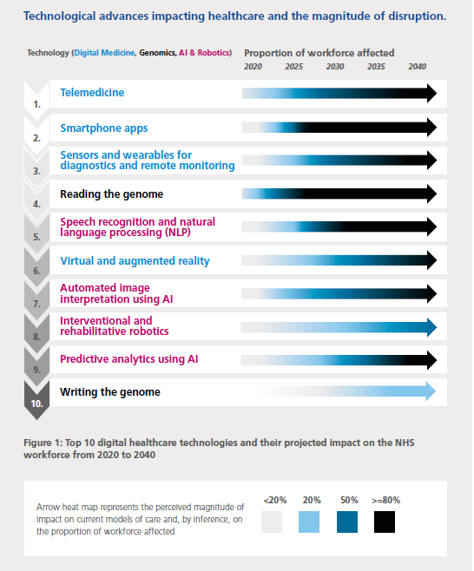
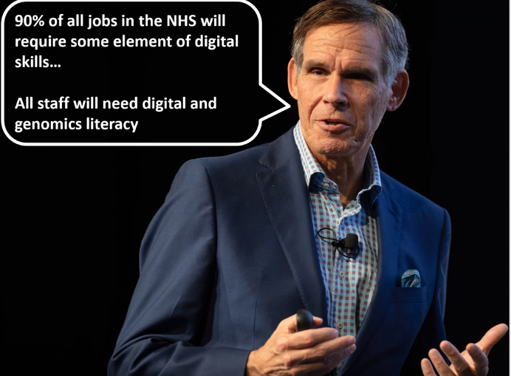
Topol Review – Skills and Knowledge

Slide 15
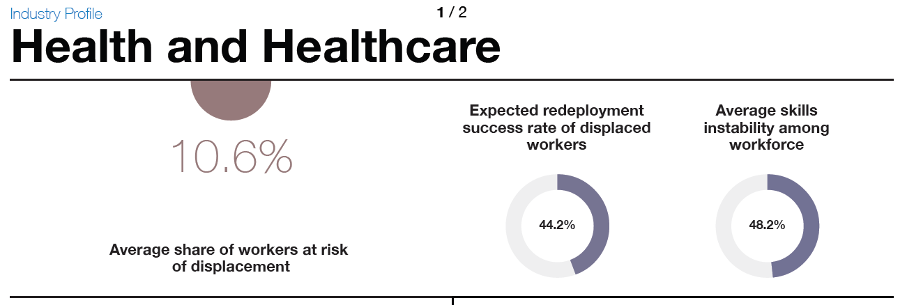
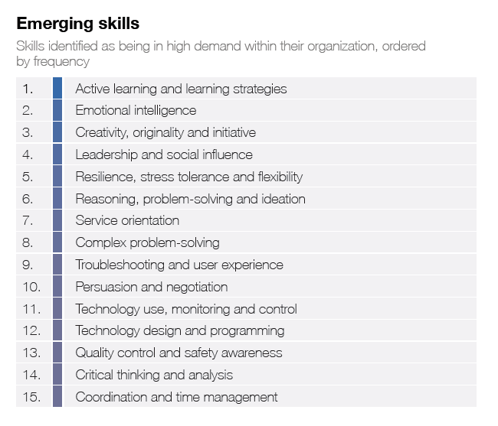
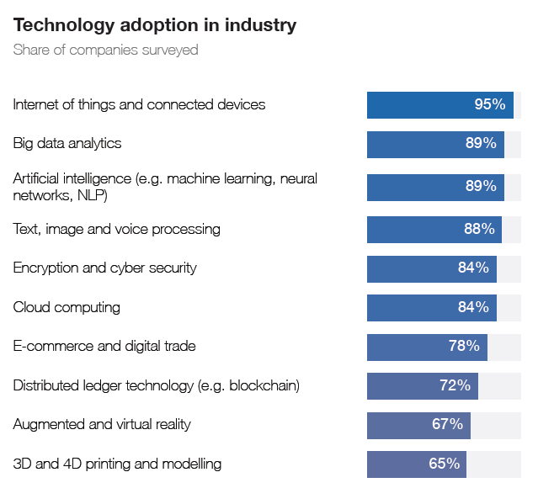
World Economic Forum - 2020

Slide 16
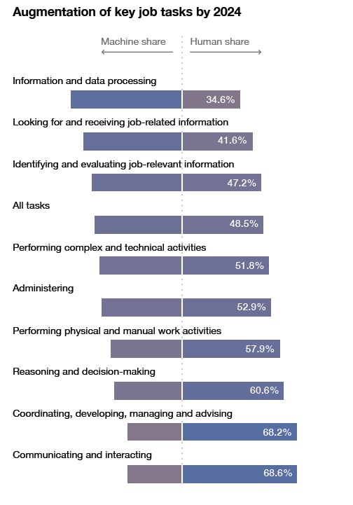
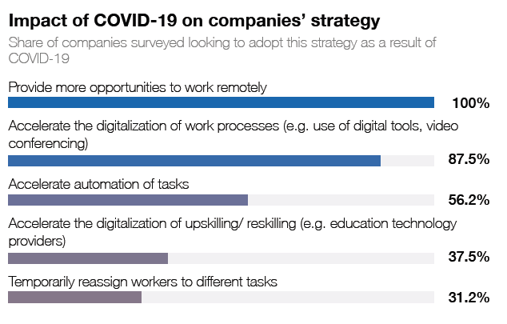

Slide 17
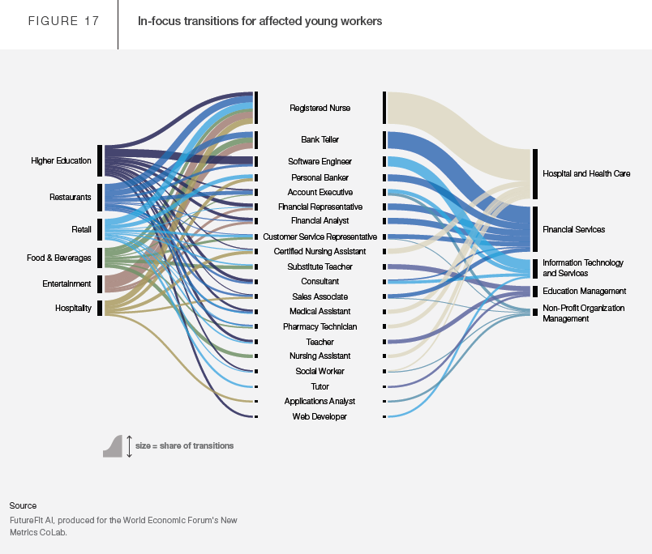

Slide 18
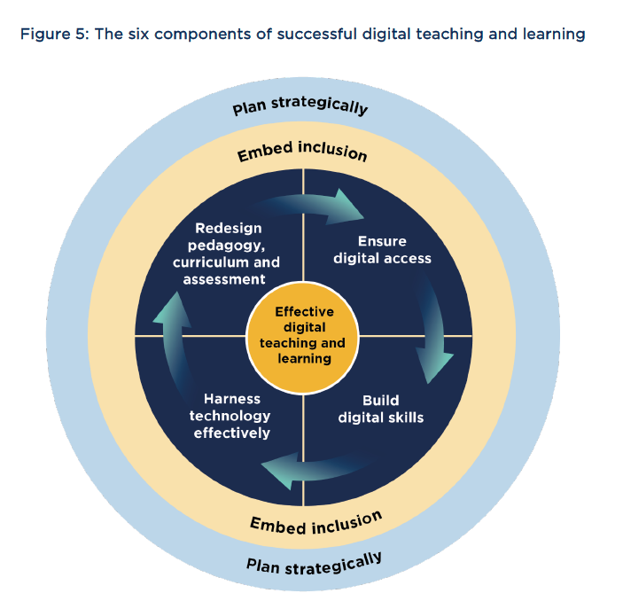

Curricula Redesign | working in partnership

Slide 19
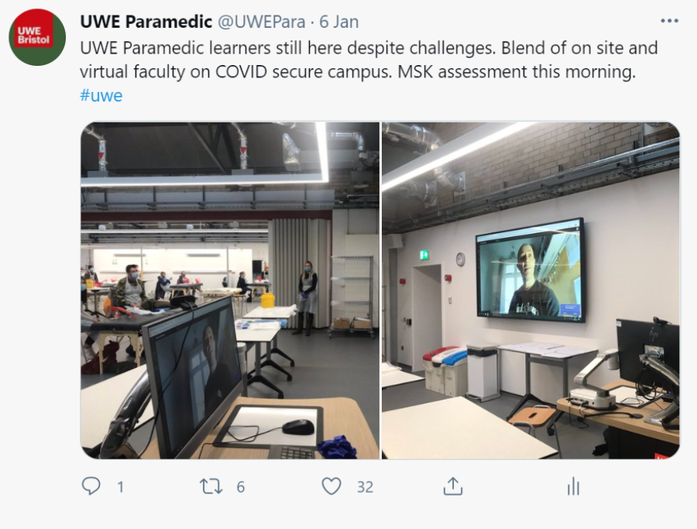
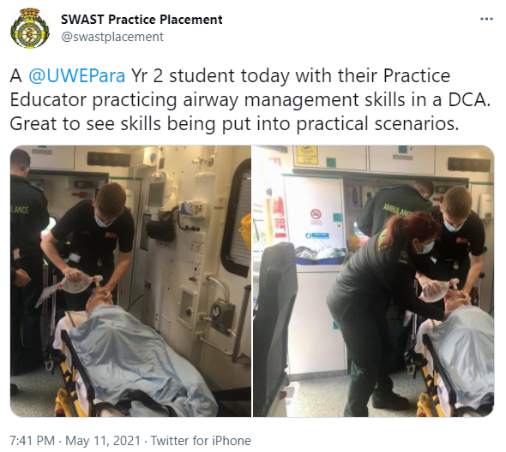
Curricula changes – Paramedic Science
Blended approach to on site and virtual
assessments
Physical environments –
Core competencies and skills assessments

Slide 20
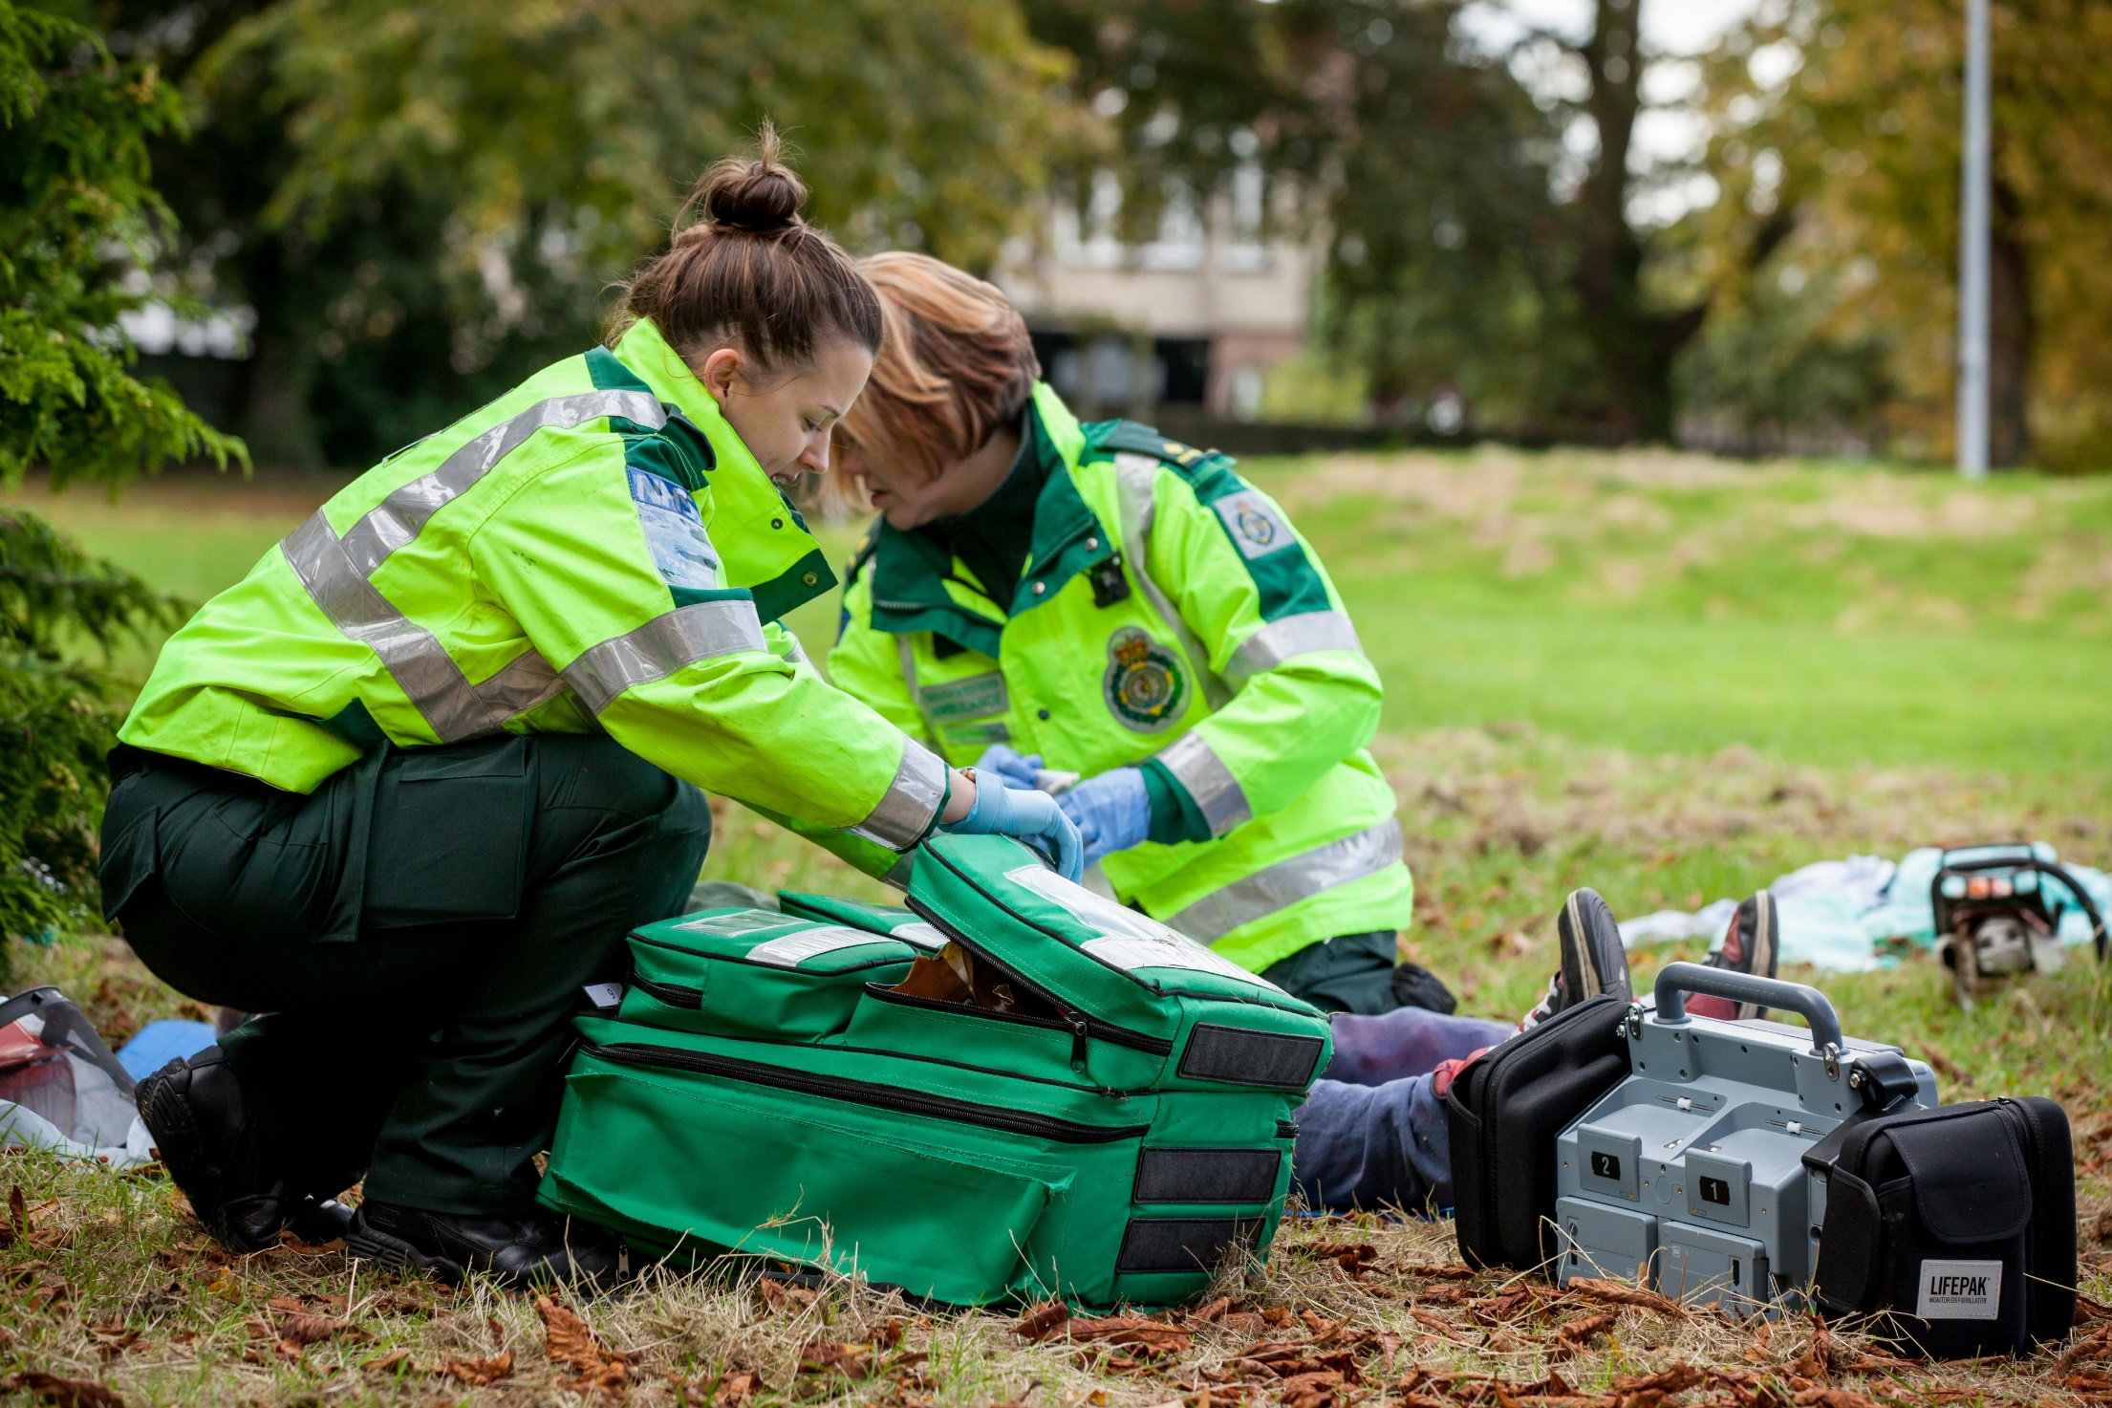
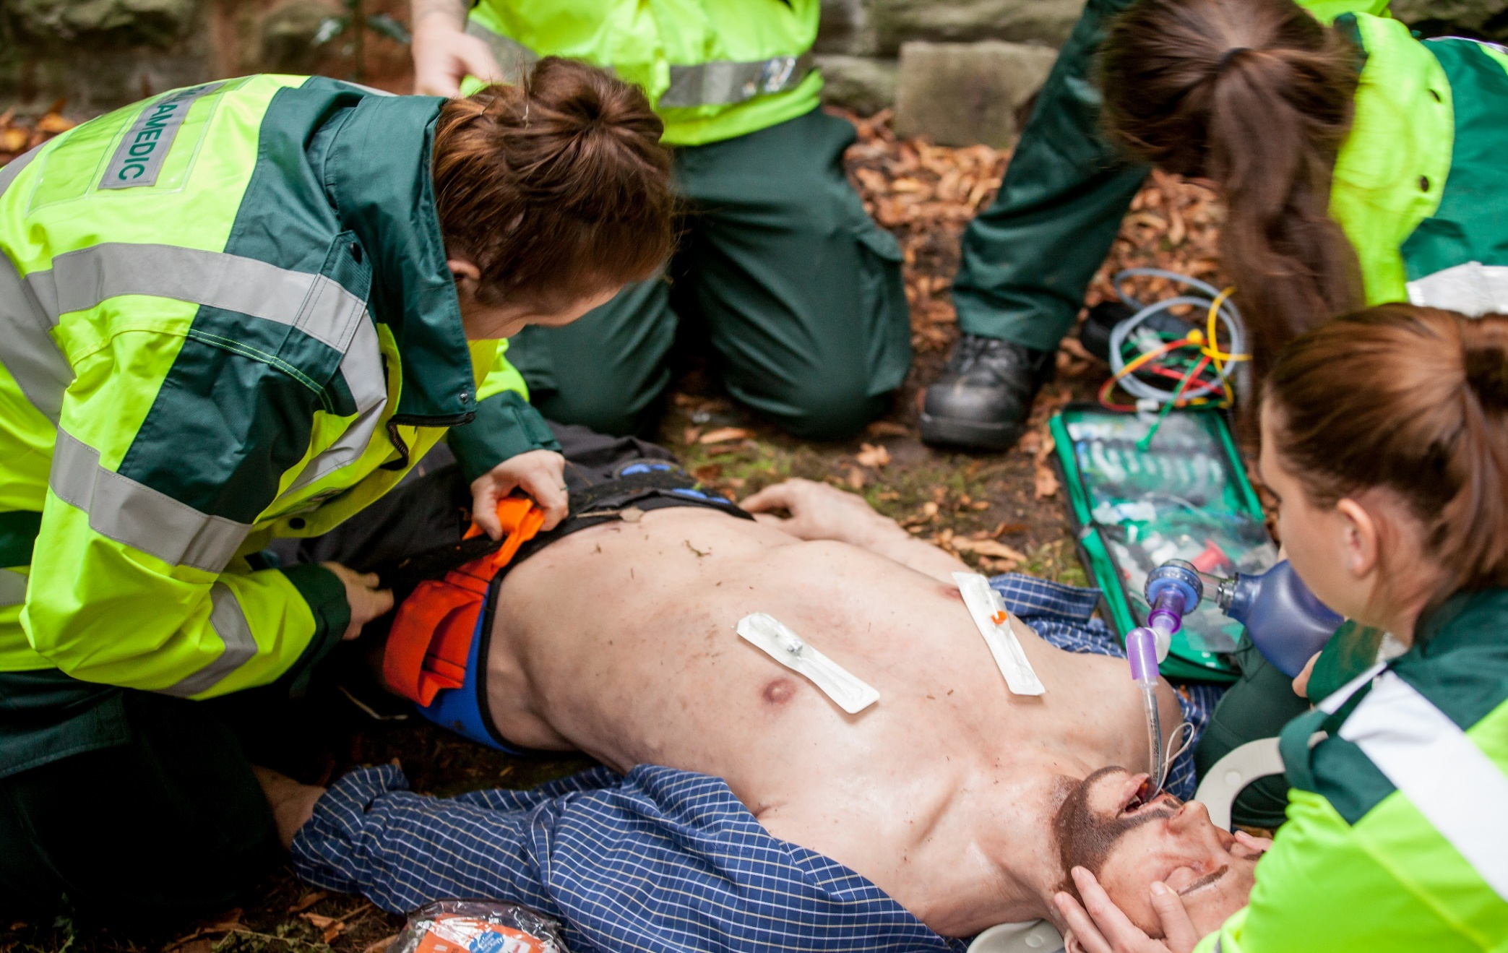
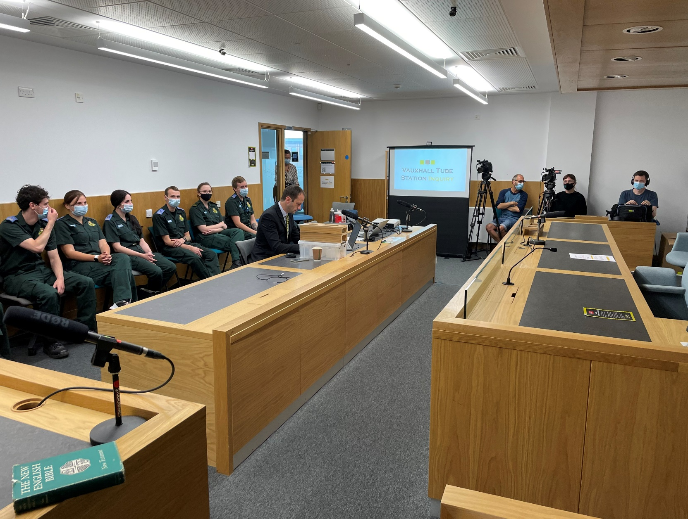
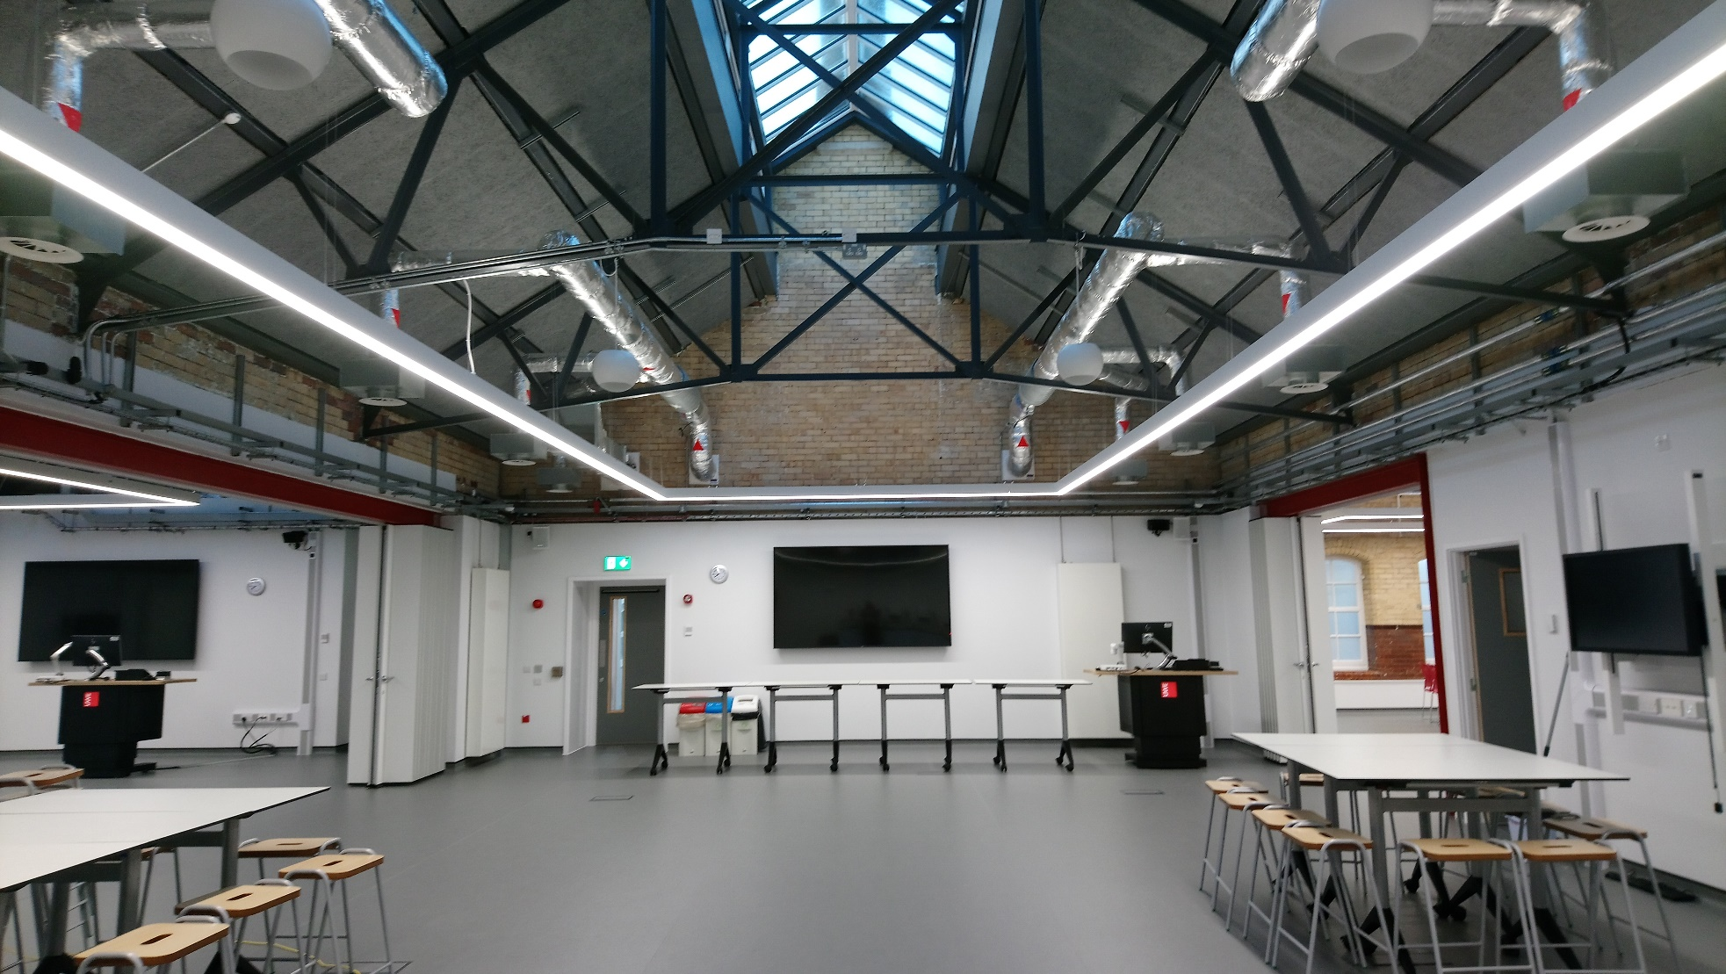

Slide 21
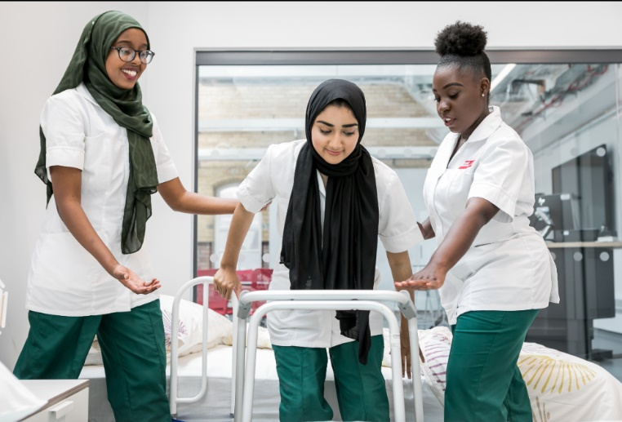
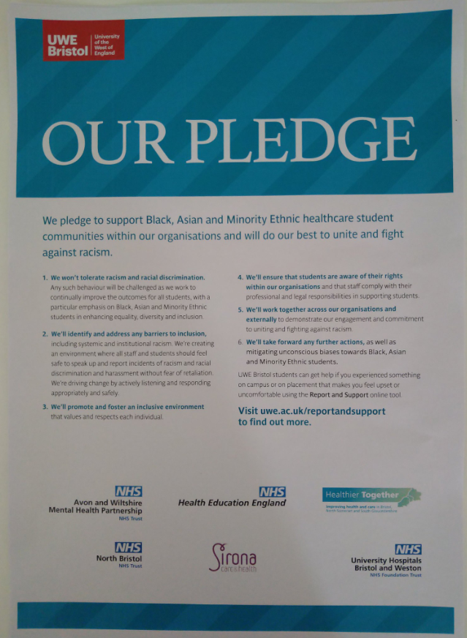
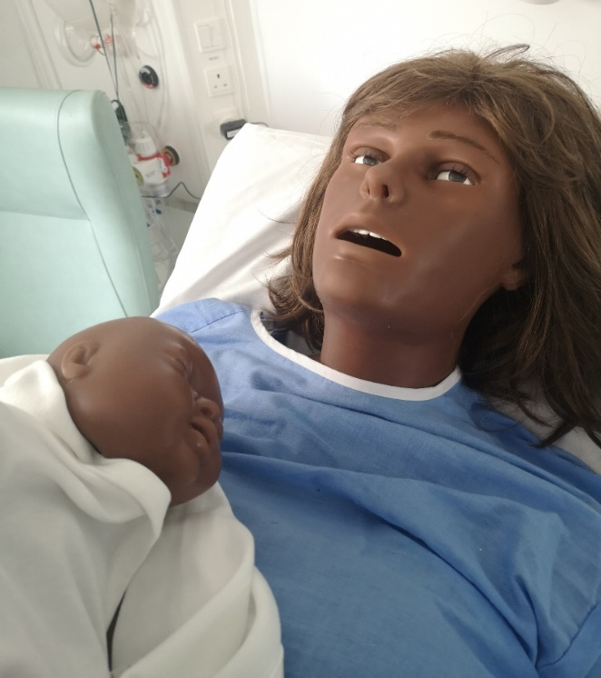
Wellbeing, Equality, Diversity & Inclusivity
Mental health support for students
Embracing diversity in student applications / recruitment to health and social care programmes.
Supporting students on placement is equally as important as the academic environment
Duty of care for students
Supporting wellbeing and promoting Speak Up / whistle blowing

Slide 22
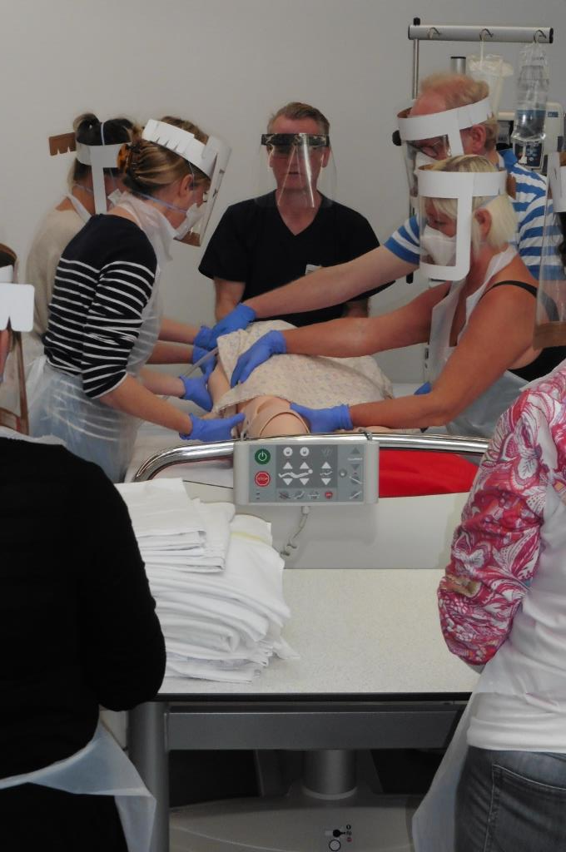
Supporting a diverse workforce |Technicians
Emerging roles with the university environment to support learning through simulation
Disrupting the traditional delivery methods of learning and assessment
Co-creating new approaches to pedagogy and assessment
Greater skills mix and career development
Shaping the ‘hybrid workforce’
Digital learning and design Technologists

Slide 23
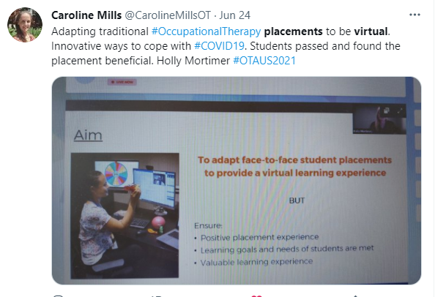
Supporting Students in Clinical Practice | Working together
Virtual assessments / tutor visits
This has changed our approach to how we support our students and clinical colleagues
Collaborative Learning in Practice (CLiP) via Remote working
Mental wellbeing and resilience training
Virtual placements and assessment of skills:

Slide 24
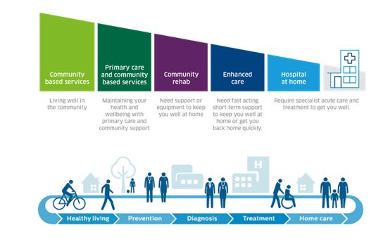
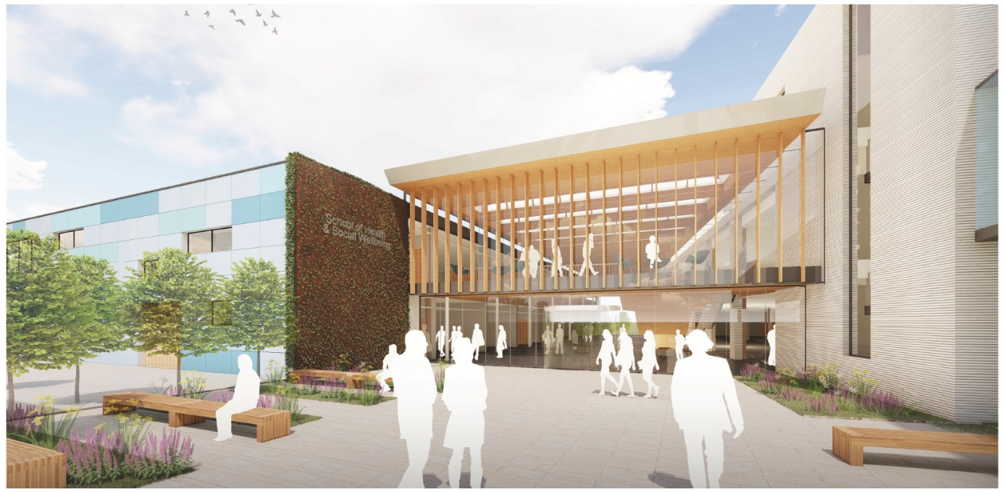
The Connected Campus – 2.0
Creating physical and digital spaces that provide access to simulation and clinical skills has become integral within health and social care.
Constraints on the availability of physical placements within practice, coupled with the experiences of Covid-19.
Having a ‘connected campus’ that creates the required conditions for professional growth, development and key graduate outcomes is vital.
Connections with remote / regional sites will be vital as long arm supervision becomes more embedded.

Slide 25
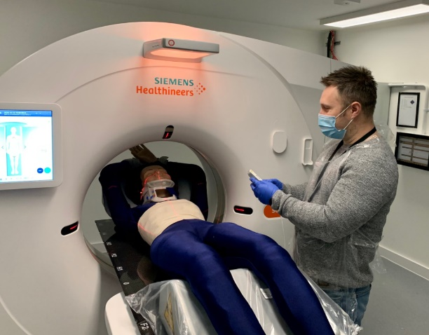
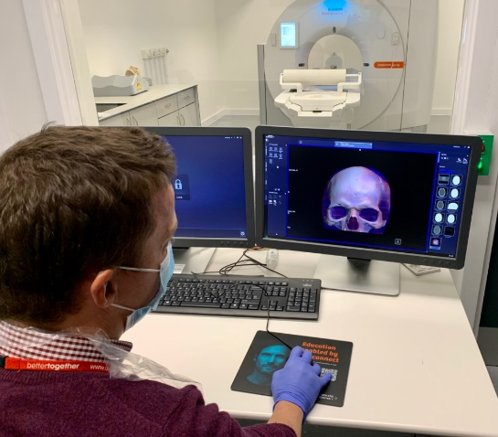
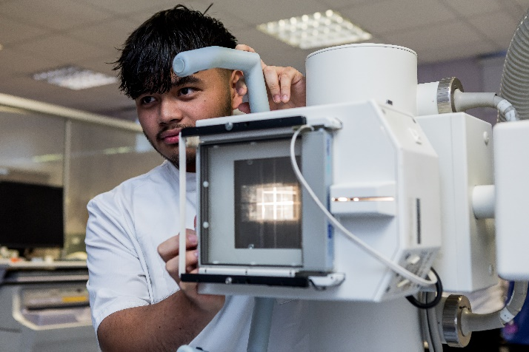
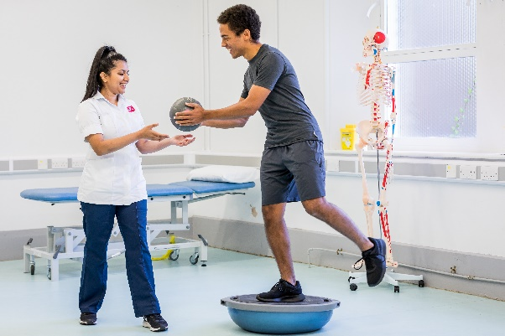
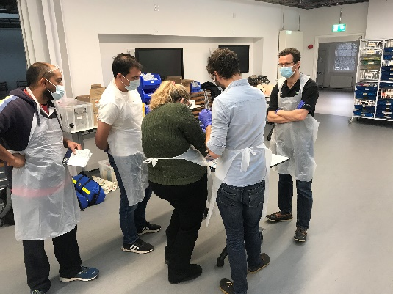
Diagnostics & rehabilitation
Case Study #8

Slide 26

Co-created Organisational Development
Developing an open and inclusive culture – Test and improve approach
Create a culture of life long learning & openness to collaboration and co-creation
Understanding human intelligence and artificial intelligence
Utilising the full potential of the Institute of Technologies across the South West
Creating truly integrated patient facing clinics across programmes / AQP status
Ensure ethical considerations are factored into any digital provision
Mapping future micro-credential learning / specialism learning / generalist learning
  HEE Genomics Education Programme
  Independent Prescribing Programme
Bringing the regulators / professional bodies with us
Tapping into the wider STEAM agenda

Slide 27
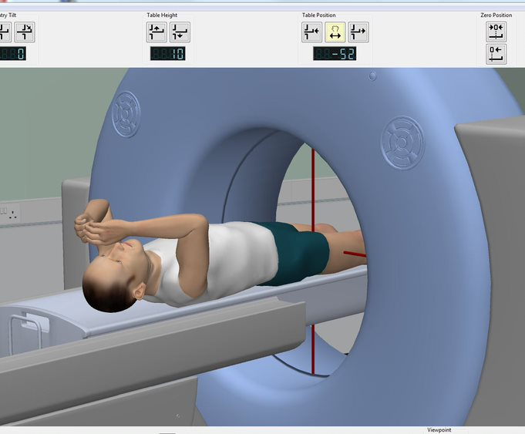
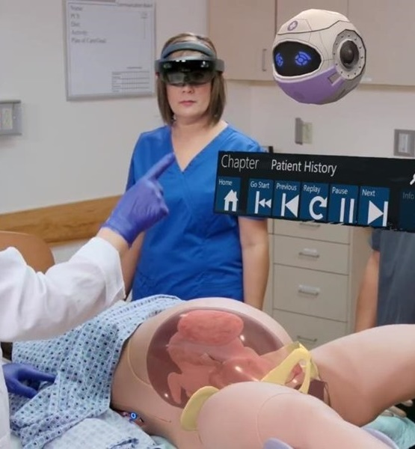
The on-going journey
Continuing the journey of ensuring our simulation environments are diverse, inclusive and reflect society
Skills development for staff and ensuring we are reflective of modern practice
Augmented reality and virtual reality – Immersive environments / 360 degrees
Self-assessment of our pedagogy and assessment approaches
Involvement in quality improvement programmes working with NHS colleagues
Re-mapping the involvement of standardised patients
Closer work with organisations such as the Associate for Simulated Practice in Healthcare
Championing the value of simulated learning and local provision through IoTs, FE partners, HEIs, Employers / Systems
Pushing boundaries to create new workforce models
  Medical Degree Apprenticeship
Notes:
The journey we have been on is one of an appreciative inquiry. From a phase of discovery, through to design and implementation of new placements within the University

Slide 28
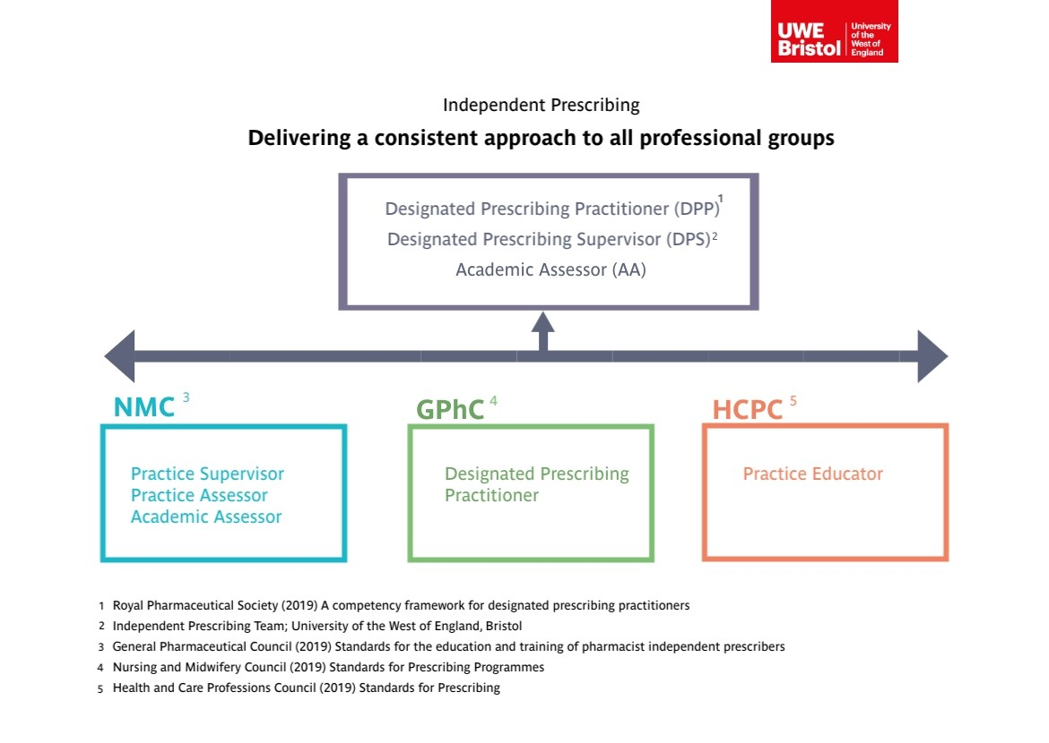
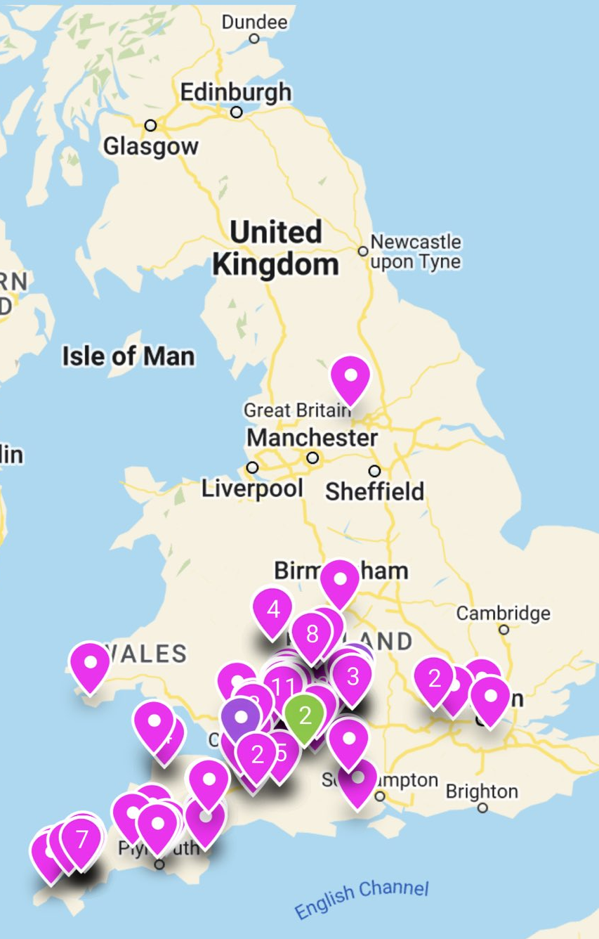

Slide 29

Practice orientated clinics | Optometry

Slide 30
Education, Research, Innovation, Leadership & Collaboration

Slide 31




Delivery by design | Bringing everyone on-board
What did we learn as a region from working together in a truly collaboratively way during the Covid-19 Pandemic?
Who are our partners today and tomorrow?
Where does the tech innovation happen across the region in reference to health & social care?

Slide 32


Creating an Integrated Care Academy
Creating the patient journey through:
Collaborative education models
Contemporary placement models
Innovative approaches to workforce mapping
Innovation and research
How do we use AI / Robotics / Diagnostics to help shape the above?

Slide 33












An integrated model for Health and Social Care education
Workforce
Regulators
UWE
UoB BU
UoG
Data Observatory
Learning Academies
ICS x 7
AHSN
Diagnostics Rehabilitation
International connection / Beacons

Slide 34













The core principles of an Integrated Care Academy
Space to innovate & test
Supply / Demand
Contemporary pedagogy approaches
Future workforce
Data Observatory
System simulation
& scenario modelling
workforce pipeline for the future
Testbed
Preferred System simulation
Tech / Innovation
Future care models
Patient clinics
Research and Evidence
Rehab / Diagnostics

Slide 35

Utilising the combined value of the whole Health and Social Care Eco-System

Slide 36








Health Technology Hub
Creating opportunities for businesses, universities and the healthcare sector to work together to solve the demanding problems faced by the healthcare sector in the UK and globally.
Notes:
Identifying and solving the challenges which the healthcare facing through collaborative cross-disciplinary approach and partnership working
Opportunities for students’ placement, summer vacation bursaries (paid), experience of working in the “real world environment”, building own network which enhances students’ CV and develops a unique set of transferable skills.
Examples of the research conducted in the Health Tech Hub: technologies for assisted living, rapid diagnostics, point-of-care tests.

Slide 37

Osteoarthritis Research
Research
Development a rehabilitation program for patients with osteoarthritis
Collaborators: St George’s University of London, healthcare professionals
Impact
The programmed was awarded the Musculoskeletal Care Initiative of the Year in the Health Service Value Awards 2020
The programme is recommended by national and international healthcare and clinical services
Improving patient’s pain, function and quality of life
Reducing health and social care cost
Notes:
Note: the image is from UWE website
- The programme is more cost-effective when compared to the traditional GP-led care.

Slide 38

Caring for Craniofacial Conditions
Research
Understanding the concerns and needs of the patients with craniofacial conditions
Collaboration with the UK Charity CLAPA and healthcare professionals
Leading collaboration with cleft professionals practice in 26 countries
Impact
Recommendations on the approaches to reduce the risk of social anxiety, social withdrawal behaviour and unfavourable psychological outcomes
Change in patient care
Training of 500 health professionals
Influencing prenatal and adult health and social care
services in the Netherlands
Notes:
Note: this image is from the UWE website which describes this case study. Therefore I assume we have a permission to use it.
The leader of this research Prof Rumsey received OBE for this research
500 health professionals have been trained to identify and address the psychological issues impacting patients and their parents.

Slide 39

Alzheimer’s disease
Research
Understanding of the mechanisms of Alzheimer’s disease
Collaboration with Bristol’s Southmead Hospital and the regional charity BRACE with the patients and public involvement
Impact
Identifying blood biomarkers for the Alzheimer’s disease and dementia
Early diagnostic tool for improving patients outcome is under development

Slide 40

Biofilm Model Systems in Healthcare
Research
Development of novel technologies for measuring the microbial growth
Application to wound healing and dental care
Collaboration with Colgate-Palmolive, Philips Research Laboratories Givaudan, Aryballe, GEMAG Care, Insense LTD, NHS partners
Impact
New products for dental care and wound healing
Development of non invasive detection of diabetic foot ulcers and periodontal disease Tailored CPD courses on breath analysis
Integrating the research in undergraduate and
post-graduate teaching and students’ projects
Notes:
UWE Bristol developed a system to measure how fast the microbes grow. This helps to develop dressing for wounds and products to dental care
This work had real world impact on the development of dental and wound healing products
Supported by and in collaboration with the world leading companies Colgate-Palmolive, Givaudan, Insense Ltd,
UWE provides training on breath analysis to the companies producing health products

Slide 41

Safer Drugs
Research
UWE pioneering work on creating drugs for conditions resistant to regular antibiotics
Collaboration with GlaxoSmithKline and the NHS
AI and Machine Learning were integral to this research
Impact
The research is rated as ‘world leading’ in the REF2021
The new technology for improving drug formulation to overcome antibiotics resistance
Notes:
This work is unique as it allowed to improve hospital treatment for potentially fatal conditions such as tuberculosis and sepsis.
Led by a multidisciplinary team in collaboration with the world-leading company Glaxo Smith Kline and NHS
Real impact of healthcare practice
This work was used as an Impact Case Study for the REF where it was recognised as “world leading”.
Led by Dave McCalley who was recognised as one of the world’s 100 most influential analytical scientists in 2013, 2015, 2019 and 2021 by the Journal The Analytica Scientist

Slide 42


Slide 43



A model for change | collaborative working
Balogun et al (2016)

