Slide 1
Teaching Tolerance in Troubled Times
Dr Sarah Whitehouse
Dr Karan Vickers-Hulse
Notes:
Karan

Slide 2
Aims
What is tolerance?
Rethinking tolerance
Case study from the UK
Notes:
Karan

Slide 3
What is Tolerance?
a fundamental virtue that embodies acceptance, understanding, and respect for the diversity of thoughts, beliefs, cultures, and identities that exist within our global society.
tolerance recognises that individuals possess unique perspectives and experiences shaped by their backgrounds, values, and upbringing. It goes beyond mere tolerance of differences, urging us to embrace and celebrate them.
tolerance fosters an inclusive and harmonious coexistence, promoting peace and social cohesion in a world often plagued by conflicts and divisions.
a powerful force that enables societies to thrive by bridging divides and nurturing cooperation.
Notes:
Sarah
It is not a passive act, but an active commitment to creating a world where differences are valued, conflicts are resolved through dialogue, and humanity flourishes in all its magnificent diversity.

Slide 4
Why is Tolerance important?
It encourages open dialogue and the free exchange of ideas, facilitating intellectual growth and progress.
Through tolerance, we acknowledge that no single perspective holds absolute truth, and enrich our own understanding of the world by engaging with diverse viewpoints.
Embracing tolerance requires empathy, and demands the recognition of the inherent dignity and worth of every individual, regardless of their race, religion, gender, sexual orientation, or any other characteristic.
Tolerance promotes fairness and equality, as it combats discrimination, prejudice, and injustice.
In the Declaration of Principles on Tolerance, UNESCO states that tolerance "involves the rejection of dogmatism and absolutism" and calls for fostering attitudes of openness, dialogue, and mutual understanding (UNESCO, 1995).
Research has shown that tolerant attitudes enhance social cohesion and reduce intergroup conflicts (Dovidio et al., 2010).
By embracing diversity and recognising the value of different perspectives, societies can tap into the richness of cultural exchange and create an environment where all individuals can thrive.
Tolerance encompasses acceptance, respect, and understanding of diverse opinions, beliefs, and identities. It is a crucial element for the promotion of peace, social harmony, and human rights in our increasingly interconnected world.
Notes:
This all sounds easy but….
Sarah - 2 – this is important however, although there is no singular truth, we need to be mindful that some behaviours are not to be tolerated. Link to equality act in UK – that is an absolute truth in some respects because it is law.
Karan 7 – some people may only accept the diversity which they feel comfortable with – this is not tolerance but selection.

Slide 5
Rethinking Tolerance (taken from Rethinking Tolerance by Antonio Petagine).
European history produced two fundamental conceptual paradigms of tolerance:
The medieval paradigm which emerged between the twelfth and sixteenth centuries. During this period the idea that grew up was that tolerance meant patient endurance of evil in order to pursue a greater good.
The modern paradigm which arose between the seventeenth and nineteenth centuries. It associated tolerance with the defence of pluralism and the rights of the individual conscience.
Modern philosophers did their utmost to transform tolerance into a positive attitude, marked by an appreciation of individual freedom and pluralism. Although the modern paradigm predominates in the educational promotion of tolerance, the medieval paradigm re-emerges when one questions the "limits" of tolerance: is it right to tolerate the behaviour or opinion of others when they convey negative values like racism, discrimination, and antisemitism? Asking this question means reconsidering the relationship between tolerance and objectionable opinions and behaviour, typical of the medieval account of tolerance.
Notes:
Karan – tolerance is not a new idea – rooted in philosophy and linked to previous points – it is not okay to be tolerant of racist or sexists or fascists…..

Slide 6
Rethinking Tolerance (taken from Rethinking Tolerance by Antonio Petagine).
The enemies of tolerance are fanaticism and nationalism.
Some forms of communication, based on emergencies, can fuel generalisations and fear which foment conflict and mistrust.
When addressing the challenges that European society is called upon to face, tolerance can favour an educational style that makes pluralism not an indifferent multiplicity of opinions and lifestyles but a reality within which different people learn to engage in dialogue and deal with each other.
Tolerance makes it possible to achieve peaceful coexistence and acquire respect for human rights, not only regardless of dissonance and disagreement but, to some extent, departing from them.
Notes:
Karan – sometimes tolerance instils such a trigger response in those with binary views that they turn to fanaticism to try and get their voices heard or nationalism. In UK there is a debate about migration (which one could say impacted the BREXIT decision) and sprung out of fanaticism and nationalism. Extremism is the enemy of peaceful co-existence – the question is where this aligns with activism. Some people may view an act as extremism whereas others view it as activism – depending on your values and beliefs.

Slide 7
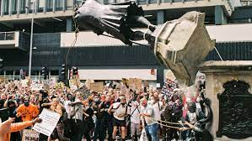
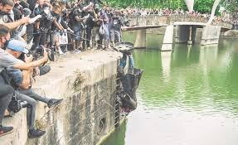
Tolerance in the UK: A case study from England
A statue, erected in 1885 of Edward Colston in Bristol, was toppled and thrown into the nearby harbour in Bristol, England, during a demonstration linked to the ‘Black Lives Matter’ movement in 2020.
Notes:
Sarah

Slide 8
Tolerance in the UK: A case study from England Statues and Significance
Around the world, statues play a significant role in making visible the values, history and cultural priorities of places and spaces.
Statues, monuments and memorials are often erected to honour a particular person or to commemorate an event in history and represent the socio-political values of their time.
In England and many European cities there was a proliferation of statues in the nineteenth and early twentieth centuries and these often commemorated ‘the great and the good’.
When we look around at the statues in our cities today, we see a reflection of the values of the period of history in which they were commissioned and a reflection of those responsible for making decisions about who and what would be immortalised or commemorated in a statue or monument.
Looking around the city of Bristol in England, statues are generally of white men from the past or commemorating men lost at war. Women and women’s contributions to society are largely missing and people of colour are mostly invisible.
Notes:
Sarah

Slide 9
Activity
Think about the statues in your local towns and cities.
Who are the statues of, or what do they show?
Who is being represented and why? What is their role in history?
Do any of the statues represent a ‘general theme’ rather than a specific person?
Who is missing from the statues you have looked at? Are there groups of people missing e.g. women and children?
Which people of significance are missing?
Are there any values that your town or city has that are not represented in statues, monuments or perhaps other forms of public art? For example, how could the value of tolerance be represented in a statue or monument?
Notes:
Karan – facilitate the chat

Slide 10
The Statue of Edward Colston: A History
Edward Colston was born in the city of Bristol in 1638 and died in London, in 1721. In 1885 a statue was erected to his memory to celebrate Colston’s charitable giving. Colston, having amassed a huge wealth established schools and other educational provision for the poor as well as other charitable donations.
1885 was a period of history when there was great poverty alongside great riches. It was not an uncommon idea that the poor could be divided into the ‘deserving and undeserving poor’.
It may appear that a statue to a man that set up schools, almshouses for the poor and established many charitable organisations is quite an appropriate subject for a statue but we need to explore a little more deeply how Colston made his money before being able to make any judgements……
In 1670, Colston began working with the Royal Africa Company which provided ships for the transportation of slaves from West Africa. He became a governor of the company which oversaw its ships transportation of over 84,000 people from Africa, many from Sierra Leone, 19,000 died en route.
The Royal Africa Company was the main and often only company engaged in the West African slave trade and it burnt into the skin (branded) the people it captured and then sold as slaves with the initials RAC.
Colston was an active member of the Royal Africa Company for eleven years and it is thought that he used his sale of his shares in the company to establish further businesses as well as his philanthropic giving.
Notes:
Sarah to voice over

Slide 11
The Statue of Edward Colston: Controversy
The statue is made of bronze and was created in 1895 by the Irish sculptor John Cassidy and placed on a plinth in the city centre. The statue depicts Colston in a flowing wig, velvet coat, satin waistcoat, and knee-breeches as was typical in his day. The plaque on one side bears the words "Erected by citizens of Bristol as a memorial of one of the most virtuous and wise sons of their city AD 1895".
In 1977 the statue was designated a grade 11 listed structure – which means under British law, it is (or was) protected. The statue was erected to acknowledge and commemorate Colston’s reputation as a philanthropist. However, the statue did not acknowledge his involvement in the Transatlantic Slave Trade.
From the 1990s onwards there was continued debate about the underlying morality of commemorating a slave trader in this way.
In 2018 a Bristol City Council project sought to add a second plague which better contextualised both the statue and acknowledged Colston’s role in the slave trade. This never materialised and discontent around the statue within the city continued.
The people of Bristol had long debated the place of Colston in its city. It was not just the statue that commemorated him but his name was visible in the names of the schools he established as well as concert halls and streets that were named after him.
How should a modern and diverse city relate to a figure such as Colston?
Notes:
Sarah – focus on the fact that people had been trying to voice concerns about representation and balance for years (plinth) and were not heard. This eventually led to activism.

Slide 12
Discussion
Should Colston’s statue have been left standing to recognise the ‘good’ he did with his charitable giving or should we not separate his philanthropy from the way his money was made?
Should we be tolerant of the actions of those in the past who had a set of values that were linked to the socio-political context of the day or should we judge those actions by their impact on the lives and deaths of the people sold as slaves and the consequences in the lives of people today, including slavery’s legacy of racism, displacement and inequality?
Are there universal codes of morality that extend both into the past and the future that should guide our judgments and understanding of tolerance?
Notes:
Karan – facilitate the discussion. Focus on number 2.

Slide 13
Colston, the City of Bristol and ‘Black Lives Matter’
The Black Lives Matter (BLM) movement began in July 2013, with the use of the hashtag #BlackLivesMatter on social media after the acquittal of the US police officer George Zimmerman in the shooting of African-American teenager Trayvon Martin 17 months earlier in February 2012. Participants in the movement had demonstrated against the deaths of numerous African Americans by police actions or while in police custody.
The movement returned to national headlines and gained further international attention during the global George Floyd protests in 2020 following his murder by Minneapolis police officer Derek Chauvin. An estimated 15 million to 26 million people participated in the 2020 Black Lives Matter protests in the United States, making it one of the largest movements in the country's history. The popularity of Black Lives Matter has shifted over time. The movement was supported around the world including in the United Kingdom.
The movement and its related organisations typically advocate for various policy changes considered to be related to black liberation. Despite being characterized by some as a violent movement, the overwhelming majority of its public demonstrations have been peaceful.
Notes:
Karan

Slide 14
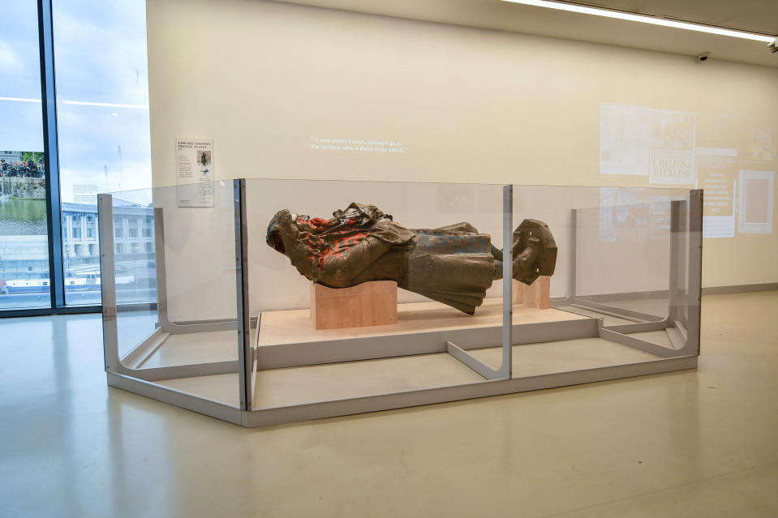
Colston now….
Following the toppling of the statue the Mayor of Bristol established the We Are Bristol History Commission. Their role is to build an improved shared understanding of the city’s story. A survey demonstrated that four out of five people from Bristol said that the statue should go on display in a Bristol museum. The statue is now in one of the city’s museums, M Shed.
Following the toppling of the statue four people were charged with criminal activity and this led to a trail in a Bristol court. The Bristol four as they became known had a lot of support within and beyond Bristol. The trail was significant because it further divided opinion in Bristol about the Colston. The four were acquitted at trail and there were mixed opinions on this and this has led to more debate about which statues should remain standing across the UK.
Notes:
Sarah

Slide 15
Final reflection
How does the Edward Colston case link to tolerance?
Any questions?

Slide 16
References
Carter, J. and Whitehouse, S. (2023) The Toppling of the Colston Statue: a perspective on tolerance from England – article written for inclusion in WG book
Dovidio, J. F., Gaertner, S. L., Ufkes, E. G., Saguy, T., & Pearson, A. R. (2010). Recategorization and cross-group friendship: Implications for reducing prejudice. In S. Demoulin, J.-P. Leyens, & J. F. Dovidio (Eds.), Intergroup misunderstandings: Impact of divergent social realities (pp. 91-113). Psychology Press.
Petagine, A. (2023) Rethinking Tolerance – article written for inclusion in WG book
UNESCO. (1995). Declaration of principles on tolerance. Accessed via: https://www.unesco.org/en/education

