Slide 1
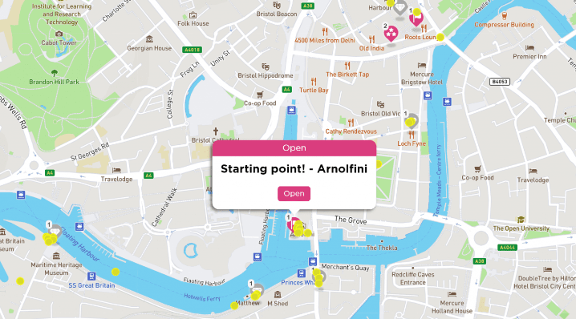
Gamification of the built environment – location-based learning and research with Seppo.
Presented by
Dr Danny Elvidge
Senior lecturer in Building Physics & Services.
April, 2023
Notes:
Hello everybody.
It's wonderful to be back in the city in which I did my undergraduate degree. I think it's fair to say that my lecturers would be astonished to hear that I'd be standing in front of you today, on time, if attending at all.
I'm here to talk about gamification in the built environment (that wonderful buzzword in education today) particularly as it relates to learning location based learning and research using the software Seppo.

Slide 2
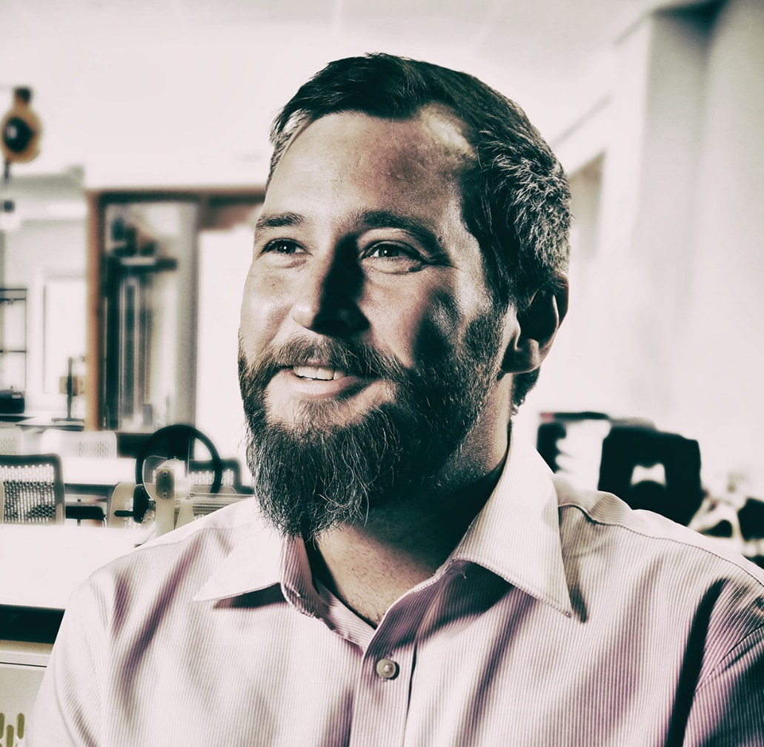
Dr Danny Elvidge
PhD. MSc. BSc (Hons). PGCE. HECert. FHEA. AMIOA.
Senior Lecturer in Building Physics & Services
Programme Leader for Building Services Engineering.
Email: Danny.Elvidge@uwe.ac.uk
Phone: 0117 32 83083
https://mysite.uwe.ac.uk/person.aspx?accountname=campus\dj-elvidge&ProfileType=
Notes:
First allow me to introduce myself, my name is Doctor Danny Elvidge and I'm Senior Lecturer in Building Physics and Services at the University of the West of England in Bristol. I'm joint programme leader for the Building Services Engineering degree and my specialty is in Architectural Acoustics and vibration and noise control and buildings which I will come to briefly at the end of this talk when it comes to research using gamification.
My staff profile picture is in black and white but I intend to make up for that by using extremely colourful language.

Slide 3

Structure of presentation
What is Gamification, Seppo and how is it used?
Case studies
Feedback from learners
Summary & additional resources
Questions (5 minutes)
Notes:
Read from slide

Slide 4
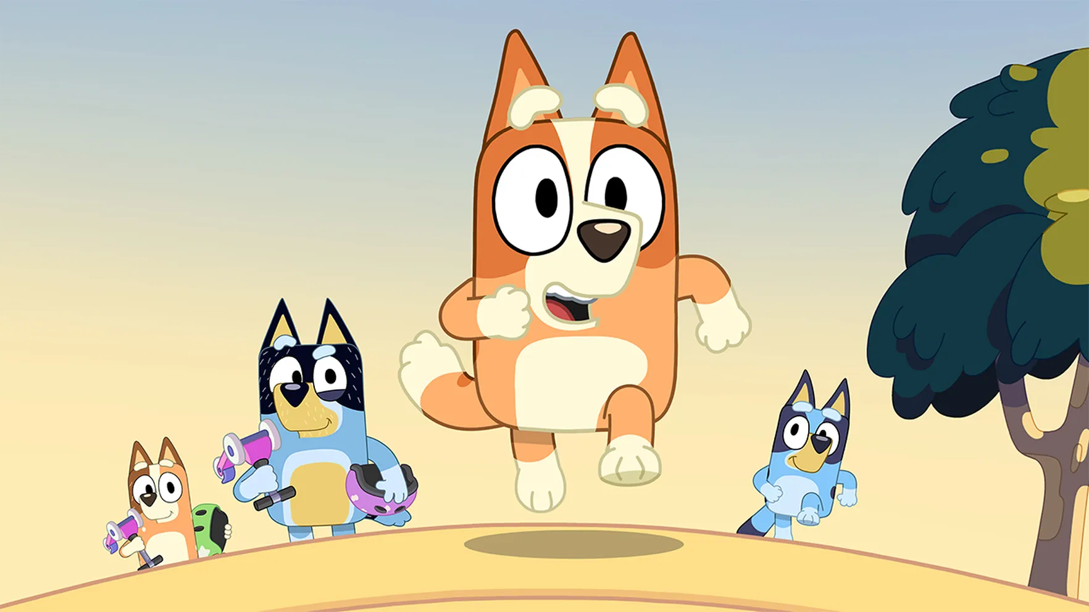
What is Gamification?
The strategic attempt to enhance systems, services, organizations, and activities by creating similar experiences to those experienced when playing games in order to motivate and engage users.
Notes:
So what is gamification?
So on the slide I have the official definition which is a little longwinded so I'll attempt to give a simpler definition. Gamification refers to the application of game mechanics - like adding points badges leaderboards - to everyday activities with the goal of nudging peoples behaviour. In my case I've been using it to engage students with learning materials and the public with my research.
But you all have experience with gamification. If you have children I can guarantee you've used gamification, and if you don't have children you've had it used up on you. Gamification is that point when you're walking along with a child and it says “I tired, I can't go any further”, “I'm exhausted carry me!” and you say “I'll race you to that tree” and immediately this tops up a reserve of energy they definitely didn’t have and engagement in the activity is rekindled. You’ve done this yourselves, whether that be with children, having bets or competition with friends (“last one there’s buying the lunch”) and even in the work environment (“I bet I can mark ten of those reports before we go on lunch break”).
Gamification taking a monotonous or difficult task and turning it into a game in order to make it more engaging.

Slide 5

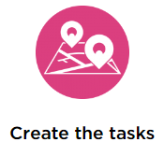
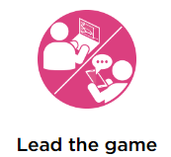
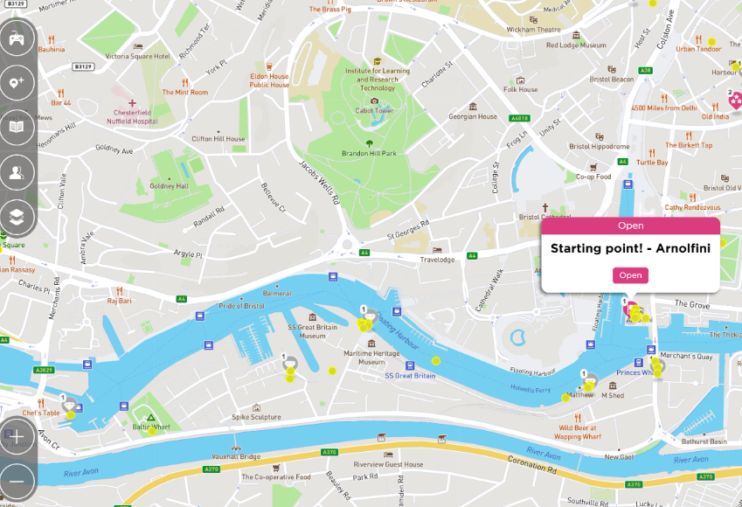

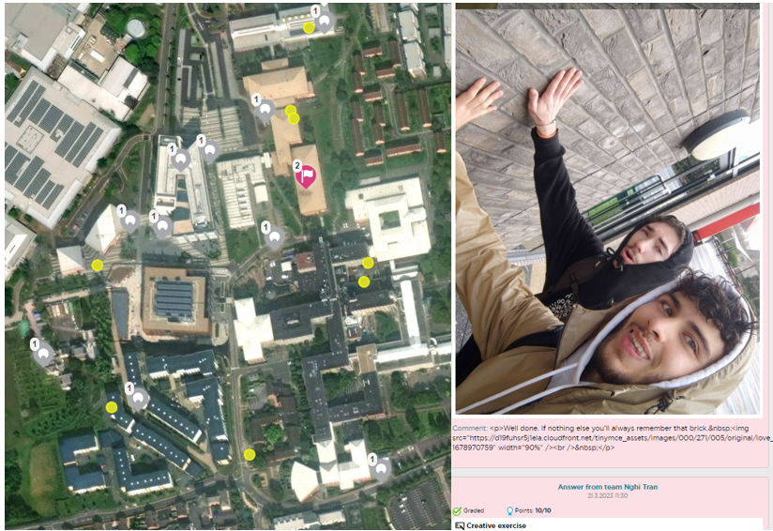
What is Seppo?
Seppo is a gamification tool designed to make location based learning fun.
Notes:
The next question is what is Seppo and how do we use it for gamification? Seppo is a gamification tool designed to make location based learning fun. It was originally designed in Finland and it's being used by training companies and schools to create more interesting learning materials.
The learning innovation unit at UWE and myself first started investigating such software after I went on a field trip with a group of civil engineers. You’ve all been on a field trip like this, it was cold, it was wet, and a group of less than engaged students had been taken off a nice warm bus to stand in front of some flood defences. The first thing I noticed was that the lecturer could not project loudly enough over the wind to be heard. So immediately of 30 people only 5 of them could hear. The rest started staring down at their feet, kicking stones, or trying to read their phones in the rain. As the tour of locations went on fewer and fewer students kept up with the group and at the end of the day I'm guessing only one, maybe two, students got the information they needed from the site visit. Everyone was frustrated and no learning objectives were met.
The learning innovation unit then went out to produce their own software so that content could be delivered at each location on a mobile phone so they didn't have to listen to the lecturer. Students arrived at the location and information was presented to them in text form on their phones. That software was good and made sure the information was available to every student but it still did not get them engaged with the information – the information didn’t matter. With Seppo you create a game within any environment using the Seppo tool. This can be simply a JPEG, but most effectively it's when you use a GPS map as your game board.
You can choose any gameboard, from a site to an entire city (SHOW MAP). You place tasks within that gameboard and the players can play within that environment on their mobile phones individually or in groups (if that's not clear I'll give some examples in a moment). So you create games and tasks from your learning materials (SHOW TASK), you can add video, audio, photos, weblinks and text straight but the power of this is not simply presenting the information, it's getting your students to solve problems when they arrive at a location. Most powerfully during that game you can monitor progress in real time (SHOW ANSWER). You can assess answers supplied by your students and give live individualised feedback. The students play within the gameboard and as they complete tasks they earn points and get live feedback from their lecturers. Seeing this progress motivates the players and you can be sure that your learning objectives are being met! You’ve made it a game and, just like the child who cannot walk any further until you have flipped the activity, made the information more engaging.

Slide 6
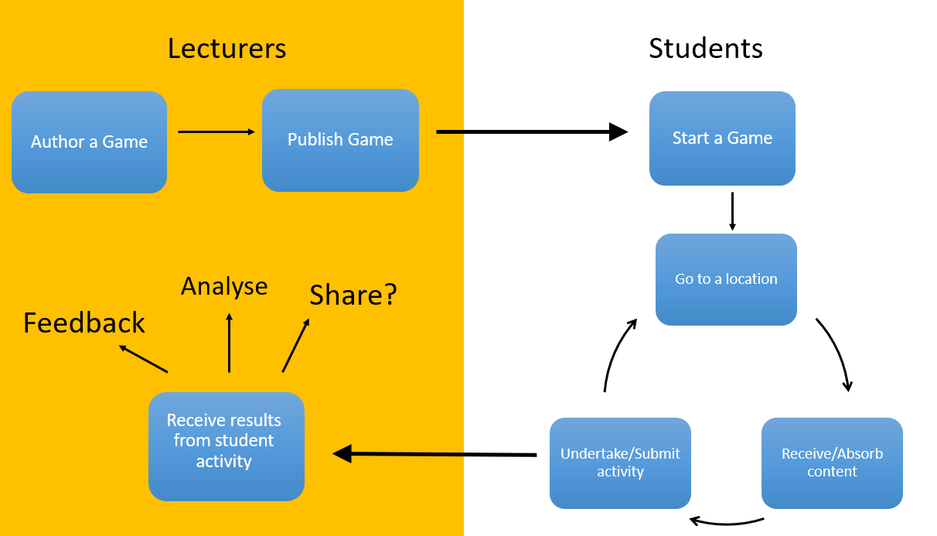
How is Seppo used at UWE?
Notes:
In a simple schematic this is what's being done. You as a lecturer author the game (you make the game). When the game’s complete you publish it (you make it live and open it to the students). You give them a code and then, either on the website or within the Seppo app they enter that code and start the game. Seppo will open up a map with a series of points on it but they must go to a point in order to open that task or game. When they get to a location they’re presented with information to absorb then undertake an activity, submit their work and then they can move on to another location.
While they are doing this you are receiving the results from the students activities in real time. You can give them feedback, make new tasks if necessary, you can analyse the information you are giving and ultimately you could choose to share it either with students or in the case of research other members of the academic community.

Slide 7
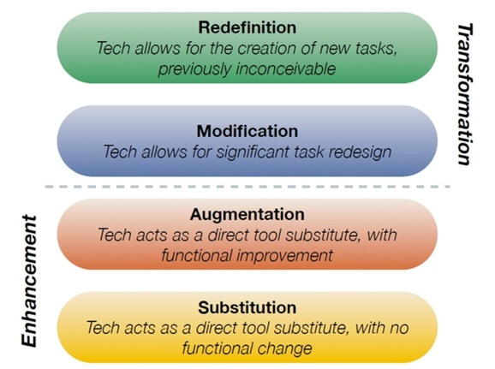
How is Seppo used at UWE?
‘SAMR model: The goal is to transform learning experiences so they result in higher levels of achievement for students.’
For example:
Receive and share results from students’ tasks immediately…
Deliver multimedia content and online tasks
Use online maps to navigate to locations specified
Paper based instructions on mobile device
Image the creation of Dr. Ruben Puentedura, Ph.D. http://www.hippasus.com/rrpweblog/
Notes:
So how is this being used in UWE? Now I don't expect you to all to read this slide it's all very busy it's really just the coloured blocks that I'm going to talk about.
We using the SAMR model to transform learning experiences so they result in higher levels of achievement and engagement for the students.
Substitution – We’re replacing paper-based self-guided field trips with a more engaging materials on an individual’s phone.
Augmentation – We’re augmenting the physical world with Google maps to create a virtual learning environment.
Modification – Using the photo/video recording functions on a phone to redesign the task.
Redefinition – The results from learners in the field immediately available to tutor/students for live individualised feedback.

Slide 8
How is Seppo used at UWE?
Constructivist learning theory – activities designed to help learners construct, retain and recall new knowledge.
Socio-constructivist variant of the learning theory maintains that learning is social and that learning is also contextual.
Moving learning out of the classroom provides more authentic learning contexts.
Personalised real time feedback from tutors and peers is vital for learning but is very difficult to deliver in large groups.
Produce appropriately challenging, scaffolded, authentic learning activities in real world environments while providing realtime formative feedback to construct knowledge.
Notes:
What is going on pedagogically?
We using constructivist learning theory. Constructivist learning theory holds that learning doesn’t happen simply by pouring information into our brains. Instead knowledge is constructed by the learner, not transmitted. To transform information into useful knowledge requires effort and purposeful mental activity by the learner. Information needs to be mentally processed, it needs to be made sense of, worked with for a while, to see how (if) it fits with existing knowledge.
Processing new information and constructing knowledge is made easier for students if they engage in meaningful learning activities that have been designed to help learners construct, retain and recall new knowledge. These activities must be appropriate for students’ existing level of understanding – not so challenging that they are overwhelmed but not so simple that learning doesn’t happen. In short you pitch you information and tasks to be just above your students existing knowledge
But there is a more important aspect of presenting this knowledge as a game. The socio-constructivist variant of the learning theory maintains that learning is social – students learn from each other and the wider social environment they inhabit. Discussion and collaboration with others helps students to construct knowledge. Learning is also contextual – the things we learn and are most likely to remember are connected to the things going on around us – which is why fieldtrips are so effective when delivered correctly.
Another element of constructivism concerns authentic learning activities. One of the reasons that fieldwork, work placements etc. are so valuable in education (and highly valued at UWE) is that they involve learning activities embedded in the social and physical context within which the learning will be used. They provide authentic learning experiences and if students make use of knowledge in a meaningful context, they are more likely to embed that knowledge and be able to draw on it when needed.
Feedback from peers and tutors is another important consideration to help make learning happen. Feedback may simply be some supportive words (“Well done, keep going”), but more usefully it addresses what learners got right and wrong, why it was right or wrong, and how it can be improved.
Our task as educators, therefore, is to design appropriately challenging, scaffolded, authentic learning activities, preferably in authentic environments, and to support students as they undertake these activities by providing formative feedback so they can make sense of information and experiences in order to construct knowledge.

Slide 9
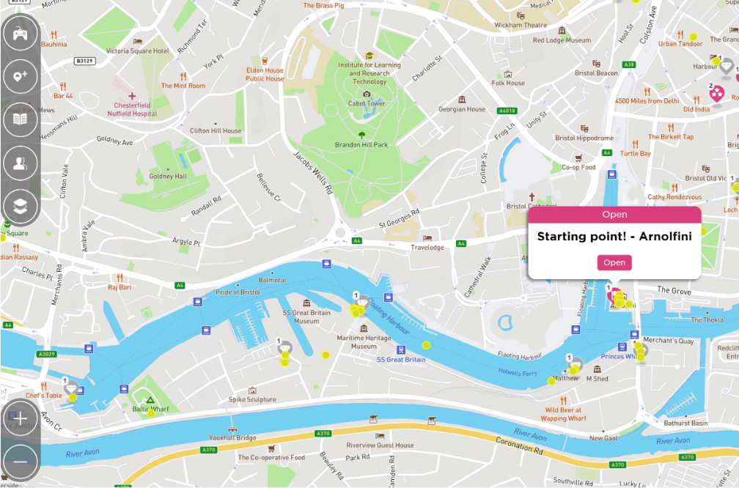
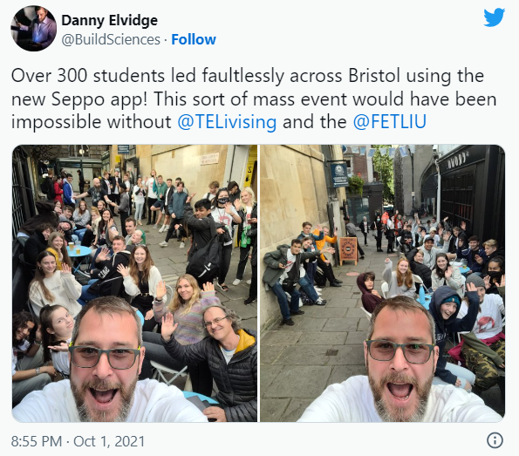
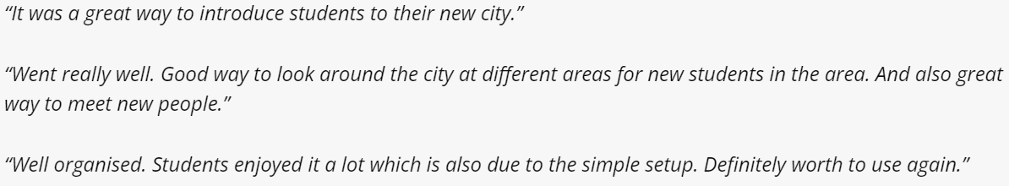
Case study 1 – Welcome induction
Assessing engagement with over 300 students
Notes:
Explain urban orienteering.
This is an example of how big your game can become. In our induction week we use the entire city of Bristol as our game board and we deliver that game for 300 students. There is no way you can staff a 300 student field trip which takes place across a major city. However with Seppo it runs successfully each year, with three staff members sat in a pub! There is nothing better than delivering a huge field trip successfully while having a pub lunch.
You can see that the feedback from these students is very positive and this is the first impression of the University and so it gives some indication of how confident we are in the software. Is particularly apparent in that last piece of feedback.

Slide 10
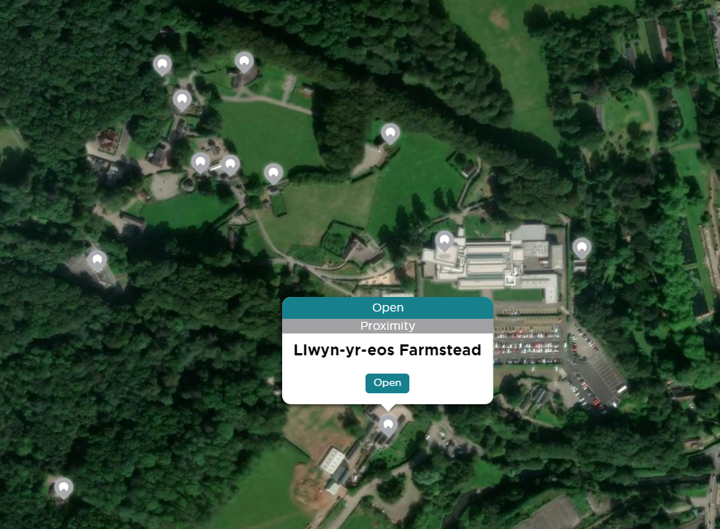
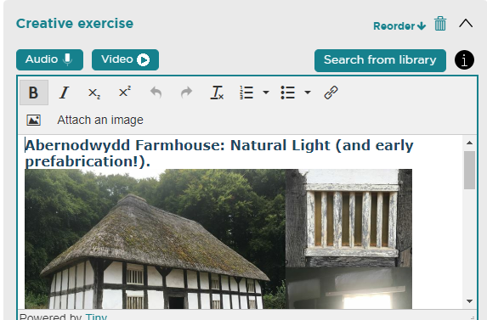
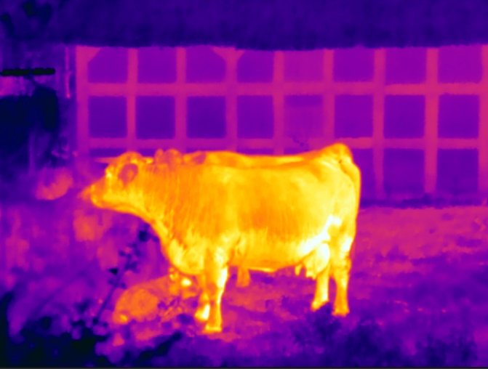
Case study 2 – St Fagans fieldtrip
Integrating one to one teaching
“Definitely helped us engage more with the site”
“You have more independence in this type of fieldtrip, it’s more interesting”
“Seppo gave the fieldtrip a point”
Notes:
My second example is the field trip to Saint Fagan’s Museum of Wales and this is the first time we started experimenting with Seppo and integrating one to one teaching.
If you've never been able to go to the Museum of Wales I strongly recommend it. It's a very large site with lots of examples of different construction methods. We take the students on site, we release them with a Seppo player code and then they can visit these locations in whatever order they wish. But this in this example it's not only a game. They still visit locations but so every now and again in Seppo we stop and address an individual group. “Building services engineers head on over to this location flag for live demonstration of the ventilation noise calculations”. “Architecture students Dr Owen Grey is now presenting a short masterclass in urban sketching”. Students are taking part in the game but integrated within that game are individualised targeted one to one teaching and here is the feedback for that approach.

Slide 11
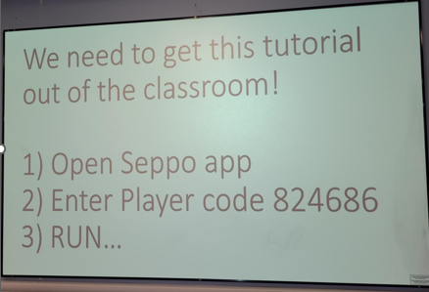
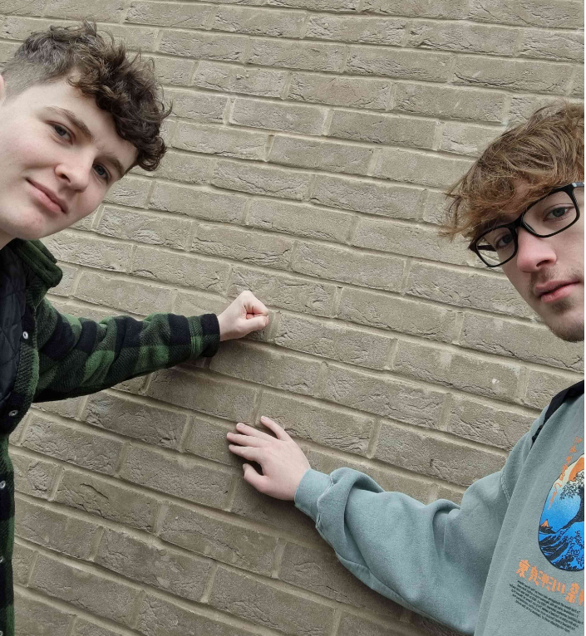
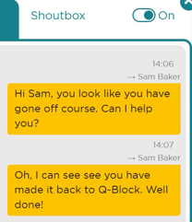
Case study 3 – Tutorials
Taking every day teaching out of the classroom
“It’s always a great opportunity to experience the material learned in lectures in real life. You’re right, masonry world is full of excitement”
“It was super fun, really enjoyed it!”
“Very different and a good way to learn”
“Fun, but make it even more competitive!”
Notes:
This is one of my favourites because this was only undertaken last week so these Seppo games are very quick to produce. I produced this tutorial in about two hours and it saved me repeating a tutorial session for 8 hours. Two hours on Seppo saved me 8 hours of teaching time and now it’s all done for next year!
This is taking day-to-day teaching out of the classroom. Students arrived at the classroom […explain tutorial]
This was the first time I'd fully automated a tutorial and it was a rainy and cold day so I was delighted to have got such positive feedback from the groups. I had originally expected to have some push back because making them compete for their attendance codes I thought maybe would be a step two competitive but actually one of the major pieces of feedback as they wanted it to become more competitive, they actually wanted the game to be harder, they wanted to work harder to get that knowledge, something which would never have occurred in a normal tutorial.
But one of the other reasons I love using this is it tracks the students while they're in the game. I notice one student called Sam who had started wandering off towards the student union bar. I sent a quick note saying “you seem to have gone off course, can I help you?” and immediately saw him turn around and start walking back to the locations!

Slide 12
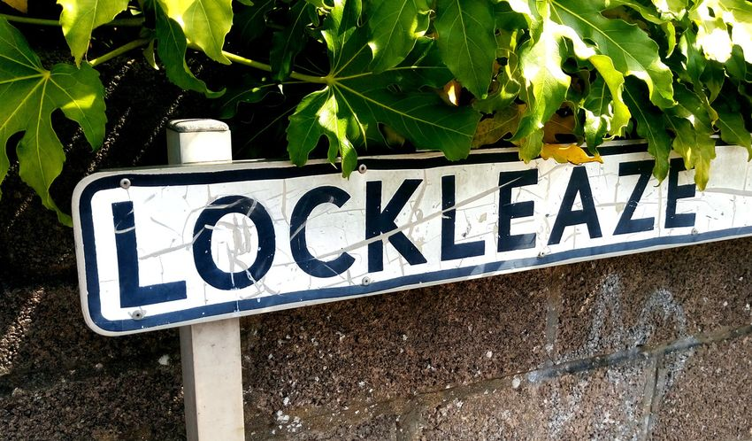

Case study 4 - Research
Engaging the local community in data collection
Gamifying Sound Walks to improve community engagement and inform urban planning
Notes:
This next use of Seppo is starting to use it in my research. I mentioned at the beginning I am in acousticians and one of the things acousticians do is perform sound walks in order to inform urban planning. So a group of people are meant to get together listen to their environment, traffic noise, access to nature, any particularly annoying tones and their impressions of that space are fed back to planners.
However when these sessions are run you get one group of people attending. They all look like me, mid 40s, male, all involved in acoustics. They take place at one time of day so if you happen to miss rush hour traffic the noise in that area is completely ignored and they almost never include any members of the community actually living in that area. I have a research project running at the moment to incorporate Seppo into it to engage the local community so that anyone who lives in the area can survey it's noise levels and this should widen the demographic of the people taking part in these surveys but also why didn't the amount of time the times of day when these surveys are completed.

Slide 13
Feedback from learners
“Very interesting activity but I am wet”
“Gamifying it was good because you can take things at your own speed”
“We got details that we would have missed if we’d been in a large group. It’s harder to engage when your in a massive group”
“My engagement was better than if we had been lead around in a group in the old way”
“The apps was really good! I felt more engaged, I don’t generally pay attention when I’m in a big group so being able to play the game without a load of people around made it much easier to understand”
Notes:
Loads of good feedback but I just want you to look at the last quote.

Slide 14
Feedback from learners
“Very interesting activity but I am wet”
“Gamifying it was good because you can take things at your own speed”
“We got details that we would have missed if we’d been in a large group. It’s harder to engage when your in a massive group”
“My engagement was better than if we had been lead around in a group in the old way”
“The apps was really good! I felt more engaged, I don’t generally pay attention when I’m in a big group so being able to play the game without a load of people around made it much easier to understand”
Notes:
Read

Slide 15
Summary
Reengage students by making learning fun.
Make learning more affective by engaging constructivist learning practices.
Lead large groups while still being able to engage and provide one to one feedback in real time.
Integrate targeted small group activates into more generalized learning.
Engage more people, more effectively and collect data.

Slide 16
Additional resources
Blog post – Gamified learning and student motivation
https://fetliu.net/blog/gamified-learning-and-student-motivation/
Blog post - Location based learning with Seppo
https://fetliu.net/blog/location-based-learning-with-seppo/
Video – UWE staff experience of game based learning with Seppo
https://vimeo.com/808372435/a27603c608
A short example of Seppo for the iBEE 2023:
Open Seppo app, Enter player code 222DA5

Slide 17
Any questions?

