Slide 1


‘Twiplomacy’ and the
Making of International Law on Social Media
presentation at
University of Westminster
4 April 2023
Professor James A. Green
james14.green@uwe.ac.uk

Slide 2

The Rise of ‘Twiplomacy’
Virtually every UN member state (189, 98%) has at least one Twitter account, most have multiple.
In total there are well over 1,000 active Twitter accounts at the ‘state level’.
These accounts have issued a combined 9 million tweets
These accounts have a combined 620 million followers
900% increase since 2013…

Slide 3

Can a tweet contribute to the making of customary international law?
The orthodox / traditional view of CIL – two elements:
  State practice
  Opinio juris
    (ICJ, variously in North Sea Continental Shelf Cases [1969]; Continental Shelf Case [1985]; Nicaragua Case [1986]; Jurisdictional Immunities Case [2012])
    (ILC, Conclusions on Identification of Customary International Law, 2018)

Slide 4
Can a ‘state level’ tweet ‘count’ as state practice and/or opinio juris?
ILC, Conclusions on Identification of Customary International Law (2018):
Both State practice and evidence of opinio juris “may take a wide range of forms.” (conclusions 6(1) and 10(1)).
State practice can include acts that amount to “official statements on the international plane.” (commentary to conclusion 6).
Evidence of opinio juris can include “public statements made on behalf of States” (conclusion 10(2)).
Ultimately, “[s]ocial media is just another form of communication.” (Maloney, Moss & Ilic, 2014)

Slide 5
What counts as a ‘state level’ tweet for the purposes of law-making?
Analogy to treaties?
If so, Vienna Convention on the Law of Treaties 1969, Article 7(2)), essentially assumes for:
Heads of state
Heads of government
Ministers of Foreign Affairs
Heads of diplomatic missions (in relation to the state where they are a diplomat)
States’ representatives to international conferences/organisations (where relevant).

Slide 6
‘Personal’ Twitter accounts
Around 35% of currently active ‘state level’ accounts are ‘personal’
“The Government acknowledges that the President’s tweets … constitute ‘official’ statements of the President”
(US Court of Appeals for the Fourth Circuit, IRAP v Trump [2018])
Although “Mr. Trump often used [@realDonaldTrump] to speak in his official capacity [… it was not a] government-controlled space”
(US Supreme Court, Biden v Knight Institute [2021])

Slide 7



Issues of Authenticity - ?
The ‘verification gap’
Only 58% of ‘state level’ accounts carry the ‘verification tick’
Additional verification for “state affiliated accounts”.
The risk of delegitimising the ‘unverified’ and re-embedding colonialism…
‘Diplomatic catfishing’ (either due to fake accounts, or due to hacking).

Slide 8
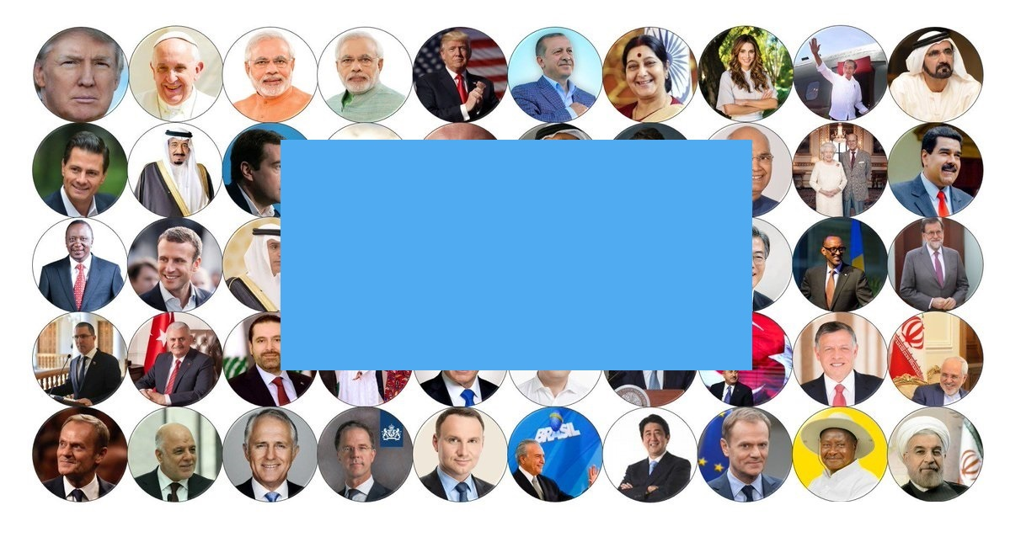
Is Custom already being made on Twitter?

Slide 9
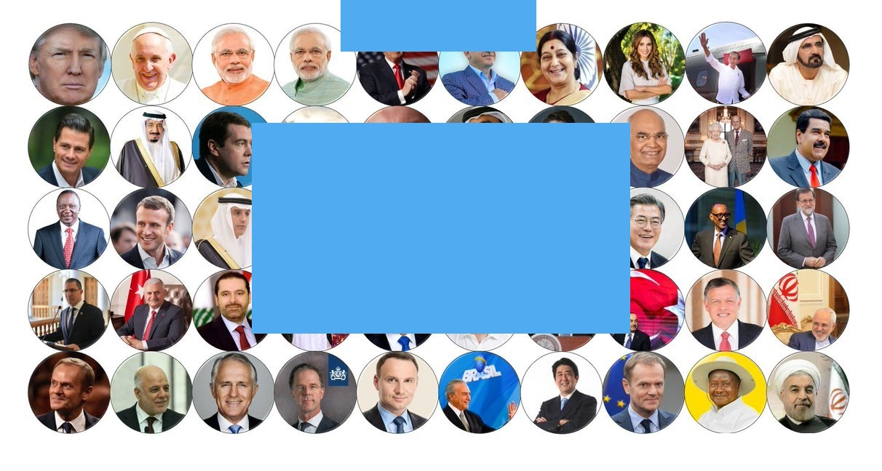
Empirical Study
Credit Konstantina Nouka
182 ‘state level’ accounts from 47 states (i.e., pool of 2-3 million tweets).
100 search terms applied.
Qualitative/contextual assessment of results.

Slide 10
Empirical Study
36 tweets with potential implications for customary international law.
  Most were reaffirming existing custom.
  But 10 could be interpreted as having potential to contribute to the modification or creation of custom.

Slide 11
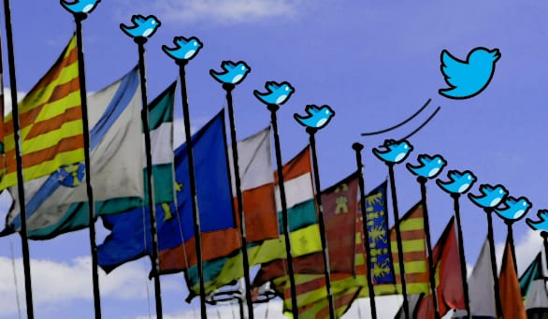
Conclusion

Slide 12
Conclusion
”…[tweets] are unbounded resources by which to find intent of various kinds. They are often short-hand for larger ideas ... And they are often susceptible to multiple interpretations, depending on the outlook of the recipient.”
(US Court of Appeals for the Fourth Circuit, IRAP v Trump [2018])
Vs.
Ability for one person to review a dataset of statements in the millions over a mere 6-week period…

Slide 13
Selection criteria for accounts searched
Global regional distribution
Political, social, economic, and religious diversity
Number of followers (range through from high to low)
Representative mix of both ‘official’ and ‘personal’ accounts

Slide 14
Search terms
General terms- apply to many categories | International Investment Law | International Environmental Law | Law of the Sea | Law of Use of Force/ IHL | International Criminal Law
Belief Believe Customary international law Host states ICJ Illegal International law Jus cogens Legal Opinio juris Sovereignty State conduct State practice State responsibility UN Charter Vienna Convention on the Law of the Treaties | Agreements Assets Bilateral investment Bilateral investment treaties BITs Companies Contracting parties Economic order Foreign investment Investors Multilateral agreements on investment Natural resources OECD Transnational cooperation WTO | Antarctic Treaty Atmosphere Climate change Council of Europe Convention on Civil Liberties for Damage Resulting from Activities on the Environment “due diligence” ecocide Endangered Species Environment International Maritime Organization Kyoto Protocol Marine Nature Nuclear Ozone Paris Agreement “polluter pays” Pollution “precautionary principle” Protocol on Environmental Protection Rio Declaration on Environmental Development Stockholm Conference on the Human Environment UN Convention on Biological Diversity UN Environment Programme | Bays Coast Coastal state Contiguous zone Continental shelf Economic Zones EEZ External waters Fishing zones High Seas Innocent passage Internal waters International Seabed Authority LOSC Piracy Straight baseline Territorial sea Territory Transit passage UNCLOS | Armed conflict Combat Geneva Conventions Hague Convention Hostilities humanitarian intervention International Committee on the Red Cross Jus ad bellum Jus in bello Necessity Proliferation Proportionality Security Council self-defence / self-defense Weapons | Aggression Civilians Crimes against humanity Criminal liability Criminal responsibility Extradition Genocide Rome Statute Terrorism Torture Treaties War crimes

