Slide 1
Drift and Diffusion Functions of Historical Time Series and UKCP18 Convection-Permitting Model Outputs for Bristol and Filton
Kwok P Chun, Luminita Danaila and Manuel Fossa

Slide 2
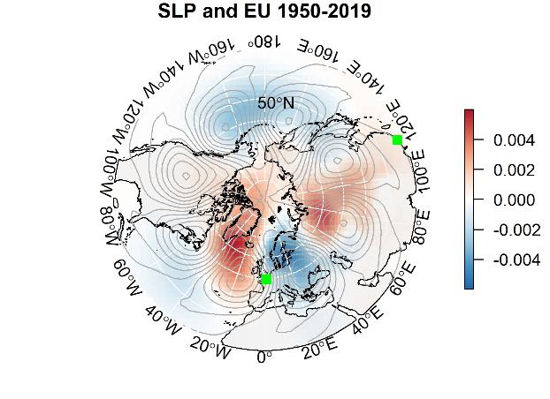
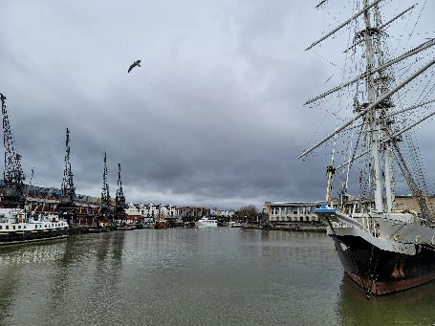
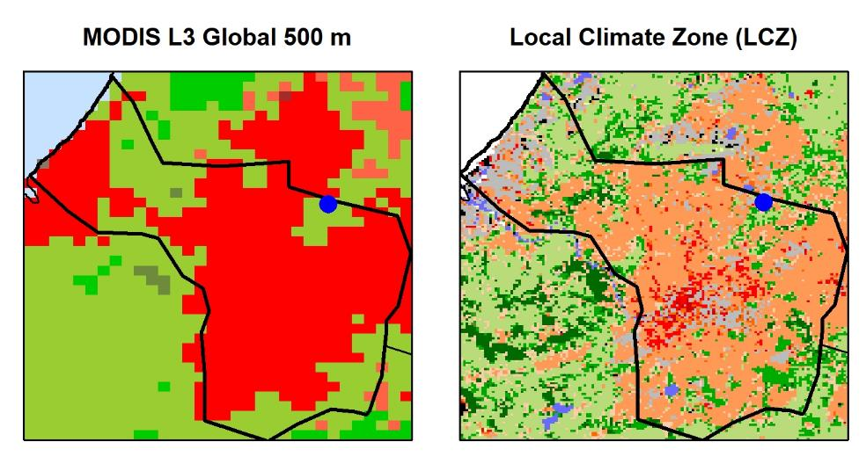
Outline
Climatology and Hydrology
Connecting different scales
Our data
UKCP18 and Observations
Land use information
Environmental Management and Climate change actions

Slide 3
Regional and local interactions
Hydrology and Climatology for Environmental Management
Climate action and sustainability
Regional variations and local extremes
Scaling approaches for environmental applications and hazard management
My university’s strategy: “Powering the future workforce, supporting local economic prosperity, shaping the health and sustainability of our communities and creating solutions to global challenges.”

Slide 4
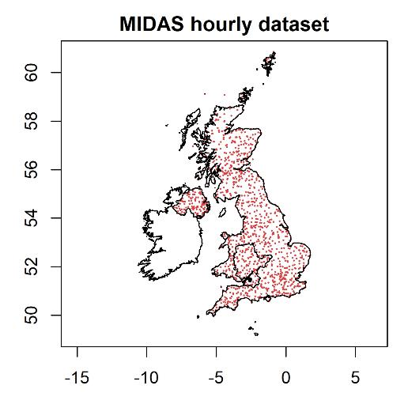
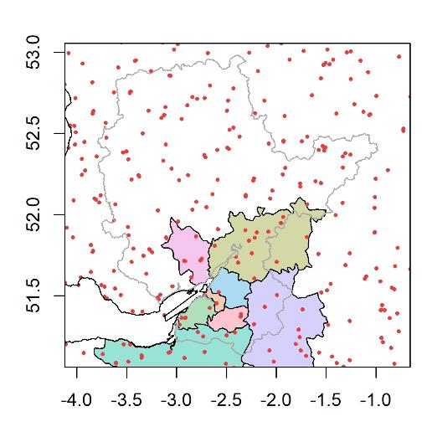
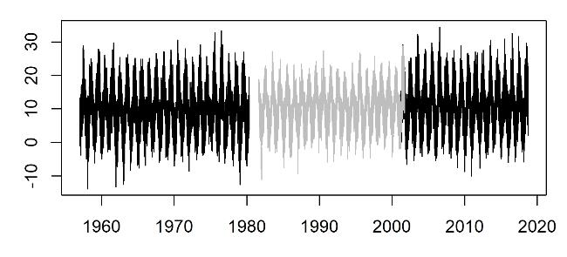
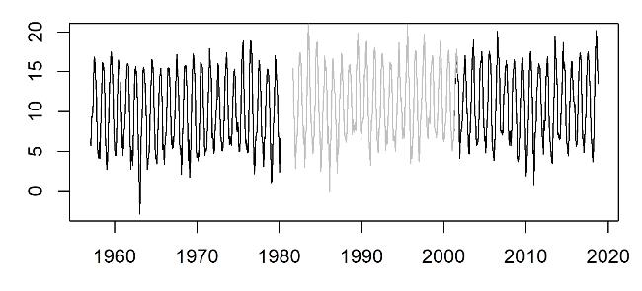
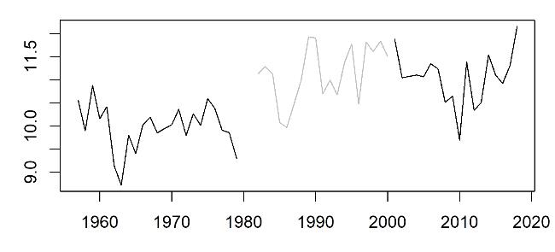
A story of long weather records Filton (black) and Bristol (grey)
Observations (legacy)
Hourly data
Our changing temperatures since the 1950s
Hourly data
Monthly data
Annual data

Slide 5
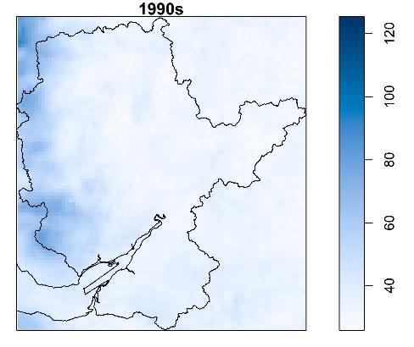
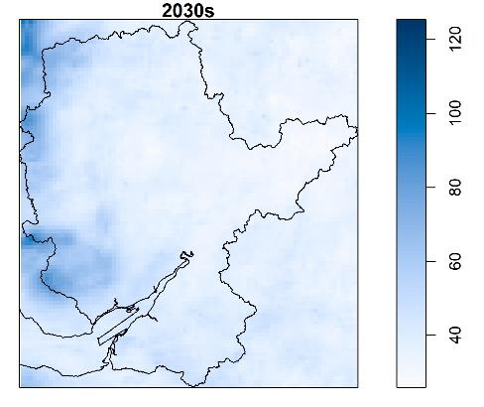
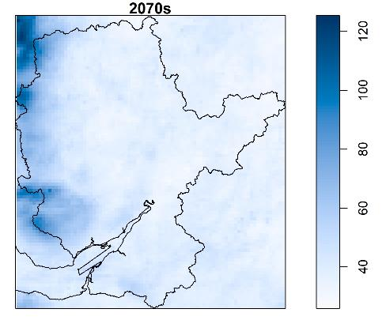
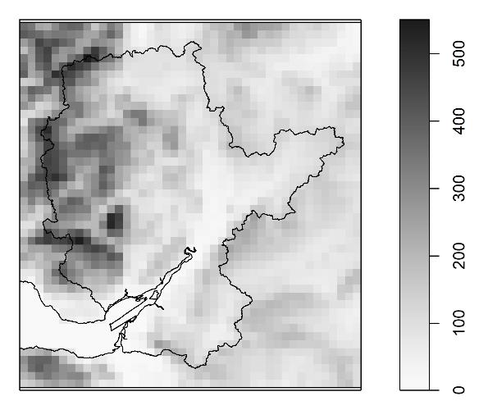
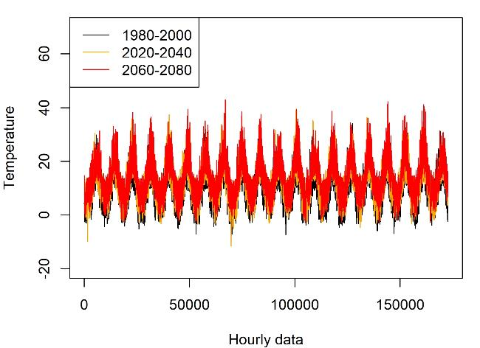
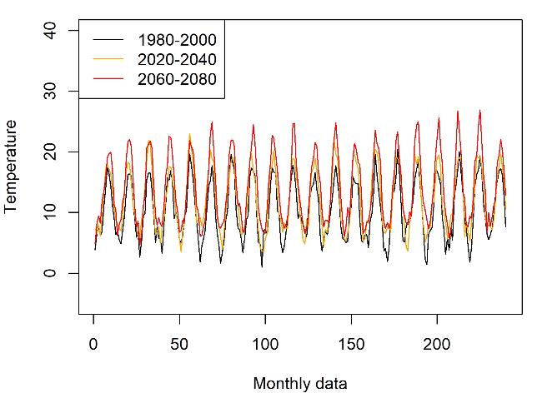
UKCP18
1990s
2030s
2070s
The UKCP18 Convection-Permitting Model (CPM) Projections (2.2km and 5km)
Topography and Land use (5km and 12km)
Hourly data
Monthly data

Slide 6
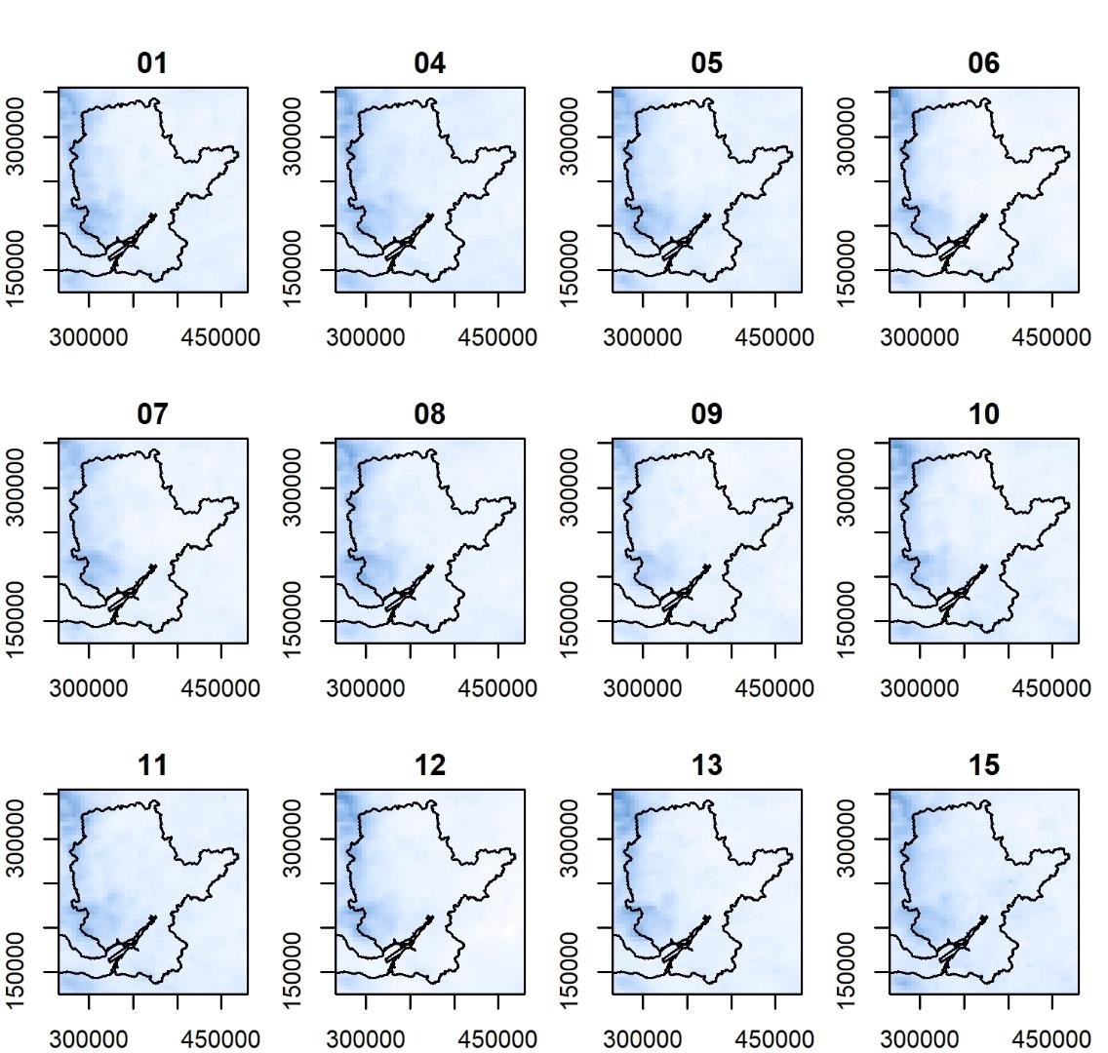
Ensemble (5km)
1990s
12 members of the UKCP18 simulation
Similar patterns of all members
Overall precipitation is higher in the 2070s compared to the 1990s
It is difficult to tell the change between the 2030s and the 1990s

Slide 7
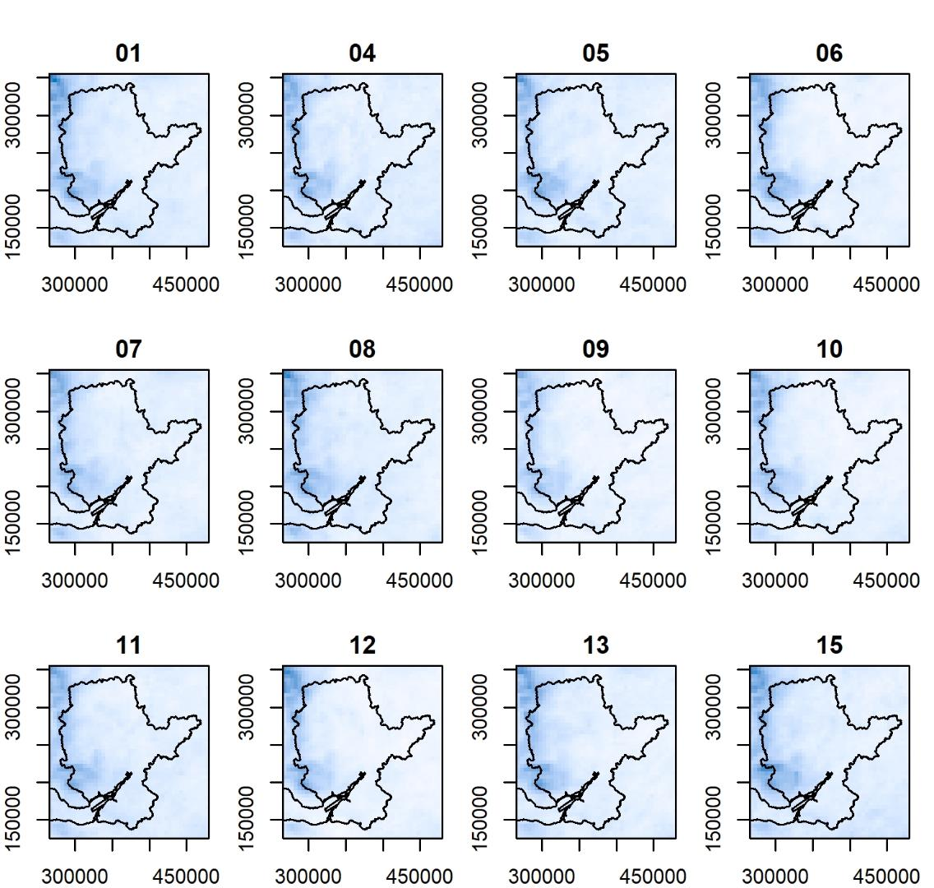
Ensemble (5km)
2030s
12 members of the UKCP18 simulation
Similar patterns of all members
Overall precipitation is higher in the 2070s compared to the 1990s
It is difficult to tell the change between the 2030s and the 1990s

Slide 8
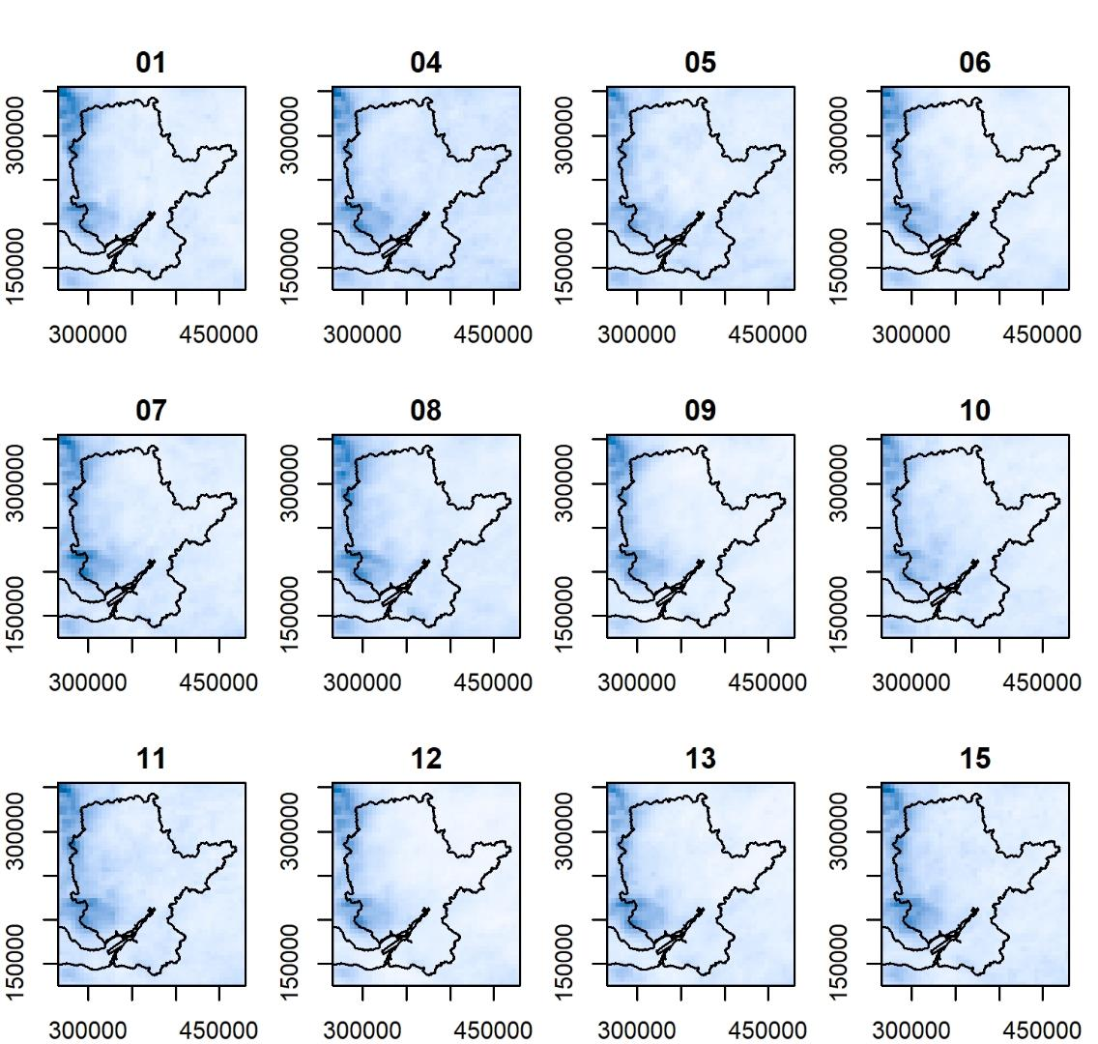
Ensemble (5km)
2070s
12 members of the UKCP18 simulation
Similar patterns of all members
Overall precipitation is higher in the 2070s compared to the 1990s
It is difficult to tell the change between the 2030s and the 1990s

Slide 9
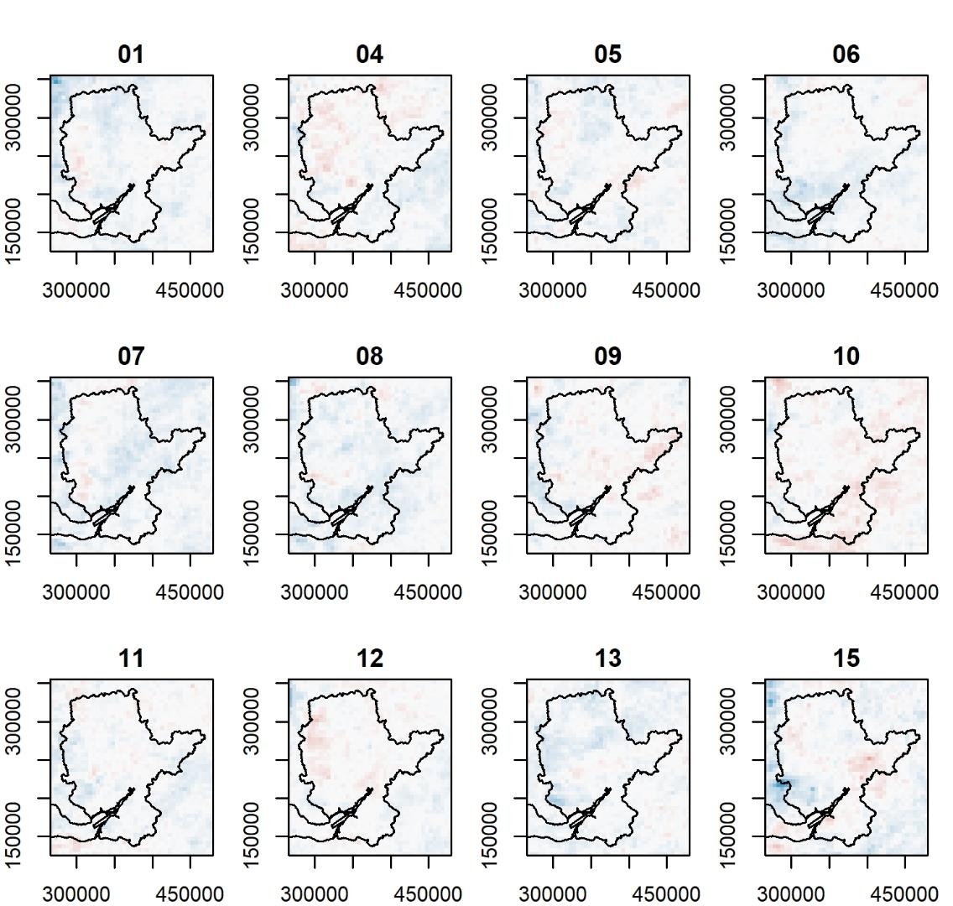
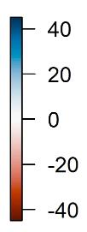
Ensemble (5km)
2030s-1990s
12 members of the UKCP18 simulation
Similar patterns of all members
Overall precipitation is higher in the 2070s compared to the 1990s
It is difficult to tell the change between the 2030s and the 1990s

Slide 10
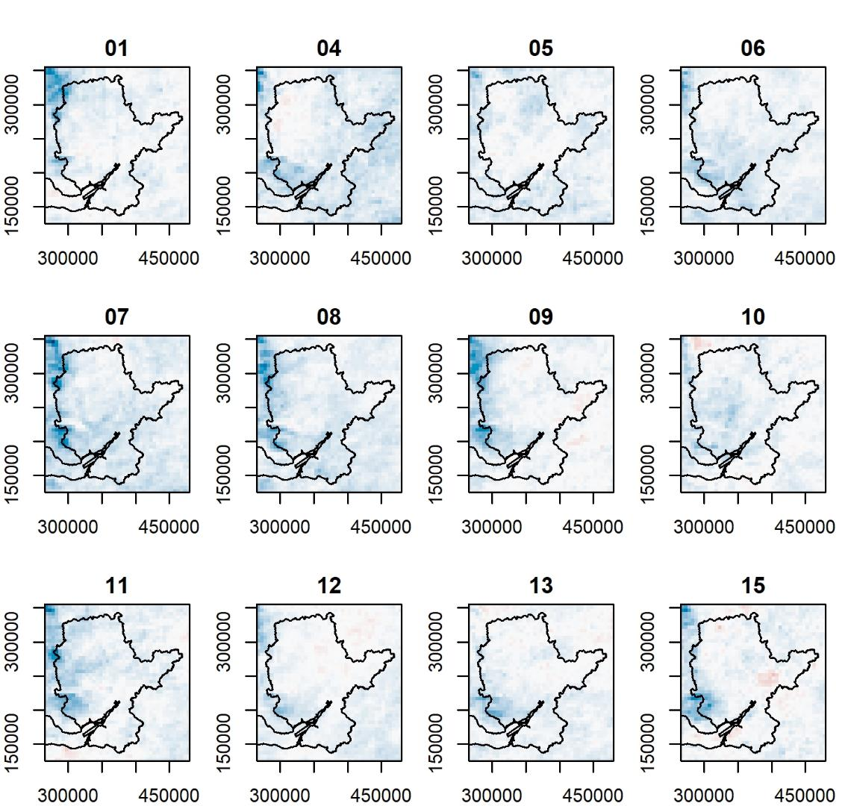
Ensemble (5km)
2070s-1990s
12 members of the UKCP18 simulation
Similar patterns of all members
Overall precipitation is higher in the 2070s compared to the 1990s
It is difficult to tell the change between the 2030s and the 1990s

Slide 11
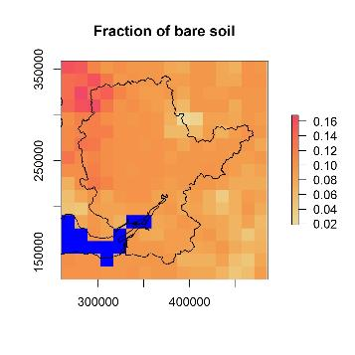
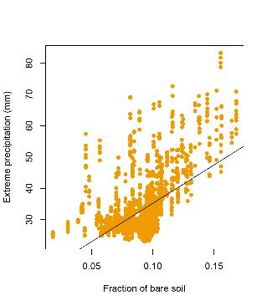
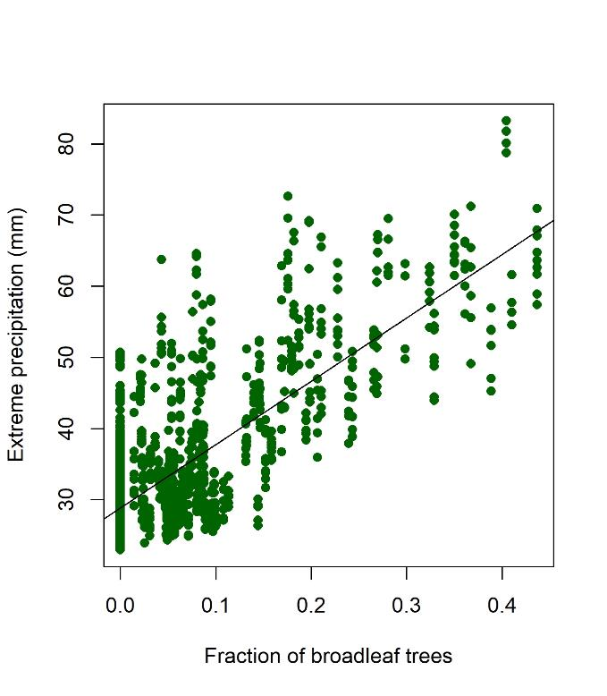
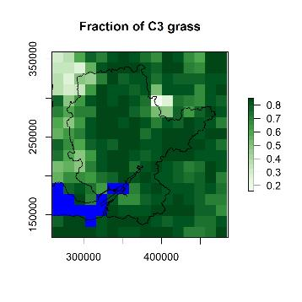
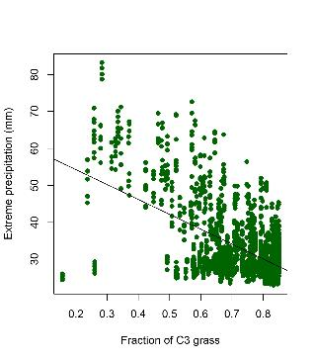
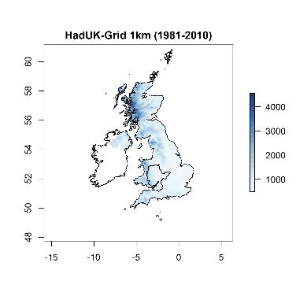
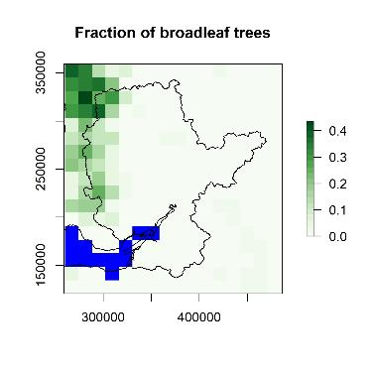
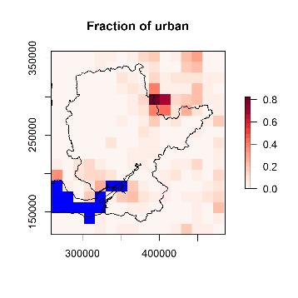
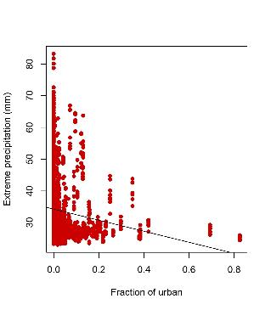
Land use and precipitation
Bare soil
Fraction maps of land use
Precipitation map
New hypotheses
Grassland/Cropland
Trees
Urban

Slide 12
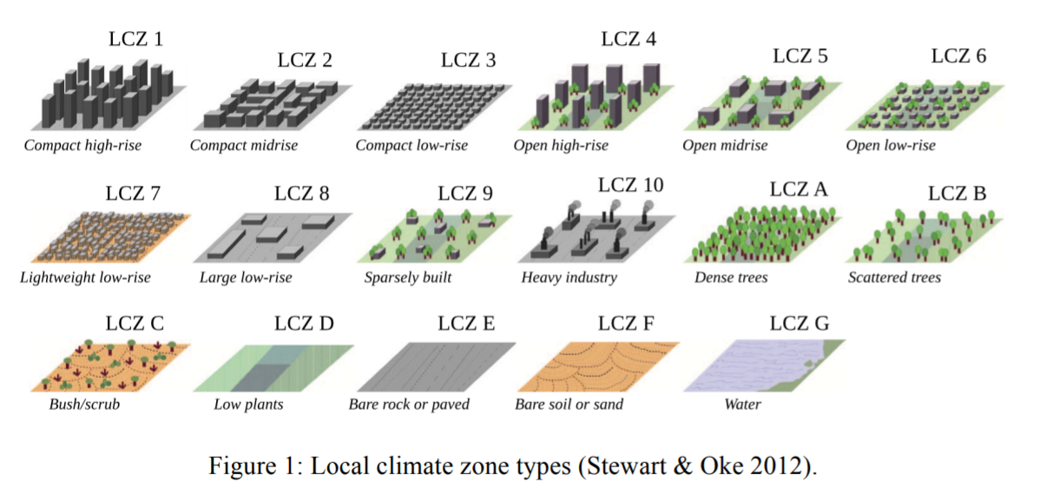
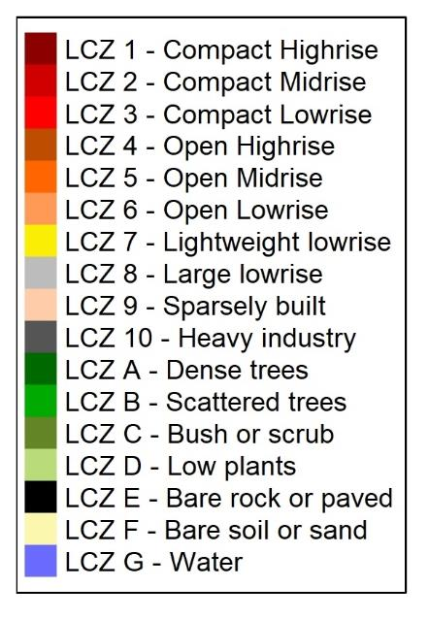
Local Climate Zone (LCZ)
Land use types for urban planning

Slide 13
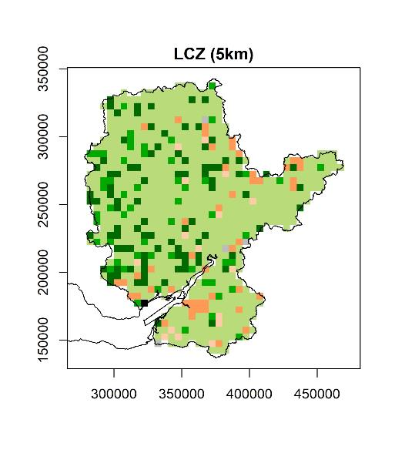
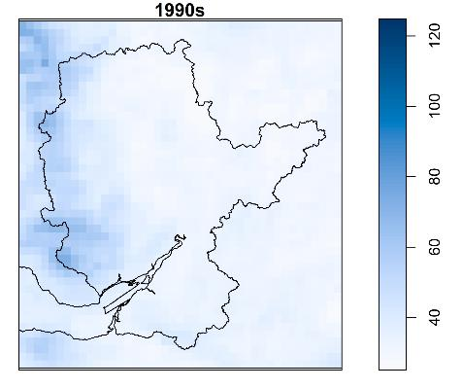
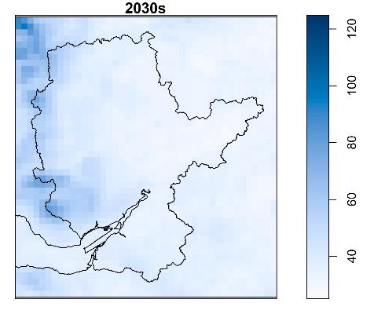
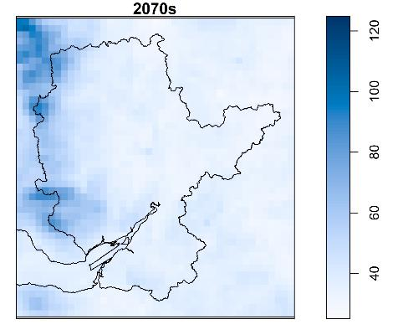
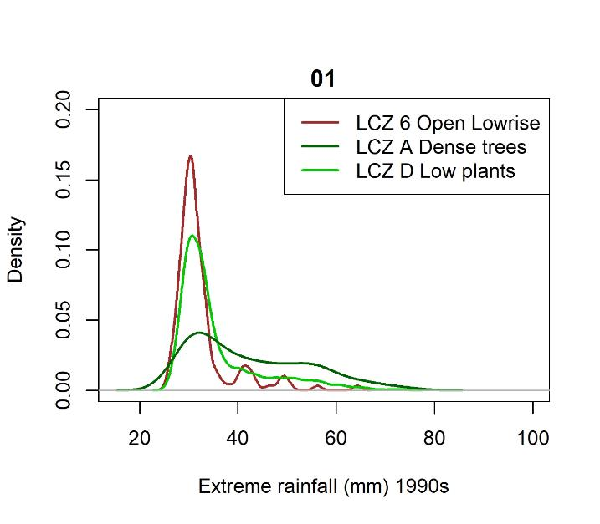
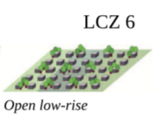
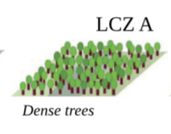
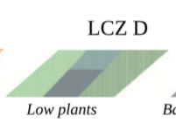
UKCP18
Emissions scenario RCP8.5
5km
1990s

Slide 14
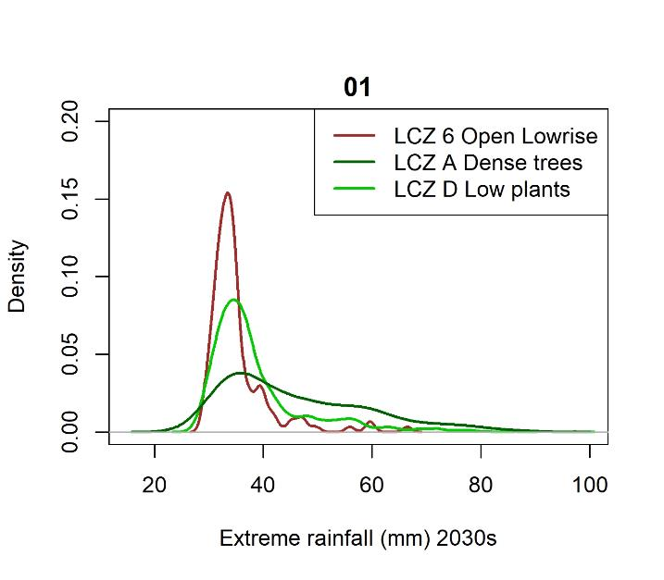
UKCP18
Emissions scenario RCP8.5
5km
2030s

Slide 15
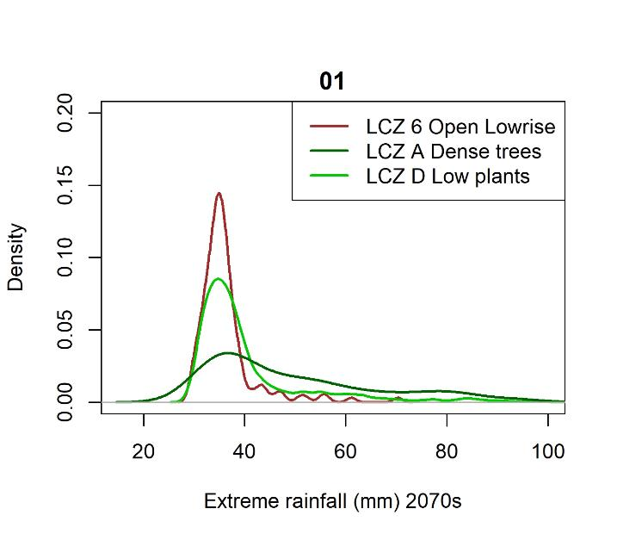
UKCP18
Emissions scenario RCP8.5
5km
2070s

Slide 16
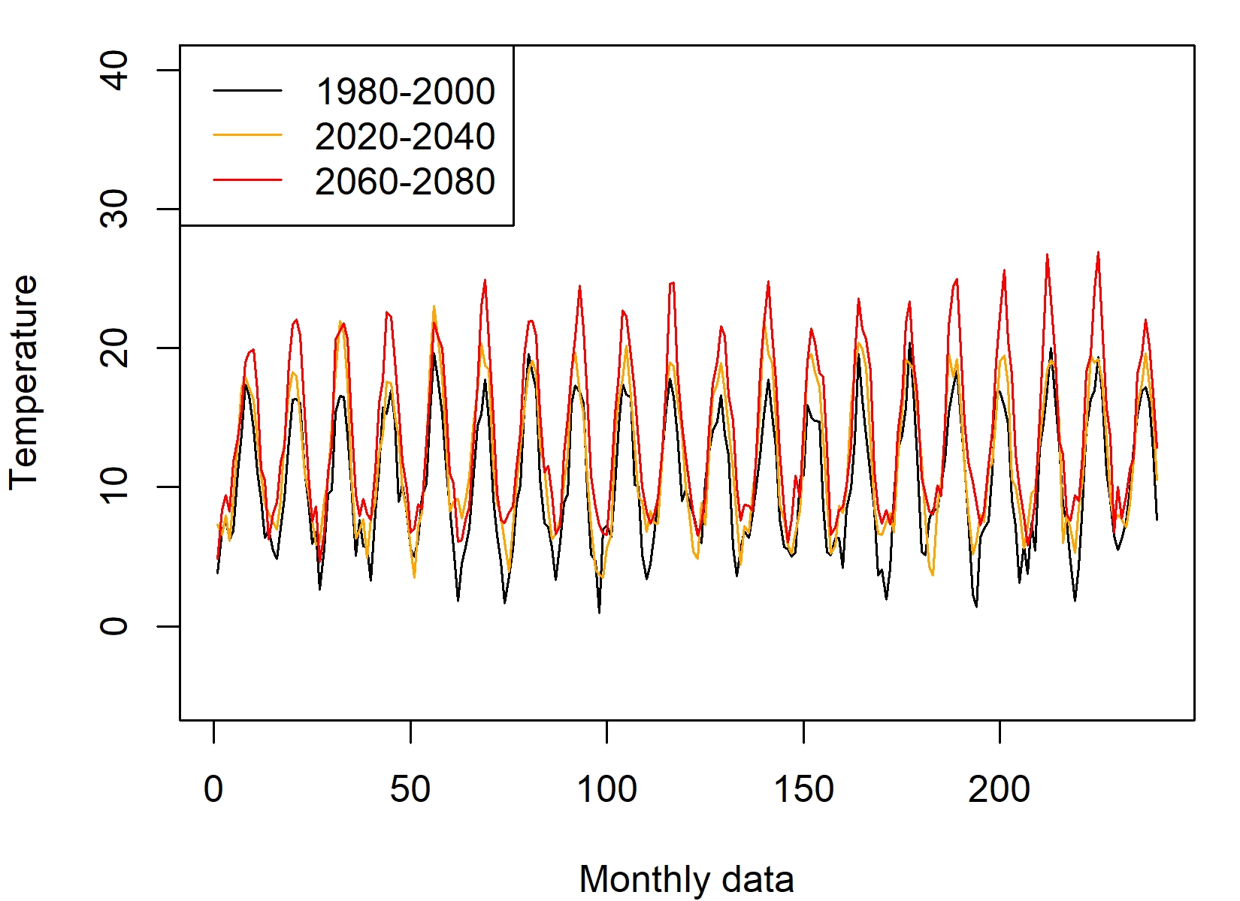
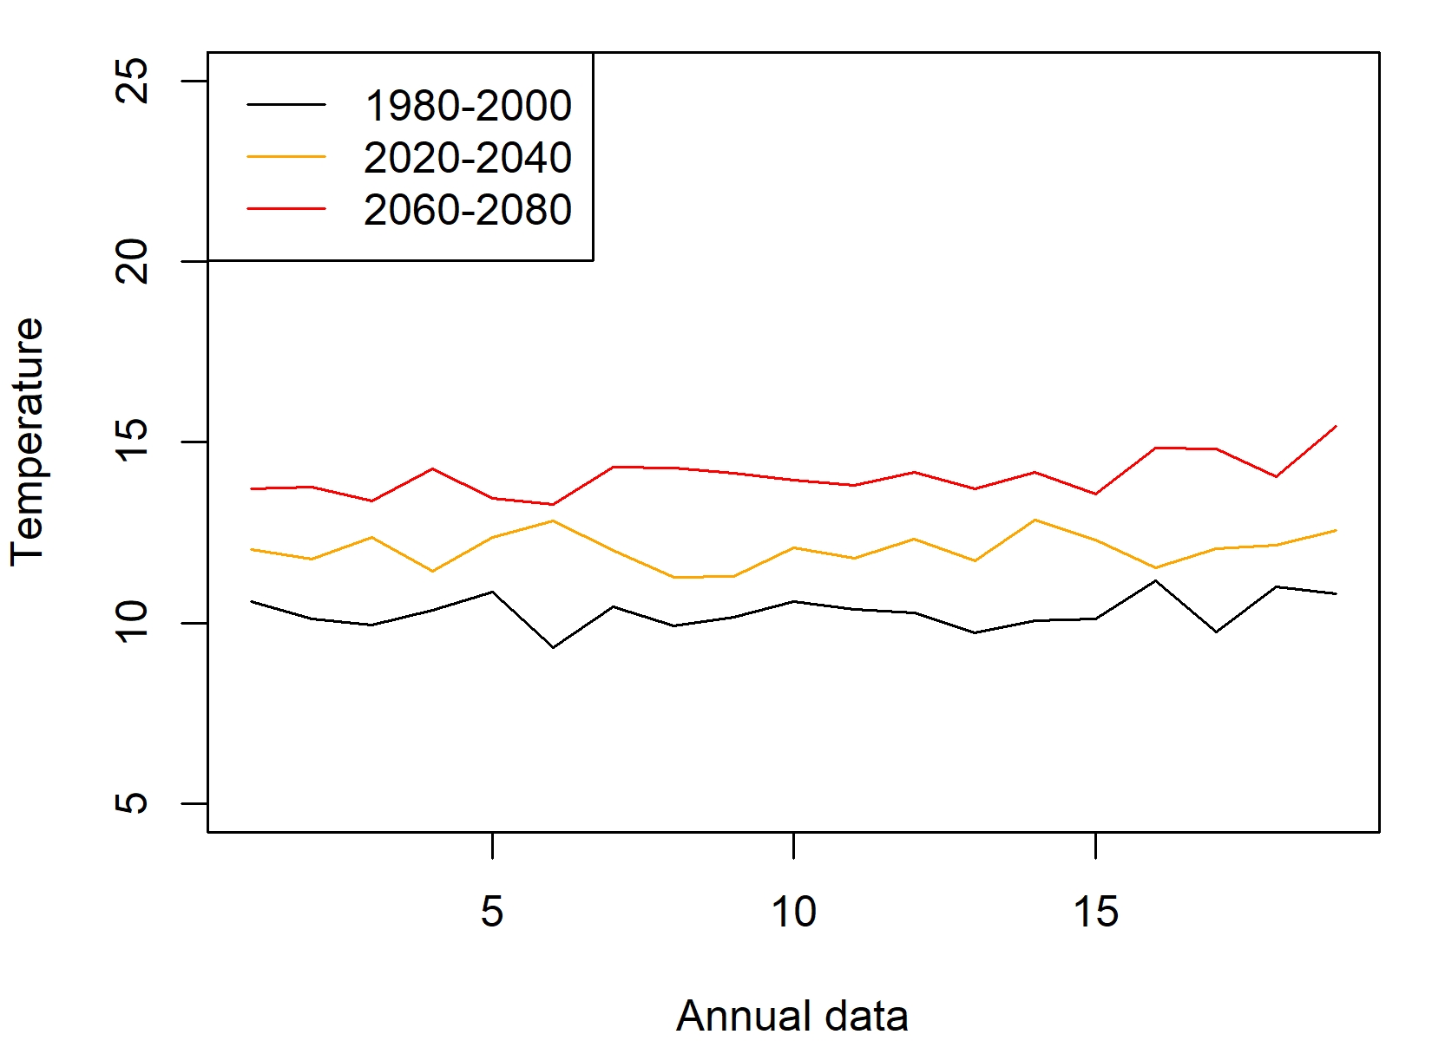
Results of 2.2km simulations from Convection-permitting models
Drift and Diffusion Functions of Historical Time Series and UKCP18
Here are the time series Convection-permitting models

Slide 17
A story of long weather records Filton (black) and Bristol (grey)
Observations (legacy)
Hourly data
Our changing temperatures since the 1950s
Hourly data
Monthly data
Annual data

Slide 18
Stochastic differential equation approach Langevin equation
The time derivative of variable $X(t)$ can be expressed based on drift $D^{(1)}$and diffusion $D^{(2)}$.
$\dot{X}(t)=D^{\left(1\right)}\left(X\left(t\right),t\right)+\sqrt{D^{\left(2\right)}\left(X\left(t\right),t\right)}Γ(t)$
We use the Fokker–Planck equation for the probability density of $X(t)$, so that $D^{(1)}$and $D^{(2)}$ can be expressed by statistical moments.
$D^{\left(n\right)}\left(x,t\right)=\lim_{τ→0}{\frac{1}{τ}M^{\left(n\right)}}(x,t,τ)$
$M^{\left(n\right)}\left(x,t,τ\right)=\frac{1}{n!}〈{(X\left(t+τ\right)−x)}^{n}〉|_{X\left(t\right)=x}$
$\dot{X}(t)$ is consist of a deterministic drift function $D^{\left(1\right)}\left(X\left(t\right),t\right)$ and a stochastic diffusion function which is a stochastic force $Γ(t)$ weighted by diffusion coefficient $D^{\left(2\right)}\left(X\left(t\right),t\right)$. Γ(t) is the δ-correlated Gaussian white noise with vanishing mean which is assumed that
$〈γ_{l}\left(t\right)〉=0$
$〈γ_{l}\left(t\right)γ_{k}\left(t′\right)〉=2δ_{lk}δ(t−t′)$
For example, a standardized Ornstein-Uhlenbeck-Process has $D^{\left(1\right)}$=-1 and $D^{\left(2\right)}$=1, and $Γ(t)$ is referred to be the Wiener process
$\dot{X}\left(t\right)=−1+Γ(t)$

Slide 19
Correlation structures
Based on scaling behaviour, the theoretical multiscale correlation function can be expressed as follows
$γ_{p+q}\left(r+R\right)=〈{[X\left(t+r\right)−X(t)]}^{p}[{X\left(t+R\right)−X(t)]}^{q}〉$
$γ_{p+q}\left(r+R\right)=〈{[∆_{r}X(t)]}^{p}[{∆_{R}X(t))]}^{q}〉$
Independent of the details of many classes of processes, the correlation function can be expressed by following moment relationships
$γ_{p+q}\left(r+R\right)\sim M_{p}\left(r\right)M_{p+q}\left(R\right)/M_{p}\left(R\right)$
where $M_{m}\left(r\right)=〈[X\left(t+r\right)−X(t)]^{m}〉$
The above relationship of the increments in length scale is consistent for the time series a multiplicative random process

Slide 20
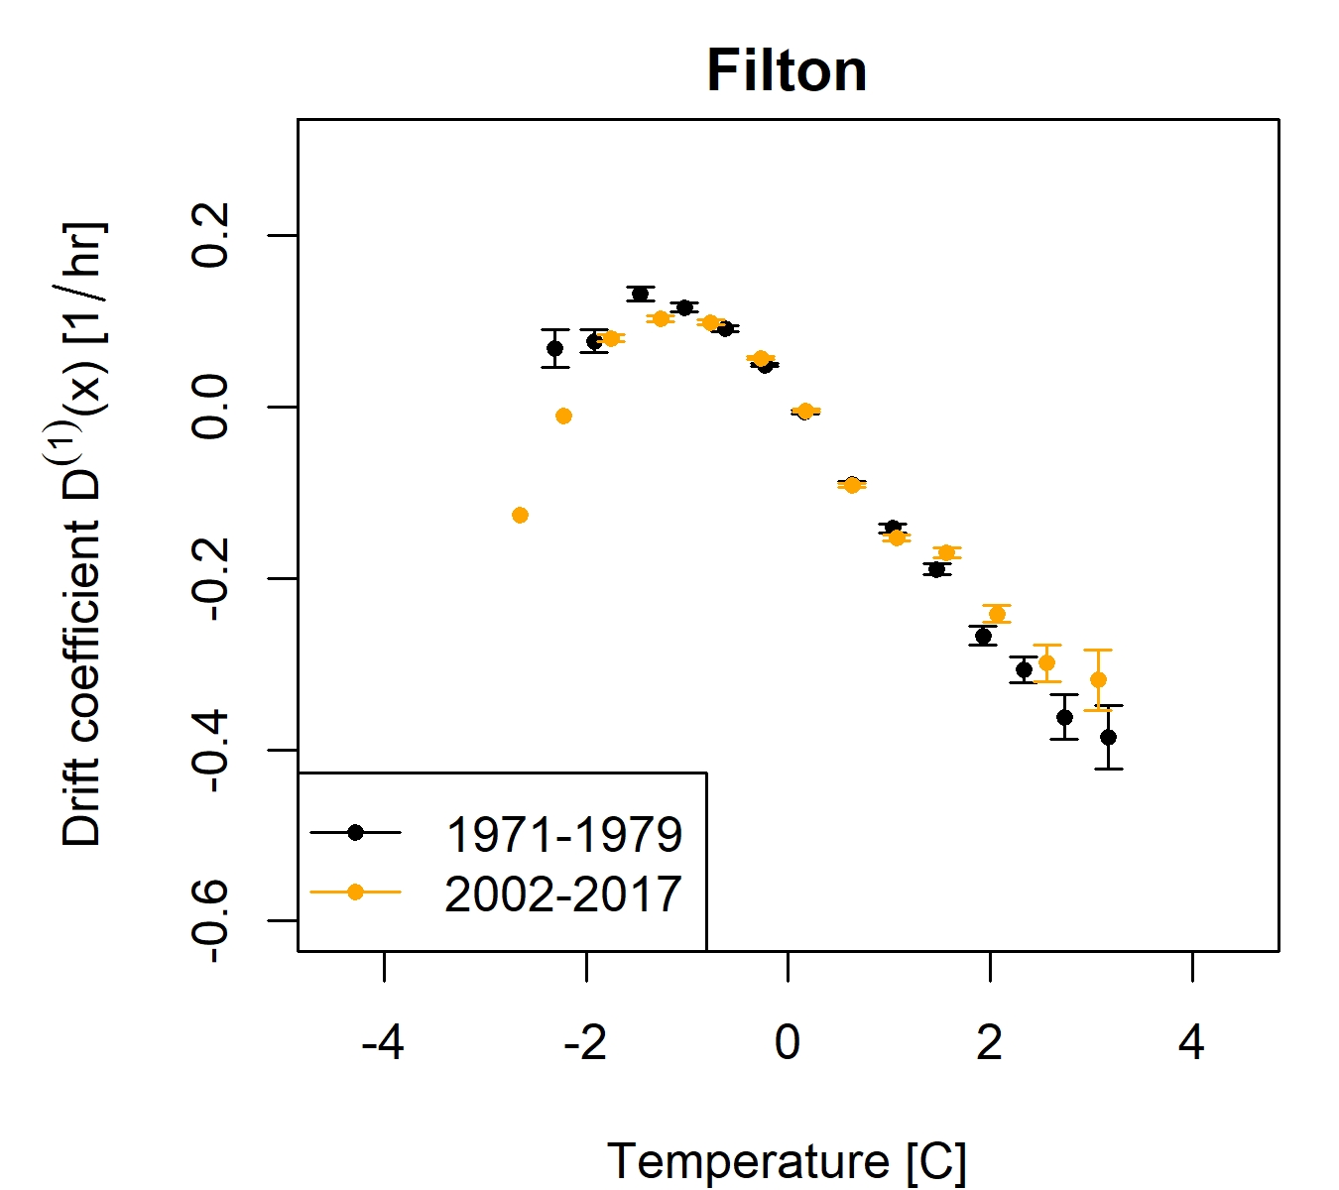
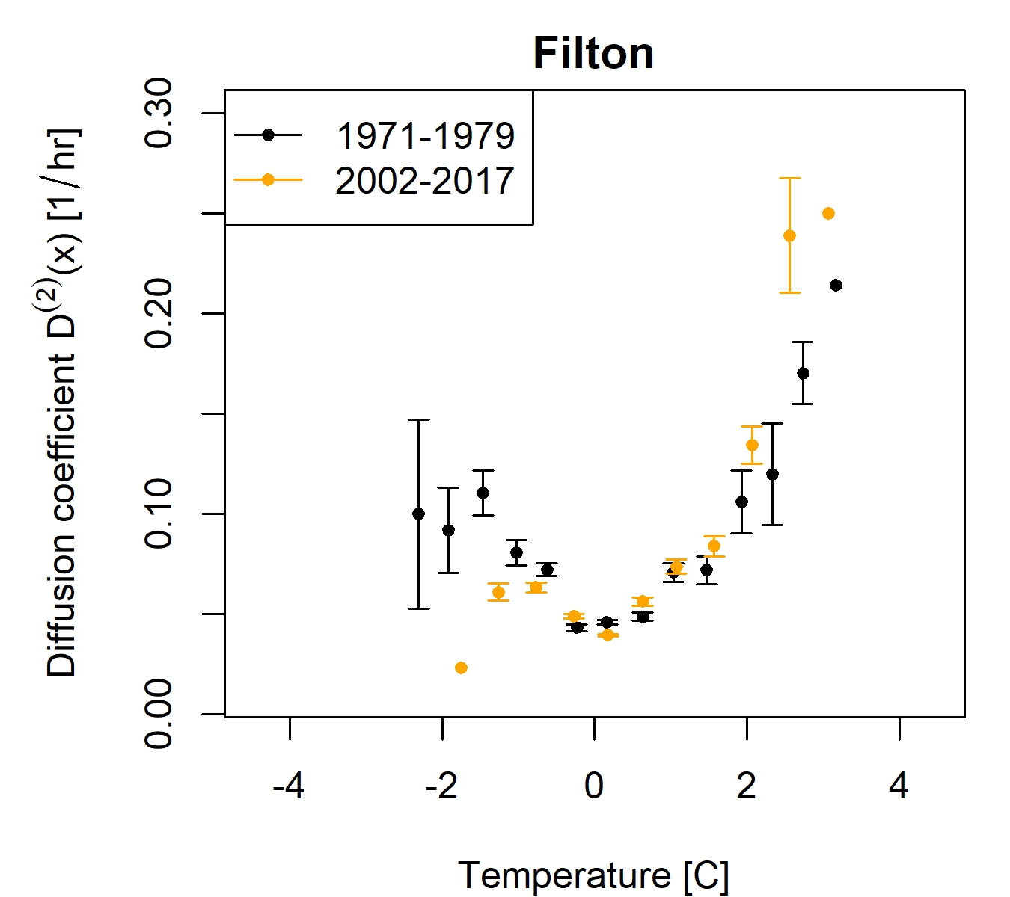
Empirical results for observations
The estimated drift function has a nice structure forms (restoring forces)
The estimated diffusion function has larger more spreads for different values (random noise)

Slide 21
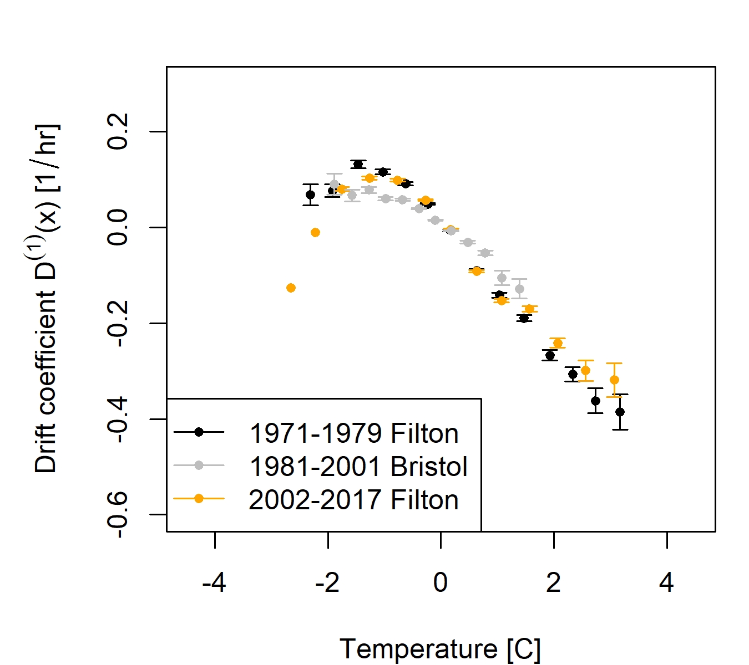
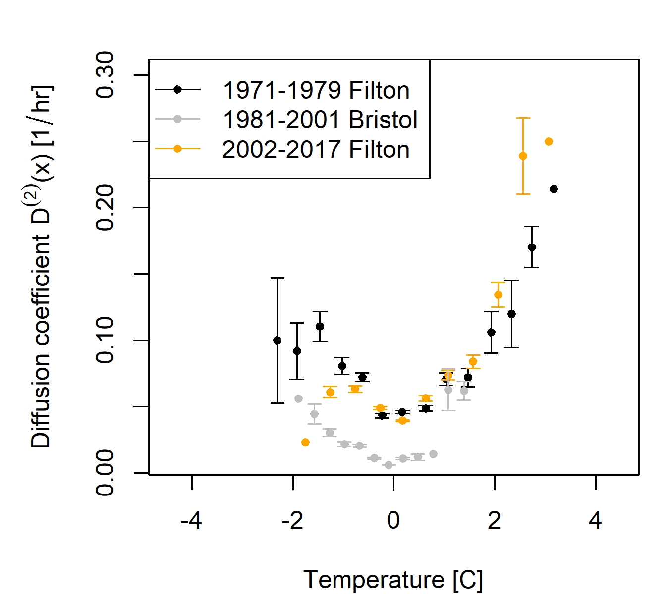
Empirical results for observations
The estimated drift function has a nice structure forms (restoring forces)
The estimated diffusion function has larger more spreads for different values (random noise)

Slide 22
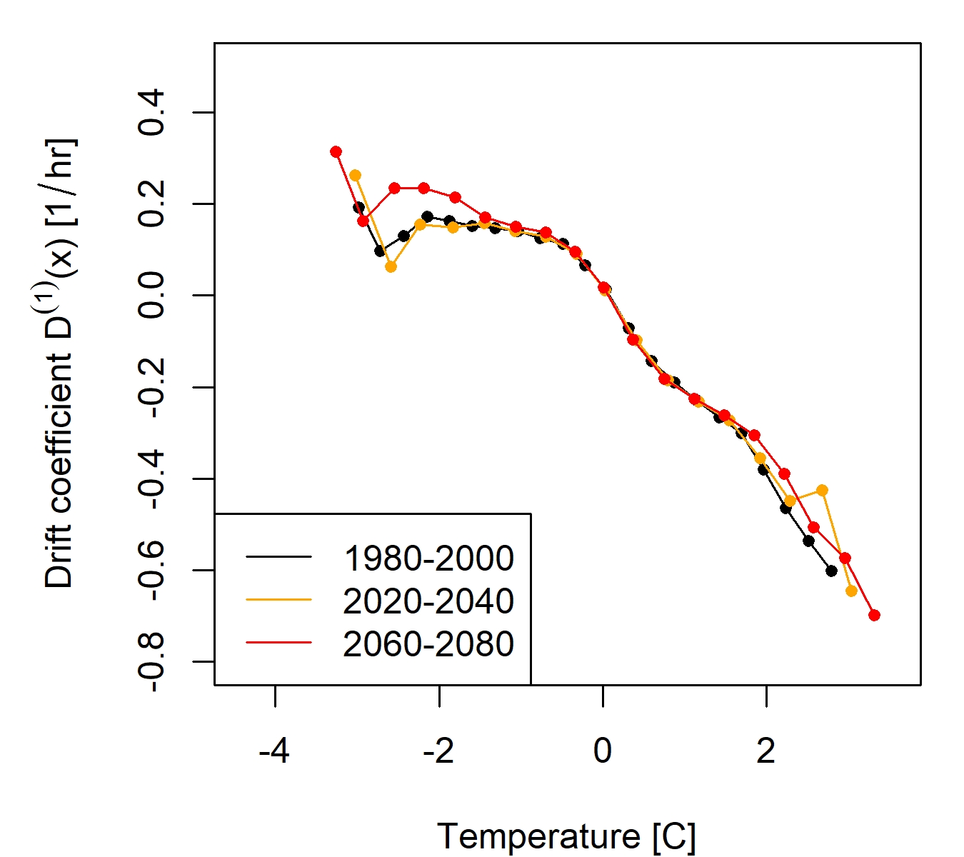
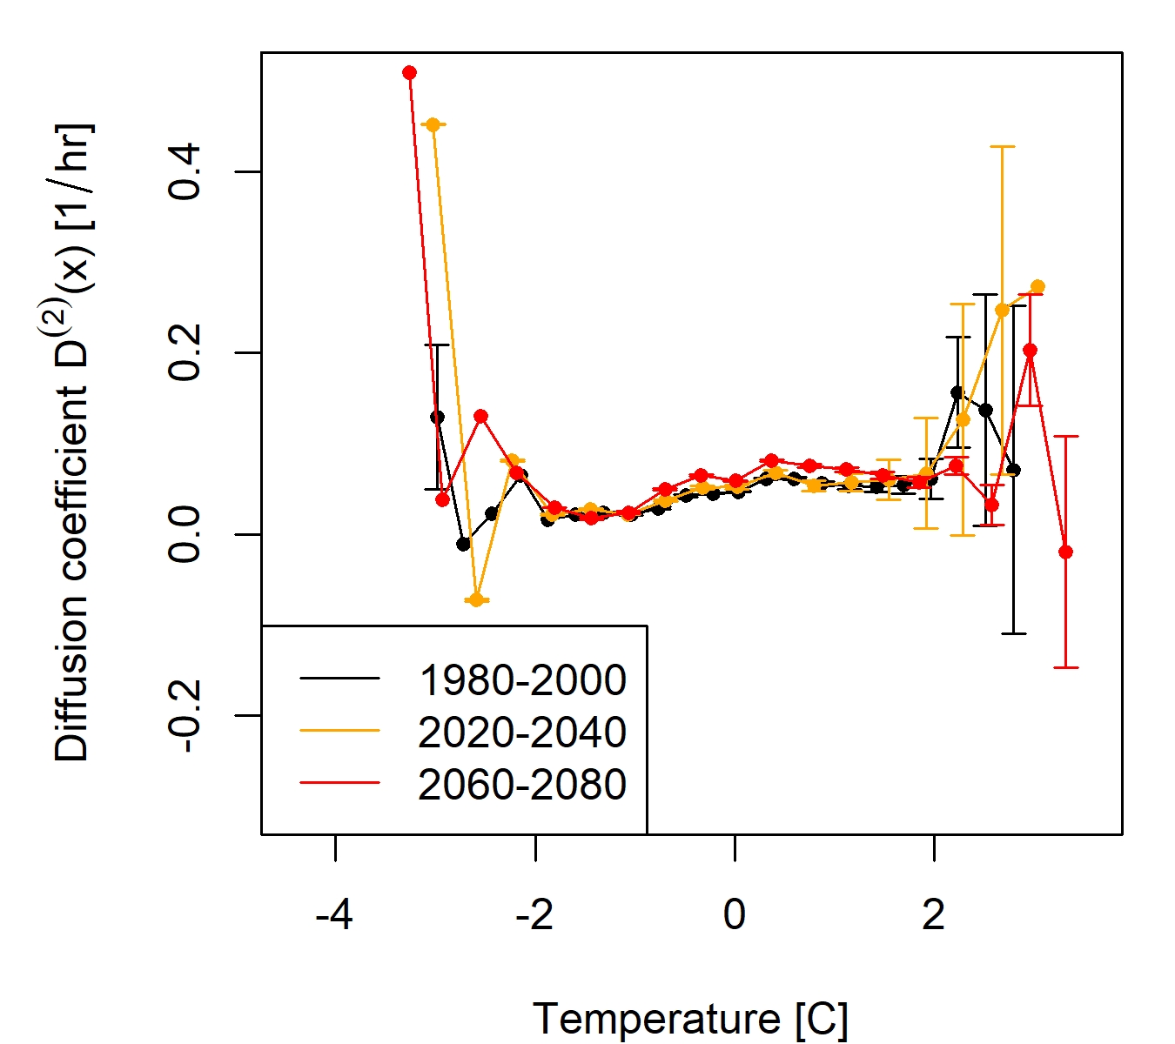
Empirical results for UKCP18 simulated outputs
Drift and Diffusion (Different noise levels affect the stability of distribution)

Slide 23
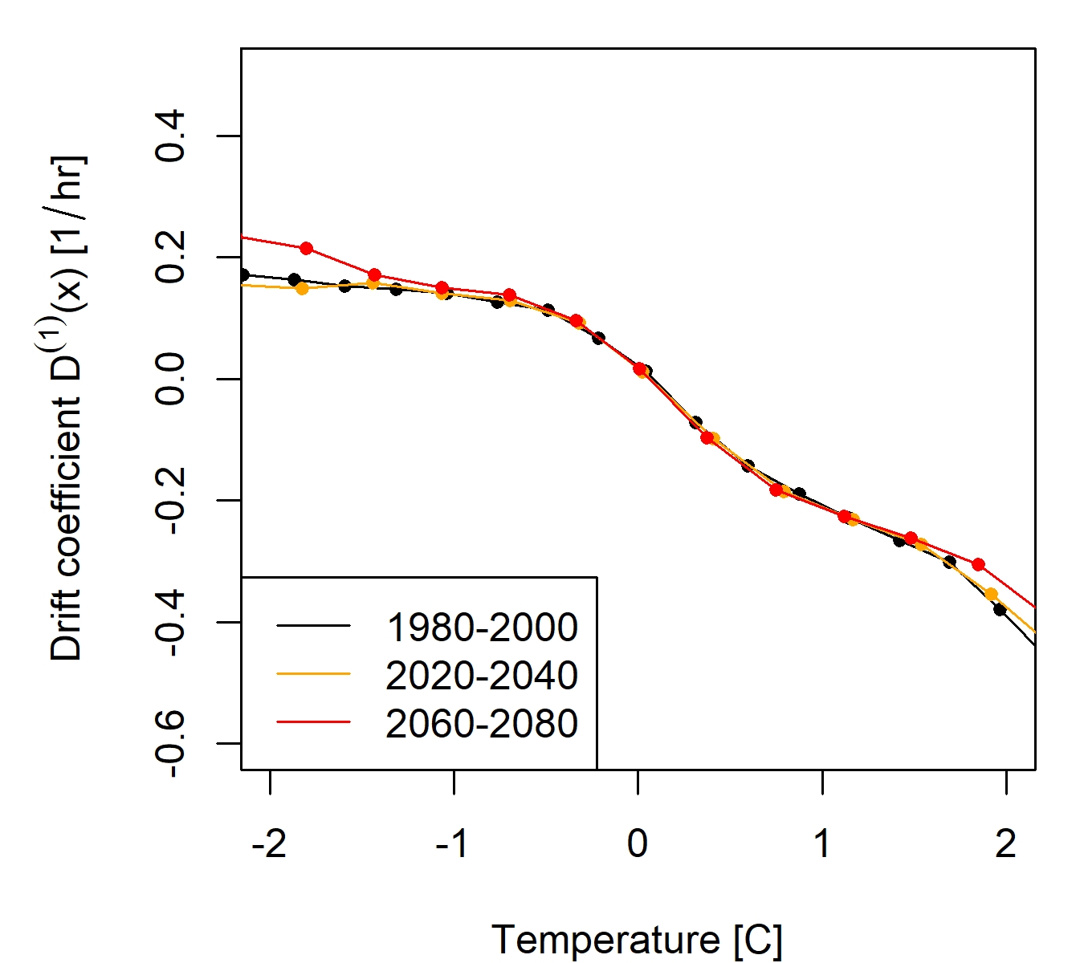
Empirical results
We try to form a drift and diffusion models using linear functions for $D^{\left(1\right)}\left(X\left(t\right),t\right)$ and $D^{\left(2\right)}\left(X\left(t\right),t\right)$
$\dot{X}(t)=D^{\left(1\right)}\left(X\left(t\right),t\right)+\sqrt{D^{\left(2\right)}\left(X\left(t\right),t\right)}Γ(t)$

Slide 24
Empirical results
We try to form a drift and diffusion models using linear functions for $D^{\left(1\right)}\left(X\left(t\right),t\right)$ and $D^{\left(2\right)}\left(X\left(t\right),t\right)$
$\dot{X}(t)=D^{\left(1\right)}\left(X\left(t\right),t\right)+\sqrt{D^{\left(2\right)}\left(X\left(t\right),t\right)}Γ(t)$

Slide 25
Let’s look at bit more of the simulated results $$\dot{X}(t)=D^{\left(1\right)}\left(X\left(t\right),t\right)+\sqrt{D^{\left(2\right)}\left(X\left(t\right),t\right)}Γ(t)$$
Hourly temperature based on linear functions
Dynamic and statistical equilibrium
Stability
distributions and moment estimations
Regional disturbances destabilises the equilibrium of local system and causes extremes

Slide 26
One more consideration
Ensemble for climate change

Slide 27
One more consideration
We adjust results to make model results closer to the observations. Then, we apply same adjustment for the UKCP simulations
The characteristics of drift function change in the UKCP simulation

Slide 28
Value added in Bristol
Sensor data network
To evaluate climate model data
The Met office data did not have some of these extreme characteristics which are in the sensor data

Slide 29
Fokker-Planck equation assumptions and its limitations
For Markov processes which are modelled by stochastic differential equation, the transition probability, g(x,t|x₀,t₀) is a condition probability to get the probability density f(x,t) given a specified initial condition (x₀,t₀).
For the diffusion approximation, g is the green function of the Fokker-Planck equation, i.e. g(x,t|x₀,t₀)=δ(x-x₀,t-t₀)
g is assume to vanish fast enough at the boundary conditions, so that the second moment is enough represent the processes.
If the data have a long memory, two moments (i.e. mean and variance) could not be enough.
We will expect the tail of distribution would be poorly represented by the Fokker-Planck equation
Our next step: Higher moments and Nonstationary spatial signals
Luminita will explain how we can do next together

Slide 30
Luminita
Our research direction
Advection
Production
Turbulent Diffusion
Transfer
Diffusive
Term
Inhomogeneity Term
Mean dissipation
rate
Isotropy Test

Slide 31
International collaborations
South America
Turkey
Malaysia
France
Germany

Slide 32
Wrapping up
Climatology and Hydrology
Connecting different scales using stochastic equation approaches with higher moments
Our next steps
to include higher resolution of land use information
to explore the extreme properties of historical observations and model simulations (e.g. UKCP18) based on drift and diffusion functions
Environmental Management and Climate change actions by our international collaboration

Slide 33
Acknowledgment
UWE Accelerator programme
UWE Starter fund
CATE College-building Research Fund 2022-2023

