Slide 1
The Benefits and Challenges of Online Learning during the COVID-19 Pandemic: Lessons for Future Blended Learning
Harry West, Jennifer Hill, Aida Abzhaparova, Will Cox, Anoushka Alexander
Geographies of Blended Learning Conference
University of Cardiff
Feb 2023

Slide 2
Introduction

Slide 3
Introduction
The COVID-19 pandemic resulted in a profound shift in pedagogic approaches in Higher Education institutions globally.
In March 2020, most aspects of teaching, learning and assessment pivoted rapidly from on-campus to predominantly online remote learning environments.
The pivot to online learning required staff to rethink and adapt their practice quickly (Hodges et al., 2020).
For many, this involved a move away from long-established campus-based pedagogic norms.

Slide 4
Introduction
The sudden disruption resulted in the adoption of a suite of novel and sometimes innovative online ‘pandemic pedagogies’.
The pandemic provided opportunities for staff to be courageous (Dyer et al., 2020) and to reflect on how and what they teach and assess (Blanford et al., 2022).
This provided opportunities to enhance the student experience, whilst also presenting new challenges and potential barriers to teaching and learning.

Slide 5
Our Research
Many studies have reported on the different approaches undertaken in response to the pandemic (for example, Crawford et al., 2020; Bartolic et al., 2021).
However, fewer have assessed the benefits and challenges presented to students by the pedagogic approaches that were implemented (Crawford et al., 2020).
In this study, we aimed to create an evidence base regarding the benefits and challenges of online learning for geography students during the pandemic, reflecting on a suite of pedagogies, and identifying best practice to take forward in teaching, learning and assessment.

Slide 6
Study Context & Methodology

Slide 7
Study Context
This research was undertaken as a student-staff partnership project, where students (Cox and Alexander) were actively involved in designing, implementing and presenting the research with staff (West, Hill, Abzhaparova).
The context of this study is a geography department in a large, teaching-oriented university in the UK, with data collection taking place at the end of the 2020-21 academic year.
The department delivers two undergraduate programmes in human and physical geography, with 262 registered students in the 2020-21 academic year across three year-groups (FHEQ Levels 4-6).

Slide 8
Pandemic Pedagogies
Asynchronous Delivery | Most large lectures, where the primary focus was content delivery, were pre-recorded using software such as Panopto and PowerPoint. Students were asked to watch and engage with these resources in their own time prior to synchronous sessions. Virtual fieldtrips were introduced to showcase locations to students. These were photo/GIS-based activities completed asynchronously.
Synchronous Delivery | Live sessions were typically scheduled in small groups (between 5-20 students). For the majority of the academic year these sessions took place in digital spaces, such as Blackboard Collaborate or MS Teams. The sessions provided students the opportunity to apply and/or reflect upon the knowledge developed in their asynchronous learning. Towards the end of the academic year, the easing of COVID-19 restrictions allowed for limited local day-long field-based learning.
Assessment and Feedback | Exam-based assessments were either removed from module specifications or undertaken online as open-book assignments taken off campus with a 24-hour time window from release to submission. Synchronous sessions offered students frequent formative feedback/feed-forward on their coursework and mock exam answers. Many staff offered additional weekly online drop-ins to support students and provide a space to ask assessment-related questions.

Slide 9
Data Collection
A two-stage, mixed-methods approach was adopted for data collection.
Stage 1 used an online survey to prompt students to reflect on the benefits and challenges of the teaching, learning and assessment experiences adopted during the pandemic.
The survey was conducted in April and May 2021, towards the end of the final teaching semester. The response rate was 40% (a sample of 105 from a population of 262 students).
Stage 2 of data collection invited students to participate in a focus group to explore the themes covered in the survey in greater depth. Fourteen students, who nominated themselves at the close of the survey, participated across six focus groups.

Slide 10
Results

Slide 11
Overall Student Experience
Respondents were asked in the survey to rate their overall student experience during the pandemic, and the overwhelming majority (85.7%) reported a negative impact.
This was true across demographic groups (i.e. year of study and programme) and prior experience of online learning.
The qualitative survey comments suggest the negative responses related mainly to the lack of campus/social opportunities and activities external to studies.

Slide 12
Online Learning Experience
There was a greater spread of responses related to the effectiveness of online learning.
The most common response (40% of students) was ‘neutral’ - with 32.4% indicating that online learning had been effective and 27.6% highlighting that it had been ineffective.
In the qualitative survey comments and focus groups, students expanded on how there were both benefits and challenges associated with online learning.

Slide 13
Key Themes
Experiences of asynchronous online learning
Experiences of synchronous online learning
Experiences of assessment and feedback (not discussed today!)
Establishment and development of learning communities

Slide 14
Experiences of asynchronous online learning
The use of pre-recorded lectures for content delivery was the second highest scoring practice with over 80% of respondents rating them as moderately/very valuable for their learning.
Aspect of pre-recorded lecture | Mean
The recordings can be re-watched when needed (e.g. revision before an exam) | 4.72
There is flexibility in terms of watching (e.g. when you watch, ability to pause or watch in small parts) | 4.71
It’s easy to take detailed notes for revision | 4.04
I can understand what I am meant to learn from the pre-recordings | 3.44
I can find a quiet study space to watch the recordings | 3.38
I am motivated to watch them (e.g. they are interesting and engaging) | 3.25
The amount of time it has taken to undertake any work from them has generally been manageable | 2.84
The amount of time it has taken to watch them each week has been manageable | 2.77
I can ask my tutor questions in a timely manner | 2.10
“I like the recorded lectures as they were good to re-watch before the exams for top tips you missed the first time. It was good to be able to go back and check something if you were unsure from your notes.”

Slide 15
Experiences of asynchronous online learning
Students perceived that pre-recorded lectures offered them a personalised and flexible approach to their learning.
The provision of pre-recorded lectures and other asynchronous learning resources clearly offered students a greater sense of autonomy as they could self-pace their learning and complete tasks when it suited their individual timetables.
“I find I work best when I wake up immediately in the morning, so I could tailor all of my learning to that schedule. I would say freedom to organise yourself, that’s been my biggest positive.”
“The pre-recorded lectures for me are fantastic as I can learn when I am best suited ... it just means I can get the most out of it as I am in the right head space.”

Slide 16
Experiences of synchronous online learning
In the survey, students rated the small group online sessions lower than the asynchronous pre-recorded lectures, with only 56% rating them as moderately/very valuable to their learning, and 11.5% rating them as not particularly valuable.
Utility of online synchronous sessions* | Mean
Some students are not keen to put on cameras and microphones and this impacts negatively on my learning | 4.04
It’s good to focus on the practical task or the assessment rather than learning new content | 3.79
It’s easier to ask staff questions about the content compared with large on-campus lectures | 3.67
I find it productive to work in a small group of students with a staff member | 3.50
I have the opportunity to test my understanding of the content in the pre-recorded lecture | 3.23
It’s a good way to get to know other students and staff members | 2.73
It can be daunting speaking up in front of my peers | 2.70

Slide 17
Experiences of synchronous online learning
The online nature of the sessions presented opportunities for technology enhanced learning, with digital tools and applications used to engage students.
In the focus groups, students generally commented positively about these tools.
A common benefit was the ability to engage with the class anonymously, removing the potential barrier of a student lacking confidence to ask a question verbally or in front of the rest of the class.
“I liked the ability to contribute on the whiteboard without having to speak in front of the class. Additionally, everybody can contribute at the same time rather than waiting for their turn to speak and possibly missing out.”

Slide 18
Experiences of synchronous online learning
However, after repeated or frequent use in sessions, for some students they became a detracting factor to their learning.
This suggests a need to provide carefully planned variety in the types of technology used in online sessions.
“Some lecturers used breakout rooms every week, and after a while they were really draining. In the end I don't think they helped at all with learning using them that much.”

Slide 19
Experiences of synchronous online learning
A further challenge identified in the focus groups was poor engagement by students with the tutor and materials in online synchronous classes. A key contributing factor was the lack of use of (web) cameras and microphones.
The majority of students (approximately 80%) agreed that not using cameras made sessions harder to engage with, impacting negatively on their learning.
“You would go into sessions and nobody would have their cameras on, and nobody would talk, apart from in the chat box. You just didn’t get the feel of doing group work or attending a session.”

Slide 20
Experiences of synchronous online learning
Despite our students generally agreeing that the online classes would have been more enjoyable and beneficial had there been greater use of cameras, they also identified a number of barriers which made them hesitant to turn on their cameras:
“It sounds so vain, but in a normal classroom you don't have a mirror in front you. You are not sat there thinking do I look tired, am I paying attention, do I look like I’m interested?”
“If people were at home they might not be comfortable having their camera on in their bedroom as that is their private space. Like, this is my private area, I don't want to let the whole class into my room.”
“There were definitely a couple of times for me where I had just rolled out of bed at 8:55 before a 9:00 class, so I just don't feel like I look good at all.”

Slide 21
Challenges to Online T&L
Challenges to learning online | Mean
Keeping motivated when studying at home | 4.68
Not being able to interact with my peers | 4.20
Managing my time | 4.09
Not being able to physically see my tutors for feedback and support | 4.05
Not being able to go on fieldtrips to apply my learning | 3.49
Being confident enough to participate in online discussions/activities | 2.70
Poor internet access making it hard to attend online synchronous classes | 2.56
Being unfamiliar with the technology and tools used by staff | 2.30
Not being on campus to access student support services | 2.14
Having to undertake alternative types of assessment | 2.10

Slide 22
Establishment and development of learning communities
The majority of students (53.4%) responded that they did not feel a part of a community.
Whilst many students felt able to undertake their studies successfully online, opportunities to engage in wider aspects of university life, including social and non-academic activities, were severely limited:
“Whilst the teaching has been as good as it can be, it just wasn't the experience I was expecting as a first-year uni student. But this is more social and campus life than the actual teaching.”

Slide 23
Establishment and development of learning communities
“I think the biggest disadvantage was not being able to talk to your mates easily. Normally I see and speak to them about assessments, either in or after the class, or on the way to the next one. Those quick and informal discussions don’t happen online, and you don’t realise they are actually quite important to keeping up with the work and staying motivated.”
“It’s just draining not having that social interaction. Even in university if you are stuck on something, that informal peer reviewing process is one of things which was get you unstuck and motivated again to carry on.”

Slide 24
Establishment and development of learning communities
Not physically seeing staff and peers led some students to describe the online learning experience as impersonal, which many link to the lack of use of cameras and microphones in online synchronous classes.
Remote online learning lessened a spirit of community amongst students and staff:
“There was definitely something about not seeing staff often in person, which was negative or impersonal about the online sessions, especially when everyone didn't have cameras on.”

Slide 25
Fieldwork
Generally, the students agreed that not being able to go on residential fieldtrips was a challenge.
They commented that whilst they felt their learning had not necessarily suffered due to the virtual replacements offered, they had lost the social opportunities fieldwork provides, and some of the skills associated with this:
“I've definitely missed field trips due to COVID. It's not only the learning, as we can do that online and with GIS, but I feel I have missed out on the social and fun part of the residential trips.”
“Not going on the residential trips was a real shame as we were all looking forward to it. This is a big part of why we do geography and being a geography student.”

Slide 26
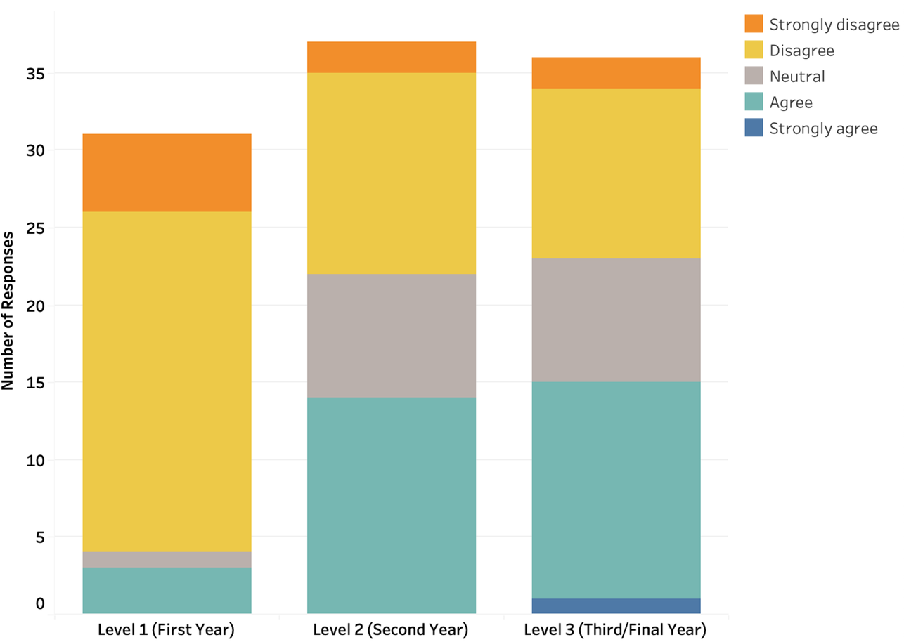
Fieldwork
“I feel not having the fieldtrip at the start of the year made getting to know everyone even harder than it was already with everything online. I feel I have ended the year and still don’t know everyone on the course, which is not great really.”
“Unless you were lucky and happened to live with other geography students, I think it was very hard to make friends on the course, and not having the fieldtrip where we all are together for a week was a big loss.”

Slide 27
Best Practice

Slide 28
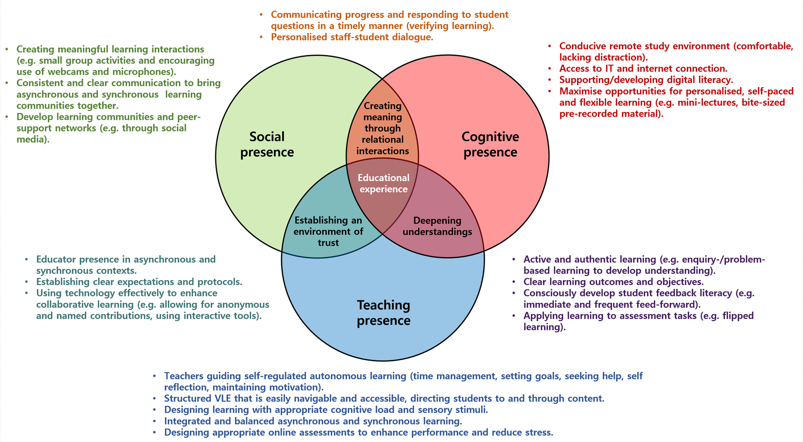
COI Framework: Garrison, 2000; Peacock & Cowan, 2016

Slide 29
Conclusions
Our research has showcased the benefits that online pedagogies can have on student learning, which, when combined with campus-based teaching moving forward, can result in a rich and varied suite of practices and a resilient, digitally enabled, high-quality student learning experience.

Slide 30

Pandemic Pedagogies Paper
West, H., Hill, J., Abzhaparova, A., Cox, W. & Alexander, A. (Accepted), Pandemic Pedagogies: Reflecting on Online Learning using the Community of Inquiry Framework, Journal of Geography in Higher Education.

Slide 31
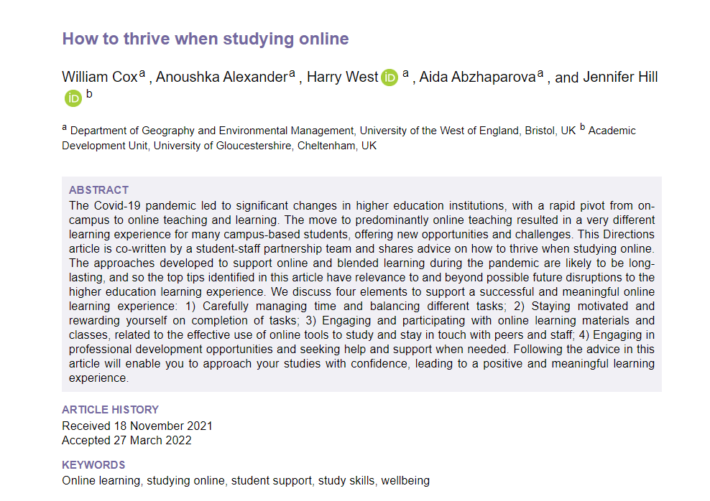
How to Thrive when Studying Online
Cox, W., Alexander, A., West, H., Abzhaparova, A. & Hill, J. (2022). How to Thrive when Studying Online. Journal of Geography in Higher Education, Available at: https://www.tandfonline.com/doi/full/10.1080/03098265.2022.2087214?src=

Slide 32
References
Blackledge, J. (2021). Thoughts on the Future of Higher Education in the UK: A Personal View with a Historical Context. Education Sciences, 11(9), 474.
Blanford, J.I., Bowlick, F., Gidudu, A., Gould, M., Griffin, A.L., Kar, B., Kemp, K., de Roiste, M., deSabbata, S., Sinton, D., Strobl, J., Tate, N., Toppen, F. & Unwin, D. (2022). Lockdown lessons: An international conversation on resilient GI Science teaching. Journal of Geography in Higher Education, 46(1), 7-19.
Bos, D., Miller, S. & Bull, E. (2021). Using virtual reality (VR) for teaching and learning in geography: fieldwork, analytical skills, and employability. Journal of Geography in Higher Education, DOI: https://doi.org/10.1080/03098265.2021.1901867.
Crawford, J., Butler-Henderson, K., Rudolph, J., Malkawi, B., Glowatz, M., Burton, R., Magni, P.A. & Lam, S. (2020). COVID-19: 20 countries’ higher education intra-period digital pedagogy responses. Journal of Applied Learning and Teaching, 3(1), 9-28
Dyer, S., Walkington, H. & Hill, J. (2020). Six months on: What does compassionate and courageous pedagogy look like now? [ONLINE]. Available at: https://teachingfocusedgeesnetwork.wordpress.com/2020/09/05/six-months-on-what-does-compassionate-and-courageous-pedagogy-look-like-now/ (Accessed 07/09/2021).
Fuller, I., Gaskin, S. & Scott, I. (2003). Student Perceptions of Geography and Environmental Science Fieldwork in the Light of Restricted Access to the Field, Caused by Foot and Mouth Disease in the UK in 2001. Journal of Geography in Higher Education, 27(1), 79-102.
Garrison, D.R., Anderson, T. & Archer, W. (2000). Critical inquiry in a text-based environment: Computer conferencing in higher education model. The Internet and Higher Education, 2(2-3), 87-105.
Hodges, C., Moore, S., Lockee, B., Trust, T., & Bond, A. (2020). The difference between emergency remote teaching and online learning. Educause Review, 27(1), 1-9.
Peacock, S, and Cowan, J. (2016). From presences to linked influences within communities of Inquiry. International Review of Research in Open and Distributed Learning, 17(5), 267-283.
Thomas, M. & Bryson, J.R. (2021). Combining proximate with online learning in real-time: ambidextrous teaching and pathways towards inclusion during COVID-19 restrictions and beyond. Journal of Geography in Higher Education, 45(3), 446-464.
Welsh, K.E., Mauchline, A.L., Park, J.R., Whalley, B. & France, D. (2013). Enhancing fieldwork learning with technology: practitioner's perspectives. Journal of Geography in Higher Education, 37(3), 399-415.

