Slide 1
Beyond the Ballot: Girls’ Education, Women’s Welfare and the Bristol Suffragists
Alison McClean
University of the West of England
Alison.McClean@uwe.ac.uk

Slide 2
International Women’s Day 2018, Redmaids’ High School

Slide 3
The Bristol Outrages

Slide 4
Agnes Montgomerie Beddoe
Moved to Bristol in 1858
1866 Suffrage Petition
1868 Bristol and West of England Society for Women’s Suffrage
Kingswood Reformatory for Boys
Red Lodge Reformatory for Girls

Slide 5
Bristol and West of England Society for Women’s Suffrage

Slide 6
Red Maids’ School
Darning Day at Red Maids’ School, Eyre Crowe RA, 1879 (Aberdeen Art Gallery and Museum)

Slide 7
Commission for Endowed Schools
“The educational aim of schools in this class is never high. The life lived in them is for the most part joyless and uninteresting. The children are dressed in hideous costume; they are subject to many restraints of a humiliating kind”.
Westminster Review, April 1873
“They learn the 3 Rs, saying the Catechism and bobbing a curtsey. And thus £3000 is spent, just for the sake of supplying Clifton people with servants (about 15 per annum) warranted to have as little education as possible and to know to ‘keep their place”.
Western Daily Press, 1873

Slide 8
Walter Sampson, A History of Red Maids’ School (1908)
“Miss Roberts was a lady of high intellect and strong character. The rapid rise in the educational state of the school from 1875 to 1879 is very remarkable. During this period French was ordered to be taught the girls in the first class, and the Governors decided to enter girls for the Cambridge Local Examinations (…) 21 certificates were awarded in December 1885, 10 with honours – 4 in the first class. The eldest student-teacher gained a first class senior certificate – a great distinction when it is remembered that 15 only were awarded first class honours out of 1138 senior candidates throughout the country. In addition she received the Royal Geographical Society’s Medal for political geography (..) Miss Roberts had, indeed, done a great work.”
Walter Sampson, A History of Red Maids’ School, 1908

Slide 9
“Lectures for Ladies”
There were, however, large numbers of young women, anxious for opportunities of improvement ,who could never hope to become students (at Oxford and Cambridge) and for their benefit a system of local 'lectures for ladies' was established. We were fortunate in having in Clifton a circle of enlightened men and women by whom the idea was warmly taken up, and for several years courses on a great variety of subjects were given by many eminent men. We elder sisters attended a number of them, as well as our aunts and some of their contemporaries. Of course, such a method of study was very unsystematic; one jumped from one subject to another; but the mental stimulus was of lasting value. We read diligently, and every week handed in papers signed by a number or pseudonym - such was the dread at that time of having your name known in such a connection. There was great excitement when the lists were read out - some who had not attained to the position they hoped for were even known to weep!
Elizabeth Sturge, Reminiscences of My Life (1928

Slide 10
Clifton Association for the Higher Education of Women
Benjamin Jowett, Balliol College, Oxford
University College, Bristol 1874

Slide 11
Susannah and Catherine Winkworth
Dowry Square, Hotwells
Jacob’s Wells Industrial Dwellings, Hotwells

Slide 12
Working Women’s Dwellings
Bishop Street, St Paul’s
Mary Carpenter Memorial Home for Working Girls
Bristol Working Women’s Dwelling House
Notes:
The Loxton Drawing here is one of of the Bishop Street properties operated by Agnes Beddoe – most likely the Bristol Working Women’s Dwelling House. The area around Bishop Street sustained heavy bombing during World War II and Bishop Street has been extensively redeveloped – to the extent that only one of the original houses at the end of the terrace has survived.

Slide 13
Mary Estlin
Bristol and Clifton Ladies Anti-Slavery Society
Ladies National Association
Contagious Diseases Act
National Union of Working Women

Slide 14
Bristol Association of Working Women
Agnes Beddoe
Female Cigar Workers Protective Union
Central Conference of Women Workers 1892
Isabella Ford

Slide 15
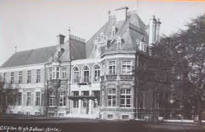
Emily and Elizabeth Sturge
Clifton High School for Girls 1877
Bristol School Board 1880
Redland High School for Girls 1880
Bristol Evening Class and Recreational Society 1884

Slide 16
Enid Stacy
Redland High School
University College, Bristol
NUWSS
Fabian Society
Independent Labour Party
National Union of Gas Workers and General Labourers

Slide 17
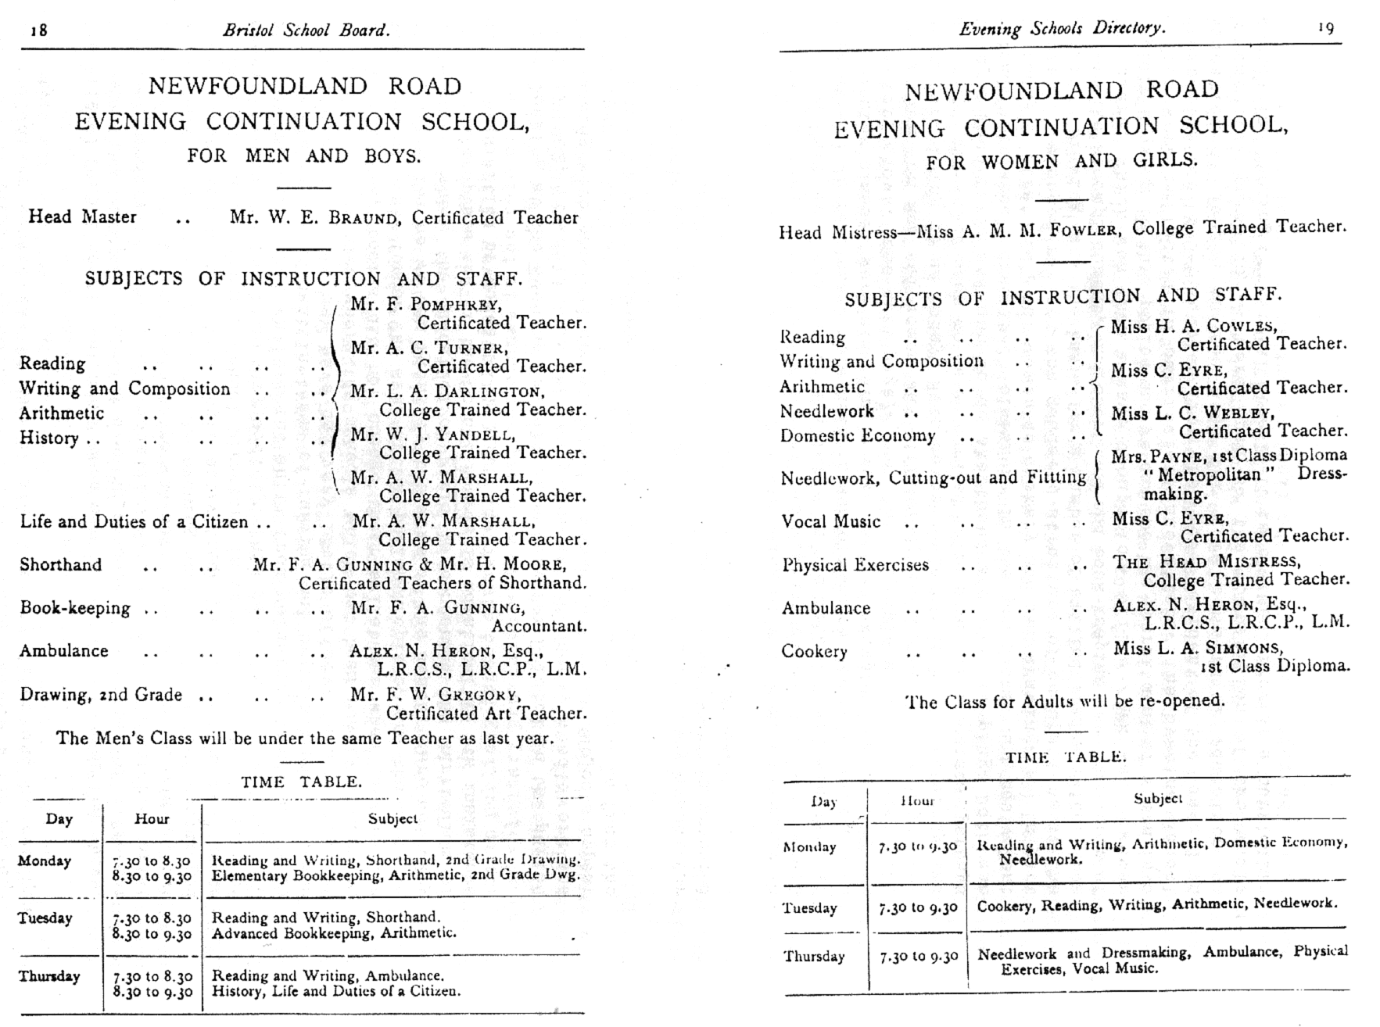
Bristol School Board Evening Classes

Slide 18
Agnes Beddoe: The Final Years
NUWSS Executive Committee
Women’s Social and Political Union (WSPU)
Bradford on Avon Board of Guardians
1908 Hyde Park Demonstration

Slide 19
Bibliography
Elizabeth Bird, Curricular Innovations in Women’s Adult Education 1865-1900, (1985) http://www.leeds.ac.uk/educol/documents/00002647.htm
Lucienne Boyce, The Bristol Suffragettes (2013)
Elizabeth Crawford, The Women’s Suffrage Movement in Britain A Regional Survey (2013)
June Hannam, ‘An Enlarged Sphere of Usefulness’: The Bristol Women’s Movement c.1860-1914, pp.184-209 in Madge Dresser and Philip Ollerenshaw (eds.) The Making of Modern Bristol, (1996)
Ellen Malos, ‘Bristol Women in Action 1839-1919: The Right to Vote and the Need to Earn a Living’, pp.97-128, Ian Bild (ed) Bristol’s Other History (1983)

Slide 20
Bibliography
Moira Martin, Single Women and Philanthropy: A case study of women’s associational life in Bristol, 1880-1914, pp. 395-417, Women’s History Review, Vol.17, No.3, (2008)
Walter Sampson, A History of the Red Maids’ School (1908)
Margaret Shaen, A Memorial of Two Sisters: Susanna and Catherine Winkworth (1904)
Jean Vane, Apparelled in Red: The History of the Red Maids’ School (1984)

