Slide 1




Role of Assistive Devices in Rehabilitation of people with Stroke
Dr Praveen Kumar
Assistive Tech workshop
23rd June 2022
Home | Dhek Bhal

Slide 2
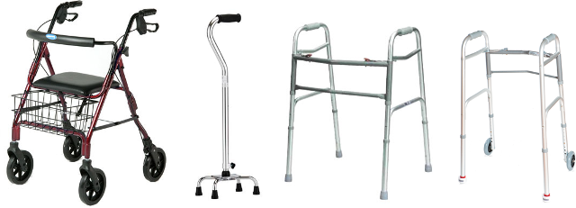
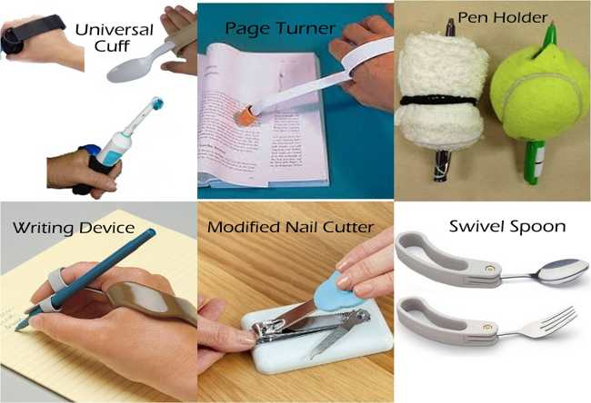
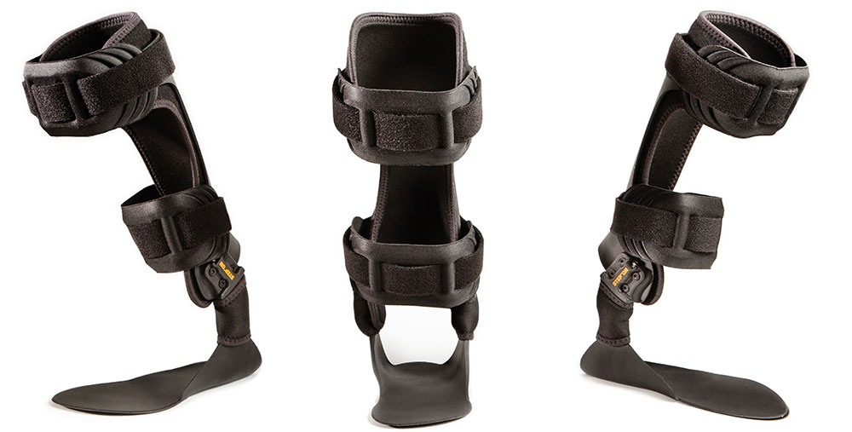
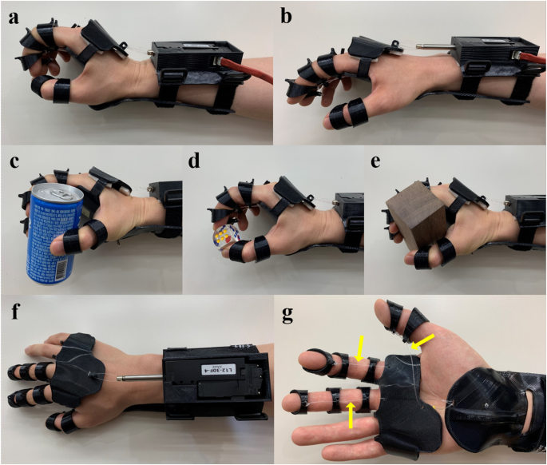
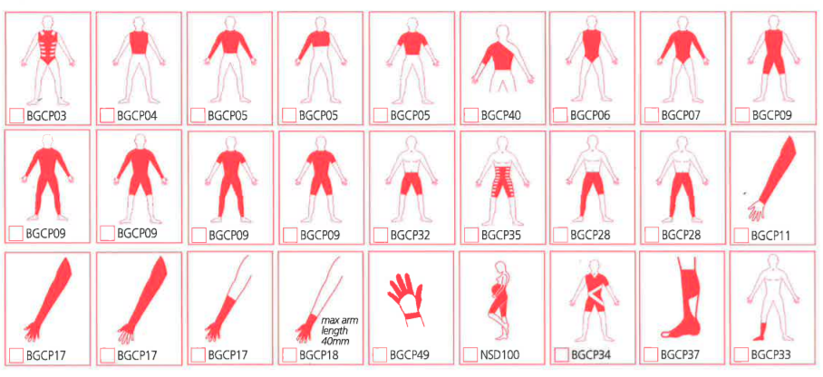
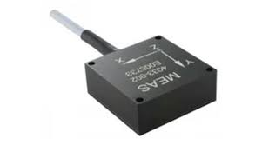
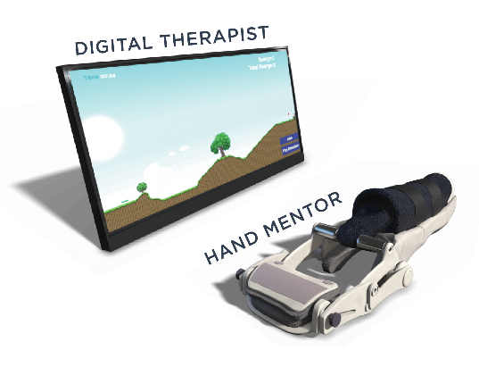
Assistive Devices

Slide 3
Stroke – Background
Incidence
Cost
Clinical features
Clinical Problems

Slide 4
Upper Limb Problems
Weakness
Glenohumeral subluxation (GHS)
Hemiplegic Shoulder Pain (HSP)
Increased Tone – Spasticity
Sensory Impairments
Reduced Functional use

Slide 5
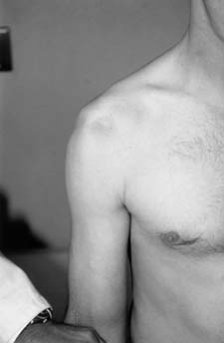
Overview of GHS and HSP
Incidence
Risk Factors
Aetiology
Management
Suethanapornkul et al, 2008, Lindgren 2007, Paci 2007, Stolzenberg, 2012, Vafadar 2015, RCP, 2016,

Slide 6
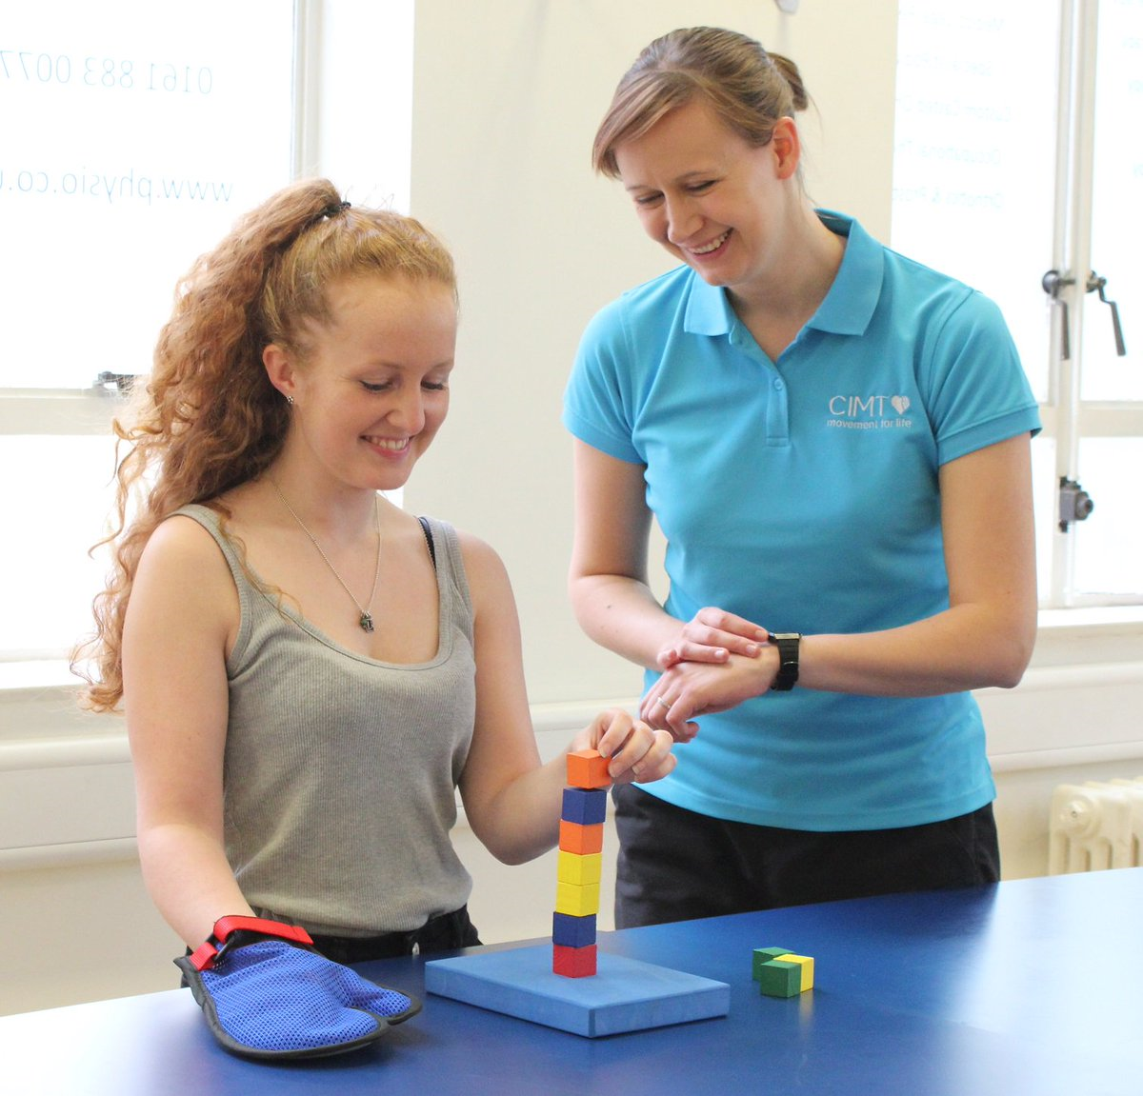
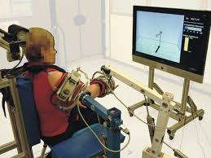
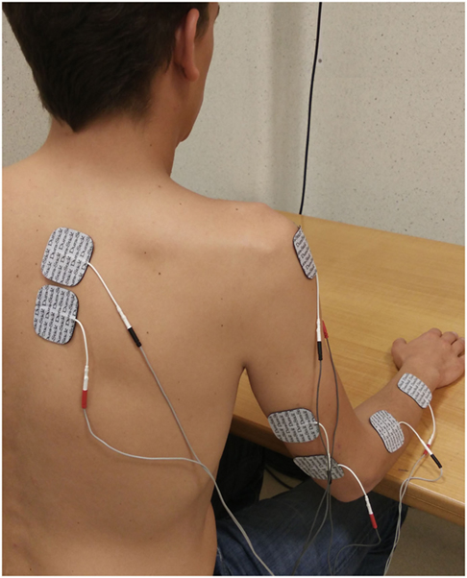
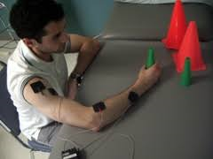
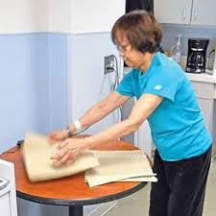
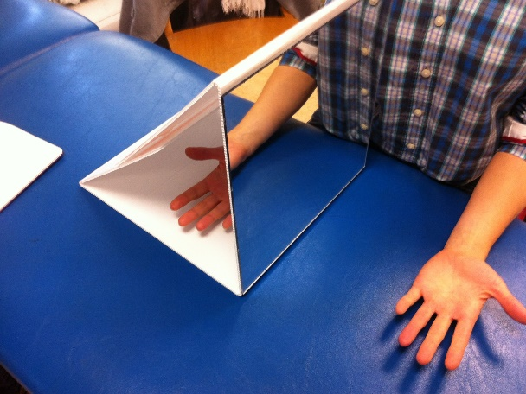
Evidence for UL Rehab in Stroke

Slide 7
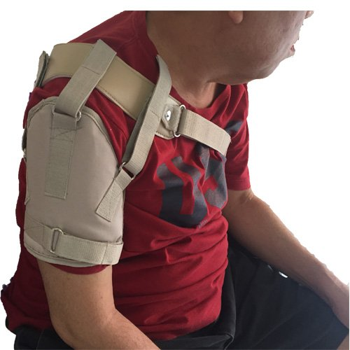
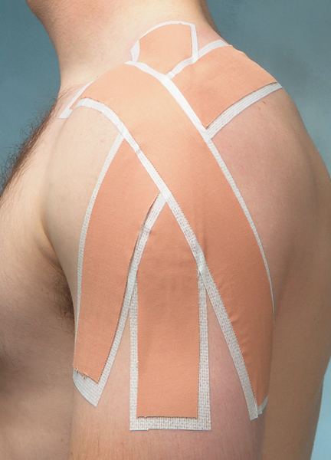
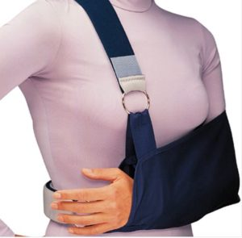
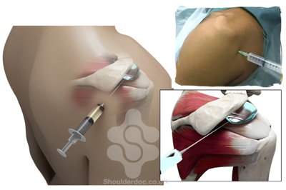
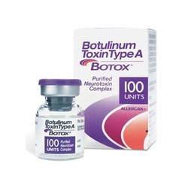
Evidence for UL Rehab in Stroke

Slide 8
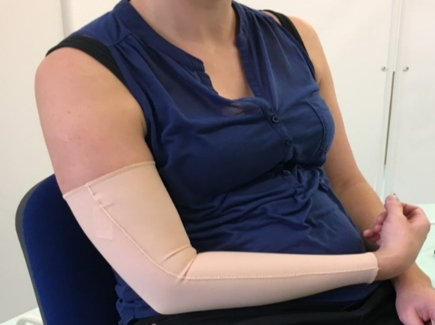

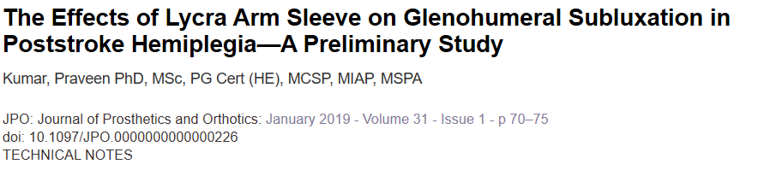
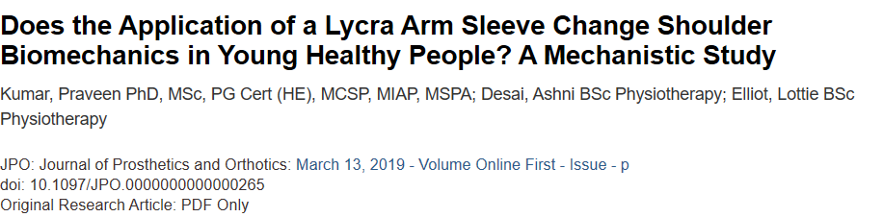
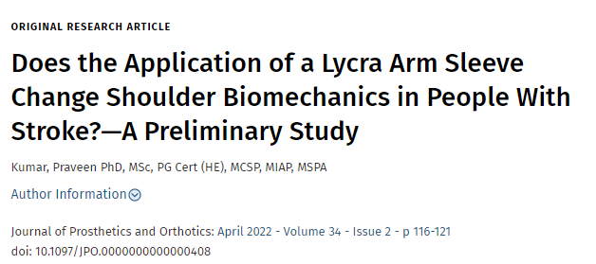
Lycra Arm Sleeve

Slide 9




Acceptability of Lycra Arm Sleeve in people with sub-acute stroke: patients’, carers’ and clinicians’ perspectives.
*
**

Slide 10
AIM
The primary aim of this study was to explore patients’, carers’ and staff perceptions, regarding acceptability of the use of Lycra sleeves over a three month period in the sub-acute phase (up to 6 months from the date) of stroke.

Slide 11
Methods
Design: A prospective cohort study design
Settings: In-patient rehabilitation.
Evaluation points: Baseline and at three months.
Intervention: Patients were randomly divided into to immediate or delayed (received sleeve at three months) groups.
Training: Staff, patients and carers received training on application of sleeve.
Ethical Approval: South West- Frenchay Research Ethics Committee (REC reference: 17/SW/0173)

Slide 12
Acceptability Questionnaire
Acceptability of the sleeve was assessed using a questionnaire
Separate questionnaires were developed
Patients wore the sleeve for 3 months and maintained a dairy / log
The questionnaire consisted of questions on a 7 point Likert Scale with 1- Entirely disagree to 7- Entirely agree categories.

Slide 13
Results

Slide 14
Demographic characteristics of patients

Slide 15
Adverse Events
Of 27 participants, 24 had no adverse effects (88%) and three (12%) reported swelling in the hand/wrist.
Staff groups noted slight temporary redness (therapy staff n=2 (4%)
Discomfort at the wrist (nurses n=2) (5%)
Itchy sensation (nurses=1), although these were not reported by patients.
Notes:
None of these caused discontinuity of wearing the sleeve.

Slide 16
Log / Diary
20 participants (74%) returned log-sheets, of which only 4 (20%) had entries for the full 90 days (i.e. worn every day).
The remaining 16 participants had entries for a median of 55 days with a range of 10-84 days.
Across all returned log-sheets, mean duration of daily wear was 11 hours (range = 8-15 hours).

Slide 17
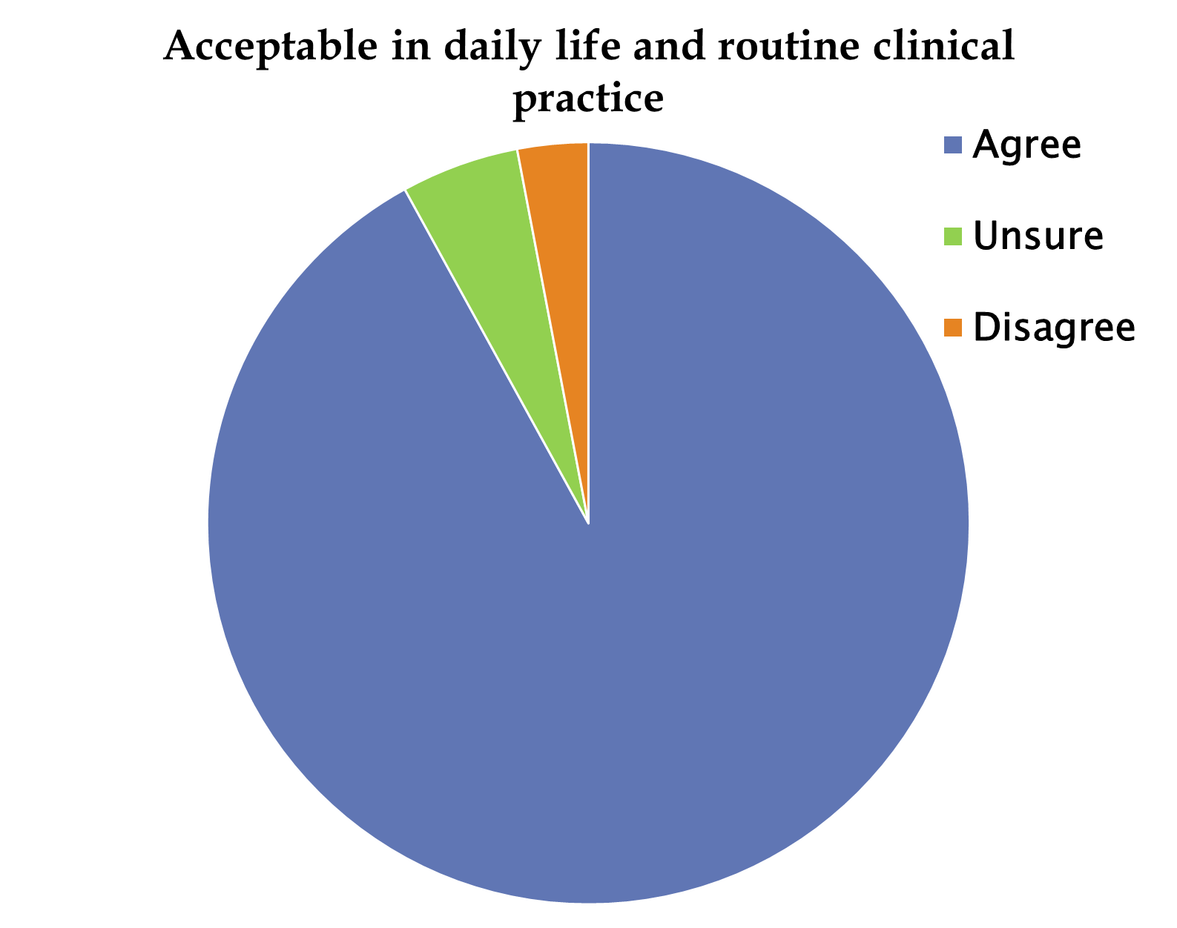

Slide 18
Patients feedback
63% (n=17/27) of patients felt the sleeve made them more aware of the affected arm
67% (n=18/27) felt minimal or no shoulder looseness when the sleeve was applied.
70% (n=19/27) of patients found the sleeve to be supportive
60% (n=16/27) of patients were willing to wear sleeve for longer term.
92% (n=24/26) of patients felt that the sleeve allowed them to participate in rehabilitation

Slide 19
Therapists Feedback
28% (n=13/46) of therapists felt that the sleeve improved the resting alignment and 54% (n=25/46) were neutral about this
37% (n=17/46) of therapists did recommend longer term use, while 49% (n=23/46) were neutral.
Seventy percent (n=32/46) of therapists were neutral about the sleeve improving patients engagement in rehabilitation.

Slide 20
Conclusion
The use of a Lycra sleeve, as an adjunct to therapy, is acceptable to Patients, carers, nurses and therapists and is not a burden or hindrance to nursing care or therapy in either hospital, nursing home or home environments.
Understanding the purpose of the sleeve, providing basic training and defining potential benefit would be necessary in the larger scale study.
Maintaining diary / log was a big challenge

Slide 21
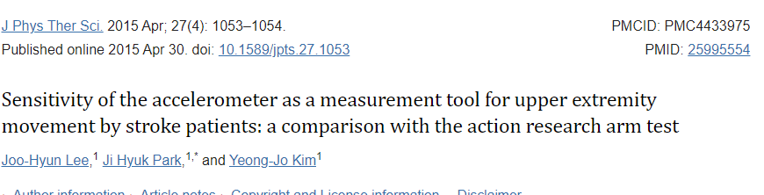
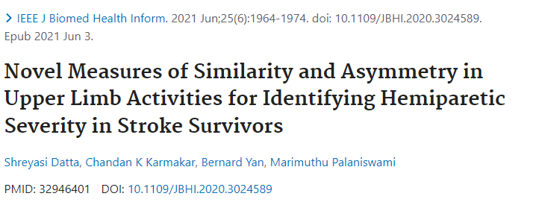
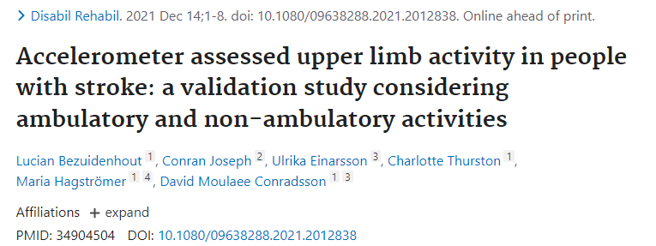
Accelerometer in Stroke Rehabilitation

Slide 22
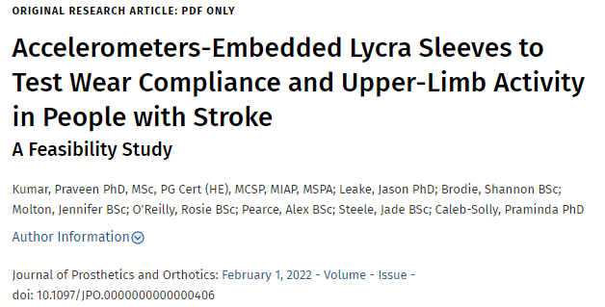

Slide 23
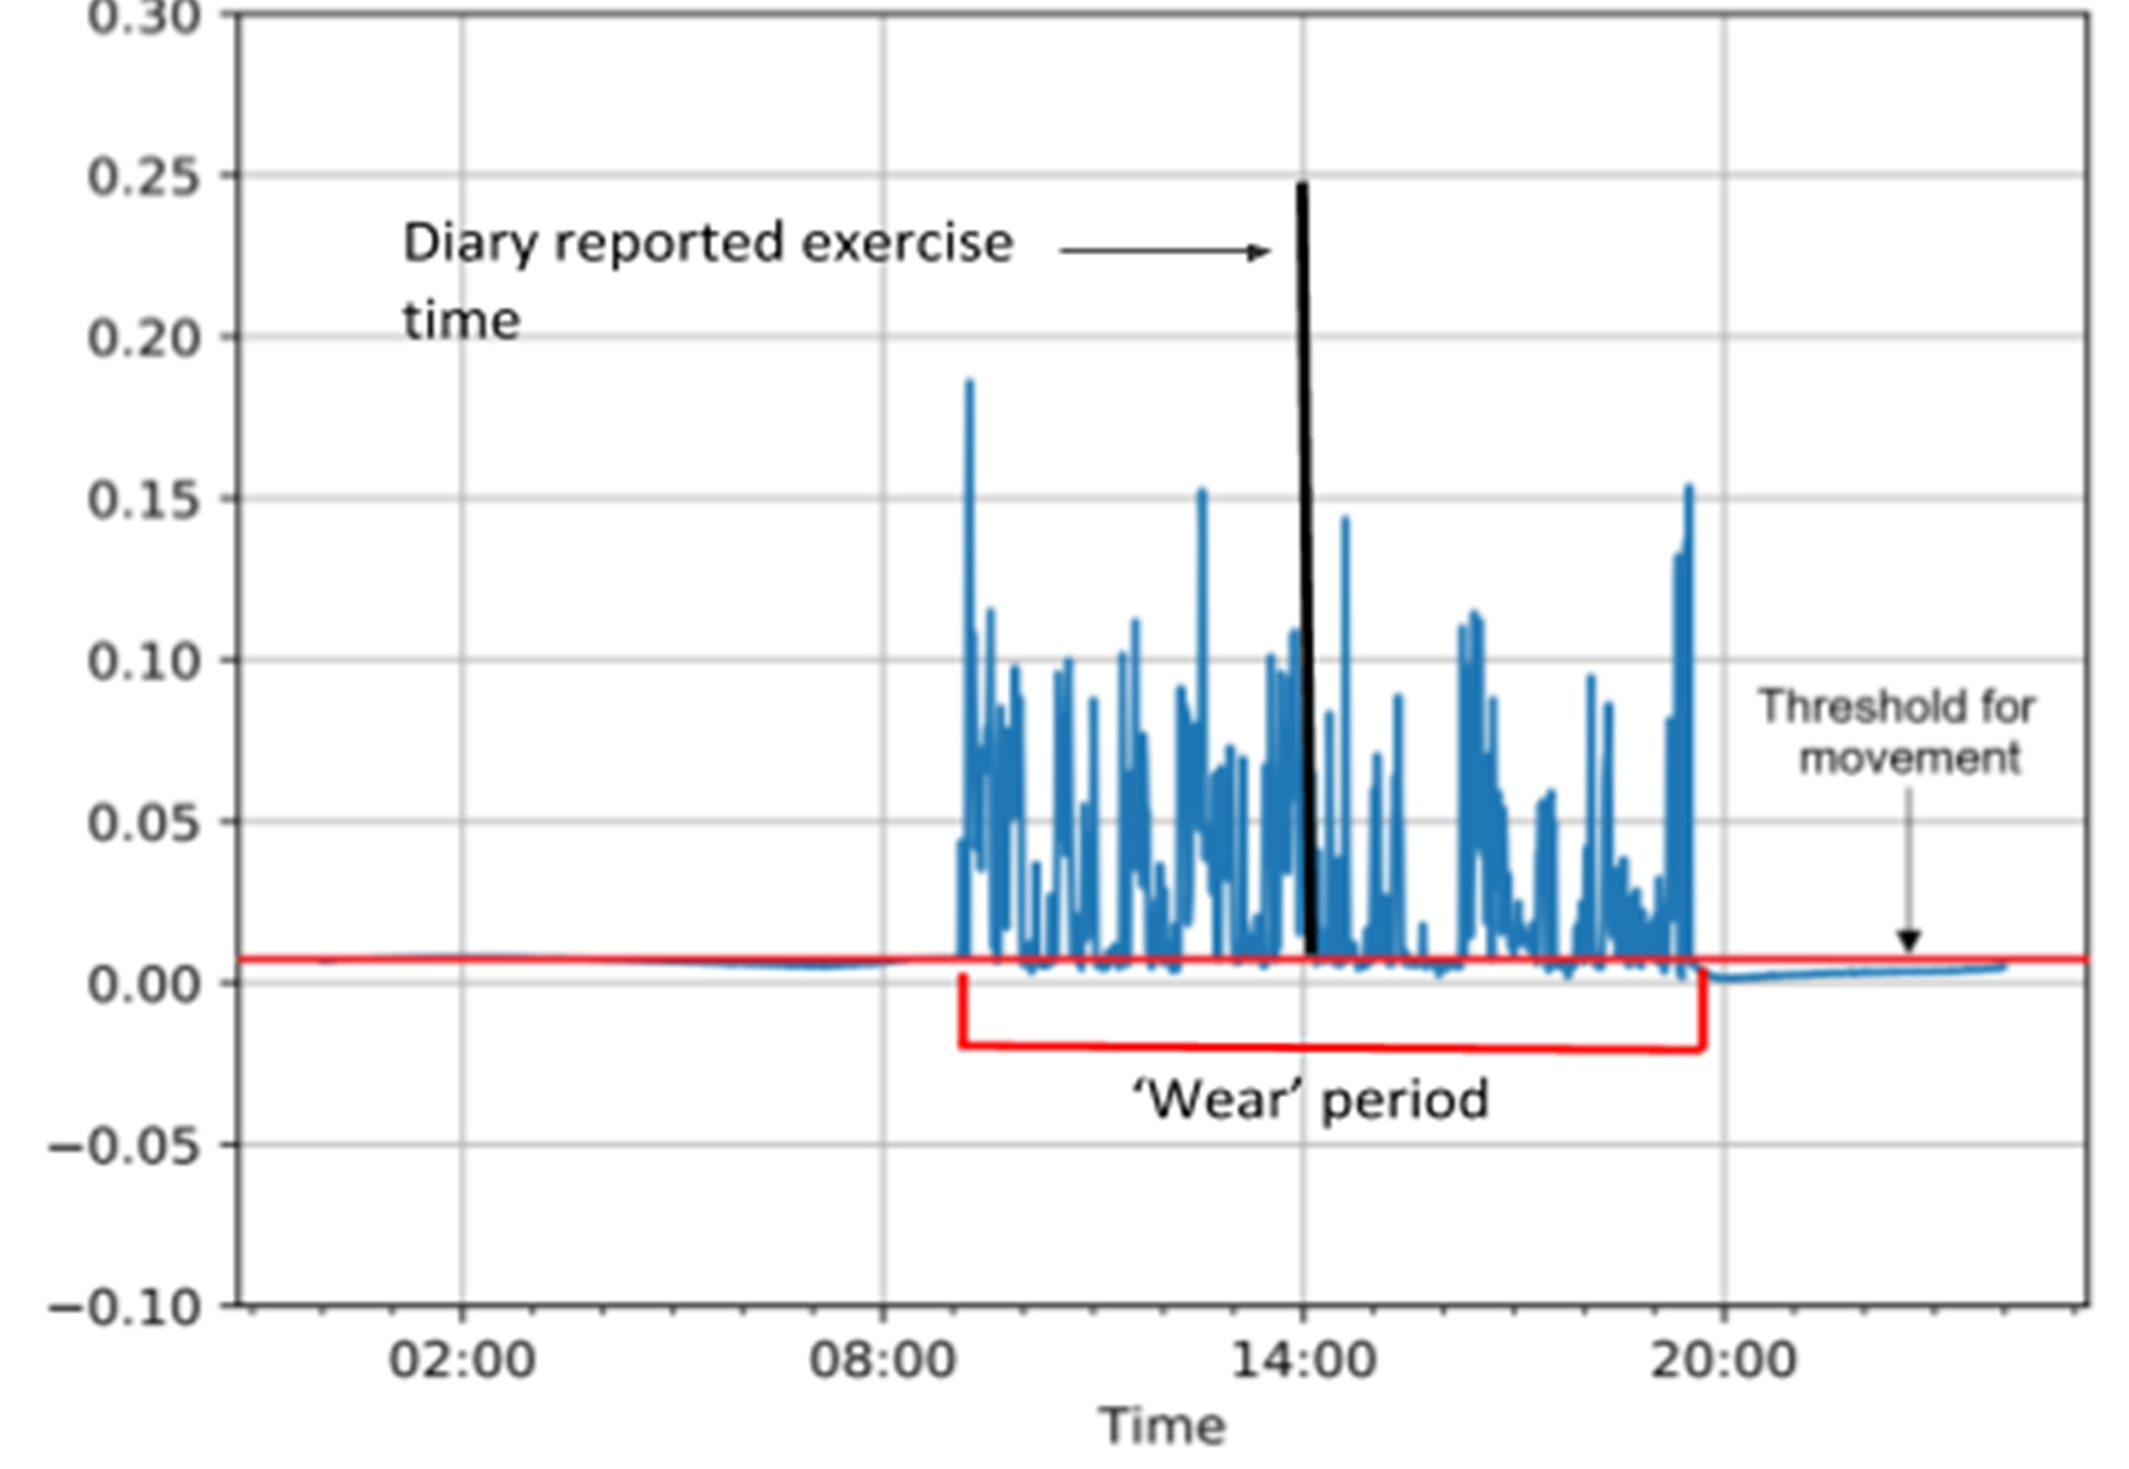

Slide 24
Future Work
Enhancing self-directed arm exercise practice using GripAble gaming device integrated with wearable (accelerometer and Lycra arm Sleeve) technologies in chronic stroke survivors
                Professor Praminda Caleb-Solly
Virginia.RuizGarate@uwe.ac.uk
Home | Dhek Bhal

Slide 25
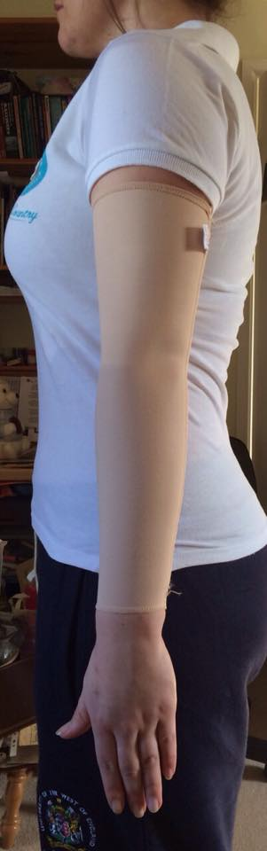
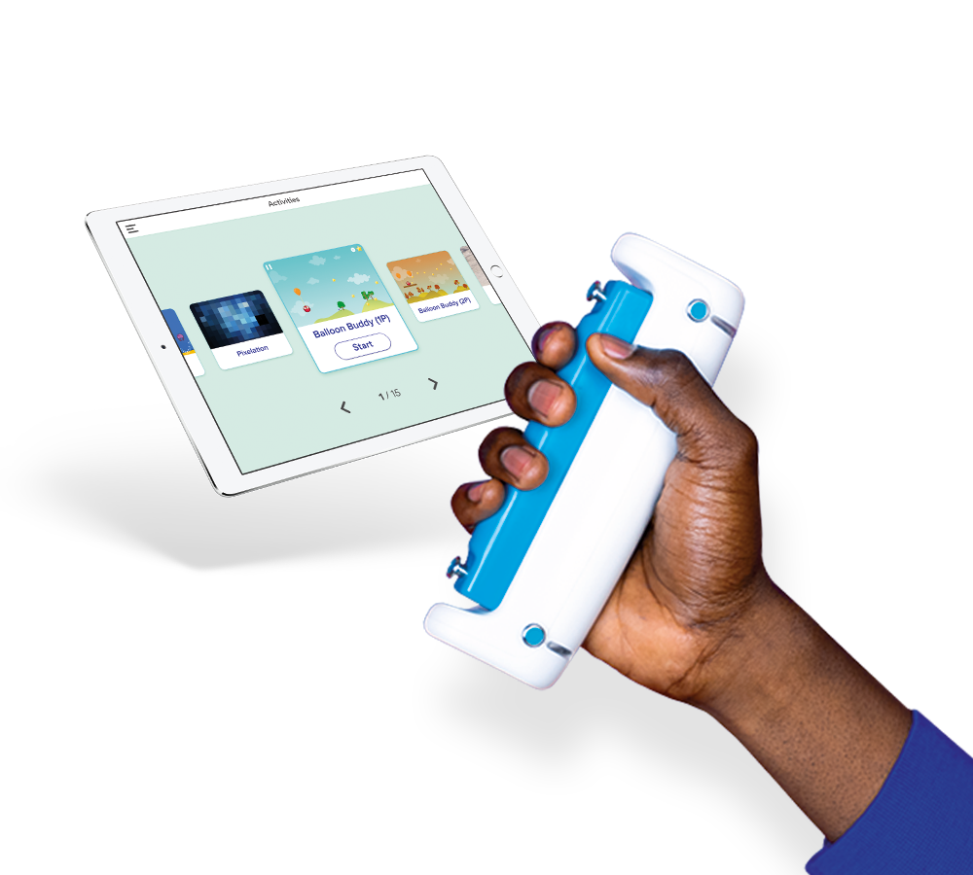
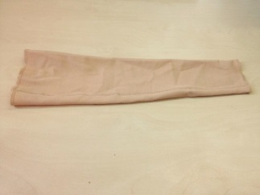



Combining Assistive Devices in Upper Limb Stroke Rehabilitation
Lycra Arm Sleeve
Accelerometer - Sensors

Slide 26
Acknowledgement / Team
Rob Jones
Chris Easton
Dr Rosemary Greenwood
Dr Ailie Turton
Dr Paul White
Dr Mary Cramp
Professor Praminda Caleb-Solly
Jason Leake
Undergraduate students – BSc Physiotherapy (UWE)
Rebecca Sheehy - Bristol After Stroke
Elinor Griffith - Research Development Unit, UHB for support
Amy Steele, Mairead Osborn (UHB) –for help with initial set up of the study
Patients for Participation
Clinical colleagues - Physiotherapy, Occupational therapy, Therapy assistants at the acute, rehab units and ESD team for help with Recruitment
Nursing staff for help with application of sleeve and participation

Slide 27


Slide 28


Praveen.Kumar@uwe.ac.uk
Twitter: @KumarDrP

Slide 29
References
Gracies, J., Marosszeky, J.E., Renton, R., Sandanam, J., Gandevia, S.C. and Burke, D. (2000) Short - term effects of dynamic lycra splints on upper limb in hemiplegic patients. Archives of Physical Medicine and Rehabilitation [online].
Kendall FP, McCreary EK, Provance PG. (1993) Muscles Testing and Function. Williams and Wilkins, Baltimore.
Lannin, N.A. (2004) Reliability, validity and factor structure of the UL subscale of the Motor Assessment Scale (UL-MAS) in adults following stroke. Disability Rehabilitation.26 (2): 109-116
Kumar P, Mardon M, Bradley M, Gray S, Swinkels A (2014) Assessment of glenohumeral subluxation in post-stroke hemiplegia: Comparison between ultrasound and fingerbreadth palpation methods. Physical Therapy, 94 (11):1622-31
Matthews, MJ., Payne, C. and Watson, M. (2011) The use of a dynamic elastomeric fabric orthosis to manage painful shoulder subluxation: A case study. Journal of Prothetics and Orthotics [online]. 23 (3), pp.155-158
Royal College of Physicians, National Clinical Guidelines for Stroke. 2016 [online]. Available from https://www.strokeaudit.org/SupportFiles/Documents/Guidelines/2016-National-Clinical-Guideline-for-Stroke-5t-(1).aspx
Stolzenberg D, Siu G, Cruz E (2012)Current and future interventions for glenohumeral subluxation in hemiplegia secondary to stroke. Topics in Stroke Rehabilitation. 19(5):444-56.
Suethanapornkul, S., Kuptniratsaikul, P.S., Kuptniratsaikul, V., Uthensut, P., Dajpratha, P. and Wongwisethkarn, J. (2008) Post stroke shoulder subluxation and shoulder pain: a cohort multicenter study. J Med Assoc Thai. 91:885-93.
Turner-Stoke, L, Jackson D (2006) Assessment of shoulder pain in hemiplegia: Sensitivity of the ShoulderQ. Disability and Rehabilitation, 28:6, 389-395
Vafadar AK, Cote JN, Archambault PS (2015) Effectiveness of functional electrical stimulation in improving clinical outcomes in the upper arm following stroke: a systematic review and meta-analysis .BioMed Research International. doi: 10.1155/2015/729768. Epub 2015 Jan 22.
Watson, M.J., Crosby, P. and Matthews, M. (2007) An evaluation of the effects of a dynamic lycra orthosis on arm function in a late stage patient with acquired brain injury. Brain Injury. 21 (7):753-761

