Slide 1
Hemiplegic Shoulder Pain – Assessment and Treatment 30 minutes
Presented by
Dr Praveen Kumar
Senior Lecturer in Physiotherapy
11th and 12th July 2022

Slide 2
Aims of the workshop
Introduce key risk factors for HSP
Refer to MSK / physical assessment of HSP
Introduce the concept of Myofascial Trigger points – Assessment and treatment – Practical
Electrical stimulation to Rotator cuff muscles – Practical

Slide 3
Conclusions: Risk factors
Patients with shoulder pain @ 4 months are at risk of having persistent shoulder pain @ 1 year
Left sided hemiplegia
Pain reported Frequency
Decreased Passive ROM – shoulder abduction @ 4 months

Slide 4
Forty patients within 2 weeks of stroke with a very weak upper limb (<4/6 Item 6 of Motor Assessment Scale)
Upper limb activity (Items 6, 7, and 8 of Motor Assessment Scale),
shoulder subluxation (vertical distance),
shoulder pain (visual analogue scale),
and upper limb range of motion were measured at 2, 6, and 12 weeks poststroke.
Key Findings
Shoulder pain during movement at 2 weeks predicted shoulder pain during movement at 6 and 12 weeks after stroke (p = 0.05).

Slide 5
HSP and Muscle Weakness
Variable | Grade 0 (n=11) | Grade 1 (n=14) | Grade 2 (n=9) | Grade 3 (n=11) | Grade 4 (n=10) | P value
Pain | 6 (55%) | 10 (71%) | 5 (56%) | 9 (82%) | 2 (20%) | 0.050
N = 55

Slide 6
Hemiplegic shoulder pain Summary – Predictors of HSP
Shoulder pain during movement at 2 weeks is a possible predictor of future shoulder pain
Patients with Left sided hemiplegia
Pain reported Frequency
Decreased Passive ROM – shoulder abduction @ 4 months
Patients with <3 MRC strength are likely to have RCT and HSP

Slide 7
MSK assessment
Range of movement
Strength
Shoulder girdle assessment
HSP – specific shoulder Q
Special tests
Palpation / Trigger points

Slide 8
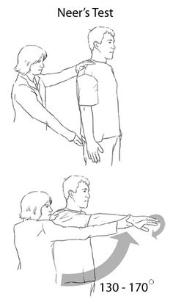
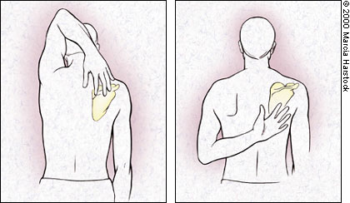
Hand Behind Head and Hand Behind Back
Adey-Wakeling 2014, Adey-Wakeling 2016

Slide 9
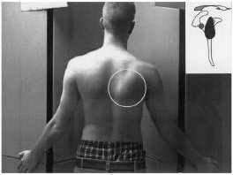
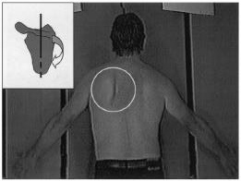
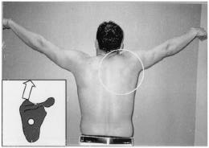
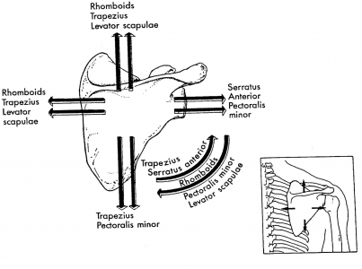
Scapula dyskinesis
Type 2 (medial boarder)
Type 1 (inferior angle)
Type 3 (superior angle)
Note: patients can present with a combination of these patterns
(Kibler and Sciascia, 2016)
A picture to help you out

Slide 10
Myofascial trigger points
Trigger points are regions of the body surface over the muscles that are painful to palpation
TrP diagnosis can be conducted according to Travell and Simons , 1998 :
1) palpable taut band in a skeletal muscle;
2) hyperirritable tender spot in the taut band;
3) local twitch response elicited by the snapping palpation of the taut band; and
4) presence of referred pain in response to TrP compression

Slide 12
Treatment
Trigger point release
Dry needling
Electrical needling
Electrical stimulation to Rotator cuff muslces

Slide 13
Trigger Points Release
a visual analogue scale (VAS)
pressure pain thresholds
A significant negative association
(rs = −0.525; P = 0.049) between the increase in PPT over the
supraspinatus muscle and the decrease in pain was found:
the greater the decrease in pain, the greater the increase in pressure pain threshold.
Notes:
TrP diagnosis was conducted according to Simons et al. (1999): 1) palpable taut band in a skeletal muscle; 2) hyperirritable tender spot in the taut band; 3) local twitch response elicited by the snapping palpation of the taut band; and 4) presence of referred pain in response to TrP compression (Fig. 1).
over the levator scapulae (2 cm superior to the superior angle of the scapula bone), supraspinatus (middle point over the fosa of the scapula), infraspinatus (middle muscle belly), pectoralis major (middle point under the clavicle bone),
Patients also received a neuromuscular technique (longitudinal stroke) (Chaitow, 2010) over the affected muscle, particularly supraspinatus, infraspinatus, and pectoralis major muscles. The thumb of the therapist was placed over the taut band and longitudinal strokes were applied slowly with moderate pressure which was not painful for the patient. This technique has been found to be effective for reducing TrP pressure sensitivity (Ibáñez-García et al., 2009).
The mean duration of shoulder pain history was 8.7 ± 4.8 months (95%CI 5–12.4), and the mean intensity of pain experienced during arm active elevation was 5.1 ± 1.9 (95% CI 3.9–6.4).

Slide 15
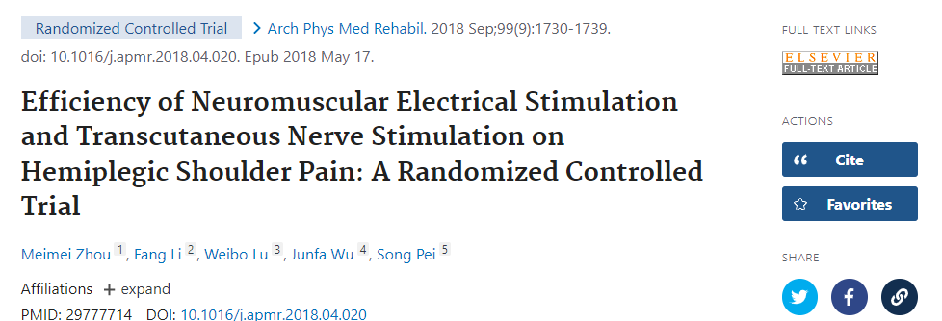

Slide 16
References
Li, Lihui PhD*,†,‡; Stoop, Rahel MSc*,§; Clijsen, Ron PhD*,§,∥; Hohenauer, Erich PhD*,§,∥,¶; Fernández-de-las-Peñas, César PhD#,**; Huang, Qiangmin PhD‡; Barbero, Marco PhD* Criteria Used for the Diagnosis of Myofascial Trigger Points in Clinical Trials on Physical Therapy, The Clinical Journal of Pain: December 2020 - Volume 36 - Issue 12 - p 955-967
doi: 10.1097/AJP.0000000000000875
.Travell, J. G. & Simons, D. G. Myofascial pain and dysfunction: the trigger point manual. (Lippincott, Williams & Wilkins, 1998).
Travell and Simons' Myofascial Pain and Dysfunction: The Trigger Point Manual Hardcover – Illustrated, 25 Feb. 2013

