Slide 1
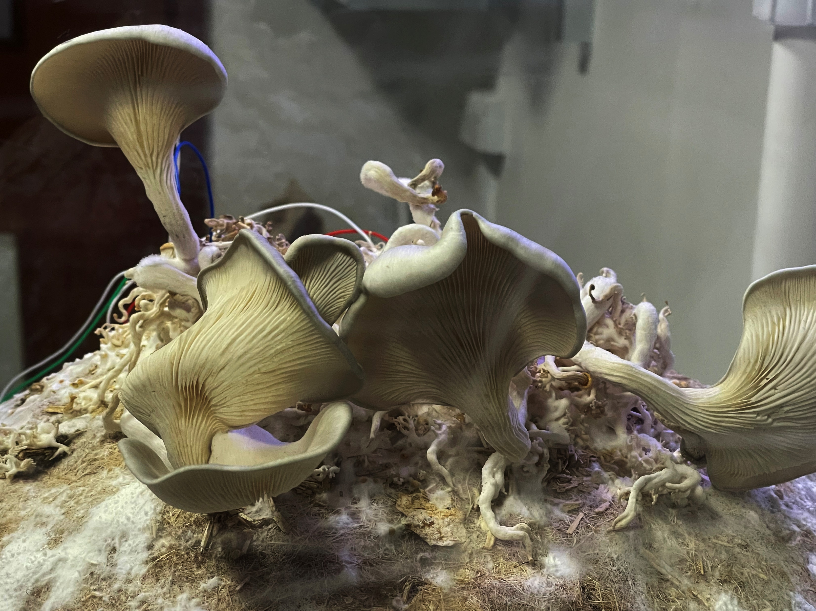

Post- Apocalyptic Computing workshop
Living wearables & architecture
Anna Nikolaidou | anna.nikolaidou@uwe.ac.uk
Architect | Senior Lecturer
Unconventional Computing Lab
University of the West of England
Unconventional Computing Lab

Slide 2
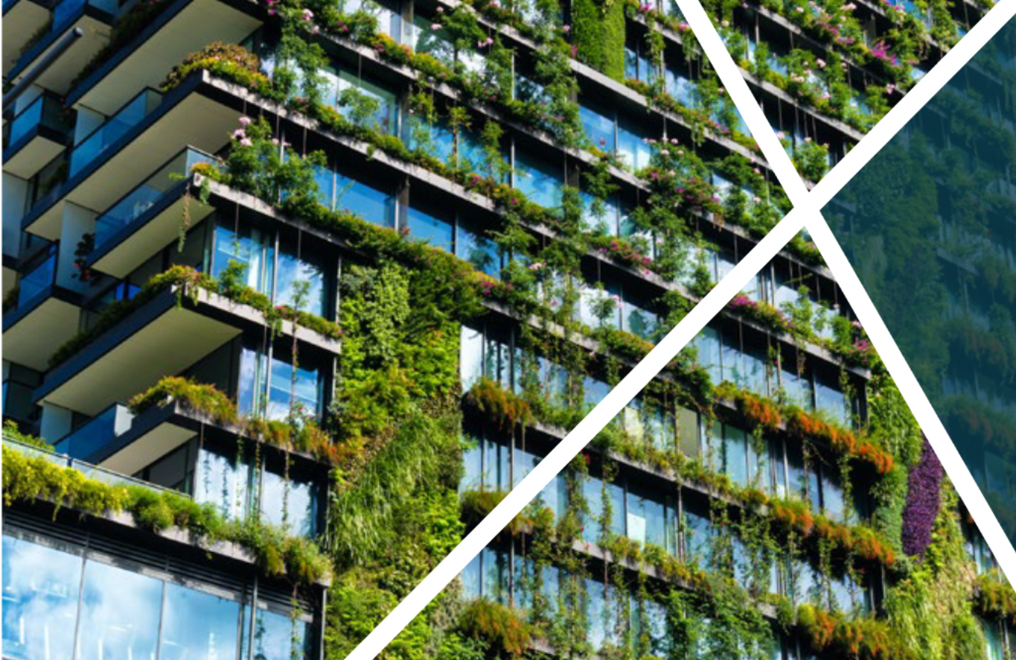
Depletion of natural resources In 2019, the world generated 53.6 metric tons of e-waste, an average of 7.3 kg per capita.
On average, the total weight of global Electronic Equipment waste consumption increases annually by 2.5 million metric tons.
Occupants of buildings & the space that they occupy are often considered as separate entities
Re-evaluate the relationship between the human body and the built environment
Develop sustainable alternatives
to conventional materials
Facilitate the exchange of information between users & buildings
Wearables as second skin to the human body and report the presence of various environmental, chemical and mechanical stimulants in the environment.
UN Environment Programme & Global Alliance for Buildings and Construction (2020) 2020 Global Status report for buildings and construction

Slide 3
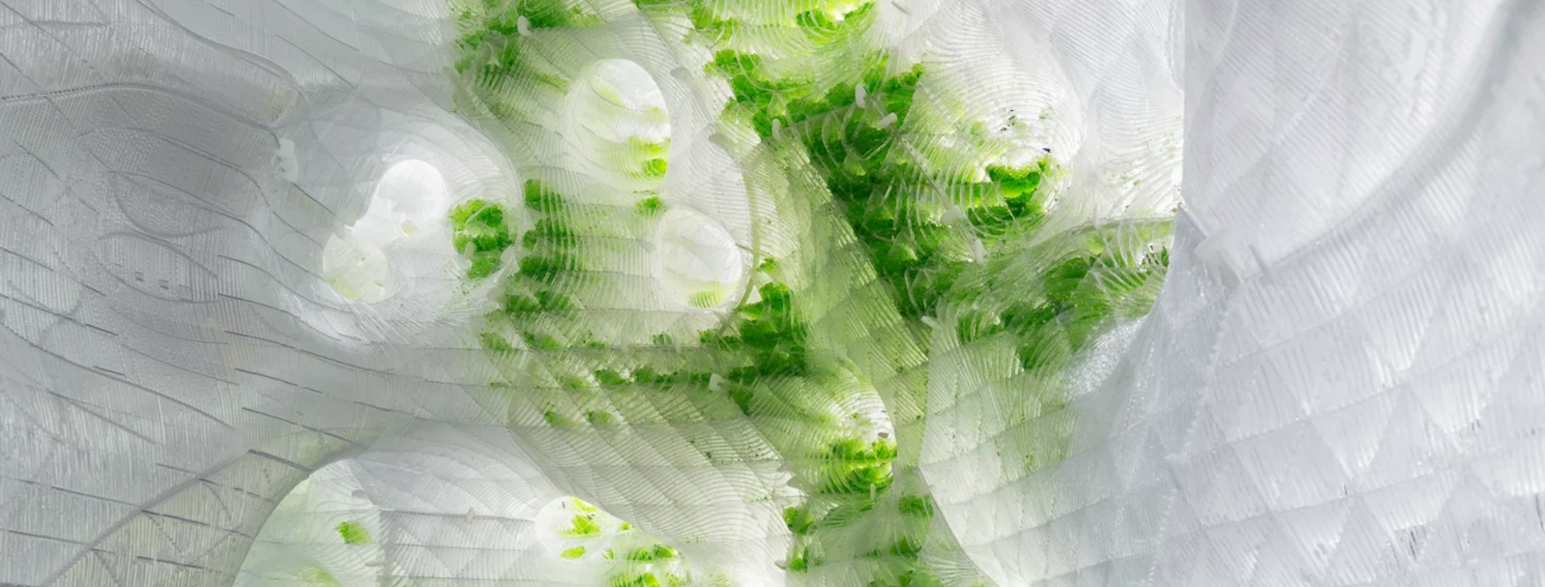
“There is untapped value in bringing the bio-intelligence of natural systems into cities, turning buildings into living machines that produce energy, store CO2 and clean the air. To achieve that we need to think about the living world as a part of the current digital revolution, so nature becomes part of a new bio-smart infrastructure.”
Dr. Marco Poletto
EcoLogic Studio, Photosynthetica 2019

Slide 4
Biological intelligence
3 principles of animacy
active | change their properties or perform actions, often by taking energy, material or nutrients from the environment
adaptive | in sensing changes in their environment and responding through action to a specific prompt so that they maintain or promote their function
autonomous | select an appropriate response to stimuli without any kind of external control or guidance and showing versatility in combining various inputs to generate a suitable behaviour from a diverse repertoire (Royal Society, 2021)
Establish communication protocols between user & building | exchange of data
Self-sustainable |self-regenerating| self-regulating |cost-effective |reduced environmental impact | simple maintenance
The Royal Society (2021) Animate Materials [online]. London: The Royal Society. Available from: royalsociety.org/animate-materials.

Slide 5
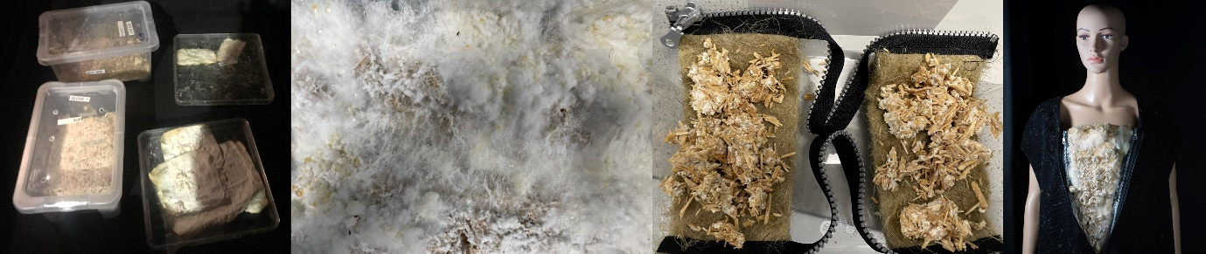
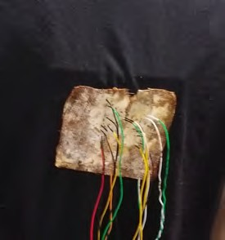
Fabrication of wearables
culture Pleurotus Ostreatus on hemp bedding substrate | spread colonized substrate on hemp fabric fragments | integrate colonised fabric into a cloth | record electrical activity of fungal pads

Slide 6
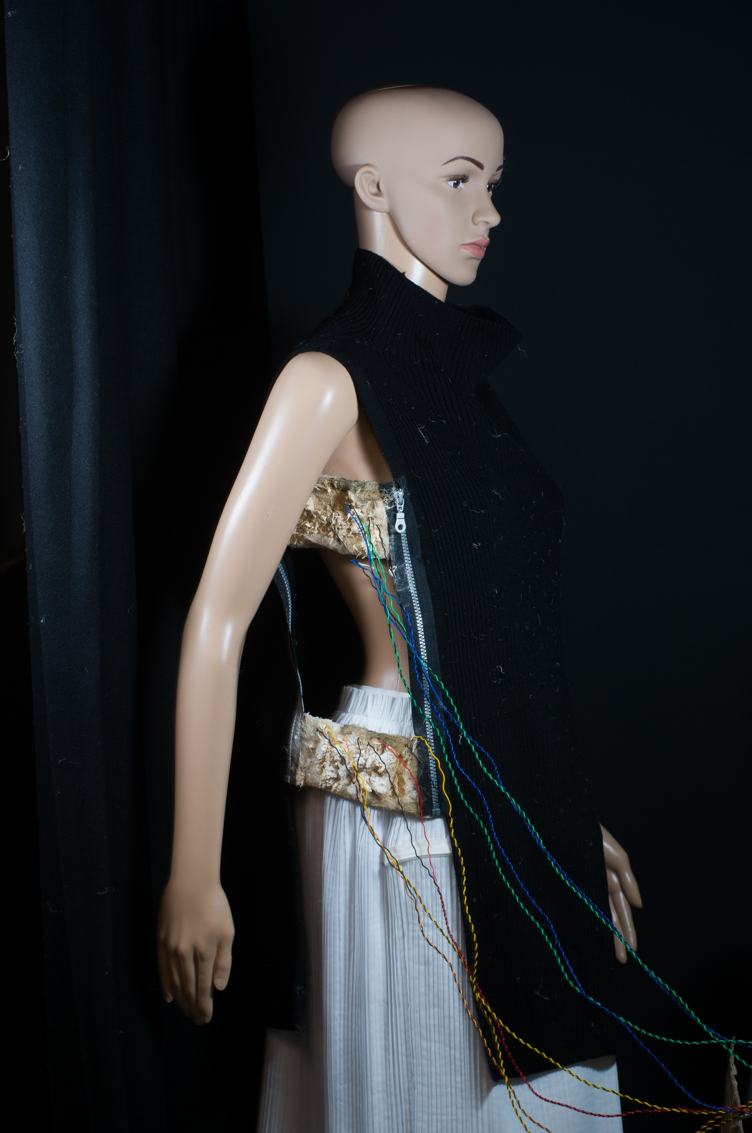
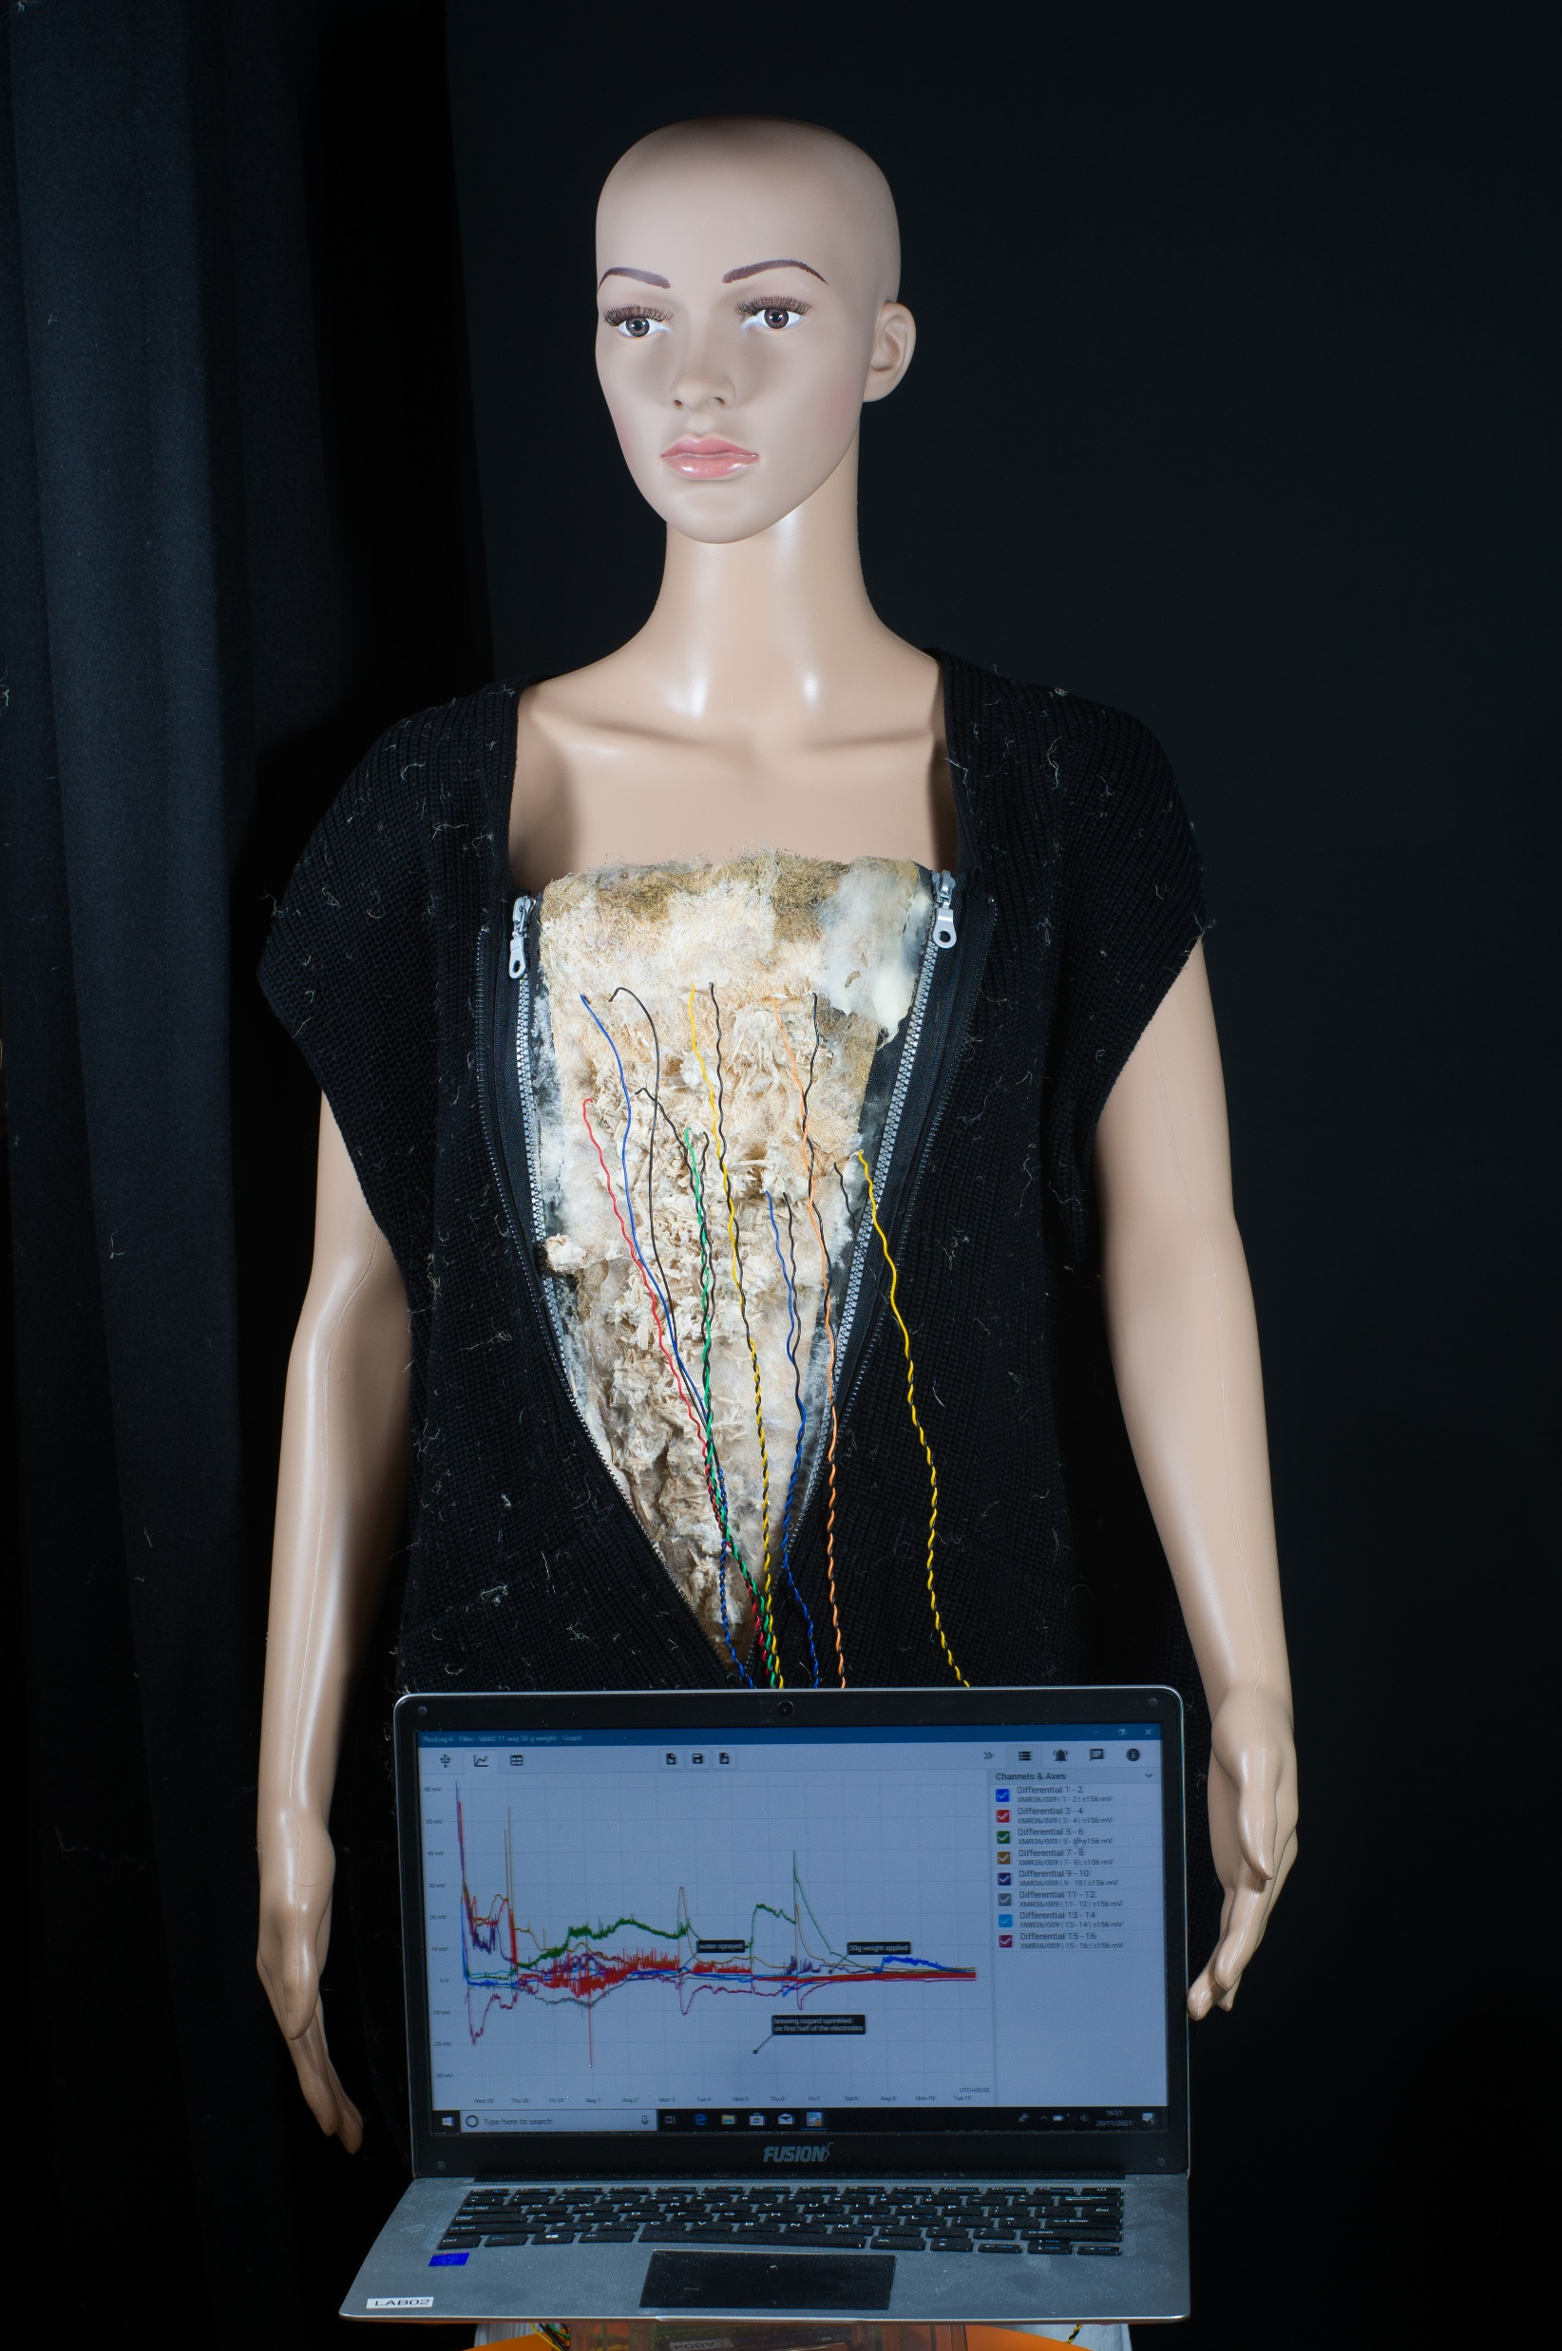
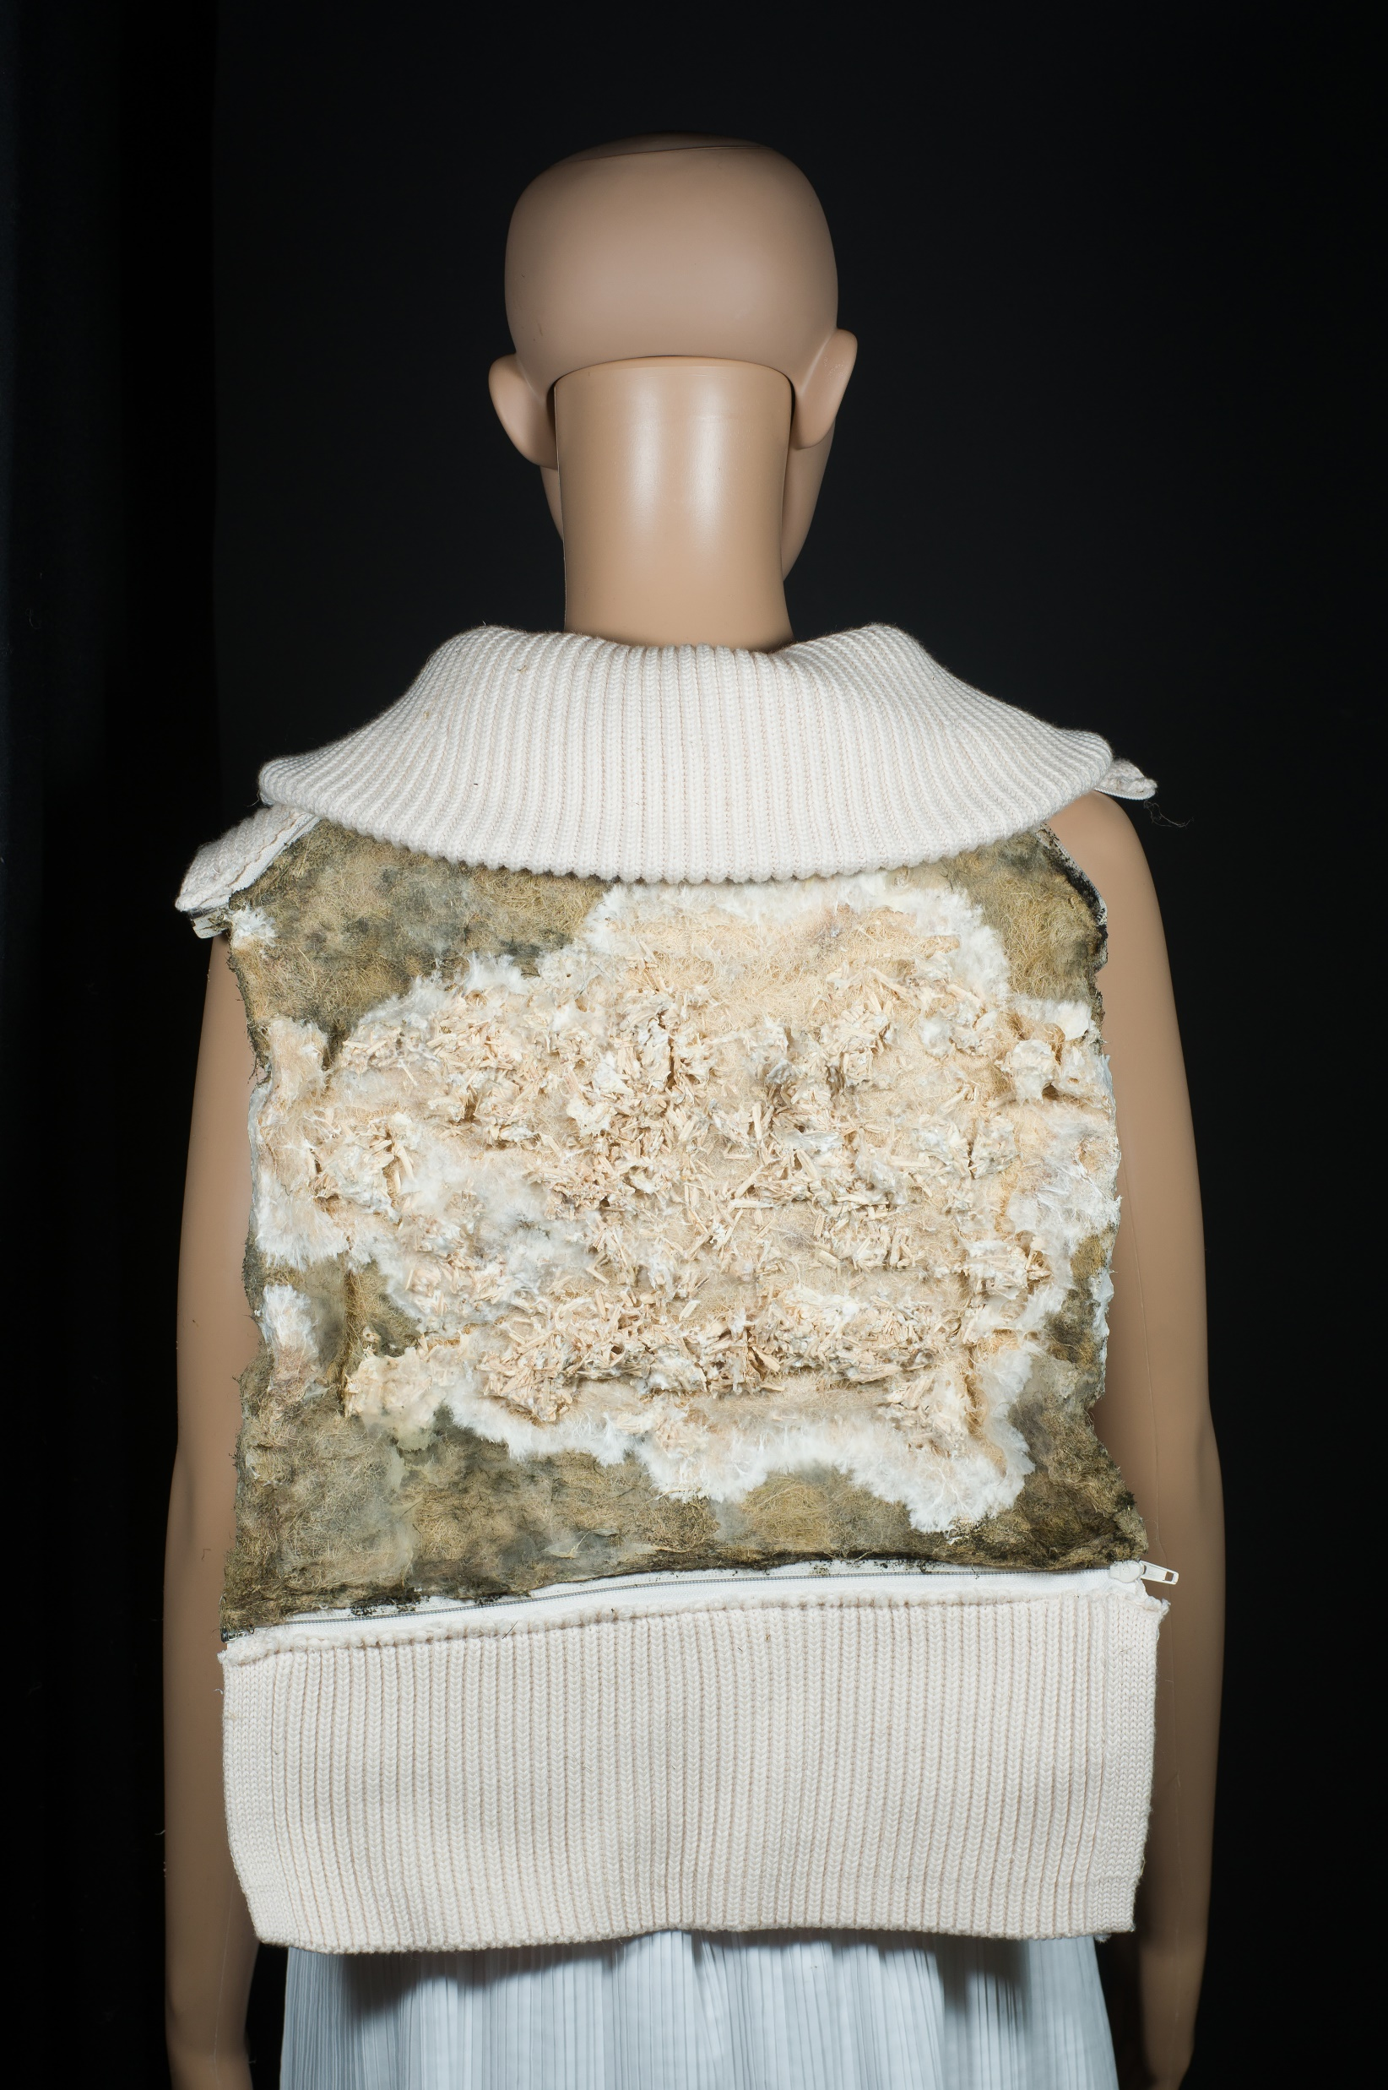
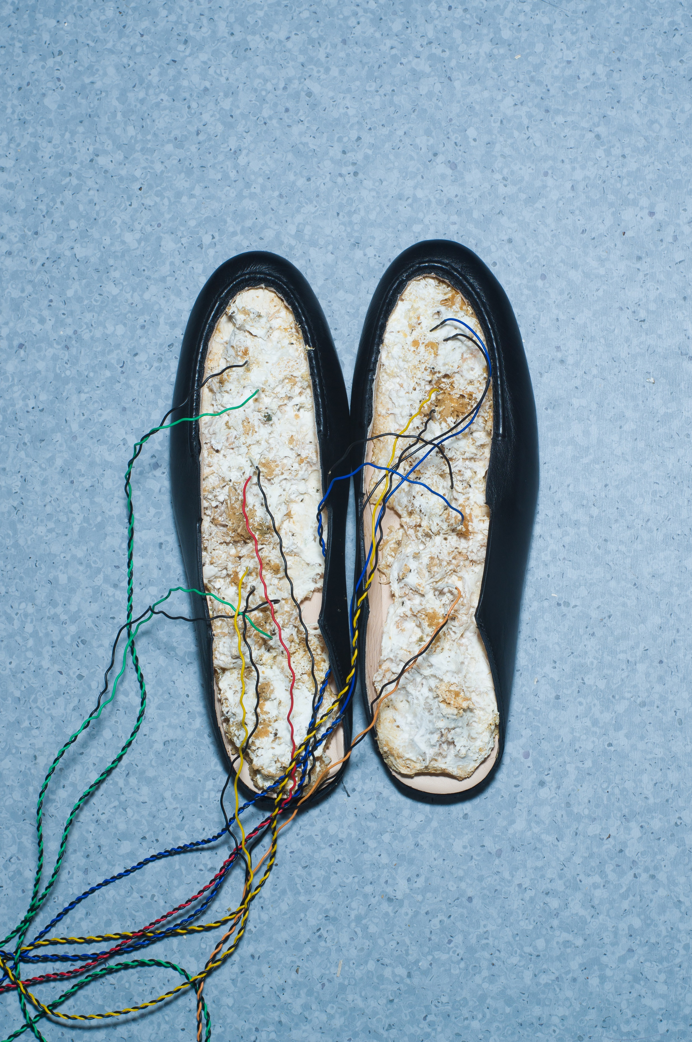
Fabrication of wearables
photo credit: Irina Petrova

Slide 7
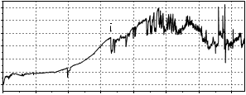
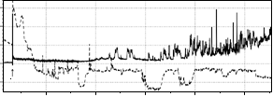
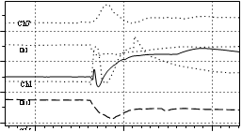
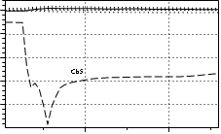
Establish stimulus-responsive behaviors
exposure of fungal pads to chemical and mechanical stimulation
distinctive sets of electrical responses were recorded
discern a nature of stimuli from the fungi generated electrical potential impulses in the form of spike events
Response to application of dextrose, UCL
Response to application of malt extract, UCL
Response stretching 50g weight, UCL

Slide 8
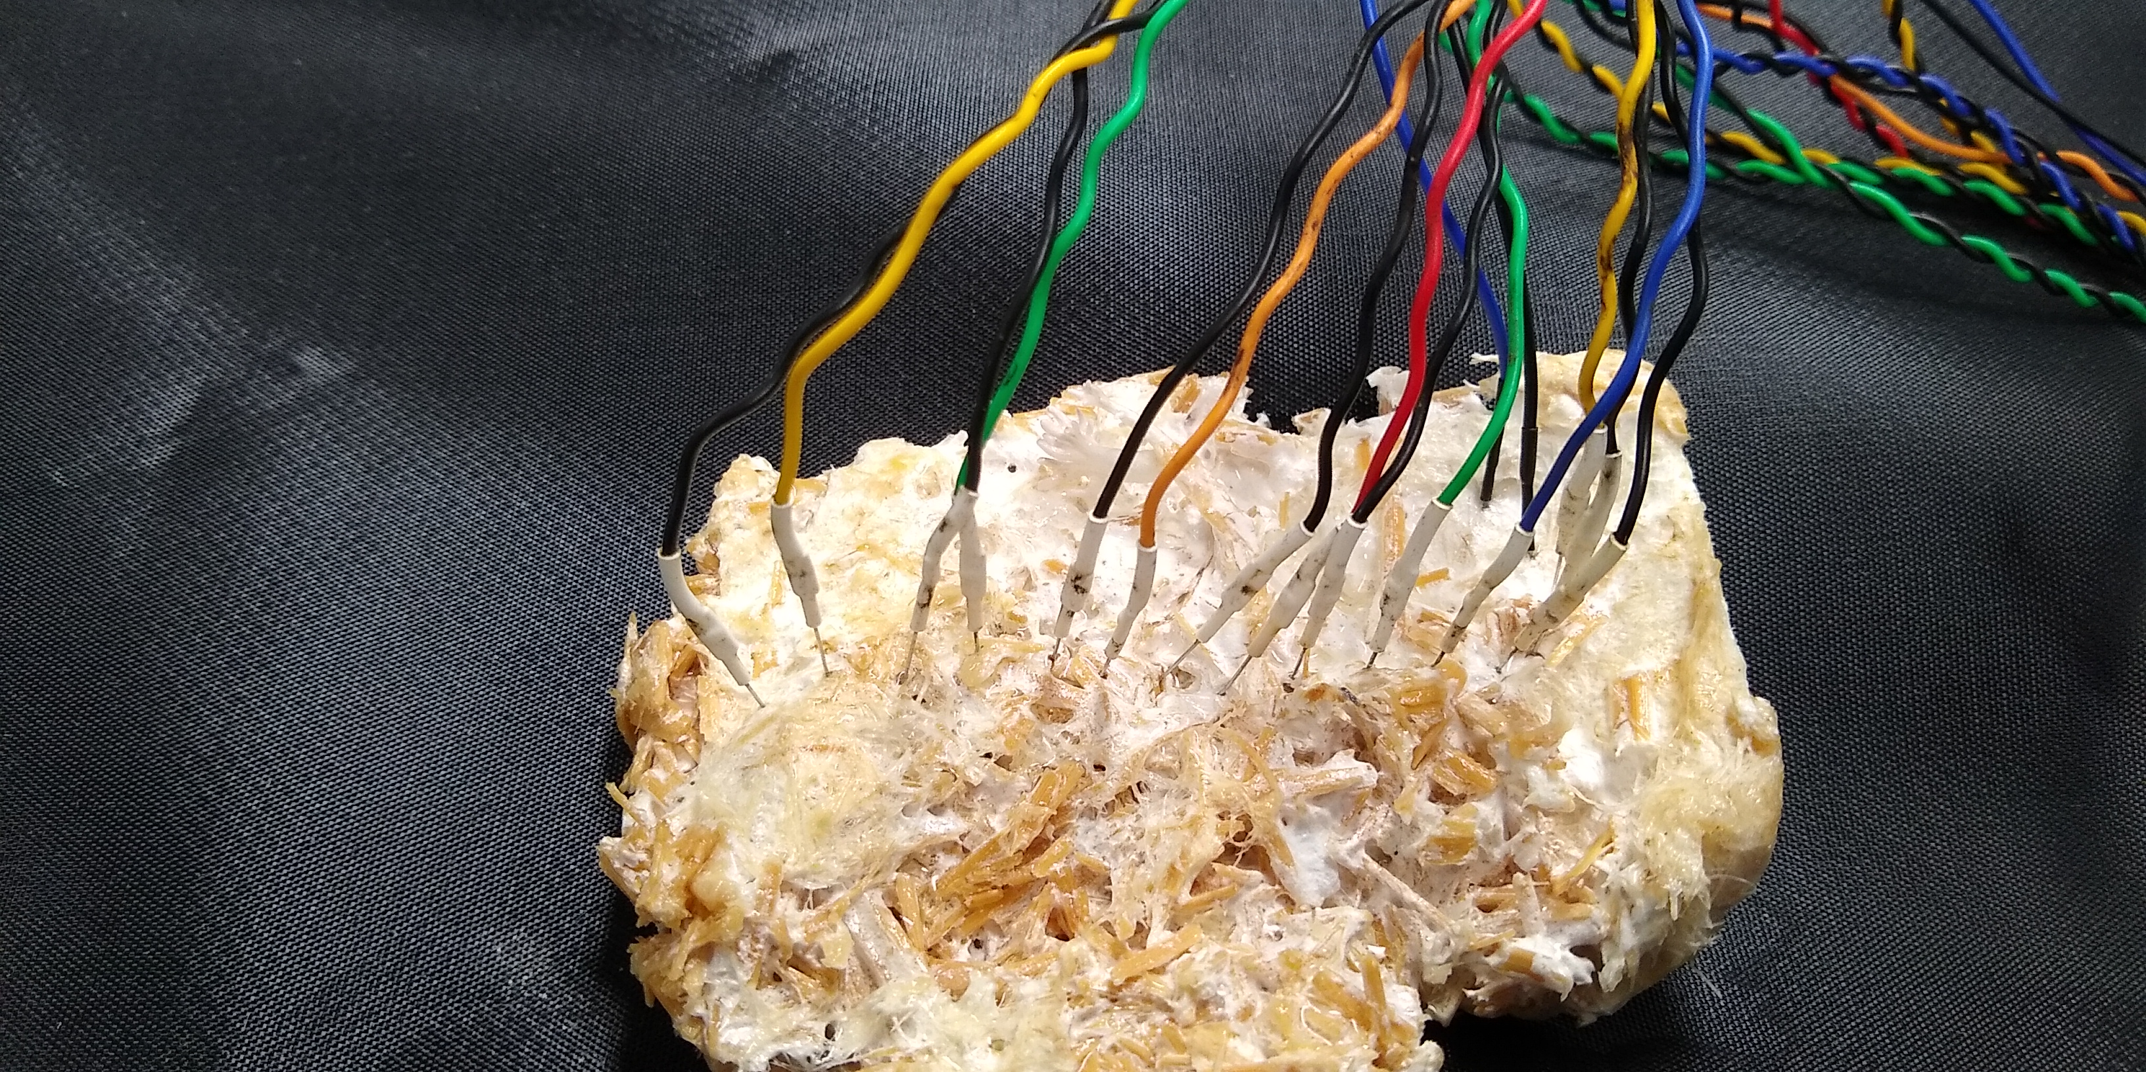
Can wearables & buildings sense humans?
expose fungal biomaterial to hormones – cortisol
changes in cortisol levels released by the body indicate the presence of disease/ changes in stress levels
medicinal hormone replacement- hydrocortisone - similar to the natural stress hormone cortisol
experimental set up, UCL

Slide 9
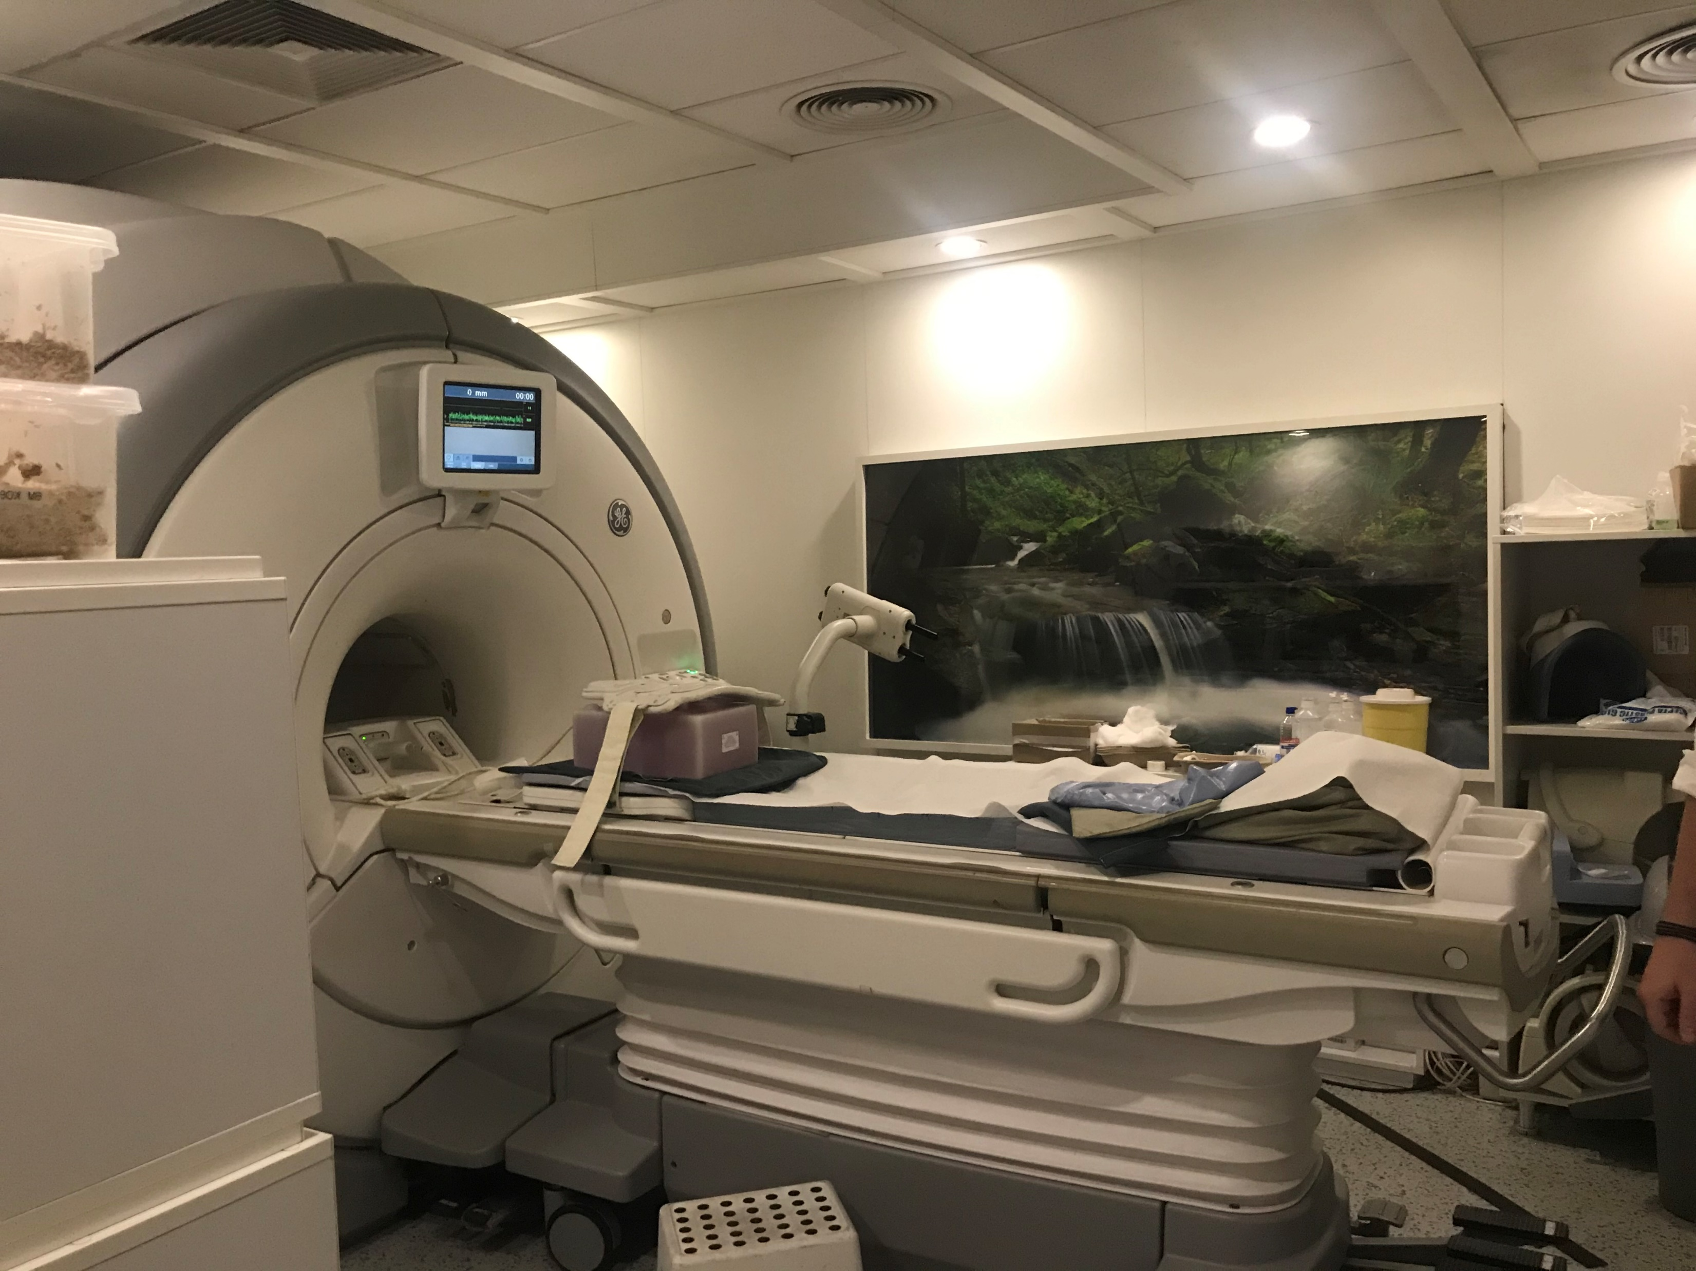
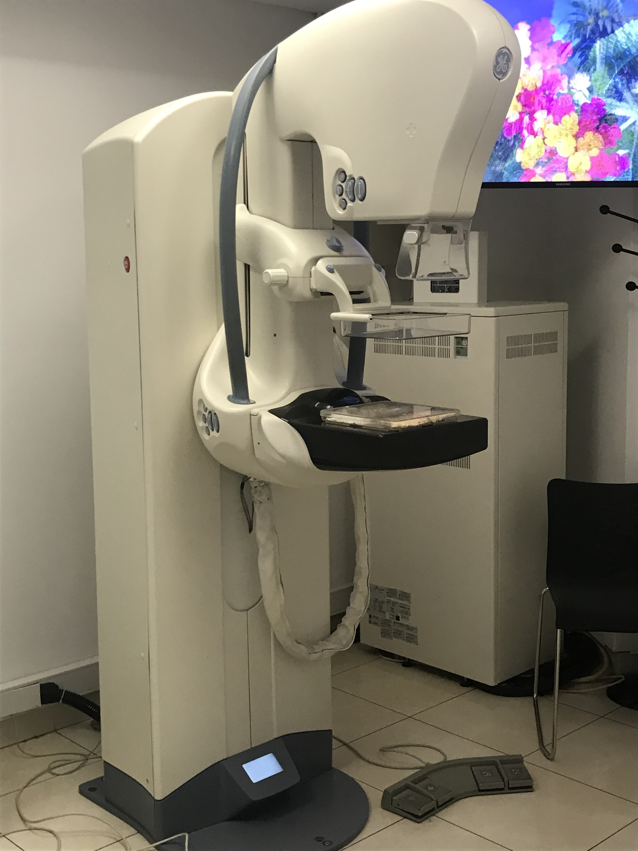
CT/ MRI and X-ray scans were used to investigate changes in the fungi tissue before and after exposure to hydrocortisone
Performance of scans, Bioiatriki, Athens, Greece

Slide 10
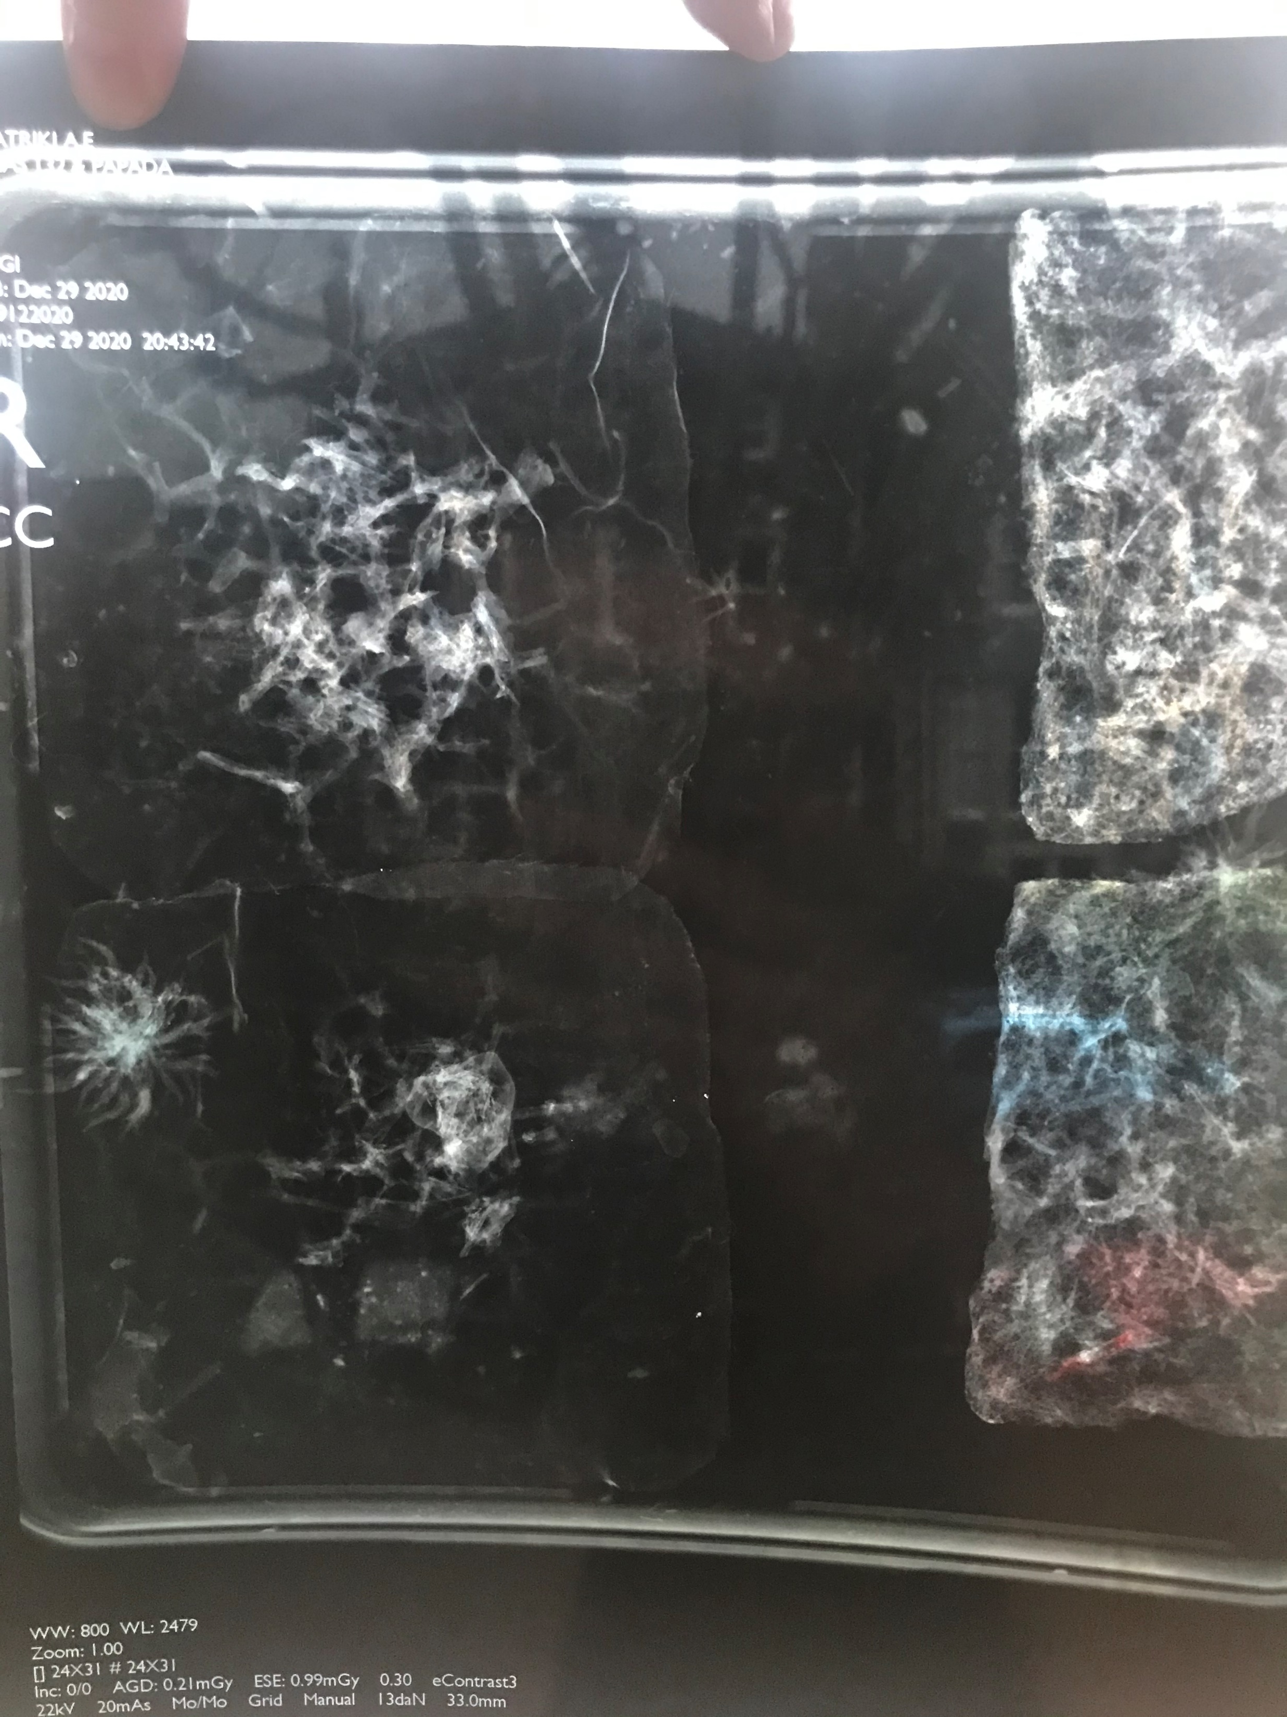
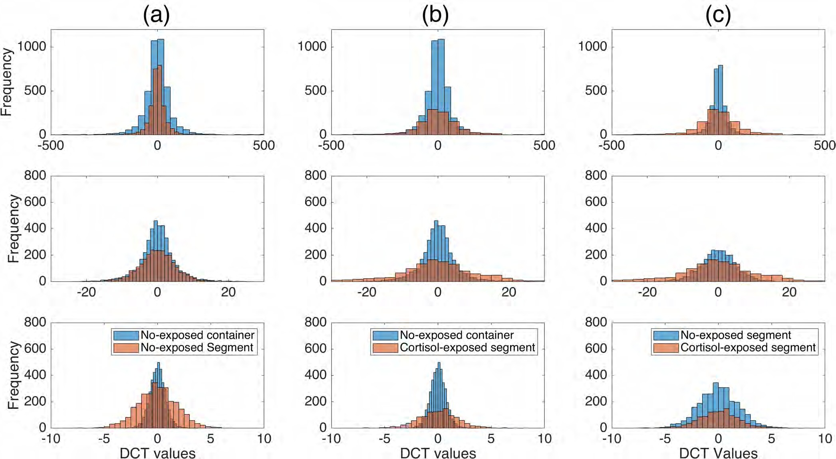
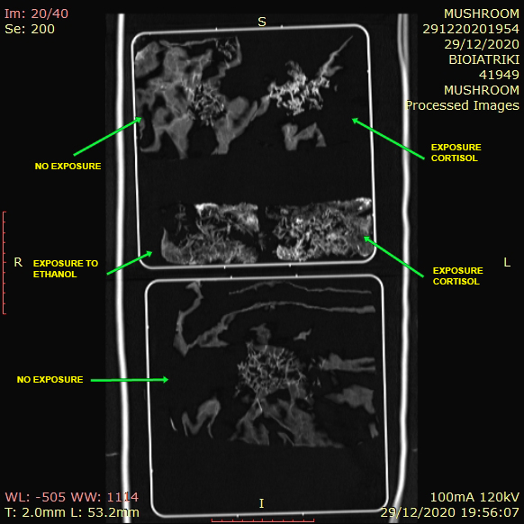
The impact of hydrocortisone exposure is visible in the distribution of energy levels.
The substrate that was not exposed to hydrocortisone had a higher energy frequency than the cortisol-exposed segment
Distribution of energy (a) no-exposed container and no-exposed segment (b) no-exposed container and cortisol-exposed segment, and (c) no-exposed segment and cortisol-exposed segment. UCL
CT scan images
X-Ray images

Slide 11
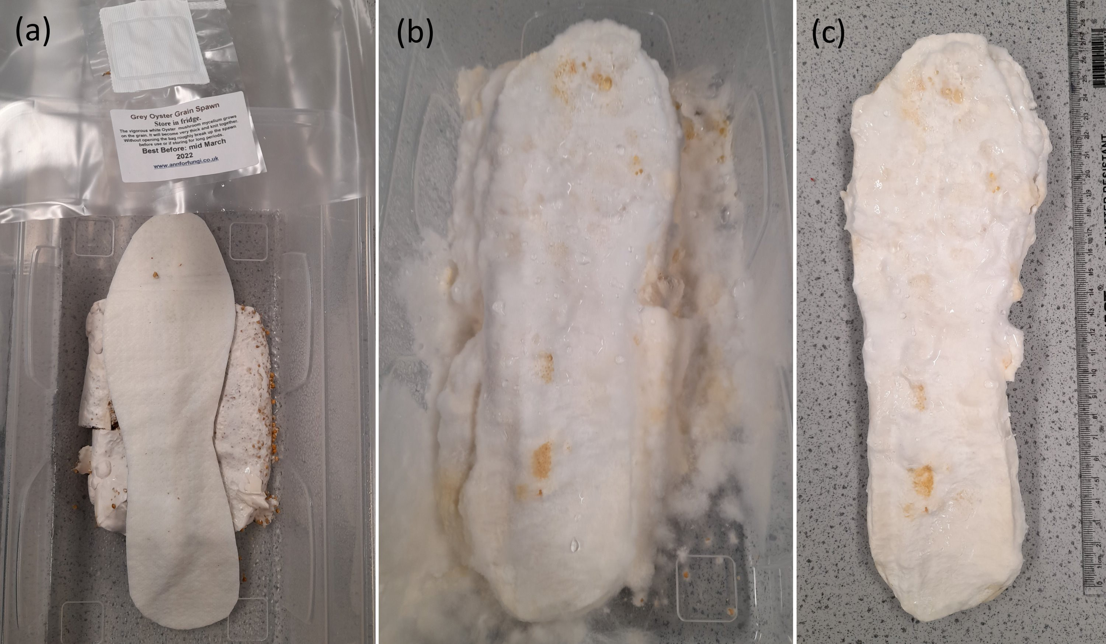
Smart insoles
(a) capillary matting cut into insole pattern on bed of spawn (b) matting being colonised (c) well colonised insole

Slide 12
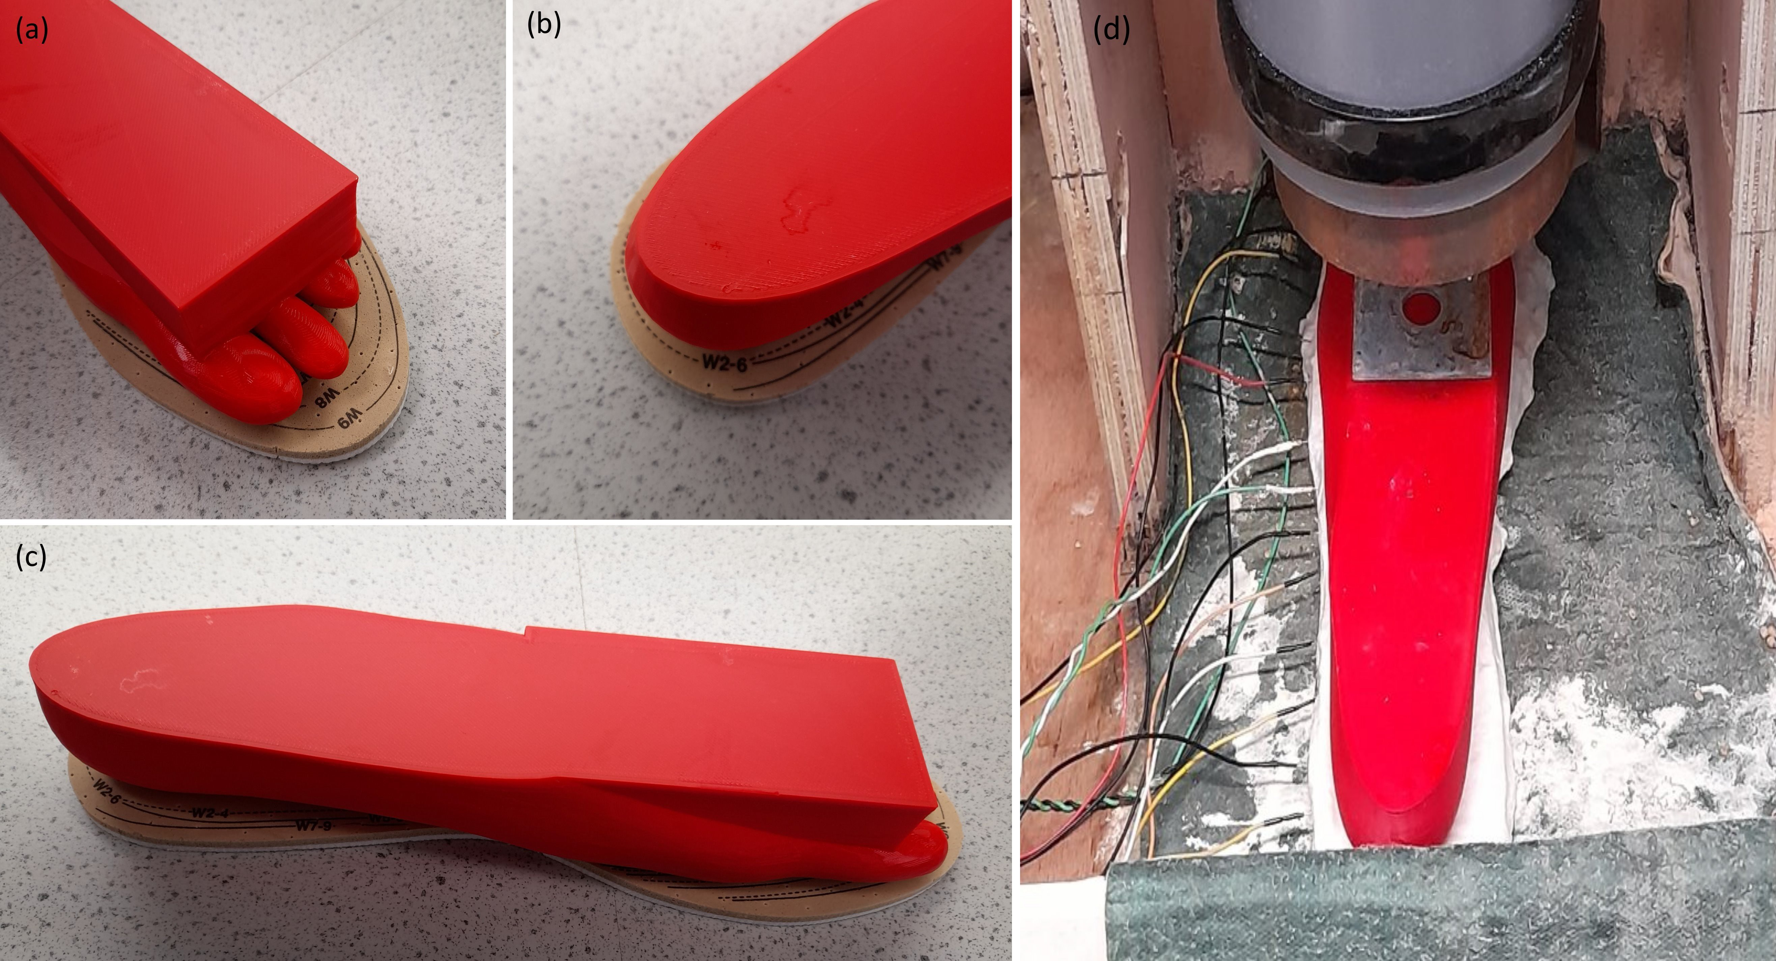
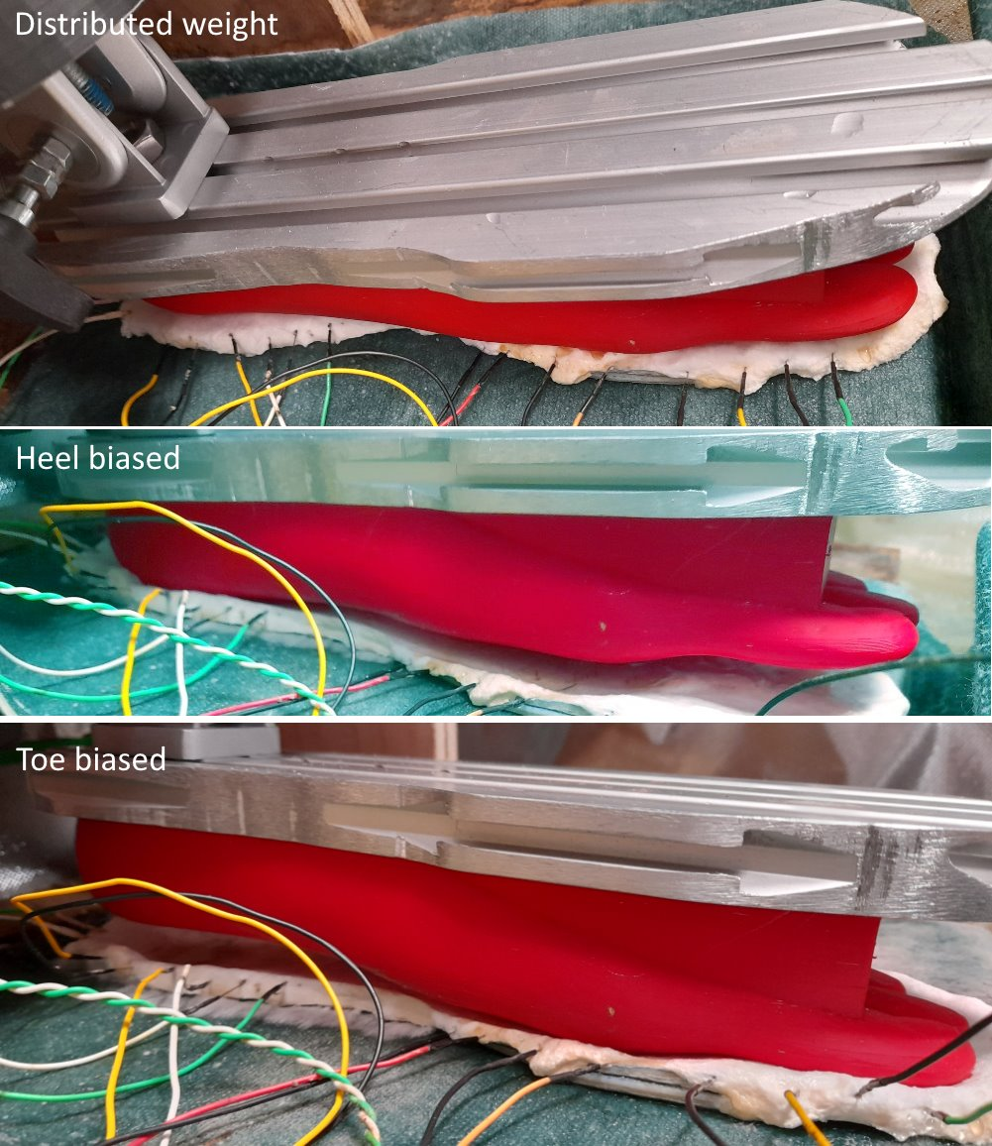
shifting of weight
reduce fall and slip rate when walking or standing
identify impairments in balance, gait, muscle strength and cognition

Slide 13
Future Applications
air quality monitoring
identification of air pollutants and toxic substances
recognition of unhealthy behavioral patterns – walking, standing …
diagnostics & disease detection
monitoring of performance data
References
Adamatzky et al., 2021 Biosystems; 11. Dehshibi et al., 2021 ACS Biomater Sci Eng
International Resource Panel (2019) Building resilient societies after the Covid-10 pandemic

Slide 14
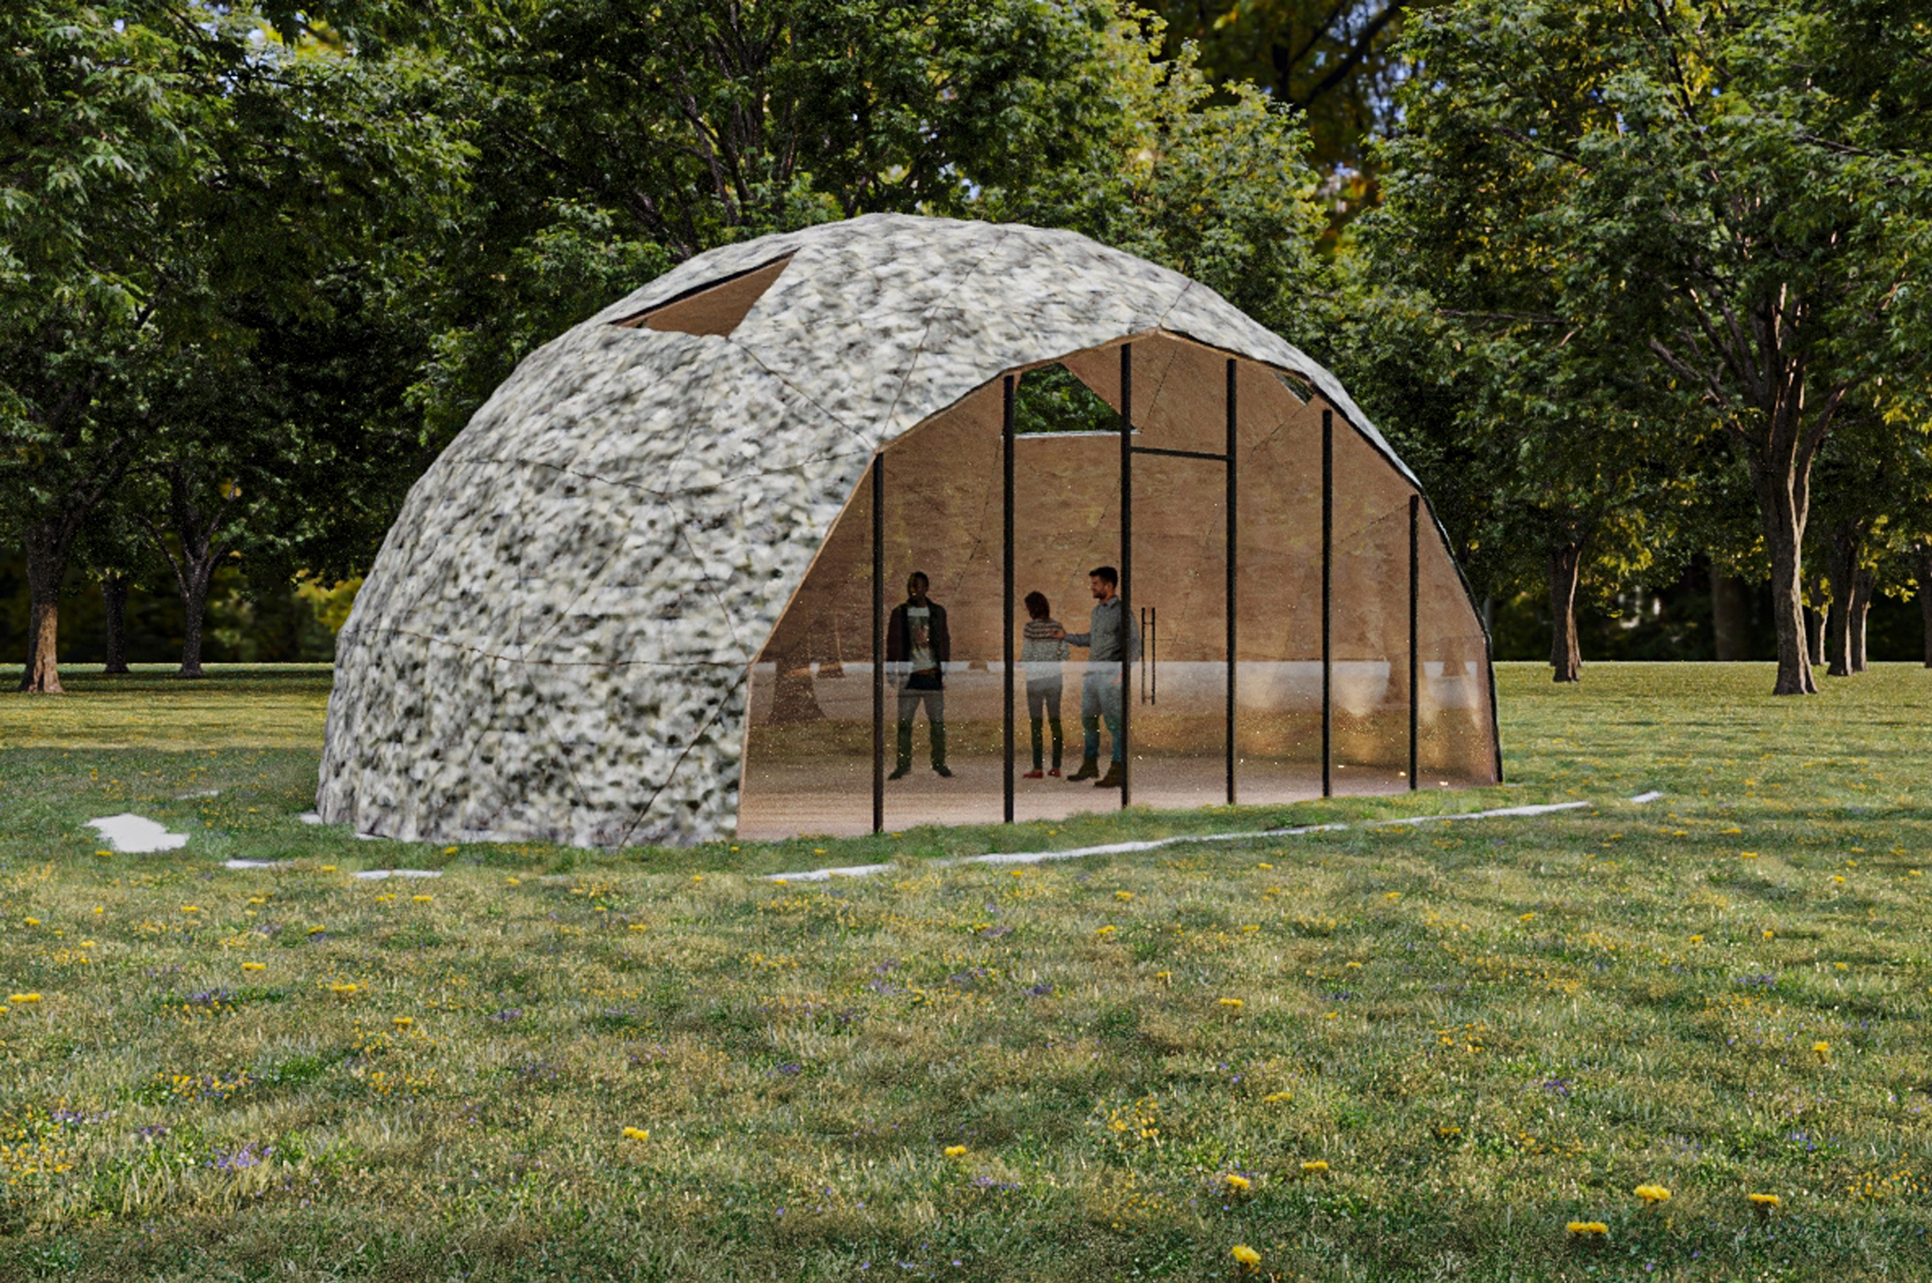
Thank you !

