Slide 1

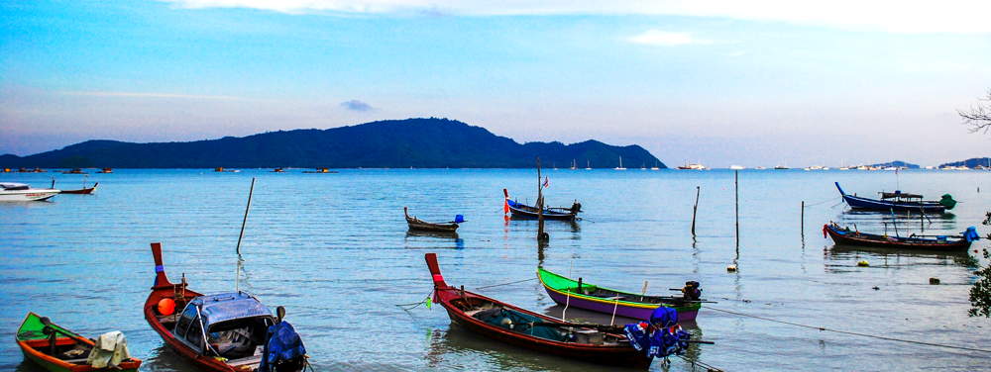

December 6-8, 2022
IWA BIOFILMS CONFERENCE 2022
Phuket, Thailand
Managing Biofilms in Ultrafiltration Membranes within a Point-of-Use Drinking Water System
Gillian Clayton, Robin Thorn & Darren Reynolds
Centre for Research in Biosciences, University of the West of England, Bristol, UK

Slide 2
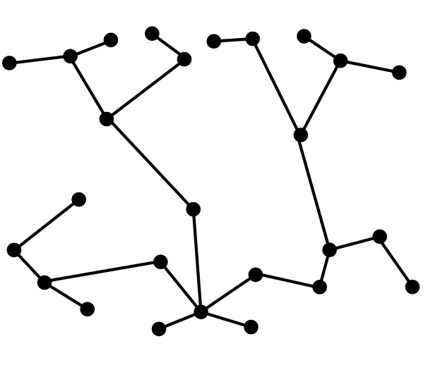
Background
2 billion people worldwide do not have access to safely managed drinking water¹
Biofilms in drinking water treatment systems can result in biofouling, causing non-operational periods
UF membrane manufacturers advise against long-term exposure of membranes to chlorine (e.g. NaOCl or Ca(OCl)₂) due to the oxidative damage such solutions can have on material surfaces
Decentralised
¹ WHO & UNICEF. Progress on drinking water, sanitation and hygiene in households 2000-2020 (2021);
IWA BIOFILMS CONFERENCE 2022
Notes:
Globally around 40% of rural communities do not have access to safely managed drinking water services.
Where centralised drinking water treatment systems are not necessarily feasible options, decentralised, point-of-use systems could be far more effective and valuable in rural communities or resource constrained environments.
When implementing hybrid POU systems with a combination of filtration and disinfection processes, UF membranes are often overlooked due to the potential for biofouling and blockages that lead to non-operational periods.
To deep clean blocked UF membranes block, strong acid/alkaline washes are required to remove blockages such as sediment and biofilms
Hypochlorite solutions are used widely in centralised treatment systems, but are not necessarily the most practical in decentralised systems due to the residual chlorine
In addition OCl⁻ solutions are less efficacious against biofilms¹, and have a greater affinity to produce trihalomethanes²

Slide 3
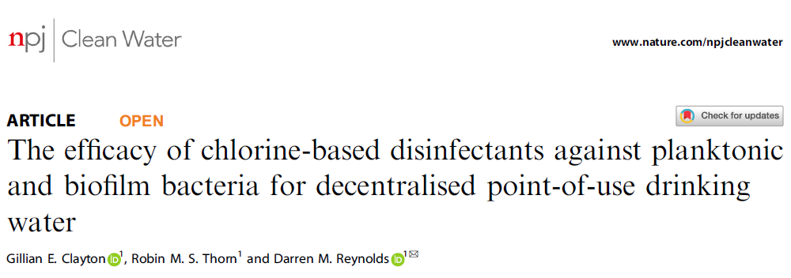
HOCl efficacy against biofilms
~1% (w/v) NaCl aqueous solution
Hypochlorous acid (HOCl) can be generated through the electrolysis of a weak saline solution
Current
Membrane
OH
H₂O
H⁺O₂
H⁺
H₂O
OH⁻ H₂
Cl⁻
Cl₂
NaOCl
HOCl (NaDCC)
Acidic Electrochemically Generated HOCl
-
+
Cathodic
Output (NaOH)
Na
Anodic output (HOCl)
Cl⁻
IWA BIOFILMS CONFERENCE 2022
Notes:
Electrochemically generated HOCl has the ionic neutrality of HOCl, whereby there is not charge on the molecule, but within the anodic solution there are metastable oxidative species which can disrupt the EPS of biofilms more easily through oxidative reactions, in comparison to chemically derived HOCl which does not exhibit the same oxidative nature.
In previous studies using lab-scale models we have demonstrated that HOCl is more efficacious in terms of antimicrobial activity both against planktonic bacteria and established biofilms using a standard CDC biofilm reactor model against Pseudomonas
Other lab-scale experimental models were developed including Polyethersulphone coupons and in-situ disinfectant dosing, with environmental water as the source media, and HOCl exhibited greater antimicrobial efficacy in comparison to NaOCl.

Slide 4
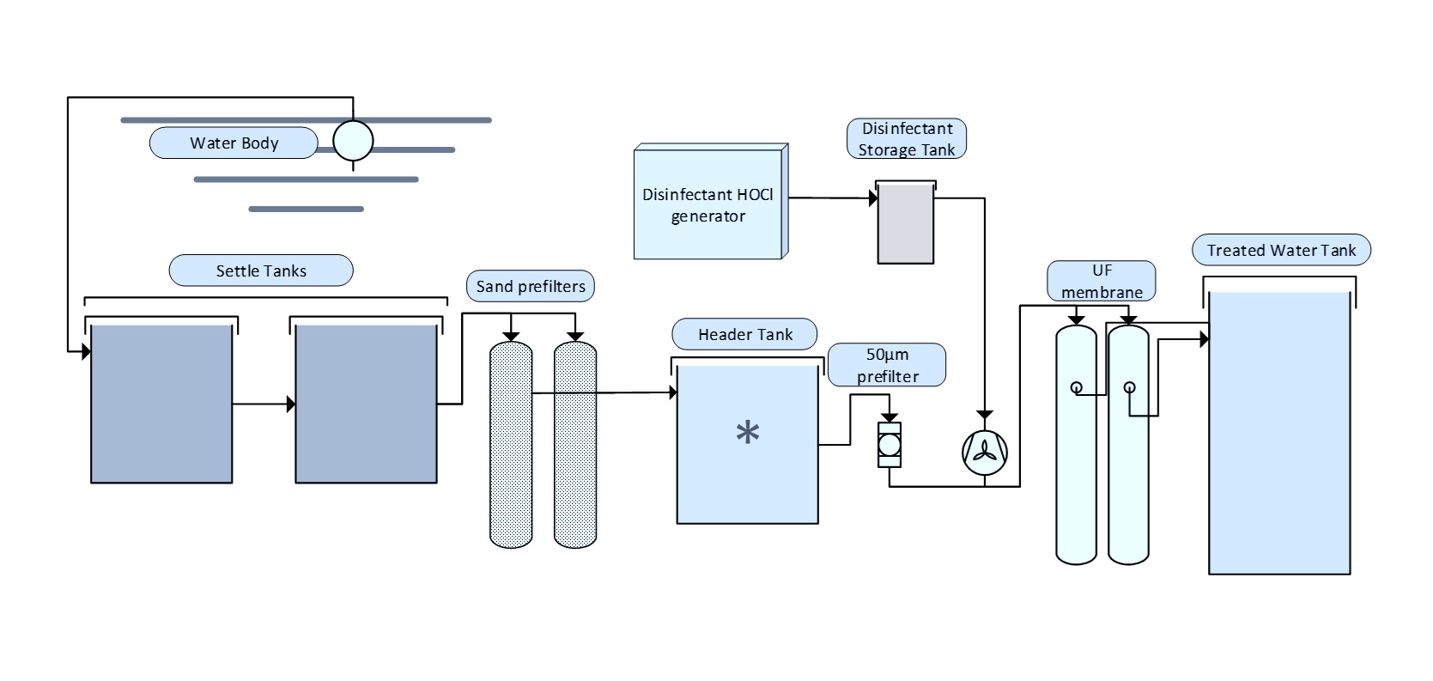
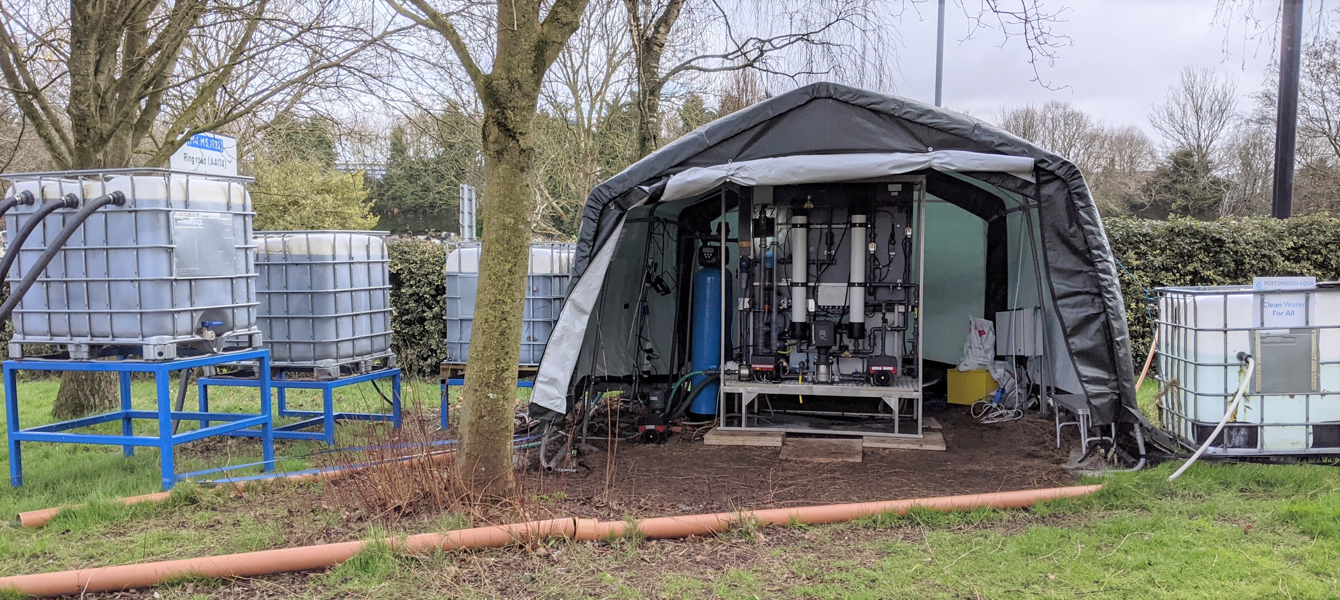
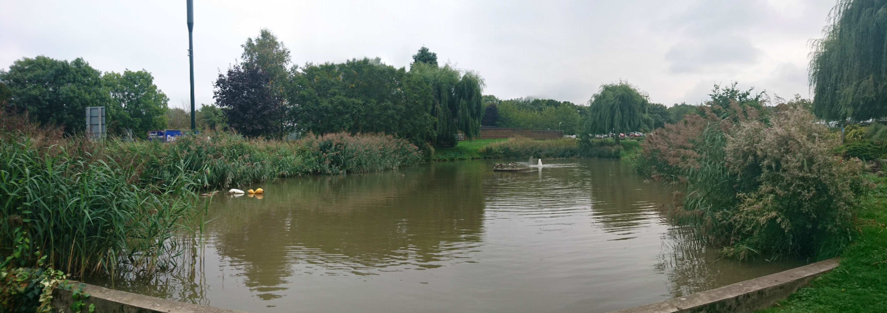
Decentralised Point-of-Use Drinking Water Treatment System
This study demonstrated the use of slightly acidic electrochemically generated HOCl at managing biofilm formation, enabling long-term permeability stability within a community scale drinking water treatment system
IWA BIOFILMS CONFERENCE 2022
Notes:
The POU DWTS produces drinking water that meets WHO guidelines./EU Standards

Slide 5
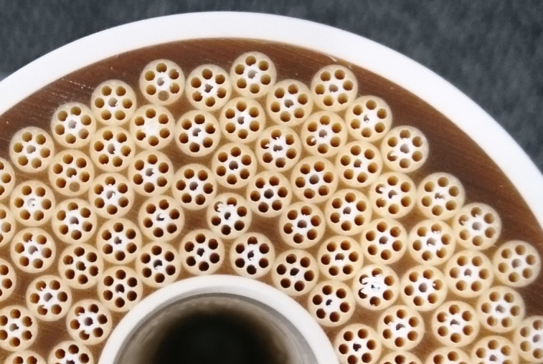
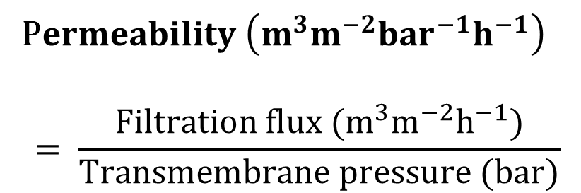
Methods
UF Membranes: Inge Dizzer 4040-4.0 1.5
HOCl generated using an ELA-900 generator (Envirolyte)
Continuous operational monitoring via Grundfos Remote Management page and in-line Grundfos and s::can sensors
P$ermeability \left(m^{3}m^{−2}{bar}^{−1}h^{−1}\right)$
$$= \frac{Filtration flux (m^{3}m^{−2}h^{−1})}{Transmembrane pressure (bar)}$$
IWA BIOFILMS CONFERENCE 2022
Notes:
HOCl produced at pH: ~5.65, FAC ~365 mg/L & ORP: ~800mV
The data presented here covers a 2 and a quarter year period
Operational parameters monitored in real-time include; power, free chlorine, ORP, flow rate, transmembrane pressure, temperature – free chlorine/ORP is measured at point of dosing not in the treated water tank.
Total UF membrane area of 8m²
HOCl within this system was used for two applications: to disinfect the water to ensure biologically safe water is produced, and also to minimise the formation of biofilms forming on surfaces within the UF membrane, reducing blockages

Slide 6
Clayton et. al (In Preparation)
Results
Flow Rate
IWA BIOFILMS CONFERENCE 2022
Notes:
Over the two year trial period, we wanted to test the maximum flow rate that was possible from the source water. A minimum set flow rate of 0.3m³ and a maximum of 0.75m³. Between operational weeks 51 and 69 flow rate was gradually increased from the minimum to the maximum flow rate.

Slide 7
Clayton et. al (In Preparation)
Results
Permeability
Free Available
Chlorine
Oxidation Reduction Potential
IWA BIOFILMS CONFERENCE 2022
Notes:
FAC and ORP allow us to monitor the quality of HOCl produced from the in-line generator.
Free chlorine concentration not the values in the treated water, but the values at point of dosing.

Slide 8
Clayton et. al (In Preparation)
Results
Weeks 89 – 94 HOCl dosing location was changed
IWA BIOFILMS CONFERENCE 2022
Notes:
The HOCl dosing location was altered in weeks 89 and 94, to see whether HOCl could also reduce fouling in the 5um reverse flushing prefilter

Slide 9
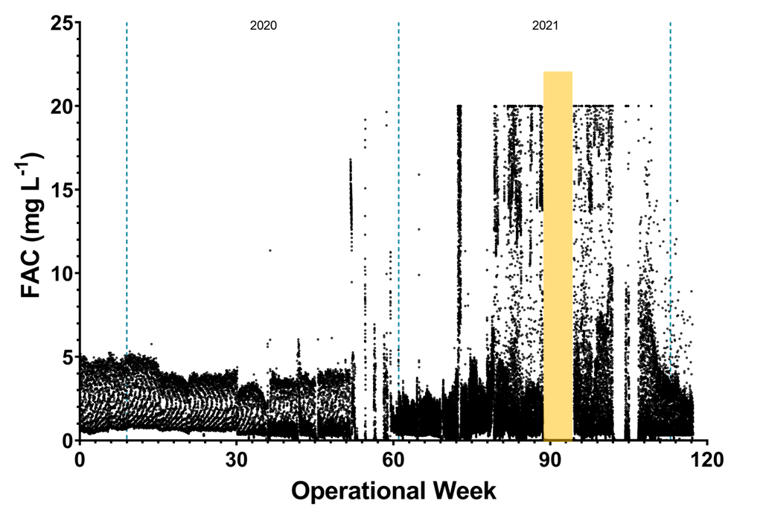
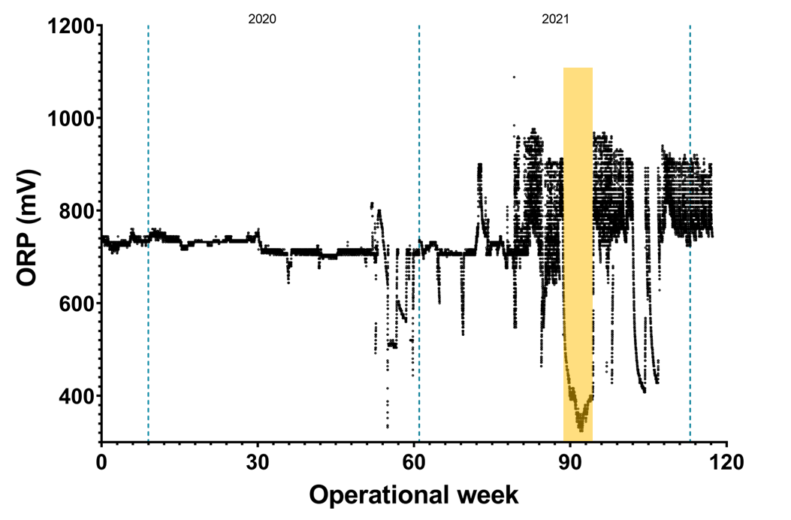
Clayton et. al (In Preparation)
Results
Free Available
Chlorine
Permeability
Oxidation Reduction Potential
IWA BIOFILMS CONFERENCE 2022
Notes:
Between weeks 89 – 94 (yellow bar), the HOCl dosing location was changed to pre- 5µm filter, whereby HOCl was not dosed immediately prior to UF membranes. After week 94 the dosing location was moved back to immediately before UF membranes – no effect on the permeability across the UF membrane throughout this period.
The blue boxes show when the free chlorine concentration of the HOCl generator was increased from ~350ppm to ~500ppm, to see whether a reduced dosing rate (i.e. not continuous) would impact the permeability of the UF membranes. There were more backflushing events and automatic ‘chemical cleans’ as the transmembrane pressure.,
The chlorine concentration in final drinking water was not affected by the increase in FAC between weeks 70 to 120.

Slide 10
Conclusions and Future Work
In-situ dosing of HOCl within a decentralised POU drinking water treatment system resulted in the constant production of safe drinking water for over 2 years
No additional cleaning regimen was required to maintain system permeability, even when flow rate and HOCl dosing location was altered
The stable permeability is likely a result of constant in-situ dosing of HOCl minimising biofilm formation within UF membranes
  No current indication that constant HOCl dosing negatively impacts UF membranes
Once POU DWTS trial at UWE Bristol has finished, UF membranes will be imaged and compared to new UF membranes
IWA BIOFILMS CONFERENCE 2022
Notes:
Dosing of electrochemically generated HOCl has negated the need for harsh acid/alkaline washes.
The UF membranes have not been chemically cleaned in the three years since the system was installed on UWE’s Campus
The system has produced over 5 million L of drinking water throughout the three years it has been running on UWE’s campus.

Slide 11



Acknowlegdements
UWE Bristol
Professor Darren Reynolds
Dr Robin Thorn
Dr Bethany Fox* (Jacobs Solutions)
Portsmouth Aqua
Nick Scott
Gary Driscoll
Simon Escott
Funding
NERC/Newton Bhabha: Grant NE/R003106/1
Gillian.Clayton@uwe.ac.uk
IWA BIOFILMS CONFERENCE 2022

