Slide 1
Health, wealth and happiness: the price of everything and the value of nothing !!!!!
Jane Powell,
Professor Public Health Economics,
the University of the West of England Bristol, UK
Jane.Powell@uwe.ac.uk

Slide 2
Acknowledgement of Country
I would like to begin by acknowledging the Gadigal people of the Eora Nation the Boorooberongal people of the Dharug nation, the Biadigal people and the Gamaygal people upon whose ancestral lands the University of Technology Sydney stands. I would also like to pay respect to the elders past present and future, acknowledging them as traditional custodians of knowledge for these lands

Slide 3
Public health, economics and me
An economist and social scientist, postgrad in business and economic forecasting. Early career in economic modelling and forecasting for British Telecom, public sector and others
Gave that up in mid twenties to become academic teaching economics. Interested in what makes a good life. PhD on the relationship between alcohol dependence and quality of life.
Moved to UWE Bristol in Sept 2000 and did service teaching on new multidisciplinary MSc Public Health programme. This changed my life. Started to specialise in multidisciplinary public health and build research profile based on all the above elements.

Slide 4
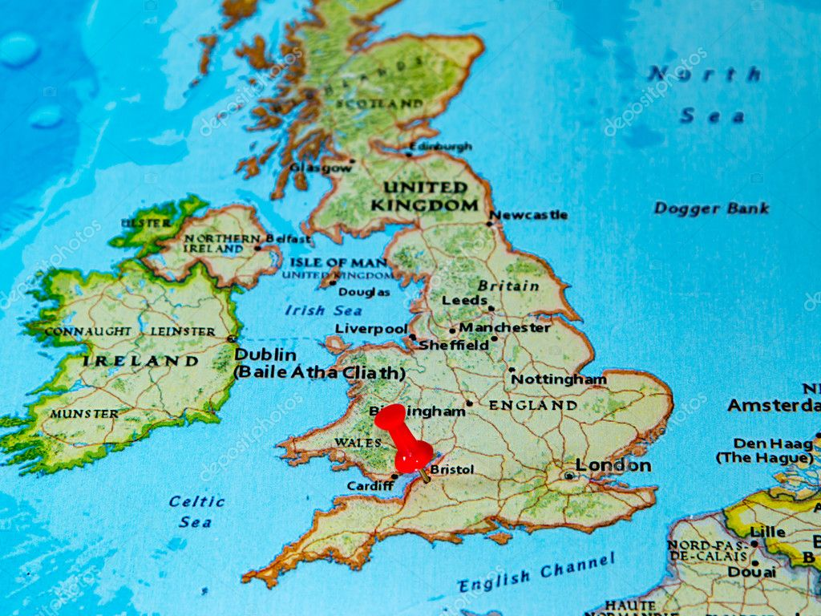


Slide 5
What is economics?
The study of how people and society end up choosing, with or without the use of money,
to employ scarce productive resources, that could have alternative uses, to produce various commodities [efficiently]
and distribute them for consumption [equitably], now or in the future, among various people and groups in society
It analyses the costs and benefits of improving patterns of resource allocation (Paul Samuelson, 1976)

Slide 6

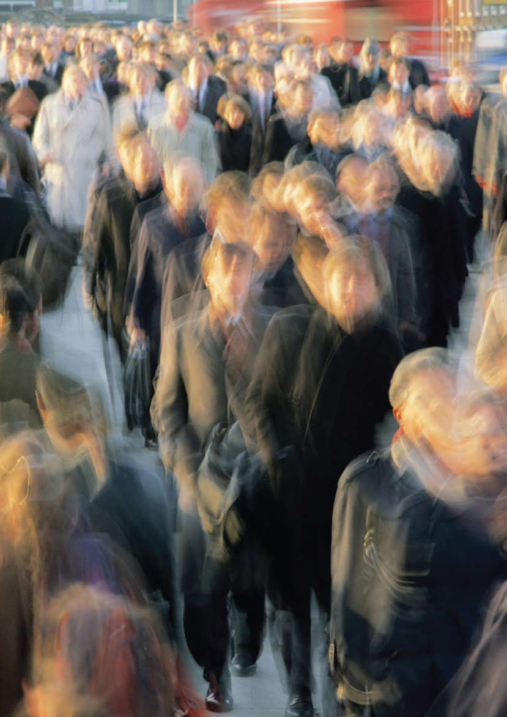
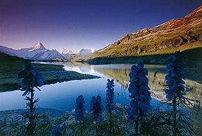
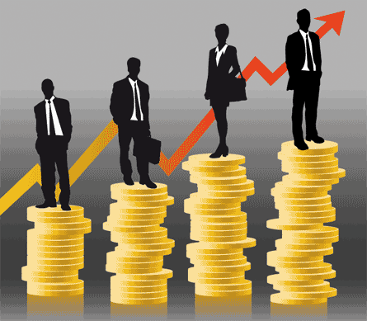


Slide 7
The market society knowing the price of everything and value of nothing
Logic of buying and selling commodifies and governs the whole of life
How people and society end up choosing, with or without the use of money, to employ scarce productive resources, that could have alternative uses, to produce various commodities [efficiently]
and distribute them for consumption [equitably], now or in the future, among various people and groups in society
It analyses the costs and benefits of improving patterns of resource allocation (Paul Samuelson, 1976)
A MARKET SOCIETY GIVES RISE TO POPULISM AND UNDERMINES OUR BASIC SOCIAL CONTRACT OF EQUALITY OF OUTCOMES, OPPORTUNITY AND FAIRNESS ACROSS GENERATIONS

Slide 8
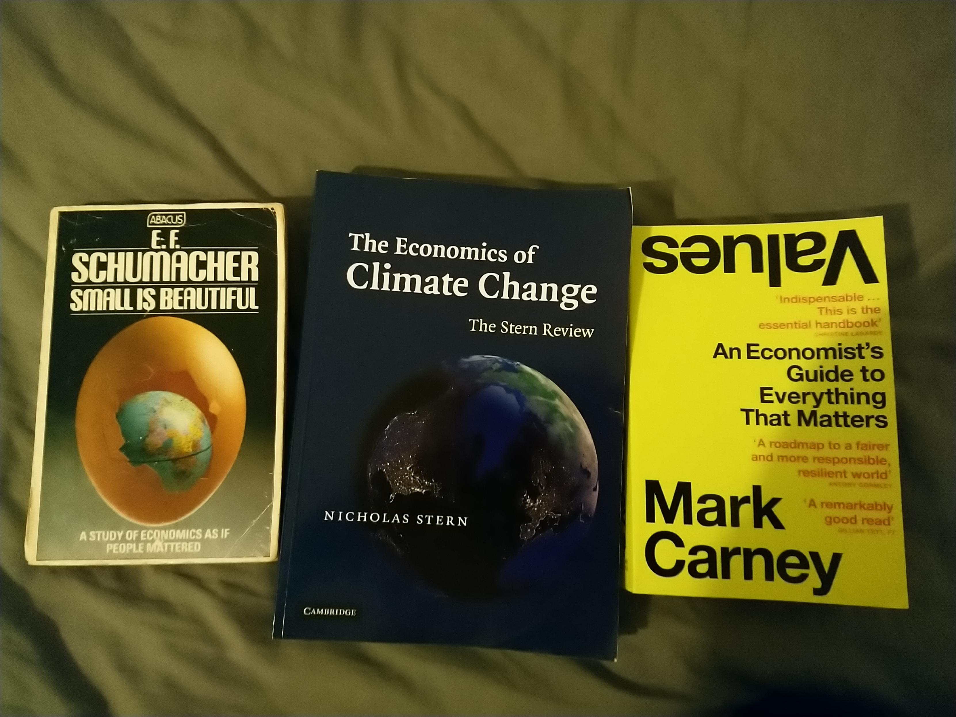

Slide 9
From knowing the price of everything to understanding true value
Credit, COVID and Climate three events being driven by a common crisis of values
Responses to COVID could begin to recast the relationship between values and value, reinforcing social capital and resilience. This is the path to net zero

Slide 10
Common values and beliefs that underpin a successful economy are:
Dynamism – create solutions channel creativity
Resilience – make it easier to bounce back from shocks
Sustainability – long term perspectives that align incentives across generations
Fairness – particularly in markets to sustain their legitimacy
Responsibility – producers then consumers
Solidarity – share a sense of community and society
Humility – recognise limits of knowledge understanding and power, seek to improve the common good.

Slide 11
Structure and agency
Health of Environments - structure
Health of Populations - agency
Vulnerability/inequality
enabling people / citizens to have agency / power
creating safe, just & humane societies
& ‘framing debates’ to challenge established orthodoxy

Slide 12

Key Public Health Objectives …
Prevention, Protection & Promotion
Empowerment & Participation
Inter-sector Action (forging partnerships)
Health System and Policy Development
Creating Supportive Environments for Health
Acting on the Social Determinants of Health

Slide 13
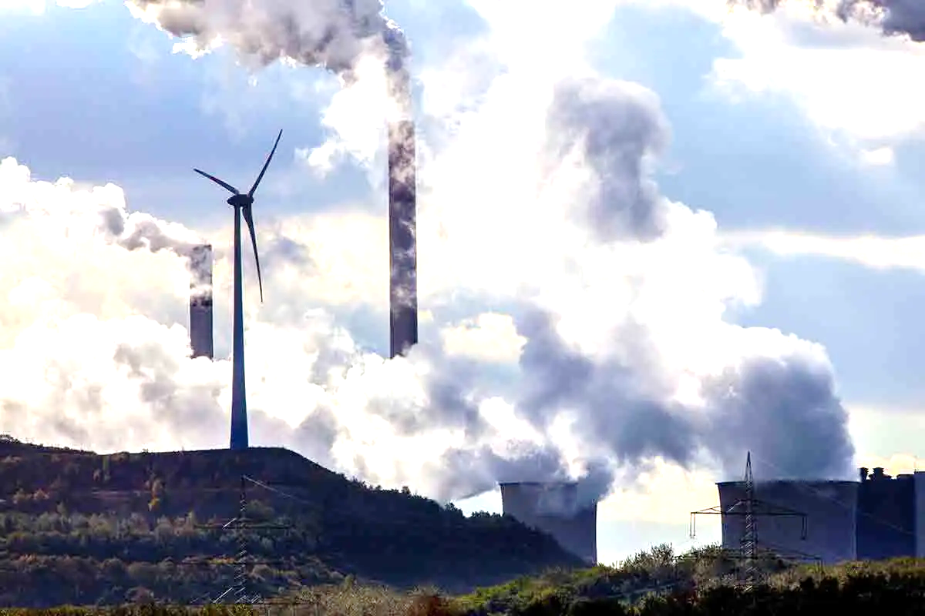
human agency
knowledge, attitudes
beliefs & values
behaviour, skills
health needs
cultural assets
structures / systems
healthy public policy
health & environmental protection
equity, rights, social justice
systems change
Environmental Pollution Climate Change
Disease Pandemics
Natural Disasters
Population Displacement
Human Rights Violations
etc.
Education Settings
Communities/Neighbourhoods
Employment Settings
Organisations/Institutions
Prison / Justice Settings
Political Systems/Governance
Cities/Towns/Villages
Healthcare Settings
etc.

Slide 14


