Slide 1
Health wealth happiness: what now?
Jane Powell,
Professor Public Health Economics,
the University of the West of England Bristol, UK
Jane.Powell@uwe.ac.uk

Slide 2
Acknowledgement of Country
I would like to begin by acknowledging the Gadigal people of the Eora Nation the Boorooberongal people of the Dharug nation, the Biadigal people and the Gamaygal people upon whose ancestral lands the University of Technology Sydney stands. I would also like to pay respect to the elders past present and future, acknowledging them as traditional custodians of knowledge for these lands

Slide 3
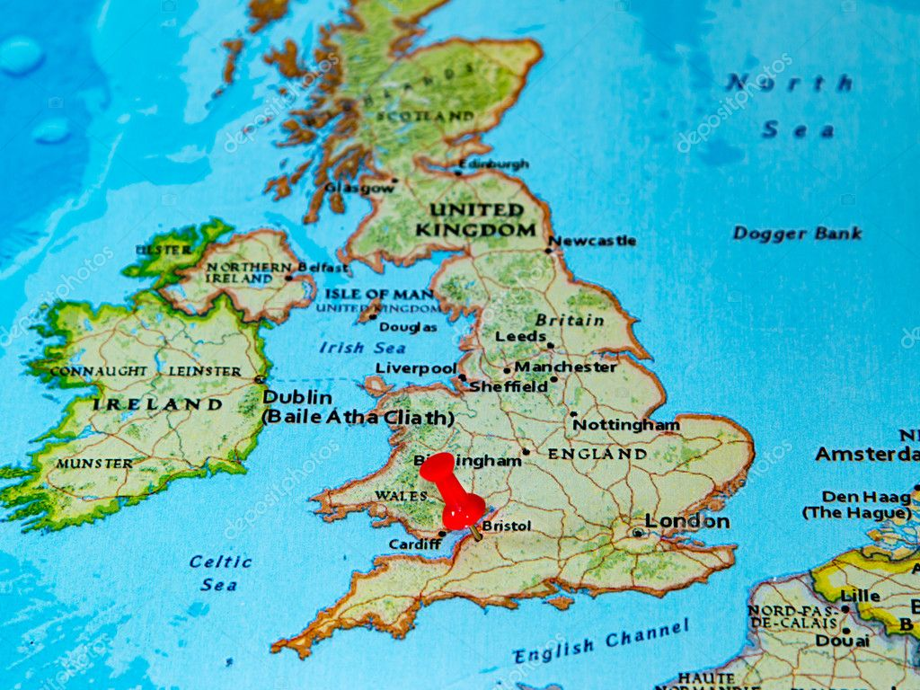


Slide 4
HEALTH
Health ..a state of complete physical mental & social wellbeing not merely the absence of disease or infirmity
(World Health Organisation, 1974)

Slide 5

WEALTH

Slide 6
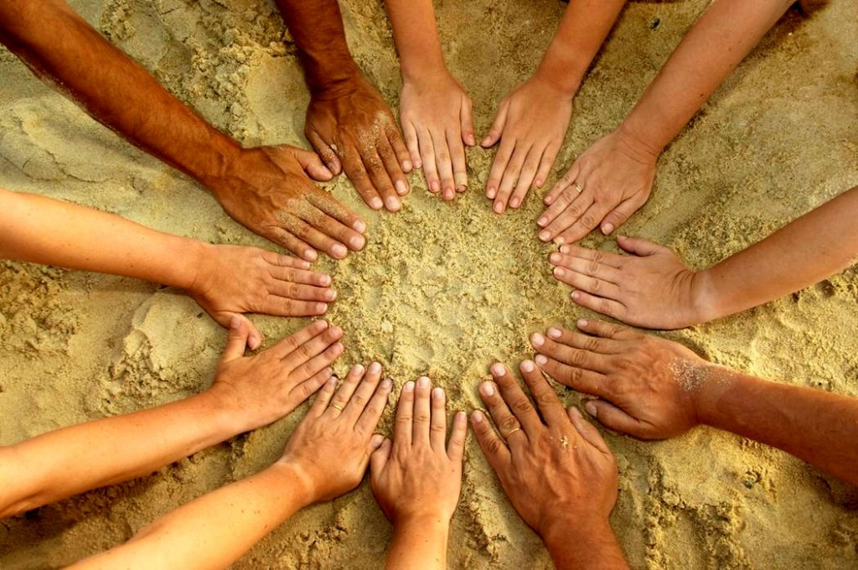
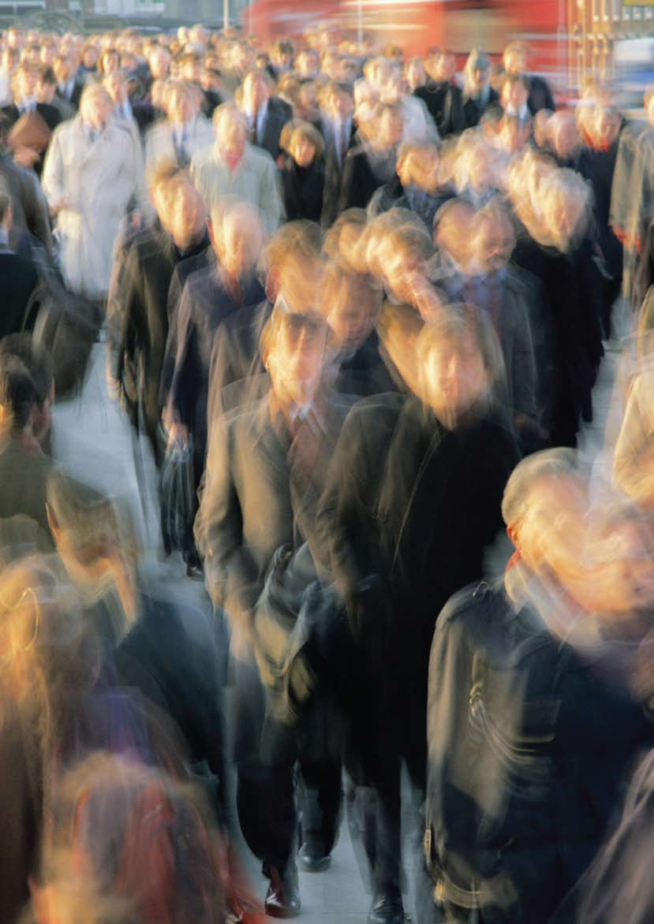
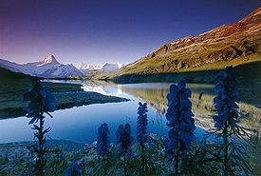
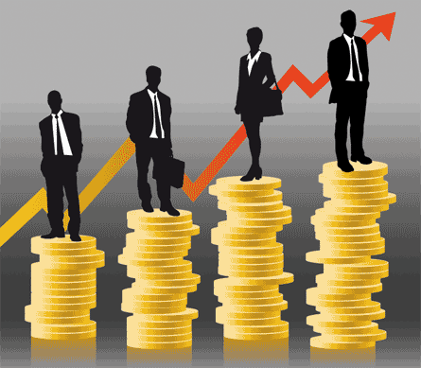


Slide 7
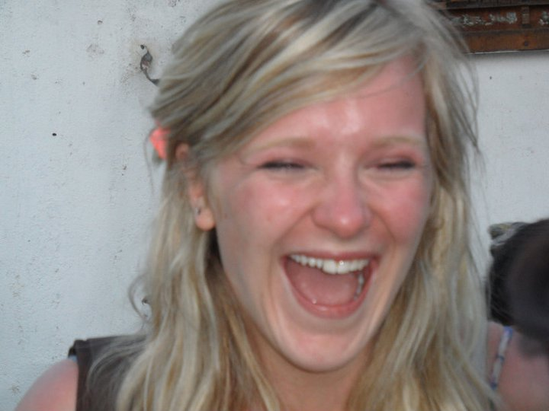
HAPPINESS
WHAT MAKES US HAPPY?
SUCCESSIVE SURVEYS report...

Slide 8
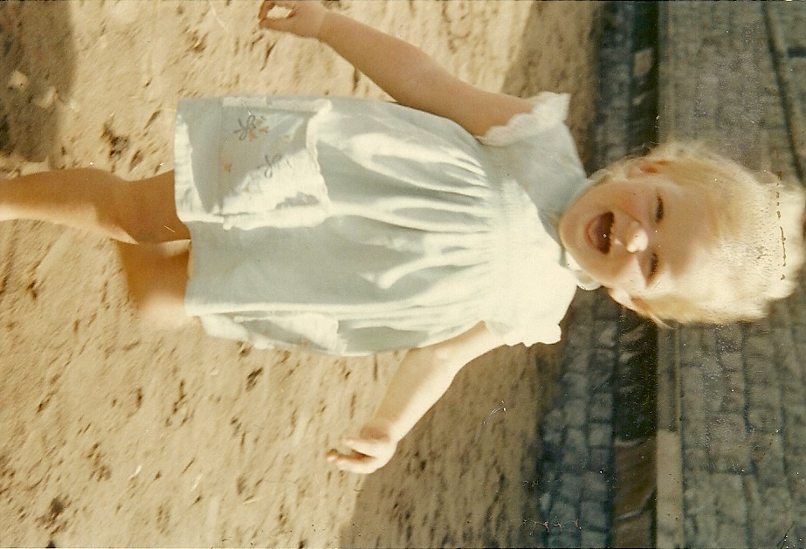
Good mental and physical health

Slide 9
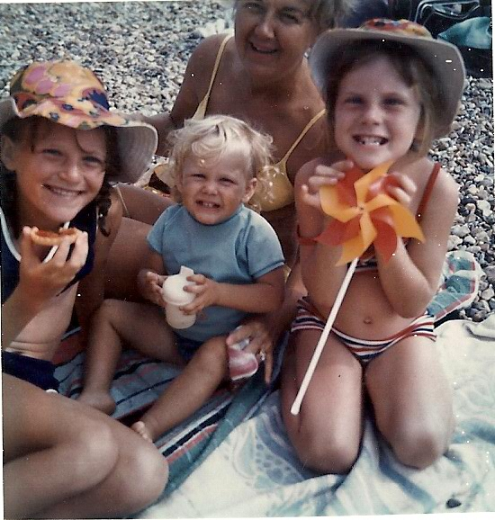
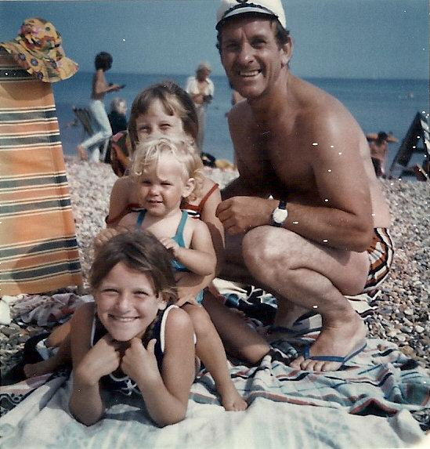
family and community ties

Slide 10
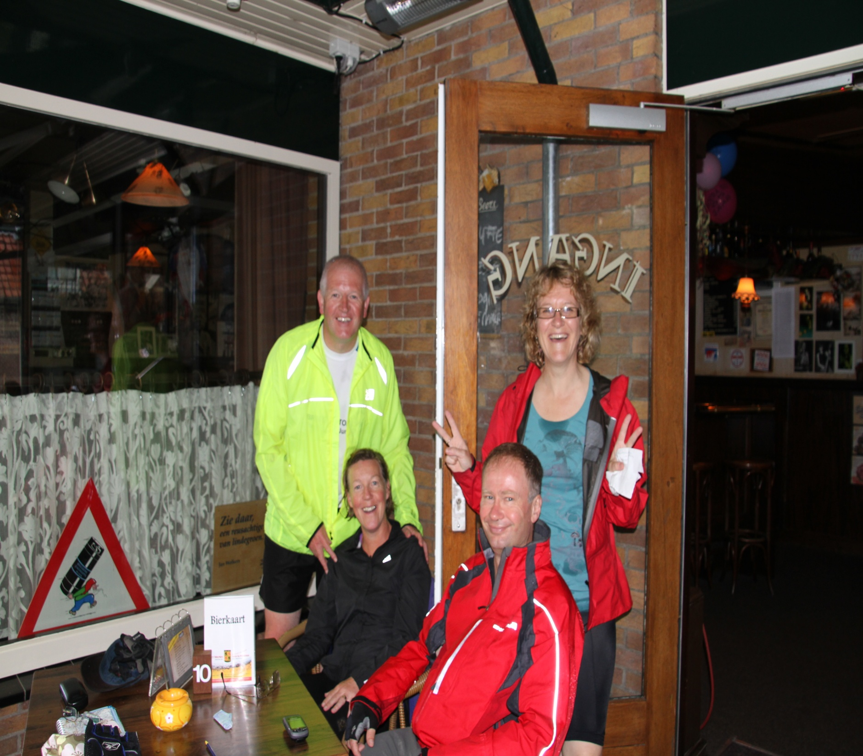
Social Connections

Slide 11
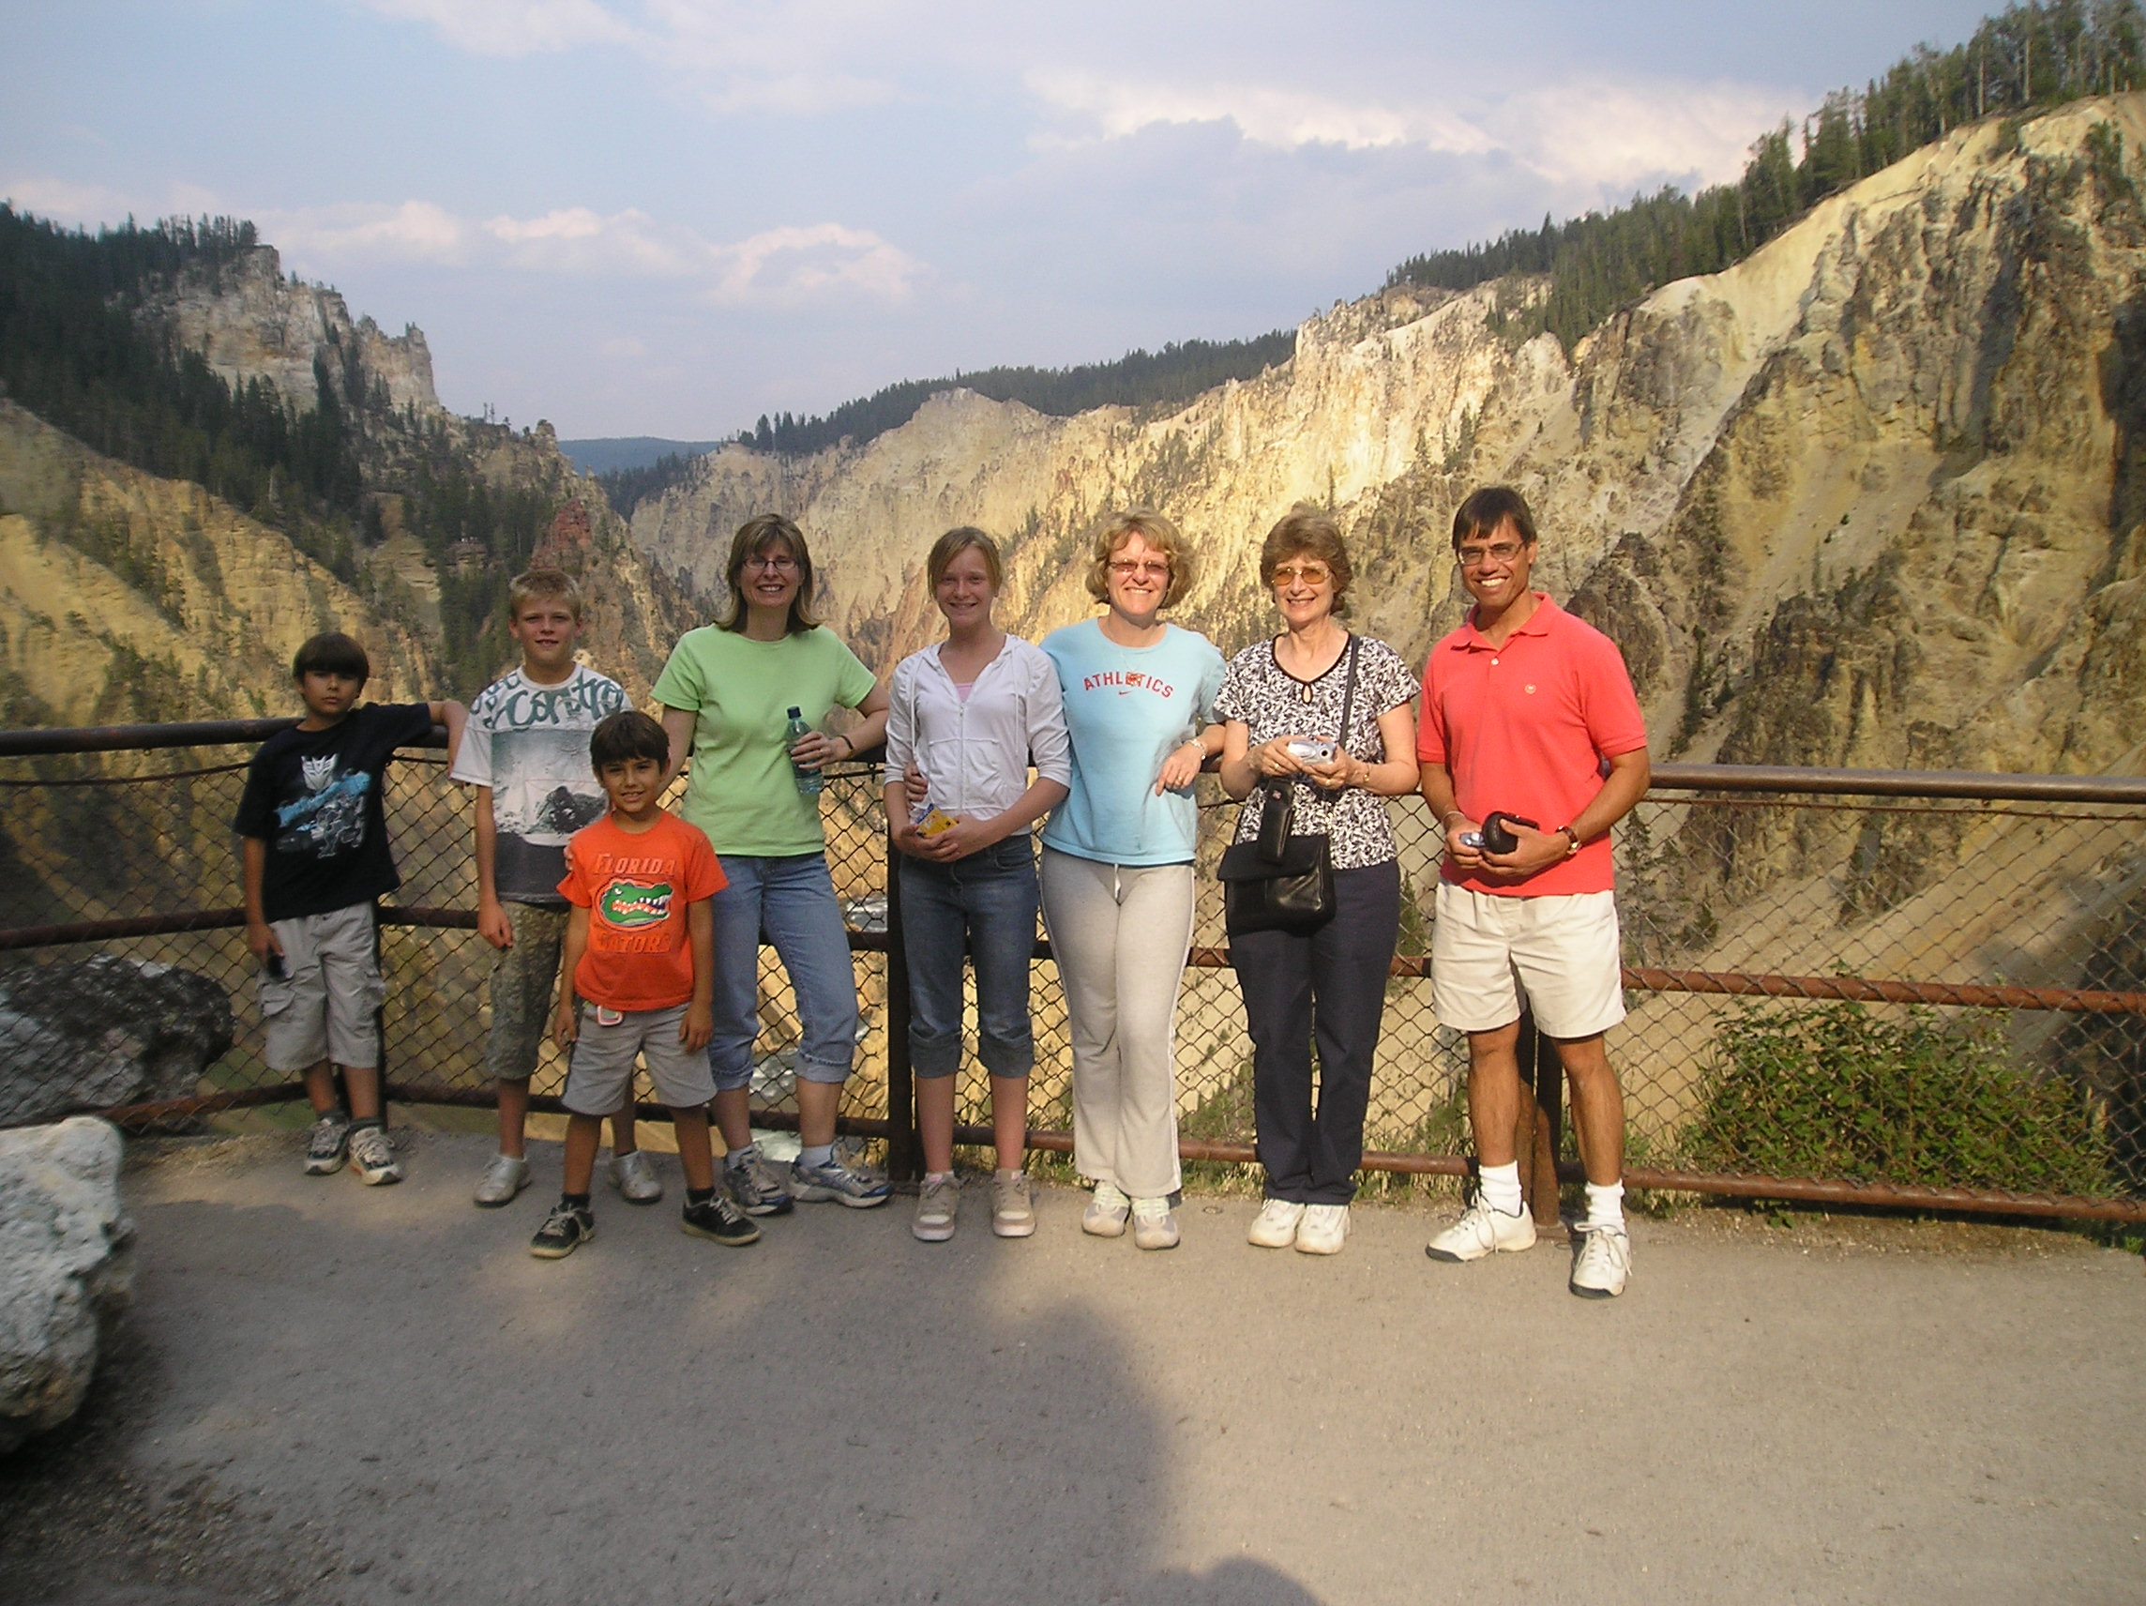
LEISURE TIME

Slide 12
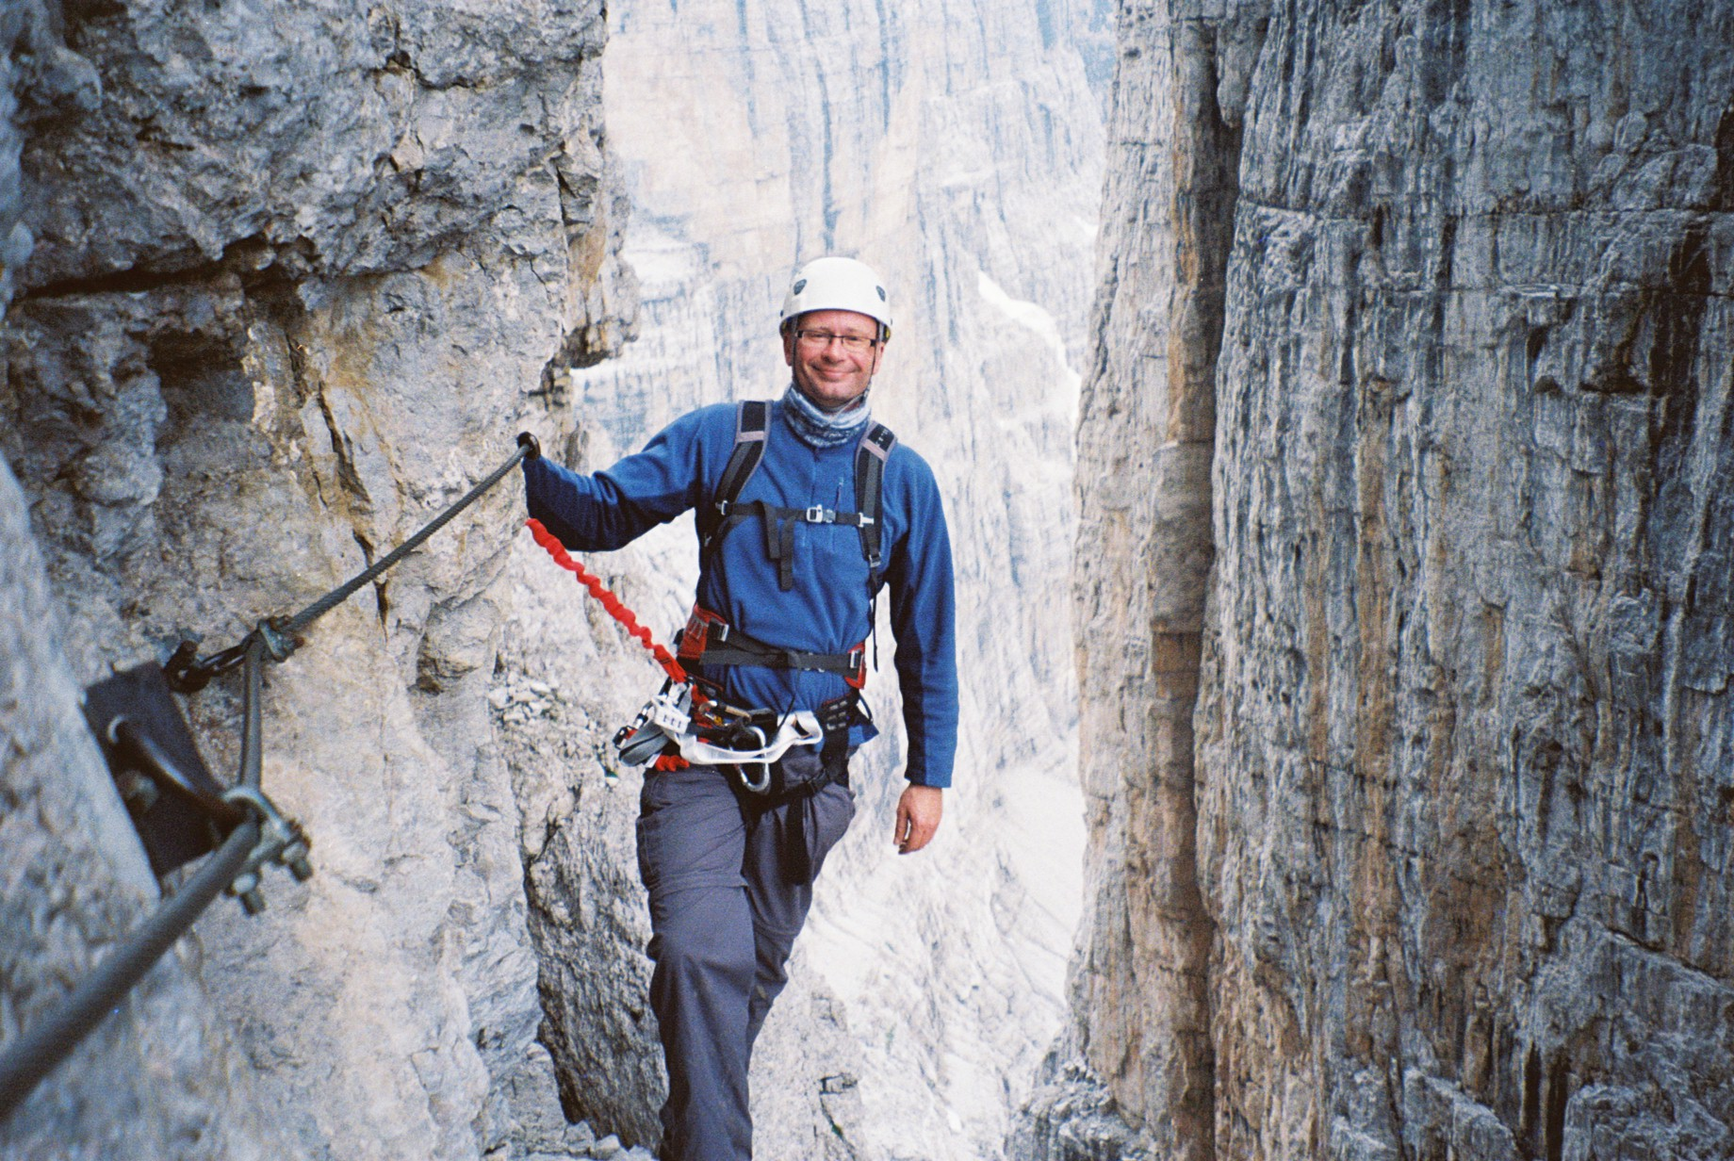
A sense of control over life
A sense of control over life

Slide 13
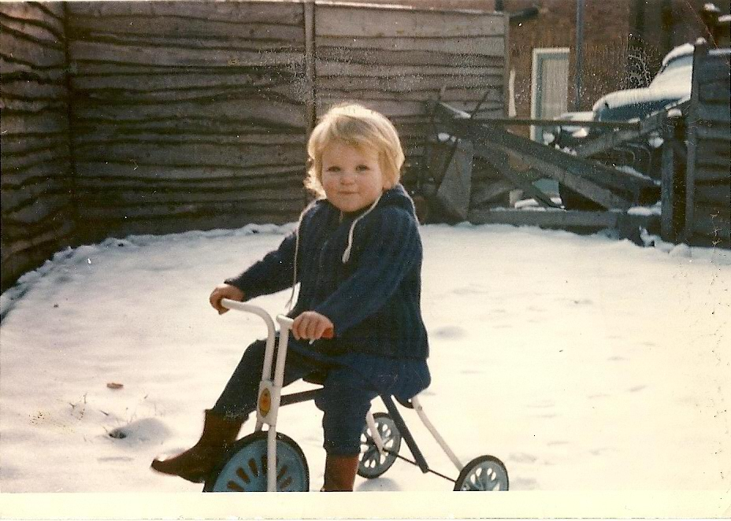
EMOTIONAL RESILIENCE

Slide 14
Sphere of Influence
26 climate summits words ‘fossil fuels’ barely mentioned.
Dominance of producers over ‘right’ to extract fossil fuels
Focus on consumers and what they can do to achieve net zero (subtext consumers are responsible for climate action not producers)
Platform for regular reporting of the impact of environment and climate on planetary and human health is tiny
Everyday familiarity with facts and evidence on environmental change is low, mainstream media accepts the orthodoxy of status quo and is left behind

Slide 15
Economics - The market society
The study of how people and society end up choosing, with or without the use of money,
to employ scarce productive resources, that could have alternative uses, to produce various commodities [efficiently]
and distribute them for consumption [equitably], now or in the future, among various people and groups in society
It analyses the costs and benefits of improving patterns of resource allocation (Paul Samuelson, 1976)

Slide 16
Health Wealth and Happiness
Understanding true value
COVID and Climate two events being driven by a common crisis of values
Responses to the COVID emergency could begin to recast the relationship between values and value, reinforcing social capital and resilience. This is the path to net zero - a state in which the greenhouse gases going into the atmosphere are balanced by removal out of the atmosphere.

Slide 17
Health Wealth and Happiness
Health of Environments - structure
Health of Populations - agency
Vulnerability/inequality
enabling people / citizens to have agency / power
creating safe, just & humane societies
& ‘framing debates’ to challenge established orthodoxy

Slide 18
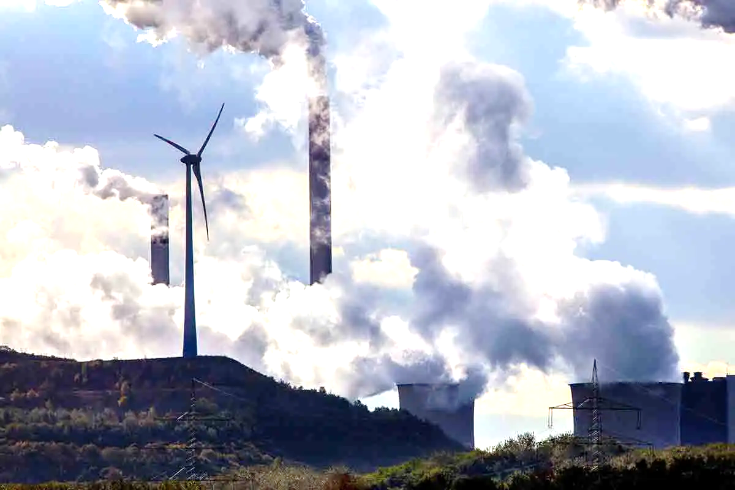
human agency
knowledge, attitudes
beliefs & values
behaviour, skills
health needs
cultural assets
structures / systems
healthy public policy
health & environmental protection
equity, rights, social justice
systems change
Environmental Pollution Climate Change
Disease Pandemics
Natural Disasters
Population Displacement
Human Rights Violations
etc.
Education Settings
Communities/Neighbourhoods
Employment Settings
Organisations/Institutions
Prison / Justice Settings
Political Systems/Governance
Cities/Towns/Villages
Healthcare Settings
etc.

Slide 19

Key public health objectives
Prevention, Protection & Promotion
Empowerment & Participation
Inter-sector Action (forging partnerships)
Health System and Policy Development
Creating Supportive Environments for Health
Acting on the Social Determinants of Health

Slide 20
Jane.Powell@uwe.ac.uk
THANK YOU FOR LISTENING

