Slide 1

The University of the West of England, Bristol

Slide 2
Enforcing Local Environmental Protection: Current Challenges & Future Prospects
Environmental Protection UK
Annual Conference 2022
Warwick University
October 19th 2022
Presentation by
Professor Jim
Longhurst
University of the West of England, Bristol

Slide 3
Structure of Presentation
This presentation considers the role of Local Authorities (LA) in providing environmental protection services.
It considers the challenges faced by LAs in 12 years or more of austerity
It reflects on in the capability and competency to deliver environmental protection services.
The role of LAs in managing air pollution is used to exemplify the contemporary challenges and potential future LA actions in a resource constrained future.

Slide 4
What is Environmental Protection?
A broad range of activities in Public Health, Environmental Health and Planning domains.
Regulation set by Central Government and enforced at the local level.
Local authority initiatives to support regulatory requirements above and beyond enforcement responsibility.
Public education/ information activities
Strategic Land Use Planning to set the long term land use processes and Development Control to ensure compliance with the plan.
Strategic Transport Planning setting and responding to transport requirements

Slide 5
Some LA Regulatory Protection Functions
Air Pollution
Communicable Disease Control
Contaminated Land
Development Control
Food safety / standards
Noise Pollution
Nuisance
Odour
Pest Control
Recycling
Water
Waste /Litter
Etc etc.

Slide 6
Environmental Protection & Planning
“Planning and Environmental Protection sit at the very heart of council services, helping to shape the places where we live and work to develop safe and prosperous communities.”
A guide for Environmental Health Professionals
Endorsed by CIEH, RTPI, POS, 2012
http://rtpi.org.uk/media/11204/environmental_protection___planning-a_guide_for_environmental_health_professionals_lgr-_rtpi_endorsed_nov_2012.pdf
The aspiration still exists but is the capability still present?

Slide 7
The Public Health Role of LAs
“Local authorities should embed these new public health functions into all their activities, tailoring local solutions to local problems, and using all the levers at their disposal to improve health and reduce inequalities. They will create a 21st century local public health system, based on localism, democratic accountability and evidence.”
Public Health in Local Government
Department of Health, 2012

Slide 8
A Decade of Public Health in Local Government
2022 marks a decade of public health in local government
https://www.local.gov.uk/publications/public-health-local-government-celebrating-10-years-transformation
Whist recognising the important role of public health and reaffirming that public health is rightly a local government function, the report acknowledges that there are problems recruiting and retaining suitably trained and qualified staff, particularly in rural areas.

Slide 9
Staffing Challenges Affecting Environmental Protection
The Planner frequently reports on the stark resourcing issues at council planning departments including the difficulty of recruiting suitability qualified staff.
https://www.planningresource.co.uk/article/1596562/staff-planning-authorities-find-hardest-recruit
https://www.theplanner.co.uk/2019/06/19/rtpi-says-public-sector-planning-facing-serious-recruitment-challenges updated 13/8/22
The 2021 CIEH EH workforce survey highlighted significant recruitment difficulties
‘‘There is a shortage of experienced qualified EH officers. Due to financial and other pressures local authorities are delaying recruiting and not taking on more trainees or apprentices, which will be the 'future lifeblood' of the profession.’’
https://www.cieh.org/ehn/public-health-and-protection/2021/april/eh-workforce-survey-highlights-recruitment-difficulties/

Slide 10
Environmental Health Challenges
The CIEH 2020/21 workforce survey revealed that budgets remained unchanged in around half of all local authorities (51%).
More EH departments reported decreases (24%) in their budgets than increases (17%), which CIEH suggests is indicative of budgets continuing to shrink.
https://www.cieh.org/policy/campaigns/workforce-survey-england/
Budgets and staffing challenges affect the capacity and capability of local authorities to discharge their environmental protection duties and functions.

Slide 11
Regulation and Enforcement
To conceive and execute environmental protection responsibilities Local Authorities require an effective regulatory framework and a well trained and efficient enforcement capability.
Both must be present to deliver effective environmental protection.

Slide 12
Ability to Act
Local Authorities are
Not free actors
They are tightly bound to Central Government demands and requirements
Frequently reorganised in the name of efficiency
Not immune to the great tides of economic and social change sweeping society in recent decades

Slide 13
Managing Air Pollution
Local authorities have been both proactive in anticipating problems and reactive to complaints and concerns about air pollution.
Thorough their powers and the deployment of resources LAs have helped improve air quality across the UK space whilst advising the public on protective measures to take to minimise their exposure.
Using the powers of the Environmental Protection Act, 1990 and the Environment Act, 1995 Local Authorities have discharged permitting and management responsibilities for selected industrial sources (Part A(2) or Part B activities), conducted reviews and assessments and prepared action plans for local air quality management (LAQM).

Slide 14
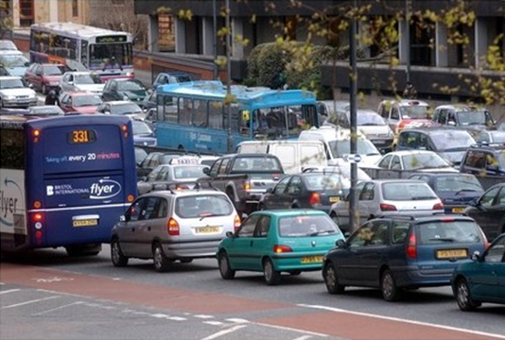
Local Air Quality Management (LAQM)
Requirements for local air quality management (LAQM) are set out in Part IV of the Environment Act 1995 as amended by the Environment Act 2021.
Local Authorities are
’’required to carry out regular ‘Review and Assessments’ of air quality in their area and take action to improve air quality in those areas where objectives set out in regulation have been shown not to have been achieved, or areas where it is thought there is a risk that they will not be achieved.’’

Slide 15
LAQM
When the Review and Assessment process identifies an exceedance of an Air Quality Strategy objective, the Local Authority must declare an Air Quality Management Area (AQMA) and develop an Action Plan to tackle problems in the affected areas.
Action Plans set out the measures the LA proposes to take to work towards meeting the air quality objectives (not to meet!).
They may include a variety of measures but authorities have few of the powers needed to make these effective and to deliver air quality improvements.

Slide 16
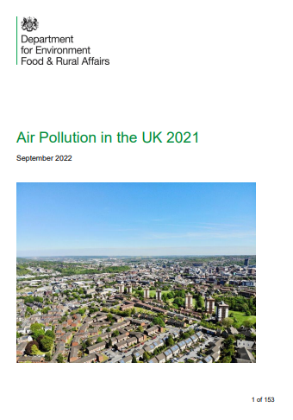
Problem Diagnosis Good
LAQM has helped to reveal a new spatial and temporal geography of air pollution in the UK.
The number of AQMAs in the UK have continued to rise over the last 20 years with 256 local authorities (68%) * having one or more spatially defined areas where air quality objectives have not been met. Many AQMAs have been in existence for a long time!
Most AQMAs in the UK are in urban areas and have been established to address the contribution to air pollution from traffic emissions of NO₂ or PM10, or in some cases both. A small number are for SO₂.
* Out of 374. Data from 2021,
Defra (2022) Air Pollution in the UK 2021 https://uk-air.defra.gov.uk/library/annualreport/viewonline?year=2021_issue_1#report_pdf

Slide 17
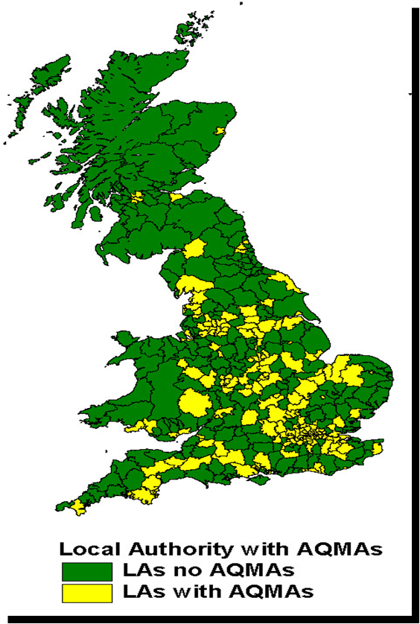
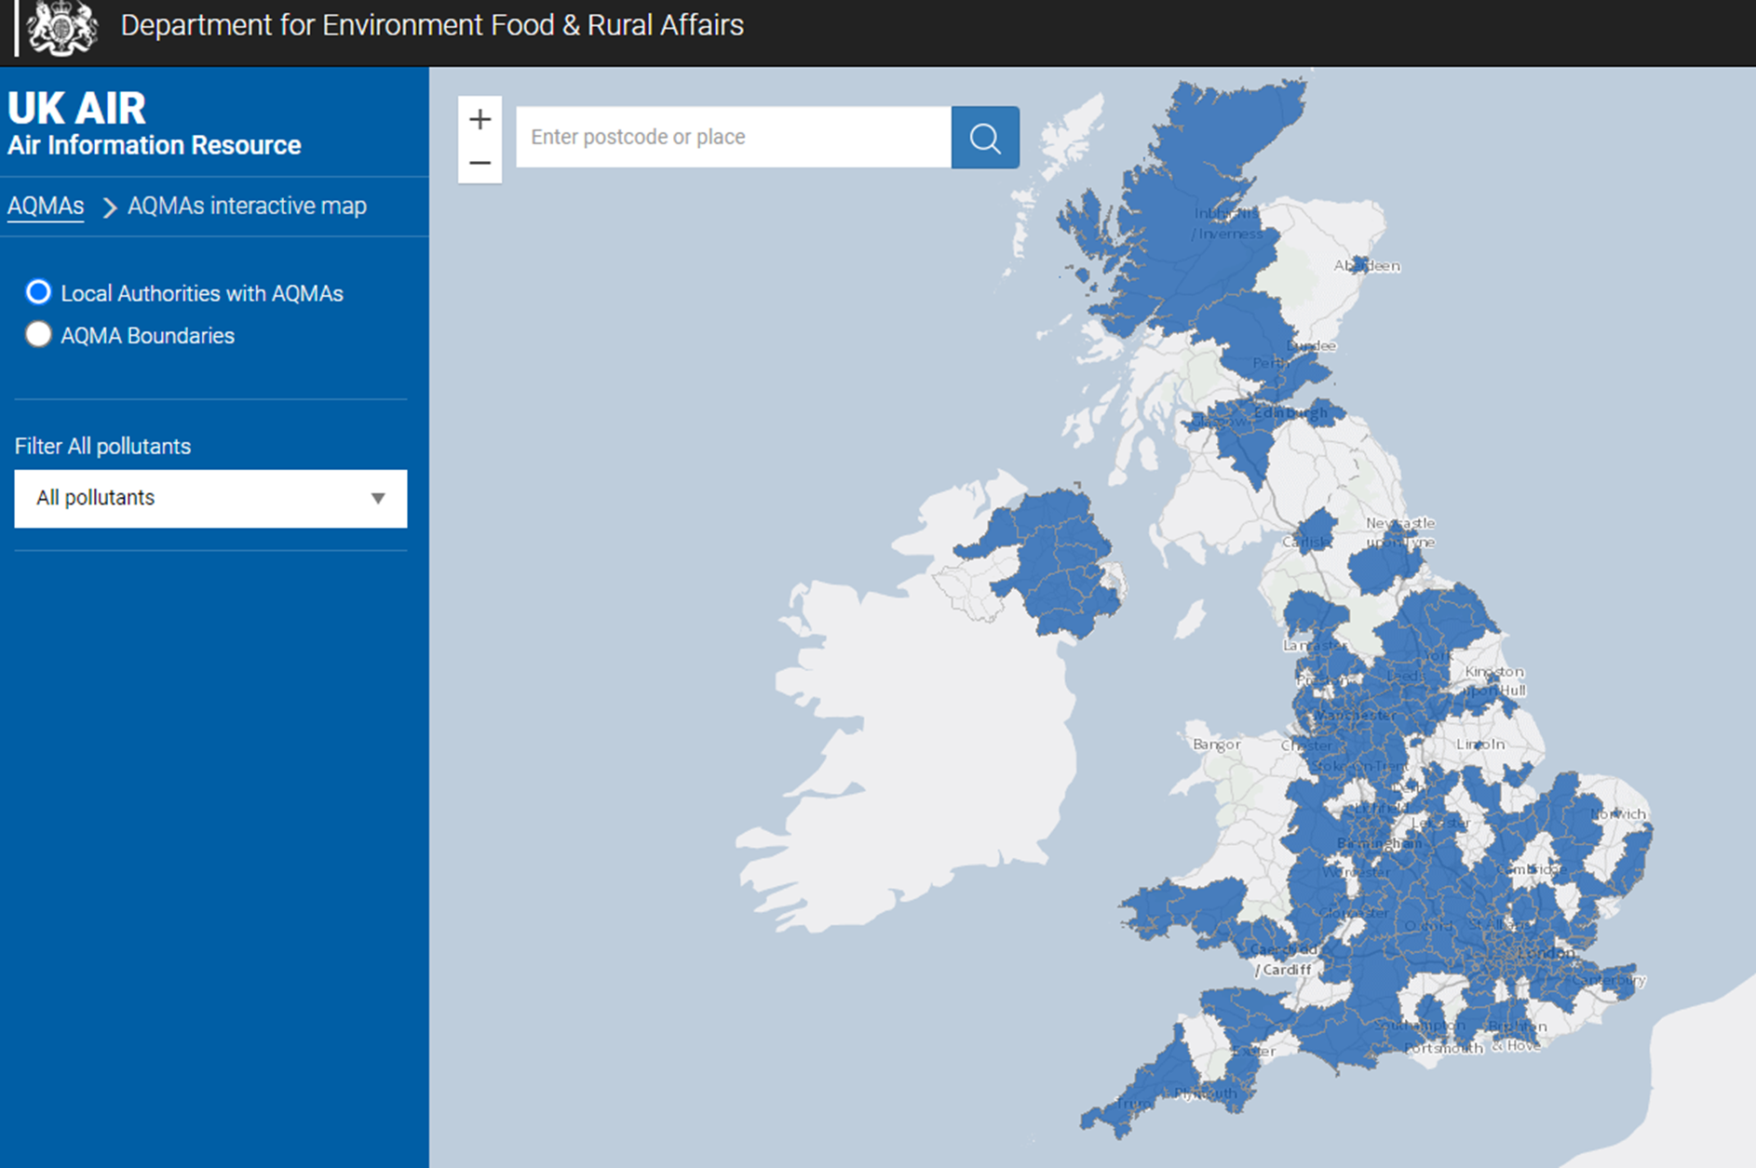
Changing Spatial Pattern of AQMAs
2006
2021
https://uk-air.defra.gov.uk/aqma/maps/

Slide 18
Growth in Number of AQMAs
2004 more than one hundred local authorities have AQMAs for NO₂
2008 225 LAs (52%) had AQMAs (≈500 AQMAs in total)
2016 259 /389 LAs with AQMAs (613 AQMAs in total)
2018 264/391 Local Authorities – 68% of those in the UK – have one or more AQMAs.
2021 256/374 local authorities - 68% of those in the UK – have one or more AQMAs.
These are not ‘localised hotspots’ they are local manifestations of a systemic national problem
A problem that has proved strongly resistant to the current policy prescriptions for management

Slide 19
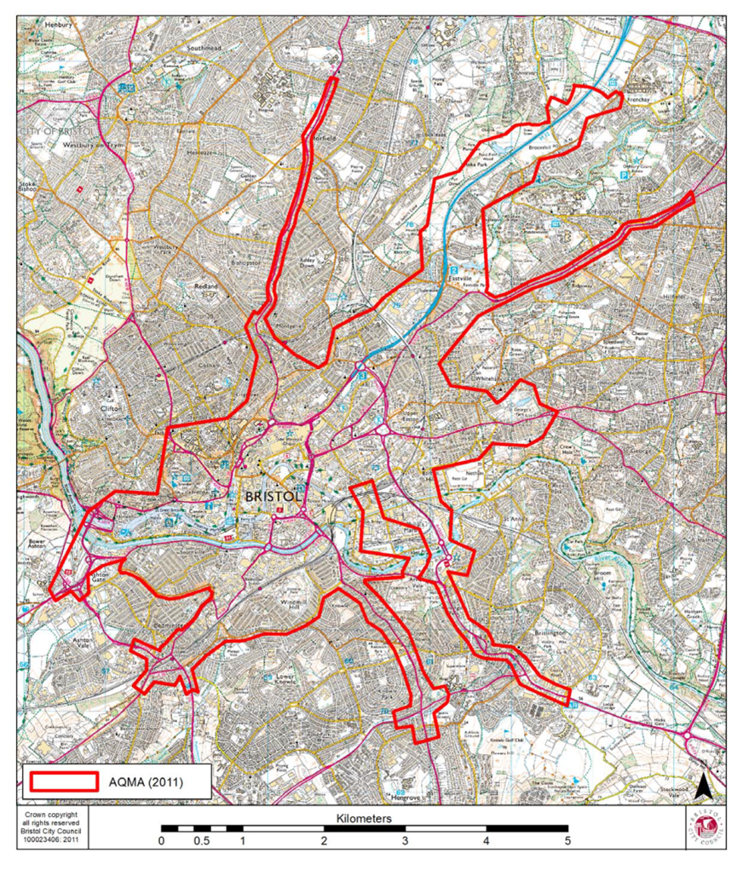
Bristol AQMA
AQMA first declared for Nitrogen dioxide and Particulate Matter in May 2001.
Amended in 2003
Amended again in 2008
Amended again in 2011.
https://uk-air.defra.gov.uk/aqma/details?aqma_ref=10

Slide 20
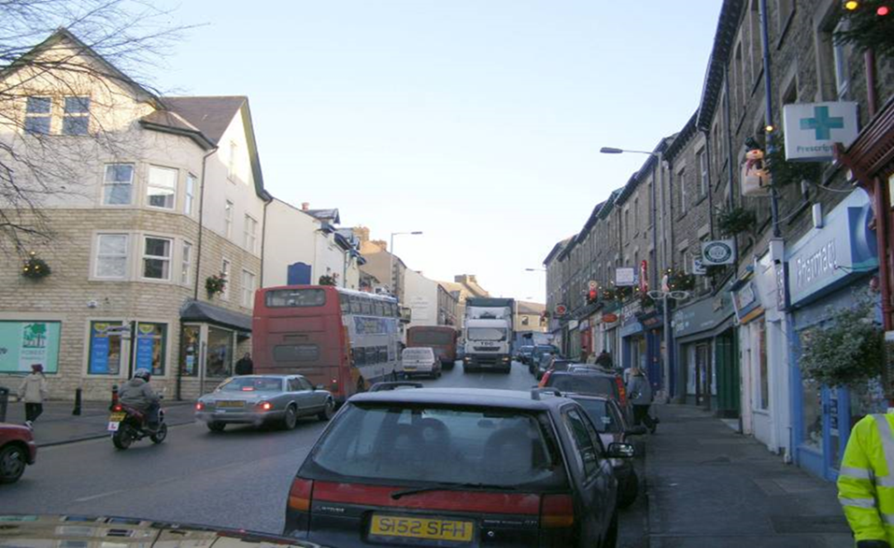
Who is polluted? Who is polluting?

Slide 21
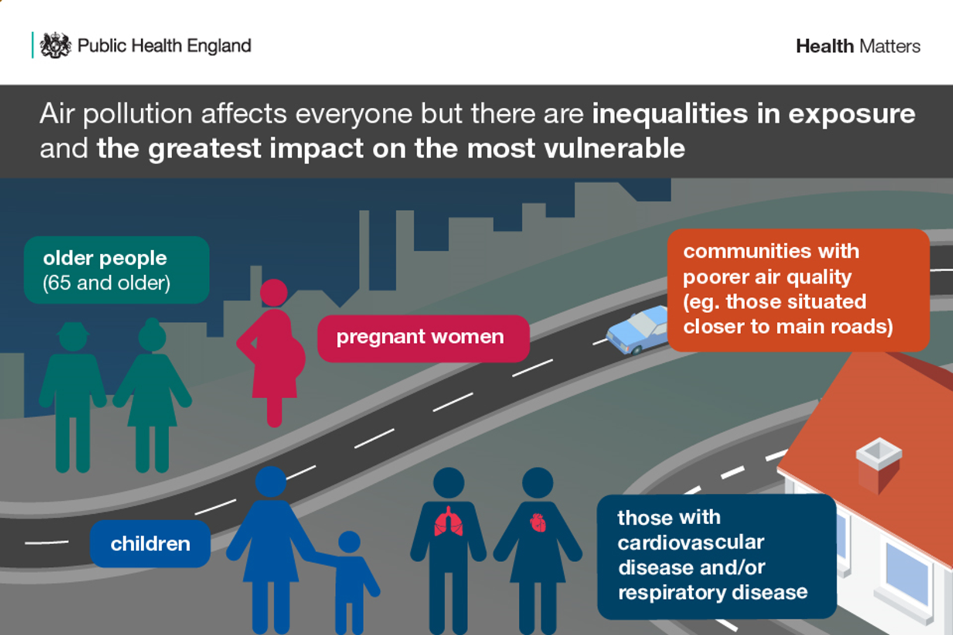
https://www.gov.uk/government/publications/health-matters-air-pollution/health-matters-air-pollution

Slide 22
How did this come about?
Local authorities were never given the powers to enforce Air Quality Objectives. They are only required to work towards meeting the air quality objectives.
Hence Action Plans were and are weak and ineffective rarely bringing forward targeted and achievable measures likely to be effective in addressing problems mostly but not exclusively caused by transport systems.
Action on air quality is now urgent, as Defra acknowledge poor air quality remains the greatest environmental risk to public health in the UK.

Slide 23
LAQM Weaknesses
Air Quality Objectives are no more than “policy intentions” and not legally binding
Focus on the process rather than the decision outcome
No de facto ability to prevent new local developments on Air Quality grounds
Lack of responsibilities for those in charge of sources (land-use and transport planning)
Constraints of local action in national policy context
Has it improved Air Quality? If not does this mean that it is a failure?

Slide 24
AQMAs and Revocation
Local Authorities have been very good at uncovering locations with public exposure which exceed air quality objectives.
They have been less successful at implementing air quality remediation actions.
Once declared an AQMA remains for a long time as a Local Authority rarely has the powers or capabilities to address the root causes of the problem.
Will this change in the near future as local authorities budgets decline?

Slide 25
Environment Act 2021
The Environment Act 2021 ’’enables English local authorities to take more effective, co-ordinated actions to achieve their air quality objectives and deliver improvements to public health, and tackle emission from domestic burning, a source of PM10’’.
The Act establishes a duty for the UK Government to set a legally binding target in England to reduce PM2.5, alongside at least one further long-term target on air quality.
https://www.legislation.gov.uk/ukpga/2021/30/contents/enacted

Slide 26
Environment Act 2021 – LAQM Changes
The Act requires the Secretary of State to publish a national Air Quality Strategy as well as an annual report on how central Government has supported local authorities’ in meeting their air quality duties.
Air Quality Action Plans must now be prepared for the purpose of securing achievement of air quality standards and Objectives and must set out how the local authority will exercise its functions in order to do so.
Upper tier authorities, neighbouring local authorities, the Environment Agency and designated “Relevant Public Authorities” are now required, where locally relevant, to commit to action they will take to assist in securing required air quality improvements and to commit to dates by when measures will be implemented.
The Act also makes it easier for local authorities to enforce smoke control areas.
https://laqm.defra.gov.uk/air-quality/featured/england-exc-london-policy-guidance/

Slide 27
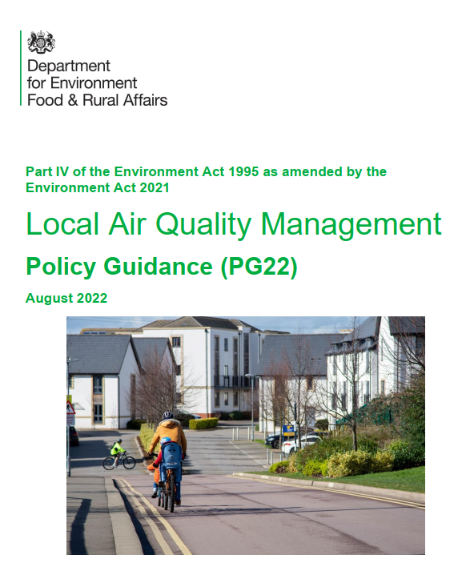
LAQM Policy Guidance
Published in August PG22 sets out the expectations for and requirements of Local Authorities in respect of their LAQM duties.
It covers English LAs but excludes London Boroughs where LAQM guidance is provided by the Mayor of London.
’’All layers of local government have legal duties to act to address elevated concentrations of local air pollution.’’
‘‘All levels of local government are expected to commit to taking the actions necessary to ensure that local air quality objectives are secured.’’
https://laqm.defra.gov.uk/air-quality/featured/england-exc-london-policy-guidance/

Slide 28
High in Aspiration but is it Deliverable?
Does the capacity and capability exist to deliver air quality improvements at the scale and pace needed to address the problem of air pollution?
The resource challenges facing LAs – in staffing and budgets – are stark.
Can national and local actors provide the financial, technical and human capital at pace and scale to meet the challenge of reducing, if not removing, the greatest environmental risk to public health in the UK?
The evidence is not encouraging.

Slide 29
Defra Budget
The most recent Defra Annual Report and Accounts reveals a total budget of £7,098m, amongst the smallest of government department budgets
The Defra budget under various administrations has been subjected to significant cuts.
https://assets.publishing.service.gov.uk/government/uploads/system/uploads/attachment_data/file/1037320/defra-year-end-accounts-2020-2021.pdf

Slide 30
The Continuing Age of Austerity
Recent research from Grant Thornton shows English councils face a £7.3bn financial black hole by 2025/26. This is an increase of £4.6bn since the beginning of the year, according to the data.
It warns that without additional income, councils will be forced to make savings of over £125 per head of population by 2025/26. (6/10/22)
’’Local authorities are also now facing the risk of interest rate rises increasing debt financing costs and the real risk of reduced funding from central government, in response to the current economic turmoil facing the country.’’
https://www.localgov.co.uk/One-in-six-councils-at-risk-of-running-out-of-money-next-year/54951

Slide 31
Local Authority Revenue
Local authorities have three main sources of revenue:
  government grants – money from central government for local services
  council tax – a property tax levied on residential properties
  business rates – a property tax levied on business premises.
In 2019/20, local authorities in England received 23% of their funding from government grants, 50% from council tax, and 27% from retained business rates – revenue from business rates that they do not send to the Treasury.
https://www.instituteforgovernment.org.uk/explainers/local-government-funding-england

Slide 32
Local Authority Revenue
Local authority ‘spending power’ – that is, the amount of money local authorities have to spend from government grants, council tax, and business rates – has fallen by 16% since 2010.
This is because largely because of reductions in central government grants, which have been the most sharply cut component of local government revenue since 2009/10.
Central government grants – including retained business rates – were cut 37% in real-terms between 2009/10 and 2019/20, from £41.0bn to £26.0bn in 2019/20 prices.
While grants from central government were cut, rates of council tax were increased. Local authorities raised 25% more council tax, in real terms, in 2019/20 compared to 2009/10.
https://www.instituteforgovernment.org.uk/explainers/local-government-funding-england

Slide 33
Costs Rising, Resources Diminishing, Service Demands Increasing
Local Authorities across the UK are facing budget crises as energy costs continue to rise and inflation accelerates. Budgeted service expenditure for all forms of local authorities was £105.6 billion in 2021/22
Education funding 34%
Adult Social Care 18%
Children’s social care 10%
Police 13%
Everything else 26%
Environmental Protection expenditure is a very small part of local authority expenditure.
https://assets.publishing.service.gov.uk/government/uploads/system/uploads/attachment_data/file/996192/Local_authority_revenue_expenditure_and_financing_in_England_2021_to_2022_budget.pdf

Slide 34
Bleak Outlook
Local authorities will seek to minimise the impact of the budget reductions on the statutory duty to provide services.
Cuts will fall disproportionately on discretionary services including environmental protection.

Slide 35
Enforcement Action
Unsurprisingly enforcement action has dropped dramatically in local authorities as budget cuts lead to staff cuts and capacity and capability to act is reduced.
Enforcement is the necessary adjunct to the regulatory powers at a local authority’s disposal.
Enforcement is a visible sign of intent and a means of changing cultures.

Slide 36

The Future
What might the future hold for environmental protection services in local authorities?
Continuing budget cuts, reduction in staff, reduction in competency and capability.
Reduced capacity to innovate and respond to emerging problems.
Yet new responsibilities for environmental protection are emerging.
Not least the duties and implications of the Environment Act 2021,implementing the net zero ambition, identifying the local impacts of a changing atmospheric chemistry in a warmer world, and the continuing need to manage air pollution to reduce the public health impacts arising from exposure to multiple and quite possibly new pollutants.

Slide 37
The Long Term Solution
Meaningful integration of environmental and public health protection into policies and practices for
  Spatial Planning
  Economic Development Planning
  Transport Infrastructure Planning
The problem is that the beneficial impacts arising from these planning processes are long term whilst the problems of air pollution are immediate and near term.
There is a disconnect between the resource inputs and the benefits.

Slide 38
A Continuing Role
Local Authorities have been instrumental in developing and delivering proactive and reactionary services to protect the environment and public health.
The impact of austerity on capacity, capability and willingness to act can not be over estimated.
Public services to protect the environment and public health are stretched and enforcement and public awareness / education activities are diminishing.
Yet, the need for local authority action remains as strong as ever.

Slide 39

Professor James Longhurst
University of the West of England,
Frenchay Campus,
Bristol,
BS16 1QY
UK
Email James.Longhurst@uwe.ac.uk
Public profile
https://people.uwe.ac.uk/Person/JamesLonghurst
Sustainability at UWE
https://www.uwe.ac.uk/about/values-vision-strategy/sustainability
UWE website
https://www.uwe.ac.uk/

